Slide 1
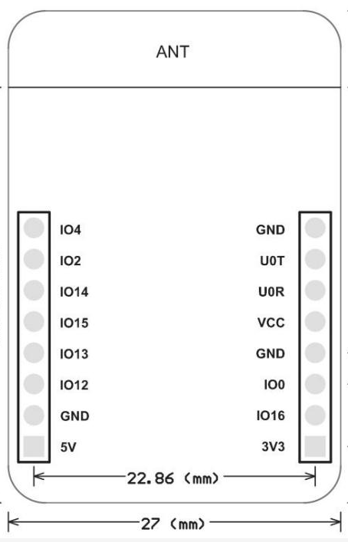
Out No
common
5V
PIR
Relay
0V
0V
0V
5V
3.3V

