Slide 1
Sorting Algorithms in Bash Script
Mansur Muaz Ekici

Slide 2
Your script will receive two input arguments. The first argument will be a filename that stores numbers that are going to be sorted and the second argument will be an integer that will be used to select a sorting algorithm.
./bash_sort –f | --filename <input filename> -a | --algorithm <sorting algorithm> [-h | --help]
Examples:
./bash_sort –f input.dat –a 1
or
./bash_sort -–filename input.dat –-algorithm 1
or
./bash_sort –h
or
./bash_sort –-help

Slide 3
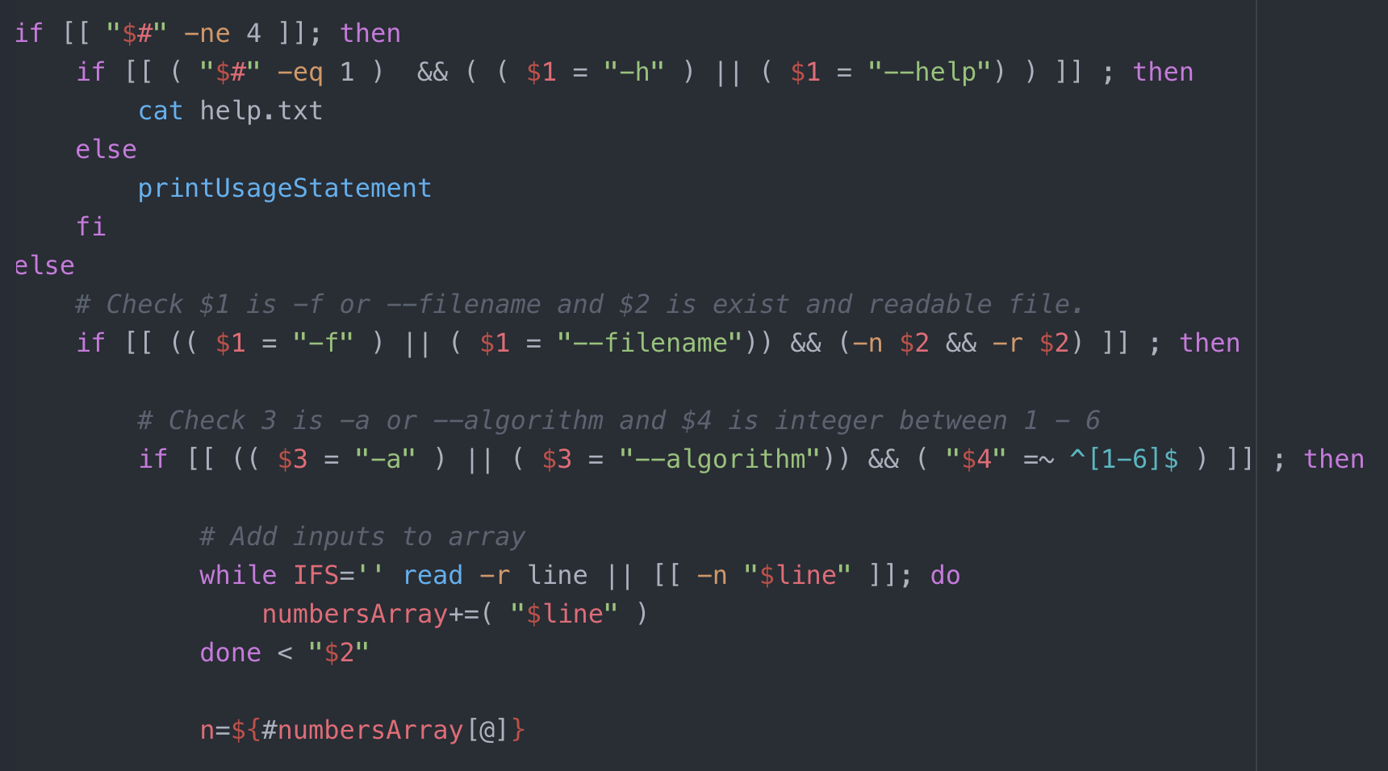
a)

Slide 4
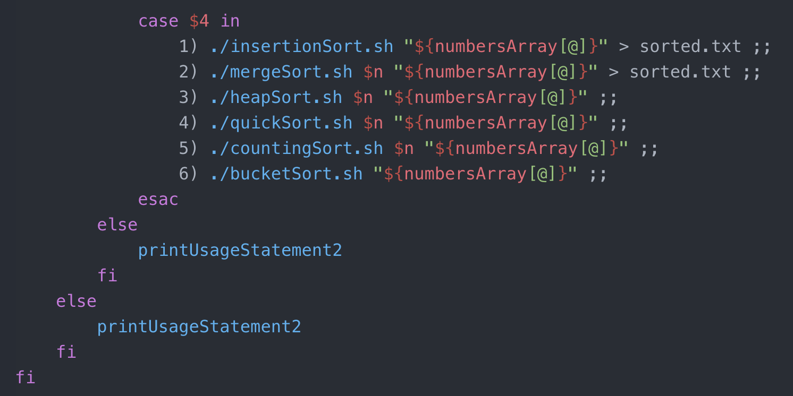
a)

Slide 5
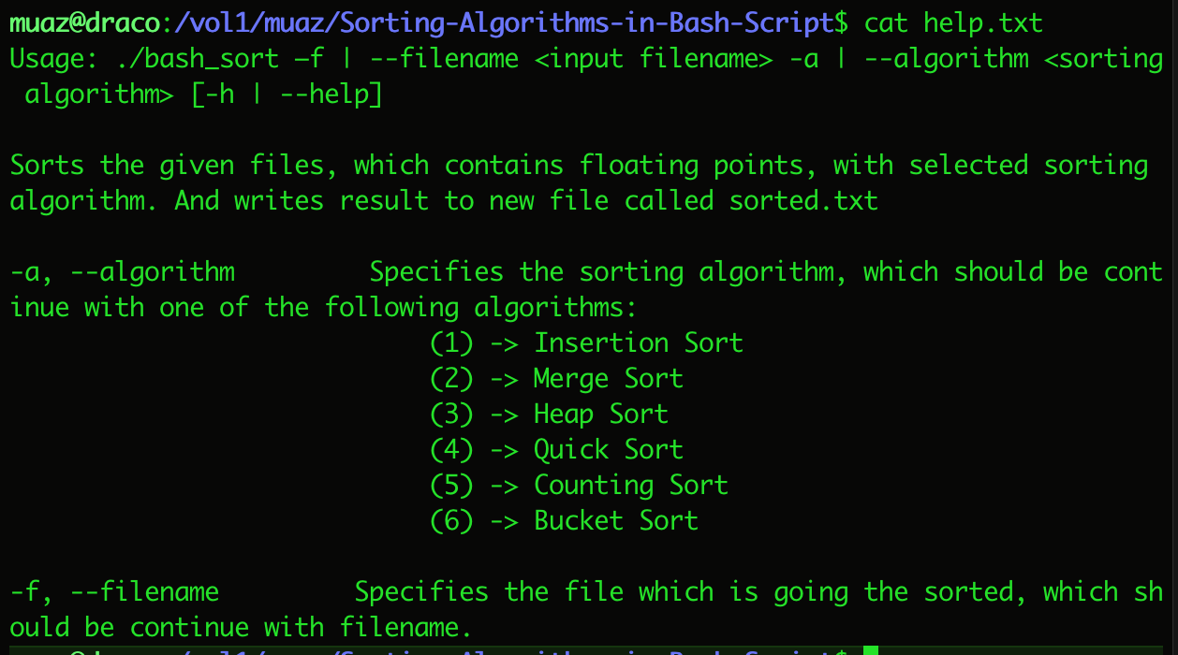
a) then your script will display a help menu explaining the parameter options and the available sorting algorithms.

Slide 6
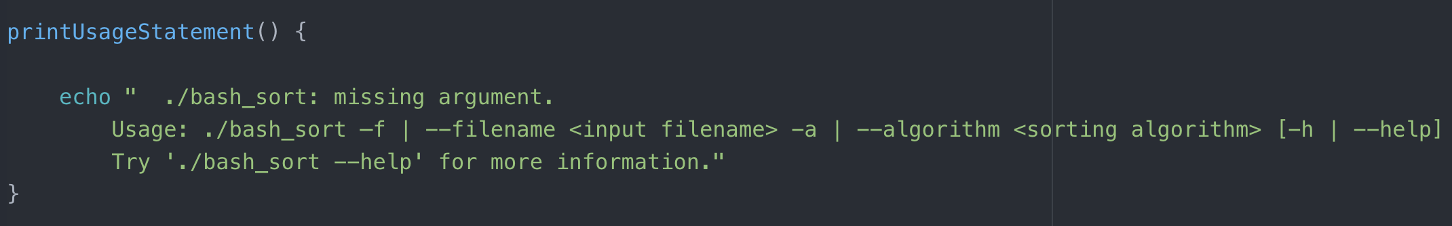
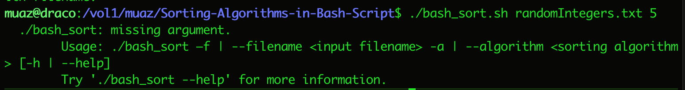
b) Implement a bash function inside your script that prints a usage statement. Your main script will call this function if the number of input arguments is not 2 or if the help option is not selected.

Slide 7
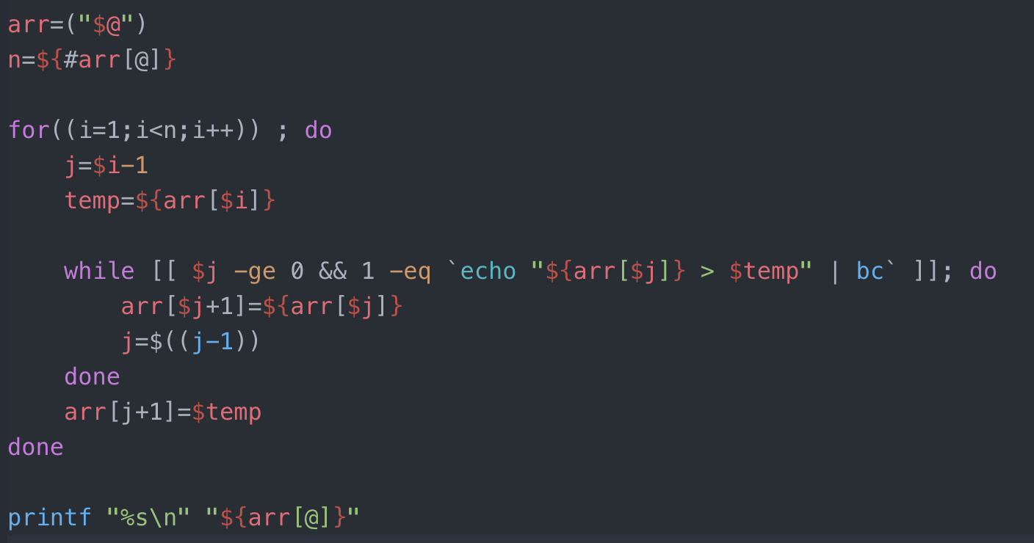
c) Insertion Sort

Slide 8
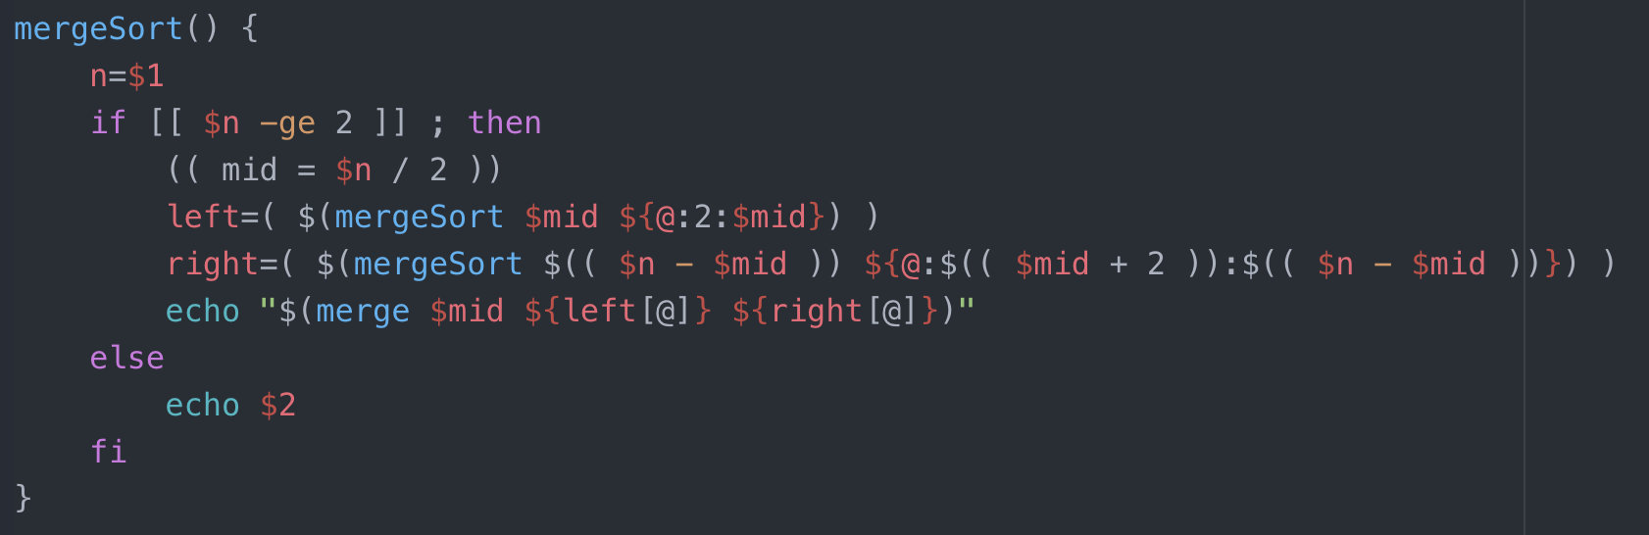
c) Merge Sort

Slide 9
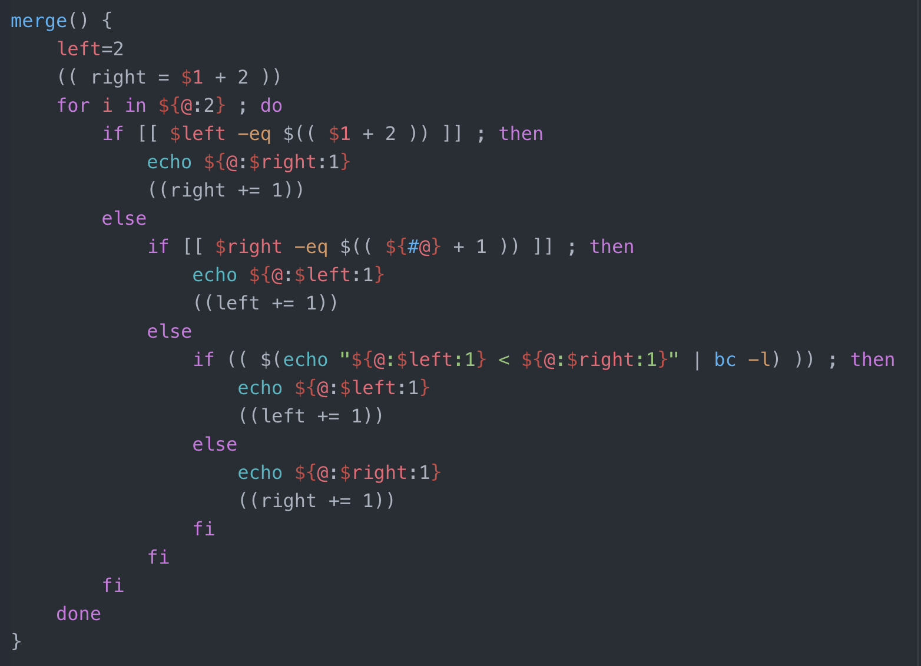
c) Merge Sort

Slide 10
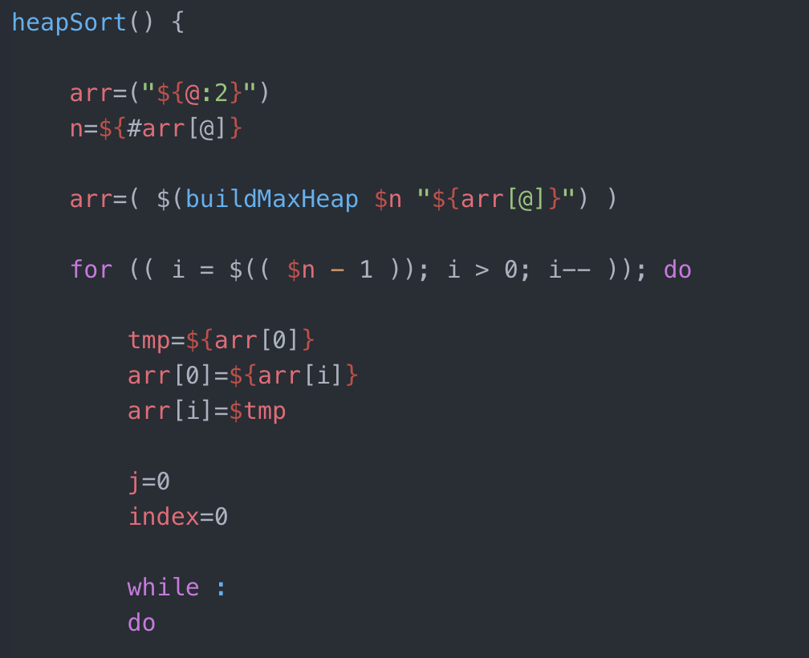
c) Heap Sort

Slide 11
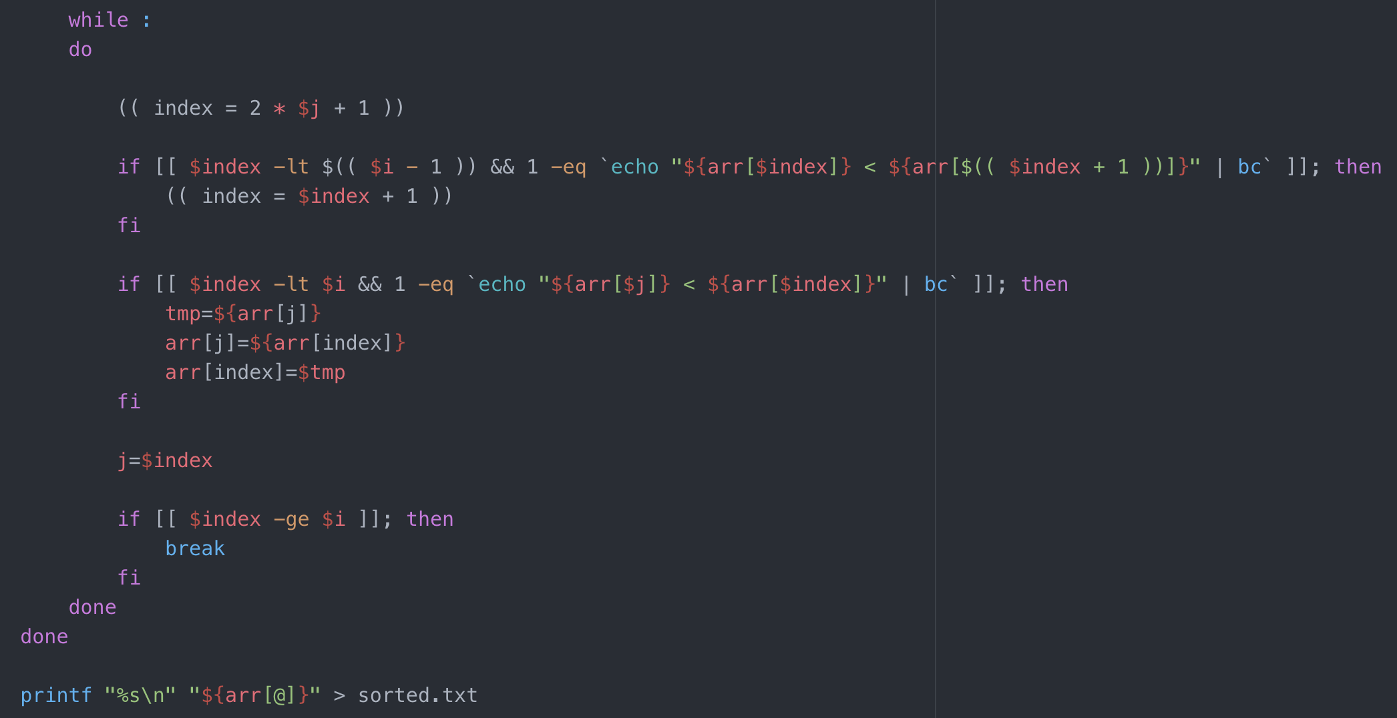
c) Heap Sort

Slide 12
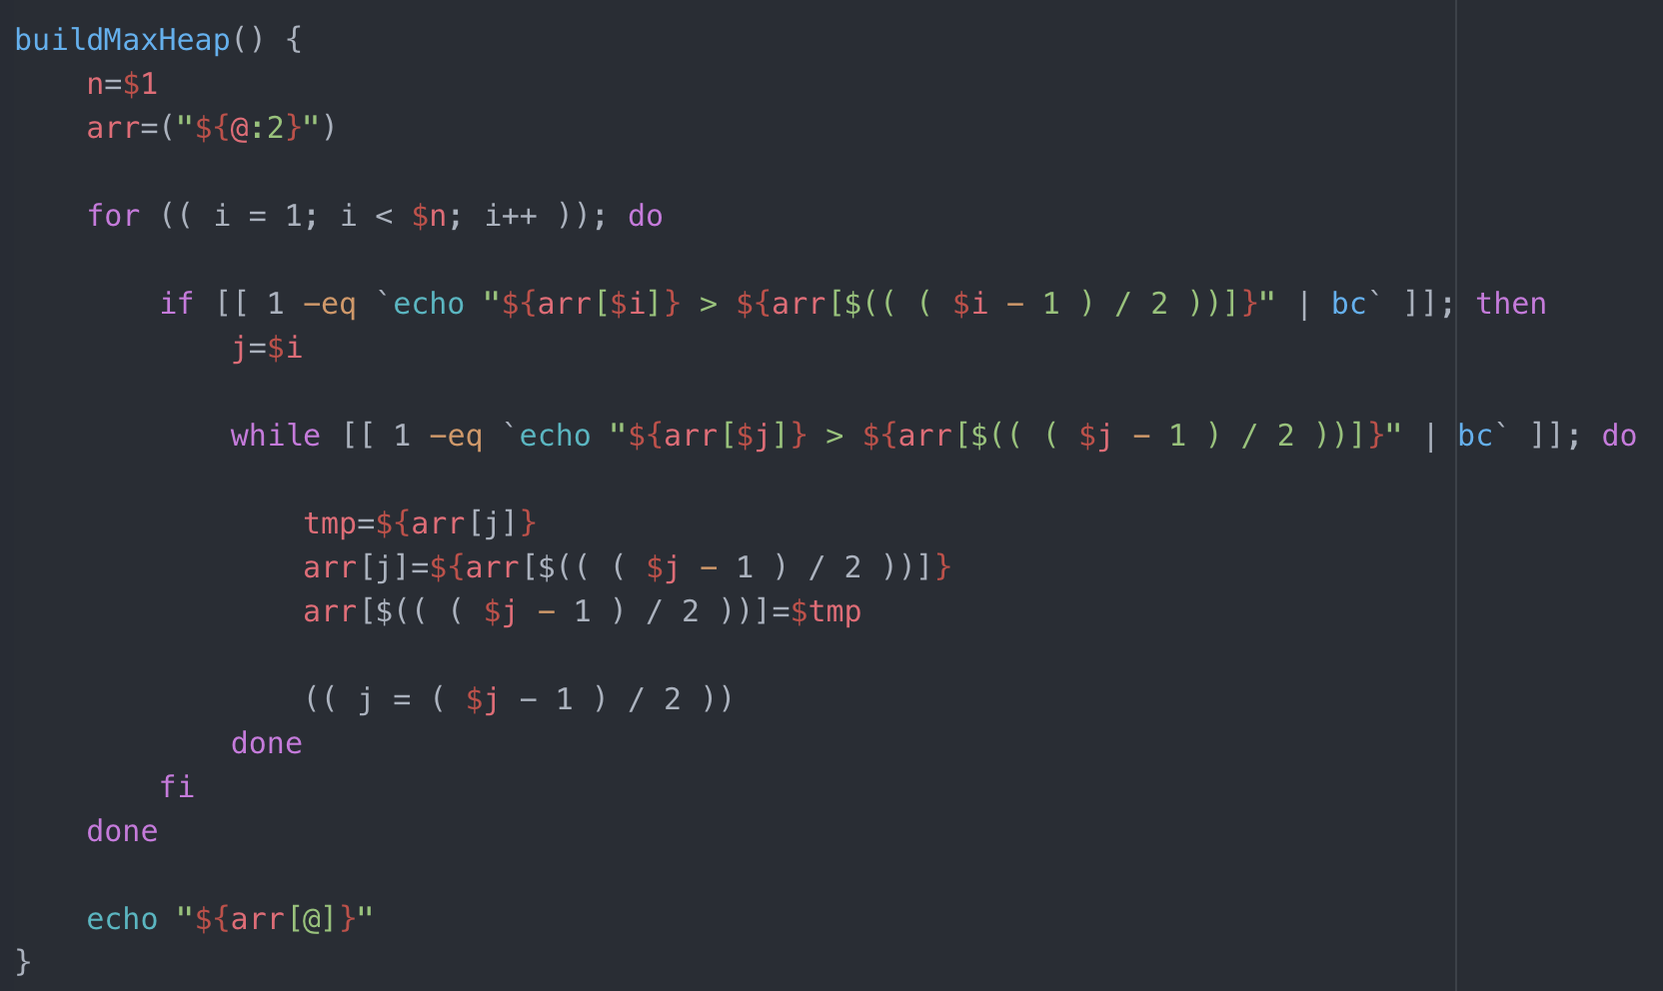
c) Heap Sort

Slide 13
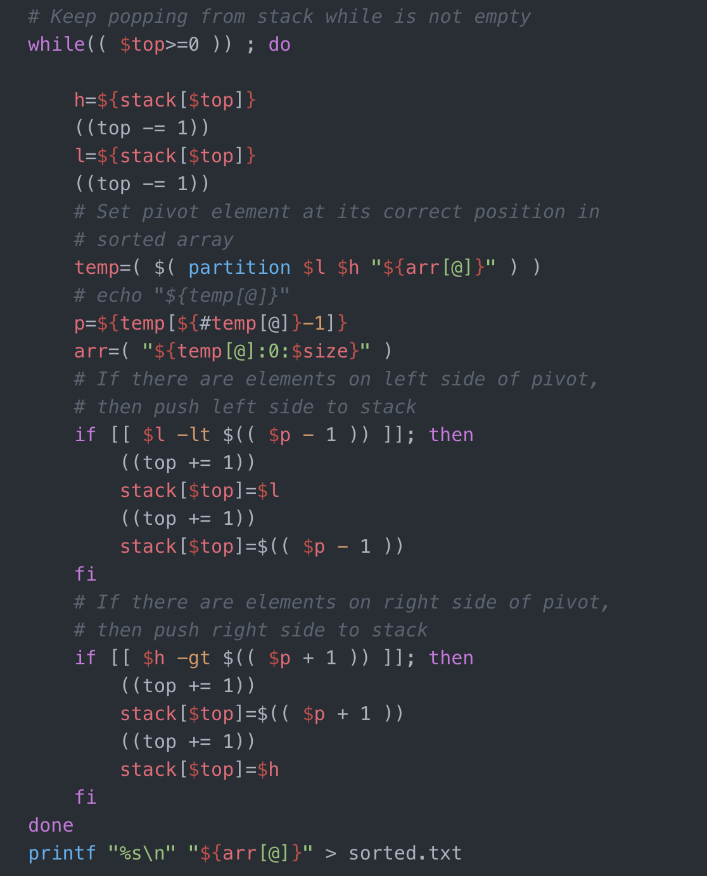
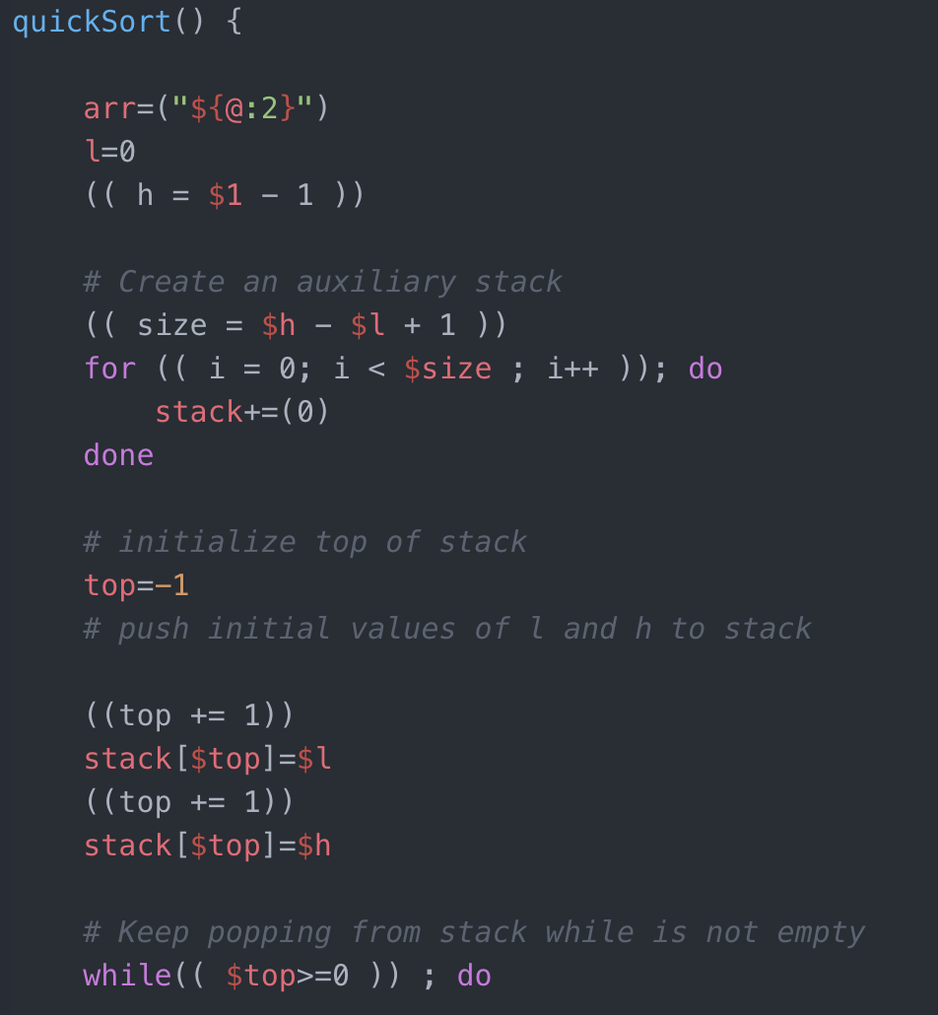
c) Quick Sort

Slide 14
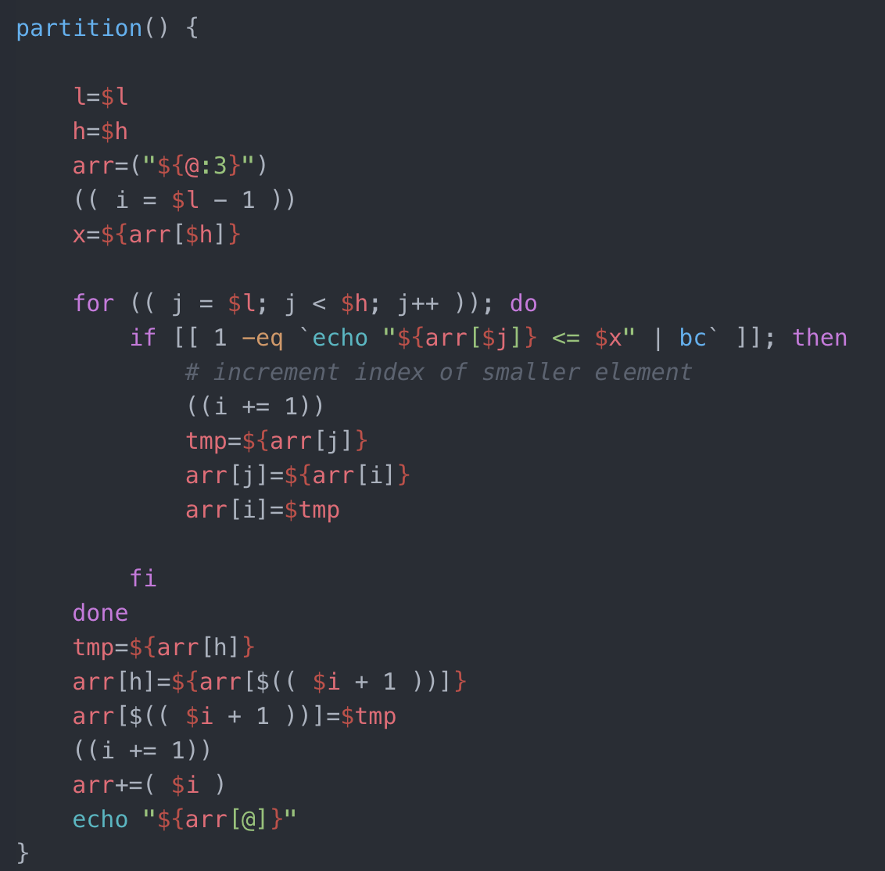
c) Quick Sort

Slide 15
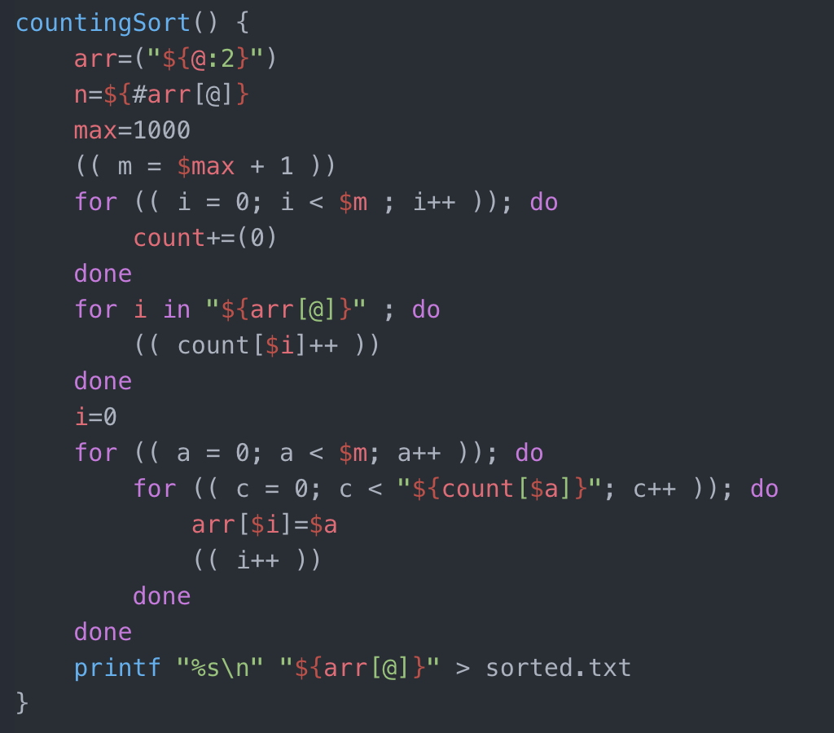
c) Counting Sort
Assumed that the range of integers is between 0 and 1000

Slide 16
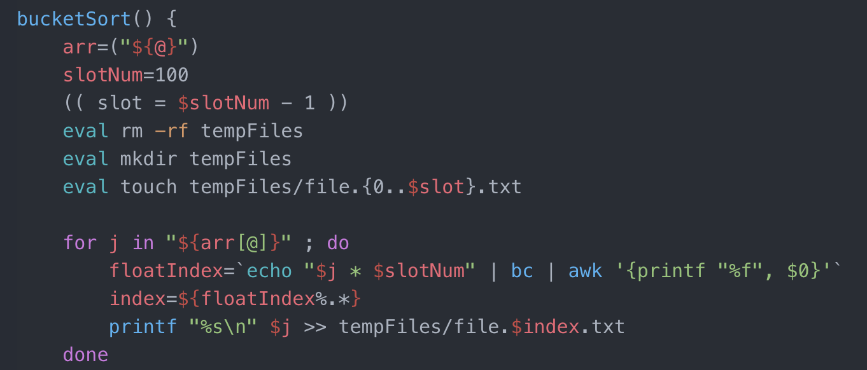
c) Bucket Sort
Assumed that the bucket size is 100

Slide 17
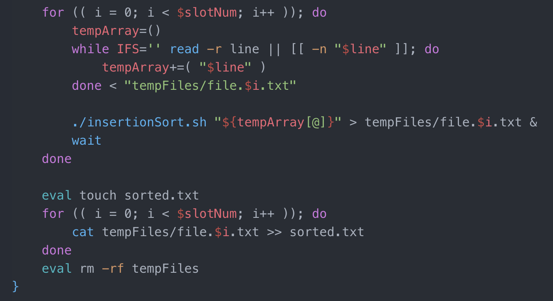
c) Bucket Sort

Slide 18
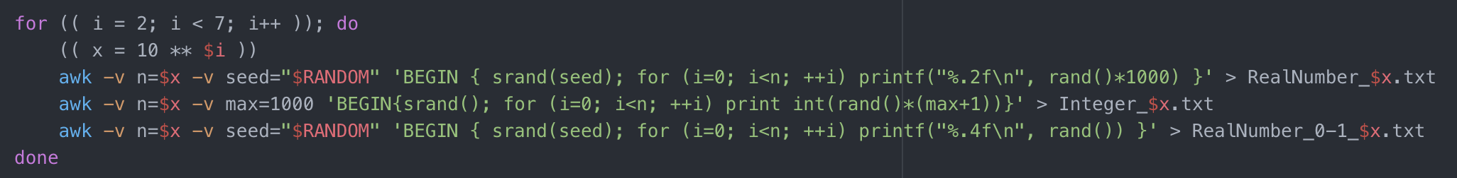
d) Comparison of Sorting Algrorithms
Random number generation script:
Since testing the large number of random numbers, take too much time, I’ve implemented 100, 1000, 10000, 100000, 1000000.

Slide 19
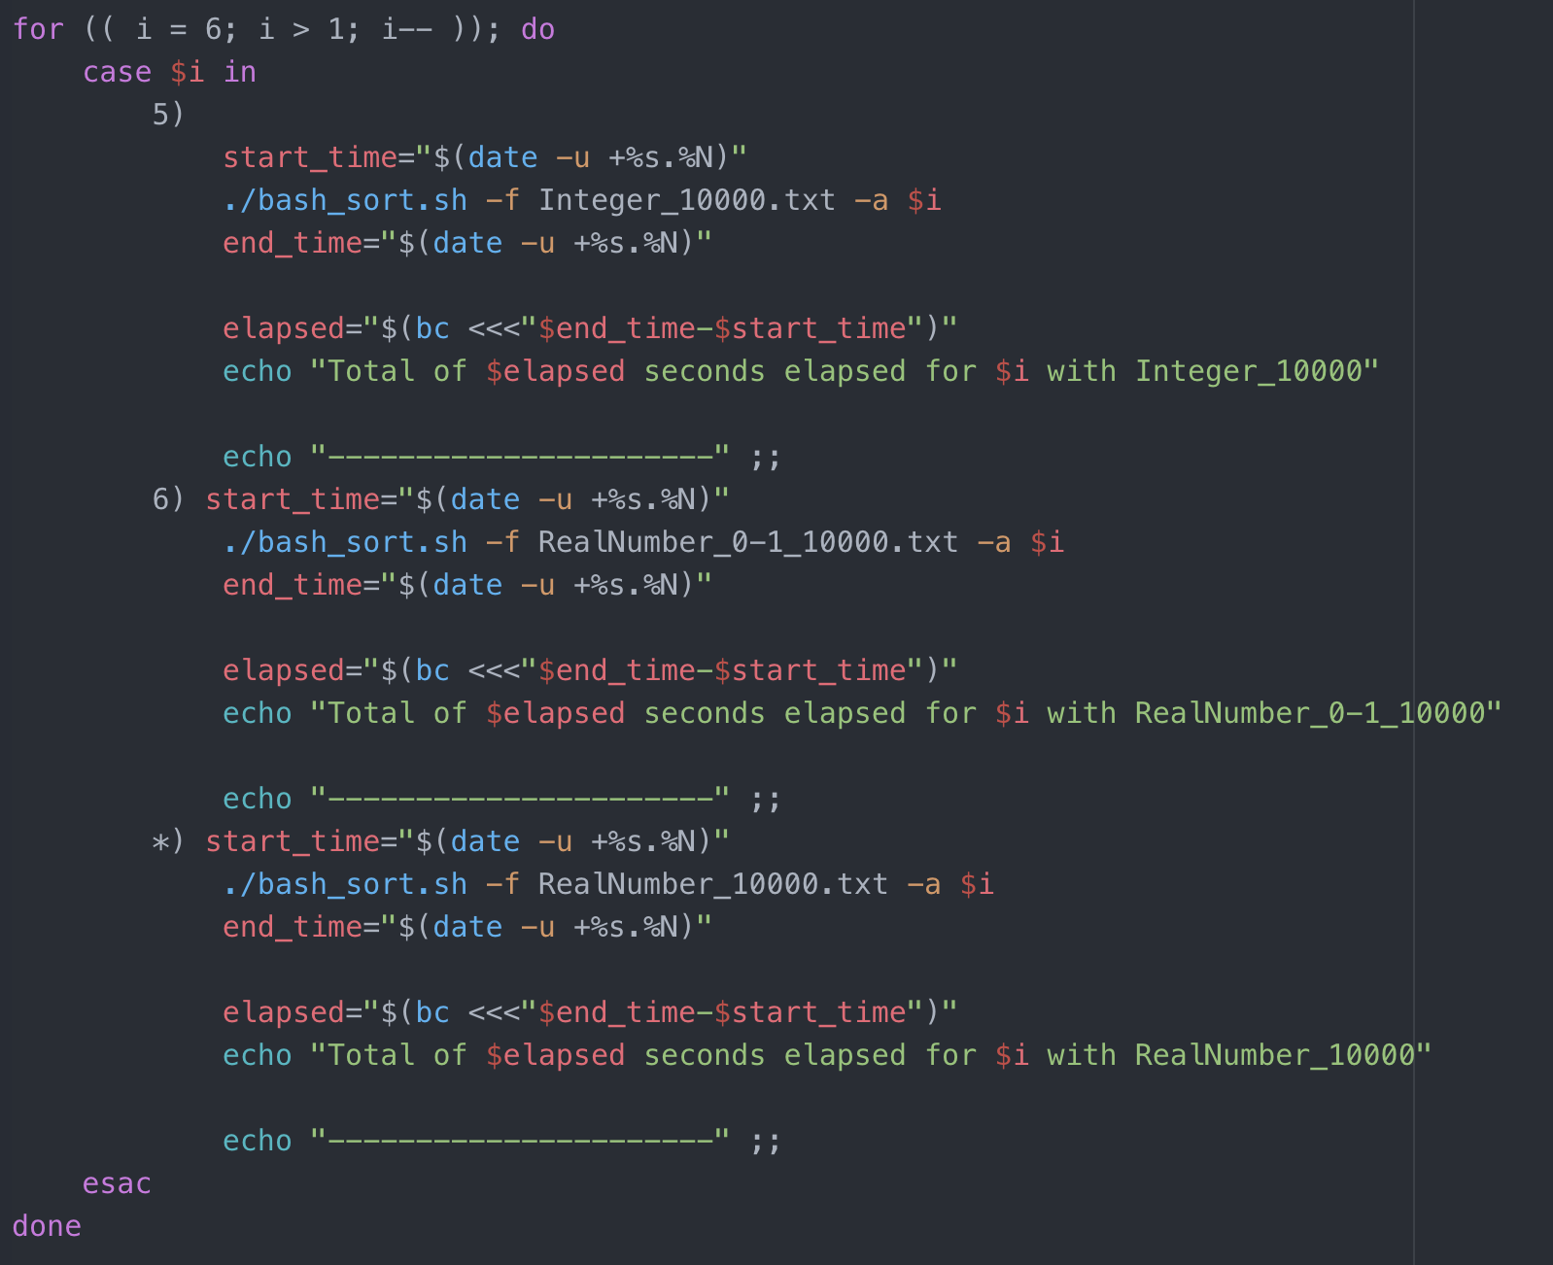
d) Comparison of
Sorting Algrorithms
A part of the test script for different sorting algorithms with various number of random numbers.
You can find whole the test script in test.sh

Slide 20
d) Comparison of Sorting Algrorithms
Sorting Algorithms | 100 random number | 1,000 random number | 10,000 random number | 100,000 random number | 1,000,000 random number
Insertion θ(n²) | 4.37 s | 321.65 s | ? | ? | ?
Merge θ(n log(n)) | 1.10 s | 17.14 s | 499.12 s | ? | ?
Heap θ(n log(n)) | 1.57 s | 25.85 s | 445.94 s | ? | ?
Quick θ(n log(n)) (expected) | 1.09 s | 22.83 s | 1330.10 s | ? | ?
Counting (range: 0-1000) θ(n+k) | .04 s | .08 s | .98 s | 41.76 s | ?
Bucket (100 bucket) θ(n) (average-case) | 1.93 s | 4.77 s | 85.46 s | 12024.37 s | ?

Slide 21
e) Sorting Algrorithms vs Sort command in Linux
Sorting Algorithms | 200 random number
Insertion | 14.9331 s
Merge | 2.5380 s
Heap | 3.9781 s
Quick | 2.6932 s
Counting | .03213 s
Bucket | 2.17123 s
Sort(Linux) | .00229 s
Linux Sort uses an External R-Way merge sort according to Algorithm details of UNIX Sort Command.
You can find whole the test script in sortTest.sh

Slide 22
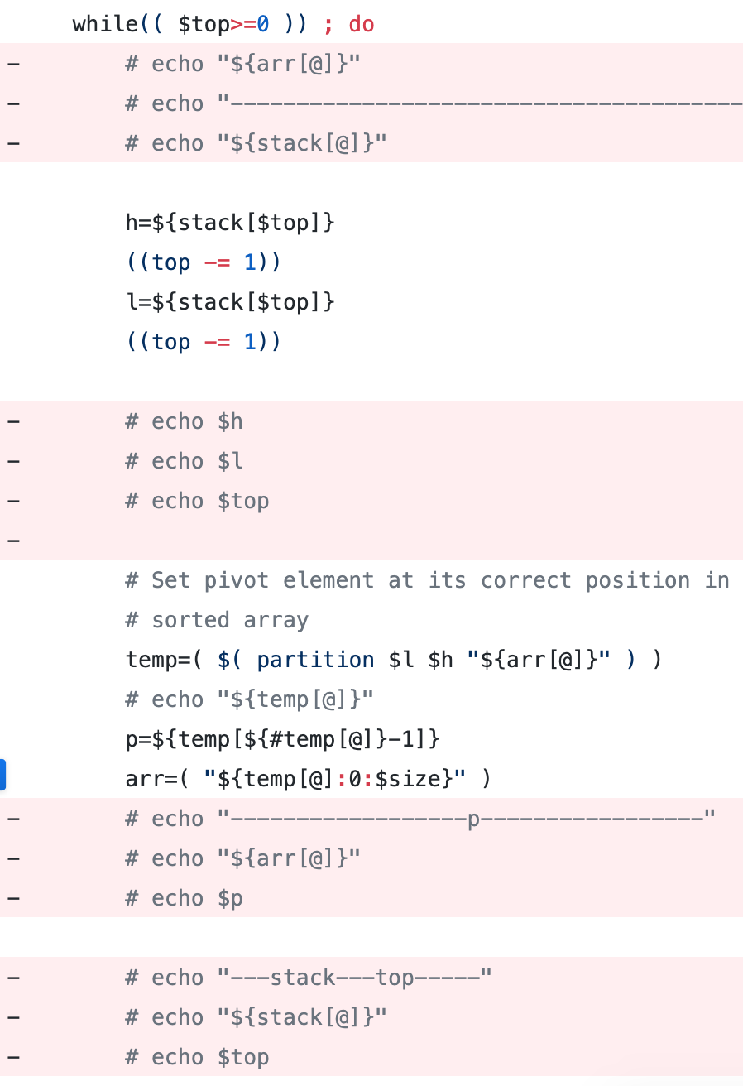
Challenge
Debugging

Slide 23
Thanks for listening

