Slide 1
Home Automation

Slide 2
Screen
Speaker
A/V Rack
CS1
SW1
Stand/Rack
AC
CL1
FS1
CL1
FS2
Light
WL1
WL2
CL3
Power Points
1 . Projector
2. AVR
3. Fire Stick
4. Wall LED 1 & 2
5. Ceiling Light 1 & 2
6. Ceiling Light 3, 4 & 5
7. Fan
8. Plug
9. Plug
10. Plug
11. Plug
WMS1
WMS2
CP1
CP2
CL4
CL5
4
Power
6
3
7
5
Projector Stand
2
Door
1

Slide 3
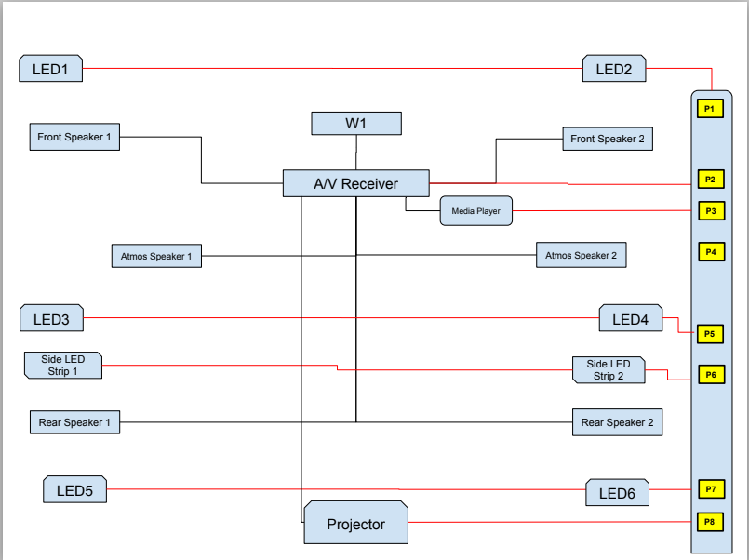

Slide 4
Electrical Design
Edge Gateway (NodeMCU)
NodeMCU1 (Sensor)
Serial 3V
DTH
Motion
Sound
NodeMCU1 (Power)
NodeMCU2 (Power)
VCC GND
5 4 14 12
VCC GND
5 4 14 12
Home Automation Server (Raspberry Pi)
4 Ch Relay 2
4 Ch Relay 1
P1
LED
LED1
LED2
LED1
LED2
LED5
LED6
P2
P3
LS1
LS2
P4
A/V
P5
240V
P6
Projector
A/V Receiver
Streaming Device
P7
P8

Slide 5
Hand switch to Relay wiring
Relay switch
Off
On
220V Phase
COM
Hand Switch
Light/Fan
Neutral

Slide 6

Automation Architecture
MQTT Broker (Mosquitto)
PowerControl Microservice
Ambience Microservice
Switch
Control
Switch
Trigger
Edge NodeMCU (PowerControl)
ControlJSON
{“Switch1”:1, “Switch2”:0, “Switch3”:1, “Switch4”:1,
“Switch5”:0, “Switch6”:0,
“Switch7”:1}
Power Report
Ambience Report
SwitchControlServer
Publish/Subscribe MQTT
REACT.JS
REACT.JS
MQTT
Python
Python
PostGreSQL
PostGreSQL
Edge NodeMCU (Ambience)
AmbienceReportingServer
Home Automation Server (Raspberry Pi)
{Topic: Ambience, AmbienceData:
{“Temp”:23, “Humidity”:76, “Sound”:78}}
HTTP
{Topic: Motion, MotionData
{“Motion”:1} }

Slide 7
Data Model for home Automation – Swtich Control
Table Name: SwitchControl
Column Name | Description | Data Type
NodeID | ID of Control Board | String
SwitchID | ID of Switch | String
DeviceID | ID of Connected Device | String
Description | Description of Device/Sensor | String
Power | Power Consumption by Device in Wattage | Decimal
Table Name: SwitchState
Column Name | Description | Data Type
NodeID | ID of Control Board | String
SwitchID | ID of Switch | String
State | On or Off | Boolean
DateTime | Timestamp of the state change | Timestamp

Slide 8
Data Model for home Automation – Ambience control
Table Name: AmbienceControl
Table Name: AmbienceMeasureSchedule
Column Name | Description | Data Type
NodeID | ID of Control Board | String
SensorID | ID of Sensor | String
Description | Description of Device/Sensor | String
LowerLimit | Lower Threshold Limit of the Sensor value | Decimal
UpperLimit | Lower Threshold Limit of the Sensor value | Decimal
UOM | Unit of measure of sensor value | String
Column Name | Description | Data Type
NodeID | ID of Control Board | String
SensorID | ID of Sensor | String
MeasureInterval | Time interval of measure in seconds | Decimal
MeasurePauseStartTime | Time of start of pause measure daily | Time
MeasurePauseEndTime | Time of end of pause measure daily | Time
Table Name: AmbienceMeasure
Table Name: AmbienceEvent
Column Name | Description | Data Type
NodeID | ID of Control Board | String
SensorID | ID of Sensor | String
SensorValue | Measured value by sensor | Decimal
DateTime | Timestamp of the measure | Timestamp
Column Name | Description | Data Type
NodeID | ID of Control Board | String
SensorID | ID of Sensor | String
SensorValue | Threshold value by sensor | Decimal
Operator | Operator sign of the threshold value comparison | String
DelayTime | Time to measure and condition fulfilment in seconds | Decimal
ServiceToCall | Service to call on condition fulfilment | String

