Slide 1
Home Automation

Slide 2
Hardware & Electrical Architecture

Slide 3
Screen
Speaker
A/V Rack
CS1
SW1
Stand/Rack
AC
CL1
FS1
CL1
FS2
Light
WL1
WL2
CL3
Power Points
1 . Projector
2. AVR
3. Fire Stick
4. Wall LED 1 & 2
5. Ceiling Light 1 & 2
6. Ceiling Light 3, 4 & 5
7. Fan
8. Plug
9. Plug
10. Plug
11. Plug
WMS1
WMS2
CP1
CP2
CL4
CL5
4
Power
6
3
7
5
Projector Stand
2
Door
1

Slide 4
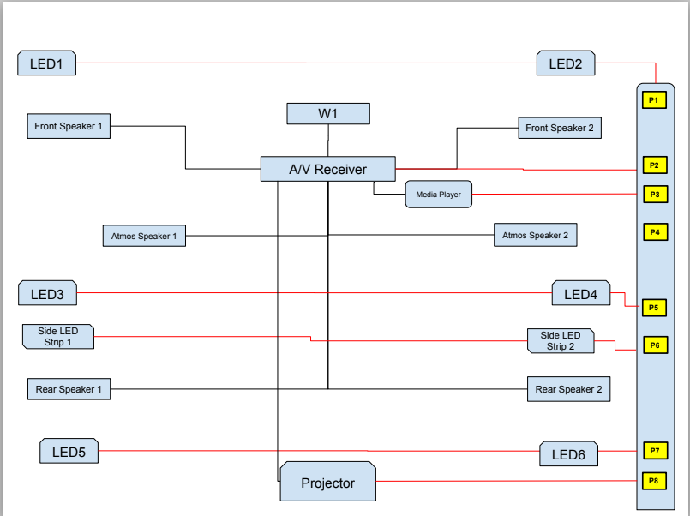

Slide 5
Electrical Design
Edge Gateway (NodeMCU)
NodeMCU1 (Sensor)
Serial 3V
DTH
Motion
Sound
NodeMCU1 (Power)
NodeMCU2 (Power)
VCC GND
5 4 14 12
VCC GND
5 4 14 12
Home Automation Server (Raspberry Pi)
4 Ch Relay 2
4 Ch Relay 1
P1
LED
LED1
LED2
LED1
LED2
LED5
LED6
P2
Plugs:
1 - Projector
4 – Relay Power (4)
4 – AVR, FTS, Fan
2 – Fan (1)
P3
LS1
LS2
Lamp
P4
A/V
P5
240V
P6
Projector
Fan1
Fan2
P7
P8

Slide 6
Hand switch to Relay wiring
Board | Type | Relay Connection | Connected Device
1 | Plug | Yes | Projector
2 | Switch | Yes | Back LED
2 | Switch | Yes | Front LED
2 | Switch | Yes | Small LED
2 | Switch | Yes | Side LED
2 | Switch | Yes | Bulb
2 | Plug | No | 12v Adapter
2 | Plug | No | 5V Adapter
2 | Plug | No | Open
2 | Plug | No | Open
3 | Plug | No | AVR
3 | Plug | No | FTS
3 | Plug | No | PSW
3 | Plug | Yes | Fan
4 | Plug | Yes | Fan
4 | Plug | No | Open
Relay switch
Off
On
220V Phase
COM
Manual Switch
Light/Fan/AC
Neutral

Slide 7
Room Design
FS1
W 10.5 feet = 3200 mm
SW
FS2
CS
Screen
W 9.2 feet
AVR
H 5.2 Feet
H 9 feet = 2743 mm
Window
L 14.6 feet = 4470 mm
CS1
CS12
L 6.6 feet
SS1
Recliner
SS2
Table
W 3 feet
W 3 feet
L 4 feet
Sofa
L 4 feet
Electrical Unit
W 6 feet
W 3 feet
W 3 feet
W 7.5 feet
Cabinet
Projector
Door

Slide 8
Application Architecture

Slide 9

Automation Architecture
MQTT
MQTT Broker (Mosquitto)
PowerControl Microservice
Ambience Microservice
Switch
Control
Switch
Trigger
ControlJSON
{“Switch1”:1, “Switch2”:0, “Switch3”:1, “Switch4”:1,
“Switch5”:0, “Switch6”:0,
“Switch7”:1}
Python-MQTT bridge
Edge NodeMCU (PowerControl)
Power Report
Ambience Report
SwitchControlServer
Publish/Subscribe MQTT
REACT.JS
REACT.JS
Python
Python
PostGreSQL
PostGreSQL
InfluxDB
Edge NodeMCU (Ambience)
AmbienceReportingServer
Home Automation Server (Raspberry Pi)
{Topic: Ambience, AmbienceData:
{“Temp”:23, “Humidity”:76, “Sound”:78}
{“Motion”:true, “Smoke”:76, “CO2”:78}}
IoT Platform (Sinric Pro)

Slide 10
Data Model for home Automation – Switch Control
Table Name: SwitchControl (PGSQL)
Column Name | Description | Data Type
NodeID | ID of Control Board | String
SwitchID | ID of Switch | String
DeviceID | ID of Connected Device | String
Description | Description of Device/Sensor | String
Power | Power Consumption by Device in Wattage | Decimal
Table Name: SwitchState (InfluxDB)
Column Name | Description | Data Type
Measure | ID of Switch | String
State | On or Off | Boolean
DateTime | Timestamp of the state change | Timestamp

Slide 11
Data Model for home Automation – Ambience control
Table Name: AmbienceControl (PGSQL)
Table Name: AmbienceMeasureSchedule (PGSQL)
Column Name | Description | Data Type
NodeID | ID of Control Board | String
SensorID | ID of Sensor | String
Description | Description of Device/Sensor | String
LowerLimit | Lower Threshold Limit of the Sensor value | Decimal
UpperLimit | Lower Threshold Limit of the Sensor value | Decimal
UOM | Unit of measure of sensor value | String
Column Name | Description | Data Type
NodeID | ID of Control Board | String
SensorID | ID of Sensor | String
MeasureInterval | Time interval of measure in seconds | Decimal
MeasurePauseStartTime | Time of start of pause measure daily | Time
MeasurePauseEndTime | Time of end of pause measure daily | Time
Table Name: AmbienceMeasure (InfluxDB)
Table Name: AmbienceEvent (PGSQL)
Column Name | Description | Data Type
Measure | ID of Sensor | String
SensorValue | Measured value by sensor | Decimal
DateTime | Timestamp of the measure | Timestamp
Column Name | Description | Data Type
NodeID | ID of Control Board | String
SensorID | ID of Sensor | String
SensorValue | Threshold value by sensor | Decimal
Operator | Operator sign of the threshold value comparison | String
DelayTime | Time to measure and condition fulfilment in seconds | Decimal
ServiceToCall | Service to call on condition fulfilment | String

