Slide 1

RedLightRunners
https://github.com/buddyp450/RedLightRunners
Author: Buddy Patton
NTID: cpauz

Slide 2
Greensboro - NC
Some self observations:
Certain intersections are “known” to be more dangerous than others
Could it be because of a lack of traffic law enforcement?
What could I as a citizen do about it?

Slide 3
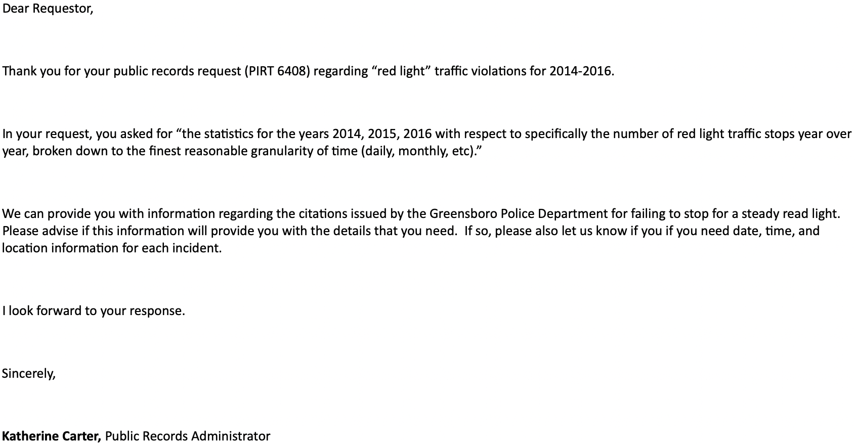
FOIA to the rescue! (Freedom of Information Act)

Slide 4
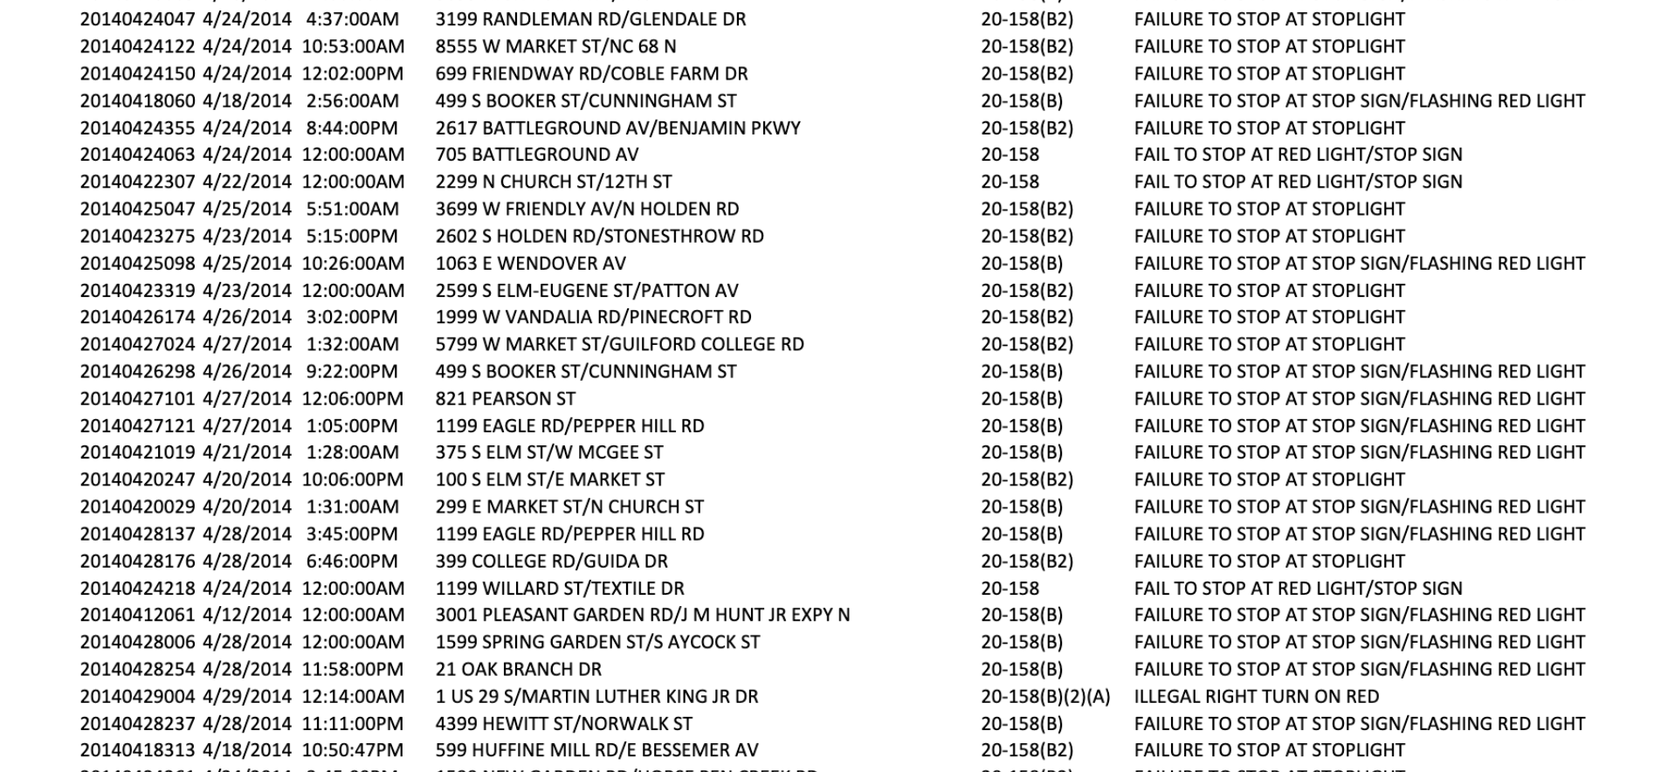

Slide 5
https://postgis.net/install/
Homebrew users can just run “brew install postgis” and tends to be a favorite for more advanced users since there are brew scripts for most of the popular PostgreSQL extensions, not always present in other Mac distributions.
Requires: Postgresql >= 9.1
(I’m using 11.5)
Pgadmin v4.12 (macOS 10.12 and above)
In hindsight, I recommend an all-in-one solution like: the installer certified by EnterpriseDB for all supported PostgreSQL versions.

Slide 6

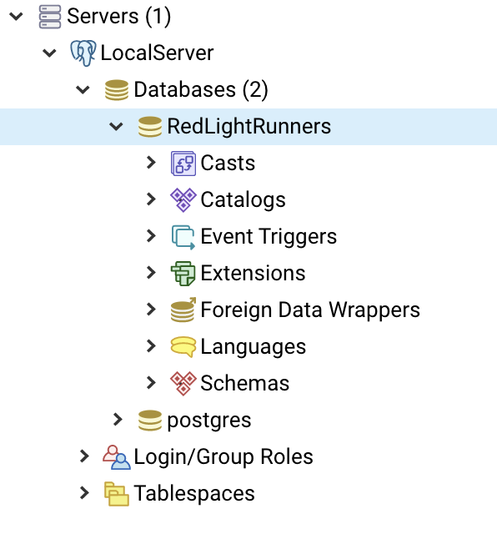
Up and running!
Now we need PostGIS.. How?
Many googles later...
https://www.e-education.psu.edu/spatialdb/node/1958
Ultimately I will need a “shapefile”

Slide 7
Postgres, PostGIS, shapefiles, oh my!
What in the heck is a shapefile? > A shapefile is a simple, nontopological format for storing the geometric location and attribute information of geographic features.
Ok, so how do I make one? “There’s an app for that…”
LMGTFY:
https://mrcc.illinois.edu/gismaps/pointsfromcsv.htm

Slide 8
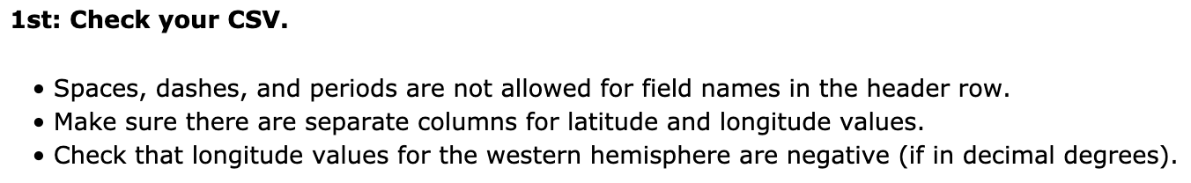
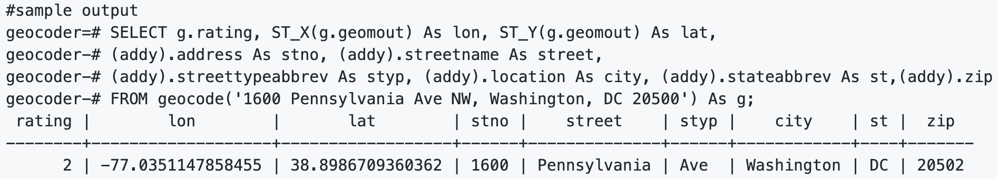
We have an issue…
I don’t have LAT/LNG.. So we’ll need to convert it
But I have a LOT of data, how do I do this easily with my existing intersection-style column of data?
https://github.com/moofish32/postgis-geocoder – seems like this would help me a LOT

Slide 9
It’s data-massaging all the way down…
But my data is intersections, not exact addressing..
So what is a geocode?
Takes in an address as a string (or already normalized address) and outputs a set of possible locations which include a point geometry in NAD 83 long lat, a normalized_address (addy) for each, and the rating. The lower the rating the more likely the match.
Surely this is a common problem… with API support no doubt!?
Yup: https://postgis.net/docs/Geocode_Intersection.html
Takes in 2 streets that intersect and a state, city, zip, and outputs a set of possible locations on the first cross street that is at the intersection, also includes a point geometry in NAD 83 long lat, a normalized address for each location, and the rating.

Slide 10
Goals:
Learn Docker to utilize existing potential solutions
Ingest the preliminary CSV data into LAT/LNG geo-points and then visualize it (OpenStreetmap <?>)
Automate the ingestion process to consume as much data as possible
Convert repository to a docker image containing the postgres/postgis implementation along with visualizatation

Slide 11
Acknowledgements
Wear your hats (overheard at ADS table)
Code for America

