Slide 1
Rat Tracking Data Model

Slide 2
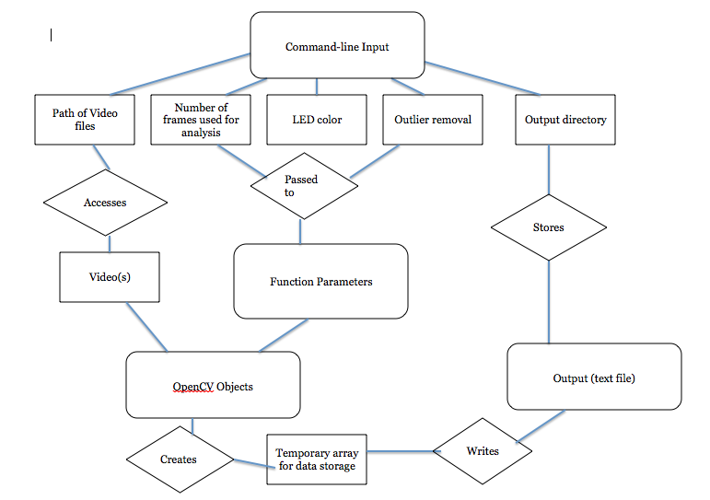

Slide 3
Data Structures
Video
Temporary Array
OpenCV objects
Variables (from command line to function parameters)
Output text file

Slide 4
Control Flow
Viedo accepted into program by noting its path
Stores other command-line variables as Strings
Function parameters indicate how program is run
OpenCV object functions play video
Data recorded into temporary array and then written to text file

