Slide 1
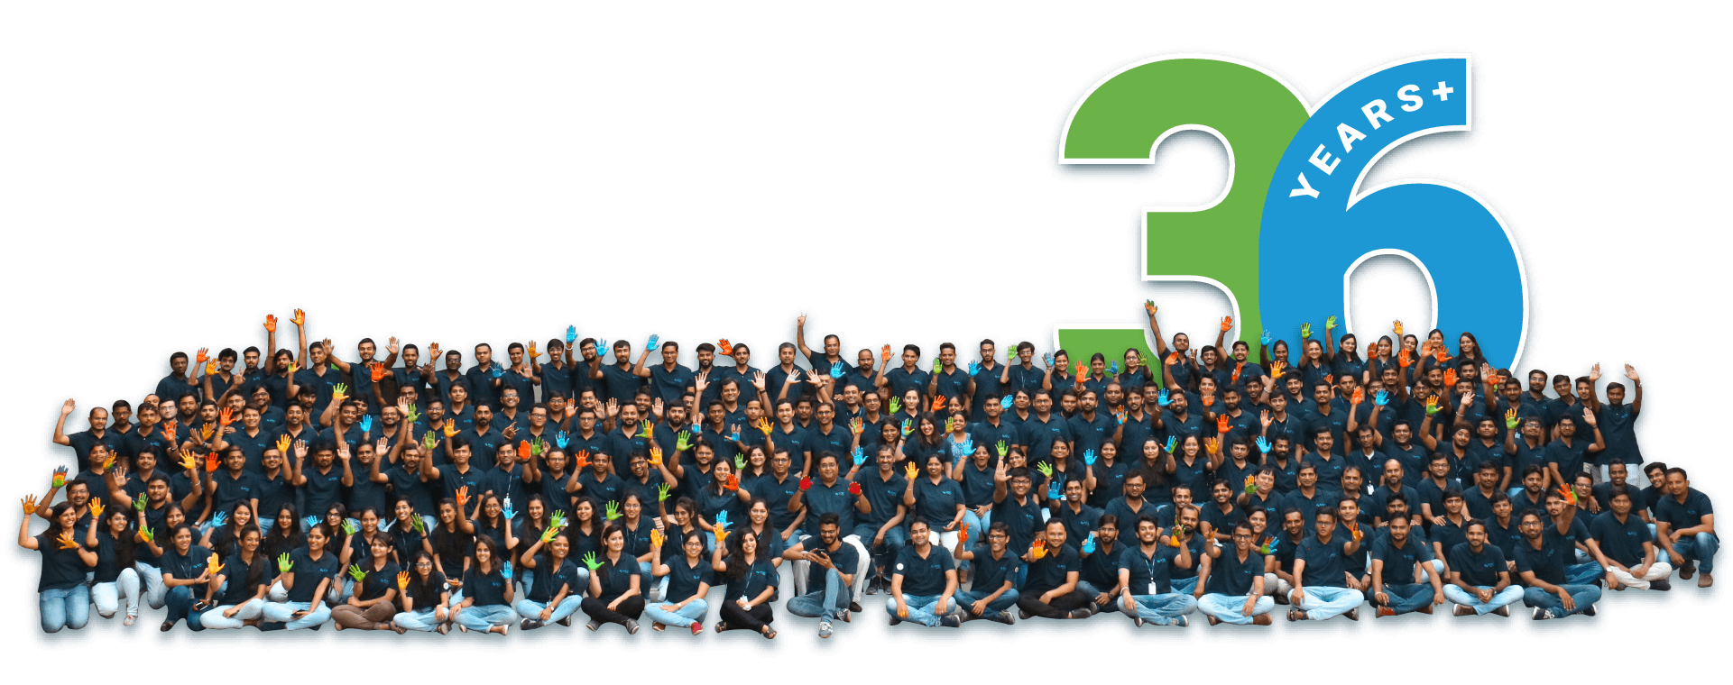
Laravel Design Pattern
Presented by : Budha Jethava(IAS)

Slide 2
What are Design Patterns?
Design patterns are typical solutions to commonly occurring problems in software design. They are like pre-made blueprints that you can customize to solve a recurring design problem in your code.
Design patterns in the context of Laravel offer programmers a set of principles and best practices that guarantee the production of high-quality applications.
04
www.spec-india.com

Slide 3
Design Patterns
Here are some common design patterns used in Laravel:
MVC Pattern
Repository Pattern
Factory Pattern
Singleton Pattern
Observer Pattern
Strategy Pattern
Facades Pattern
Adapter Pattern
04
www.spec-india.com

Slide 4
MVC Pattern
Laravel makes considerable use of the Model-View-Controller (MVC) design pattern, which is a key design principle. Model:
The Model is a representation of the application’s data and business logic.
View:
The display layer and user interface are handled by the view.
Controller:
Between the Model and View, the Controller serves as a mediator. It responds to user queries, manages data processing, and refreshes the view as necessary.
04
www.spec-india.com

Slide 5
Repository Pattern
Between the business logic and the data source of the application, it offers a layer of abstraction.
Utilizing the Repository pattern will enable you to centralize your data access logic and make switching between several data sources (such databases and APIs) simpler.
By encapsulating the data access logic and insulating the rest of the application from the specifics of the underlying data storage, the repository serves as a bridge.
04
www.spec-india.com

Slide 6
Factory Pattern
The Factory pattern is often used with Dependency Injection to help create complex objects.
It is useful when we need to choose between several interchangeable classes at runtime.
By using factories we are also separating the creation of an object from the actual implementation.
Overall, the Factory pattern helps make your code more flexible and modular by making object creation simpler and more organized.
04
www.spec-india.com

Slide 7
Singleton Pattern
Making ensuring a class has just one instance throughout the entire application is possible with Laravel’s Singleton approach. Managing shared resources or global setups is a frequent application of it.
You can manage access to these shared resources from one central area by using the Singleton design. Because to this, extraneous instance creation is prevented. Additionally, it makes it simple to transfer data between sections of your program, promoting efficiency and consistency.
In Laravel, the Singleton pattern, which ensures that there is only one instance of a class, helps you stay organized by ensuring that data is consistent across your application and shared resources are managed.
04
www.spec-india.com

Slide 8
Observer Pattern
The Observer pattern is a behavioral design pattern that allows objects to notify other objects about changes without depending on them.
Laravel Model Observers are used to group event listeners for a model.
Observers classes method names refer to the Eloquent event you want to listen for. These methods receive the model as their only argument.
Eloquent models fire several events, allowing you to hook into the following points in a model's lifecycle: https://github.com/mobiosolutions/laravel-observer-example/tree/master
04
www.spec-india.com

Slide 9
Strategy Pattern
Strategy is a behavioral design pattern that turns a set of behaviors into objects and makes them interchangeable inside original context object.
This increases the code’s modularity and reusability and makes it simpler to alter an object’s behavior during runtime.
This design pattern that lets you define a family of algorithms, put each of them into a separate class, and make their objects interchangeable.
04
www.spec-india.com

Slide 10
Facades Pattern
A complicated subsystem’s interface is made simple and unified by the facade pattern. It conceals the underlying complexity and offers a straightforward user interface so that clients may communicate with the subsystem.
With the help of Laravel’s wide use of the Facade design, you may access different framework elements using a concise and expressive vocabulary.
You must first import the desired facade into Laravel before you can use the facade pattern.
For instance, you would import the following code to use the Cache facade:
use Illuminate\Support\Facades\Cache;
Cache::put('key', 'value', 10);
04
www.spec-india.com

Slide 11
Adapter Pattern
Adapter is a structural design pattern that allows objects with incompatible interfaces to collaborate.
This pattern is frequently applied when an existing object that you want to utilize has an interface that is incompatible with the interface you require.
The Adapter design is frequently used in Laravel to integrate with external APIs.
04
www.spec-india.com

Slide 12
Benefits of Design Patterns
Code Reusability:
Design patterns encourage code reuse, enabling you to make advantage of current solutions and cut down on duplicate code. This improves output and cuts down on development time.
Scalability:
Your codebase becomes modular and versatile when you use design patterns. As your needs change, you can quickly adapt and scale your application.
Code Organization:
Design patterns help your code have a clear structure, which makes it simpler to comprehend and maintain. This results in better teamwork and quicker debugging.
Maintainability:
By following design patterns, you can make sure that your code is well-organized and adheres to current standards. This makes maintenance easier and lessens the chance of adding bugs.
04
www.spec-india.com

Slide 13
Thank you
04
www.spec-india.com

Slide 14













Thank You For Your Time & Attention!
India
lead@spec-india.com
Looking forward to having a mutually beneficial association! Assuring you of our best services always!
+91-79-26404031 to 34
SPEC House”, Parth Complex,
Near Swastik Cross Roads, Navarangpura, Ahmedabad 380009, INDIA.
Visit us at
www.spec-india.com
Write to us at
lead@spec-india.com
USA
lead@spec-usa.net
+ 1 908-450-9862
SPEC Partner”, 350 Grove Street, Bridgewater, NJ 08807, United States.
© 2024 SPEC INDIA. All Rights Reserved.

