Slide 1

Scaler
Ecommerce Domain Analytics
PRICE OPTIMIZATION CASE STUDY
BUDHAJIT ROY
February 3rd 2024

Slide 2
OBJECTIVE
Different Pricing Strategies to help TrendElite effectively price its products to enhance its overall revenue and market competitivenes.

Slide 3
COST PLUS PRICING
Cost-Plus Pricing = Break-Even Price * Profit Margin Goal

Slide 4
OBJECTIVE

Slide 5
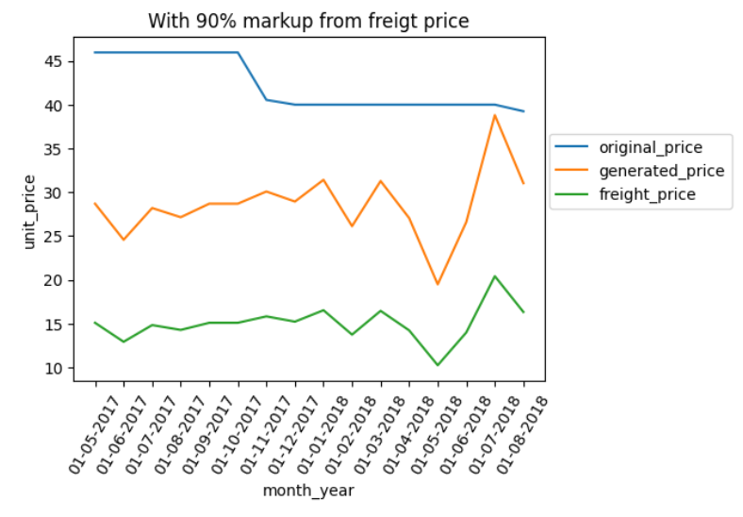
COST PLUS PRICING
Cost-Plus Pricing = Break-Even Price * Profit Margin Goal

Slide 6
COST PLUS PRICING
Focus only on internal costs and not on customer demand and competitor prices

Slide 7
COST PLUS PRICING
Focus only on internal costs and not on customer demand and competitor prices
Simple, easy and requires less research

Slide 8
COST PLUS PRICING
Focus only on internal costs and not on customer demand and competitor prices
Simple, easy and requires less research
Reduce Efficiency and set price can lead to reverse impact

Slide 9
COST PLUS PRICING
Focus only on internal costs and not on customer demand and competitor prices
Simple, easy and requires less research
Reduce Efficiency and set price can lead to reverse impact
What Next??

Slide 10
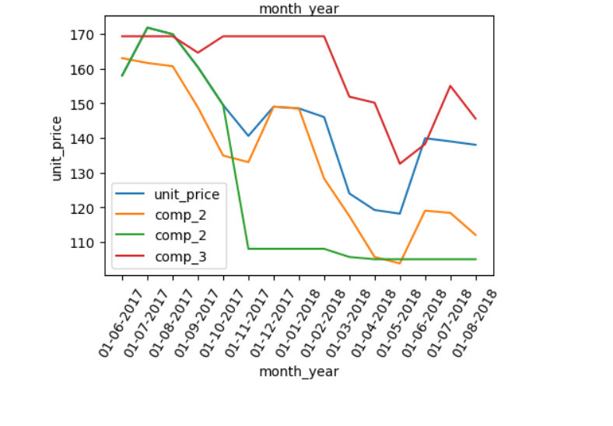
COMPETITOR PRICING

Slide 11
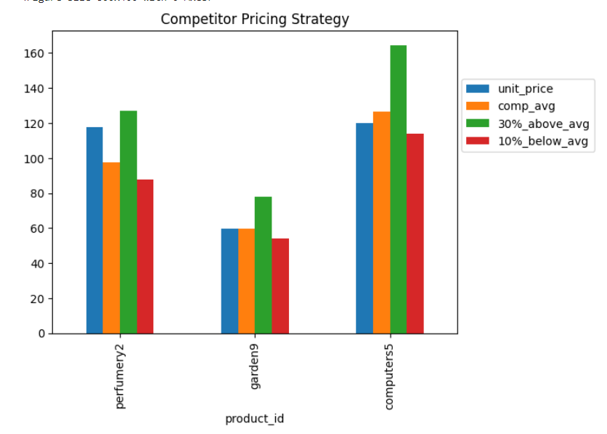
COMPETITOR PRICING
3 methods
Pricing same level
Above Competitors avg
Below Competitors avg

Slide 12
COMPETITOR PRICING
3 methods
Pricing same level
Above Competitors avg
Below Competitors avg

Slide 13
COMPETITOR PRICING
3 methods
Pricing same level
Above Competitors avg
Below Competitors avg
can be used if considering only competitors pricing range

Slide 14
COMPETITOR PRICING
3 methods
Pricing same level
Above Competitors avg
Below Competitors avg
can be used if considering only competitors pricing range
Different value and market offerrings

Slide 15
COMPETITOR PRICING
3 methods
Pricing same level
Above Competitors avg
Below Competitors avg
can be used if considering only competitors pricing range
Different value and market offerrings
Price too high or too low

Slide 16
COMPETITOR PRICING
3 methods
Pricing same level
Above Competitors avg
Below Competitors avg
can be used if considering only competitors pricing range
Different value and market offerrings
Price too high or too low
What NEXT??

Slide 17
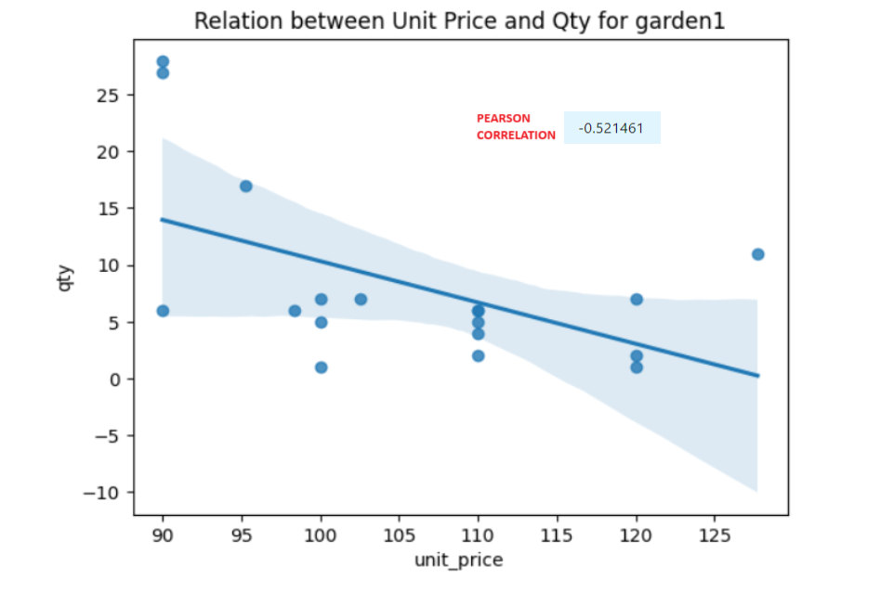
PRICE ELASTICITY DEMAND
PED = %change in quantity / % change in Price

Slide 18
PRICE ELASTICITY DEMAND
PED = %change in quantity / % change in Price
OLS Simple Regression model to predict qty using Unit Price

Slide 19
PRICE ELASTICITY DEMAND
PED = %change in quantity / % change in Price
OLS Simple Regression model to predict qty using Unit Price
Feed ranges of Unit Price values and get the one that yields max Quantity

Slide 20
PRICE ELASTICITY DEMAND
PED = %change in quantity / % change in Price
OLS Simple Regression model to predict qty using Unit Price
Feed ranges of Unit Price values and get the one that yields max Quantity

Slide 21
PRICE ELASTICITY DEMAND
PED = %change in quantity / % change in Price
OLS Simple Regression model to predict qty using Unit Price
Feed ranges of Unit Price values and get the one that yields max Quantity
Not considering other features, less robust, may not always be linear relationship,

Slide 22
PRICE ELASTICITY DEMAND
PED = %change in quantity / % change in Price
OLS Simple Regression model to predict qty using Unit Price
Feed ranges of Unit Price values and get the one that yields max Quantity
Not considering other features, less robust, may not always be linear relationship,
What NEXT??

Slide 23
PRICE ELASTICITY DEMAND
More robust model, Regressor Tree Model to predict Revenue

Slide 24
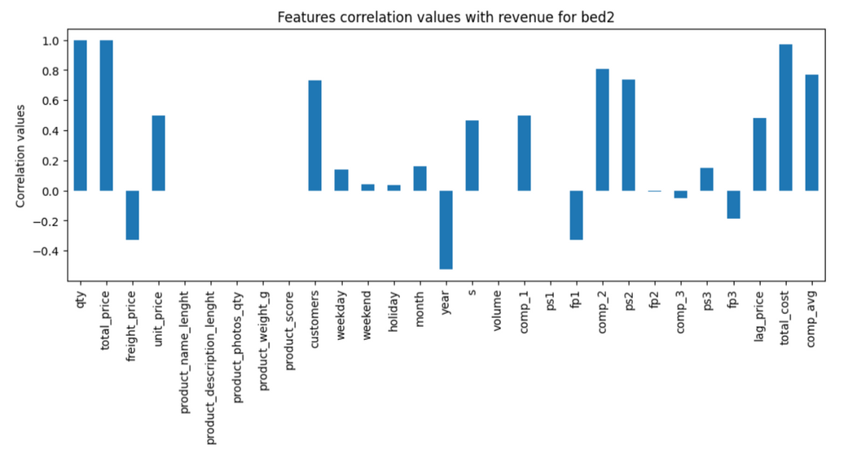
PRICE ELASTICITY DEMAND
More robust model, Regressor Tree Model to predict Revenue
Considering other features with correlation values > 0.3

Slide 25
PRICE ELASTICITY DEMAND
More robust model, Regressor Tree Model to predict Revenue
Considering other features with correlation values > 0.3
Predict Revenue for all price ranges keeping other features constant, get price with max revenue

Slide 26
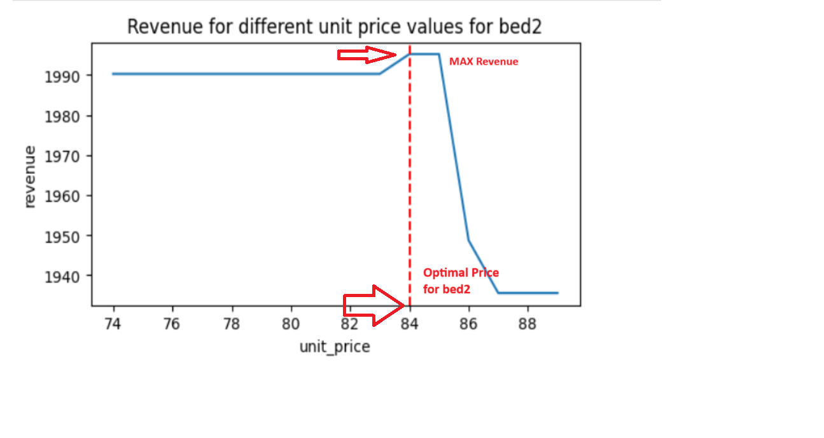
PRICE ELASTICITY DEMAND
More robust model, Regressor Tree Model to predict Revenue
Considering other features with correlation values > 0.3
Predict Revenue for all price ranges keeping other features constant, get price with max revenue

Slide 27
PRICE ELASTICITY DEMAND
More robust model, Regressor Tree Model to predict Revenue
Considering other features with correlation values > 0.3
Predict Revenue for all price ranges keeping other features constant, get price with max revenue
More robust, captures comp prices, demand, seasonality,etc

Slide 28
CONCLUSION
1
Determining optimal price of a product is first very much dependent on the business goal, like whether to increase sales, or increase profits or overall revenue, decrease cost, etc.

Slide 29
CONCLUSION
1
Determining optimal price of a product is first very much dependent on the business goal, like whether to increase sales, or increase profits or overall revenue, decrease cost, etc.
2
Just add markup to the production cost, then go with Cost Plus Pricing OR if to benchmark against competitors' prices to remain competitive in the market, then go with Competitor Pricing Strategy.

Slide 30
CONCLUSION
1
Determining optimal price of a product is first very much dependent on the business goal, like whether to increase sales, or increase profits or overall revenue, decrease cost, etc.
2
Just add markup to the production cost, then go with Cost Plus Pricing OR if to benchmark against competitors' prices to remain competitive in the market, then go with Competitor Pricing Strategy.
3
If to adjusts prices in real-time based on various factors such as demand, seasonality, and competitor pricing to optimize revenue, then need to implement more robust models.

Slide 31
CONCLUSION
1
Determining optimal price of a product is first very much dependent on the business goal, like whether to increase sales, or increase profits or overall revenue, decrease cost, etc.
2
Just add markup to the production cost, then go with Cost Plus Pricing OR if to benchmark against competitors' prices to remain competitive in the market, then go with Competitor Pricing Strategy.
3
If to adjusts prices in real-time based on various factors such as demand, seasonality, and competitor pricing to optimize revenue, then need to implement more robust models.
4
Embracing the power of advanced AIML and other advanced pricing strategies stands as a pivotal recommendation for unlocking unprecedented potential in optimizing the pricing mode.

Slide 32
THANK YOU

