Slide 1
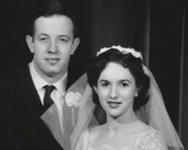
I force myself to see the man that I married and he becomes that man.
He is transformed into someone that I love a
nd I’m transformed into someone who loves him. I
thinks it’s not all the time. But.. it’s enough.”
Alicia Nash, John Forber Nas Wife

