Slide 1


Navigating the AI "Black Box": Testing Challenges
Understanding and ensuring the reliability, fairness, and safety of AI systems is a complex and evolving challenge. This presentation will explore the unique difficulties in testing AI models, which differ significantly from traditional software.
Buddireedy Ganga Nooka Shekar-322129512011

Slide 2

The Core Problem
The "Black Box" Nature T Continuous Evolution of AI Models
Unlike traditional software with defined rules, AI's behavior is shaped by training data and evolves dynamically. This inherent complexity makes it incredibly difficult to ensure an AI system is consistently reliable, fair, and safe. We'll delve into the specific challenges this presents for testing.

Slide 3
Unique Testing Challenges for AI
Non-deterministic Outcomes
AI systems can produce different outputs for the same input under varying conditions, such as after retraining. This makes creating predictable and repeatable test cases nearly impossible, a stark contrast to traditional software.
Lack of Explainability
Many AI models, especially deep learning networks, operate as "black boxes." It's often unclear why a specific decision was made, hindering debugging efforts and proving unbiased, fair system operation.
Data Dependency and Bias
AI quality is directly tied to its training data. Biased or incomplete data leads to biased AI, perpetuating unfair or incorrect decisions. Testing for all possible biases and edge cases is a significant challenge.

Slide 4
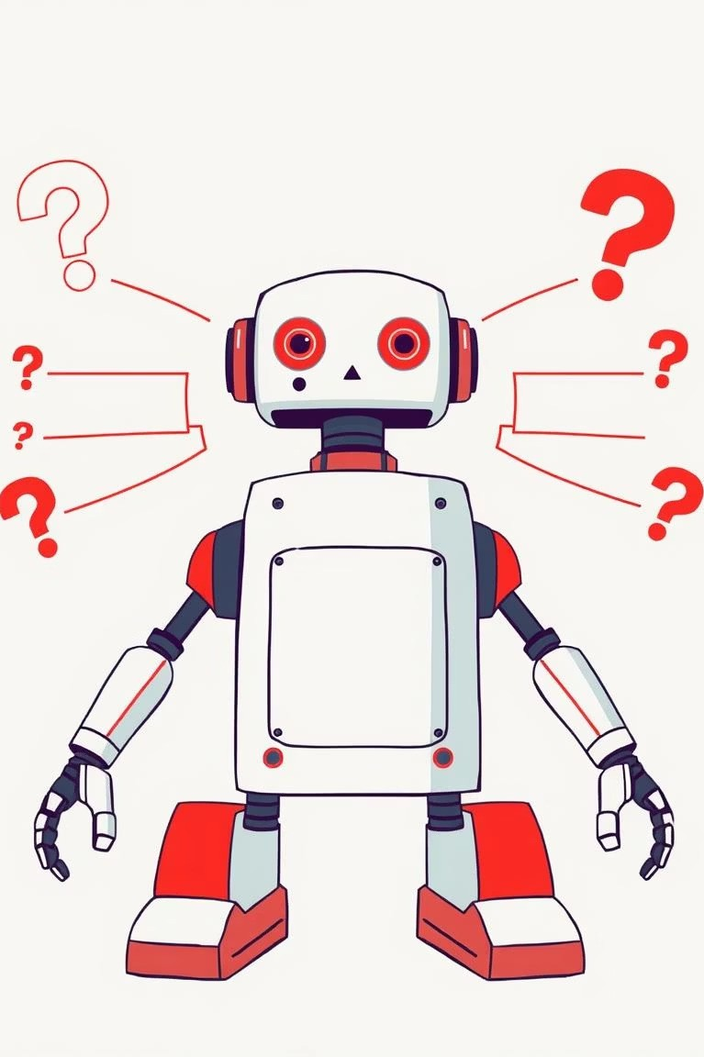
Non-deterministic Outcomes
Traditional software always yields the same output for the same input. AI systems, however, can produce different results for identical inputs, especially after retraining with new data. This dynamic behavior makes it extremely difficult to establish predictable and repeatable test cases, complicating the validation process.

Slide 5

The "Black Box" of Explainability
Many advanced AI models, particularly deep learning networks, function as "black boxes." This means that the reasoning behind a specific decision is often opaque, making it challenging to debug failures or to confidently assert that the system is operating without bias and with fairness.

Slide 6

Data Dependency and Bias
The performance and integrity of an AI system are fundamentally linked to the quality of its training data. If this data is biased or incomplete, the AI will inevitably learn and perpetuate those biases, leading to unfair or incorrect decisions.
Identifying and mitigating all potential biases and edge cases within vast datasets is an immense testing challenge.

Slide 7

Case Study: Facial Recognition Bias
Consider a facial recognition AI primarily trained on data featuring light-skinned individuals. Such a system may struggle to accurately identify people with darker skin tones, demonstrating a clear bias. This highlights the critical need for diverse and representative training data to ensure equitable AI performance.

Slide 8

Drift and Decay: The Evolving Environment
The real-world environments in which AI operates are constantly changing. An AI model that performs exceptionally well initially may experience a decline in performance as the data it encounters shifts over time. This phenomenon, known as "model drift," necessitates continuous, post- deployment testing4a concept not traditionally emphasized in conventional software testing.

Slide 9
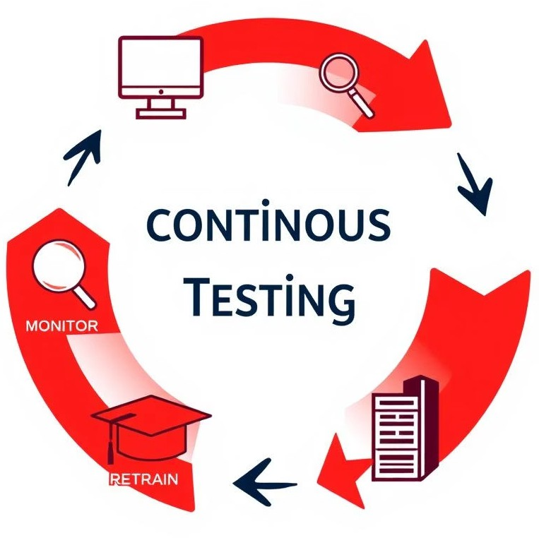
The Need for Continuous Testing
Civen the dynamic nature of AI models and their operating environments, continuous testing is not just beneficial but essential. This involves ongoing monitoring and evaluation of AI performance post-deployment to detect and address model drift, ensuring sustained reliability and fairness.

Slide 10
Key Takeaways
1
AI is Different
AI's "black box" nature and continuous evolution create unique testing challenges.
2
New Paradigms Needed
Traditional testing methods are insufficient for non-deterministic outcomes, explainability gaps, and data biases.
3
Continuous Monitoring
Ongoing testing is crucial to combat model drift and ensure long-term reliability and fairness.
Addressing these challenges requires innovative approaches to AI testing, focusing on adaptability, transparency, and continuous validation.

