Slide 1
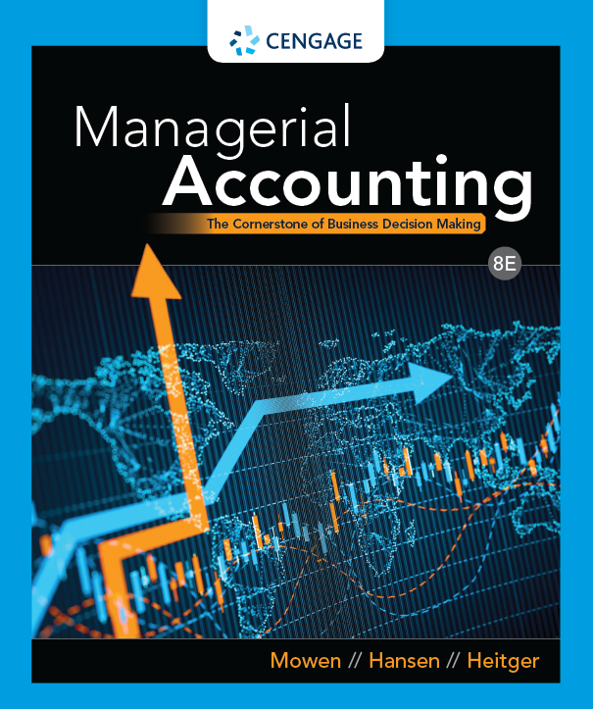
Chapter 02: Basic Managerial Accounting Concepts
Managerial Accounting, 8e

Slide 2
Chapter Objectives
By the end of this chapter, you should be able to:
02.01 Explain the meaning of cost and how costs are assigned to products and services
02.02 Define the various costs of manufacturing products and providing services as well as the costs of selling and administration
02.03 Prepare income statements for manufacturing and service organizations
Notes:
By the end of this chapter, you should be able to:
Explain the meaning of cost and how costs are assigned to products and services
Define the various costs of manufacturing products and providing services as well as the costs of selling and administration
Prepare income statements for manufacturing and service organizations

Slide 3
Icebreaker
Annie, a prospective college student, wanted to know how much it costs to obtain a college education. She asked this question to her parents and friends and received different answers. Annie quickly became concerned as she wondered if she could afford college.
Help Annie to understand the costs associated with the college education including tuition, food, dormitory housing, gas for driving home on weekends, books and online access licenses etc.
Notes:
Task: This is an introductory exercise at the beginning of the chapter.
Objectives: To provide an informal way for participants to learn about each other. This exercise allows students to practice speaking in front of a group. It also helps students to think and be aware of various types of costs associated with the college education.
Instructions: Students should introduce themselves before answering the question.
Average Time: 5 minutes
Note: To adapt this activity for an online learning environment, conduct the interviews using a web conferencing tool (e.g., Zoom or Microsoft Teams). You can provide 1 to 2 minutes to students so that they can think. After 2 minutes when students start providing their opinion, they can first introduce themselves.

Slide 4
The Meaning and Uses of Cost (1 of 2)
Important yet difficult task of managerial accounting is to determine the cost of products, services, customers, and other items to managers
Cost: Amount of cash or cash equivalent sacrificed for goods and/or services that bring a current or future benefit to the organization
Costs used up in the production of revenues are said to expire and are called expenses
On the income statement, expenses are deducted from revenues to determine income (profit)
Notes:
One of the most important tasks of managerial accounting is to determine the cost of products, services, customers, and other items of interest to managers. Therefore, we need to understand the meaning of cost and the ways in which costs can be used to make decisions, both for small entrepreneurial businesses and large international businesses. Cost is the amount of cash or cash equivalent sacrificed for goods and/or services that are expected to bring a current or future benefit to the organization. As costs are used up in the production of revenues, they are said to expire. Expired costs are called expenses. On the income statement, expenses are deducted from revenues to determine income (also called profit).

Slide 5
The Meaning and Uses of Cost (2 of 2)
We can look more closely at the relationship between cost and revenue by focusing on the units sold
Revenue per unit is called price
Notes:
We can look more closely at the relationship between cost and revenue by focusing on the units sold. The revenue per unit is called price.

Slide 6
Cost Objects
Items such as a product, customer, department, project, geographic region, plant, and so on, for which costs are measured and assigned
Managerial accounting systems are structured to measure and assign costs to entities
Notes:
A cost object is any item such as a product, customer, department, project, geographic region, plant, and so on, for which costs are measured and assigned. Managerial accounting systems are structured to measure and assign costs to entities called cost objects.

Slide 7
Accumulating Costs
Way that costs are measured and recorded
Accounting system typically does this job quite well
Notes:
Accumulating costs is the way that costs are measured and recorded. The accounting system typically does this job quite well.

Slide 8
Assigning Costs
Way that a cost is linked to some cost object
Tells the company why the money was spent
Notes:
Assigning costs is the way that a cost is linked to some cost object. As noted earlier, a cost object is something for which a company wants to know the cost. Assigning costs tells the company why the money was spent.

Slide 9
Assigning Costs to Cost Objects
Costs can be assigned to cost objects in a number of ways
The choice of a method depends on a number of factors, such as the need for accuracy
The objective is to measure and assign costs as well as possible, given management objectives
Notes:
Costs can be assigned to cost objects in a number of ways. The choice of a method depends on a number of factors, such as the need for accuracy. The objective is to measure and assign costs as well as possible, given management objectives.

Slide 10
Direct Costs
Costs that can be easily and accurately traced to a cost object
When a cost is easy to trace, we mean that the relationship between the cost and the object can be:
physically observed
easy to track
More costs that can be traced to the object, more accurate are the cost assignments
Notes:
Direct costs are those costs that can be easily and accurately traced to a cost object. When we say that a cost is easy to trace, we often mean that the relationship between the cost and the object can be physically observed and is easy to track. The more costs that can be traced to the object, the more accurate are the cost assignments.

Slide 11
Indirect Costs
Costs that cannot be easily and accurately traced to a cost object
Allocation means that an indirect cost is assigned to a cost object by using a reasonable and convenient method
Allocating indirect costs is based on convenience
Notes:
Indirect costs are costs that cannot be easily and accurately traced to a cost object. Allocation means that an indirect cost is assigned to a cost object by using a reasonable and convenient method. Since no clearly observable causal relationship exists, allocating indirect costs is based on convenience or some assumed causal linkage.

Slide 12
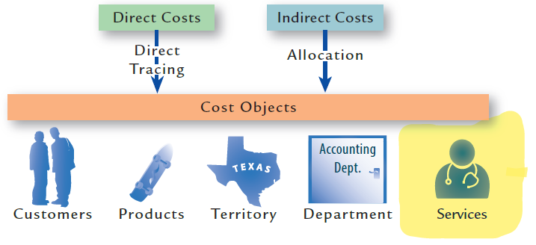
Object Costing
Notes:
Direct and indirect costs occur in service businesses as well. Some businesses refer to indirect costs as overhead costs or support costs. This slide shows examples of direct and indirect costs being assigned to cost objects.

Slide 13
Other Categories of Cost
Costs can be direct or indirect, and are analyzed with respect to their behavior patterns, or the way in which a cost changes when the level of the output changes
Variable cost: One that increases in total as output increases and decreases in total as output decreases
Fixed cost: Does not increase in total as output increases and does not decrease in total as output decreases
Opportunity cost: Net benefit given up or sacrificed when one alternative is chosen over another
Notes:
In addition to being categorized as either direct or indirect, costs often are analyzed with respect to their behavior patterns, or the way in which a cost changes when the level of the output changes.
Variable cost: A variable cost is one that increases in total as output increases and decreases in total as output decreases.
Fixed cost: A fixed cost is a cost that does not increase in total as output increases and does not decrease in total as output decreases.
Opportunity cost: An opportunity cost is the net benefit given up or sacrificed when one alternative is chosen over another.

Slide 14
The Role of Data Analytics in Management Accounting (1 of 3)
Data analytics: Process through which a company utilizes various amounts and types of data to help connect strategy and key goals to improve decision making throughout the company
Business professionals must be able to use basics of management accounting and data analytics to help decision makers throughout the company understand “the story” of what drives financial success and failure
Notes:
Data analytics represents the process through which a company utilizes various amounts and types of data to help connect strategy and key goals to improve decision making throughout the company.

Slide 15
The Role of Data Analytics in Management Accounting (2 of 3)
Understanding the company’s story requires that the following fundamental data analytic questions be answered:
Why measure?
What to measure?
How to measure?
Where to obtain data?
Which approach to employ?
How to interpret the results?
Who to communicate with?
Notes:
Understanding the company’s story requires that the following fundamental data analytic questions be answered: Why measure? (that is, focus measurement efforts on phenomena most likely to improve understanding of the company’s most important areas). What to measure? (that is, quantify, either nonfinancially or financially, the factors most critical for helping the company achieve its strategy). How to measure? (that is, think creatively to quantify challenging but important factors, such as the value of customer loyalty or reputational enhancement or damage). Where to obtain data? (that is, collect necessary data from existing or prospective internal sources or purchase from external databases or competitors) Which approach to employ? (that is, choose the particular data analytic tool or technique most appropriate for the given situation). How to interpret the results? (that is, translate the statistical output into meaningful decision relevant guidance—“the story”). Who to communicate with? (that is, consider the employees whose decisions would be most informed by the results and the communication method—sometimes referred to as data visualization—best suited to ensuring their understanding).

Slide 16
The Role of Data Analytics in Management Accounting (3 of 3)
Management accounting uses data analytics to improve many key business decisions, including:
Product and service design
Cost forecasting and budgeting
Product and service pricing
Cost management
Notes:
Management accounting uses data analytics to improve many key business decisions, including:
Product and service design, to better understand customer preferences, to create new features that increase revenues, or to discontinue overly costly existing features
Cost forecasting and budgeting, to better understand operational resource consumption patterns
Product and service pricing, to better understand costs up and down the value chain
Cost management, to better understand the relationships between various cost drivers

Slide 17
Matching Data Analytic Types to Management Accounting Analyses (1 of 2)
Data Analytic Type | Question Answered | Management Accounting Analysis Example
Descriptive | What is happening? | Create a profit and loss analysis of current products (games, virtual reality headsets, controllers) based on historical financial performance data.
Diagnostic | Why is it happening? | Conduct an analysis that identifies the drivers of customers’ most valued particular product preferences (features, platforms, consoles, multiplayer capabilities).

Slide 18
Matching Data Analytic Types to Management Accounting Analyses (2 of 2)
Data Analytic Type | Question Answered | Management Accounting Analysis Example
Predictive | What is likely to happen? | Forecast the financial impact (in terms of lost revenue) from the risk that competitors introduce new games with innovative and popular features.
Prescriptive | What do I need to do? | Build a model that informs employees about specific choices to make across the value chain (from game design to distribution to marketing to aftermarket customer interfaces) to optimize profitability.

Slide 19
Discussion Activity 1
Discuss direct cost and indirect cost. Can same cost be direct for one purpose and indirect for another? Think and give examples.
Notes:
Instructions:
Gather into small groups of three to five.
Read through the slide information.
Collectively decide on your small group’s answers to the question presented.
Share your findings with the larger group.

Slide 20
Discussion Activity 1 Debrief
Discuss direct cost and indirect cost. Can same cost be direct for one purpose and indirect for another? Think and give examples.
Answer:
A direct cost is one that can be traced to the cost object, typically by physical observation. An indirect cost cannot be traced easily and accurately to the cost object. The same cost can be direct for one purpose and indirect for another. For example, the salaries paid to purchasing department employees in a factory are a direct cost to the purchasing department but an indirect cost (overhead) to units of product.

Slide 21
Product Costs
Output represents one of the most important cost objects
There are two types of output: products and services
Products are goods produced by converting raw materials through the use of labor and indirect manufacturing resources, such as the manufacturing plant, land, and machinery
Televisions, hamburgers, automobiles, computers, clothes, and furniture are examples of products
Notes:
Output represents one of the most important cost objects. There are two types of output: products and services. Products are goods produced by converting raw materials through the use of labor and indirect manufacturing resources, such as the manufacturing plant, land, and machinery. Televisions, hamburgers, automobiles, computers, clothes, and furniture are examples of products.

Slide 22
Service Costs (1 of 2)
Services are tasks or activities performed for a customer or an activity performed using an organization’s products or facilities
Medical care, teaching, dental care, spa activities, insurance coverage, and accounting are examples of service activities
Car rental, video rental, and skiing are examples of services where the customer uses an organization’s products or facilities
Notes:
Services are tasks or activities performed for a customer or an activity performed by a customer using an organization’s products or facilities. Medical care, teaching, dental care, spa activities, insurance coverage, and accounting are examples of service activities performed for customers. Car rental, video rental, and skiing are examples of services where the customer uses an organization’s products or facilities.

Slide 23
Service Costs (2 of 2)
Services differ from products in many ways
Services are intangible
Services are perishable
Services involve direct contact between providers and buyers
Notes:
Services differ from products in many ways, including the following:
• Services are intangible: The buyers of services typically cannot see, feel, hear, or taste a service before it is bought.
• Services are perishable: Services cannot be stored for future use by a consumer but must be consumed when performed. Inventory valuation, so important for products, is not an issue for services. In other words, because service organizations do not produce and sell products as part of their regular operations, they have no inventory asset on the balance sheet.
• Services usually involve direct contact between providers and buyers: An eye examination, for example, typically requires both the patient and the optometrist to be present. Interestingly, advances in information technology are spurring the emergence of exciting telehealth capabilities for some health-related services that do not require physical proximity between provider and buyer, but still involve direct contact via a video conference session. In contrast to most service providers, producers of products need not have direct contact with the buyers of their goods. Thus, buyers of automobiles never need to have contact with the engineers and assembly line workers that produced their automobiles.

Slide 24
Providing Cost Information (1 of 2)
Managerial accountants must decide:
What types of managerial accounting information to provide to managers
How to measure such information
When and to whom to communicate the information
Managers rely on managerial accounting information that is prepared and they believe that it provides the best analysis for the decision at hand
Notes:
Managerial accountants must decide what types of managerial accounting information to provide to managers, how to measure such information, and when and to whom to communicate the information. For example, when making most strategic and operating decisions, managers typically rely on managerial accounting information that is prepared in whatever manner the managerial accountant believes provides the best analysis for the decision at hand.

Slide 25
Providing Cost Information (2 of 2)
There is one major exception
Managerial accountants must follow specific external reporting rules (i.e., generally accepted accounting principles)
When providing outside parties with cost information about the amount of ending inventory on the balance sheet and the cost of goods sold on the income statement
To calculate these two amounts, managerial accountants must subdivide costs into functional categories: production and period (i.e., nonproduction)
Notes:
There is one major exception. Managerial accountants must follow specific external reporting rules (i.e., generally accepted accounting principles) when their companies provide outside parties with cost information about the amount of ending inventory on the balance sheet and the cost of goods sold on the income statement. In order to calculate these two amounts, managerial accountants must subdivide costs into functional categories: production and period (i.e., nonproduction).

Slide 26
Determining Product Cost (1 of 2)
Product (manufacturing) costs – both direct and indirect, of producing a product in a manufacturing firm or of acquiring a product in a merchandising firm and preparing it for sale
Only costs in the production section of the value chain are included in product costs
Notes:
Product (manufacturing) costs are those costs, both direct and indirect, of producing a product in a manufacturing firm or of acquiring a product in a merchandising firm and preparing it for sale. Therefore, only costs in the production section of the value chain are included in product costs.

Slide 27
Determining Product Cost (2 of 2)
Product costs
Inventoried
Added to an inventory account and remain in inventory until they are sold, at which time they are transferred to cost of goods
Classified as direct materials, direct labor, and manufacturing overhead
Notes:
Product costs are inventoried. Product costs initially are added to an inventory account and remain in inventory until they are sold, at which time they are transferred to cost of goods. Product costs can be further classified as direct materials, direct labor, and manufacturing overhead.

Slide 28
Direct Materials
Materials that are a part of the final product and can be directly traced to the goods being produced
Materials cost can be directly charged to products because physical observation can be used to measure the quantity used by each product
Notes:
Direct materials are those materials that are a part of the final product and can be directly traced to the goods being produced. The cost of these materials can be directly charged to products because physical observation can be used to measure the quantity used by each product. Materials that become part of a product usually are classified as direct materials.

Slide 29
Direct Labor
Labor that can be directly traced to the goods being produced
Physical observation can be used to measure the amount of labor used to produce a product
Employees who convert direct materials into a product are classified as direct labor
A company can also have indirect labor costs and it is included in overheads
Notes:
Direct labor is the labor that can be directly traced to the goods being produced. Physical observation can be used to measure the amount of labor used to produce a product. Those employees who convert direct materials into a product are classified as direct labor. A company can also have indirect labor costs. Indirect labor is included in overhead and, therefore, is an indirect cost rather than a direct cost.

Slide 30
Manufacturing Overhead
All product costs other than direct materials and direct labor
Known as factory burden, support, or indirect manufacturing costs
Costs are included if they cannot be traced to the cost object of interest
Examples: Depreciation on plant buildings and equipment, janitorial and maintenance labor, plant supervision, etc.
Notes:
All product costs other than direct materials and direct labor are put into a category called manufacturing overhead. In a manufacturing firm, manufacturing overhead also is known as factory burden or indirect manufacturing costs. Costs are included as manufacturing overhead if they cannot be traced to the cost object of interest (for example, unit of product). Examples: Depreciation on plant buildings and equipment, janitorial and maintenance labor, plant supervision, materials handling, power for plant utilities, and plant property taxes.

Slide 31
Calculating Total Product Cost (1 of 2)
Total Product Cost = Direct Materials + Direct Labor + Manufacturing Overhead
Per-Unit Product Cost = Total Product Cost / Number of Units Produced
Notes:
The total product cost equals the sum of direct materials, direct labor, and manufacturing overhead:
Total Product Cost = Direct materials + Direct labor + Manufacturing overhead
The unit product cost equals total product cost divided by the number of units produced:
Per-Unit Product Cost = Total Product Cost ÷ Number of Units Produced

Slide 32
Calculating Total Product Cost (2 of 2)
Product costs are essential to management control and decision making
Managers use product costs to create budgets and analyses
Product costs within manufacturing can then be contrasted with period costs incurred outside of manufacturing
Notes:
Product costs are essential to management control and decision making. Managers use product costs to create budgets and analyses. Product costs within manufacturing can then be contrasted with period costs incurred outside of manufacturing

Slide 33
Prime and Conversion Costs
Product costs of direct materials, direct labor, and manufacturing overhead can be grouped into prime cost and conversion cost
Prime Cost = Direct Materials + Direct Labor
Conversion Cost = Direct Labor + Manufacturing Overhead
Notes:
Product costs of direct materials, direct labor, and manufacturing overhead are sometimes grouped into prime cost and conversion cost:
Prime cost is the sum of direct materials cost and direct labor cost. Prime cost = Direct materials + Direct labor
Conversion cost is the sum of direct labor cost and manufacturing overhead cost. Conversion cost = Direct labor + Manufacturing Overhead

Slide 34
Period Costs (1 of 3)
Not carried in inventory
Costs that are not product costs
Examples: Office supplies, research and development activities, the C E O’s salary, and advertising
Can be significant and controlling them may bring greater cost savings than the same effort exercised in controlling production costs
Notes:
The costs of production are assets that are carried in inventories until the goods are sold. There are other costs of running a company, referred to as period costs, that are not carried in inventory. Thus, period costs are all costs that are not product costs (i.e., all areas of the value chain except for production). The cost of office supplies, research and development activities, the C E O’s salary, and advertising are examples of period costs. In a manufacturing organization, the level of period costs can be significant and controlling them may bring greater cost savings than the same effort exercised in controlling production costs.

Slide 35
Period Costs (2 of 3)
Expensed in the period in which they are incurred
Recorded as long-term assets and allocated to expense through depreciation throughout their useful life if they are expected to provide economic benefits beyond the next year
Notes:
Period costs typically are expensed in the period in which they are incurred. However, if a period cost is expected to provide an economic benefit (i.e., revenues) beyond the next year, then it is recorded as a long-term asset (i.e., capitalized) and allocated to expense through depreciation throughout its useful life.

Slide 36
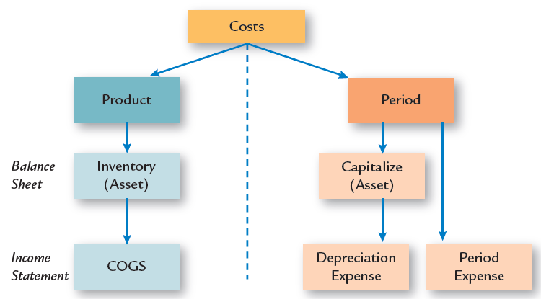
Period Costs (3 of 3)
Notes:
All completed job-order cost sheets of a firm can serve as a subsidiary ledger for the finished goods inventory. Then, the work-in-process account consists of all of the job order cost sheets for the unfinished jobs.

Slide 37
Selling Costs
Costs necessary to market, distribute, and service a product or service
Order-getting
Examples: Sales personnel Salaries & Commissions Advertising
Order-Filling
Examples: Warehousing, Shipping, and Customer Service
Notes:
Costs necessary to market, distribute, and service a product or service are selling costs.

Slide 38
Administrative Costs (1 of 2)
All costs associated with research, development, and general administration of the organization that cannot reasonably be assigned either to selling or production
General administration ensures that the various activities of the organization are integrated so that the overall mission of the firm is realized
Notes:
All costs associated with research, development, and general administration of the organization that cannot reasonably be assigned to either selling or production are administrative costs. General administration has the responsibility of ensuring that the various activities of the organization are properly integrated so that the overall mission of the firm is realized.

Slide 39
Administrative Costs (2 of 2)
Examples – executive salaries, legal fees, printing the annual report, and general accounting
Research and development costs are the costs associated with designing and developing new products and must be expensed in the period incurred
Notes:
Examples of general administrative costs are executive salaries, legal fees, printing the annual report, and general accounting. Research and development costs are the costs associated with designing and developing new products and must be expensed in the period incurred.

Slide 40
Direct and Indirect Period Costs
Helpful to distinguish between direct period costs and indirect period costs
Indirect labor is included in overhead
Do not affect the calculation of inventories or C O G S for service companies
Correct classification affects decisions, planning and control activities for managers
Service company example - Restaurant
Direct period cost: Chef’s salary
Indirect period cost: Cost of disposable napkins
Notes:
As with product costs, it is often helpful to distinguish between direct period costs and indirect period costs. Indirect labor is included in overhead. Service companies are also interested in distinguishing between direct period costs and indirect period costs. Although these costs do not affect the calculation of inventories or C O G S for service companies. Correct classification affects decisions, planning and control activities for managers.

Slide 41
Knowledge Check Activity 1
Which of the following items should be included as part of product cost?
Manufacturing overhead
Direct materials
Direct labor
All of the above

Slide 42
Knowledge Check Activity 1 Answer
Which of the following items should be included as part of product cost?
Answer: d. All of the above
Direct materials, direct labor, and manufacturing overhead costs should all be included as part of product cost because they meet the definition of product cost, which is “any cost, direct or indirect, of producing a product in a manufacturing firm or of acquiring a product in a merchandising firm and preparing it for sale.”

Slide 43
Preparing Income Statements: Cost of Goods Manufactured (1 of 3)
The cost of goods manufactured represents total product cost of goods completed during the current period and transferred to finished goods inventory
The cost of direct materials used in production can be derived using the following formula:
Beginning Inventory of Materials + Purchases − Direct Materials Used in Production = Ending Inventory of Materials
Notes:
The cost of goods manufactured represents the total product cost of goods completed during the current period and transferred to finished goods inventory. The cost of direct materials used in production can be derived using the following formula: Beginning inventory of materials plus purchases minus direct materials used in production equals ending inventory of materials.

Slide 44
Preparing Income Statements: Cost of Goods Manufactured (2 of 3)
Direct materials are then used to calculate the cost of goods manufactured as follows:
Direct materials + Direct labor + Manufacturing overhead costs + Beginning W I P inventory − Ending W I P inventory = Cost of goods manufactured
Notes:
Once the direct materials are calculated, the direct labor and manufacturing overhead for the time period can be added to get the cost of goods manufactured for the period. This is calculated as: Cost of goods manufactured = Direct materials used in production + Direct labor used in production + Manufacturing overhead costs used in production + Beginning WIP inventory - Ending WIP inventory

Slide 45
Preparing Income Statements: Cost of Goods Manufactured (3 of 3)
The primary use of calculating the direct materials used in production is to serve as the first number in calculating the cost of goods manufactured
Direct materials used in production also show managers the difference between the amount of materials purchased and the amount of materials used in manufacturing for the period
Notes:
The primary use of calculating the direct materials used in production is to serve as the first number in calculating the cost of goods manufactured. Direct materials used in production also show managers the difference between the amount of materials purchased and the amount of materials used in manufacturing for the period

Slide 46
Work-in-Process (W I P) (1 of 2)
Second type of inventory
Cost of the partially completed goods that are still on the factory floor at the end of a time period
W I P units are units that have been started, but are not finished
Have some value, but not as much as they will when they are completed; and there are beginning and ending inventories of W I P
Notes:
Once the direct materials are calculated, the direct labor and manufacturing overhead for the time period can be added to get the total manufacturing cost for the period. The second type of inventory—work in process (WIP) is the cost of the partially completed goods that are still on the factory floor at the end of a time period.

Slide 47
Work-in-Process (W I P) (2 of 2)
We must adjust the total manufacturing cost for the time period for the inventories of W I P
We will have the total cost of the goods that were completed and transferred from W I P to finished goods inventory which is the cost of goods manufactured
Notes:
We must adjust the total manufacturing cost for the time period for the inventories of W I P. After this adjustment, we will have the total cost of the goods that were completed and transferred from work-in-process inventory to finished goods inventory during the current time period which is the cost of goods manufactured

Slide 48
Cost of Goods Sold (1 of 2)
To meet external reporting requirements, costs must be classified into three categories:
Production
Selling
Administration
Notes:
To meet external reporting requirements, costs must be classified into three categories: (1) Production, (2) Selling, and (3) Administration.

Slide 49
Cost of Goods Sold (2 of 2)
Represents cost of goods that were sold during the period and then transferred from finished goods inventory on the balance sheet to cost of goods sold on the income statement
Cost of goods sold is calculated as:
Beginning finished goods inventory + Cost of goods manufactured − Ending finished goods inventory = Cost of goods sold
Notes:
Cost of goods sold represents the cost of goods that were sold during the period and, therefore, transferred from finished goods inventory on the balance sheet to cost of goods sold on the income statement (i.e., as an inventory expense). Cost of goods sold is calculated as: Cost of goods sold = Beginning finished goods inventory + Cost of goods manufactured - Ending finished goods inventory.

Slide 50
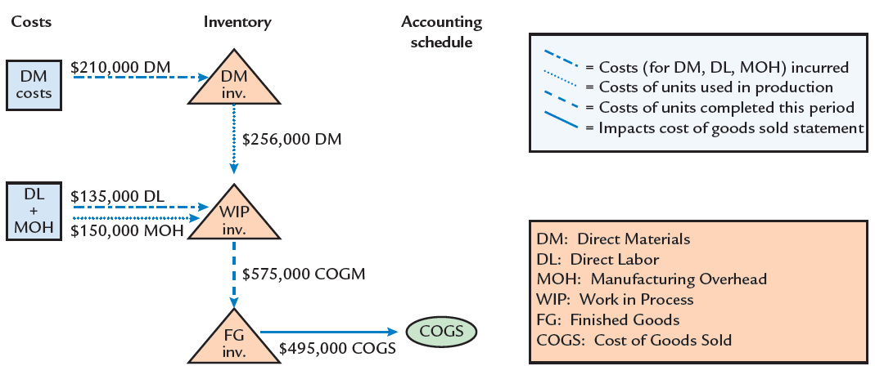
Relationship Between Flow of Costs, Inventories, and Cost of Goods Sold
Notes:
The ending inventories of materials, WIP, and finished goods are important because they are assets and appear on the balance sheet (as current assets). The cost of goods sold is an expense that appears on the income statement. Selling and administrative costs are period costs and also appear on the income statement as an expense. As this diagram shows, there is a flow of manufacturing costs (direct materials, direct labor and manufacturing overhead) through the three inventories (materials, work in process, and finished goods) and finally, into cost of goods sold.

Slide 51
Income Statement: Manufacturing Firm (1 of 3)
It is important that all sales revenue and expenses attached to a time period appear on the income statement
Expenses are separated into three categories: production (cost of goods sold), selling, and administrative
Sales revenue is calculated as:
Sales Revenue = Price × Units Sold
Notes:
It is important that all sales revenue and expenses attached to a time period appear on the income statement. Also note that in the income statement, expenses are separated into three categories: production (cost of goods sold), selling, and administrative. Sales revenue is calculated as: Sales revenue = Price x Units sold

Slide 52
Income Statement: Manufacturing Firm (2 of 3)
The primary use for the income statement is for external financial reporting
Investors and outside parties use it to determine the financial health of a firm, including the calculation of various important financial ratios
Notes:
The primary use for the income statement is for external financial reporting. Investors and outside parties use it to determine the financial health of a firm, including the calculation of various important financial ratios.

Slide 53
Income Statement: Manufacturing Firm (3 of 3)
Gross margin is the difference between sales revenue and cost of goods sold:
Gross Margin = Sales Revenue − Cost of Goods Sold
Does not equal operating income or profit as it is computed without subtracting selling and administrative expenses
If positive, the firm will charge prices that cover the product cost
Notes:
Gross margin is the difference between sales revenue and cost of goods sold: Gross Margin= Sales Revenue – Cost of Goods Sold. It shows how much the firm is making over and above the cost of the units sold. Gross margin does not equal operating income or profit. Selling and administrative expenses have not yet been subtracted. However, gross margin does provide useful information. If gross margin is positive, the firm at least charges prices that cover the product cost.

Slide 54
Gross Margin Percentage (1 of 2)
A company can compare gross margin percentage with the average for its industry
Gross margin percentage varies significantly by industry
Gross margin percentage is calculated as:
Notes:
A company can compare gross margin percentage with the average for its industry to see if its experience is within the ballpark range for other firms in the industry. Gross margin percentage varies significantly by industry. Gross margin percentage is calculated as: Gross Margin Percentage = Gross Margin ÷ Sales Revenue

Slide 55
Gross Margin Percentage (2 of 2)
Calculating the percentage of revenue for each line on the income statement informs managers of the size of each income statement line item relative to sales revenue
It also enables comparisons between fiscal periods (i.e., trend analysis) and with other firms in the industry (i.e., competitor benchmarking)
Notes:
Calculating the percentage of revenue for each line on the income statement informs managers of the size of each income statement line item relative to sales revenue. This calculation also enables comparisons between fiscal periods and with other firms in the industry.

Slide 56
Operating Income
Key figure from the income statement
Shows how much the owners are actually earning from the company
Operating Income = Gross Margin − Selling and Administrative Expenses
Notes:
Operating income is the key figure from the income statement; it is profit, and shows how much the owners are actually earning from the company. Operating Income = Gross Margin − Selling and Administrative Expenses

Slide 57
Income Statement: Service Firm (1 of 2)
Service organization
No product to purchase, like in a merchandising or manufacturing operation
No beginning or ending inventories and no cost of goods sold and gross margin on the income statement
Cost of providing services appears along with the other operating expenses of the company
Notes:
In a service organization, there is no product to purchase, like in a merchandising or manufacturing operation. As a result, there are no beginning or ending inventories and no cost of goods sold and gross margin on the income statement. The cost of providing services appears along with the other operating expenses of the company.

Slide 58
Income Statement: Service Firm (2 of 2)
Primary use is for external financial reporting
Investors and outside parties use it to determine the financial health of a firm
Cost of goods sold typically does not exist on the income statement
Income statement for a service provider is important because:
It showcases how the major expenses incurred to provide key services compare to the organization’s overall sales revenue
Notes:
The primary use for the income statement is for external financial reporting. Investors and outside parties use it to determine the financial health of a firm. Cost of goods sold typically does not exist on the income statement of service organizations because such organizations generate sales by providing services rather than selling products. Therefore, the income statement for a service provider is important because it showcases how the major expenses incurred to provide key services compare to the organization’s overall sales revenue

Slide 59
Discussion Activity 2
How is the income statement prepared by a manufacturing firm different from the income statement prepared by a service firm?
Notes:
Instructions:
Gather into small groups of three to five.
Read through the slide information.
Collectively decide on your small group’s answers to the question presented.
Share your findings with the larger group.

Slide 60
Discussion Activity 2 Debrief
How is the income statement prepared by a manufacturing firm different from the income statement prepared by a service firm?
Answer:
The income statement for a manufacturing firm includes the cost of goods sold, which is the sum of direct materials, direct labor, and manufacturing overhead. The income statement for a service firm contains no cost of goods sold because there is no product to purchase or to manufacture and, thus, there is no inventory account to expense as cost of goods sold. In addition, because there is no cost of goods sold on the income statement of a service firm, there is no gross margin, unlike a manufacturing firm.

Slide 61
Self-Assessment
Describe the meaning of cost and how costs are assigned to products and services
Determine various costs of manufacturing products and providing services as well as the costs of selling and administration
Explain income statements for manufacturing and service organizations

Slide 62
Summary
Now that the lesson has ended, you should have learned how to:
Explain the meaning of cost and how costs are assigned to products and services
Define the various costs of manufacturing products and providing services as well as the costs of selling and administration
Prepare income statements for manufacturing and service organizations

