Slide 1
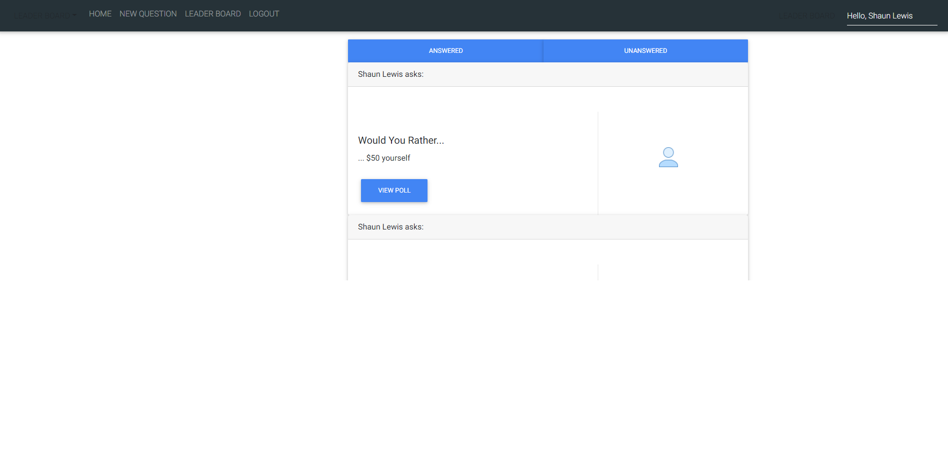
Answered View
AnswersNav Component
UserLabel Component
UserAnswer Component
App Component
Avatar Component
ViewPollButton Component
Answer Component

Slide 2
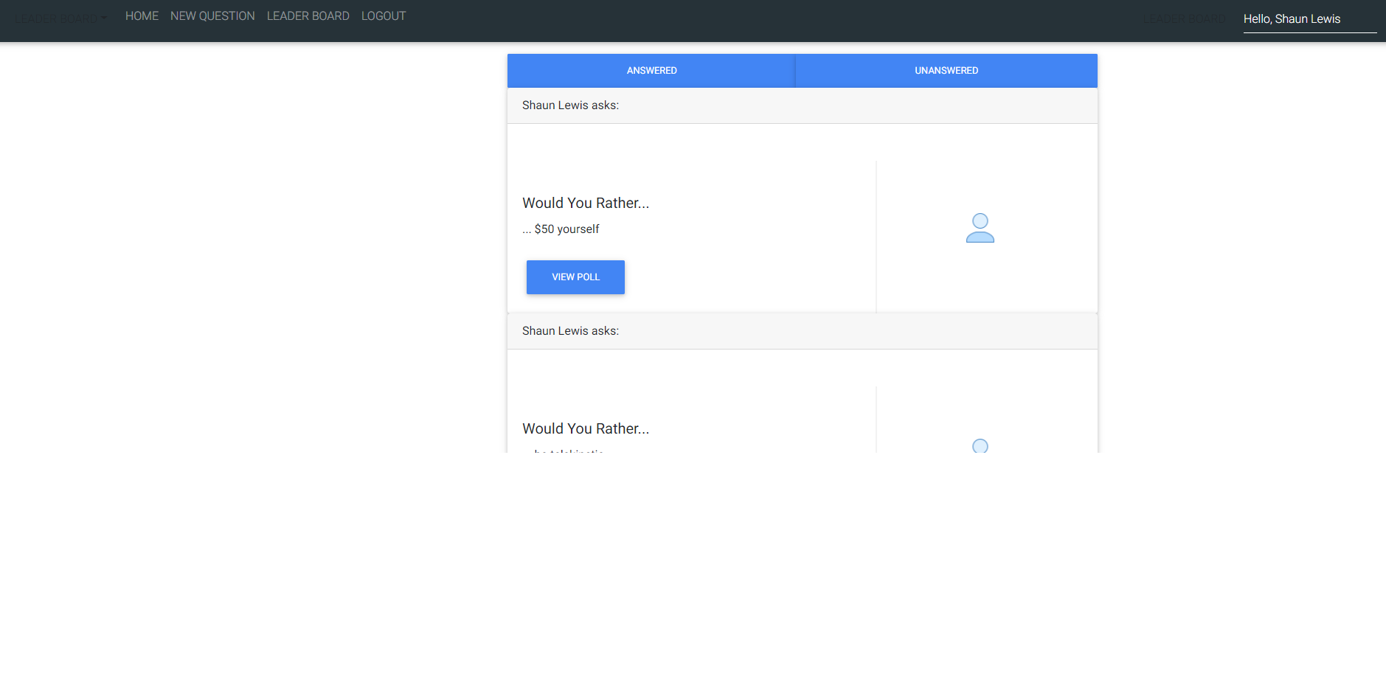
Unanswered View
AnswersNav Component
UserAnswer Component
ViewPollButton Component
Avatar Component
App Component
Answer Component

Slide 3
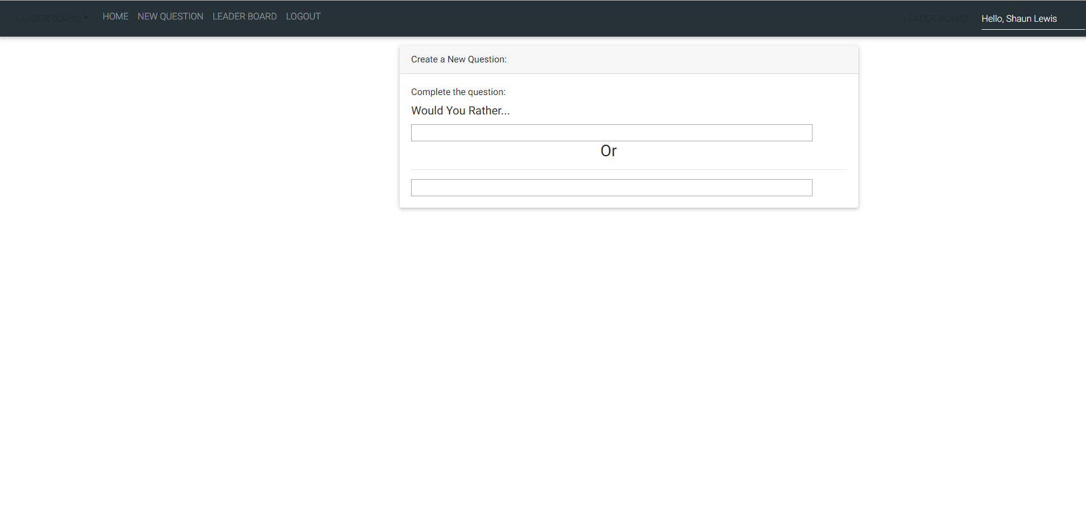
New Question View
App Component
NewQuestionAnswer Component
NewQuestion Component

Slide 4
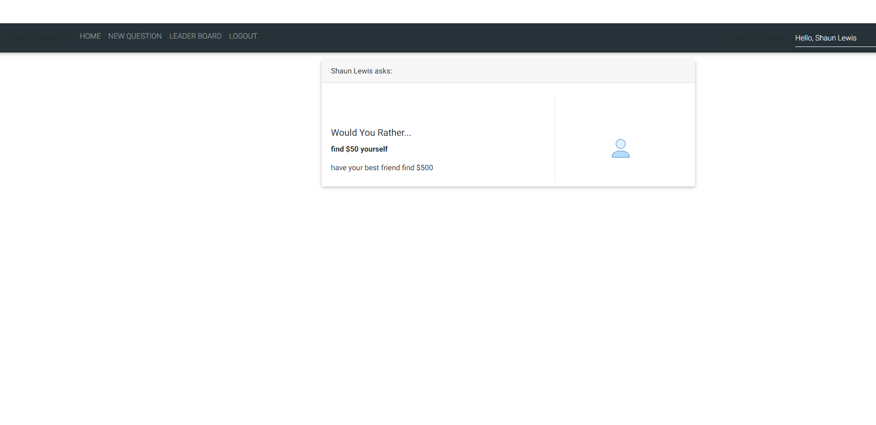
Other User Poll View
UserLabel Component
App Component
OtherUserPollAnswer Component
Avatar Component
OtherUserPoll Component

Slide 5
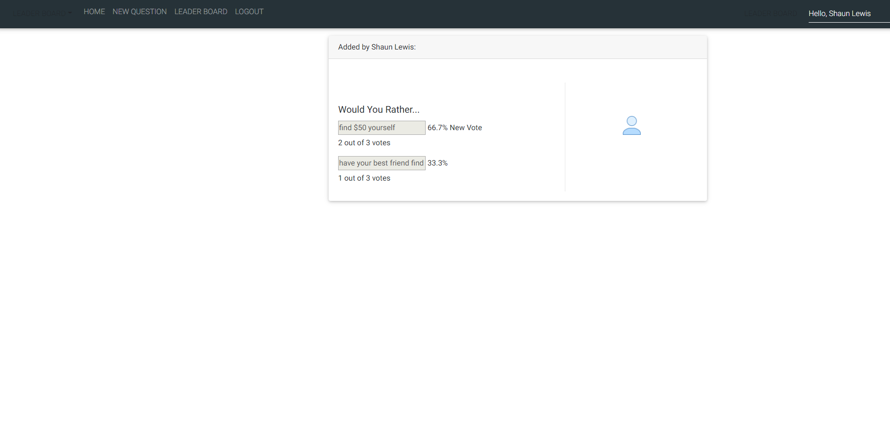
Results View
UserLabel Component
App Component
ResultsFeedback Component
Avatar Component
Results Component

Slide 6
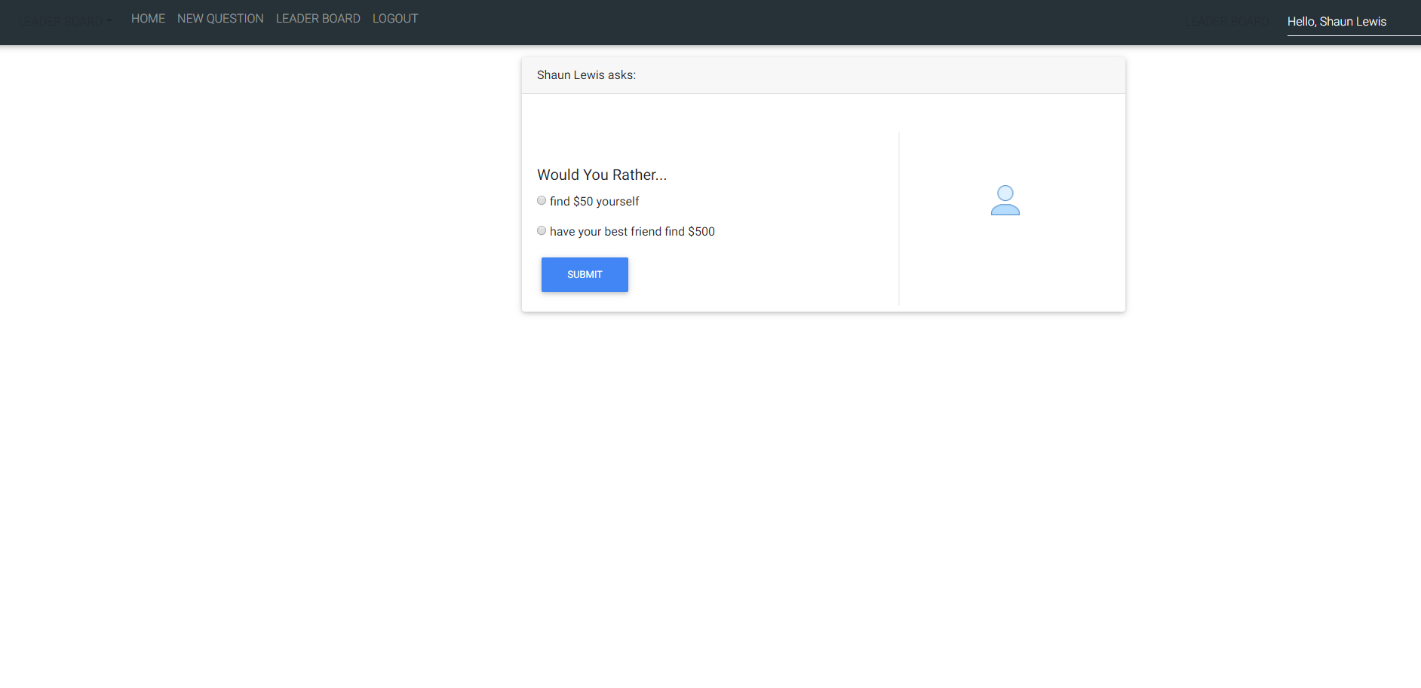
Self Poll View
UserLabel Component
App Component
SelfPollAnswer Component
Avatar Component
SelfPollButton Component
SelfPoll Component

Slide 7
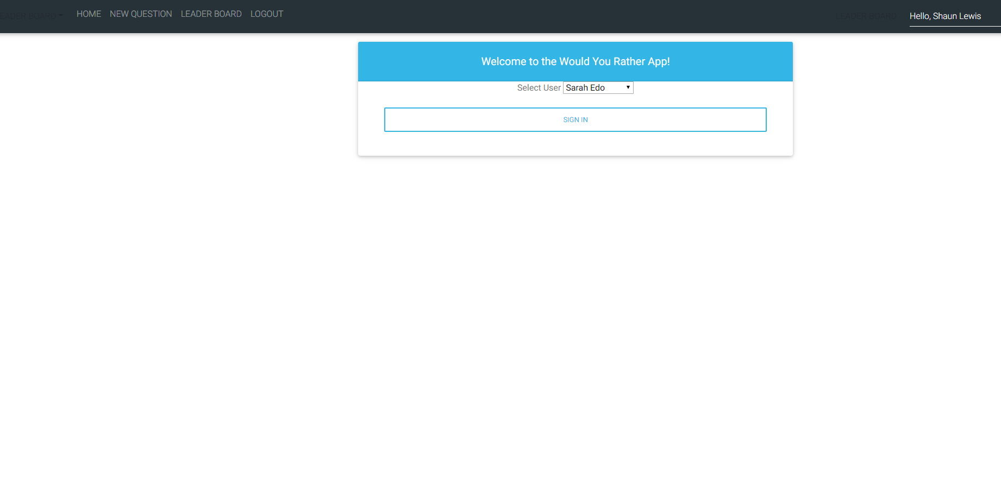
Sign In View
App Component
SignInButton Component
SignInDropdown
Component
SignIn Component

Slide 8
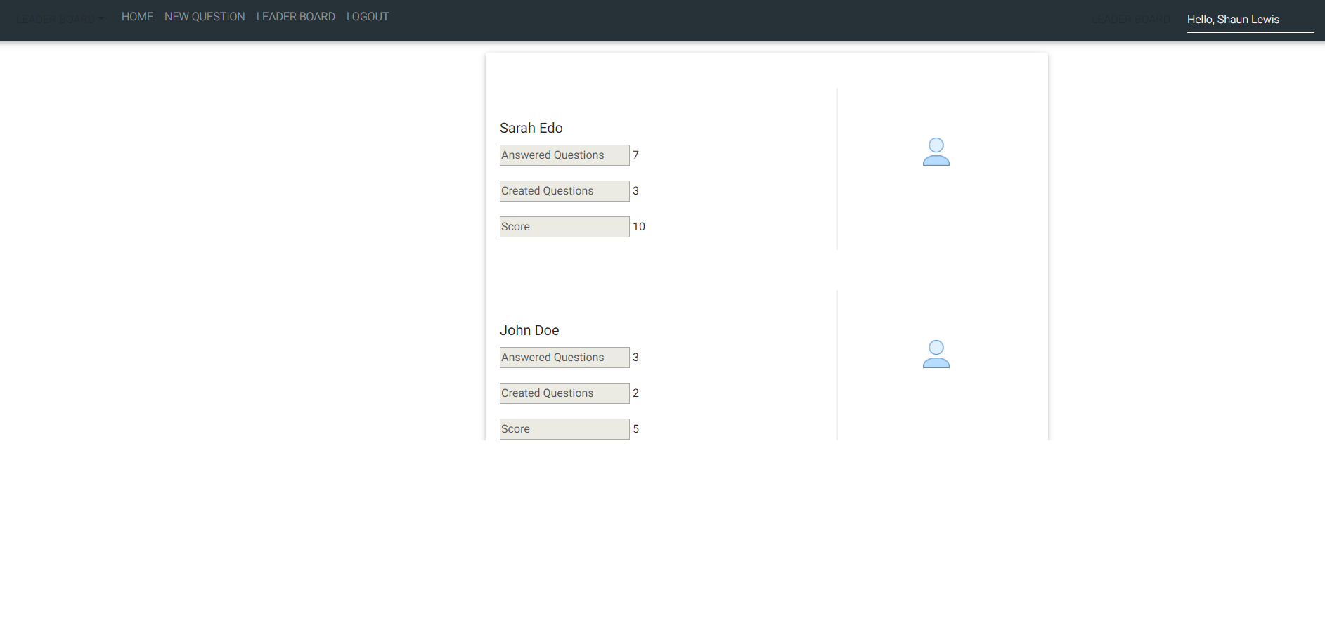
Leader Board View
UserLabel Component
App Component
LeaderBoard Component
Avatar Component
LeaderBoardResults Component

Slide 9
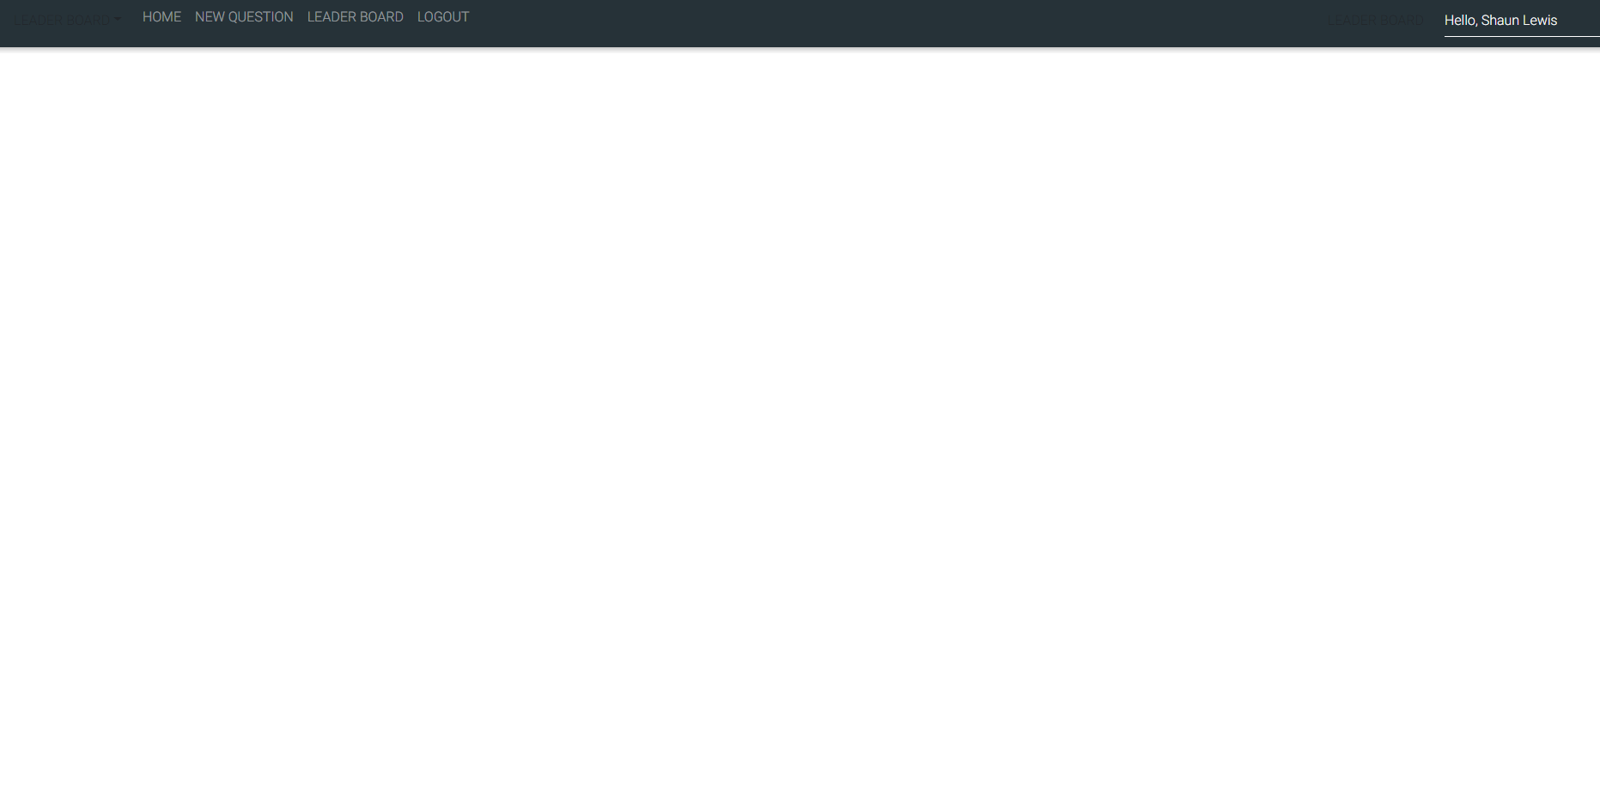
Nav View
App Component
Nav Component

Slide 10
Component Hierarchy
App Component
AnswersNav Component
Answer Component
UserLabel Component
UserAnswer Component
ViewPollButton Component
Avatar Component
NewQuestion Component
NewQuestionAnswer Component
OtherUserPoll Component
UserLabel Component
OtherUserPollAnswer Component
Avatar Component
Results Component
UserLabel Component
ResultsFeedback Component
Avatar Component
SelfPoll Component
UserLabel Component
SelfPollAnswer Component
SelfPollButton Component
Avatar Component
SignIn Component
SignInButton Component
SignInDropdown Component
LeaderBoard Component
LeaderBoardResults Component
UserLabel Component
Avatar Component
Nav Component

Slide 11
Actions
App Component : get 2nd level components
AnswersNav Component : get Answered and Unanswered Views
Answered Component : get UserLabel, UserAnswer, ViewPollButton, Avatar components
UserLabel Component: renders User Label based on options
UserAnswer Component: truncates User Answers
ViewPollButton Component: renders OtherUser or SelfPoll Views
Avatar Component: renders User Avatar
NewQuestion Component: renders NewQuestionAnswer component
NewQuestionAnswer Component: renders label; renders text boxes
OtherUserPoll Component: renders UserLabel, OtherUserPollAnswer and Avatar components
UserLabel Component: renders User Label based on options
OtherUserPollAnswer Component: renders other user answer results
Avatar Component: renders User Avatar
Results Component: renders UserLabel, ResultsFeedback and Avatar components
UserLabel Component: renders User Label based on options
ResultsFeedback Component: renders user label; renders would you rather label; renders text boxes; renders options; renders user votes; renders user percentages;
renders user new vote label
Avatar Component: renders User Avatar
SelfPoll Component: renders SelfPollAnswer, SelfPollButton and Avatar components
SelfPollAnswer Component: renders radio buttons; renders options; renders label
SelfPollButton Component: renders submit button; processes user vote; renders results view
Avatar Component: renders User Avatar
SignIn Component: renders both SignInButton and SignInDropdown components
SignInButton Component: renders home page; renders selected user from dropdown to label;
SignInDropdown Component: renders predetermine users
LeaderBoard Component: renders UserLabel, LeaderBoardResults and Avatar components
UserLabel Component: renders User Label based on answered questions, created questions, score
LeaderBoardResults Component: renders user name; renders answered questions, created questions, score textboxes;
renders answered questions, created questions, score tallies
Avatar Component: renders User Avatar
Nav Component: renders Home, New Question, Leader Board, Logout, and Current Login User labels
renders Answered, Unanswered, NewQuestion, LeaderBoard, SignIn views

Slide 12
Store Data
UserLabel Component: User Label based on options, answered questions, created questions, score
UserAnswer Component: User Answers
Avatar Component: User Avatar
OtherUserPollAnswer Component: other user answer results
ResultsFeedback Component: options, user votes, user percentages, user new vote label
SelfPollAnswer Component: options
SelfPollButton Component: user votes
SignInButton Component: selected user
LeaderBoardResults Component: user name, answered questions, created questions, score
Nav Component: selected user

Slide 13
Component Data
App Component : 2nd level components
AnswersNav Component : Answered and Unanswered Views
Answered Component : UserAnswer, ViewPollButton, Avatar components
NewQuestion Component: NewQuestionAnswer component
OtherUserPoll Component: OtherUserPollAnswer and Avatar components
Results Component: ResultsFeedback and Avatar components
SelfPoll Component: SelfPollAnswer, SelfPollButton and Avatar components
SignIn Component: SignInButton and SignInDropdown components
LeaderBoard Component: LeaderBoardResults and Avatar components
Nav Component: Home, New Question, Leader Board, Logout, and Current Login User labels, Answered, Unanswered, NewQuestion, LeaderBoard, SignIn views

Slide 14
Action Constants
App Component : get 2nd level components
AnswersNav Component : get Answered and Unanswered Views
Answered Component : get UserLabel, UserAnswer, ViewPollButton, Avatar components
UserLabel Component: renders User Label based on options
UserAnswer Component: truncates User Answers
ViewPollButton Component: renders OtherUser or SelfPoll Views
Avatar Component: renders User Avatar
NewQuestion Component: renders NewQuestionAnswer component
NewQuestionAnswer Component: renders label; renders text boxes
OtherUserPoll Component: renders UserLabel, OtherUserPollAnswer and Avatar components
UserLabel Component: renders User Label based on options
OtherUserPollAnswer Component: renders other user answer results
Avatar Component: renders User Avatar
Results Component: renders UserLabel, ResultsFeedback and Avatar components
UserLabel Component: renders User Label based on options
ResultsFeedback Component: renders user label; renders would you rather label; renders text boxes; renders options; renders user votes; renders user percentages;
renders user new vote label
Avatar Component: renders User Avatar
SelfPoll Component: renders SelfPollAnswer, SelfPollButton and Avatar components
SelfPollAnswer Component: renders radio buttons; renders options; renders label
SelfPollButton Component: renders submit button; processes user vote; renders results view
Avatar Component: renders User Avatar
SignIn Component: renders both SignInButton and SignInDropdown components
SignInButton Component: renders home page; renders selected user from dropdown to label;
SignInDropdown Component: renders predetermine users
LeaderBoard Component: renders UserLabel, LeaderBoardResults and Avatar components
UserLabel Component: renders User Label based on answered questions, created questions, score
LeaderBoardResults Component: renders user name; renders answered questions, created questions, score textboxes;
renders answered questions, created questions, score tallies
Avatar Component: renders User Avatar
Nav Component: renders Home, New Question, Leader Board, Logout, and Current Login User labels
renders Answered, Unanswered, NewQuestion, LeaderBoard, SignIn views

