Slide 1
A Quick Tour of Go
For C# programmers
Ricoh IT Solutions Co., Ltd.
Yoichiro Shimizu
@budougumi0617

Slide 2
About me
Joined RITS in 2011
Use Language C/C++, C#, Java, GoLang
Work history
Production Printing (2012 - 2016)
Document Solution (From Jul 2016)

Slide 3

What is Go?

Slide 4

Programing Language Go
New Programing Language(2009-)
Launched by Google
“C for the 21st century.”

Slide 5
What is C#?

Slide 6

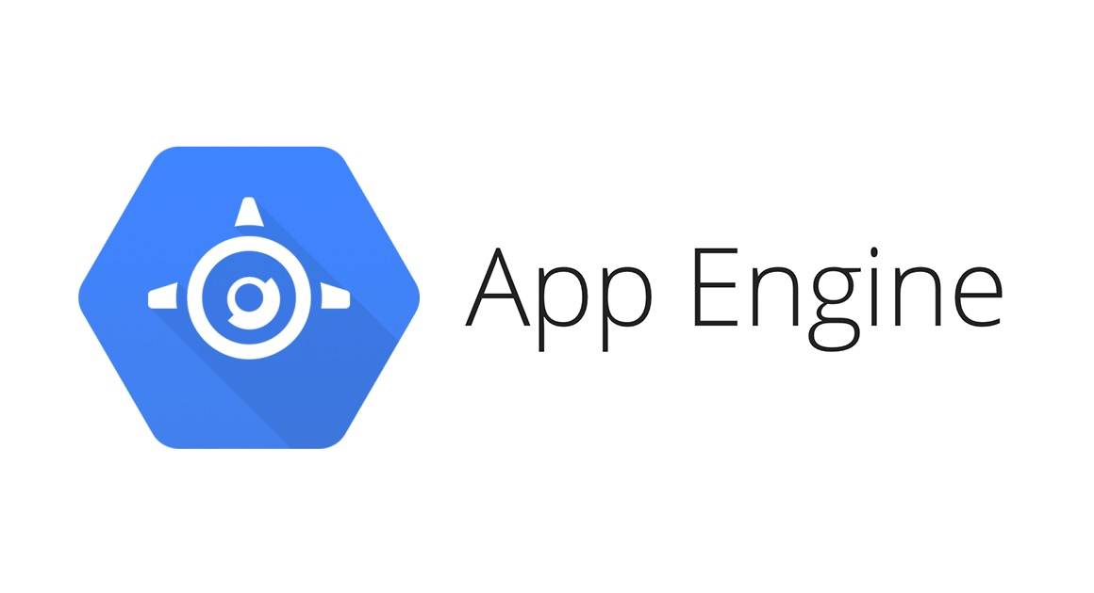

Go Product

Slide 7
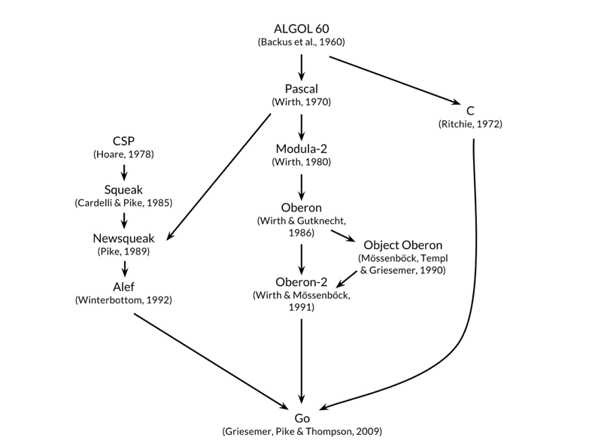
The Origin of Go
http://www.gopl.io/ch1.pdf

Slide 8
Radical Simplicity
Garbage collection
Package system
Pointer
Never use Class
goroutine etc…

Slide 9
Hello World
package main
import "fmt"
func main() {
fmt.Printf("Hello, World\n")
}

Slide 10
Heap? Stack?
func getlocal() {
i := returnLocal()
fmt.Printf("No error %d\n", i)
}
func returnLocal() int {
var localvale int
localvalue = 10
return &localvalue
}

Slide 11
Strong Type
func noboxing() {
var x int
var y int16
x = 10
// y = x // cannot use x as type int16
y = int16(x)
fmt.Printf("y = %d\n", y)
}

Slide 12
Modern Pointer
func pointer() {
x := big.Int{} // x big.Int
y := big.NewInt(0) // y *big.Int
x.SetUint64(123) // x := 123
y.SetUint64(321) // Do not use arrow(->)
}

Slide 13
Support Complex Value
func math() {
var x complex64
x = 10i + 20
fmt.Println(x) // (20+10i)
}

Slide 14
Multiple Return
func multireturn() {
q, r := division(10, 3)
fmt.Printf("%d, %d\n", q, r)
}
func division(x, y int) (int, int) {
quotient := x / y
remainder := x % y
return quotient, remainder // 3, 1
}

Slide 15
Clousure
func closure() {
f := func(i int) {
fmt.Printf("Value is %d\n", i)
}
f(20) // Value is 20
}

Slide 16
Concurrency Programing
func cuncurency() {
for i := 0; i < 10; i++ {
go func(num int) {
fmt.Printf("Thread No.%d\n", num)
}(i) // Immediate execute
}
}

Slide 17
Interprocess Communication
func channel() {
// connection channel between each gorutine
c := make(chan int)
go func(c chan int) { // Create goroutine
var ans int
// Too large process.
c <- ans // send answer
}(c)
// Recieve answer
fmt.Printf("Result %d\n", <-c)
}

Slide 18
Not use Class, Use Struct
func class() {
md := MyDirectory{name: "Document"}
fmt.Printf("Name is %s\n", md.Name())
}
// MyDirectory defines Directory.
type MyDirectory struct {
name string
}

Slide 19
If it walks like a duck and quacks like a duck, it must be a duck.
// Name returns name.
func (md *MyDirectory) Name() string {
return md.name
}
// MyComponent requests Name() method.
type MyComponent interface {
Name() string
}
func ducktyping() {
var mc MyComponent
mc = &MyDirectory{name: "Users"}
fmt.Printf("Name is %s\n", mc.Name()) // Name is Users
}

Slide 20
Rich Standard Library
func websever() {
http.HandleFunc("/",
func(w http.ResponseWriter,
r *http.Request) {
fmt.Fprintf(w, "Hello World!\n")
})
http.ListenAndServe(":8080", nil)
// http://localhost:8080/
}

Slide 21
Easy Cross Compile
$ GOOS=linux GOARCH=amd64 go build hello.go # For Linux
$ GOOS=darwin GOARCH=amd64 go build hello.go # For Mac
$ GOOS=windows GOARCH=amd64 go build hello.go # For windows
$ GOOS=android GOARCH=amd64 go build hello.go # For Android

Slide 22
Test framework
$ go test ./...
ok github.com/budougumi0617/GoTraining/ch11/ex01 0.019s
ok github.com/budougumi0617/GoTraining/ch11/ex02 0.023s
ok github.com/budougumi0617/GoTraining/ch11/ex03 0.023s
ok github.com/budougumi0617/GoTraining/ch11/ex04 0.027s
ok github.com/budougumi0617/GoTraining/ch11/ex05 0.017s
ok github.com/budougumi0617/GoTraining/ch11/ex06 0.016s
ok github.com/budougumi0617/GoTraining/ch11/ex07 0.014s

Slide 23
Get Code Coverage
$ go test -cover ./...
ok ch01/ex01 0.024s coverage: 100.0% of statements
ok ch01/ex02 0.022s coverage: 100.0% of statements
ok ch01/ex03 0.024s coverage: 100.0% of statements
ok ch01/ex04 0.024s coverage: 82.1% of statements
ok ch01/ex05 0.234s coverage: 100.0% of statements
ok ch01/ex06 0.601s coverage: 100.0% of statements

Slide 24
Execute Benchmark
$ go test -bench .
BenchmarkMyIntSetAdd100-4 200000 6307 ns/op
BenchmarkMapIntSetAdd1000-4 10000 235164 ns/op
BenchmarkMyIntSetAdd1000-4 20000 64169 ns/op
BenchmarkMapIntSetAddAll10-4 1000000 1253 ns/op
BenchmarkMyIntSetAddAll10-4 10000000 134 ns/op
BenchmarkMapIntSetAddAll100-4 100000 14568 ns/op
BenchmarkMapIntSetAddAll1000-4 10000 175950 ns/op
BenchmarkMyIntSetAddAll1000-4 200000 8360 ns/op

Slide 25
Single binary
Can execute in a single file
Do not need other file even if go env.

Slide 26
Available a lot of Cloud
CI : Travis/Circle/Wercker/drone.io/Bamboo
Analysis: Codeclimate/Go Report Card
Coverage: Coveralls
PaaS: AWS/GCP/Azure

Slide 27

Do U want to try?

Slide 28
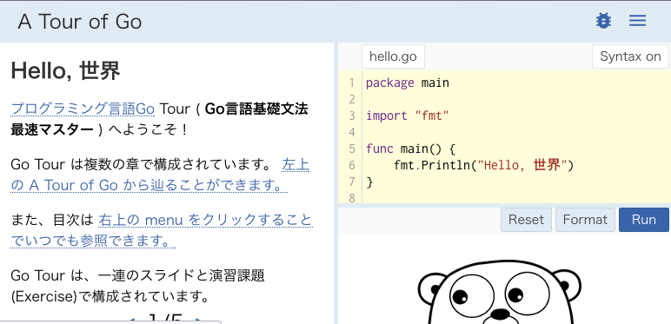
A Tour Of Go
https://go-tour-jp.appspot.com/

Slide 29


Programing Language Go
http://amazon.jp/dp/4621300253

Slide 30
Thank U for Listening

