Slide 1
Examination Timetabling
Ahmad Zaid Mahmoud Abdelkareem Mohammad Sehweil
Supervised by Dr. Ahmad Afaneh
Dr. Aziz Qaroush

Slide 2
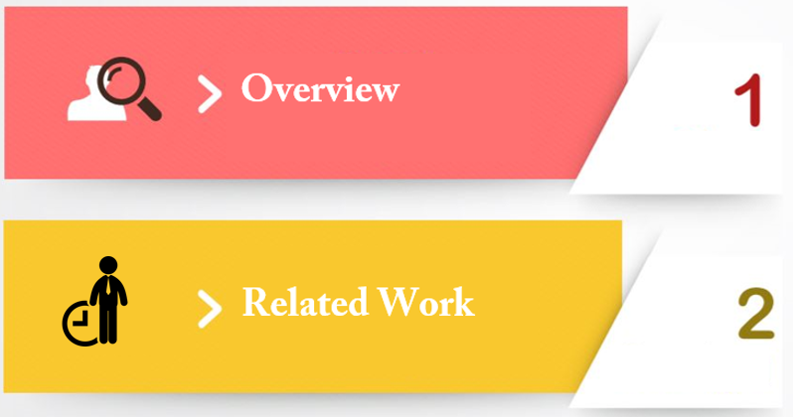
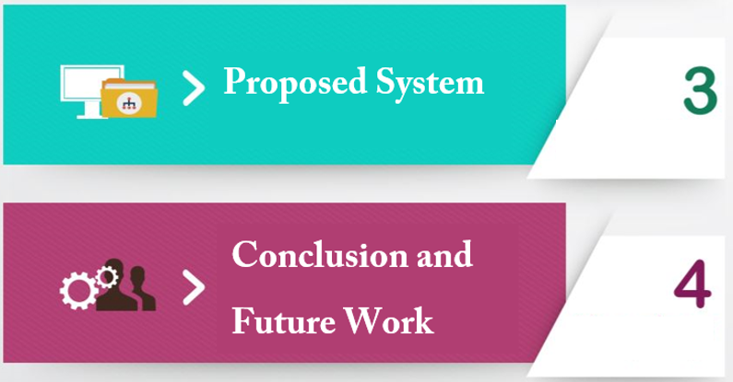
Presentation Outline

Slide 3
Introduction / Overview
1

Slide 4
Timetabling Problem - Overview
School Timetabling
Course Timetabling
Examination Timetabling

Slide 5
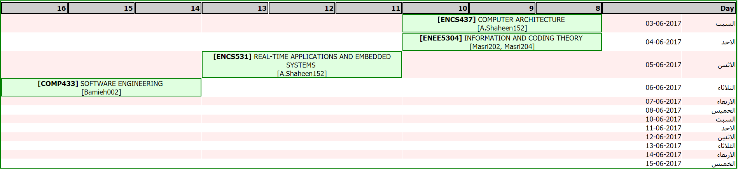
Examination Timetabling - Overview
Timeslot, Room slot
Number of days

Slide 6
Examination Timetabling - Constraints
Hard Constraints
2 exams at the
same time
2 exams in the
same room
Soft Constraints
More break Days
Multiple Room exams should be in the same building

Slide 7
ETP Feasibility, Optimality, and Complexity
Feasibility means finding a solution
Optimality means finding the best solution
Complexity describes how hard it is to find a solution

Slide 8
13,000 Students
1,000 Course
12 Days!
That’s a lot of Students
And a lot of Courses
NOT a lot of days

Slide 9
Related Work
2

Slide 10
Related Work Overview
Local Search Based Techniques
Constraint Based Techniques
Graph Based Techniques
Population Based Techniques

Slide 11
Local Search Based Techniques
Idea
Start with initial solution
Generate all feasible solutions
Move to neighboring states to satisfy most soft constraints
Advantages
little memory
Finds reasonable solution, time is not that high!
Disadvantages
Local Maximum
Doesn’t always find optimal solution

Slide 12
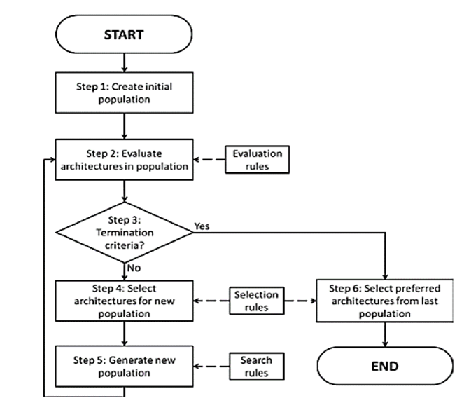
Population Based Techniques

Slide 13
Constraint Based Techniques
How it works?
Focused on finding feasible solutions, (i.e. satisfying all hard constraints). Partial solutions were first obtained since time complexity was crucial. Based on these partial solutions, particular local repairing strategies were employed successively to obtain complete solutions and make improvements.
Research Example
A paper that obtained good results is Merlot et al. An optimization programming language (OPL) was used, then Simulated Annealing and hill climbing methods were added to improve the solutions. Variables (exams) were ordered by the sizes of their domains (available timeslots) and scheduled into the earliest timeslots, one by one.

Slide 14
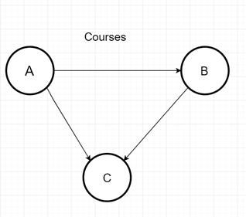
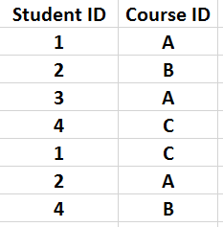
Graph Based Techniques
CSP is a GRAPH!
Vertices are the variables
Edges represent a constraint between these variables
Easiest ways to explain the timetabling problem

Slide 15
Graph Coloring
A
B
C

Slide 16
Proposed System
3

Slide 17
Constraint Satisfaction Problem CSP
Variables
Constraints
Values

Slide 18
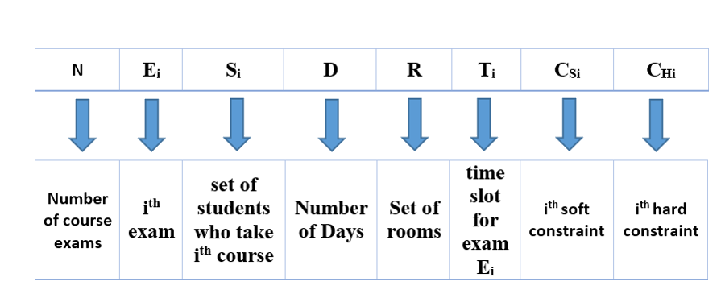
Problem Formalization

Slide 19
Pool of Constraints
Hard Constraints
All exams (i.e. variables) must be scheduled
capacity for any exam room around twice the number of students taking the exam
Each student can have one exam only at given slot.
Each Student at most can have two exam at one day.
No more than three exams in two consecutive days for any student
Soft Constraints
The average exams per day for exams period should be convergent.
At most one exam per day for each student.
Exams that are assigned to multiple rooms should be in the same building.

Slide 20
Variable Heuristic
Dynamic score
Static score
Remaining value
Variable score
Variety of department
Max # of student
Course Level

Slide 21
So Far?
Variables
Constraints
Values

Slide 22
Value Heuristic
The degree of which this value affects other variables
Two exams in the same day
Number of free days before exams
Goal
The Goal of this Heuristic is to choose the best Value (the best timeslot) out of all the available timeslots for the given exam.

Slide 23
So Far?
Variables
Constraints
Values

Slide 24
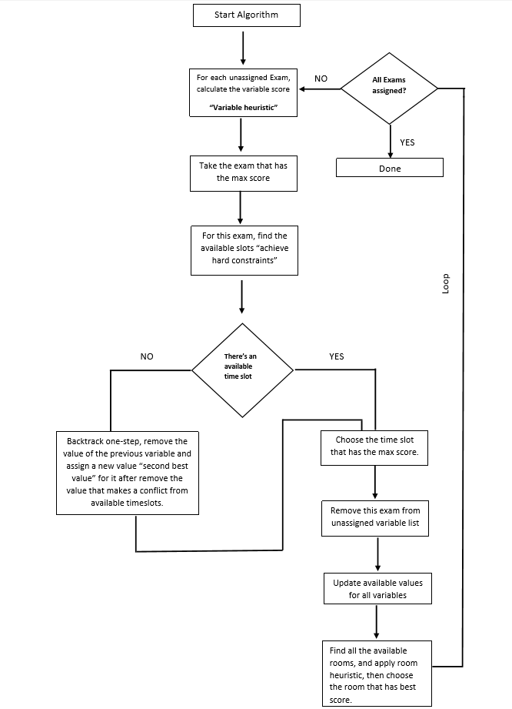
Algorithm – with Arc Consistency
Goal
The Goal of Arc consistency is to make sure that we always have a solution path.
Otherwise, BACKTRACK!

Slide 25
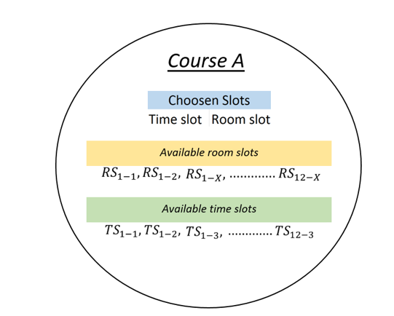
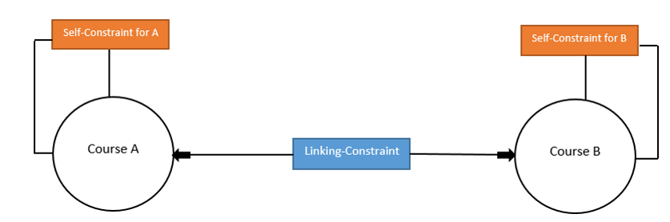
Representing the Problem as a Graph
The Node
The Constraints

Slide 26
Example – at some point in time
1. Choose Variable with Highest score
A
B
A is done
C is done
B is done
2. For that Variable, choose the value with highest score
3. For other linked Variables, check arc consistency
C
4. If any linked variables are empty valued, back track, if not move on to the next iteration
5. Update scores
Score = static score + dynamic score

Slide 27
Measurements
How do we measure a schedule?
Average and standard deviation for space for each exam for all students.
Average and standard deviation for the exam period for all students.
Number of rooms that are used in the exam period.
Box plot for spaces between exams in order to find the number of outliers
Feedback from students and university in order to compare between different solutions.

Slide 28
Data Set
Data Set provided from BZU
Database tables for Students, Courses, Departments and Schedule.
13,000 students who take around 1,000 Course.
Last years exam schedule to compare with our solution.
Student Table
Course Table
Student_Course_Table
Schedule Table

Slide 29
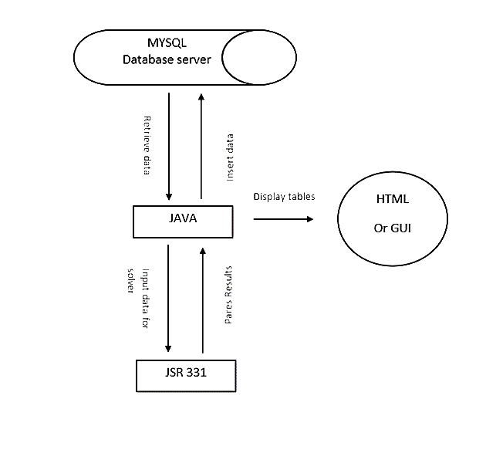
System Implementation
Tools
JAVA
JSR-331 API
Retrieve Data
Insert Data
Why JSR-331?
Easy to use
Allows for Backtracking
Good documentation
Display Tables
Input data for solver
Parse Results

Slide 30
Conclusion & Future Work
4

Slide 31
Conclusion

Slide 32
Future Work
Done so far?
Future TODO?

Slide 33
Thanks!
Any questions ?

