Slide 1
Improving Breast Cancer Diagnostics Project
Group Name: Machine Learning 04
Date: July 26, 2025

Slide 2
Contents
Business Case & Project Goals
Stakeholders
Project Flow Chart
Project Report
Risks Identified
Recommendations

Slide 3
Stakeholders
Stakeholder | Interest
Patients | Life dependency on diagnosis accuracy. Shorter treatment & recovery time.
Clinical doctors | Diagnosis Accuracy Better treatment/management for the patients.
Medical Equipment Manufacturers | Building more optimized diagnostic panels for collecting the data.
Hospital Management | Reducing treatment costs. Increased number of treated patients.
Hospital's Legal department | Avoiding the lawsuits against doctors and the hospital due to consequences of false diagnosis.
Ministry of Health | Reduce the cost and the expenses paid by Public health budget.

Slide 4
What Are We Doing Here?
Leveraging machine learning models and methodologies to find the features that are the most predictive of breast cancer diagnosis

Slide 5
But Why?
Increased Diagnosis Accuracy
Reduced Treatment & Recovery Time
Reduced Treatment & Recovery Costs
Eliminate Legal Liability

Slide 6
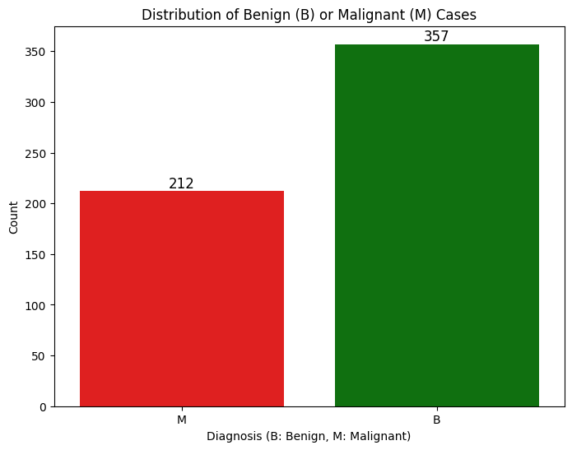
What Is The Problem?
Dataset has 30 features

Slide 7
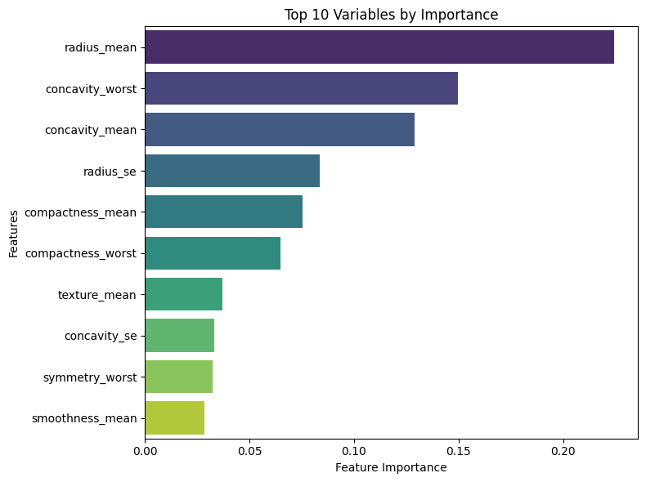
Top 5 Features

Slide 8
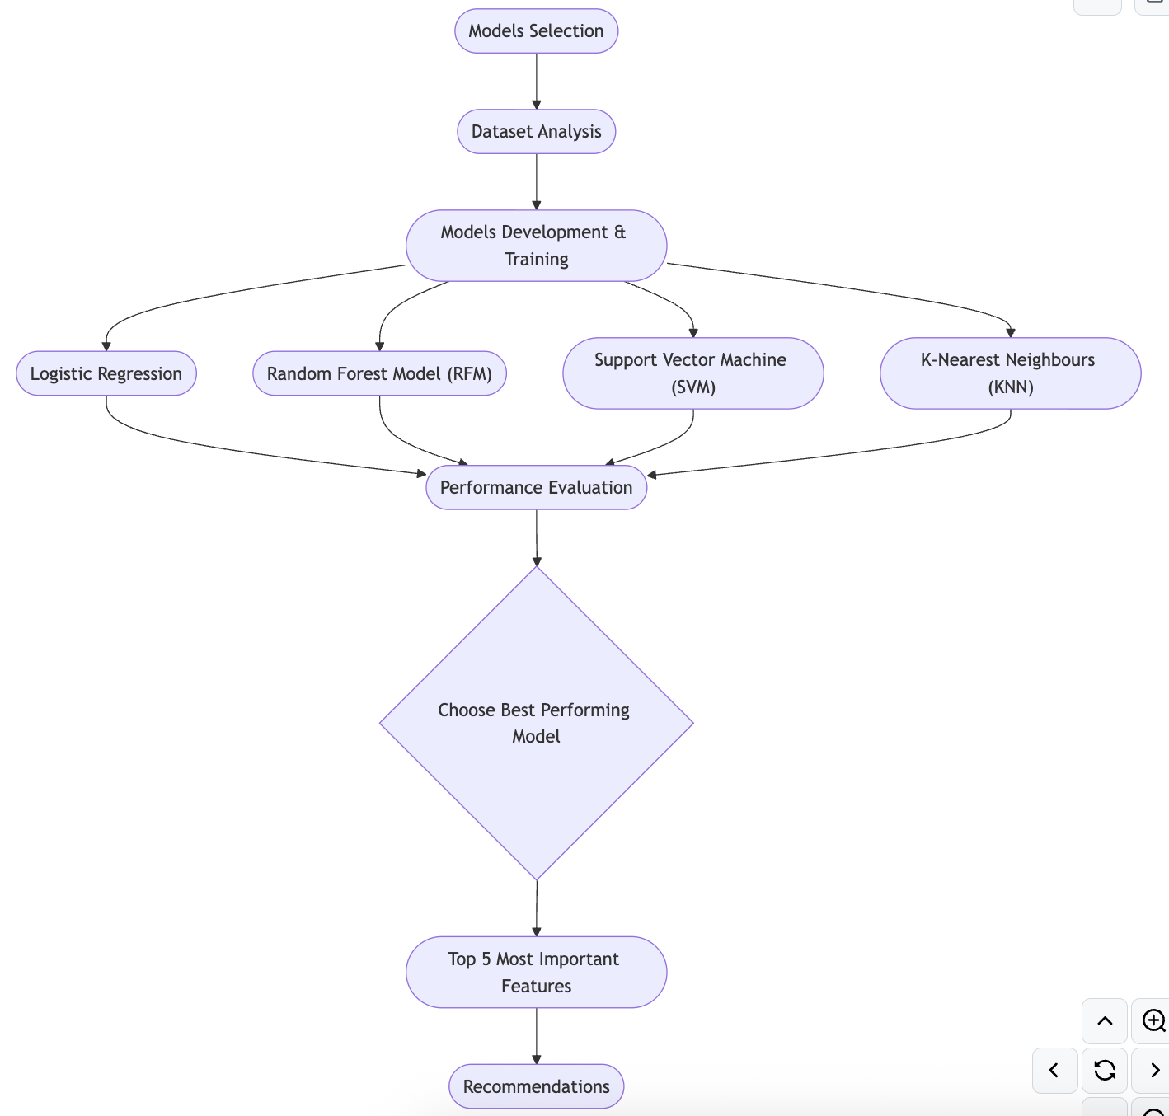
Methodology

Slide 9
Performance Evaluation
Model | Support Vector Machine | K Nearest Neighbours | Logistic Regression | Random Forest
Accuracy | 87.7% | 91.2% | 93% | 93.9%
Precision | 93.8% | 100% | 97.2% | 94.9%
Accuracy - How accurate the model is in performing the prediction.
Precision - How accurate the model is in performing positive prediction.

Slide 10
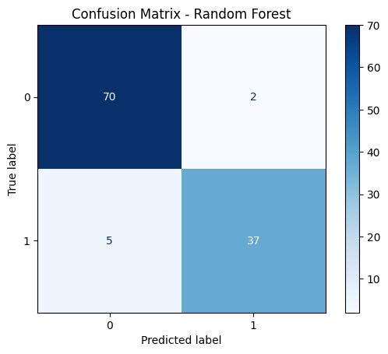
Random Forest Performance

Slide 11
Why Random Forest Model?
Highest Accuracy & Precision Combined.
The highest cross-validation score (mean ≈ 96.5%)
Most robust to outliers and less sensitive to feature scaling
Handles Feature importance natively, allowing for deeper insights into the most predictive variables.
Excellent balance in precision and recall, reducing both false positives and false negatives—crucial in breast cancer diagnosis.

Slide 12
Future Considerations
Leveraging SHAP values instead of feature importance
Interviewing clinical doctors for feedback on our findings

Slide 13
Q&A

Slide 14
Thank You

Slide 15
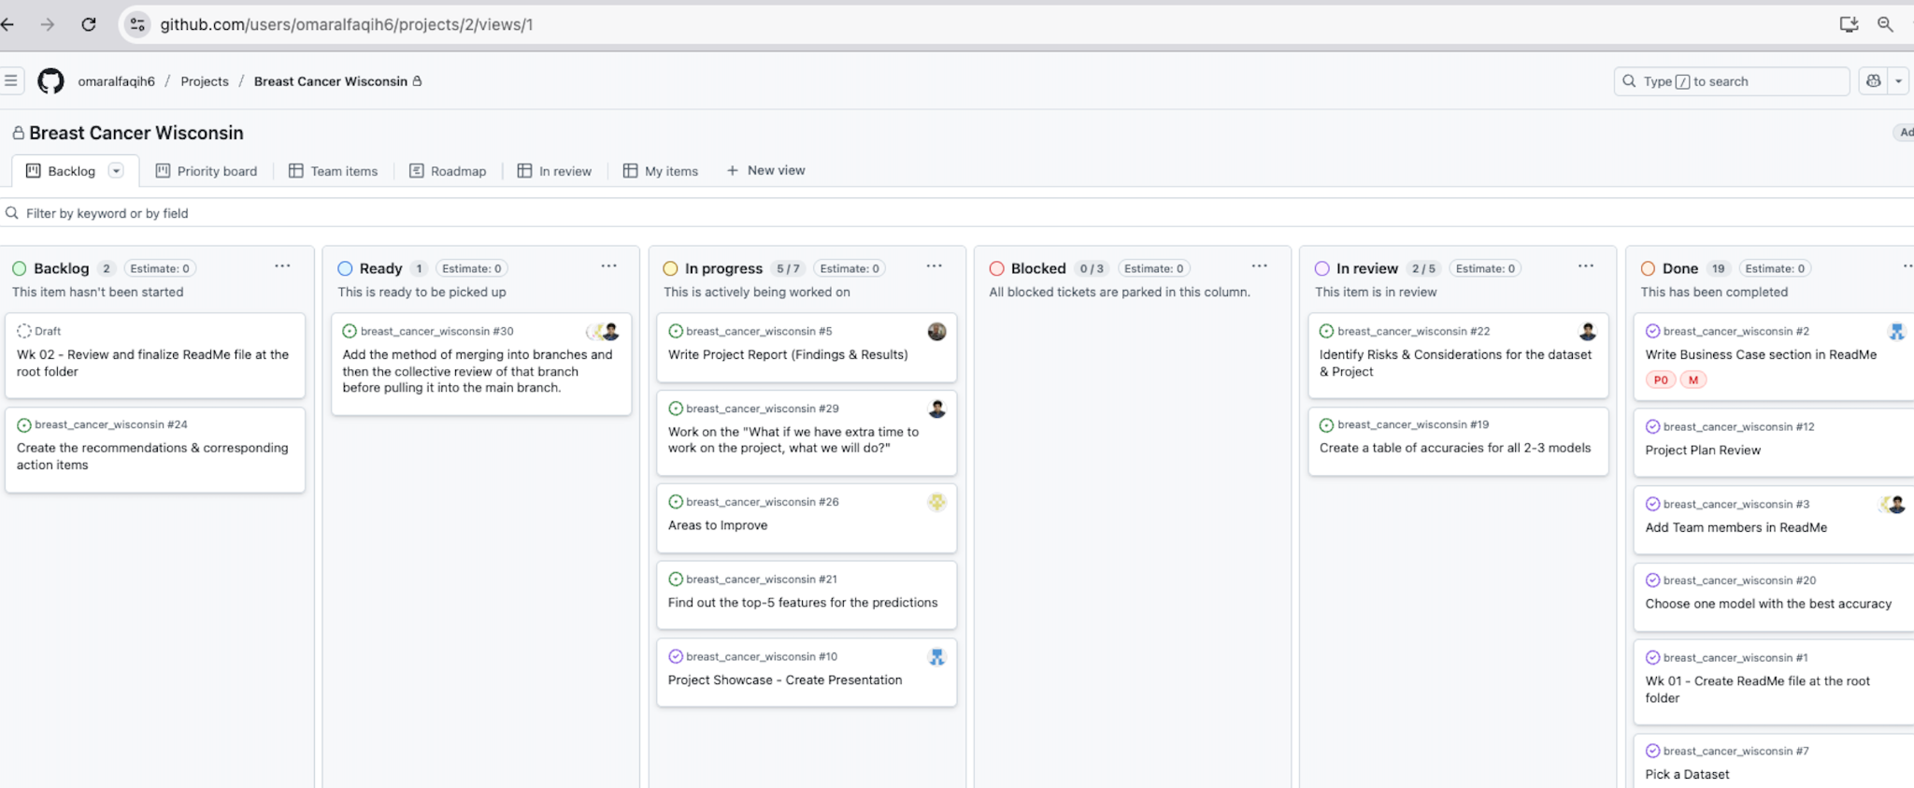
Project Management Methodology

