Slide 1

Project Title:
Audience Preference Analysis Using ML
(Movie Database)
SRI VENKATAESHWARA COLLEGE OF ENGINEERING AND TECHNOLOGY (AUTONOMOUS)
R.V.S Nagar, Chittoor – 517 127. (A.P)
Department of Information Technology
Review Presentation By
B. Nandini - 22781A1211
K.Tejaswini - 22781A1254
K.Venu Gopal - 22781A1241
K.Ravi Kishore - 22781A1248
Guided by :
“Dr.J.Velmurugan”
MTech,PhD,Professor&
HOD of IT

Slide 2
System Architecture
User interacts with frontend interface
System collects movie & user preference data
Data is cleaned and processed
ML algorithm analyzes similarity
Recommendation engine generates suggestions
Output shown to user
Feedback stored for improvement

Slide 3
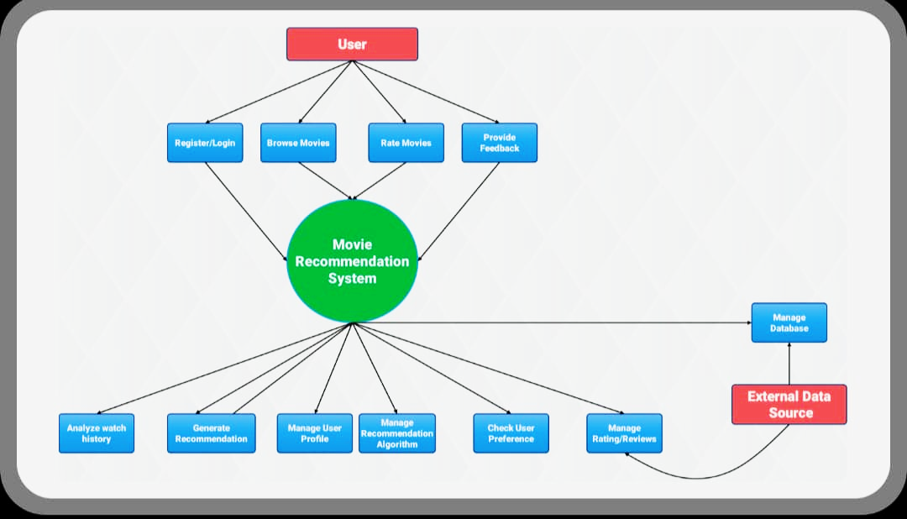
System Architecture

Slide 4
Module Design
User Interface Module Allows user login and interaction User selects genres or searches movies Displays recommended movies Collects user feedback and ratings
👉 Purpose: Acts as communication bridge between user and system
Data Collection Module Collects movie dataset Stores user watch history Maintains ratings and preferences Fetches data from database
👉 Purpose: Supplies raw data for recommendation

Slide 5
Module Design
Ratings Table Stores user ratings
Fields:
Rating_ID (Primary Key)
User_ID (Foreign Key)
Movie_ID (Foreign Key)
Rating_Value
👉 Purpose: Connects users and movies
Recommendation Table Stores generated suggestions
Fields:
Recommendation_ID
User_ID
Movie_ID
Similarity_Score
👉 Purpose: Saves recommendation results

Slide 6
Data Flow Diagram
User gives preferences / search input System processes request Recommendation engine analyzes data Recommended movies returned to user
👉 This shows the entire system as a single process.
Simple representation: User → Recommendation System → Movie Suggestions

Slide 7
Data Flow Diagram
User
↓
User Input Module
↓
Data Processing Module
↓
Recommendation Engine ↔
Database
↓
Output Module

Slide 8
Coding and implementation
Technologies Used:
Python
Pandas & NumPy (data handling)
Scikit-learn (ML algorithm)
Flask / Streamlit (frontend – optional)
CSV dataset (movie data)
Implementation Steps

Slide 9
Text Cases
Test case Id | Test scenario | input | Expected output | result
TC01 | User selects a valid movie | Avatar | System recommends similar movies | pass
TC02 | User enters unknown movie | Random text | System shows error/no result | pass
TC03 | Empty input | Blank search | Prompt user to enter movie name | pass
TC04 | Database connection | Load dataset | Movies loaded successfully | pass
TC05 | Recommendation speed | Select movie | Results generated quickly | pass

Slide 10
Deployment
Deployment is the final phase where the trained recommendation model is made available to real users through a web interface or application.
The system is hosted on a server so users can access movie recommendations anytime.

Slide 11
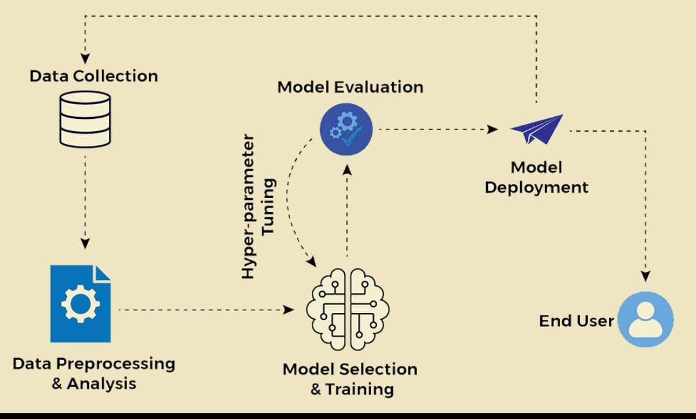
Deployment

Slide 12
Deployment Architecture Flow
User Device
Web Application
ML Model
Database
Response

Slide 13
Output Screens
User provides input such as:
  User ID or selected movie
The system generates:
  A list of recommended movies tailored to the user’s interests
Output demonstrates real-time personalized recommendations.

Slide 14
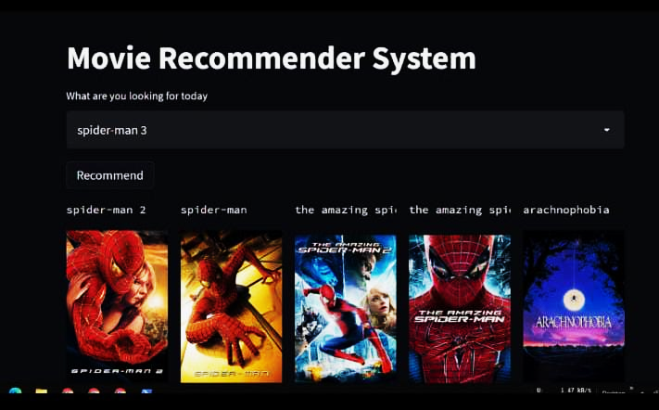
Output Screens

Slide 15
Results & Observations
The system produces accurate movie recommendations.
Personalization is significantly improved compared to generic suggestions.
Hybrid model performs better than individual techniques.
User satisfaction is enhanced through relevant movie suggestions.

Slide 16
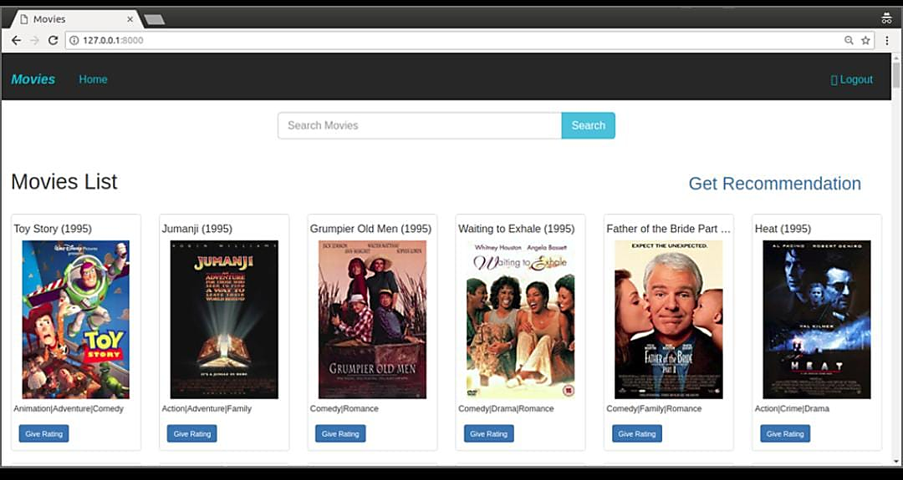
Results

Slide 17
Conclusion
The Audience Preference Analysis system successfully demonstrates how machine learning can improve movie recommendation quality by understanding user behavior and preferences.
By combining collaborative and content-based filtering in a hybrid model, the system delivers more personalized and accurate suggestions compared to traditional methods.
Despite challenges such as cold start and sparse data, the results show strong potential for real-world applications

