Slide 1
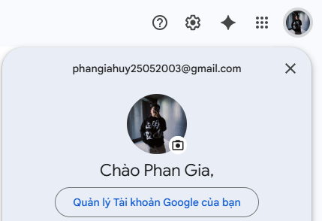
Select User information

Slide 2
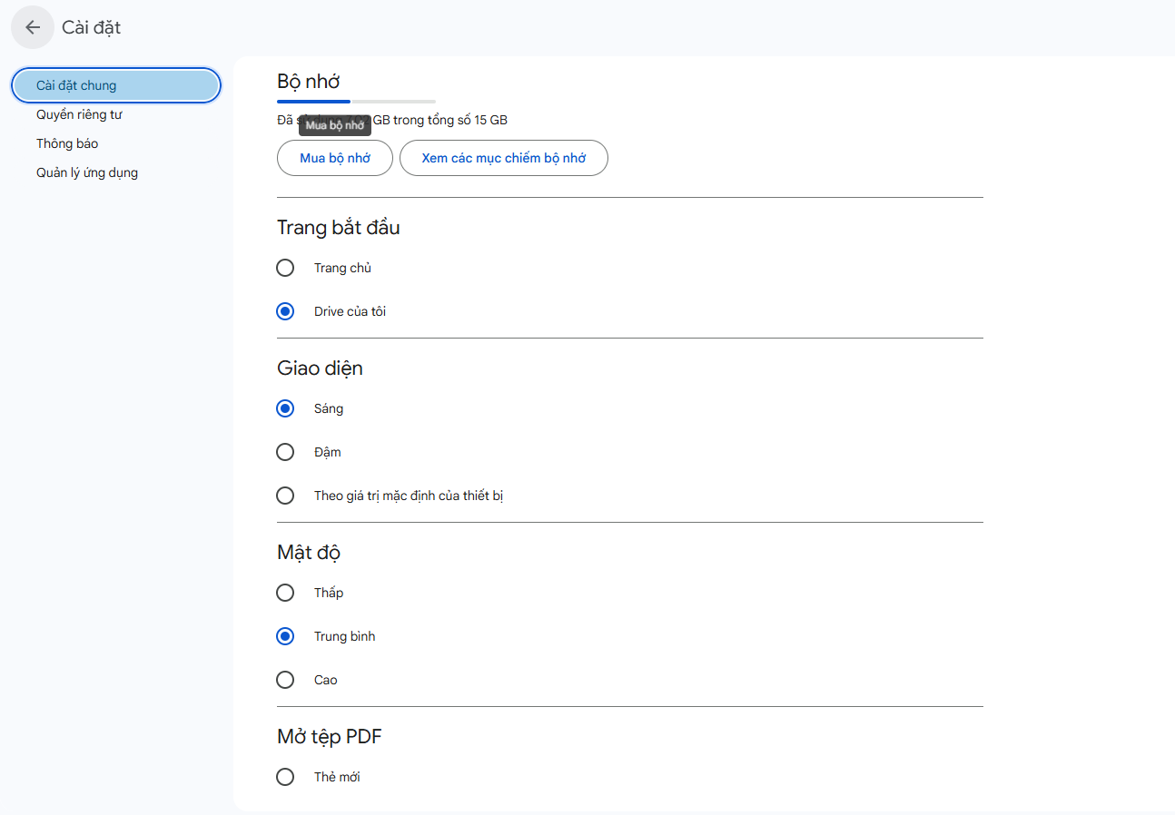
Select Setting of login User

Slide 3
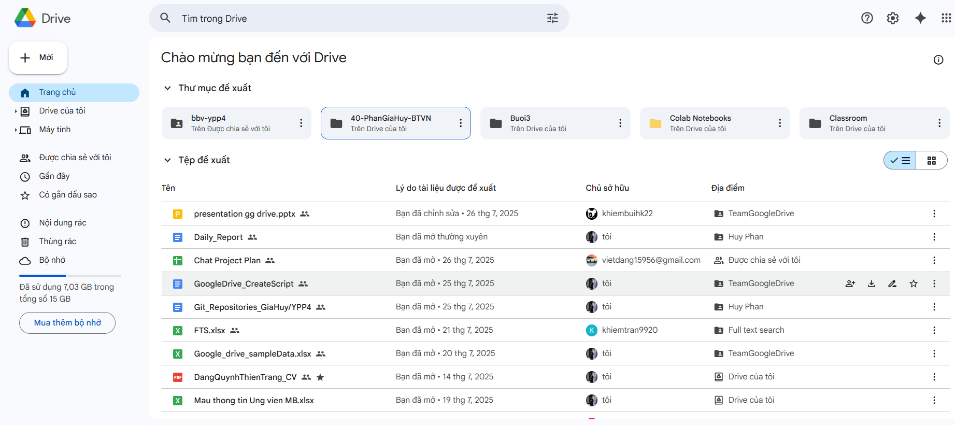
Full_text Search
Select recomment folder
Select login user Setting
Select recomment file

Slide 4
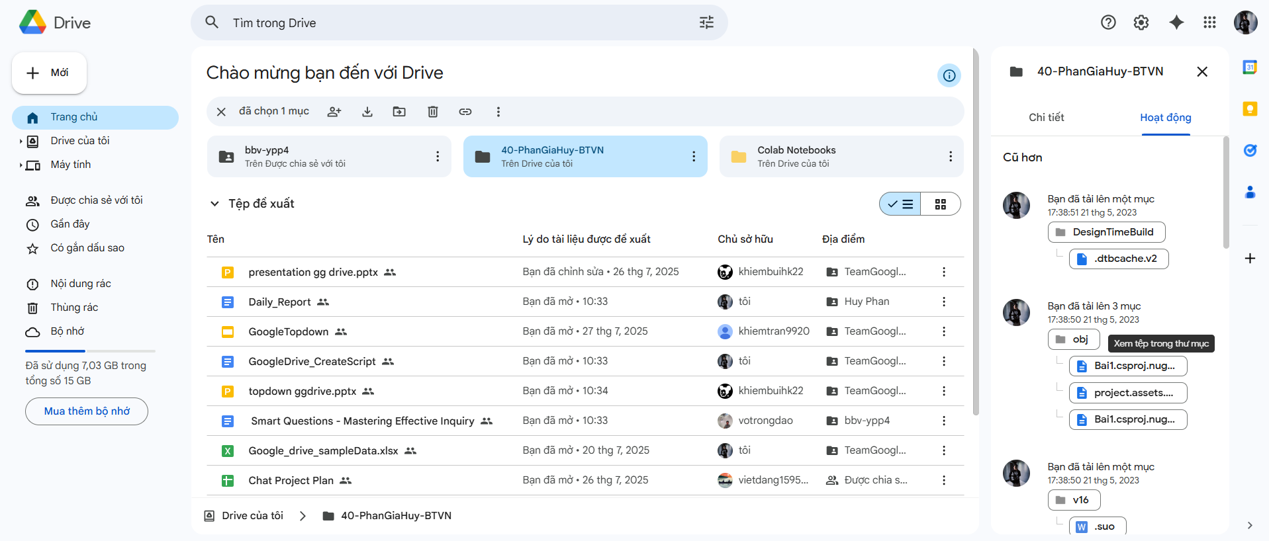
Select ActionLog of folder/file

Slide 5
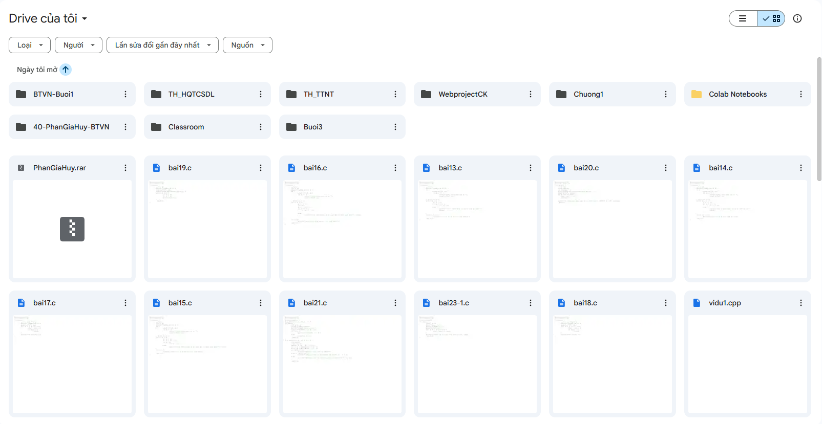
Select File/folder where user login is owner

Slide 6
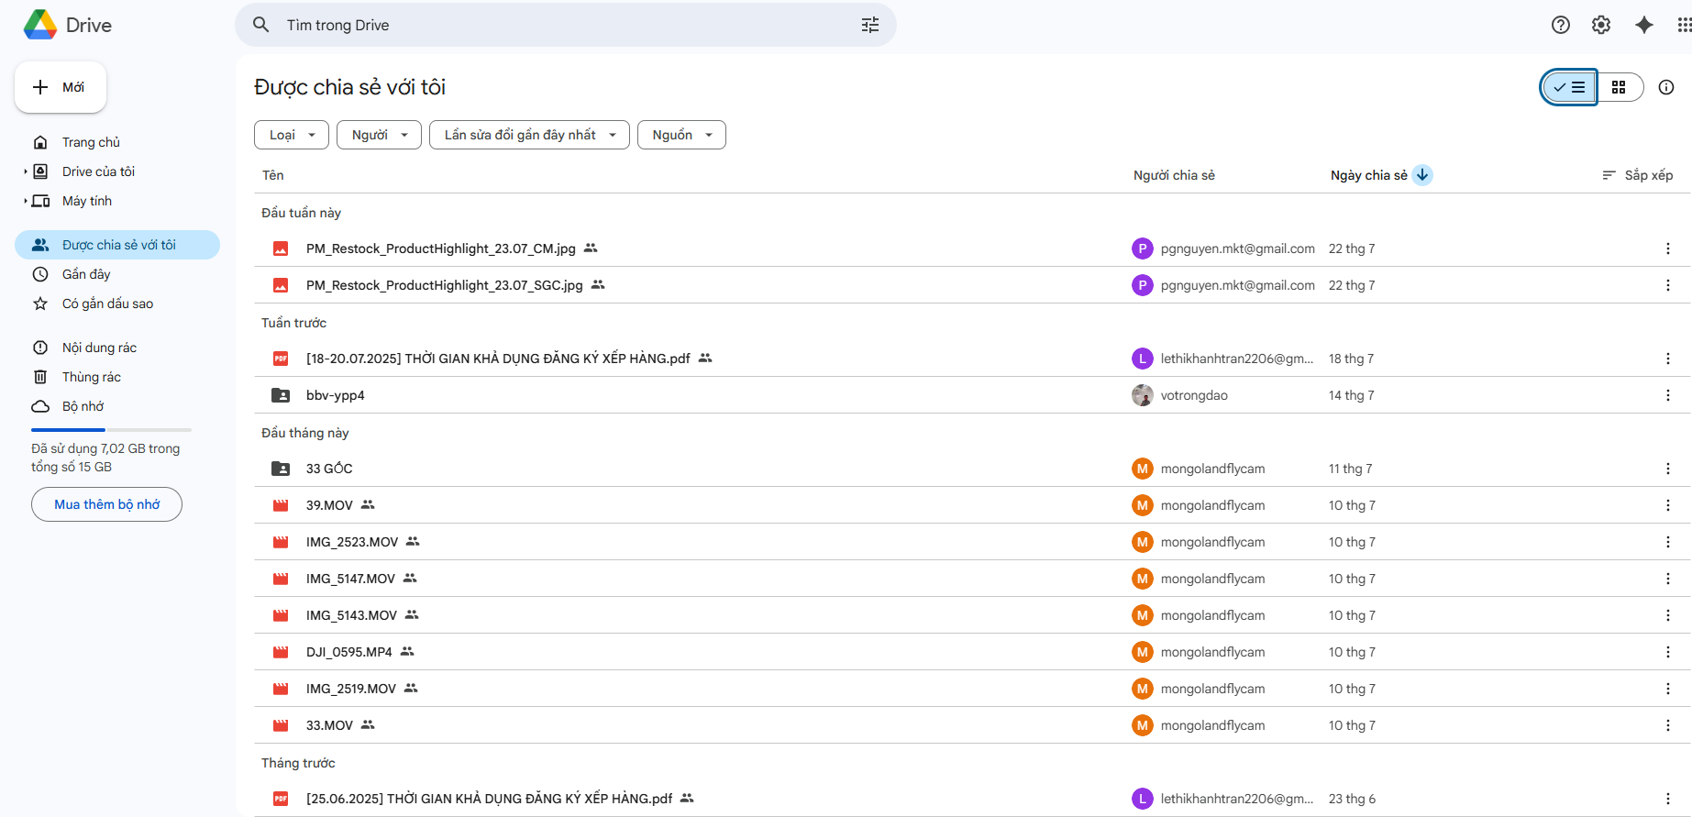
Select file/folder which share for me

Slide 7
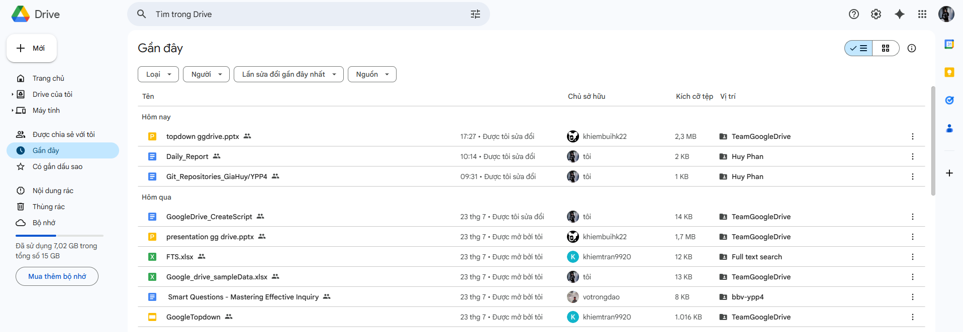
Select File/Folder which action by login user

Slide 8
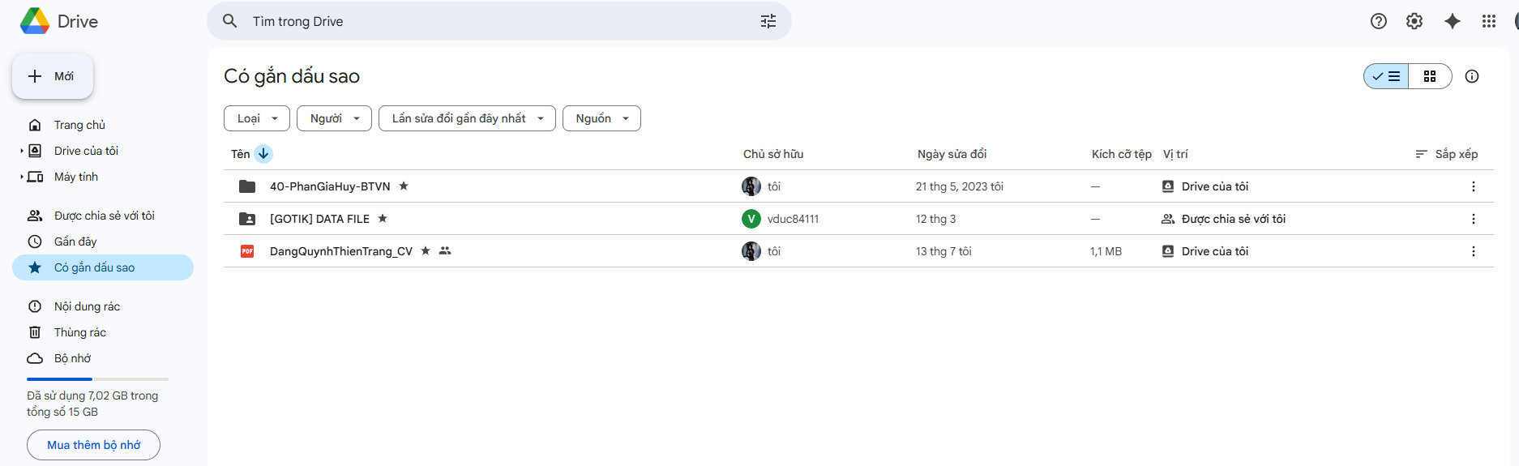
Select stared file/folder of login user

Slide 9
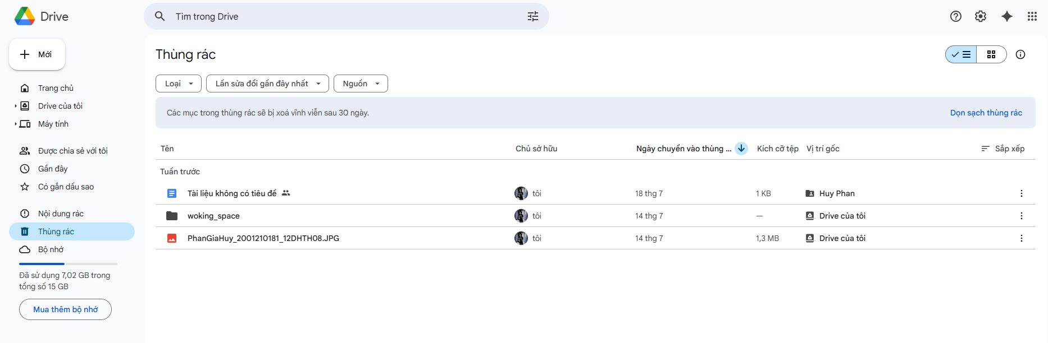
Select file/folder were deleted by login user

Slide 10
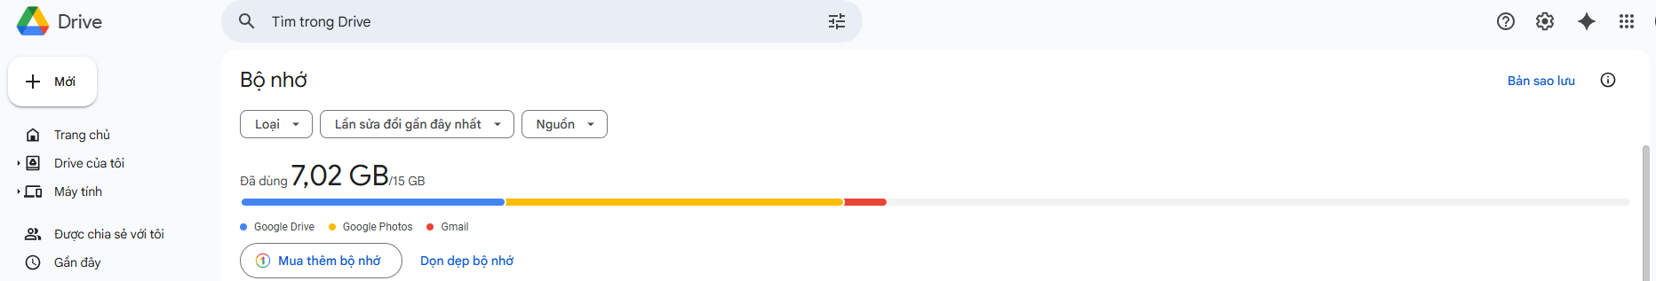
Select login User capacity and UsedCapacity

Slide 11
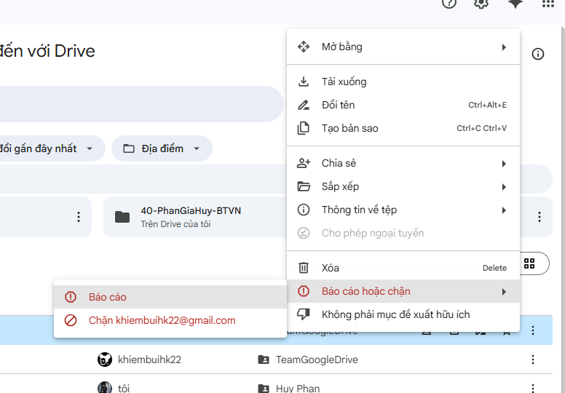
Select User have been Banned by login user

Slide 12
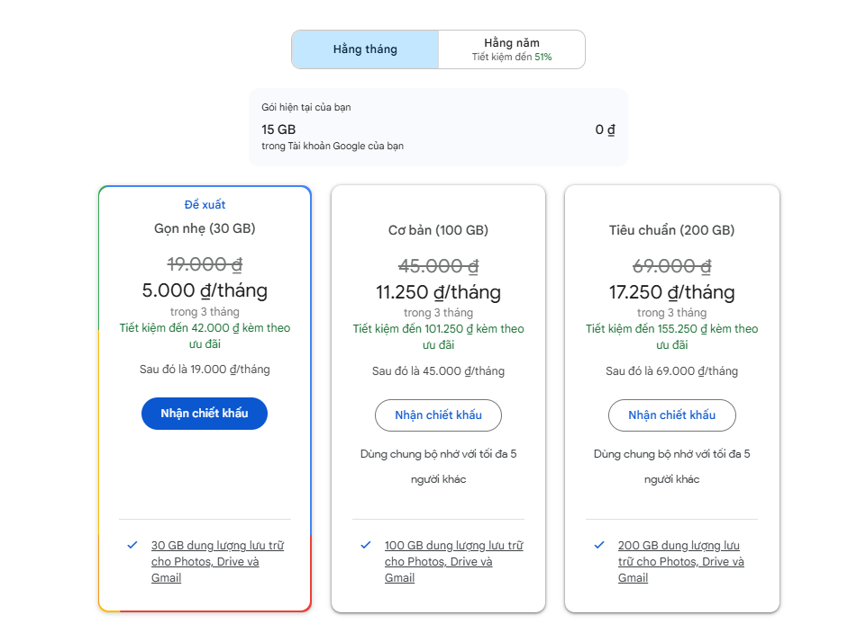
Select Product of login User
Select GoogleDrive’s Products

