Slide 1
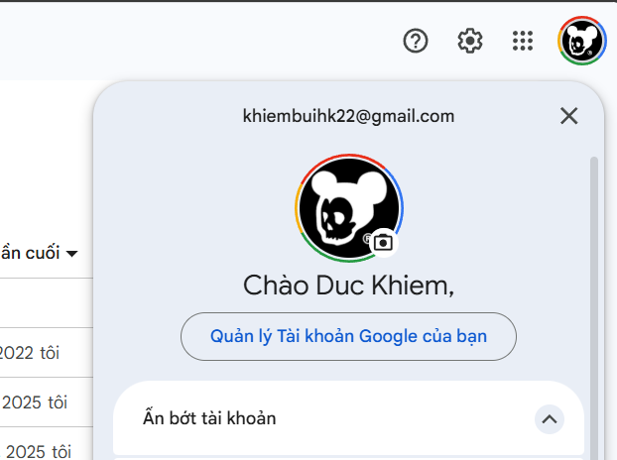
Email
Select User information
User Avatar
UserName
Notes:
1.Select User Information
Declare @userId int = 1
select
a.UserName as UserName,
a.Email as Email
from Account a
where a.UserId =@userId

Slide 2
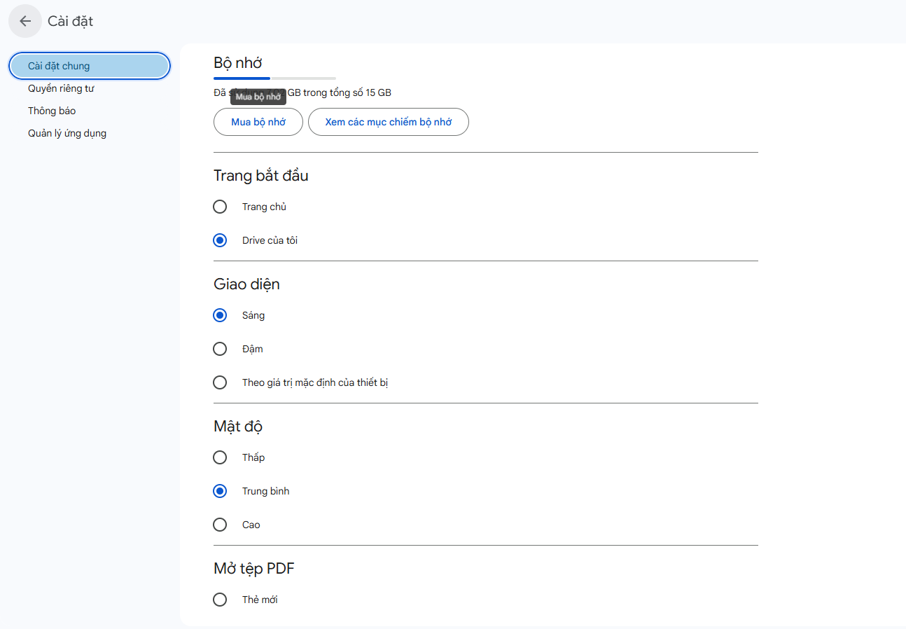
Select Setting of login User
Setting key
Setting Value
Notes:
- Select Login User Setting
Declare @userId int = 1;
select
su.SettingUserId,
a.UserName as UserName,
s.SettingKey,
s.SettingValue
from SettingUser su
join Account a on su.UserId = a.UserId
join AppSetting s on su.SettingId = s.SettingId
where a.UserId =@userId

Slide 3
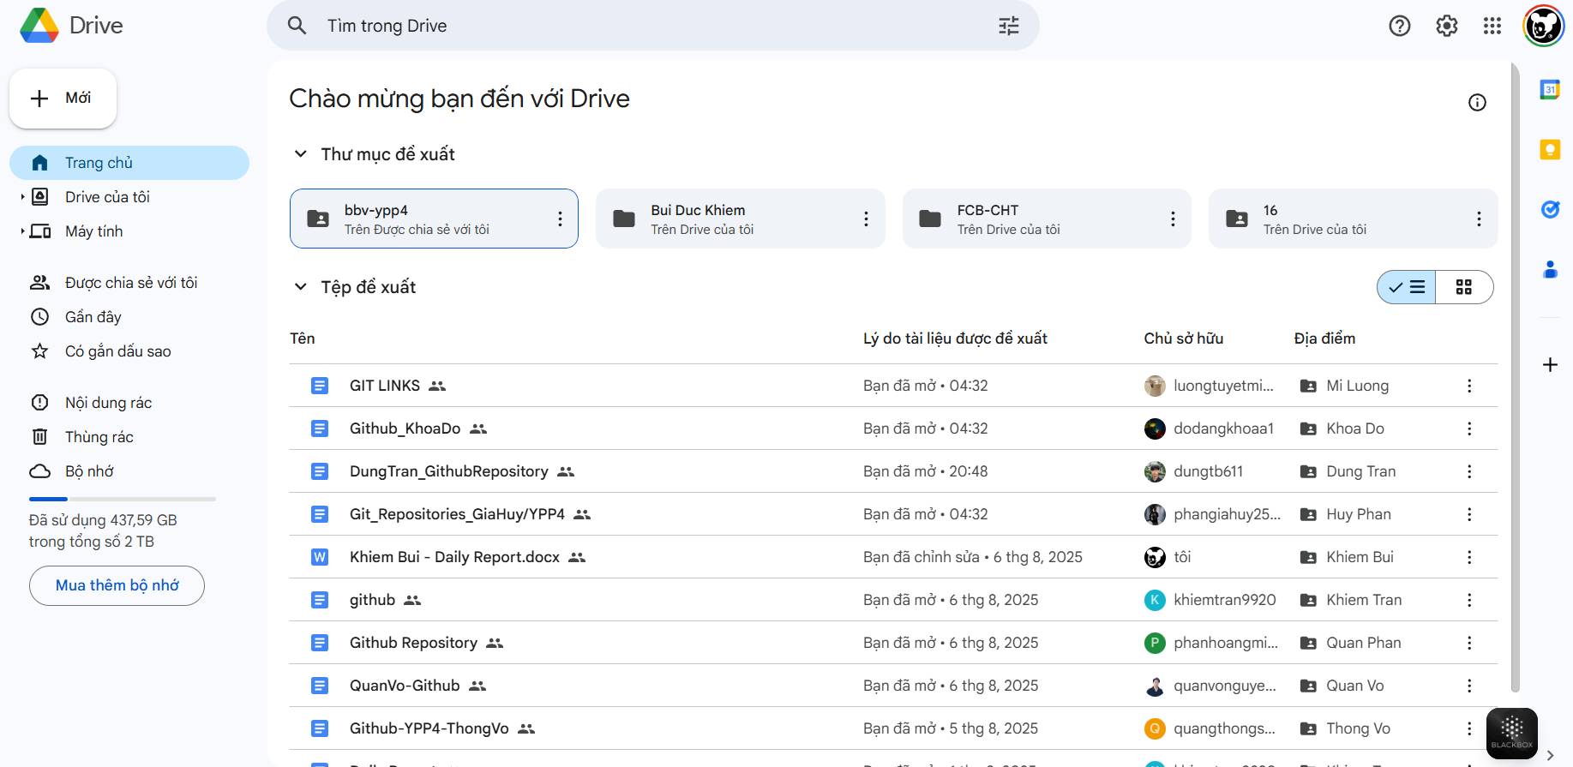
Full_text Search
Select recomment folder
Select login user view Setting
Icon
Folder
Name
Action Recent
Owner
Icon
Name
Select recomment file
Notes:
- Full-Text Search
-Select Login User Recomment Folder
-Select Login User Recomment File
-Select Login User View Setting

Slide 4
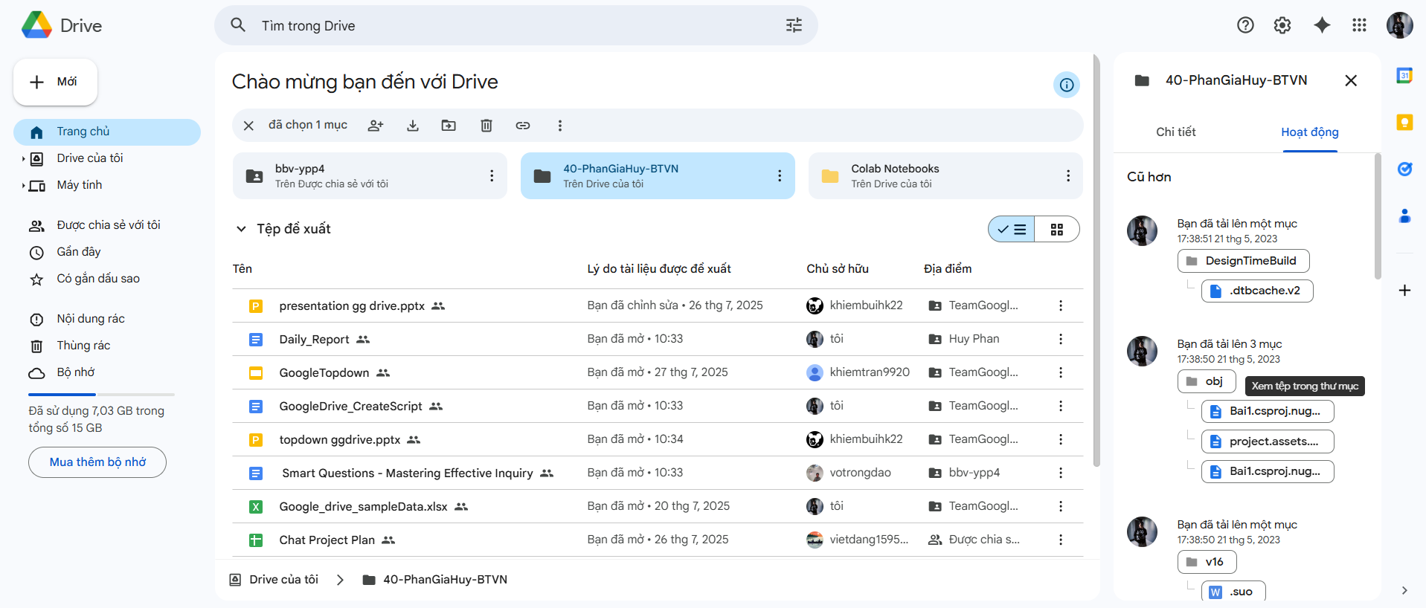
Select ActionRecent of folder/file
Avatar
Action Recent
Notes:
Select Action Log of Folder and File

Slide 5
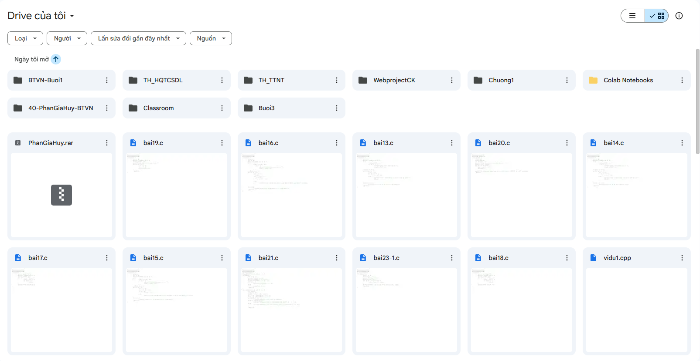
Select File/folder where user login is owner
Notes:
Select Login User’s File/Folder

Slide 6
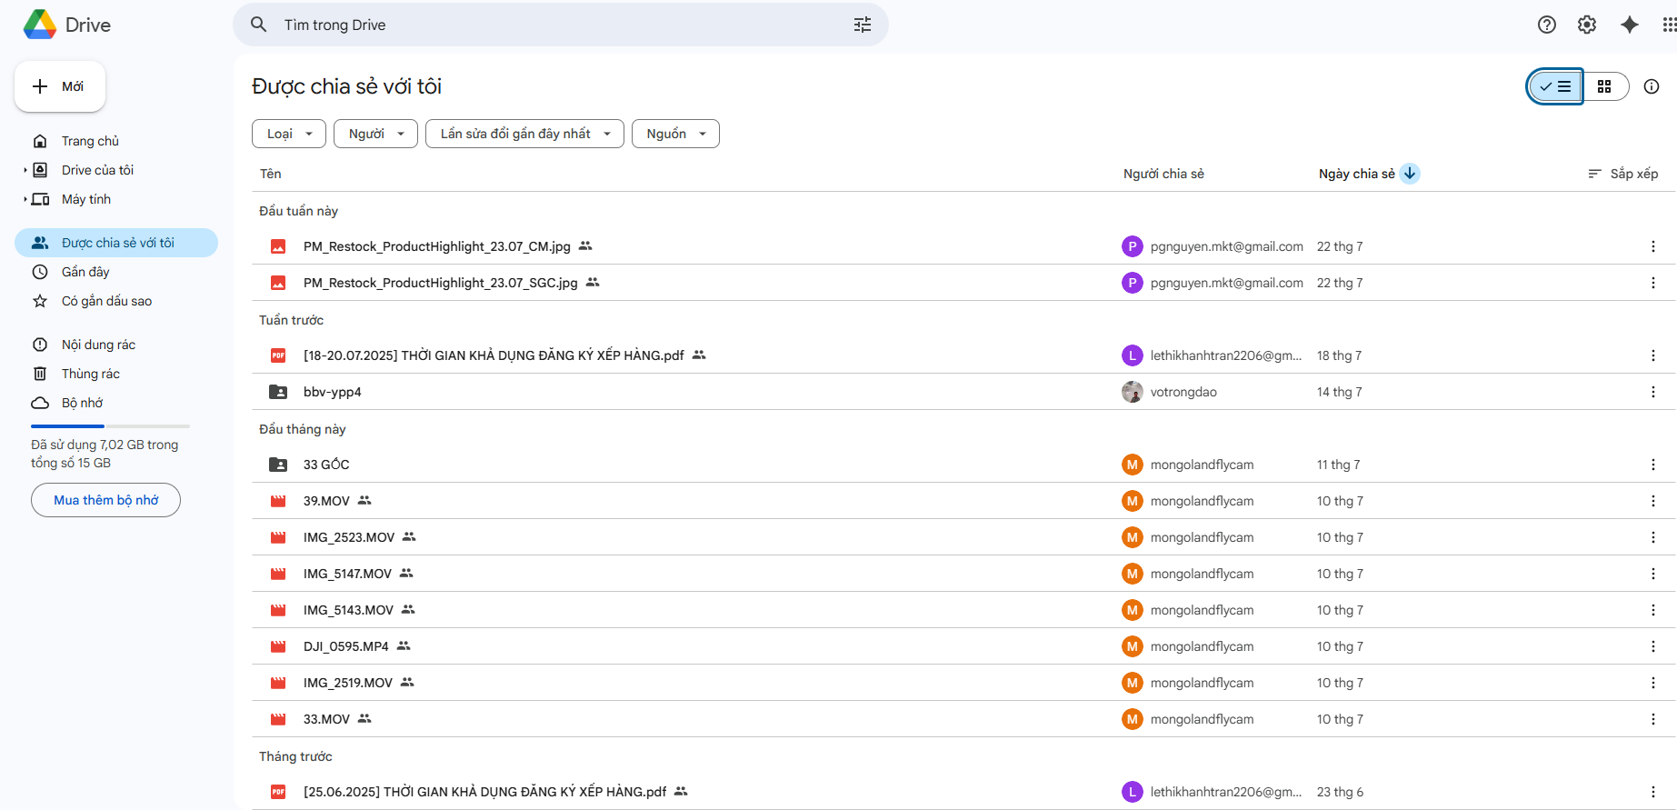
Sort by Filetype
Sort by Owner
Sort by Action Recent
Select file/folder which share for me
Notes:
Select File/Folder. Which have been shared to Login User
Sort by FileType
Sort by Owner
Sort by Action Recent

Slide 7
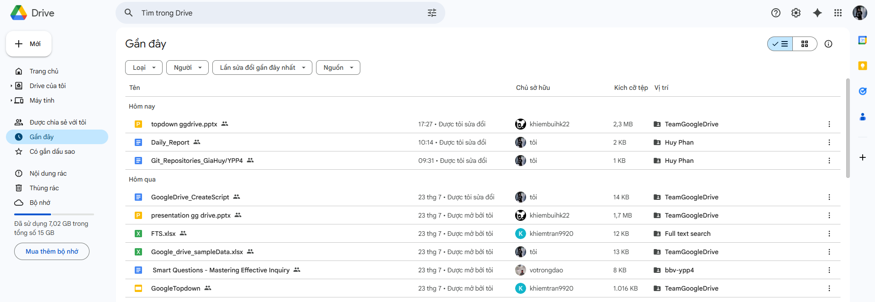
Select File/Folder which recent action
Notes:
Select File/Folder which recent action

Slide 8
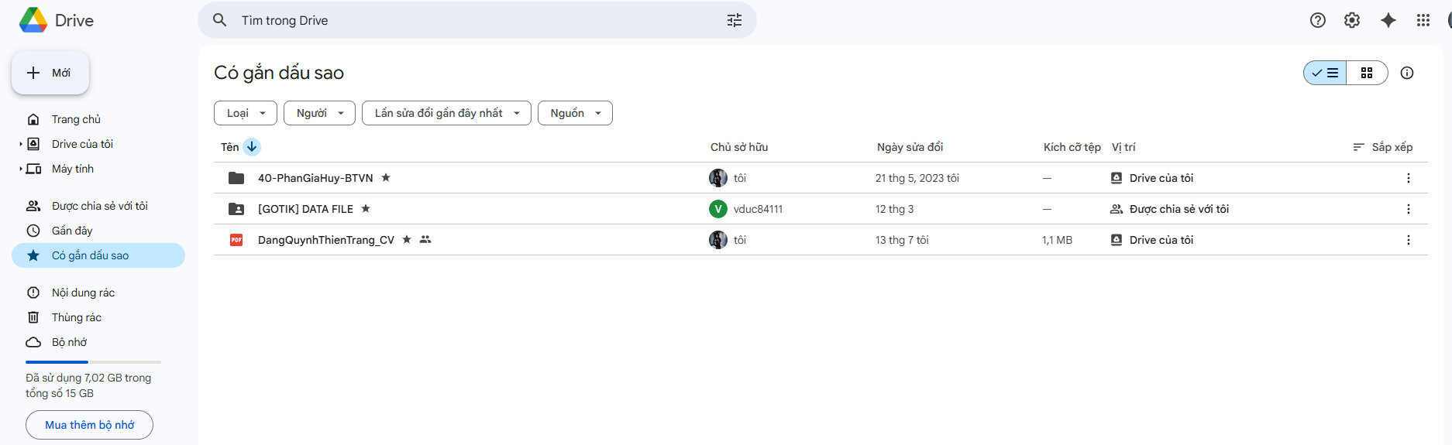
Select stared file/folder of login user
Notes:
Select stared file/folder of login user

Slide 9
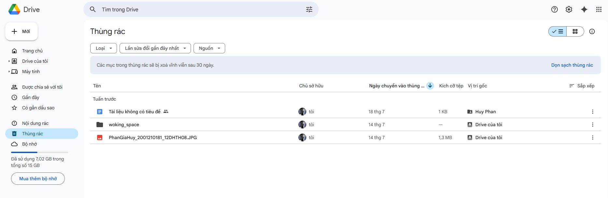
Select file/folder were deleted by login user
Location
CreatedAt
Owner
Icon
Name
Notes:
Select file/folder were deleted by login user

Slide 10
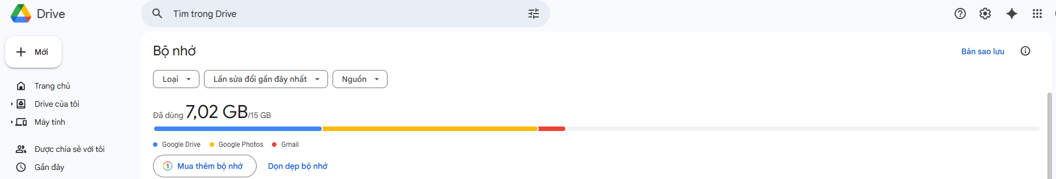
Select login User capacity and UsedCapacity
Notes:
Select login User capacity and UsedCapacity of login user

Slide 11
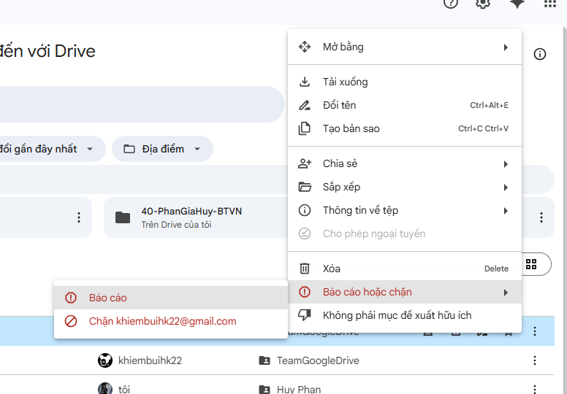
Select User have been Banned by login user
Notes:
Select User have been Banned by login user

Slide 12
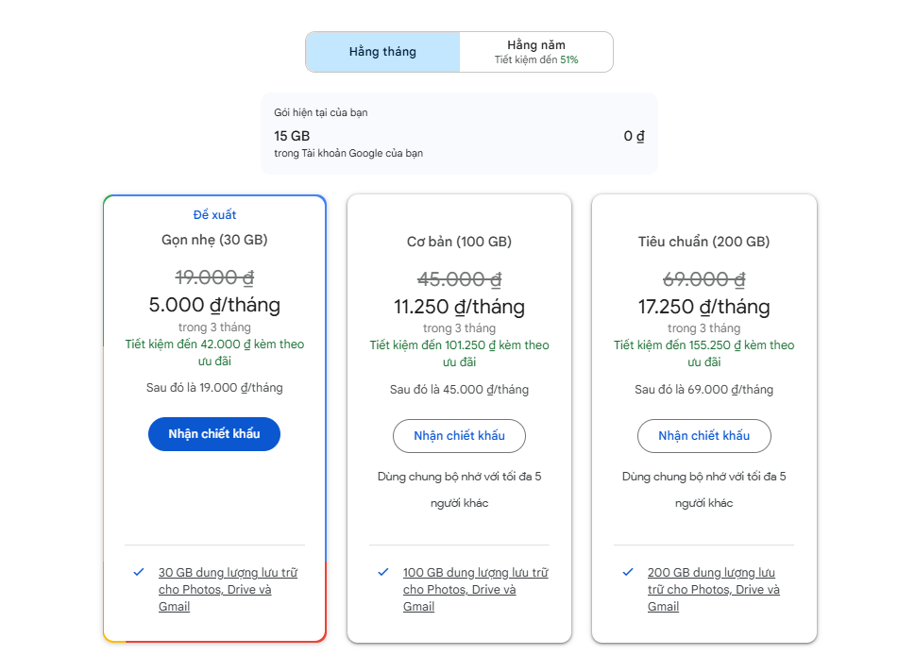
Product Item name
Select Product of login User
Select GoogleDrive’s Products
Promotion
Cost
Notes:
Select GoogleDrive’s Products
Select Product of login User

