Slide 2

Ypp 4
bbv Software Services AG | Date

Slide 3
Agenda
Google Drive functions and database design as follow
Fulltext Search with BM25
Q&A

Slide 4
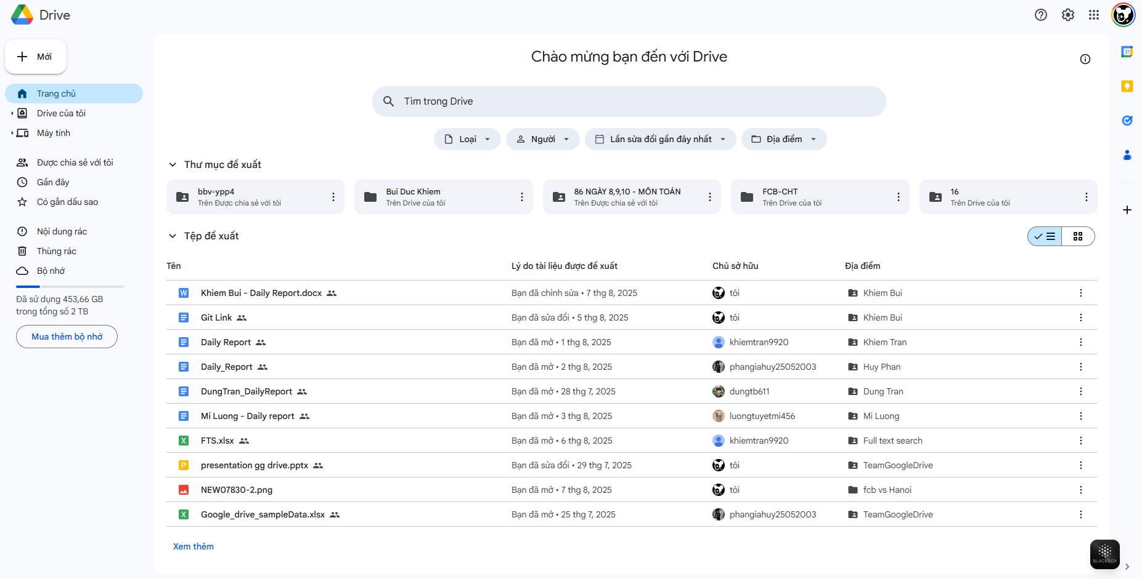
First Screen
Setting
Folder
Account
ActionRecent
UserFile

Slide 5
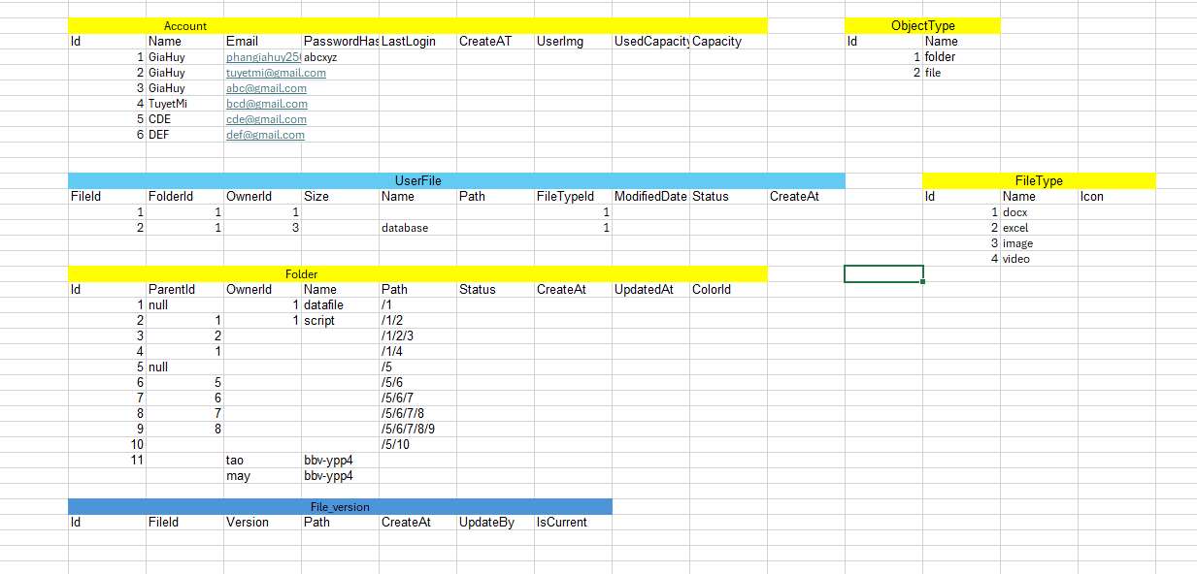
Sample Data

Slide 6
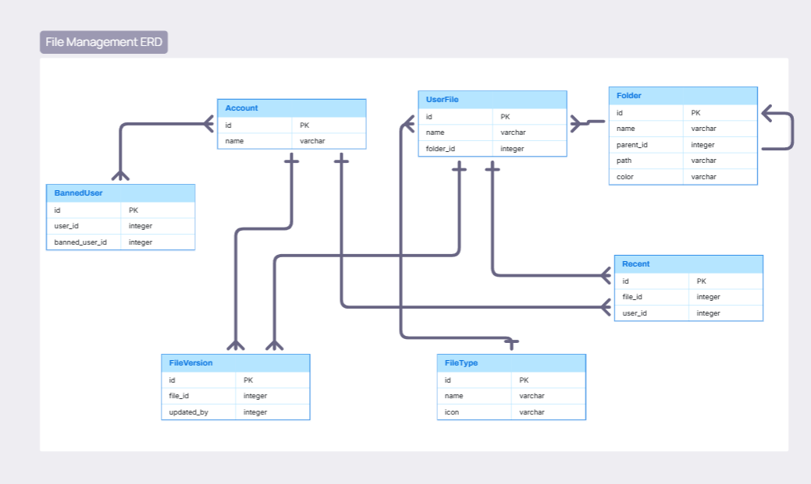
Data Structure

Slide 7
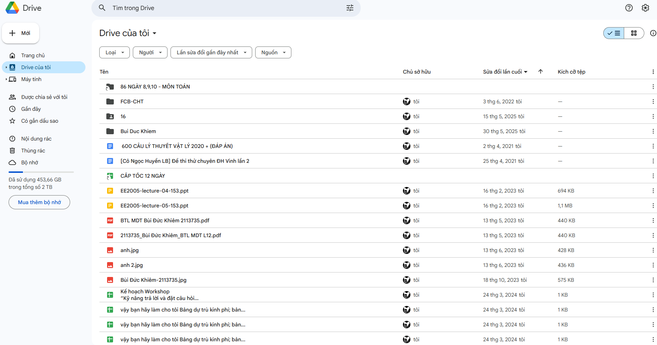
My drive
Get folder
Get file
Select File/folder where user login is owner
Notes:
SELECT login user file
DECLARE @LoginUser INT = 1
SELECT
uf.FileId,
a.UserName,
uf.UserFileName
FROM UserFile uf
JOIN Account a ON uf.OwnerId = a.UserId
WHERE a.UserId = @LoginUser
SELECT login user folder
DECLARE @userId INT = 1
SELECT
fo.FolderId,
a.UserName,
fo.FolderName
FROM Folder fo
JOIN Account a ON fo.OwnerId = a.UserId
WHERE a.UserId = @userId

Slide 8
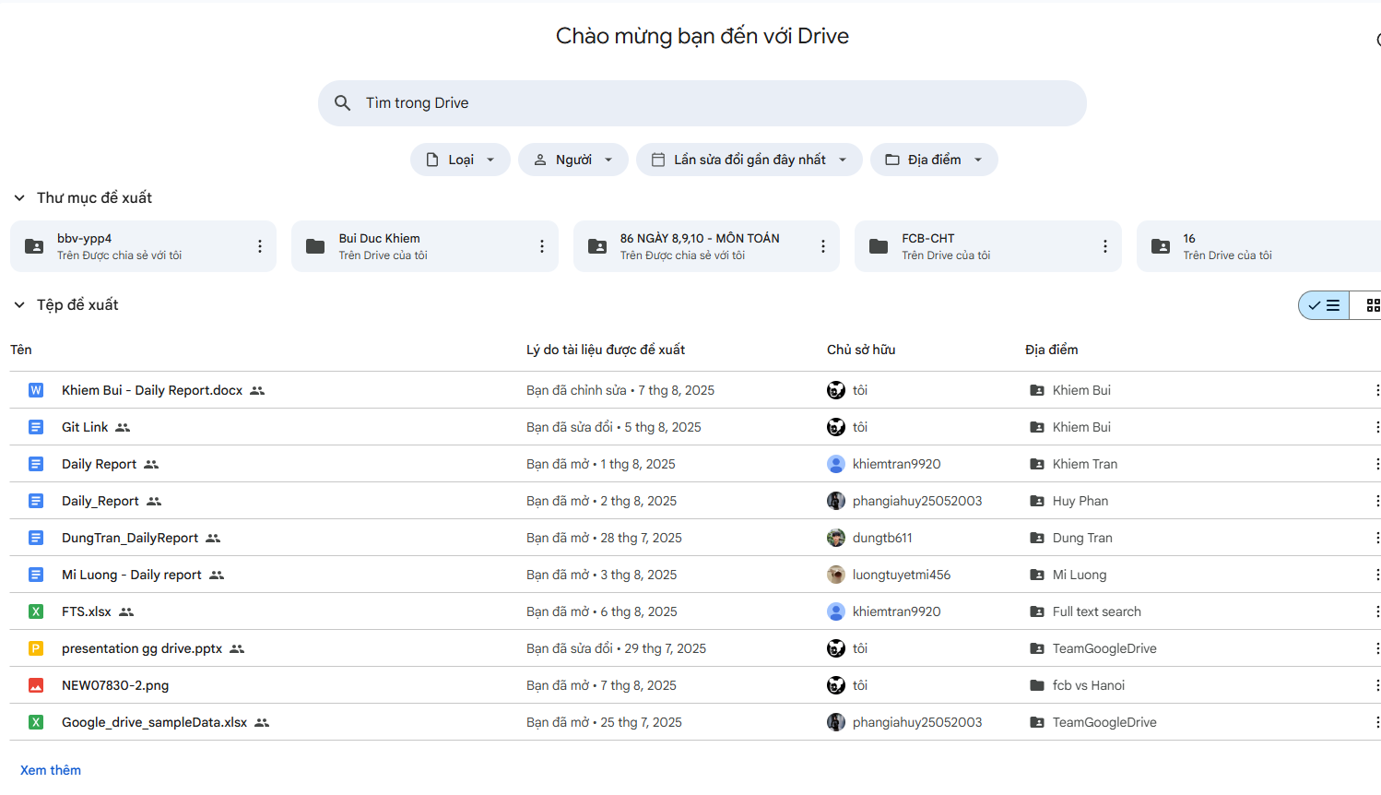
Recomment file/folder
Notes:
RECOMMENT folder
DECLARE @userId INT = 3
SELECT TOP 10
fo.FolderId,
a.UserName,
fo.FolderName,
ar.ActionLog,
ar.ActionDateTime
FROM ActionRecent ar
JOIN Account a ON ar.UserId = a.UserId
JOIN Folder fo ON ar.ObjectTypeId = 1 AND ar.ObjectId = fo.FolderId
WHERE ar.UserId = @userId
ORDER BY ar.ActionDateTime DESC
RECOMMENT file
DECLARE @userId INT = 2
SELECT TOP 10
f.FileId,
a.UserName,
f.UserFileName,
ar.ActionLog,
ar.ActionDateTime
FROM ActionRecent ar
JOIN Account a ON ar.UserId = a.UserId
JOIN UserFile f ON ar.ObjectTypeId = 2 AND ar.ObjectId = f.FileId
WHERE ar.UserId = @userId
ORDER BY ar.ActionDateTime DESC

Slide 9
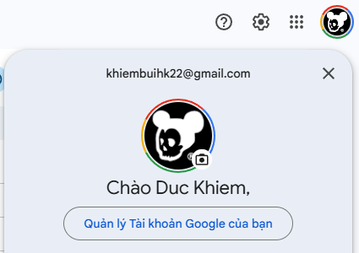
Account
Email
UserName
UserAvatar
Notes:
Select User Information
Declare @userId int = 1
select
a.UserName as UserName,
a.Email as Email
from Account a
where a.UserId =@userId

Slide 10
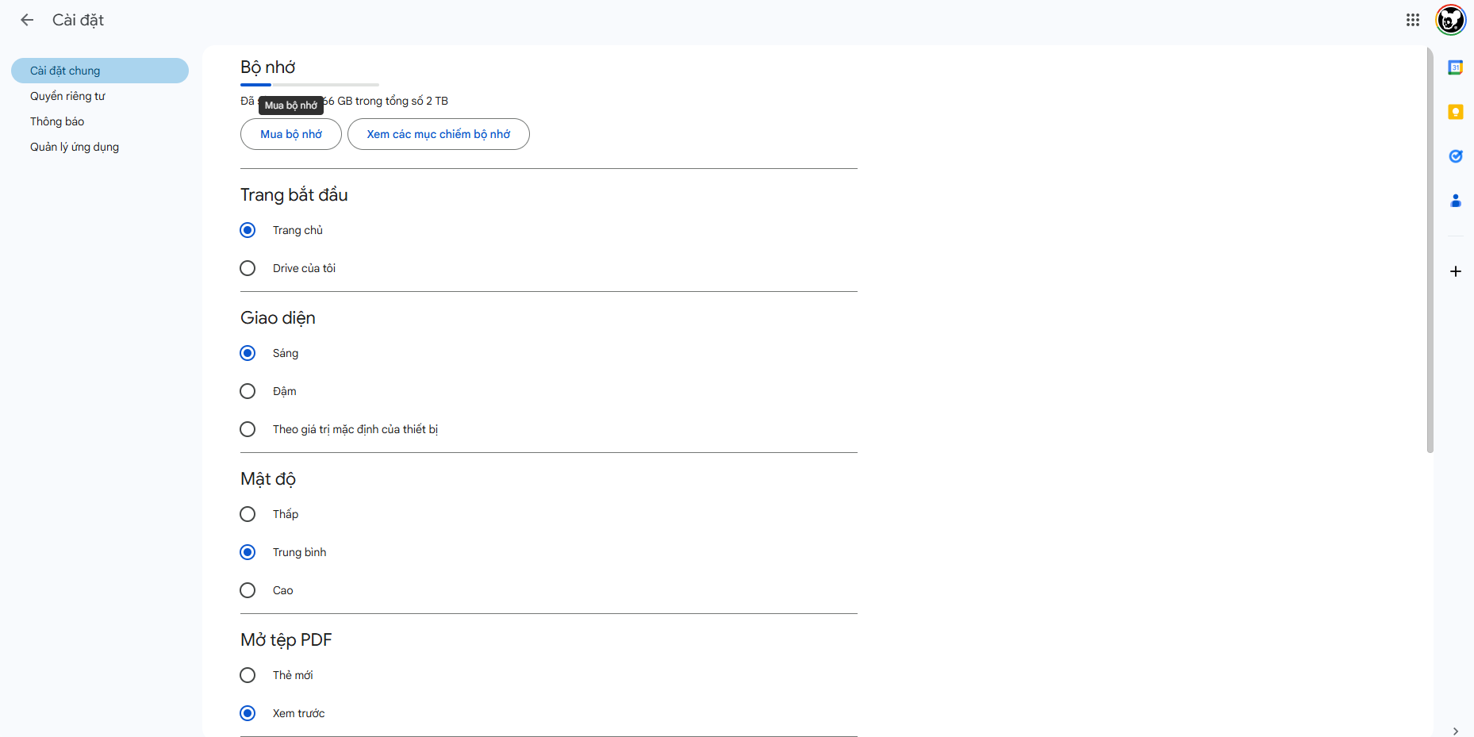
Setting
Settingkey
Setting of login Account
Settingvalue
Notes:
Select Login User Setting
DECLARE @userId INT = 1;
SELECT
su.SettingUserId,
a.UserName AS UserName,
s.SettingKey,
s.SettingValue
FROM SettingUser su
JOIN Account a ON su.UserId = a.UserId
JOIN AppSetting s ON su.SettingId = s.SettingId
WHERE a.UserId = @userId

Slide 11
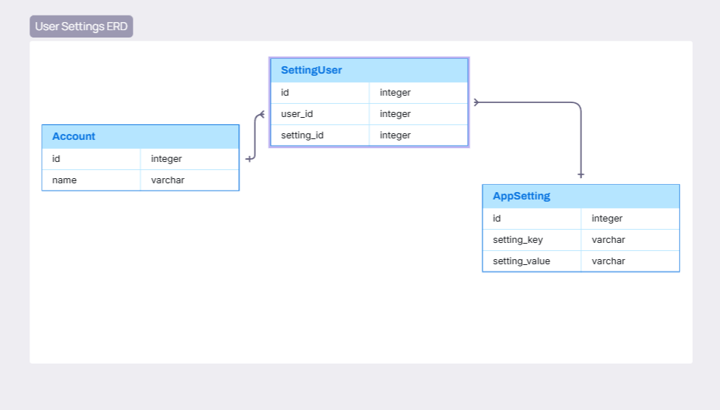
Data Structure

Slide 12
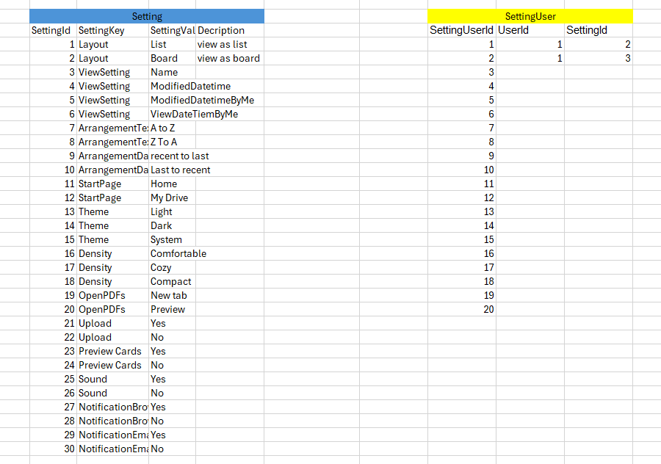
Setting Sample Data

Slide 13
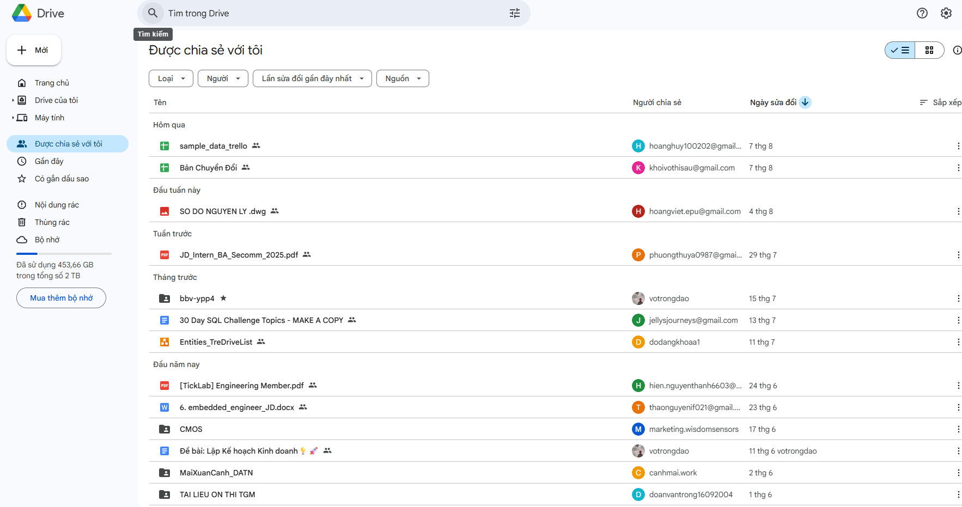
Share for login user
Sort by Owner
Sort by ActionRecent
Sort by Filetype
Notes:
Select File/Folder. Which have been shared to Login User
Sort by FileType
Sort by Owner
Sort by Action Recent
Share with me Screen
-- 1.SELECT shared file with login user
DECLARE @userId INT = 102
SELECT
f.FileId,
a.UserName,
f.UserFileName
FROM SharedUser su
JOIN Account a ON su.UserId = a.UserId
JOIN Share s ON su.ShareId = s.ShareId
JOIN UserFile f ON s.ObjectTypeId = 2 AND s.ObjectId = f.FileId
WHERE su.UserId = @userId
-- 2.SELECT shared folder with login user
DECLARE @userId INT = 101
SELECT
fo.FolderId,
a.UserName,
fo.FolderName
FROM SharedUser su
JOIN Account a ON su.UserId = a.UserId
JOIN Share s ON su.ShareId = s.ShareId
JOIN Folder fo ON s.ObjectTypeId = 1 AND s.ObjectId = fo.FolderId
WHERE su.UserId = @userId
-- SELECT folder shared for user with userid = 101
DECLARE @userId INT = 101
SELECT
a.UserName,
fo.FolderId,
p.PermissionName,
fo.FolderName
FROM SharedUser su
JOIN Account a ON su.SharedUserId = a.UserId
JOIN Share s ON su.ShareId = s.ShareId
JOIN Permission p ON su.PermissionId = p.PermissionId
LEFT JOIN Folder fo ON s.ObjectTypeId = 1 AND fo.FolderId = s.ObjectId
WHERE su.UserId = @userId
-- SELECT file shared for user with userid = 102
DECLARE @userId INT = 102
SELECT
a.UserName,
p.PermissionName,
f.FileId,
f.UserFileName
FROM SharedUser su
JOIN Account a ON su.SharedUserId = a.UserId
JOIN Share s ON su.ShareId = s.ShareId
JOIN Permission p ON su.PermissionId = p.PermissionId
LEFT JOIN UserFile f ON s.ObjectTypeId = 2 AND f.FileId = s.ObjectId
WHERE su.UserId = @userId

Slide 14
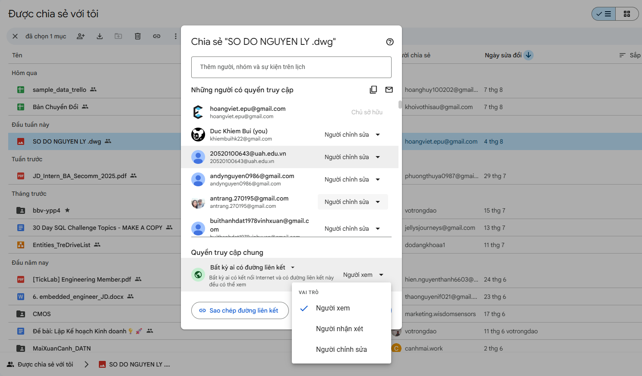
Share
Share
Permission

Slide 15
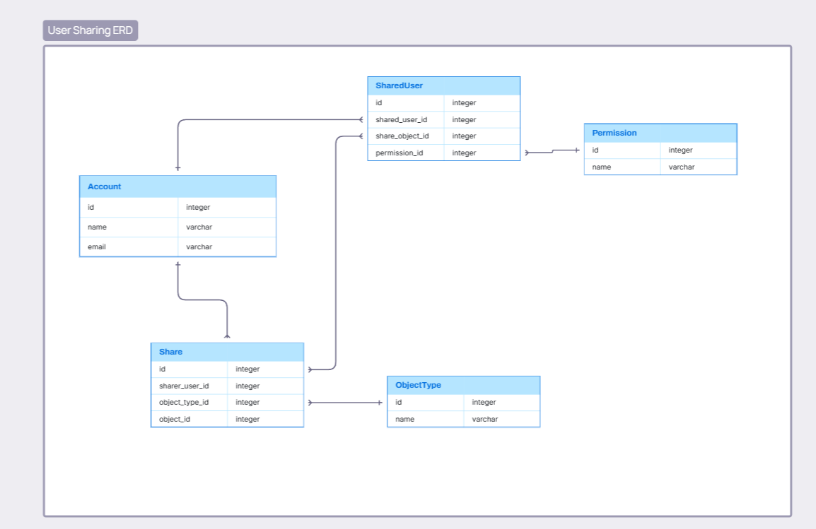
Data Structure

Slide 16
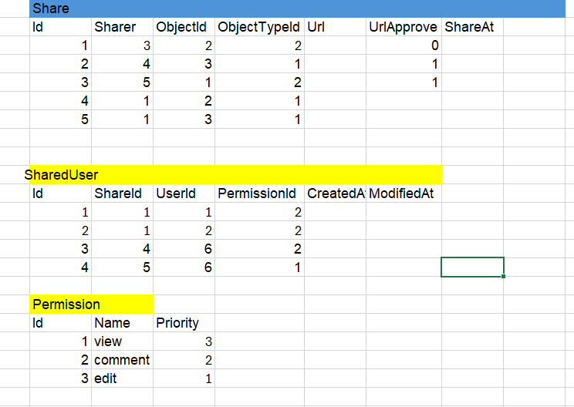
Sample Data Share

Slide 17
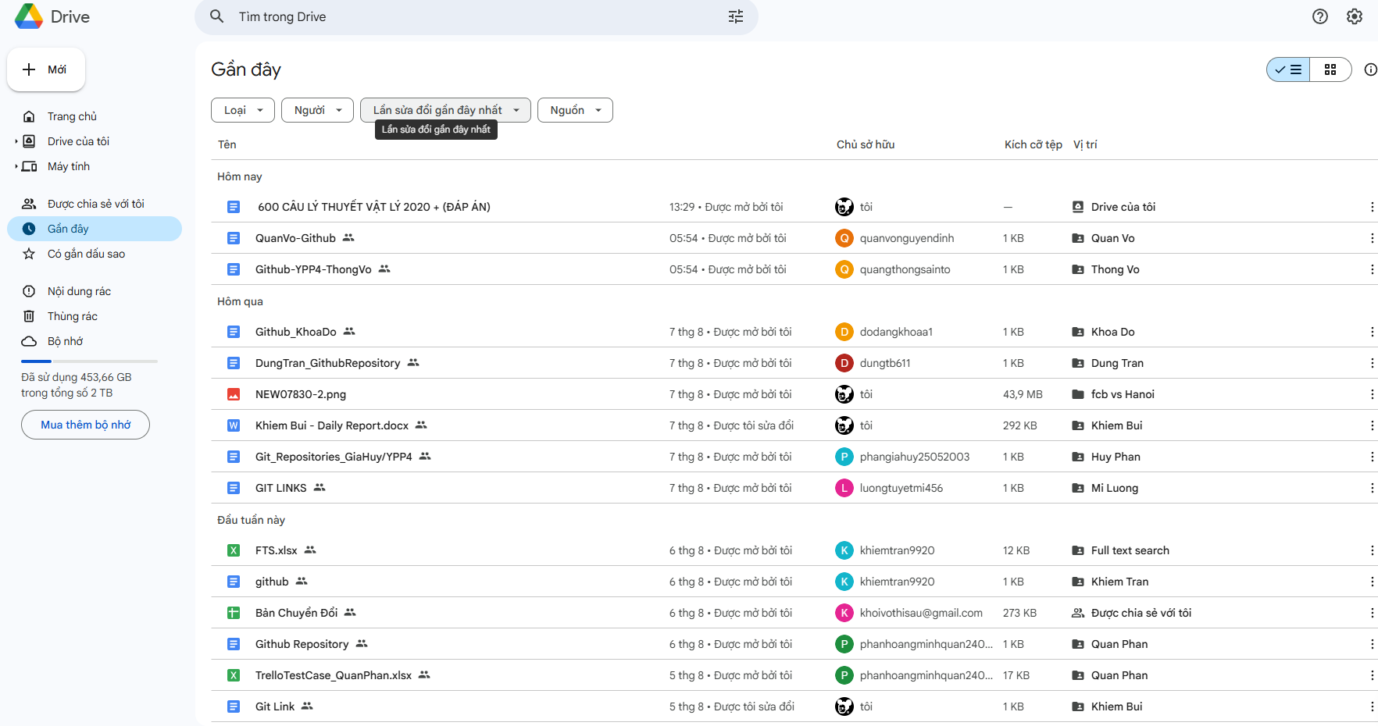
Recent Action
Notes:
Select File/Folder which recent action
Select ActionRecent of folder/file
DECLARE @userID INT =1
SELECT ar.ObjectTypeId , ar.ObjectId , ar .ActionLog , ar.ActionDateTime
FROM ActionRecent ar
JOIN Account a ON a.UserId = ar.UserId
LEFT JOIN UserFile uf ON uf.FileId = ar.ObjectId AND ar.ObjectTypeId = 2
LEFT JOIN Folder f ON f.FolderId = ar.ObjectId AND ar.ObjectTypeId = 1
WHERE a.UserId = @userId
ORDER BY ar.ActionDateTime

Slide 18
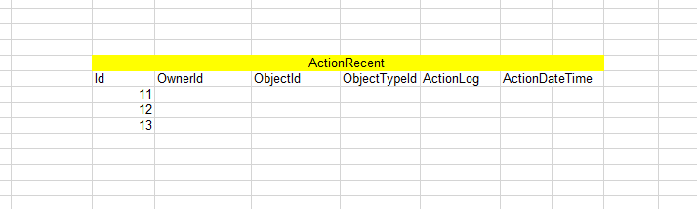
Sample Data ActionRecent

Slide 19
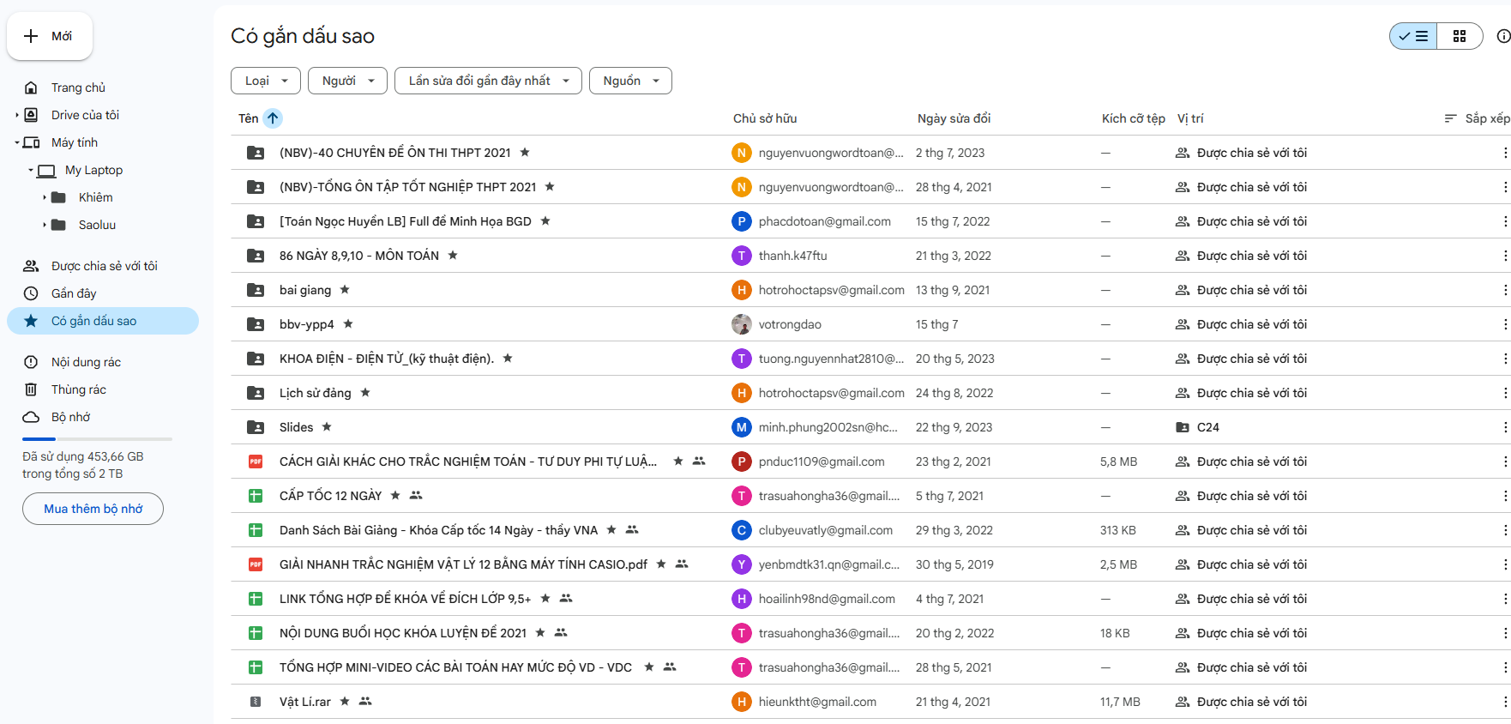
FavoriteObject
Notes:
Select stared file/folder of login user
SELECT file
DECLARE @userId INT = 794
SELECT
f.FileId,
f.UserFileName,
a.UserName AS FileOwnerName,
a.UserId AS UserId,
ft.FileTypeName
FROM FavoriteObject fa
LEFT JOIN UserFile f ON fa.ObjectTypeId = 2 AND fa.ObjectId = f.FileId
LEFT JOIN Account a ON f.OwnerId = a.UserId
JOIN FileType ft ON f.FileTypeId = ft.FileTypeId
WHERE fa.OwnerId = @userId

Slide 20
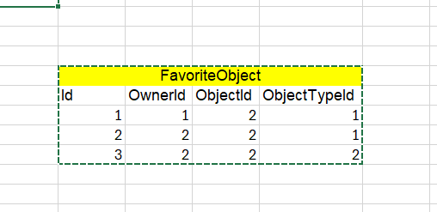
Sample Data FavoriteObject

Slide 21
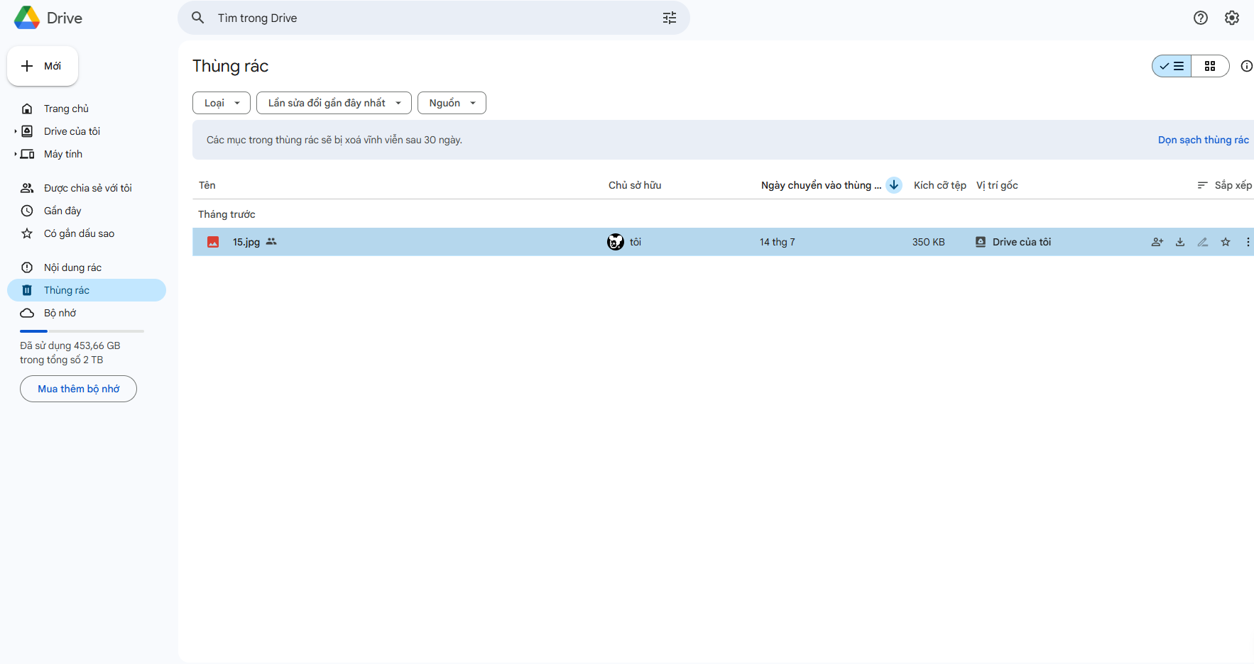
Trash
Select file/folder were deleted by login user
Notes:
Select file/folder were deleted by login user
1.SELECT file have been deleted
DECLARE @userId INT = 704
SELECT
f.FileId,
t.TrashId,
ot.ObjectTypeName,
f.UserFileName,
t.RemovedDatetime,
t.IsPermanent
FROM Trash t
JOIN ObjectType ot ON t.ObjectTypeId = ot.ObjectTypeId
JOIN UserFile f ON t.ObjectTypeId = 2 AND t.ObjectId = f.FileId
WHERE t.UserId = @userId;
-- 2.SELECT folder have been deleted
DECLARE @userId INT = 1
SELECT
fo.FolderId,
t.TrashId,
ot.ObjectTypeName,
fo.FolderName,
t.RemovedDatetime,
t.IsPermanent
FROM Trash t
JOIN ObjectType ot ON t.ObjectTypeId = ot.ObjectTypeId
JOIN Folder fo ON t.ObjectTypeId = 1 AND t.ObjectId = fo.FolderId
WHERE t.UserId = @userId;

Slide 22
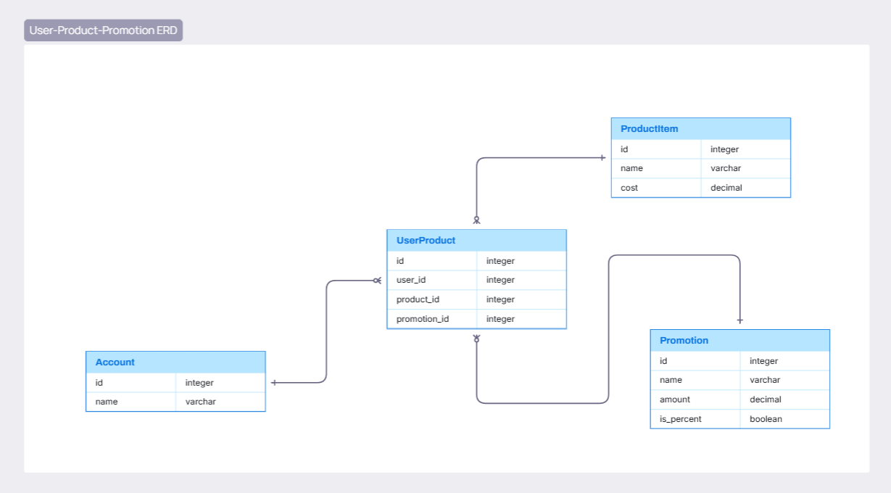
Data Structure

Slide 23
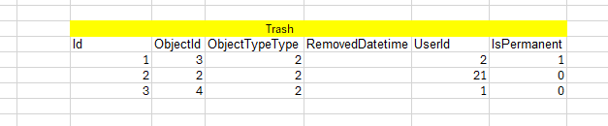
Sample Data Trash

Slide 24
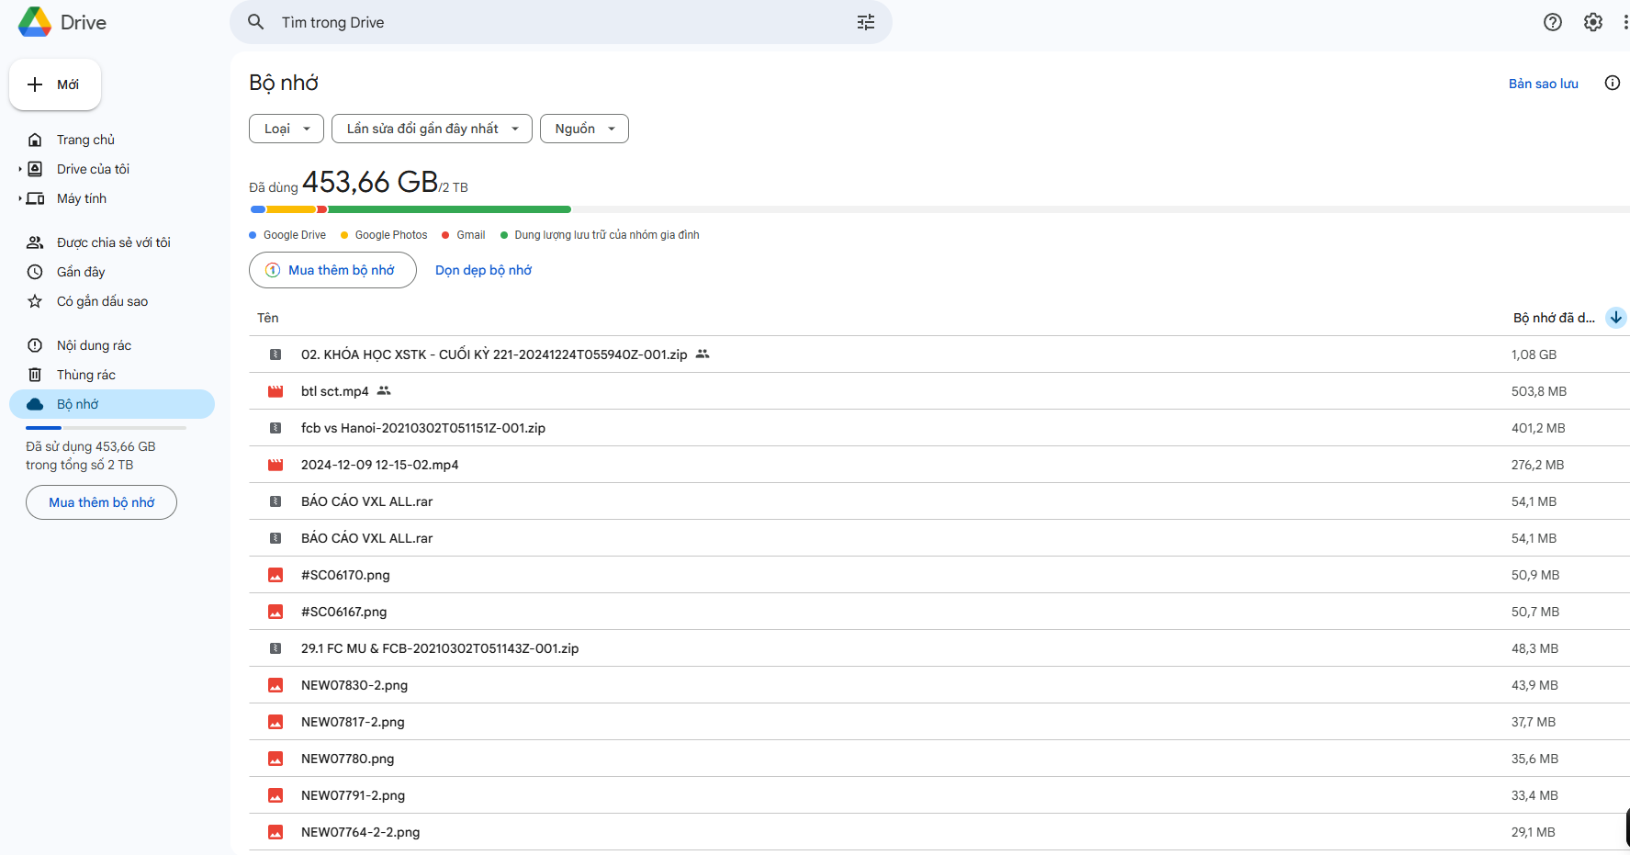
UserCapacity
Get list file by size
Select login User capacity and UsedCapacity

Slide 25
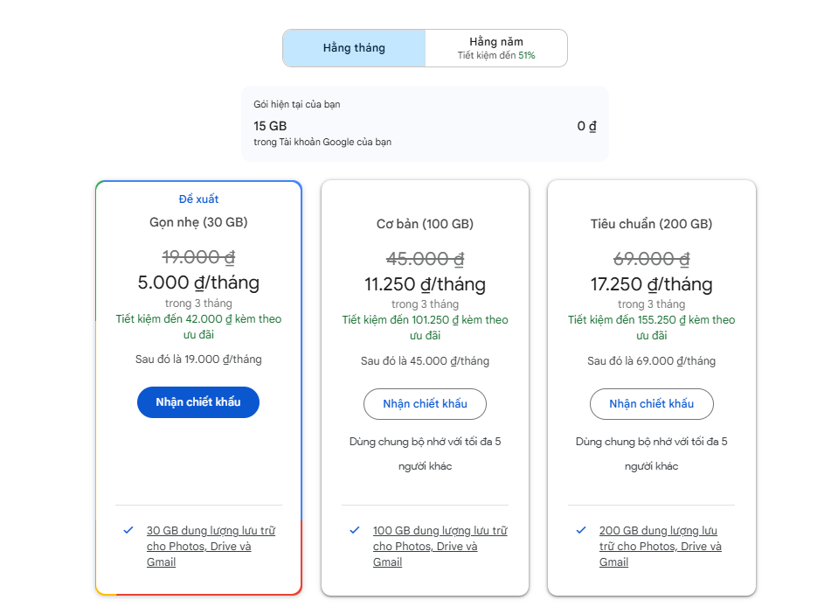
UserProduct
Select Product of login User
Duration
Product Item name
Promotion
Cost
Notes:
Select GoogleDrive’s Products
Select Product of login User
1 .SELECT all of product
SELECT
ProductId,
ProductName,
Cost,
Duration
FROM ProductItem
-- 2. SELECT Product bought by user
DECLARE @userId INT = 100
SELECT
pro.ProductId,
pro.ProductName,
a.UserId,
a.UserName,
CASE
WHEN po.IsPercent = 1 THEN pro.Cost - (pro.Cost * (po.Discount / 100))
ELSE pro.Cost - po.Discount
END AS TotalCost
FROM UserProduct up
JOIN Account a ON up.UserId = a.UserId
JOIN Promotion po ON up.PromotionId = po.PromotionId
JOIN ProductItem pro ON up.ProductId = pro.ProductId
WHERE up.UserId = @userId
-- 3 . SELECT Top 10 Payers
SELECT TOP 10
a.UserId,
pro.ProductName,
a.UserName,
CASE
WHEN po.IsPercent = 1 THEN pro.Cost * (po.Discount / 100)
ELSE pro.Cost - po.Discount
END AS TotalCost
FROM UserProduct up
JOIN Account a ON up.UserId = a.UserId
JOIN ProductItem pro ON up.ProductId = pro.ProductId
JOIN Promotion po ON up.PromotionId = po.PromotionId
ORDER BY TotalCost DESC

Slide 26
Data Structure

Slide 27
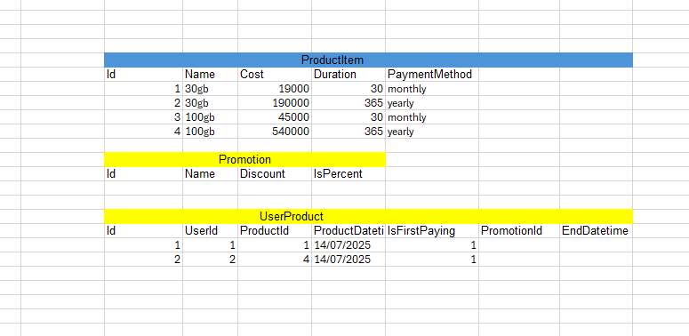
Sample Data Product

Slide 28
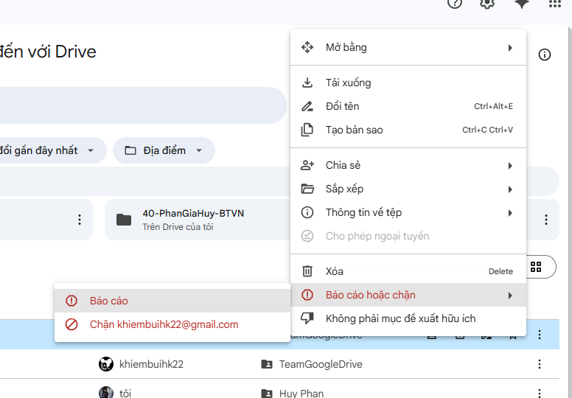
Banned
Select User have been Banned by login user
Notes:
SELECT banned user of login-user
DECLARE @userId INT = 533
SELECT
BU.Id AS BanId,
Banned.UserName AS BannedUserName,
Banner.UserName AS BannedByUserName,
BU.BannedAt
FROM BannedUser BU
JOIN Account Banned ON BU.UserId = Banned.UserId
JOIN Account Banner ON BU.BannedUserId = Banner.UserId
WHERE BU.UserId = @userId
ORDER BY BU.BannedAt DESC;

Slide 29
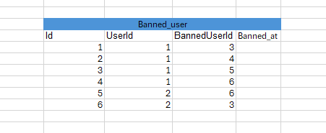
Sample Data Banned

Slide 30
Resolve permission problem
in
Google Drive

Slide 31
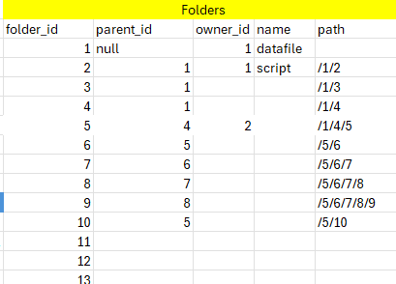
Add column path to table folder
To know what is childrent folder

Slide 32
Sample Data Share
Notes:
-- Input: UserId và FolderId
DECLARE @UserId INT = 1; -- ID của user
DECLARE @FolderId INT = 5; -- ID của folder cần kiểm tra
-- Lấy tất cả sub-folder và file trong folder
SELECT
'Folder' AS ItemType,
f.FolderId AS ItemId,
f.FolderName AS ItemName,
CASE
WHEN f.OwnerId = @UserId THEN 'Owner'
ELSE COALESCE(
(SELECT TOP 1 p.PermissionName
FROM Share s
JOIN SharedUser su ON s.ShareId = su.ShareId
JOIN Permission p ON su.PermissionId = p.PermissionId
WHERE s.ObjectId = f.FolderId AND s.ObjectTypeId = 1 -- 1 là Folder
AND su.UserId = @UserId),
'No Permission'
)
END AS Permission
FROM Folder f
WHERE f.ParentId = @FolderId
UNION ALL
SELECT
'File' AS ItemType,
uf.FileId AS ItemId,
uf.UserFileName AS ItemName,
CASE
WHEN uf.OwnerId = @UserId THEN 'Owner'
ELSE COALESCE(
(SELECT TOP 1 p.PermissionName
FROM Share s
JOIN SharedUser su ON s.ShareId = su.ShareId
JOIN Permission p ON su.PermissionId = p.PermissionId
WHERE s.ObjectId = uf.FileId AND s.ObjectTypeId = 2 -- 2 là File
AND su.UserId = @UserId),
'No Permission'
)
END AS Permission
FROM UserFile uf
WHERE uf.FolderId = @FolderId;

Slide 33
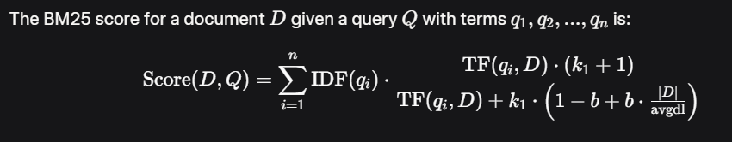
WHAT IS BM25 ?
How to score in BM25 ?

Slide 34
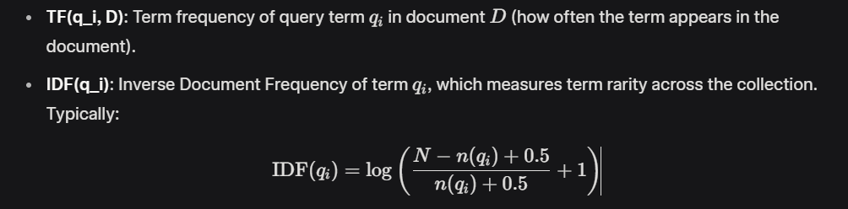
N is total number of document
n(qi) is the number of documents containing qi a.k.a df
|D| : Length of document
avgdl : Average document length in the collection

Slide 35
N is total number of document
n(qi) is the number of documents containing qi a.k.a df
|D| : Length of document
avgdl : Average document length in the collection

Slide 36
k_1: A parameter (typically 1.2 to 2.0) controlling the impact of term frequency. Higher values allow more influence from frequent terms.
b: A parameter (typically 0.75) controlling the effect of document length normalization. b=0 disables length normalization, while fully normalizes by document length.

Slide 37

HOW IT WORKS ?

Slide 38
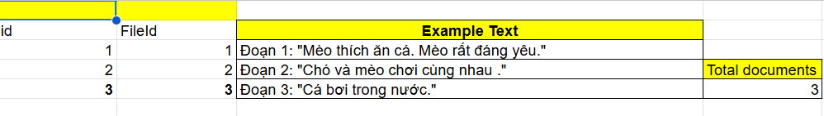
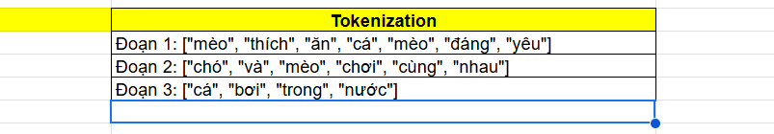
Sample Data

Slide 39
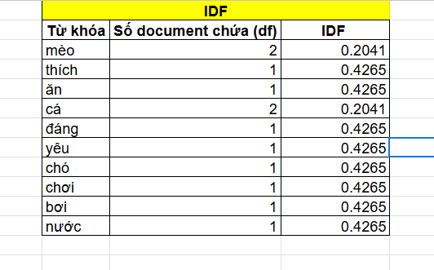

Caculate IDF ( InverseIndexFrequency)
N=3
n(qi)=df(documentfrequency)

Slide 40
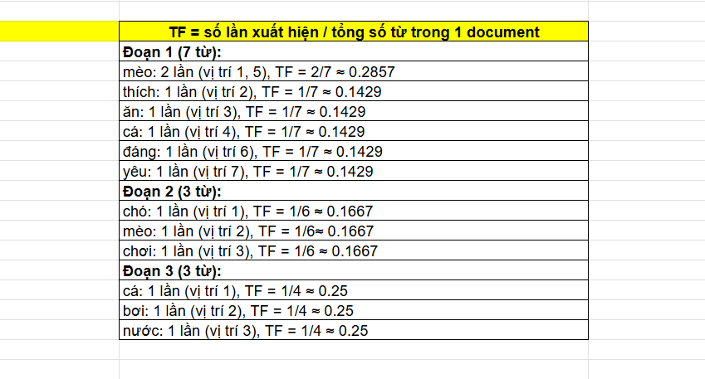
TF (TermFrequency)
Tf = ApperanceCount / |D|

Slide 41
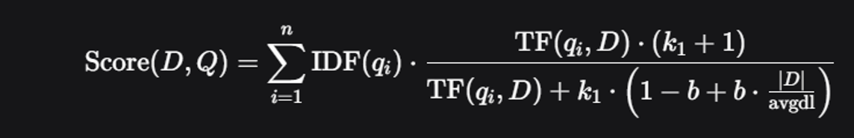
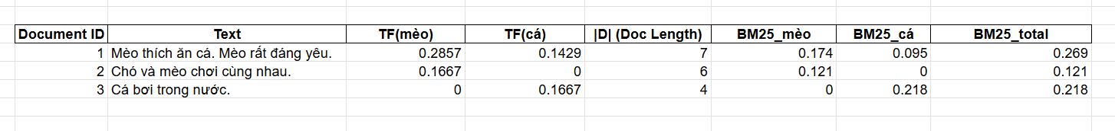
Total Score
k1=1.2
b=0.75
avgdl=5.67

Slide 42
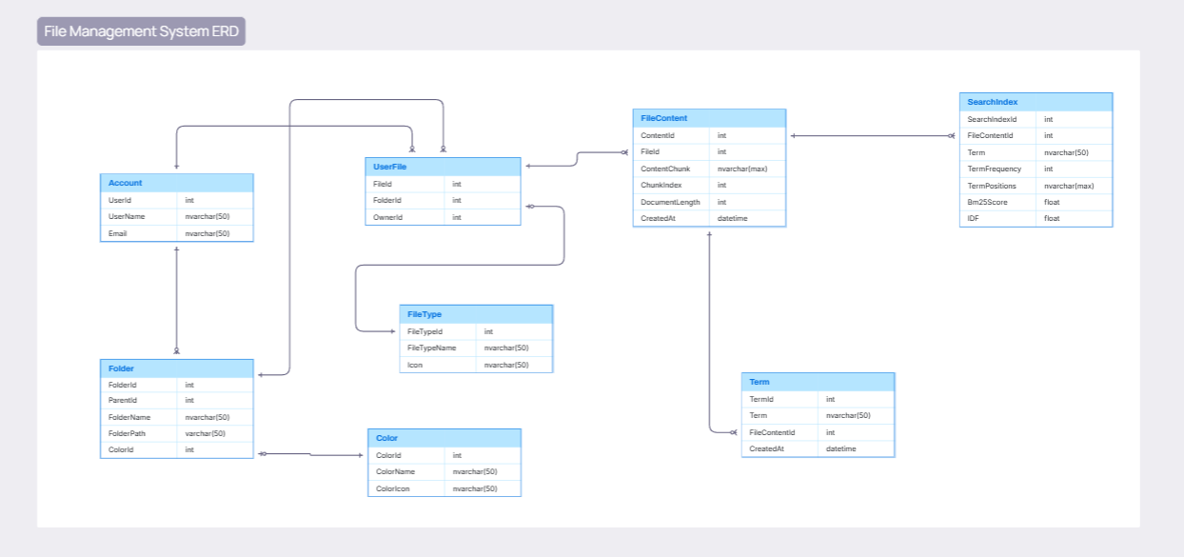
Data Structure
Notes:
Full-text search query
SELECT
uf.FileId,
uf.UserFileName,
s.Term,
s.TermFrequency,
s.TermPositions
FROM SearchIndex s
JOIN FileContent fc ON s.FileContentId = fc.ContentId
JOIN UserFile uf ON fc.FileId = uf.FileId
WHERE s.Term IN ('project', 'proposal', 'employ')
ORDER BY s.Bm25Score

