Slide 1
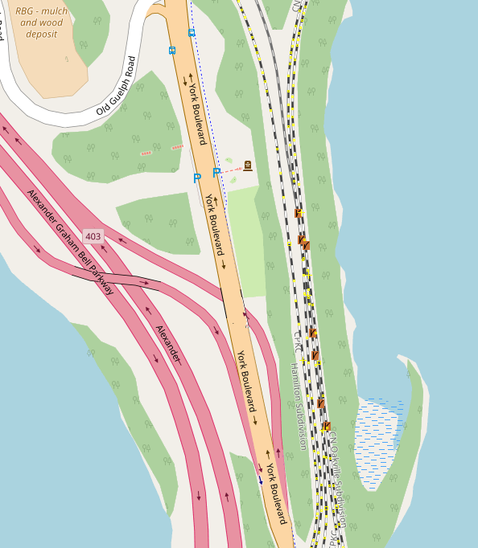
Microscopic routing graph from OSM
Simplified mesoscopic routing graph
To D
To C
To D
To C
B
B
A
A

