Slide 1
FINAL PROJECT TEMPLATE

Slide 2
THREAT SUMMARY
Summary of Situation: (Summarize the current threat situation)
3 hospitals (Hospital A , hospital B and Hospital C ) can not access their centeralized log management systems, there was a message it shown on the screen asking for a ransom to unlock the system and file recovery (decrepit files that FIN4 have it) , It start when one of the employee of Technology department opens an email attachment resource.
Asset: (What assets are being targeted?) the log management system was no longer accessible also the control system used to monitor patient state and doctor reports feature was inaccessible .
Impact: (What part of the CIA triad is being impacted?) the whole CIA triad being impacted
Threat Actor: (Identify potential threat actors) intentional external threat actors.
Intentional threat: the employee who interacted with the attachment unintentionally caused the incident.
External threat: a financially-motivated threat group called FIN4.
Threat Actor Motivation: (Share potential motivations behind the attacks) motivated by financial gain
Common Threat Actor Techniques: (Share attack methods commonly used by the threat actor.) Application Layer Protocol: Web Protocols, Proxy: Multi-hop Proxy and Phishing: Spearphishing Attachment etc.
Hint: Carefully check the ransom note for additional clues.

Slide 3
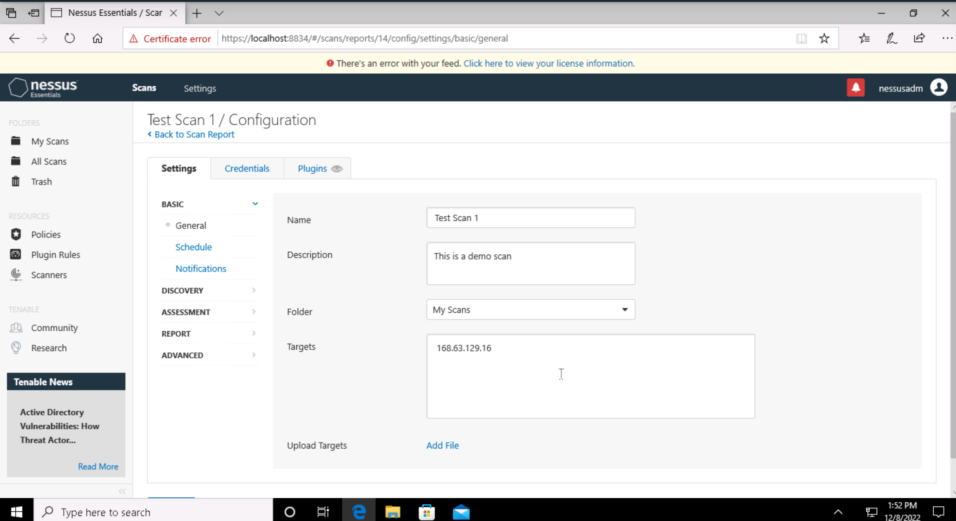
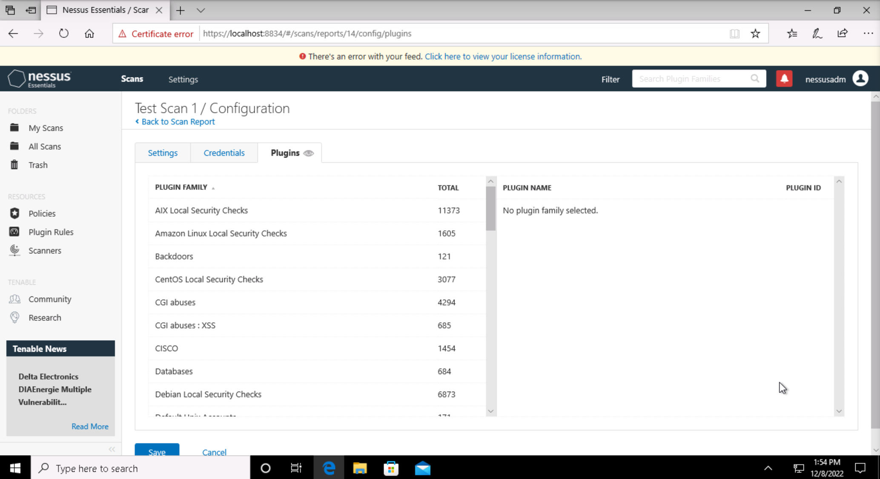
VULNERABILITY SCANNING TARGETS
Summary of scan targets:
Number of devices scanned: one device
Device type: (operating system and version) Microsoft windows 10
Primary purpose of device: (describe what the devices are used for and what kind of data might be on them) general purpose machine
(insert 2 screenshots from scan configuration window – one of the settings tab and one of the plugins tab. Be sure to click on and display a plugin group relevant to your machines operating system)

Slide 4
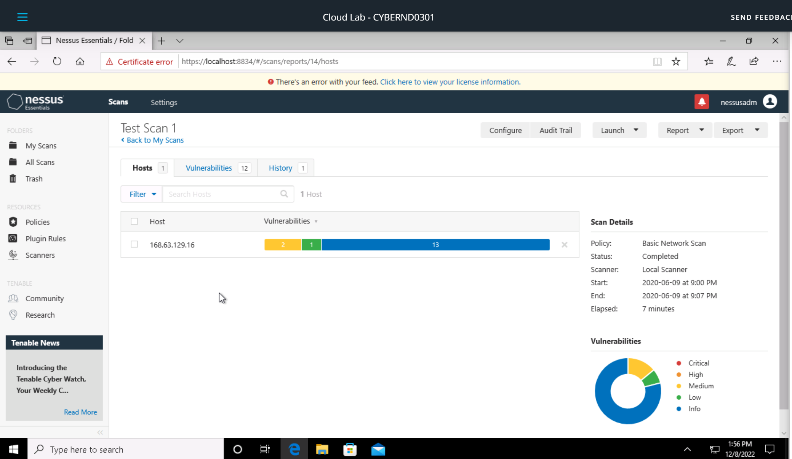
VULNERABILITY SCAN RESULTS
Summary of findings:
Total number of actionable findings: 12
Critical: 0
High: 0
Medium: 2
Low: 1
(insert screenshot from scan results dashboard)

Slide 5
REMEDIATION RECOMMENDATION
Fix within 30 days
Finding | Severity Rating | Recommended Fix
DNS server Request Amplification DDoS | medium | Restrict access to your DNS server from public network or configure it to reject such queries.
DNS cache poisoning | medium | Upgrade to the latest virion of bind.
Fix within 60 days
Prioritization Notes:
(Summarize your thought process for how you organized these here)
Finding | Severity Rating | Recommended Fix
DHCP server Detection | Low | Apply the filtering to keep this information off the network and remove any options that are not in use

Slide 6
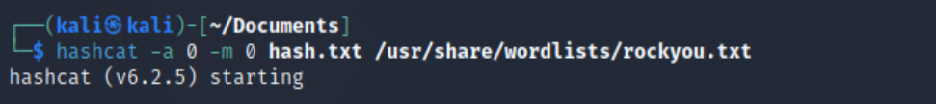
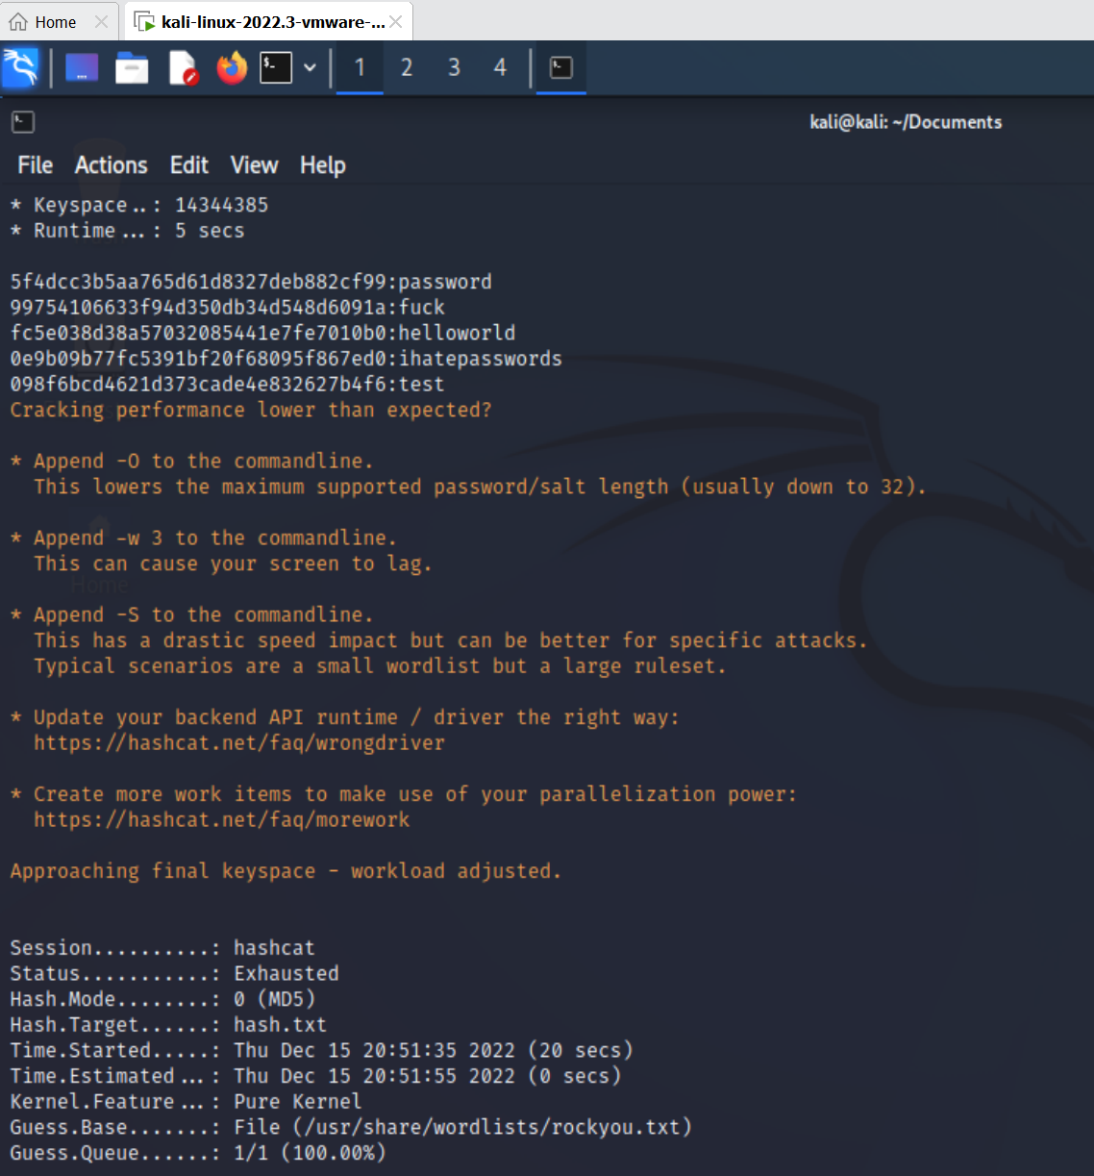
PASSWORD PENETRATION TEST OUTCOME
Methodology: (Summarize steps taken to test password security)
I used kali-linux and prepare hash file also used rockyou.txt .
Hashcat –a 0 –m 0 hash.txt /usr/share/wordlists/rockyou.txt
-a0 : means Dictionary attack
-m0 : means MD5 Algorithm
Number of passwords tested: (insert number) 41
Number of passwords cracked: (insert number) 5
Evidence of weak passwords:
Recommended steps to improve passwords security: (Summarize best practice recommendations to avoid brute force attacks in the future)
Uses a combination of symbols (@ # $ % & * - _ ) , upper&Lower case letters , Numbers and also I prefer to use phrases , make sure password length at least 10-12 , change your password Periodically ( 60 to 90 days ).

Slide 7
INCIDENT RESPONSE PRELIMINARY ASSESSMENT
Summarize ongoing incident:
What do you know so far?
The system was hit by a ransomware attack , preventing administrators , doctors and nurses from accessing the system by encrypting of all system files .
Document actions or notes from the following steps of the initial incident response checklist
Step 1: the incident was discovered by the helpdesk and end-users.
Step 2: the ransom message was the indicator of compromise, the impact that doctors cannot reach to patient reports so they cannot provide them the treatment, Name of system being targeted is(The control systems used to monitor patient stats)
Step 3: the incident was confirmed, and we can not access to the system, and it is still in progress. It is a malware (ransomware)
Step 4: human life at immediate risk
Step 6: Category one - A threat to public safety or life.
(Add another slide if needed)

Slide 8
INCIDENT RESPONSE RECOMMENDED ACTION
Summarize recommendation to contain, eradicate, and recover:
Describe the overall recommended containment, eradication, and recovery plan
Starting by isolating the affected system because if they are in the same network will explore other system
Delete the system and recover from backup system and restore the update which is missing that allow the attack happened .
Finally document all steps and lessons to better respond in future.
Documented actions and notes from the IR checklist
Step 7: (Tip: Select procedures you’d recommend for this type of incident) procedure that should the IR team follow is Malware response procedure
Step 8: ensuring business continuity by preparing temporary procedures may use digital forensic techniques, including reviewing system logs, checking computer activity
Step 9:Re-install the affected system(s) from scratch and restore data from backups if necessary.
Step 12: Document all steps and lessons to better respond in futures.
(Add another slide if needed)

