Slide 1

The Traveling Salesman Problem (TSP) is an optimization issue that involves finding the shortest route that visits each city once and returns to the starting point. This project will compare classical and quantum-inspired methods for tackling TSP based on feas.
Decision-ready project briefing
Focus: compare classical and quantum-inspired TSP approaches with transparent trade-offs.
Outcome: align implementation scope, evidence, and next decisions for delivery.

Slide 2

Agenda and Scope Decisions
1. Executive Summary
2. Current Context
3. Scope and Delivery Focus

Slide 3

Executive Summary
The Project stage aligns validated context into a coherent, delivery-ready project report.
This cycle aims to ensure that at least one thematic epic can be derived from aggregated context

Slide 4

The Traveling Salesman Problem (TSP) is an optimization issue that involves finding the shortest
Quantum vs Classical Approaches to the Traveling Salesman Problem (TSP).
Current Context

Slide 5
Goals:
Scope boundaries:
In Scope
The Traveling Salesman Problem (TSP) is an optimization issue that involves finding the shortest
Quantum vs Classical Approaches to the Traveling Salesman Problem (TSP)
Given a set of cities and distances between them, find the shortest possible route that visits e
Out of Scope
Exclude assumptions without supporting evidence.
Scope and Delivery Focus

Slide 6
Constraints:
Readiness summary:
Open questions:
none
Constraints, Risks, and Next Step

Slide 7













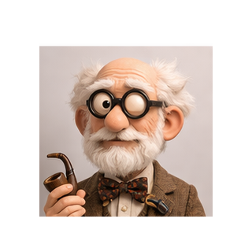
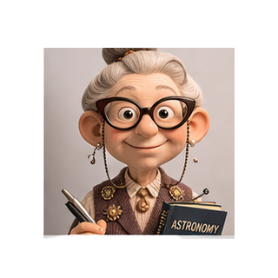





Our Team
Agile Coach
AI Expert
Container Expert
Data Scientist
Fullstack Engineer
Kubernetes Expert
MCP Expert
Platform Architect
Pull Request Reviewer
Quality Expert
Quantum Expert
Security Expert
User Standard
UX Designer

Slide 8

Thank You and Next Decision
Next step: confirm owners, close blockers, and approve the next delivery checkpoint status.

Slide 9
BACKUP
Template source slides below — for reference only

Slide 10
python-runtime
Repository: digital-generic-team

Slide 11
Agenda
•
1. Context and Objectives
•
2. Solution Overview
•
3. Next Steps and Decisions

Slide 12
01
Chapter Title

Slide 13
Section Title
Replace this with your slide content.

Slide 14
Our Team
Agile Coach
AI Expert
Container Expert
Data Scientist
Fullstack Engineer
Kubernetes Expert
MCP Expert
Platform Architect
Pull Request Reviewer
Quality Expert
Quantum Expert
Security Expert
User Standard
UX Designer

Slide 15
Thank You
Questions? Let's talk.

Slide 16

Schema
Dark Navy
Deep Blue
Teal
Sky Blue
Navy
Green Teal
Typography Specification (Live Samples)
Aptos Display Bold 34 pt | Enterprise Presentation Title
Aptos SemiBold 22 pt | Agenda, chapter and key section headings
Aptos Regular 16 pt | Body text and explanatory content
Fallback for compatibility: Calibri (Office default fallback)

