Slide 1

How algorithms modify the world
Or: why engagement scores are bad

Slide 2
RQ1

Slide 3
What counts?
Raw engagement
Machine Learning
Real-Time Aggregations

Slide 4
Ranking Process
Collect Data
Select Candidates
Machine Learning Stage
Deduplication
Add Adds and other ”un-fun” things

Slide 5
RQ2

Slide 6
Where is Grok?
Classification
Scoring

Slide 7

System Risks

Slide 8
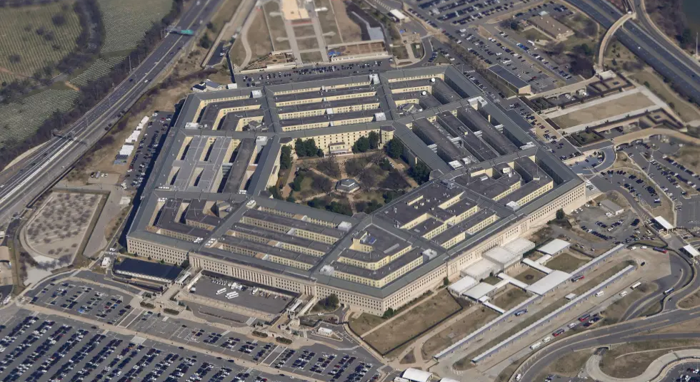


Slide 9


Slide 10

Result?
0.3% Drop in S&P 500
Which was around $111 billion
https://ycharts.com/indicators/sp_500_market_cap

Slide 11
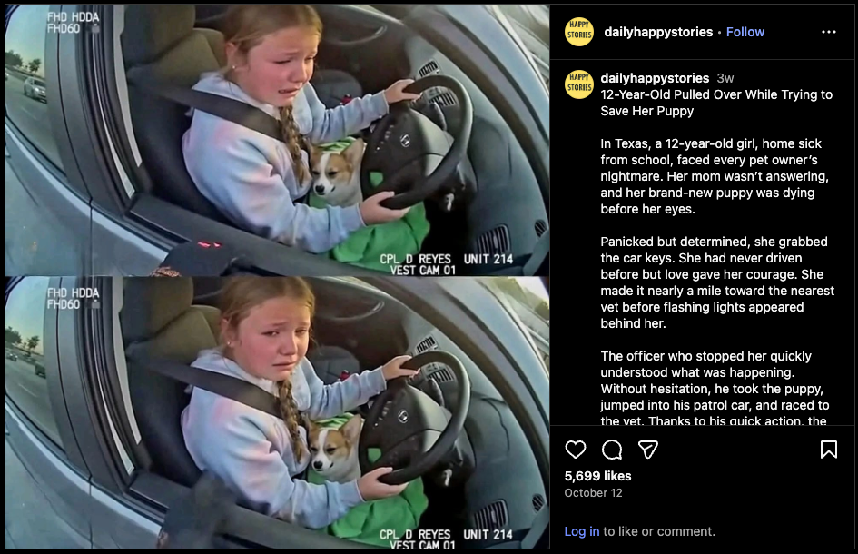

Slide 12
The possibilities
Create a run to buy basic goods
Manipulate media
Manipulate political views

Slide 13

Personal Opinion
https://www.youtube.com/watch?v=_zfN9wnPvU0
(Kurzgesagt “AI Slop Is Destroying The Internet”)

Slide 14
