Slide 1
Rethinking the Application of Technology in Hypertension Control
By Eric Buehler

Slide 2
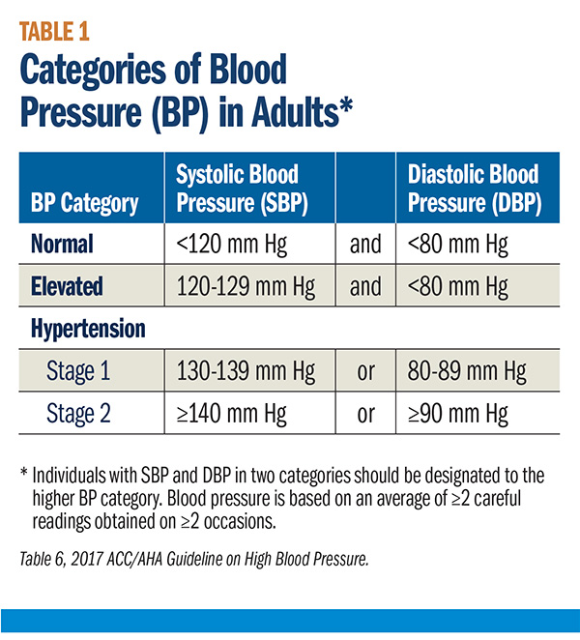
Motivation
Why care about hypertension/high blood pressure?
High blood pressure is an important risk factors for morbidity.
Uncontrolled hypertension causes hundreds of thousands of deaths each year.

Slide 3
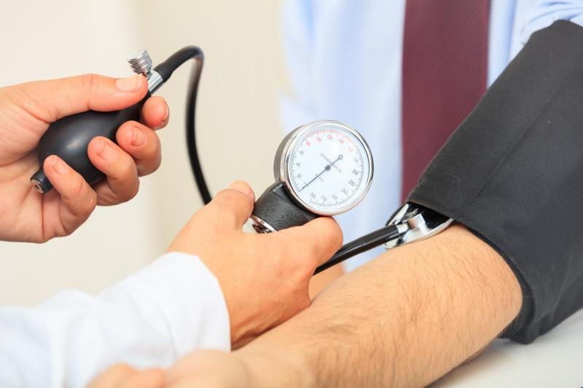
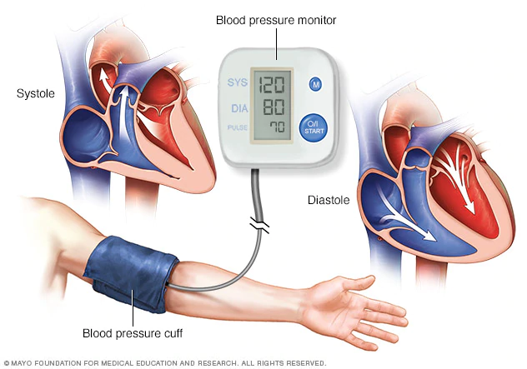
…Unfortunately
Litany of measurement errors.
Human Errors
Instrument Errors
Electronic Instruments

Slide 4

…And
New approaches
largely tailored towards privileged group.
Expensive Tech
High Efficacy

Slide 5
So what?
We need to think about how technology can serve larger audiences.
Proposal: Use machine learning to build a tool that predicts whether an observed blood pressure is due to measurement error.

Slide 6
Steps
Step 1: Predict a Blood Pressure
Step 2: Compare an Observed Blood Pressure to the Predicted (Outlier Prediction)
Step 3: Design the Tool

Slide 7
Data: National Health and Nutrition Examination Survey (NHANES)
Program of studies designed to assess the health and nutritional status of adults in the United States.
Cohort study on a bi-yearly basis since 1999.

Slide 8
Prediction

Slide 9
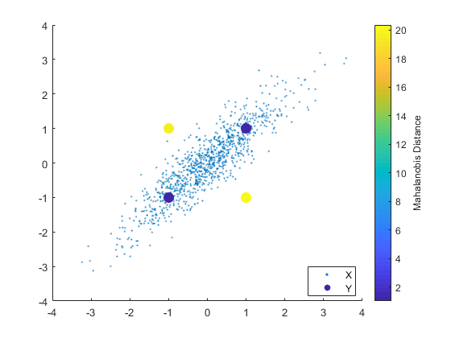
Prediction: Comparison

Slide 10
Prediction: Model Selection
 | Diastolic RMSE | Systolic RMSE | Mean Mahalanobis
Linear Model | 9.69 | 13.28 | 10.04
Linear Model w/ Clustering | 9.65 | 13.31 | 9.73
Decision Trees | 9.92 | 13.28 | 10.75
Random Forest | 5.33 | 7.64 | 6.5

Slide 11
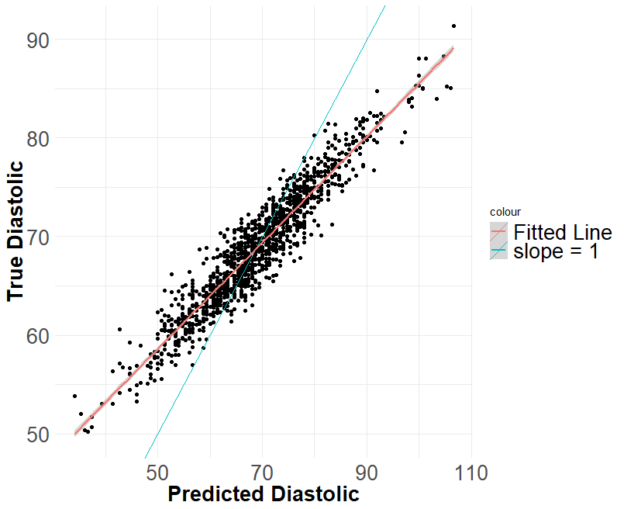
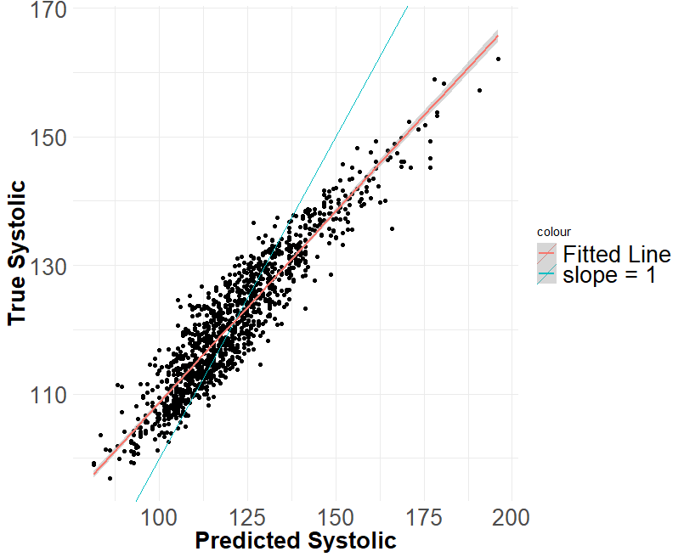
Prediction: Fit

Slide 12
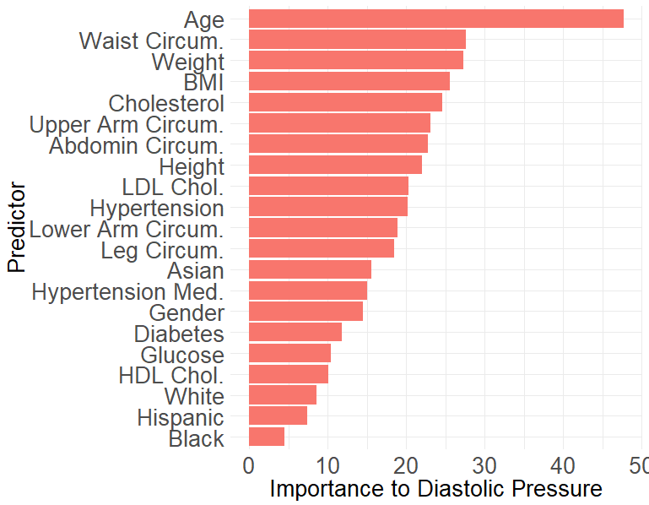
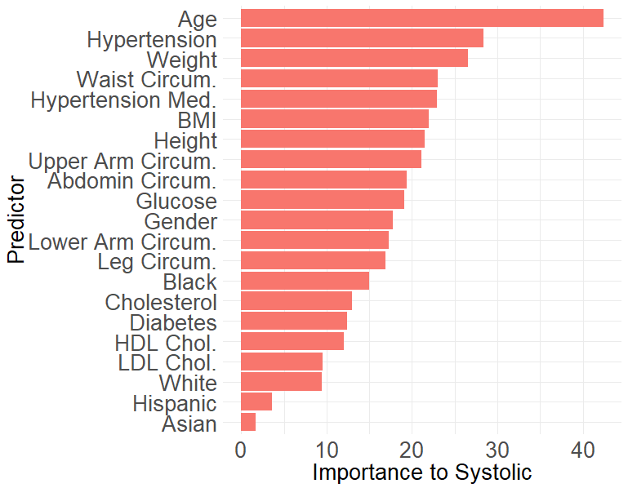
Prediction: Random Forest

Slide 13
Outlier Detection

Slide 14
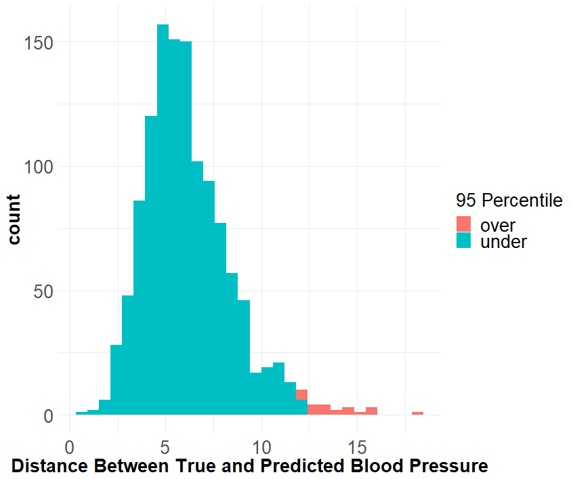
Outlier Detection: A Cut-off

Slide 15
App Interface

Slide 16
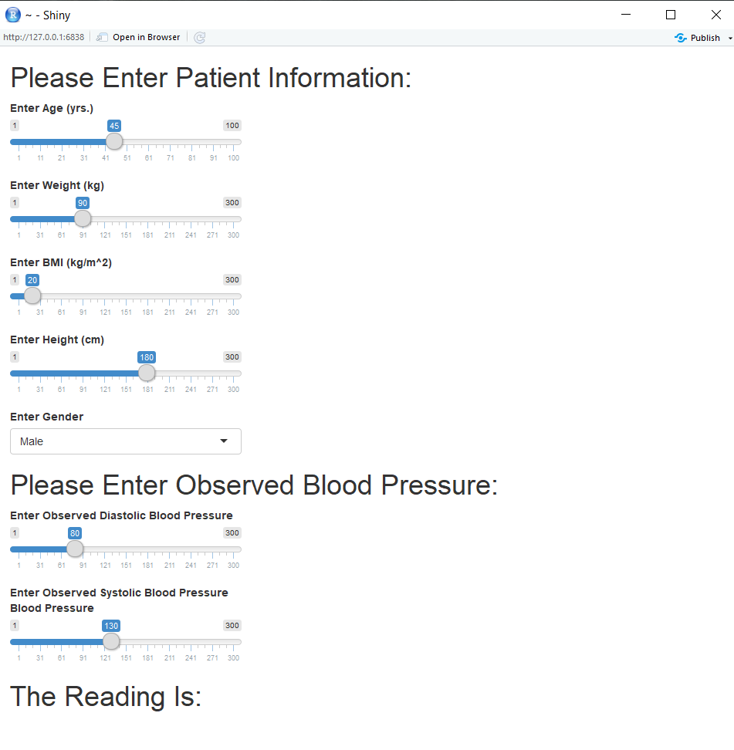

Slide 17
Discussion
Is it feasible in practice?
Proof of concept for how we might re-think application of technology to problems in public health.

Slide 18
Work cited
Angell, S. Y., De Cock, K. M., & Frieden, T. R. (2015). A public health approach to global management of hypertension. The Lancet, 385(9970), 825-827.
Olsen, M. H., Angell, S. Y., Asma, S., Boutouyrie, P., Burger, D., Chirinos, J. A., ... & López-Jaramillo, P. (2016). A call to action and a lifecourse strategy to address the global burden of raised blood pressure on current and future generations: the Lancet Commission on hypertension. The Lancet, 388(10060), 2665-2712.
Whelton, P. K., Carey, R. M., Aronow, W. S., Casey, D. E., Collins, K. J., Himmelfarb, C. D., ... & MacLaughlin, E. J. (2018). 2017 ACC/AHA/AAPA/ABC/ACPM/AGS/APhA/ASH/ASPC/NMA/PCNA guideline for the prevention, detection, evaluation, and management of high blood pressure in adults: a report of the American College of Cardiology/American Heart Association Task Force on Clinical Practice Guidelines. Journal of the American College of Cardiology, 71(19), e127-e248.
Harris, J. K., Beatty, K., Leider, J. P., Knudson, A., Anderson, B. L., & Meit, M. (2016). The double disparity facing rural local health departments. Annual review of public health, 37, 167-184.
Golino, H. F., Amaral, L. S. D. B., Duarte, S. F. P., Gomes, C. M. A., Soares, T. D. J., Reis, L. A. D., & Santos, J. (2014). Predicting increased blood pressure using machine learning. Journal of obesity, 2014.
Centers for Disease Control and Prevention (CDC). (2019). National Health and Nutrition Examination Survey Questionnaire (NHANES). U.S. Department of Health and Human Services, Centers for Disease Control and Prevention. https://wwwn.cdc.gov/nchs/nhanes/Default.aspx.
https://www.getqardio.com/healthy-heart-blog/monitoring-blood-pressure-home/ (2019).
https://today.mims.com/the-role-of-blood-pressure-devices-measurement-accuracy (2019).
https://www.mayoclinic.org/diseases-conditions/high-blood-pressure/diagnosis-treatment/drc-20373417 (2019).
https://www.mathworks.com/help/stats/mahal.html (2019).

