Slide 1
Machine Learning in Hypertension control
By Eric Buehler (larger fonts)

Slide 2
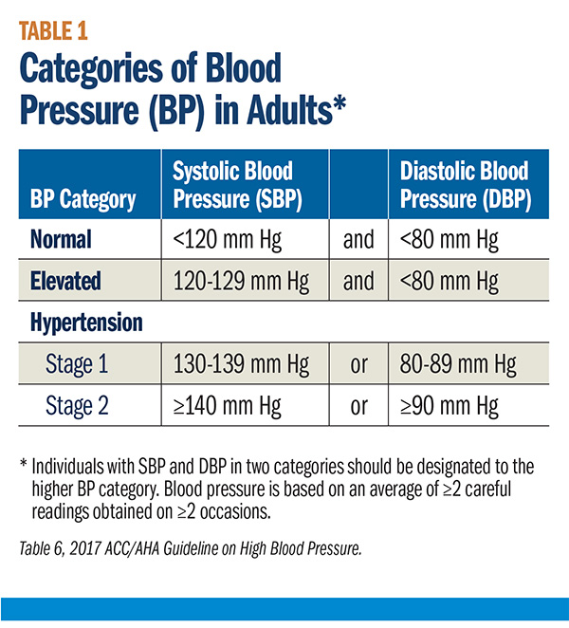
Motivation
Why care about hypertension/high blood pressure?
High blood pressure is an important risk factors for morbidity.
Uncontrolled hypertension causes hundreds of thousands of deaths each year.

Slide 3
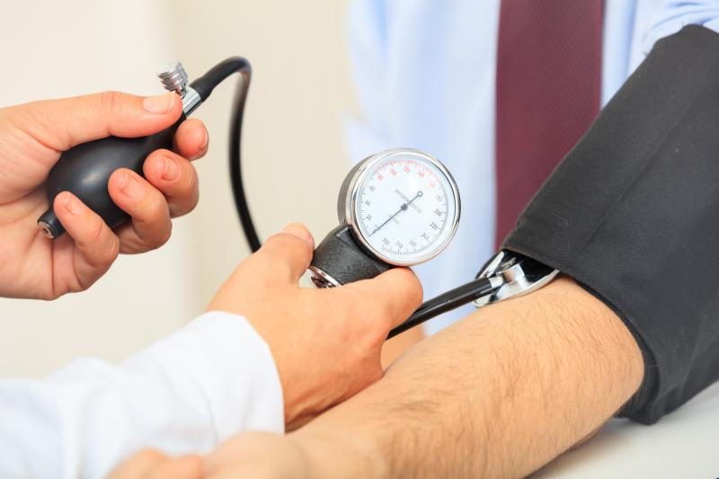
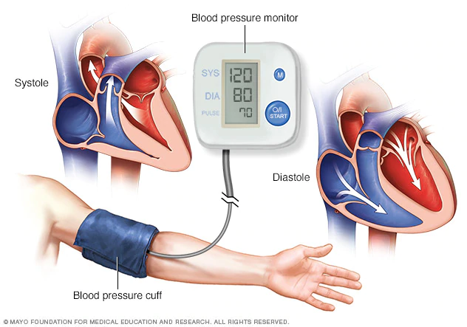
…Unfortunately
Litany of measurement devices and calibration issues.
Electronic devices

Slide 4

…And
New approaches
largely tailored towards privileged group.
Rely on error prone devices.

Slide 5
So what?
There is a need for tool that can detect outliers in blood pressure measurements due calibration issues that is accessible in variety of health settings.
Proposal: Use machine learning to predict a baseline blood pressure that can be used to detect if an observed blood pressure is a result to calibration issues.

Slide 6
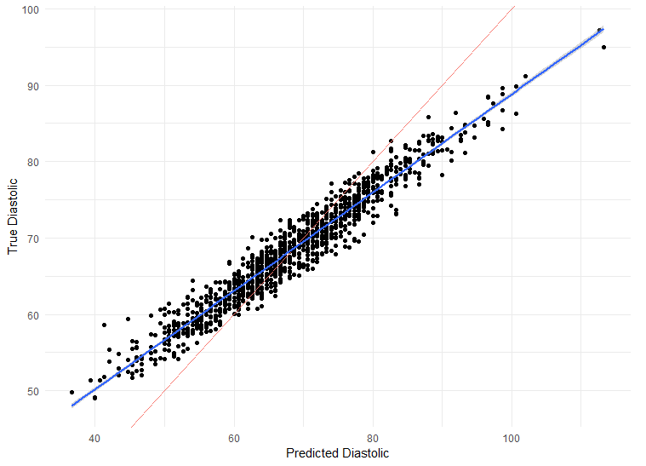
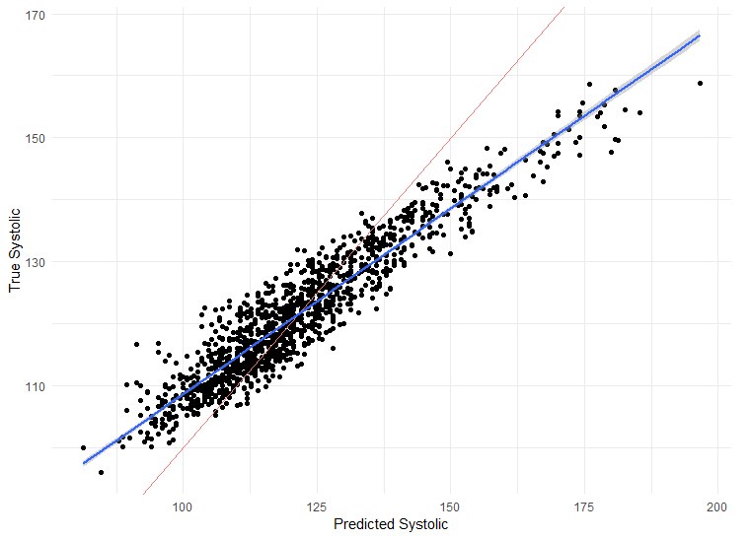
Results
Using NHANES, the fit produced by random forest is good.
On average only off by 5 mmHg.

Slide 7
Discussion
Is it feasible in practice?
Proof of concept for how we might re-think application of technology to problems in public health.

Slide 8
Work cited
Angell, S. Y., De Cock, K. M., & Frieden, T. R. (2015). A public health approach to global management of hypertension. The Lancet, 385(9970), 825-827.
Whelton, P. K., Carey, R. M., Aronow, W. S., Casey, D. E., Collins, K. J., Himmelfarb, C. D., ... & MacLaughlin, E. J. (2018). 2017 ACC/AHA/AAPA/ABC/ACPM/AGS/APhA/ASH/ASPC/NMA/PCNA guideline for the prevention, detection, evaluation, and management of high blood pressure in adults: a report of the American College of Cardiology/American Heart Association Task Force on Clinical Practice Guidelines. Journal of the American College of Cardiology, 71(19), e127-e248.
Harris, J. K., Beatty, K., Leider, J. P., Knudson, A., Anderson, B. L., & Meit, M. (2016). The double disparity facing rural local health departments. Annual review of public health, 37, 167-184.
Golino, H. F., Amaral, L. S. D. B., Duarte, S. F. P., Gomes, C. M. A., Soares, T. D. J., Reis, L. A. D., & Santos, J. (2014). Predicting increased blood pressure using machine learning. Journal of obesity, 2014.
Centers for Disease Control and Prevention (CDC). (2019). National Health and Nutrition Examination Survey Questionnaire (NHANES). U.S. Department of Health and Human Services, Centers for Disease Control and Prevention. https://wwwn.cdc.gov/nchs/nhanes/Default.aspx.
https://www.getqardio.com/healthy-heart-blog/monitoring-blood-pressure-home/ (2019).
https://today.mims.com/the-role-of-blood-pressure-devices-measurement-accuracy (2019).
https://www.mayoclinic.org/diseases-conditions/high-blood-pressure/diagnosis-treatment/drc-20373417 (2019).

