Slide 1

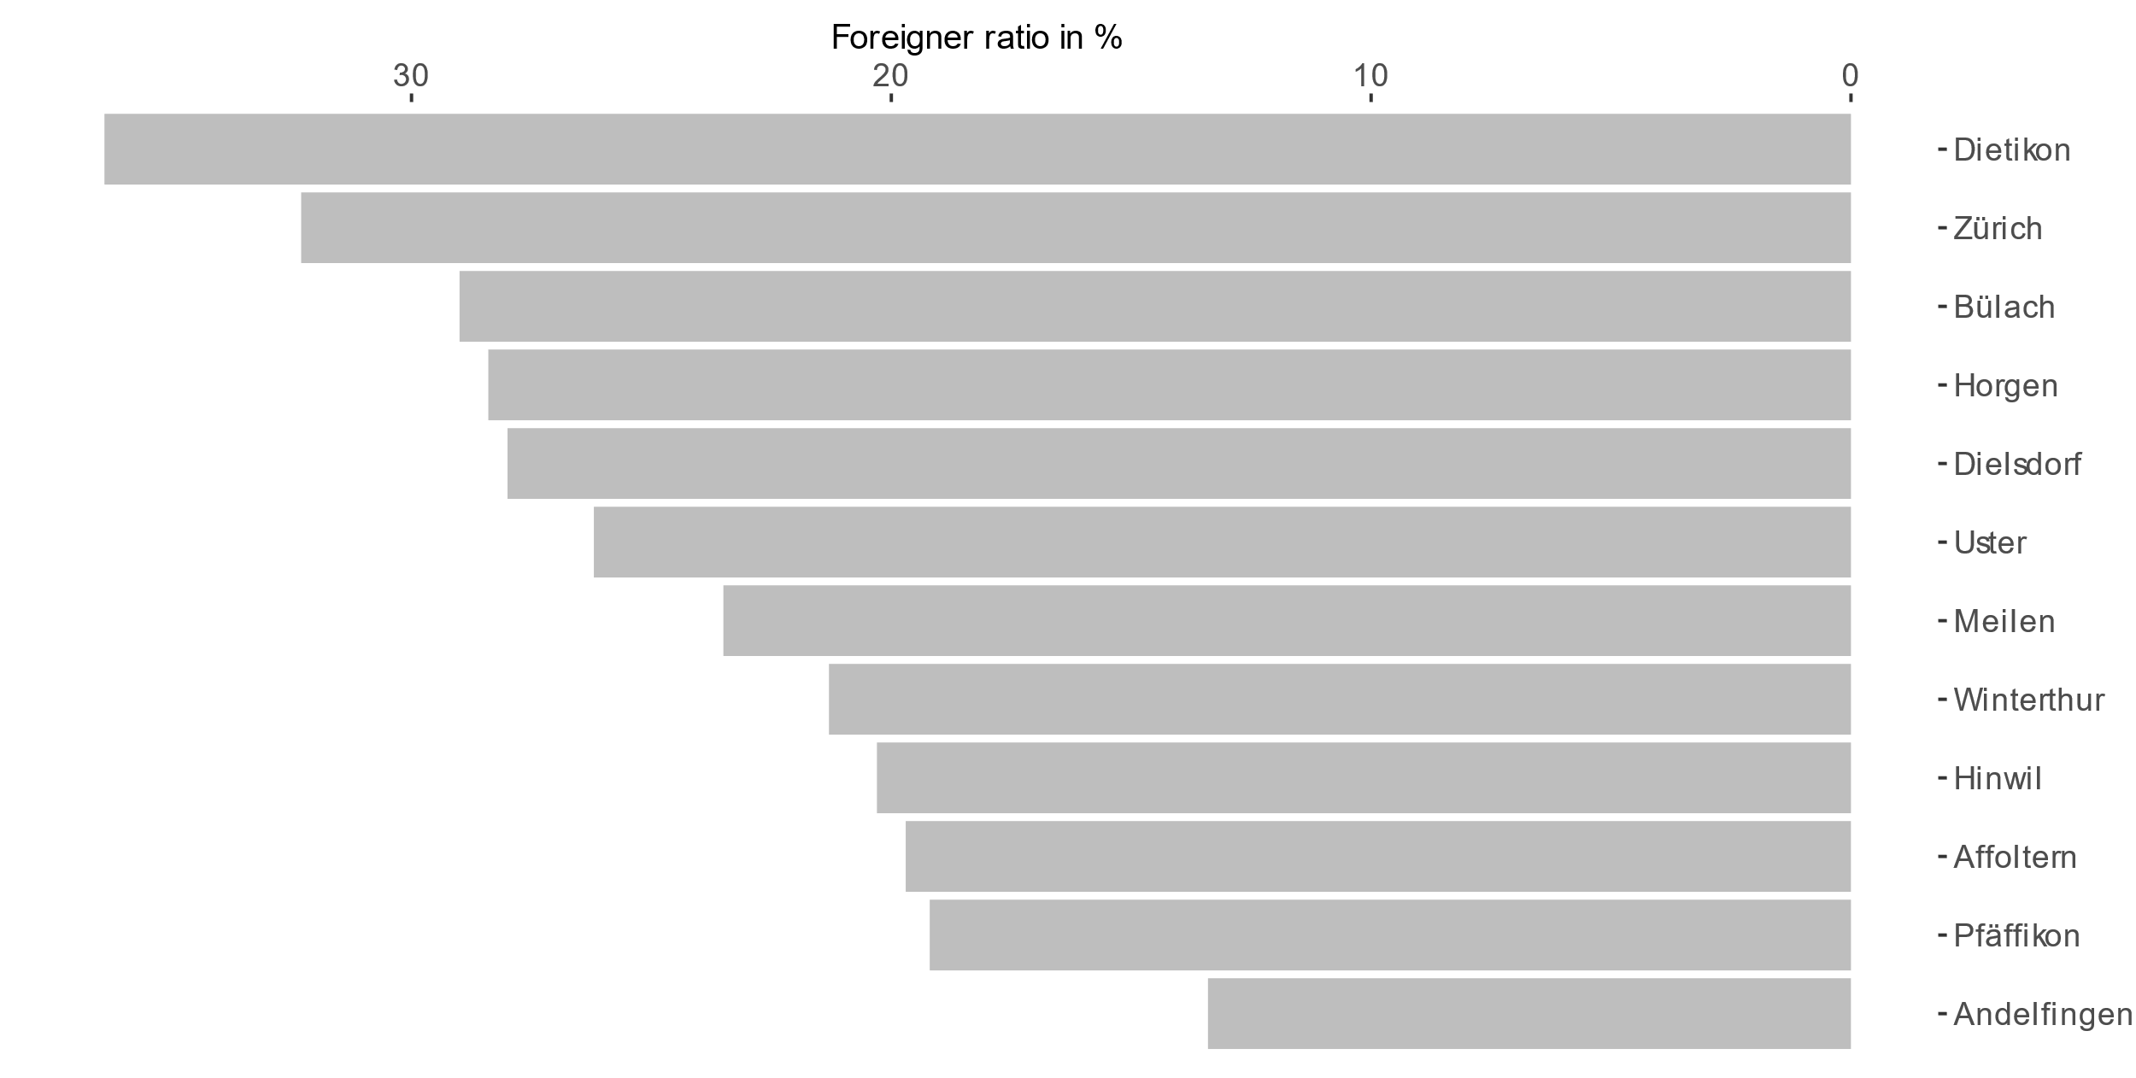
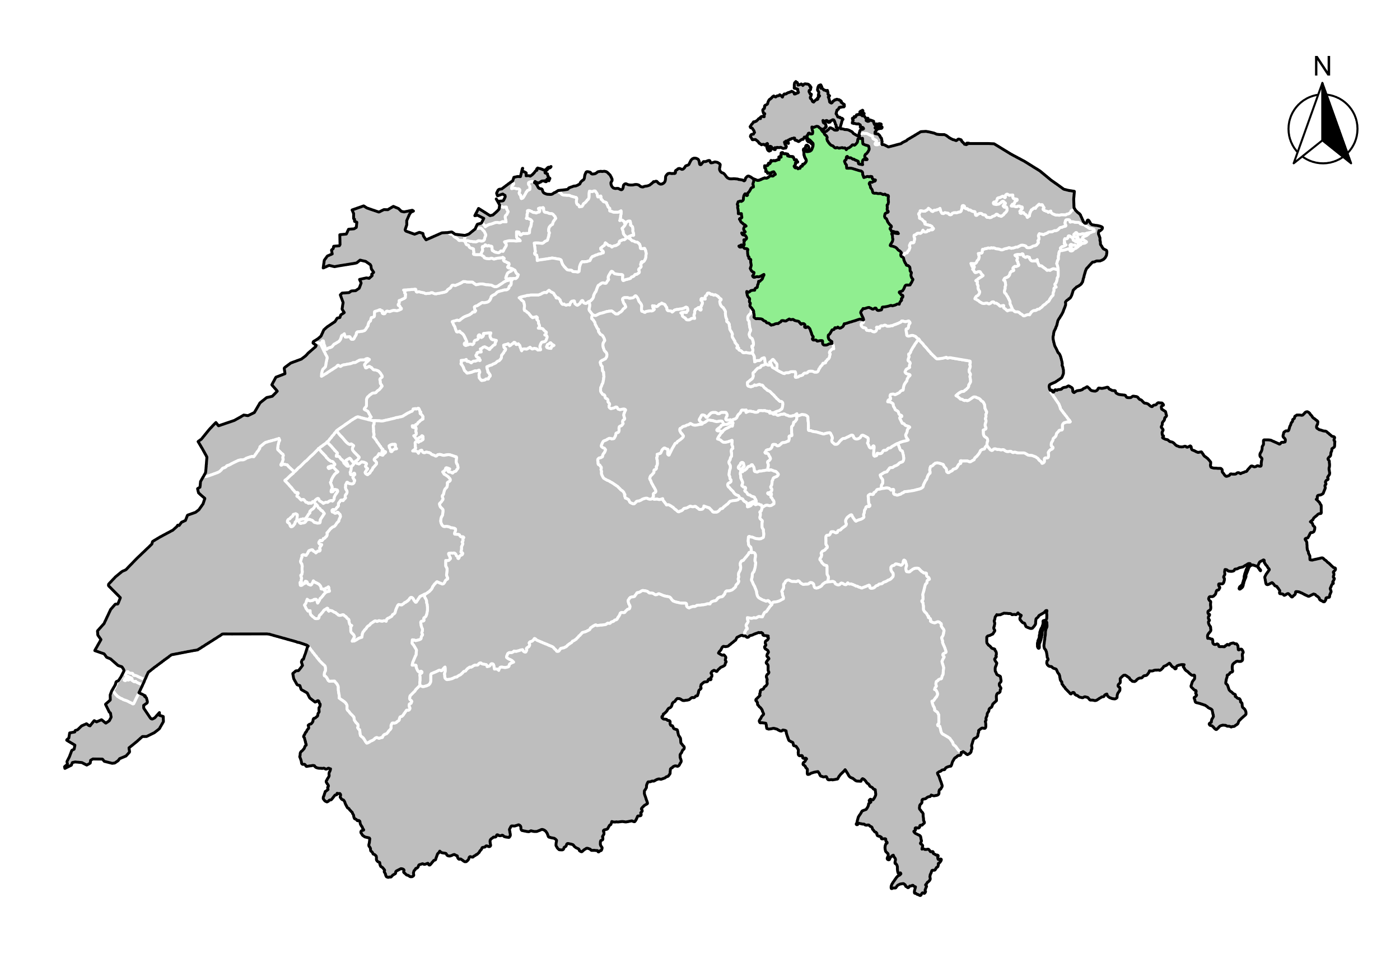
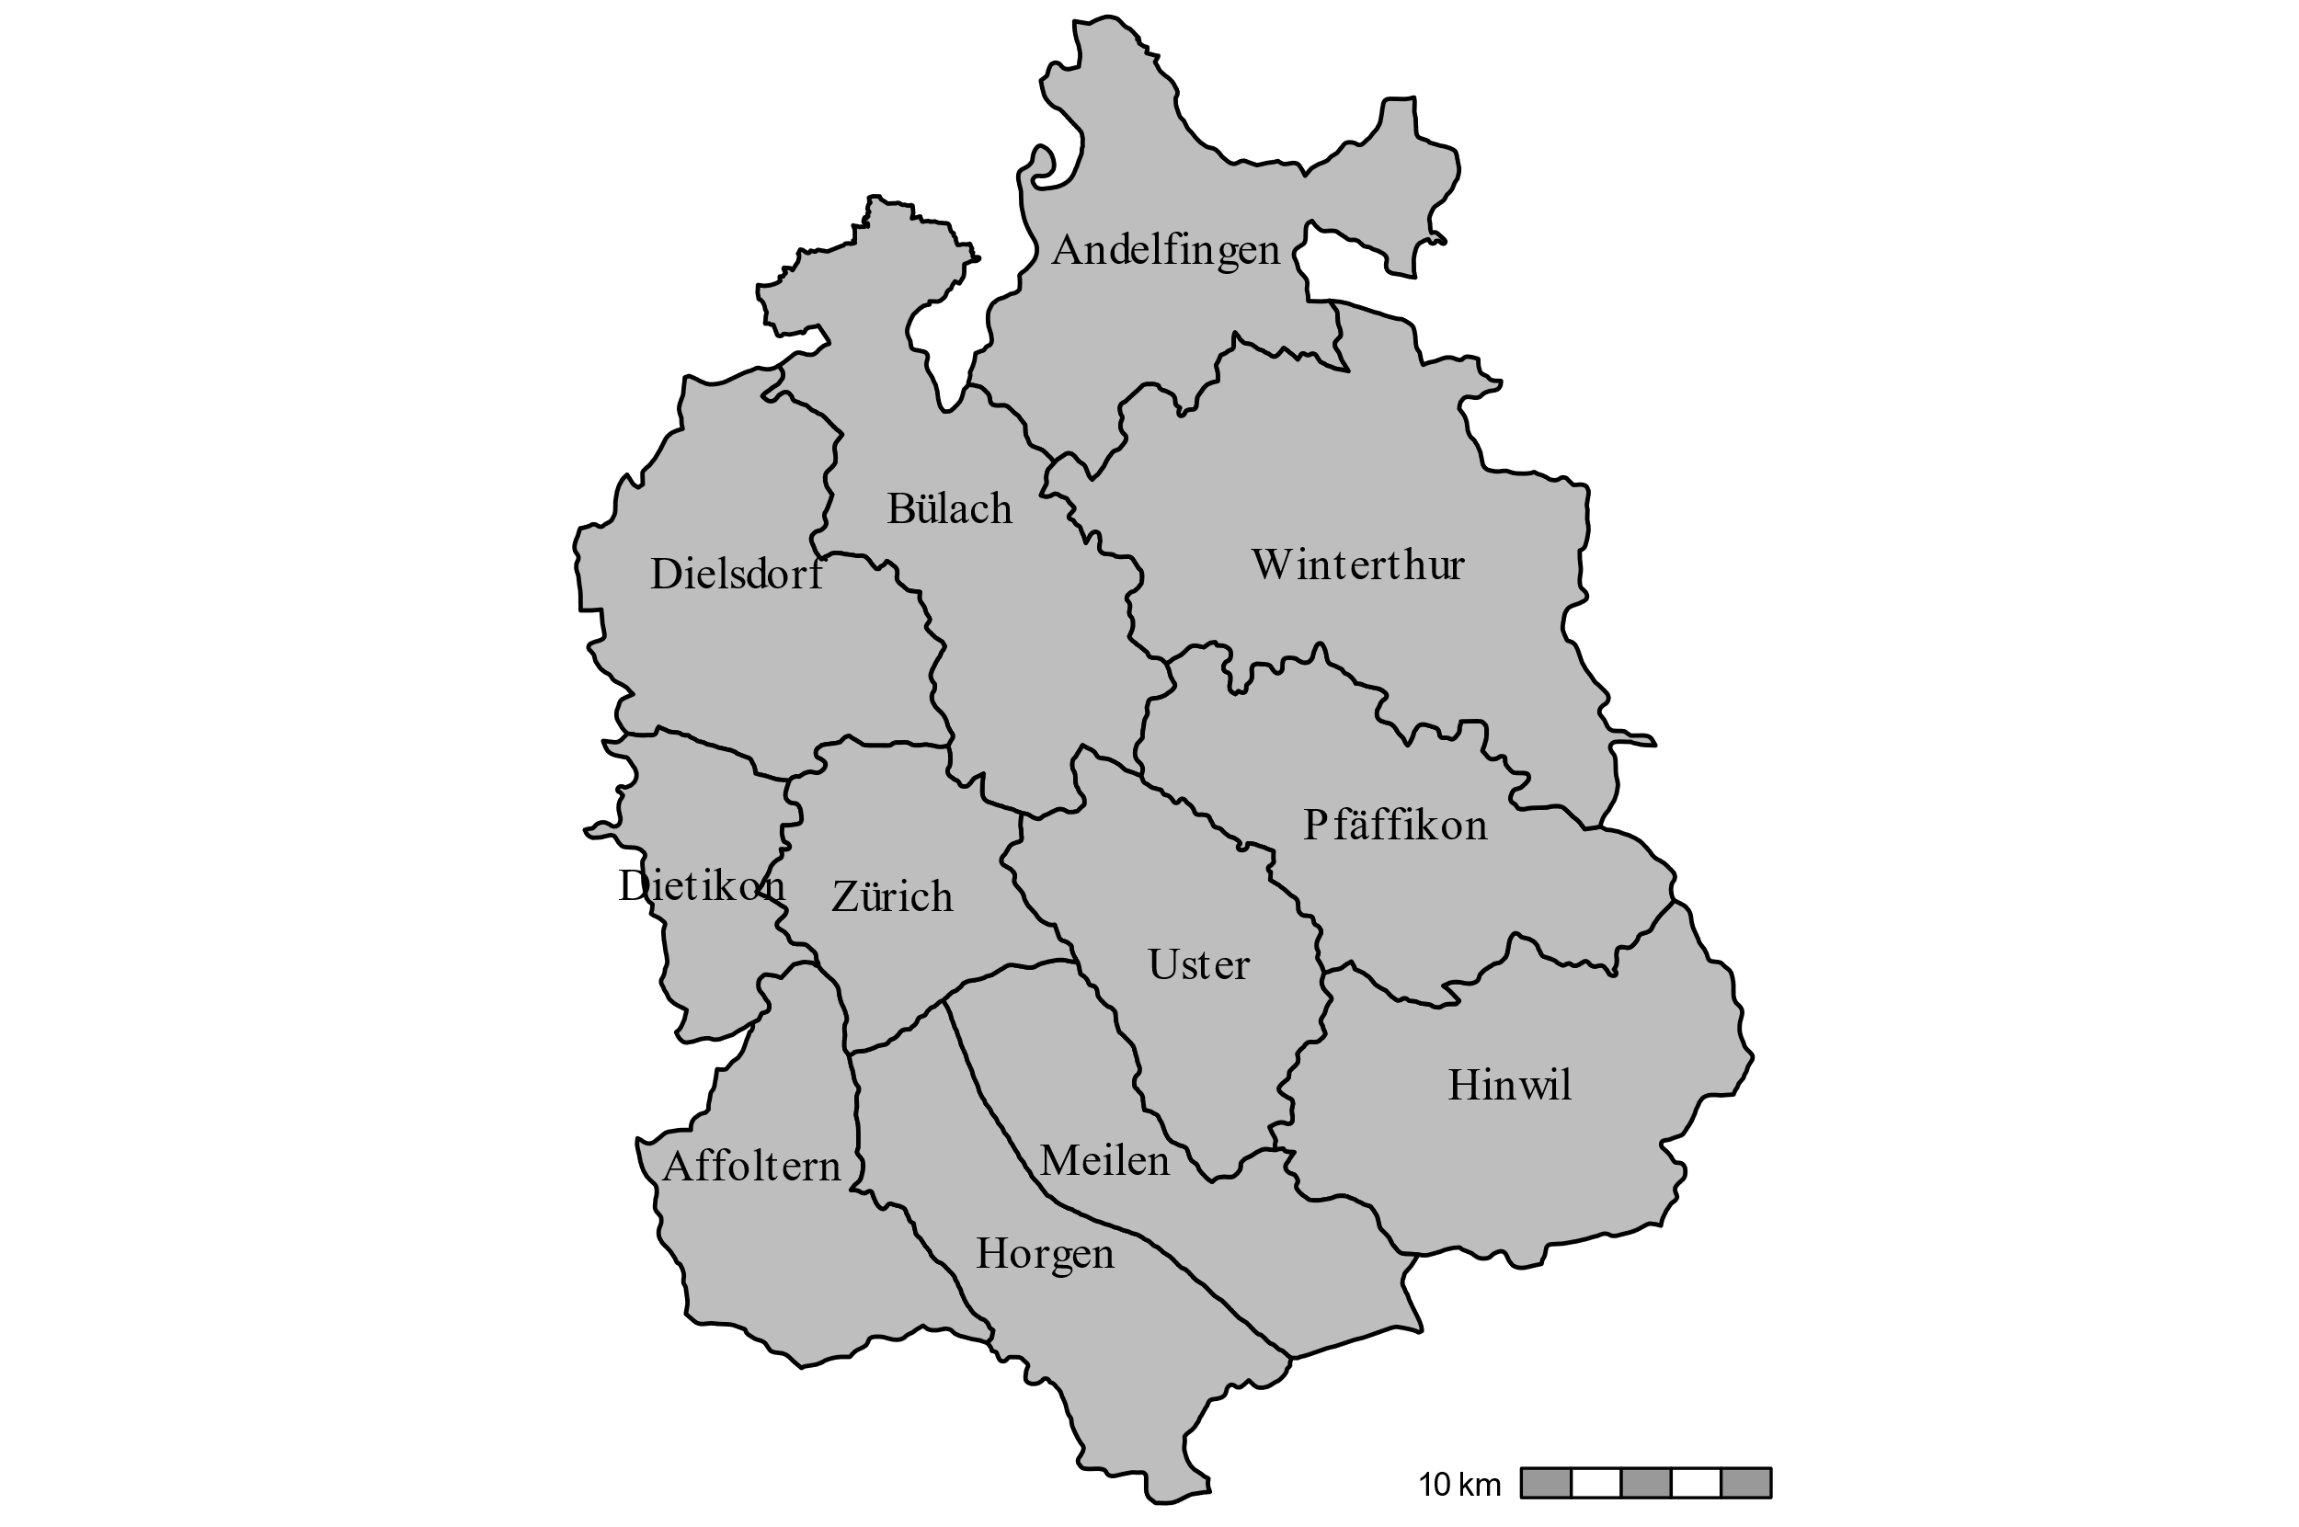
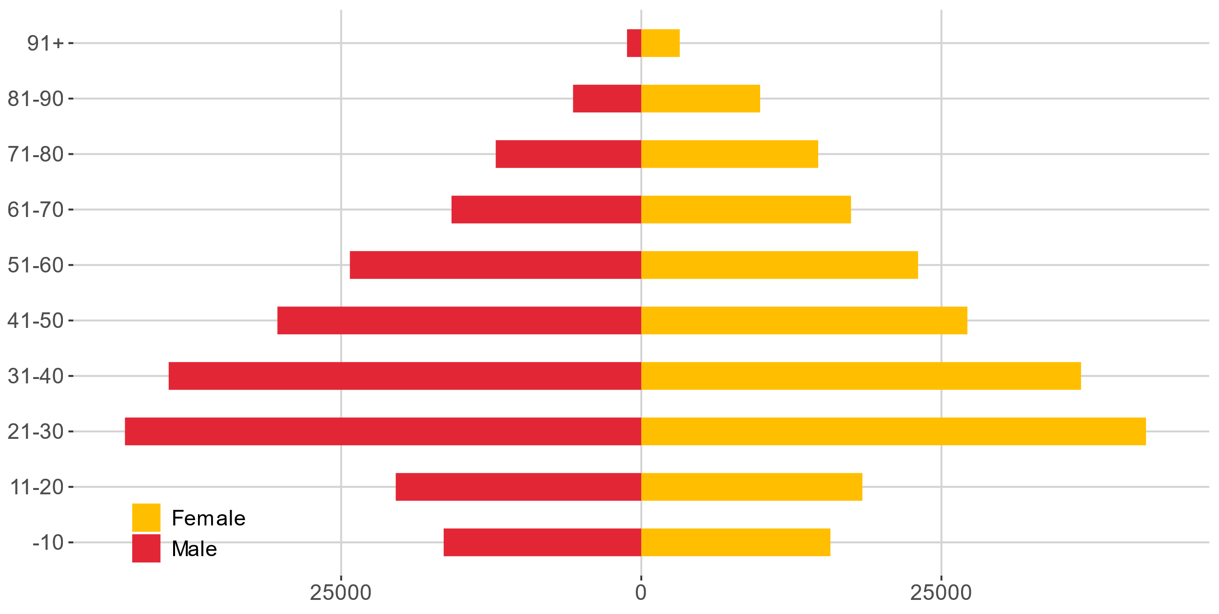
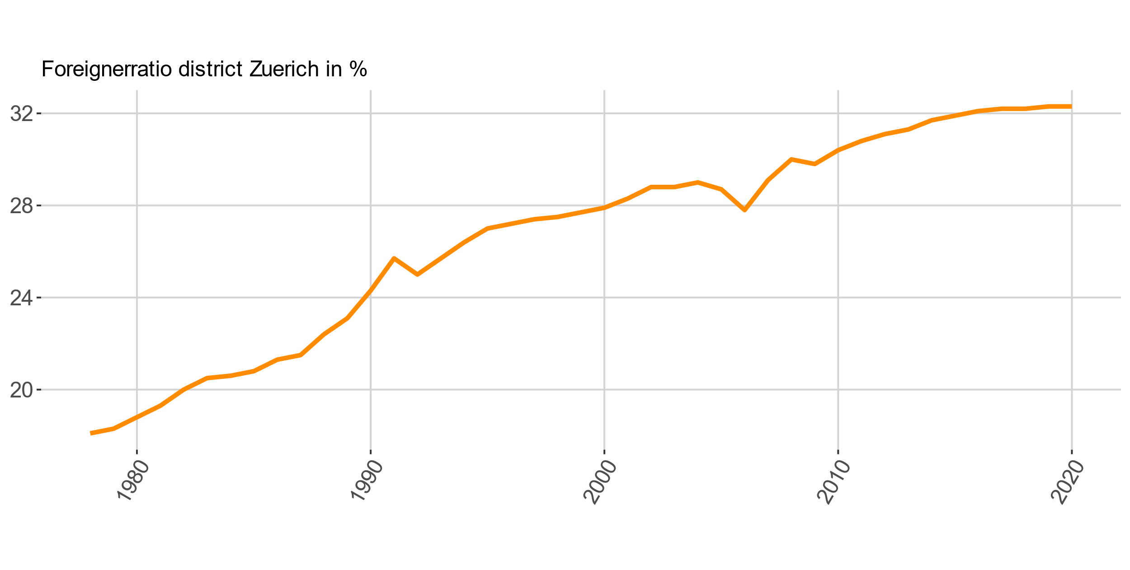
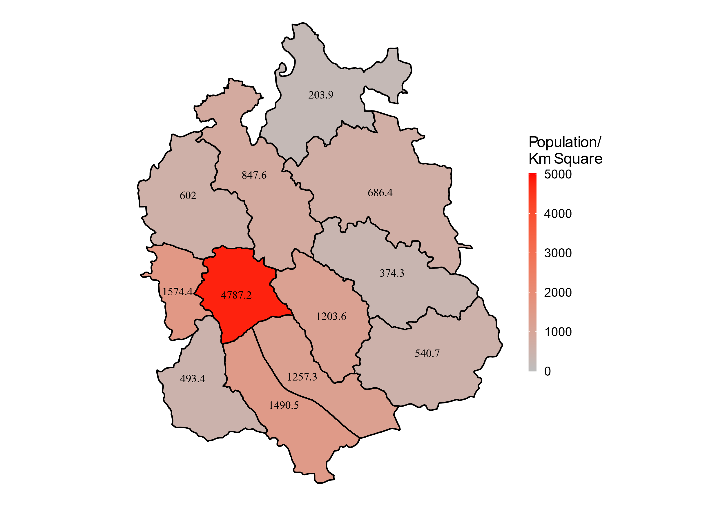
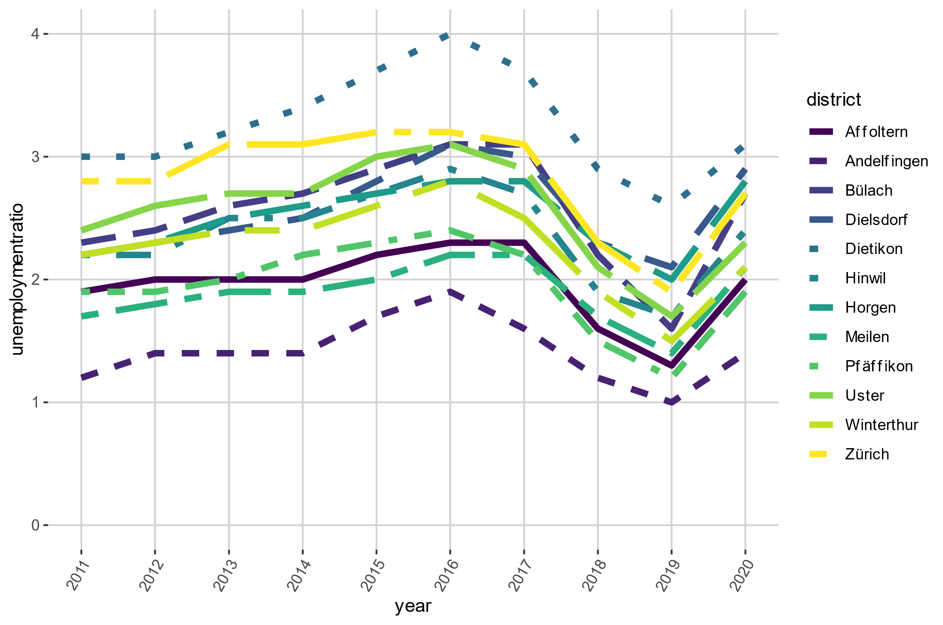
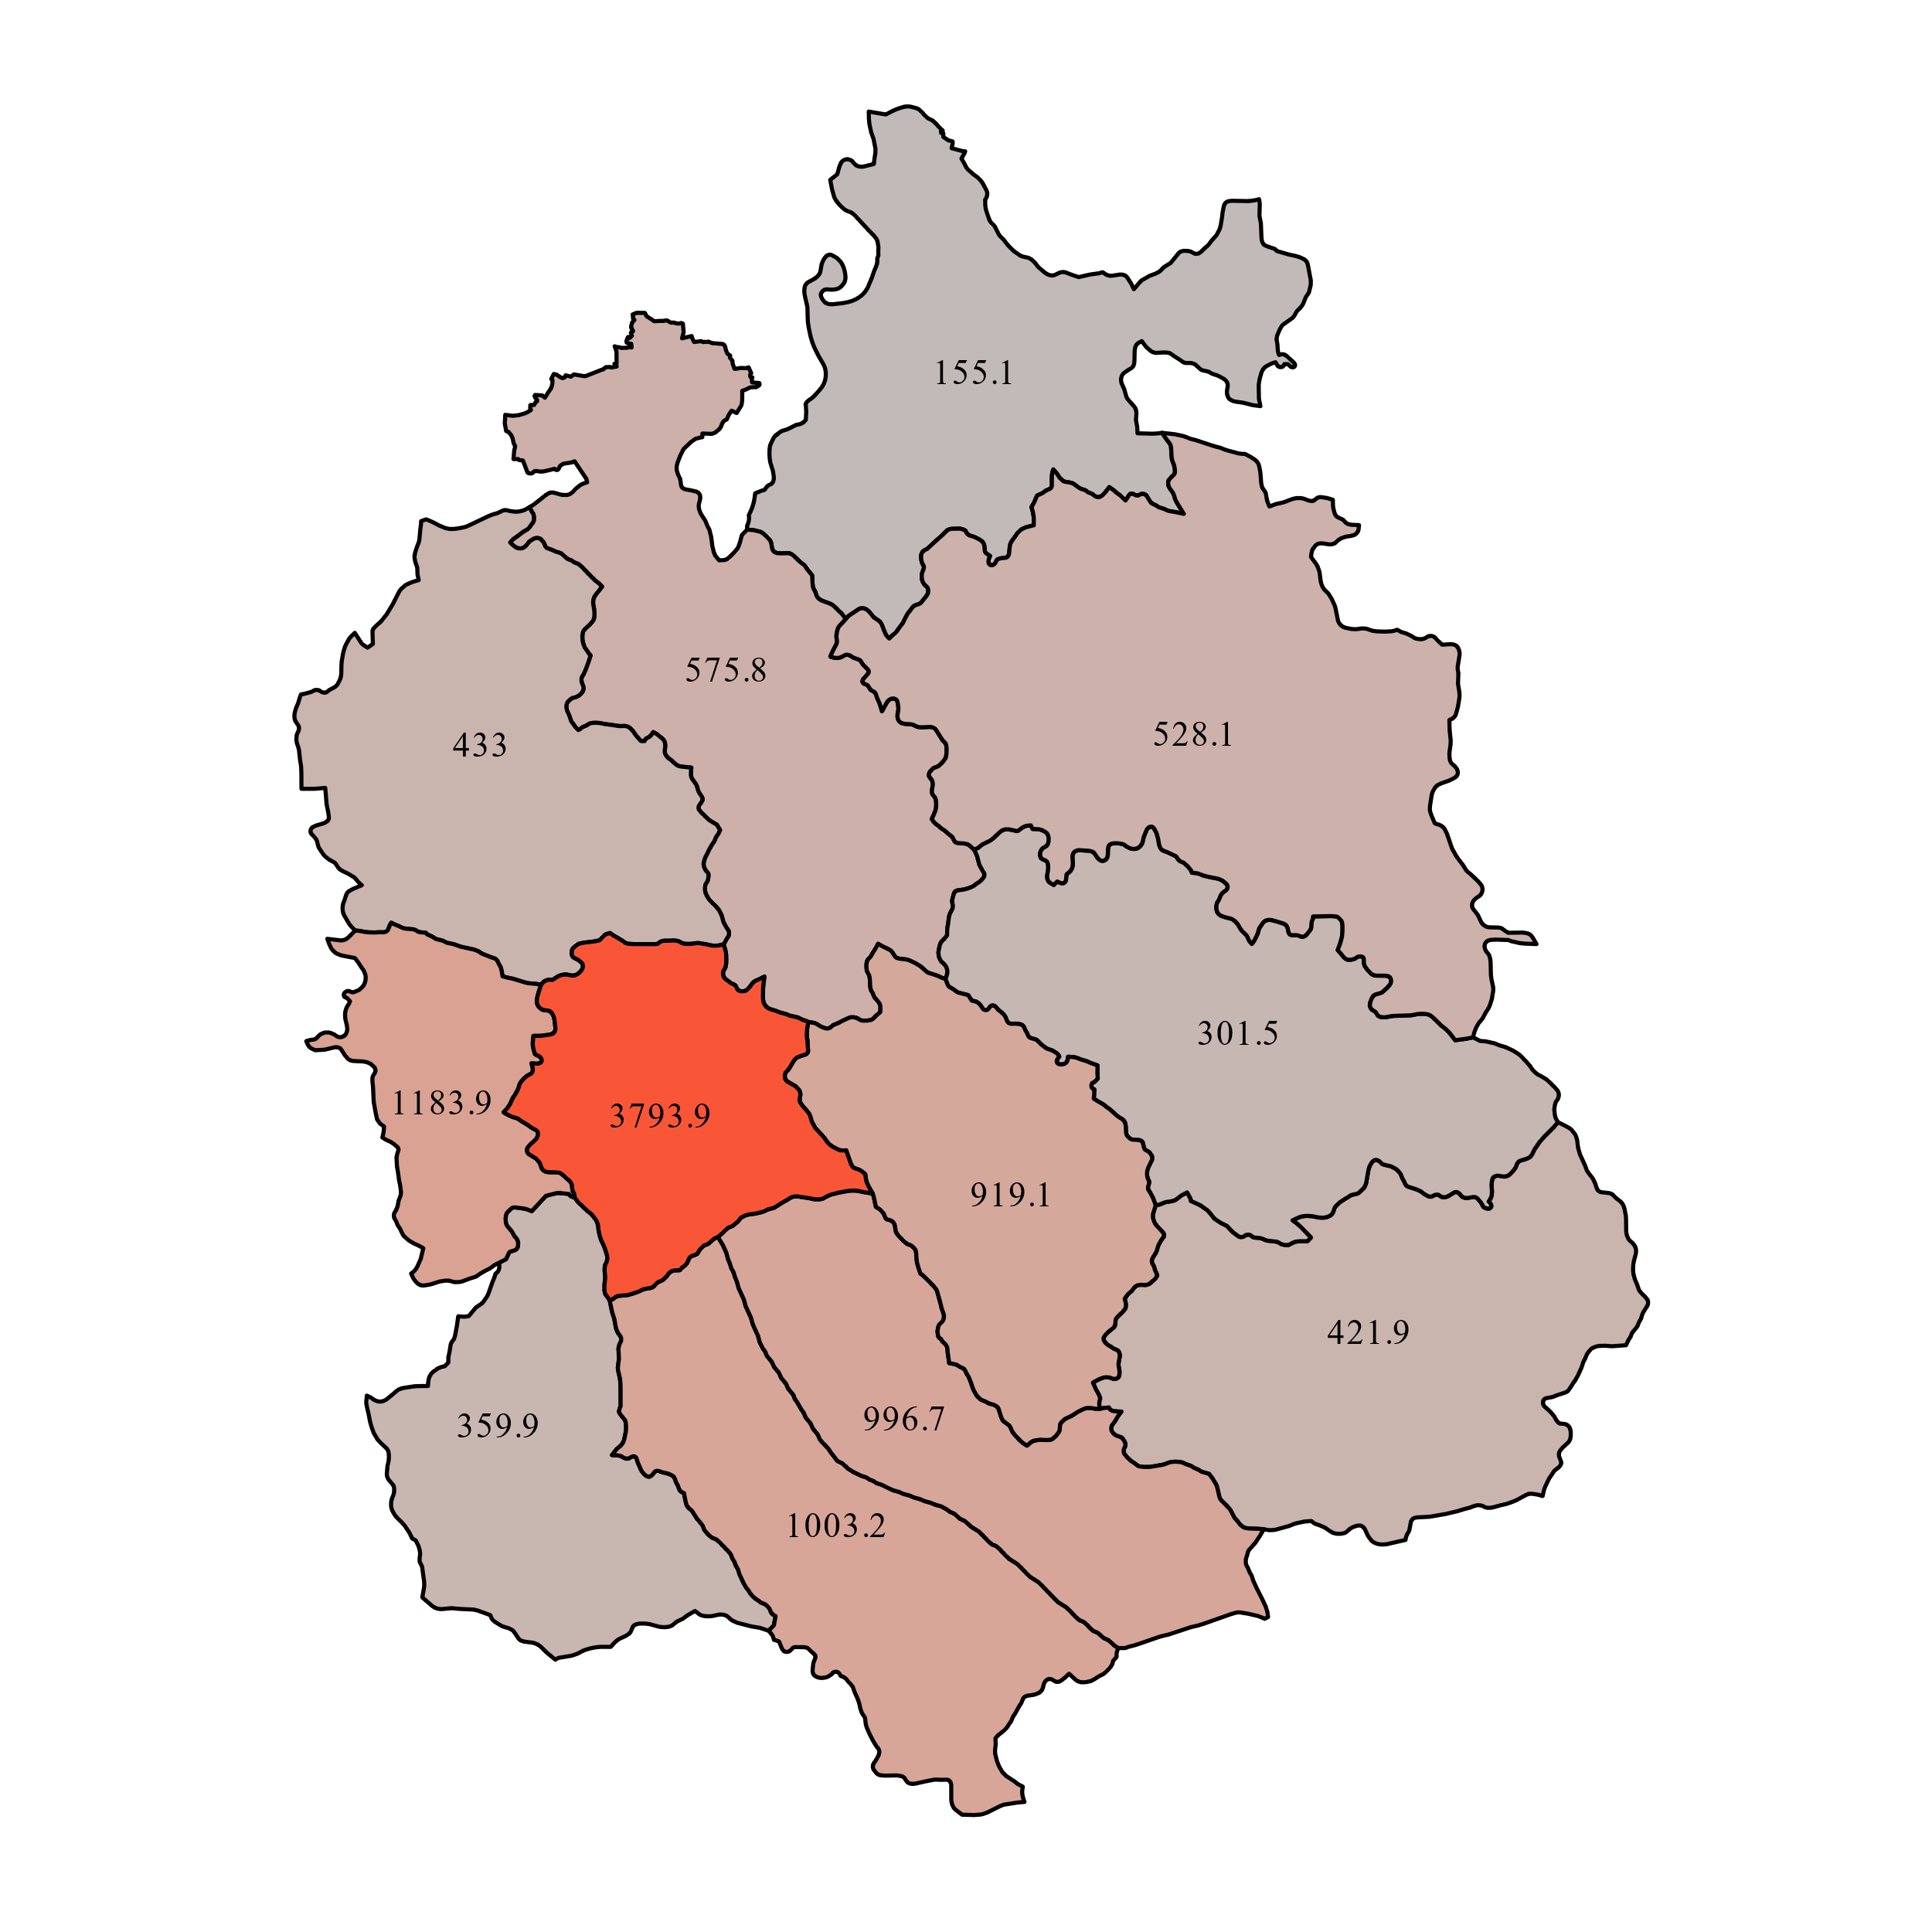
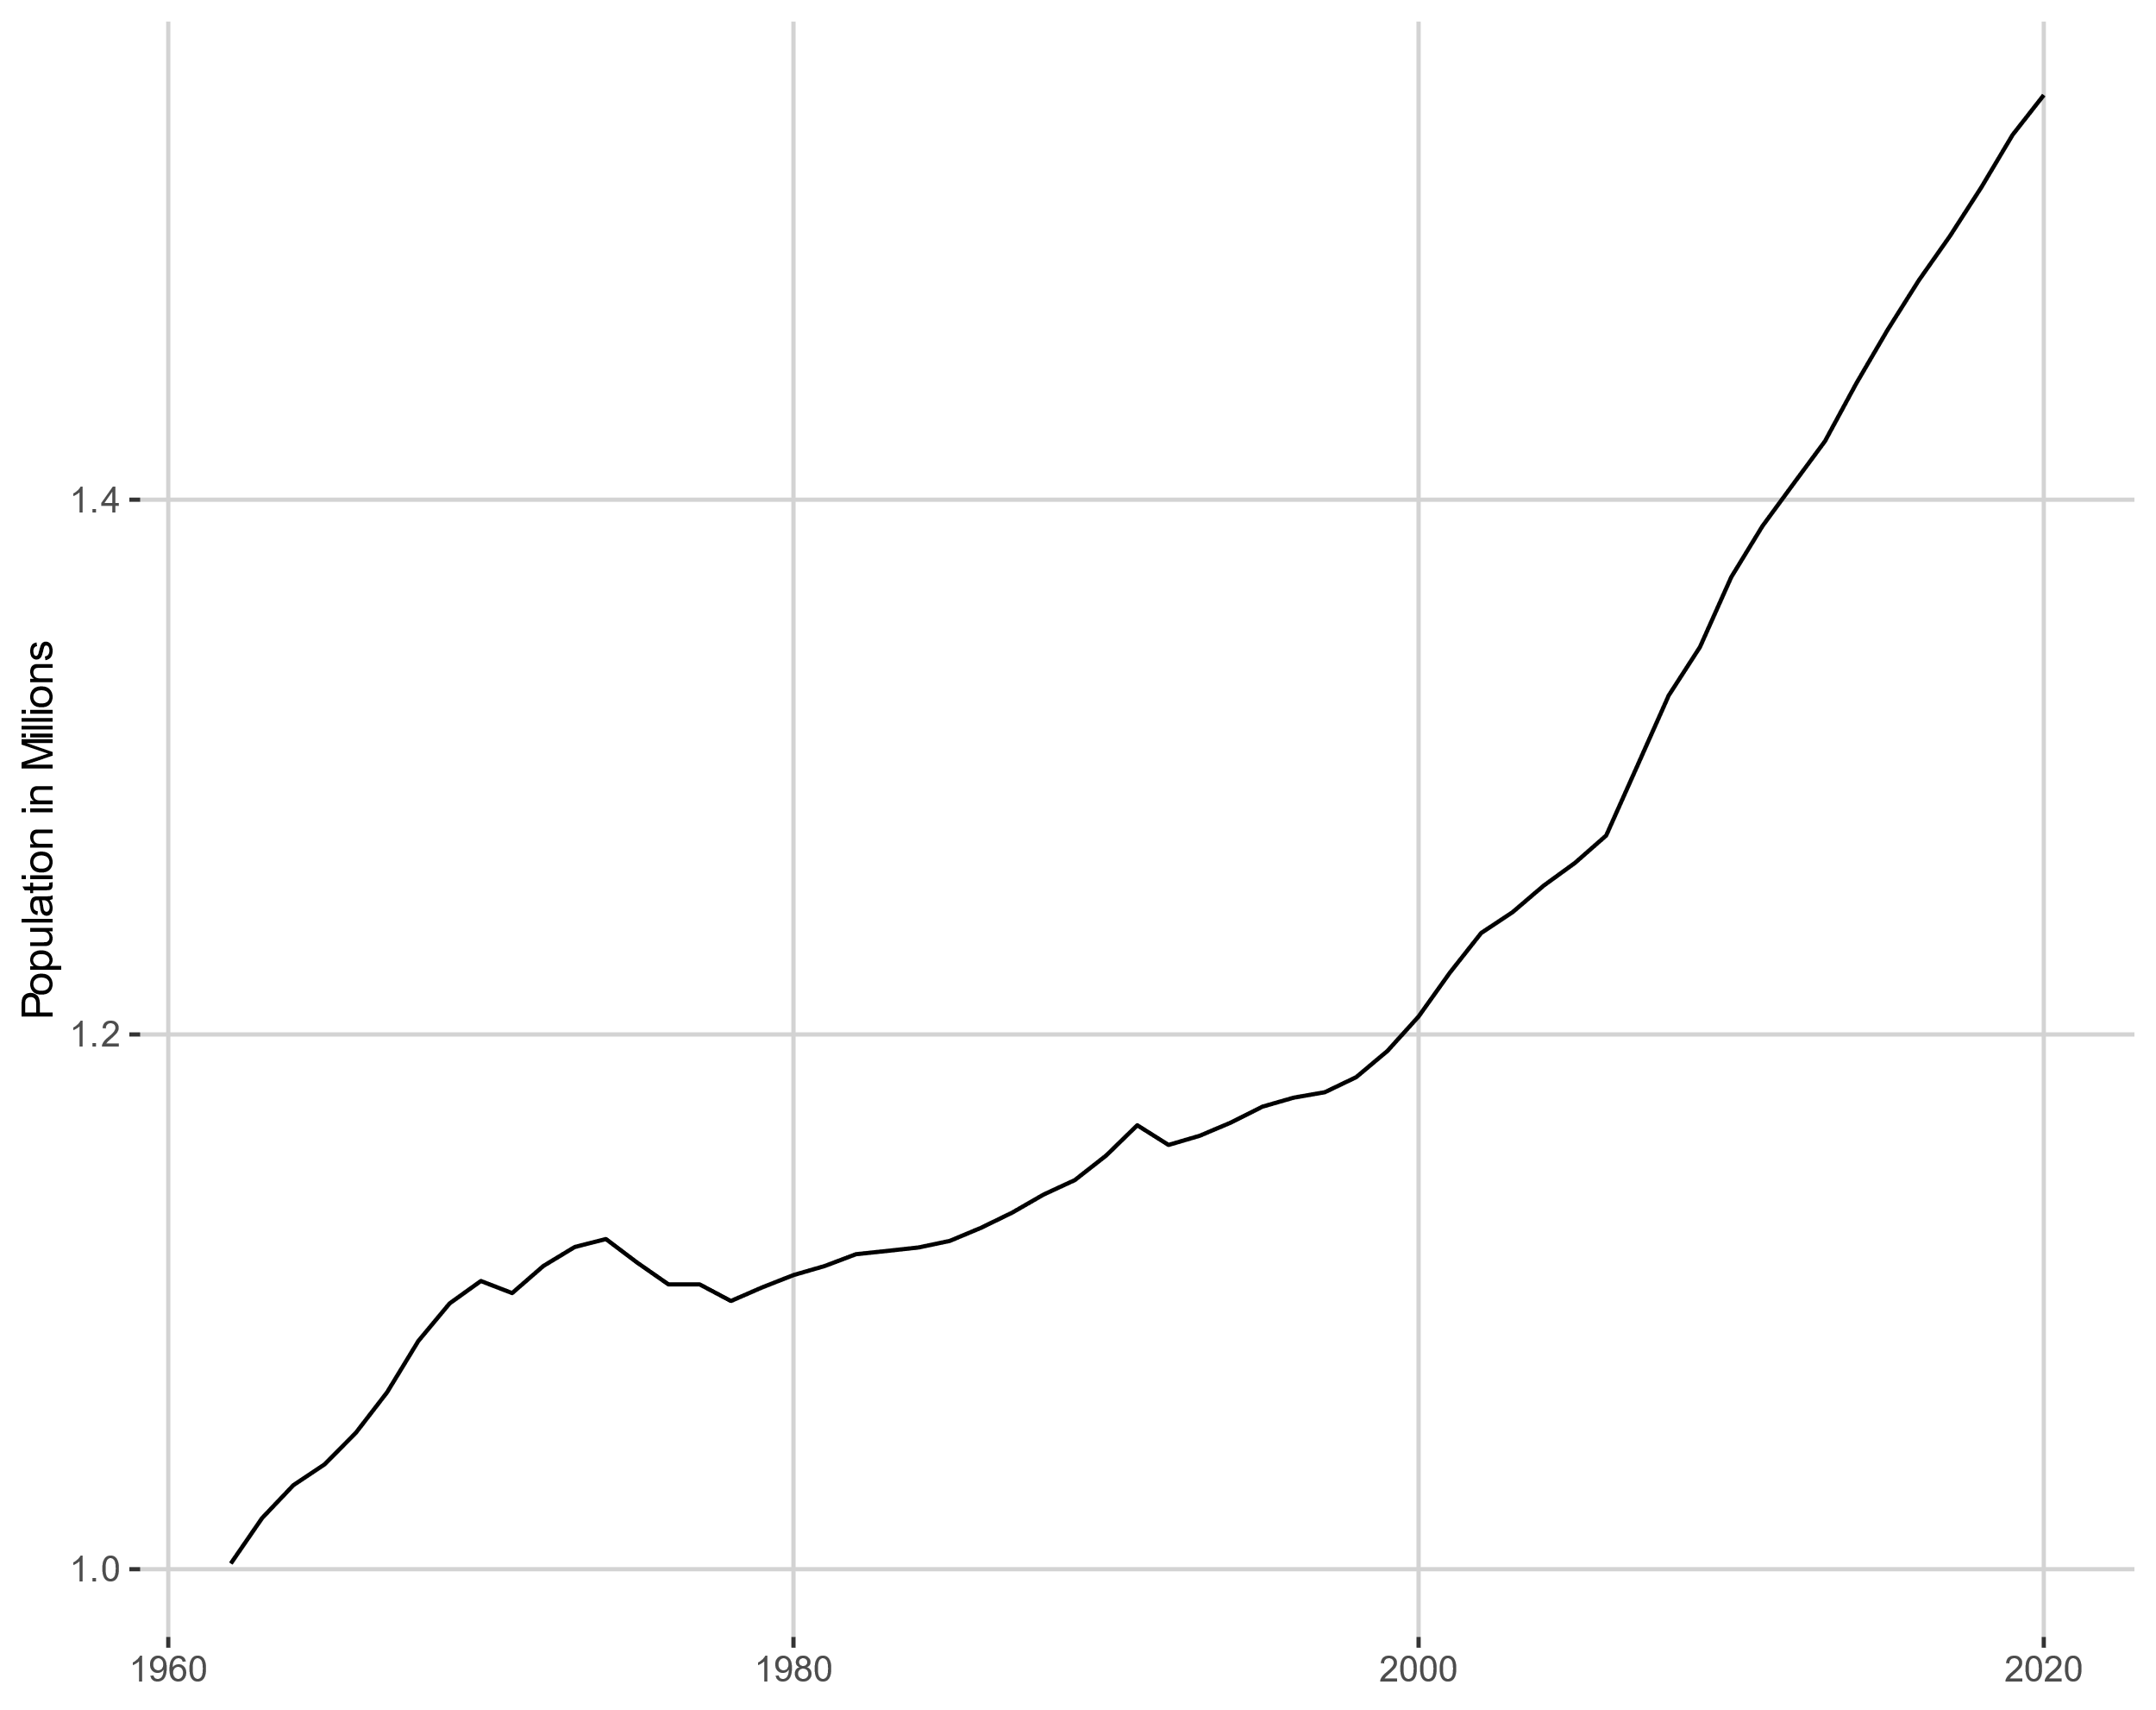
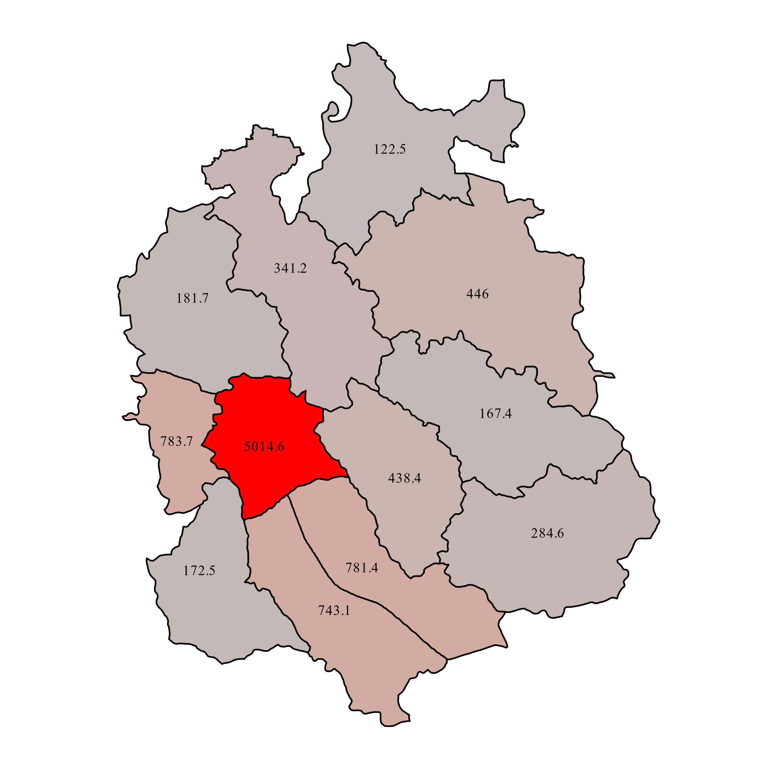
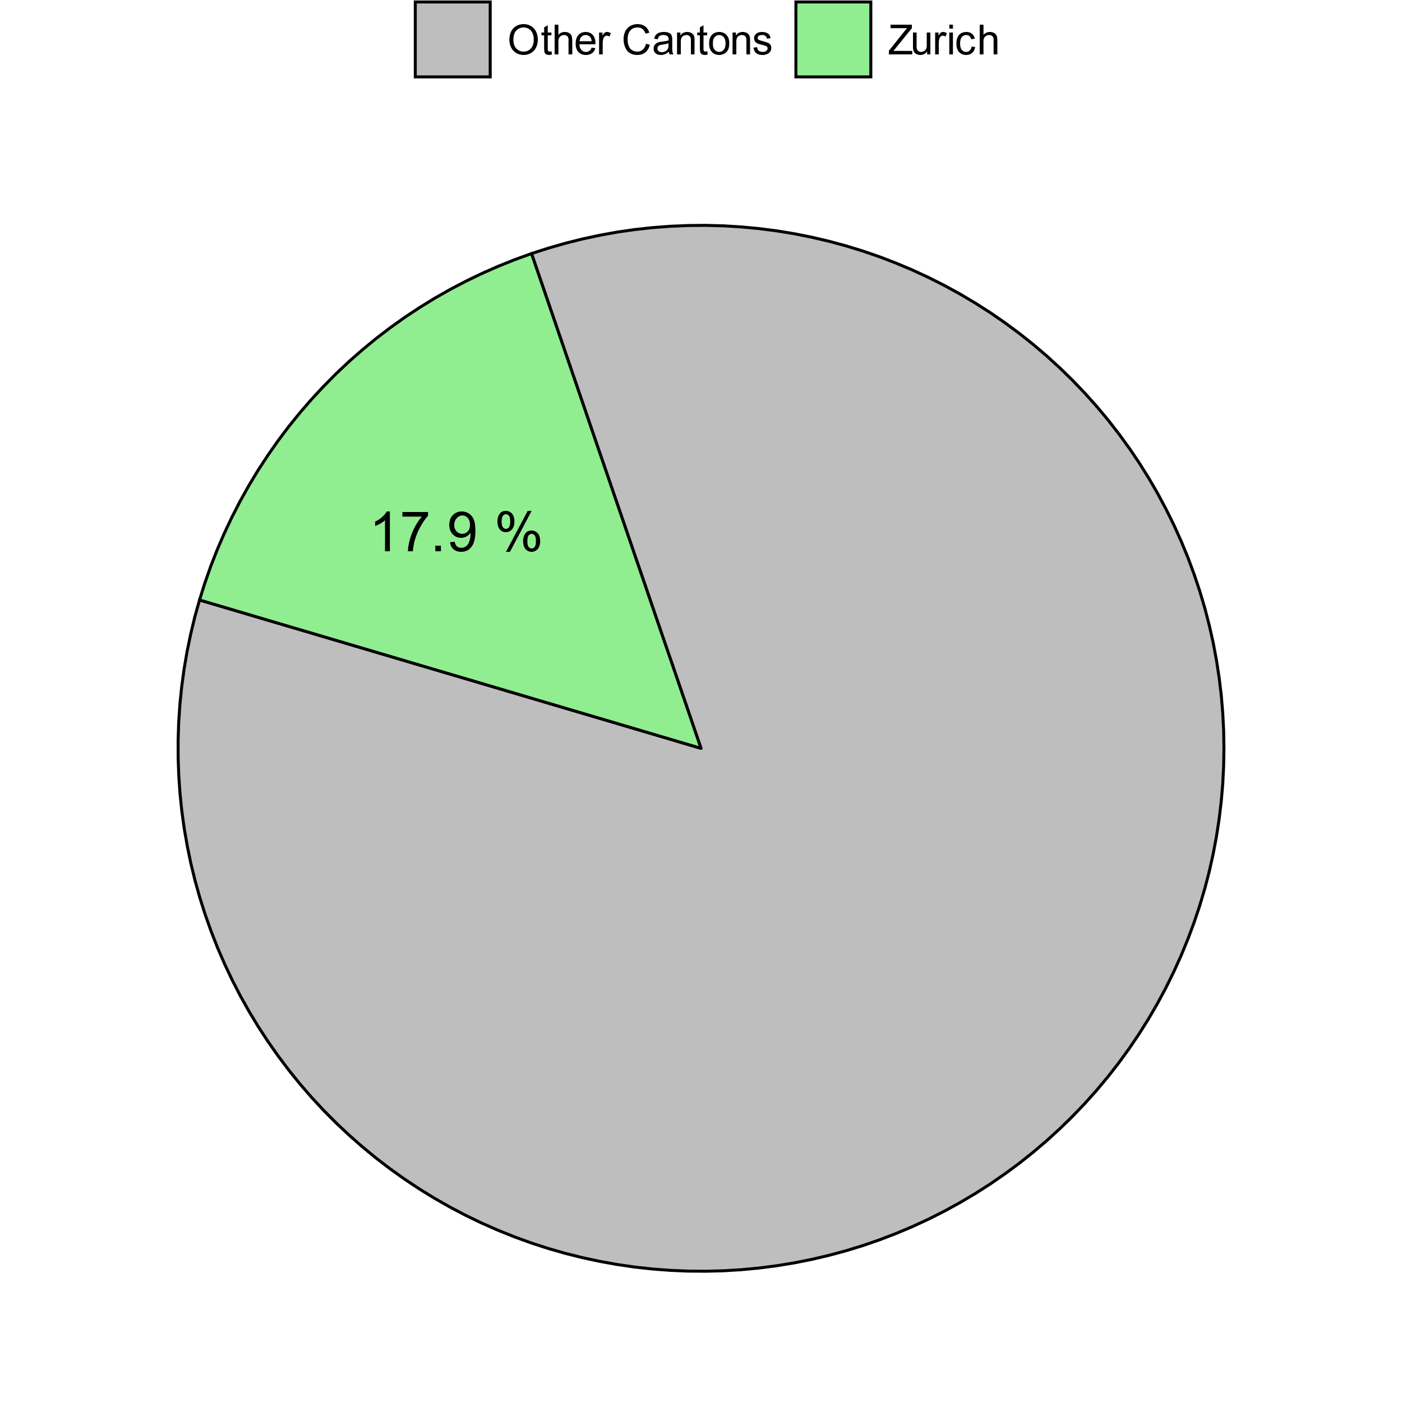


Demographic Figures in the Canton of Zürich
Heads of the Canton
image from autokennzeichen.halterauskunft.ch
This Poster illustrates some interesting facts about the Canton of Zurich. All illustrations are computed with GGplot2 from the R-language. Demographic data is provided by Opendata Zurich1, geospatial data from Global Administrative Area2.
Age Distribution
The population pyramid for 2020 of the total 420’031 inhabitants of the district Zurich reveal equal distribution between the genders. The highest ratio is represented by people between 30 and 40 years of age. There is also a decrease visible as we follow along to the top.
Foreigner
In the year 2020 the
proportion of people in the
Canton with no Swiss citizenship
has the highest ratio in the district
Dietikon with 36 %, followed by the
City itself with 32%.
The lowest ratio can be observed in the more rural district Andelfingen.
When inspecting the
Development over time
for the district Zurich, an
Increase in the ratio can be
Clearly observed.
In the 1970’s the ratio was
below 20 %
Zurich lies in the north of Switzerland and is
one of the country's 26 Cantons
Its 12 political districts cover a total area of ~ 1729 kilometersquared.
Population Distribution from 1962 to 2020
From 1962 the overall Population in Canton Zurich has increased by nearly half a Million. Nevertheless in the heart of the Canton: district Zurich itself, the population is lower today than in the 1960’s. Until 1999 the ratio [population per squarekilometer] has shrunken by over 1200. After that year the density has gradually increased. In the outer regions the population
density has also grown over time. People tend to
scatter more to the agglomeration and
the outskirt.
Unemployement
2011-2020
From 2011 an overall icreasing trend until 2016 is visible, by Andelfingen having the lowest and Dietikon the highest Rate.
All Districts started to gradually decrease the ratio after 2016. Dietikon even decreased by almost over 1 %. This movement was stopped by 2019.
In 2020 an increase is visible. This is most likely due to the regulations which were introduced after the european start of the COVID 19 Pandemic in March 2020
Proceeding for the Poster
Assembling Ideas about Demographic Data in Canton Zuerich
Getting familiar with geographical datatypes, ggplot2 and tidyverse.
Extract, Transform and Load the Data into R Studio
processing the data for different visualizations
Create completely customized Visualizations with GGplot as .SVG files
Combine the Graphics in Powerpoint in a Poster
Overall population 2020
With 17.9% of Switzerland's 8,65
Mio. population, Zurich is the largest
Canton in the country by numbers.
Authors
Pascal Bühler
Milan Hoerle
References:
www.zh.ch/de/politik-staat/opendata.html?keyword=ogd#/home
Gadm.org

