Slide 1
Autoencoders
Nathan Barnes

Slide 2
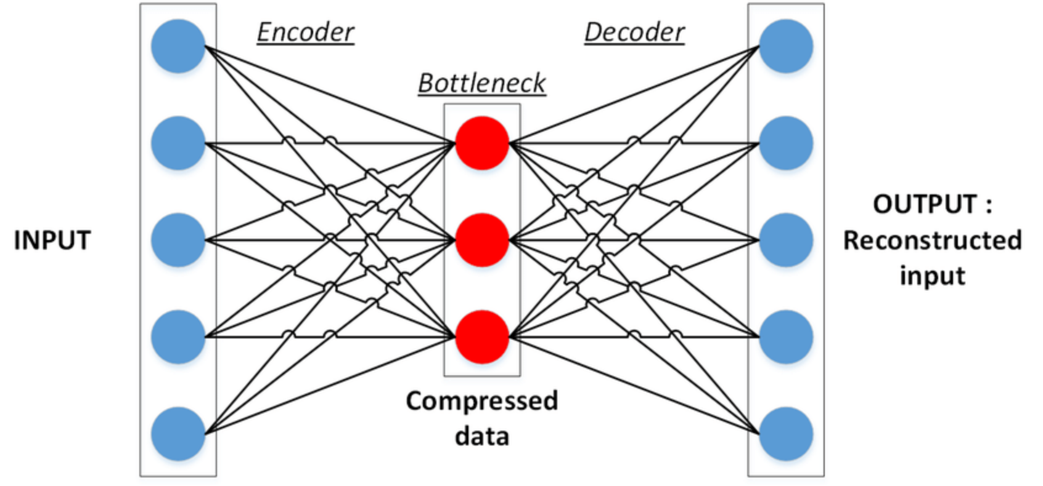
What is an autoencoder?
https://stackabuse.com/autoencoders-for-image-reconstruction-in-python-and-keras/

Slide 3
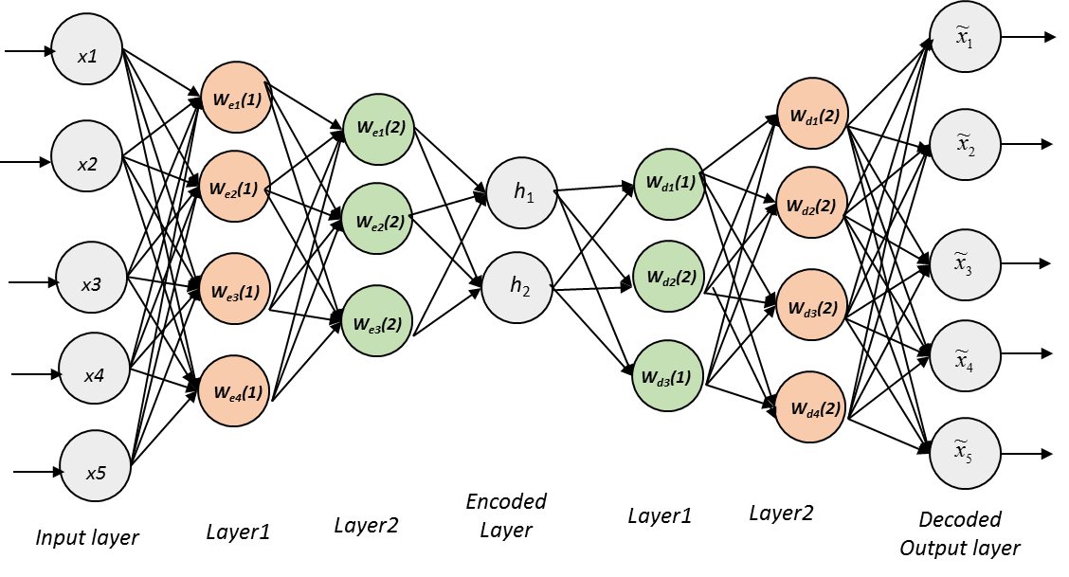
https://medium.com/@venkatakrishna.jonnalagadda/sparse-stacked-and-variational-autoencoder-efe5bfe73b64

Slide 4
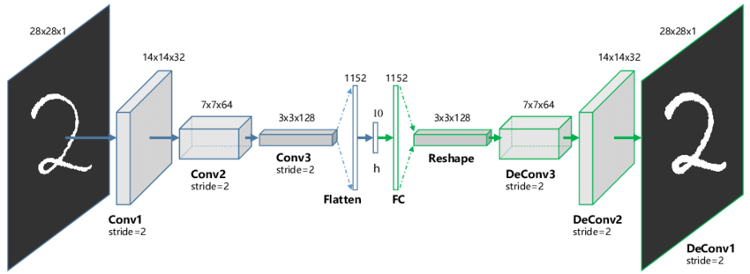

Slide 5
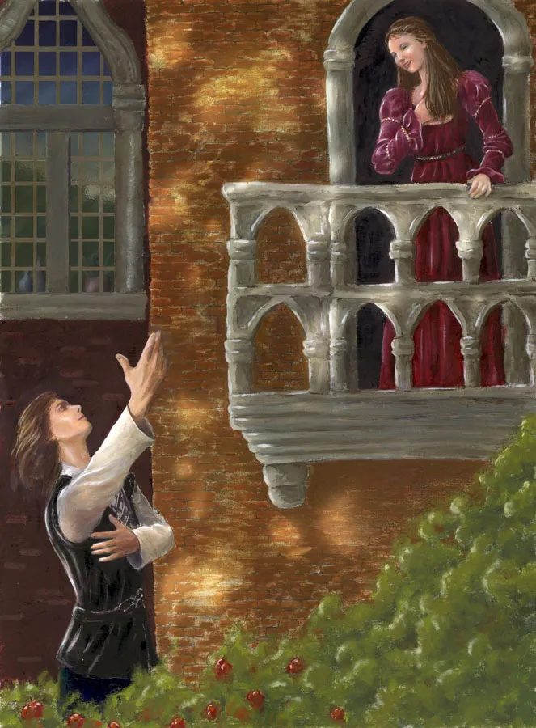
The Simplest Autoencoder
Singular Value Decomposition (SVD)
Principal Component Analysis (PCA)
Karhunen-Loeve transform (KLT)
Hotelling transform
Proper Orthogonal Decomposition (POD)
Eckart-Young Theorem
Empirical Orthogonal Function (EOF)
Empirical Eigenfunction Decomposition
Empirical Component Analysis
Quasiharmonic Modes
Spectral Decomposition
Emperical Modal Analysis

Slide 6
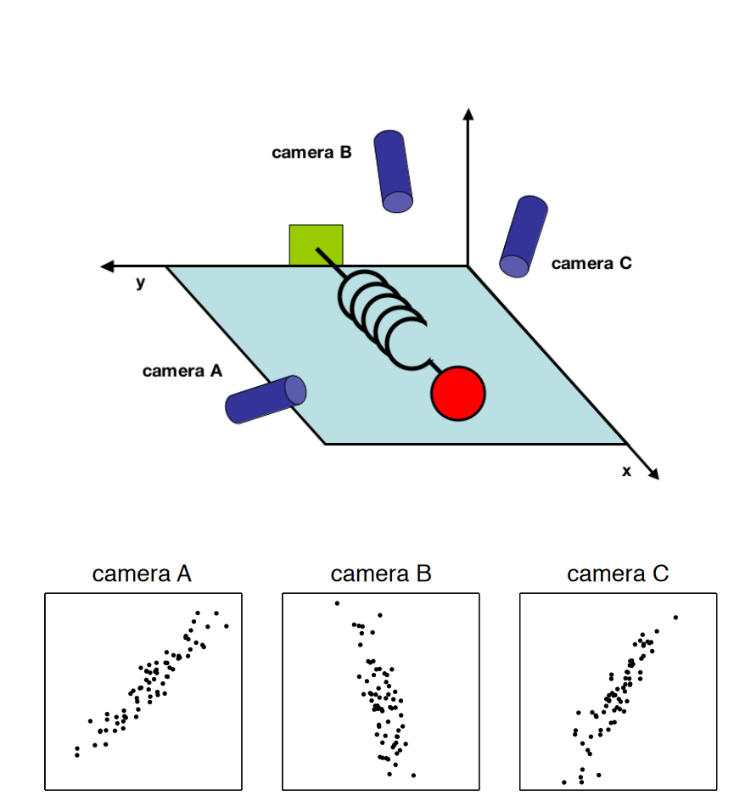
Some datasets have “bad” coordinates
We wish to automate finding “good” coordinates
Shlens (2014)
https://arxiv.org/pdf/1404.1100.pdf

Slide 7
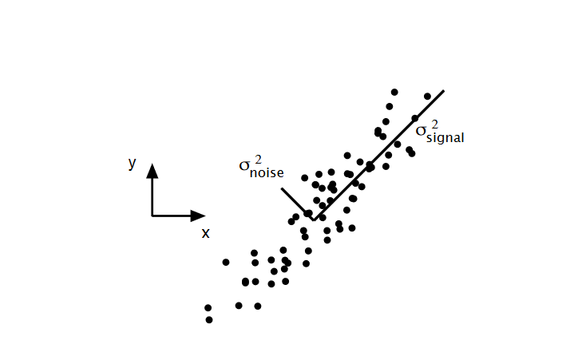
Principal Component Analysis
Question: Are there other coordinates that “better” re-express our dataset
PCA Finds the best linear change of basis
Shlens (2014)
https://arxiv.org/pdf/1404.1100.pdf

Slide 8
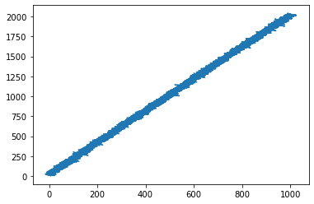
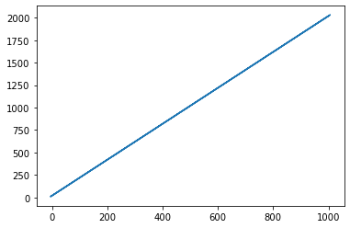

Slide 9
Computation of PCA
(without justification)
Given a data matrix
Let be its covariance matrix
The principal components of are the eigenvectors of
The corresponding eigenvalues are the variances along that principal component
Project onto a subset of its principal components

Slide 10
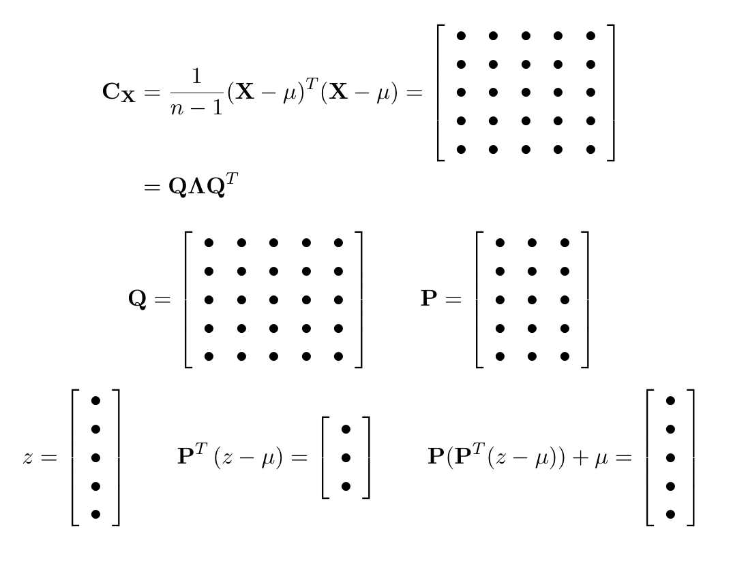
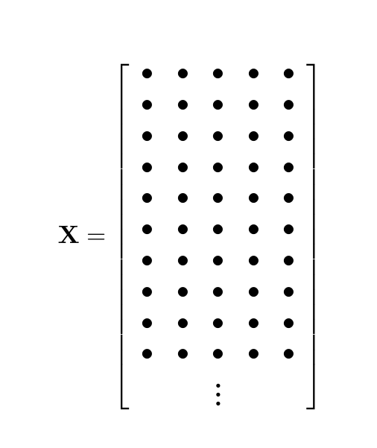

Slide 11
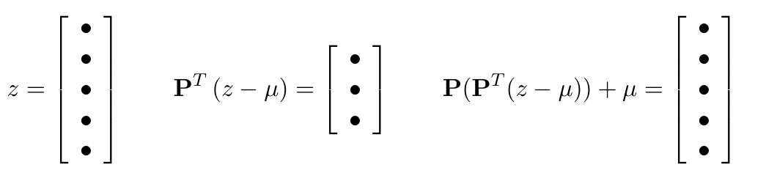
PCA is a linear autoencoder

Slide 12
Linear autoencoders “are” PCA
A linear autoencoder with one hidden layer and MSE loss function “is” PCA

Slide 13
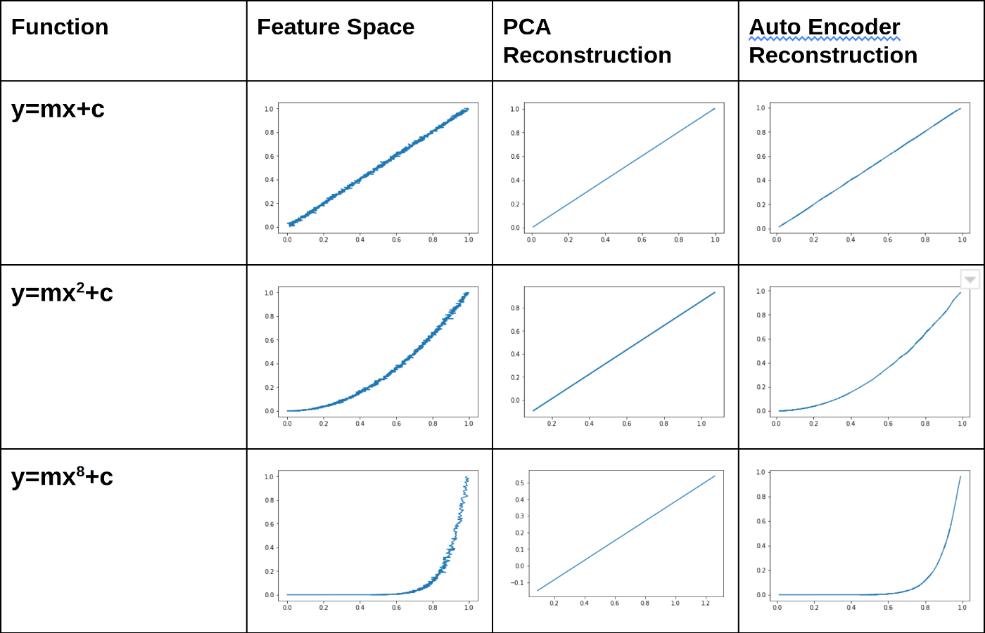
Using non-linear Autoencoders we can relax the linearity assumption
https://towardsdatascience.com/autoencoders-vs-pca-when-to-use-which-73de063f5d7

Slide 14
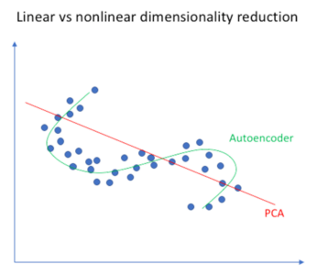

Slide 15
Applications of Autoencoders
Image Compression
Denoising
Deep fakes
Generative models (variational autoencoder)
SINDy
Recommendation systems
Anomaly detection
translation

Slide 16
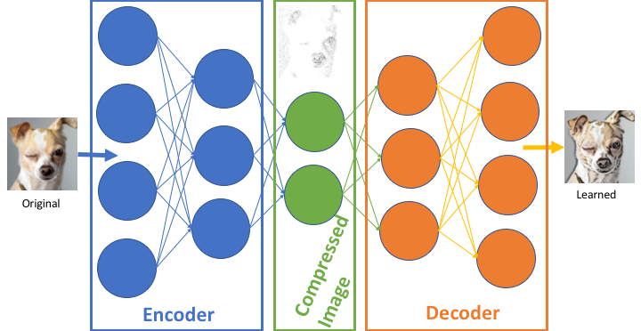
Image compression
https://arnoldkokoroko.com/projects/imagecompress/

Slide 17
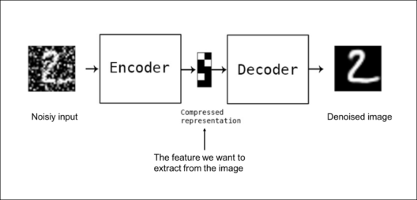
Denoising
https://medium.com/edureka/autoencoders-tutorial-cfdcebdefe37

Slide 18

DeepFakes
https://www.alanzucconi.com/2018/03/14/understanding-the-technology-behind-deepfakes/

Slide 19
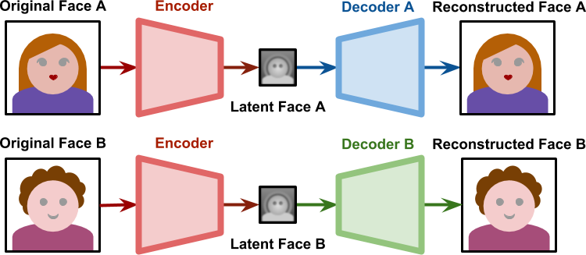
DeepFakes
https://www.alanzucconi.com/2018/03/14/understanding-the-technology-behind-deepfakes/

Slide 20
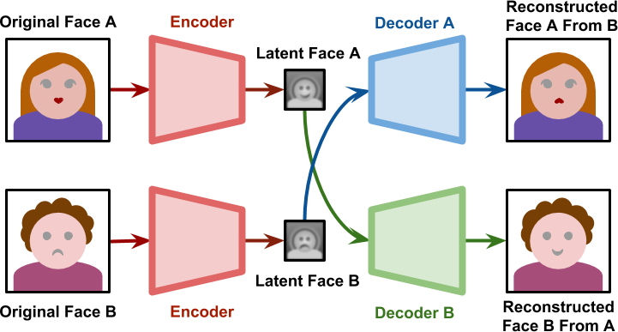
DeepFakes
https://www.alanzucconi.com/2018/03/14/understanding-the-technology-behind-deepfakes/

Slide 21
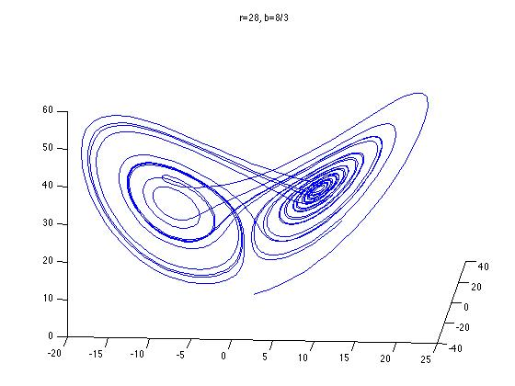
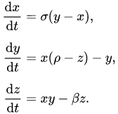
SINDy
Sparse Identification of Non-linear Dynamics
An autoencoder can help find good coordinates
Brunton, Proctor, and Kutz. 2016, PNAS
https://www.youtube.com/watch?v=NxAn0oglMVw

