Slide 1
Bayesian inference for Matern repulsive processes
Paper by Vinayak Rao, Ryan P. Adams, and David D. Dunson
Presentation by James Buenfil

Slide 2
Outline
Introduction to point processes
Poisson, Matern, and related processes
Summary of paper
Theorems
Bayesian approach to modeling
Other work on Matern processes
Model assessment tools
Application to real data sets
Limitations of Analysis
Extensions

Slide 3
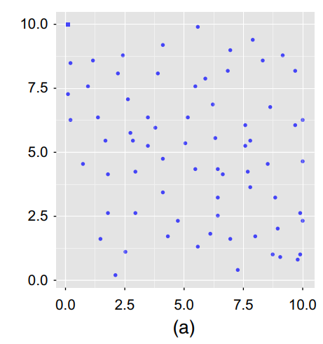
Point Processes
Widely applied in e.g., astronomy, ecology, demography, geography, seismology, and neuroscience
Point processes used to model spatial data

Slide 4
Point Processes
Simplest point process: Poisson point process
Homogeneous processes can be limited in modeling clustering or repulsiveness
Matern suggested ways of “thinning” the homogeneous Poisson process, which are named types I, II and III Matern Processes
In this paper, type III Matern Processes are considered for modeling spatial data

Slide 5
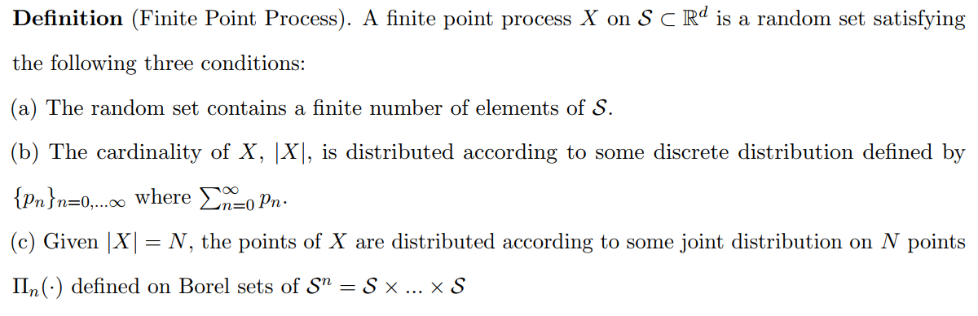

Definition of Finite Point Process
$$=1$$

Slide 6
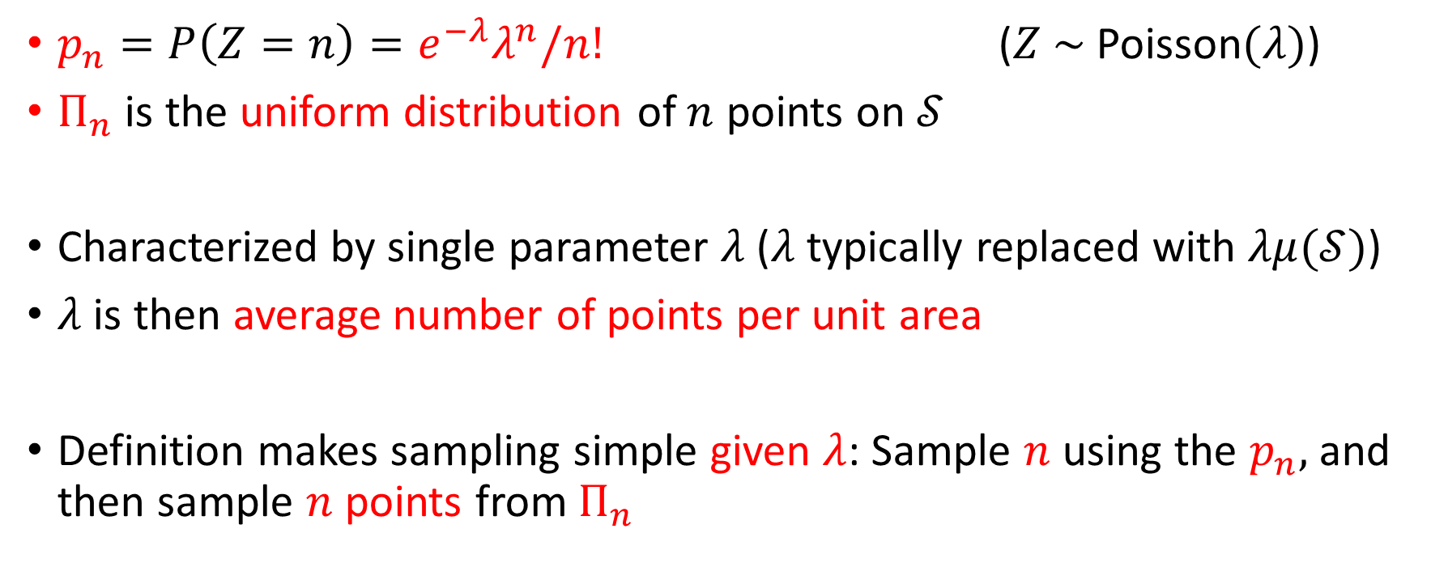
Homogeneous Poisson Process
$p_{n}=P\left(Z=n\right)=e^{−λ}λ^{n}/n!$ ($Z \sim$Poisson$(λ)$)
$Π_{n}$ is the uniform distribution of $n$ points on $𝒮$
Characterized by single parameter $λ$ ($λ$ typically replaced with $λμ(𝒮)$)
$λ$ is then average number of points per unit area
Definition makes sampling simple given $λ$: Sample $n$ using the $p_{n},$ and then sample $n$ points from $Π_{n}$

Slide 7
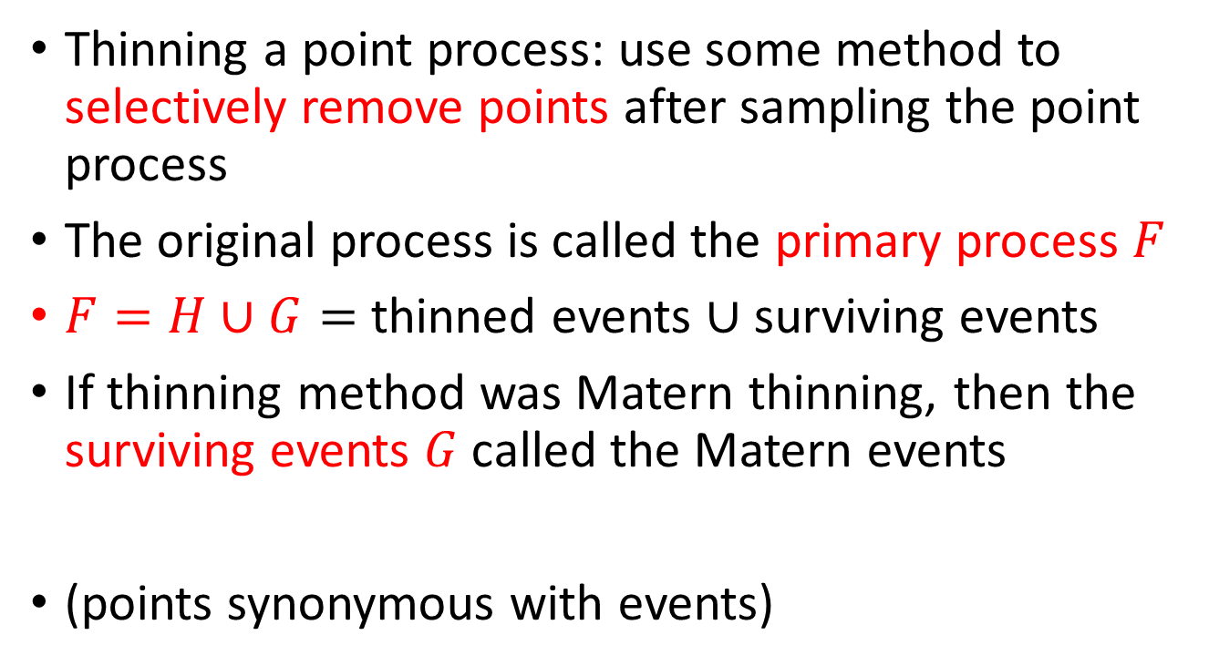
Thinning a process
Thinning a point process: use some method to selectively remove points after sampling the point process
The original process is called the primary process $F$
$F=H∪G=$ thinned events $∪$surviving events
If thinning method was Matern thinning, then the surviving events $G$called the Matern events
(points synonymous with events)

Slide 8
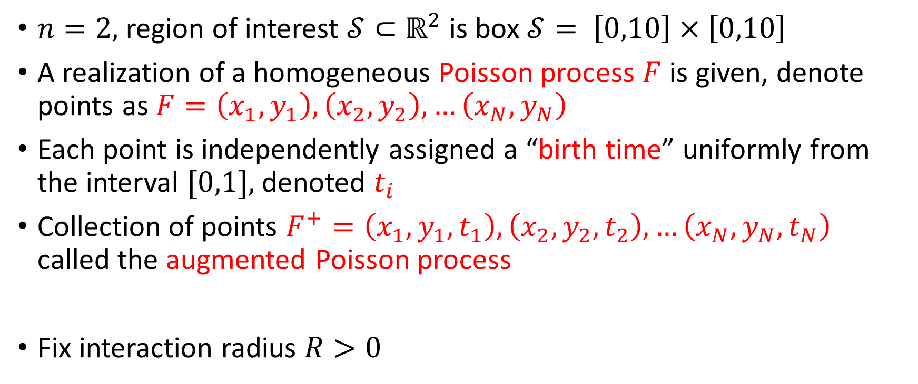
Definition of Matern Type III Thinning
$n=2,$region of interest $𝒮⊂$ $ℝ^{2}$ is box $𝒮= \left[0,10\right]$ $×$ $\left[0,10\right]$
A realization of a homogeneous Poisson process $F$ is given, denote points as $F=\left(x_{1},y_{1}\right),\left(x_{2},y_{2}\right),…\left(x_{N},y_{N}\right)$
Each point is independently assigned a “birth time” uniformly from the interval $[0,1],$denoted $t_{i}$
Collection of points $F^{+}=\left(x_{1},y_{1},t_{1}\right),\left(x_{2},y_{2},t_{2}\right),…\left(x_{N},y_{N},t_{N}\right)$ called the augmented Poisson process
Fix interaction radius $R>0$

Slide 9
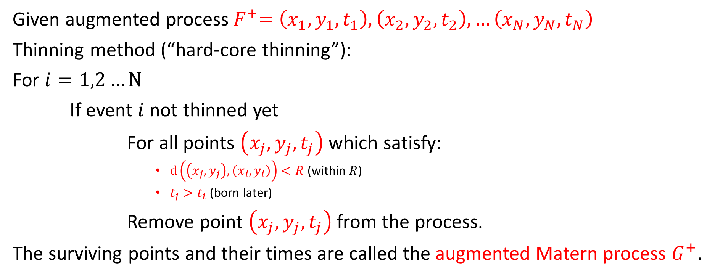
Matern Type III Thinning
Given augmented process${ F}^{+}=$ $\left(x_{1},y_{1},t_{1}\right),\left(x_{2},y_{2},t_{2}\right),…\left(x_{N},y_{N},t_{N}\right)$
Thinning method (“hard-core thinning”):
For $i=1,2…N$
If event $i$ not thinned yet
For all points $\left(x_{j},y_{j},t_{j}\right)$which satisfy:
$d\left(\left(x_{j},y_{j}\right),\left(x_{i},y_{i}\right)\right)<R$ (within $R$)
$t_{j}>t_{i}$ (born later)
Remove point $\left(x_{j},y_{j},t_{j}\right)$from the process.
The surviving points and their times are called the augmented Matern process $G^{+}$.

Slide 10
Example of Matern Thinning
t = .2
t = .85
t = .01
R
t = .07
t = .59
= Thinned Event
= Matern Event

Slide 11
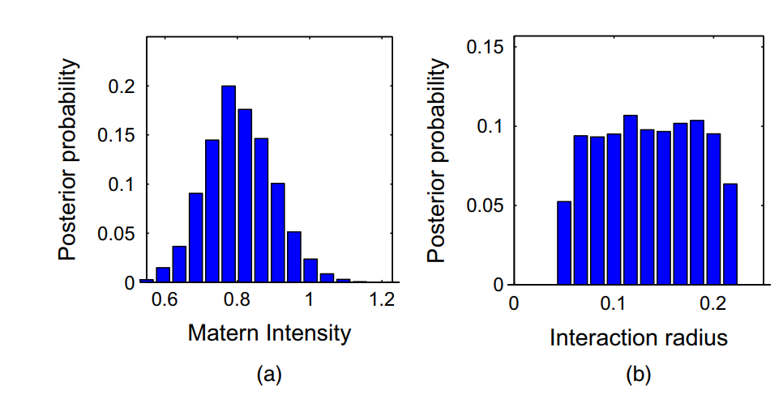
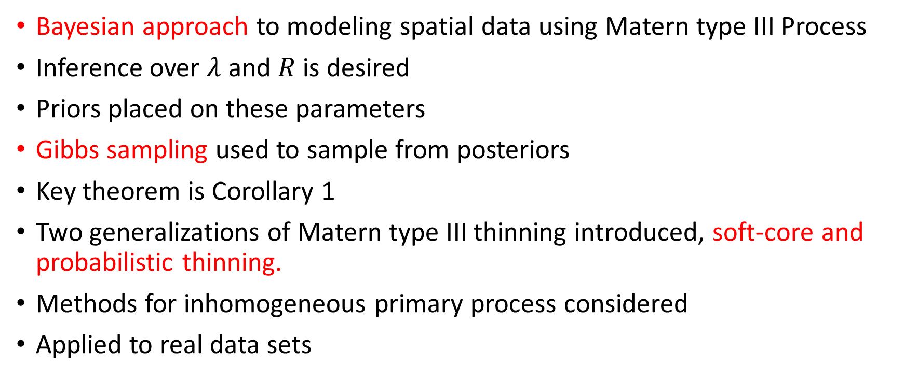
Summary of paper
Bayesian approach to modeling spatial data using Matern type III Process
Inference over $λ$ and $R$ is desired
Priors placed on these parameters
Gibbs sampling used to sample from posteriors
Key theorem is Corollary 1
Two generalizations of Matern type III thinning introduced, soft-core and probabilistic thinning.
Methods for inhomogeneous primary process considered
Applied to real data sets

Slide 12
Other repulsive point processes
Cox processes: Poisson processes where the intensity itself is a stochastic process
Gibbs Processes allows for interaction between points. Limitation is that normalizing constant of the density is generally unknown, so MCMC is required
Markov processes model repulsiveness in an explicit way involving equivalence classes of neighborhoods of points
Gaussian mixed models can also model repulsiveness
Matern type I and II processes have also been studied, a recent work is Teichmann et al. [2013] which generalized Matern type I and II processes by introducing probabilistic thinning for these processes.

Slide 13
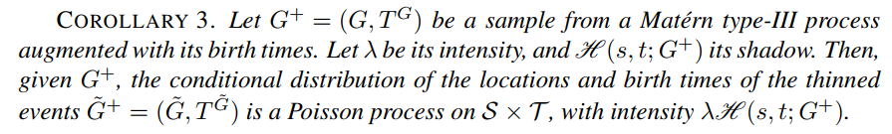
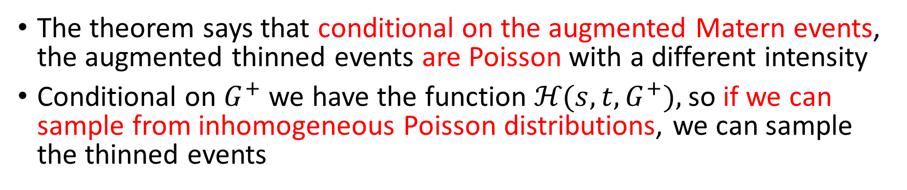
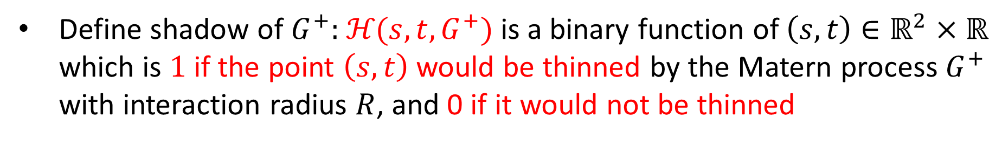
Theorems: Corollary 1
Define shadow of $G^{+}:$ $\text{ℋ}\text{(}s,t,G^{+})$ is a binary function of $\left(s,t\right)∈ℝ^{2}$ $×$ $ℝ$ which is $1$ if the point $\left(s,t\right)$ would be thinned by the Matern process $G^{+}$ with interaction radius $R$, and 0 if it would not be thinned
The theorem says that conditional on the augmented Matern events, the augmented thinned events are Poisson with a different intensity
Conditional on $G^{+}$ we have the function $\text{ℋ}\text{(}s,t,G^{+}),$ so if we can sample from inhomogeneous Poisson distributions, we can sample the thinned events

Slide 14
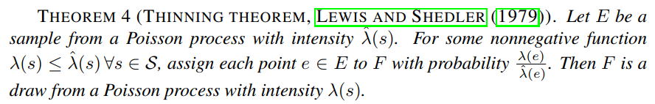
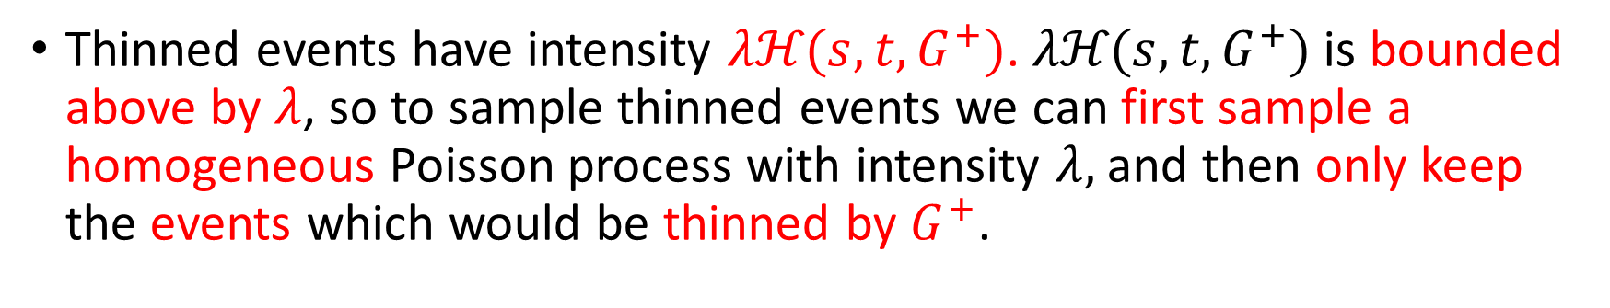
Theorems: Theorem 3
The following theorem says that we can sample Poisson processes with nonconstant intensities by thinning Poisson processes that do have constant intensity:
Thinned events have intensity $λ\text{ℋ}\text{(}s,t,G^{+})$. $λ\text{ℋ}\text{(}s,t,G^{+})$ is bounded above by $λ$, so to sample thinned events we can first sample a homogeneous Poisson process with intensity $λ,$ and then only keep the events which would be thinned by $G^{+}$.

Slide 15
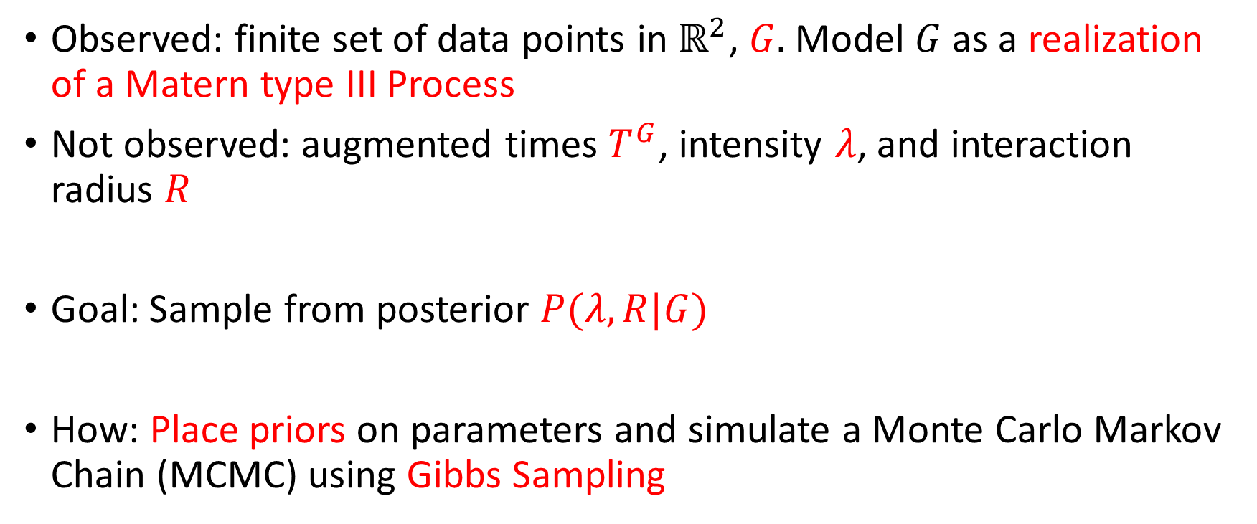
Modeling real data
Observed: finite set of data points in $ℝ^{2}$, $G.$ Model $G$ as a realization of a Matern type III Process
Not observed: augmented times $T^{G}$, intensity $λ$, and interaction radius $R$
Goal: Sample from posterior $P(λ,R|G)$
How: Place priors on parameters and simulate a Monte Carlo Markov Chain (MCMC) using Gibbs Sampling

Slide 16
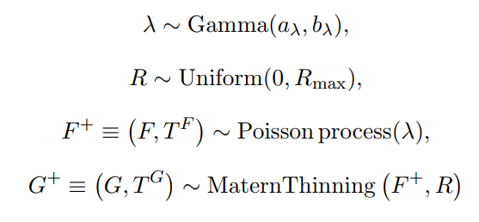
Bayesian model:
Assume: primary process is homogeneous Poisson, thinning mechanism is hard-core
Main contribution of paper: Straightforward and efficient Gibbs sampling from this model, thanks to Corollary 1

Slide 17
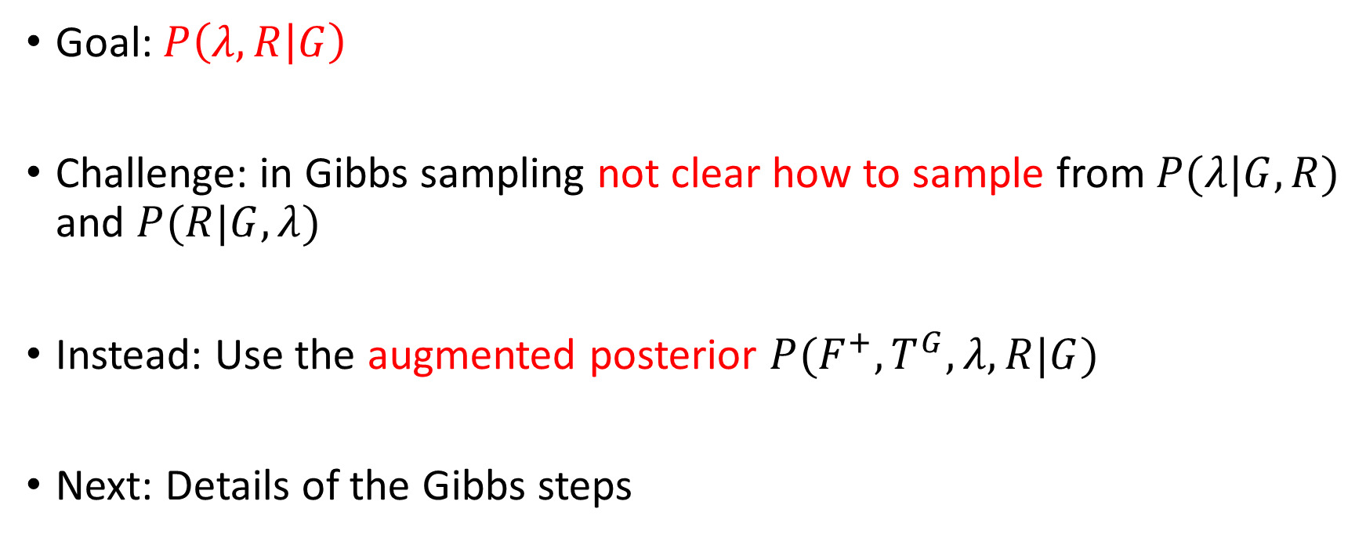
Augmented Posterior
Goal: $P\left(λ,R | G\right)$
Challenge: in Gibbs sampling not clear how to sample from $P(λ|G,R)$ and $P(R|G,λ)$
Instead: Use the augmented posterior $P(F^{+},T^{G},λ,R|G)$
Next: Details of the Gibbs steps

Slide 18
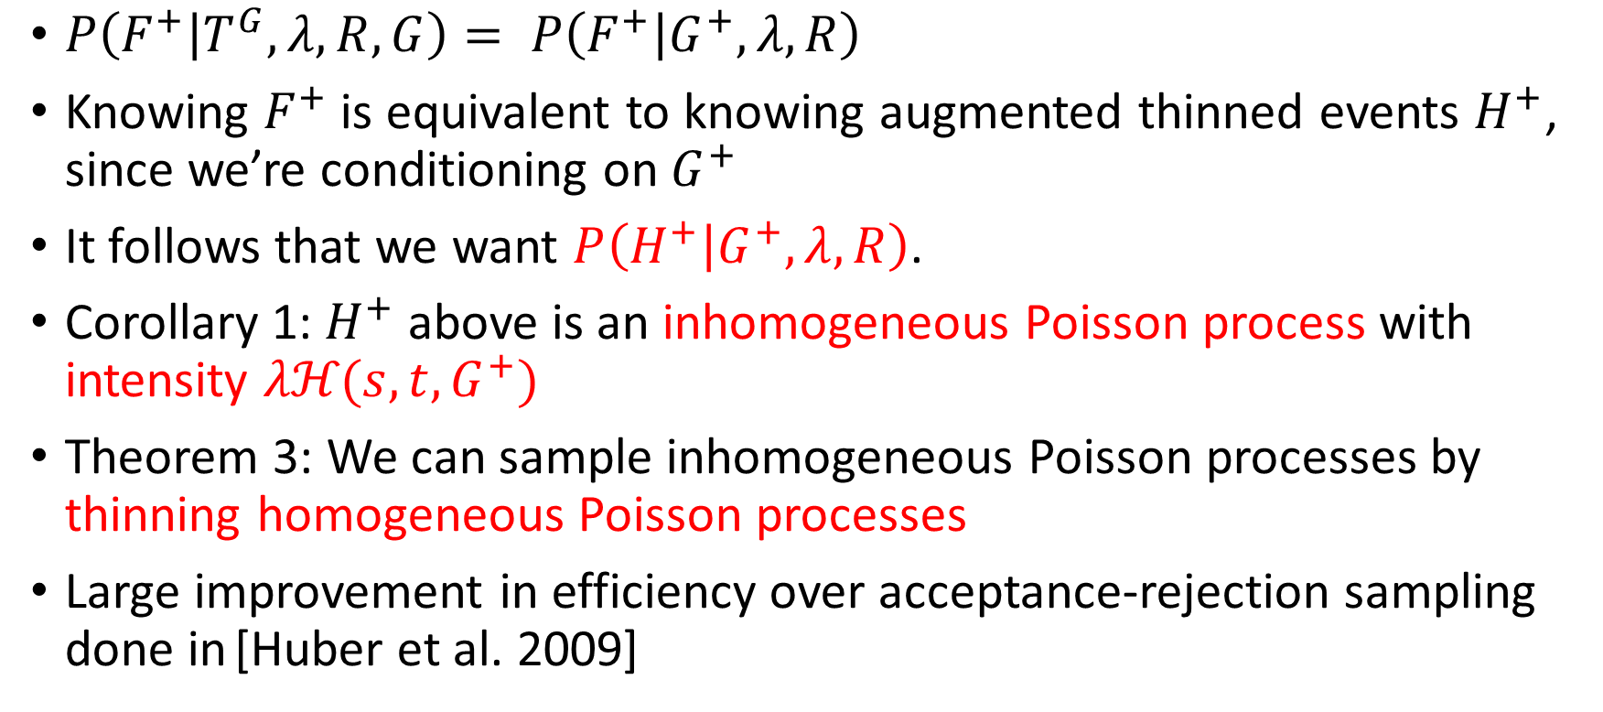
Step 1: Sampling the thinned events
$P\left(F^{+} | T^{G},λ,R,G\right)= P\left(F^{+} | G^{+},λ,R\right)$
Knowing $F^{+}$ is equivalent to knowing augmented thinned events $H^{+}$, since we’re conditioning on $G^{+}$
It follows that we want $P\left(H^{+} | G^{+},λ,R\right)$.
Corollary 1:$H^{+}$ above is an inhomogeneous Poisson process with intensity $λ\text{ℋ}\text{(}s,t,G^{+})$
Theorem 3: We can sample inhomogeneous Poisson processes by thinning homogeneous Poisson processes
Large improvement in efficiency over acceptance-rejection sampling done in [Huber et al. 2009]
Huber, Mark L., and Robert L. Wolpert. "Likelihood-based inference for Matérn type-III repulsive point processes." Advances in Applied Probability 41.4 (2009): 958-977.

Slide 19
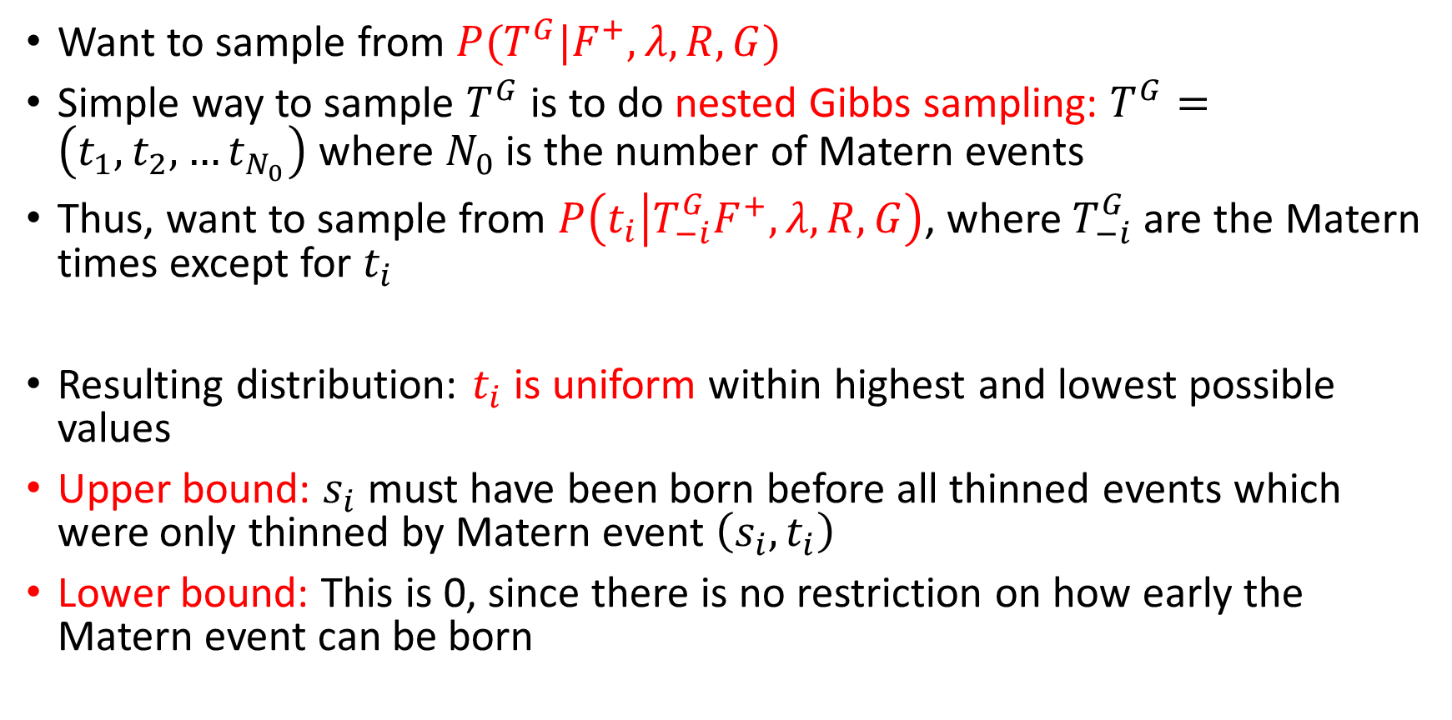
Step 2: Sampling the Matern Birth Times
Want to sample from $P(T^{G}|F^{+},λ,R,G)$
Simple way to sample $T^{G}$ is to do nested Gibbs sampling: $T^{G}=\left(t_{1},t_{2},…t_{N_{0}}\right)$ where $N_{0}$ is the number of Matern events
Thus, want to sample from $P\left(t_{i} | T_{−i}^{G}F^{+},λ,R,G\right)$, where $T_{−i}^{G}$ are the Matern times except for $t_{i}$
Resulting distribution: $t_{i}$ is uniform within highest and lowest possible values
Upper bound: $s_{i}$ must have been born before all thinned events which were only thinned by Matern event $\left(s_{i},t_{i}\right)$
Lower bound: This is 0, since there is no restriction on how early the Matern event can be born

Slide 20
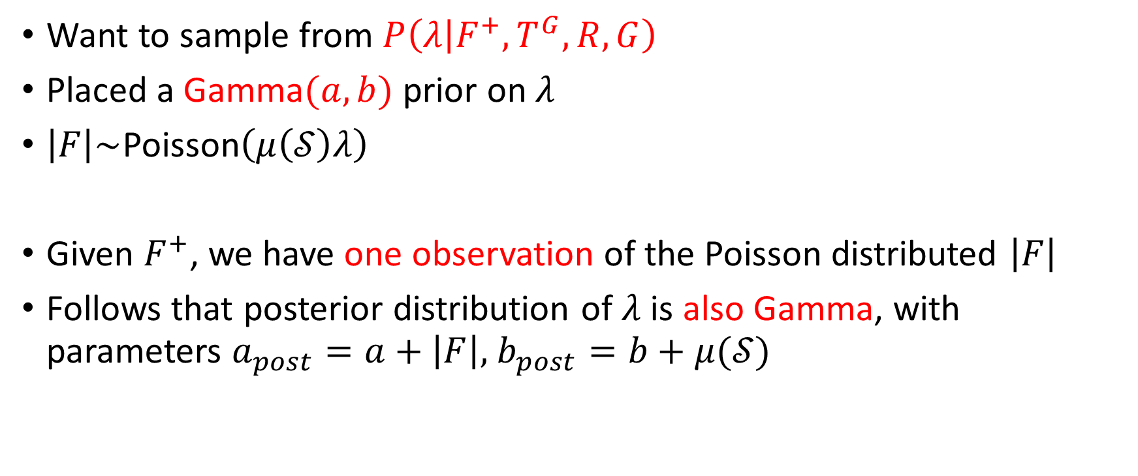
Step 3: Sampling the Poisson Intensity
Want to sample from $P\left(λ | F^{+},T^{G},R,G\right)$
Placed a Gamma$(a,b)$ prior on $λ$
$\left|F\right|\sim$Poisson$\left(μ\left(𝒮\right)λ\right)$
Given $F^{+}$, we have one observation of the Poisson distributed $\left|F\right|$
Follows that posterior distribution of $λ$ is also Gamma, with parameters $a_{post}=a+\left|F\right|,$ $b_{post}=b+μ(𝒮)$

Slide 21
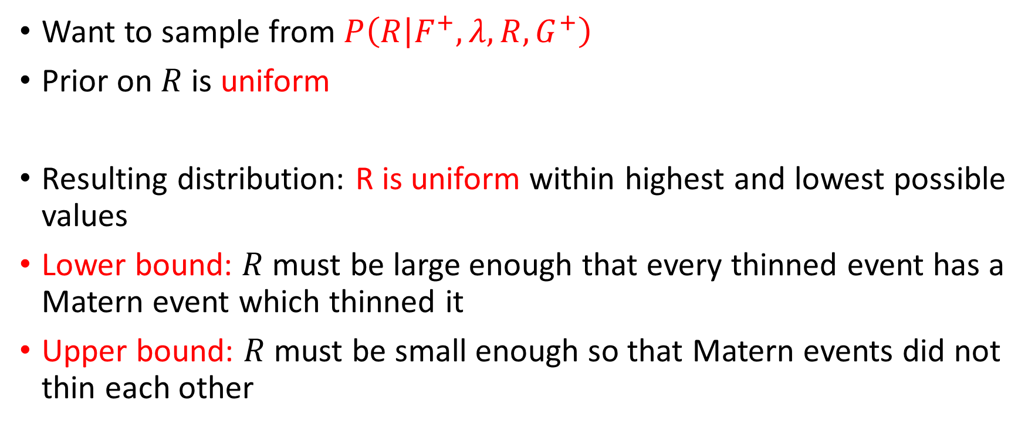
Step 4: Sampling the Interaction Radius
Want to sample from $P\left(R | F^{+},λ,R,G^{+}\right)$
Prior on $R$ is uniform
Resulting distribution: R is uniform within highest and lowest possible values
Lower bound: $R$ must be large enough that every thinned event has a Matern event which thinned it
Upper bound: $R$ must be small enough so that Matern events did not thin each other

Slide 22
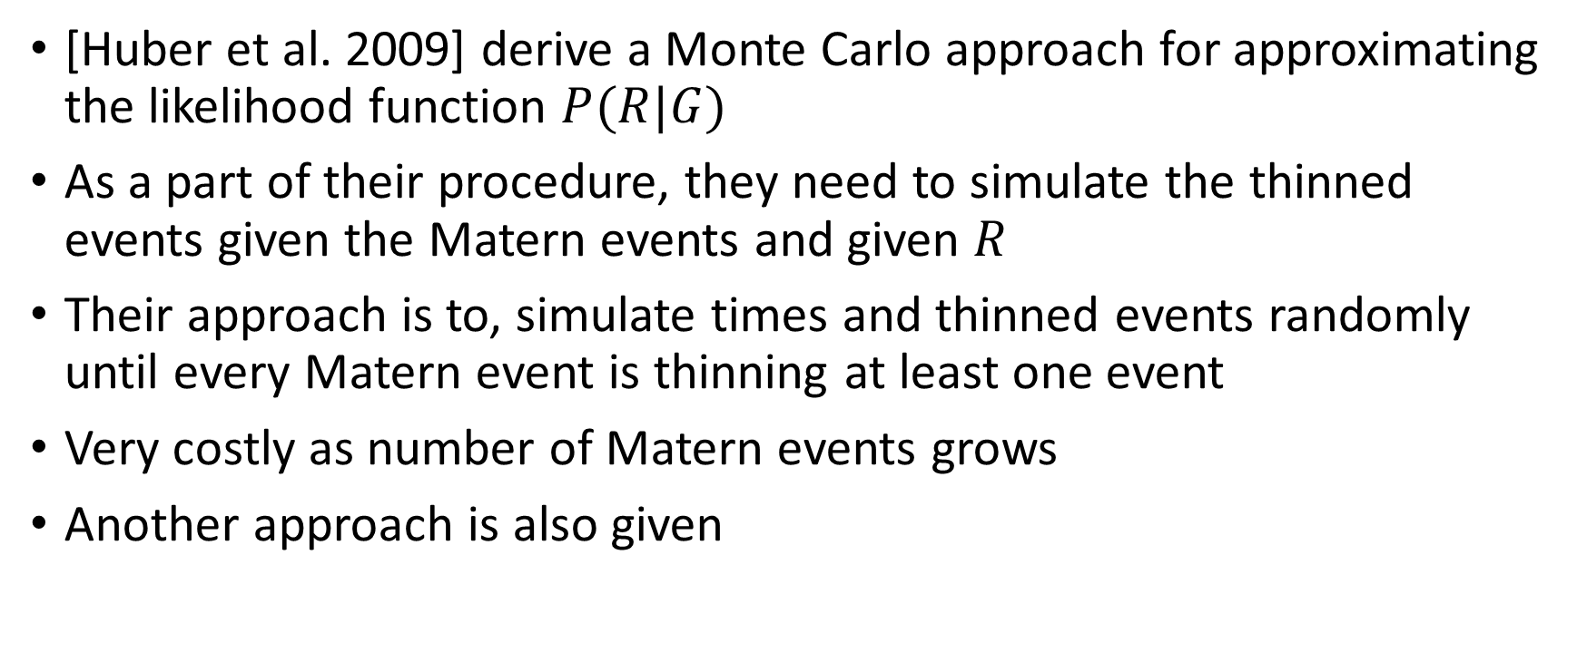
Previous work
[Huber et al. 2009] derive a Monte Carlo approach for approximating the likelihood function $P(R|G)$
As a part of their procedure, they need to simulate the thinned events given the Matern events and given $R$
Their approach is to, simulate times and thinned events randomly until every Matern event is thinning at least one event
Very costly as number of Matern events grows
Another approach is also given
Huber, Mark L., and Robert L. Wolpert. "Likelihood-based inference for Matérn type-III repulsive point processes." Advances in Applied Probability 41.4 (2009): 958-977.

Slide 23
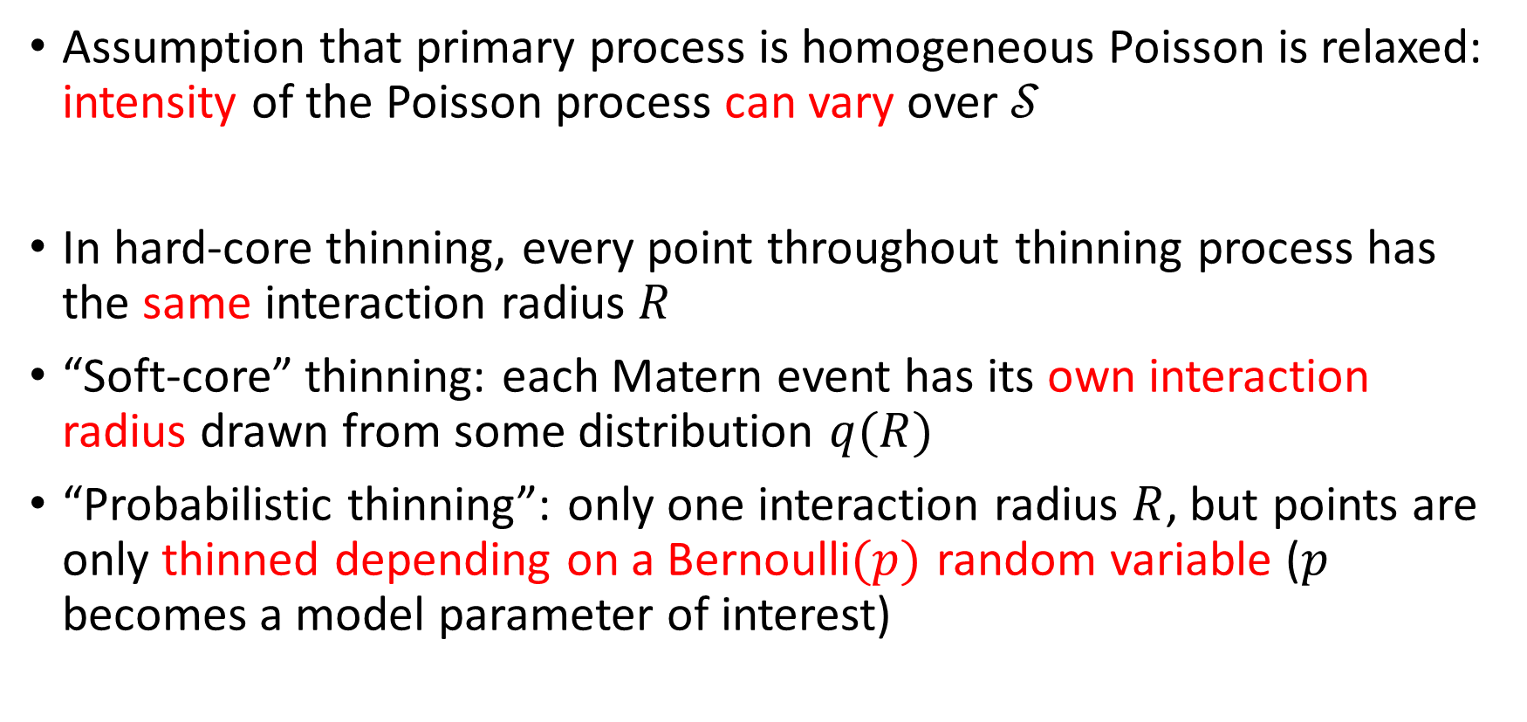
Generalizations also considered
Assumption that primary process is homogeneous Poisson is relaxed: intensity of the Poisson process can vary over $𝒮$
In hard-core thinning, every point throughout thinning process has the same interaction radius $R$
“Soft-core” thinning: each Matern event has its own interaction radius drawn from some distribution $q(R)$
“Probabilistic thinning”: only one interaction radius $R$, but points are only thinned depending on a Bernoulli$(p)$ random variable ($p$ becomes a model parameter of interest)

Slide 24


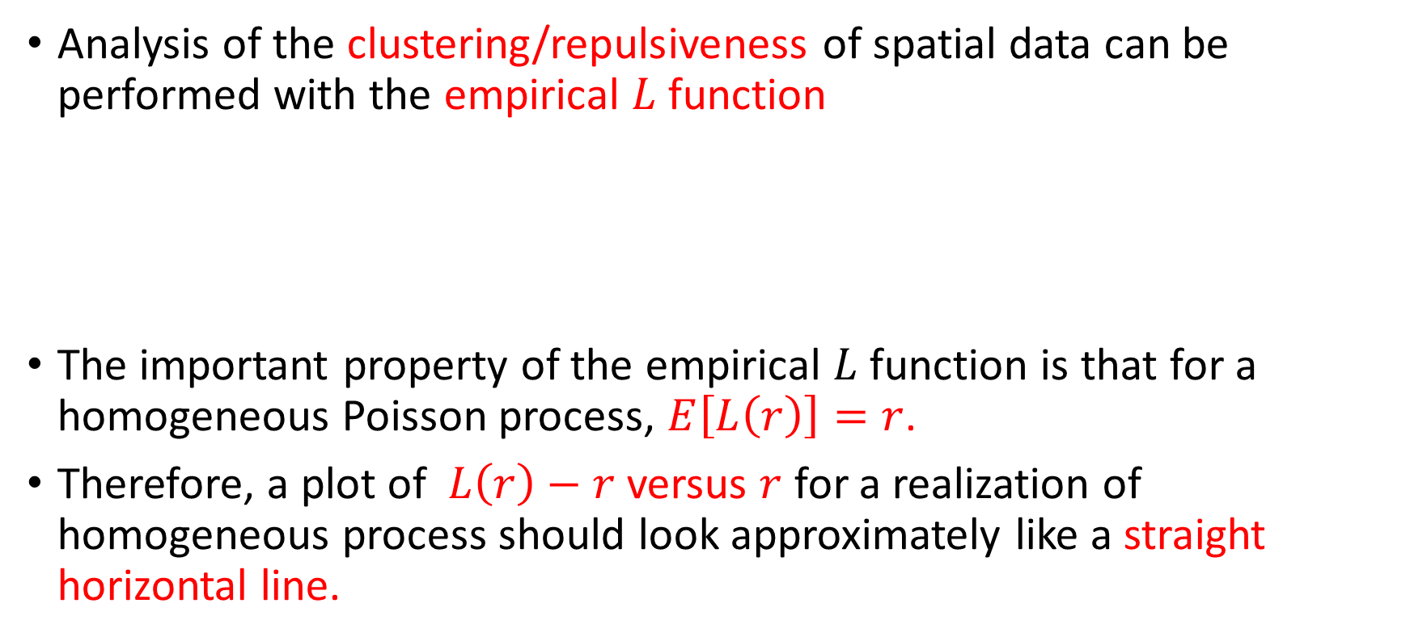
Model assessment tools: L function
Analysis of the clustering/repulsiveness of spatial data can be performed with the empirical $L$ function
The important property of the empirical $L$ function is that for a homogeneous Poisson process, $E\left[L\left(r\right)\right]=r$.
Therefore, a plot of $L\left(r\right)−r$ versus $r$ for a realization of homogeneous process should look approximately like a straight horizontal line.

Slide 25
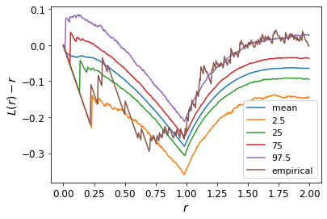
Model assessment tools: L function
Common approach to assess model fit: produce many realizations of a point process using the assumed model and its estimated parameters
For each realization: calculate the empirical L function. Calculate pointwise 25–75% and 2.5–97.5% bands for these L functions, as well as pointwise mean.
Plot empirical L function of real data over this:

Slide 26
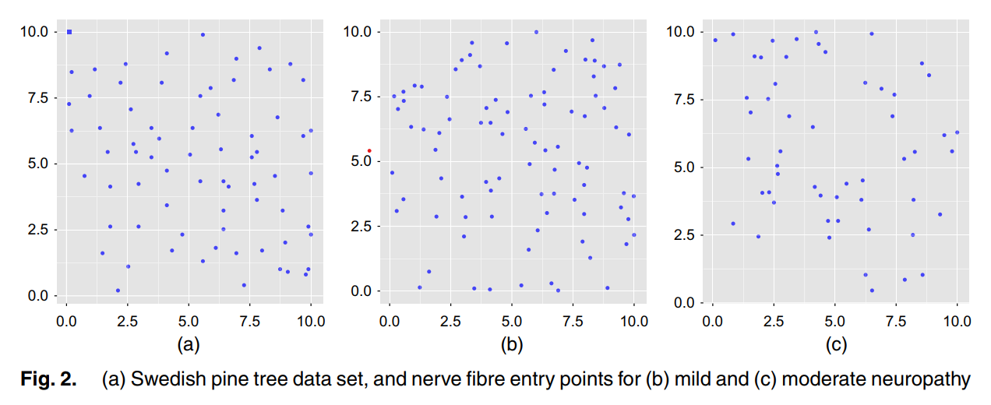
Application to real data sets

Slide 27
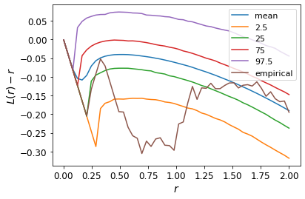
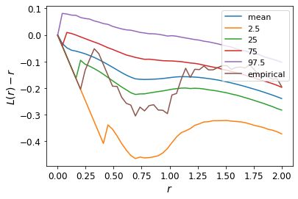
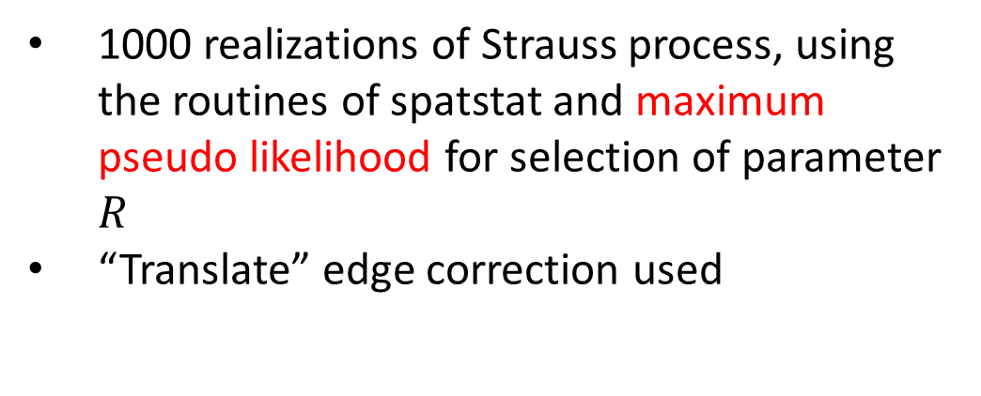
Results (Swedish Trees)
10000 MCMC iterations for hard-core, probabilistic thinning
First 1000 iterations not considered
no edge correction used to calculate L function
1000 realizations of Strauss process, using the routines of spatstat and maximum pseudo likelihood for selection of parameter $R$
“Translate” edge correction used

Slide 28
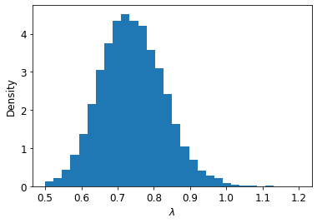
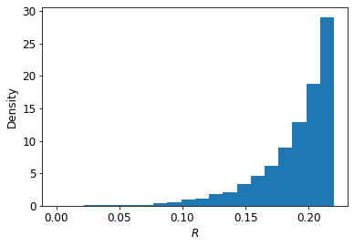
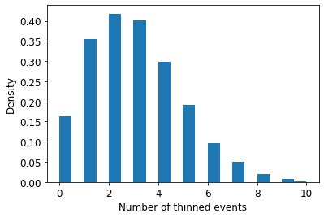
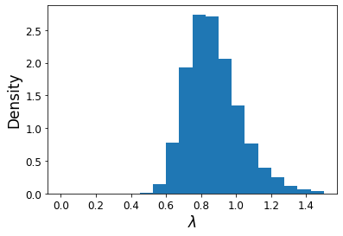
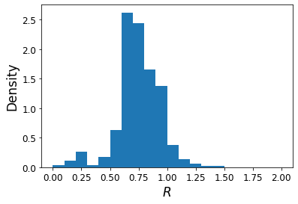
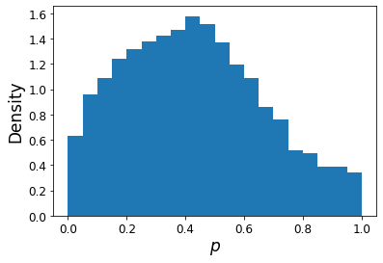
Results (Swedish Trees)
Hard-core
Probabilistic thinning

Slide 29
Extensions
Simple extension: look at how methods perform when the data are generated exactly according to the assumed model (hard-core, soft-core, and probabilistic thinning mechanisms)
They applied their methods only to real data for which the “true” values of parameters are unknown, but an application to simulated data would provide a good test case

Slide 30
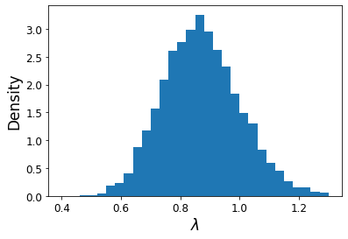
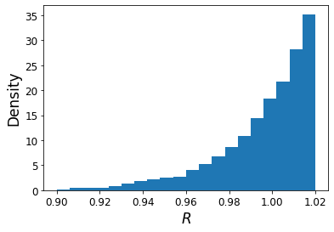
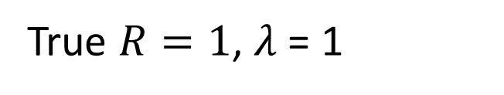
Extensions (Hard-core thinning)
True $R=1$, $λ$ = 1

Slide 31
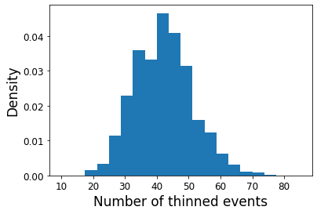
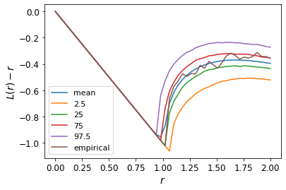
Extensions (Hard-core thinning)
Number of initial events = 107. Thinned events = 42

Slide 32
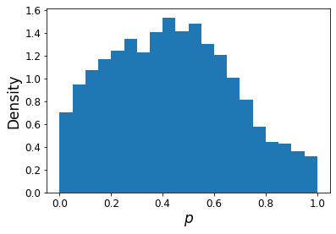
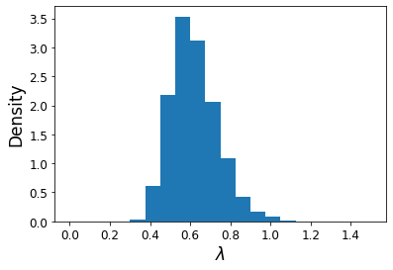
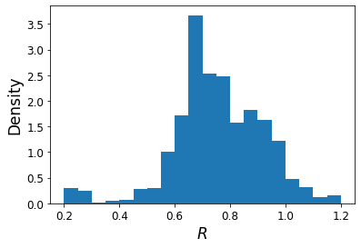

Extensions (Probabilistic thinning)
True $R=1$, $λ$ = 1, $p=0.8$

Slide 33
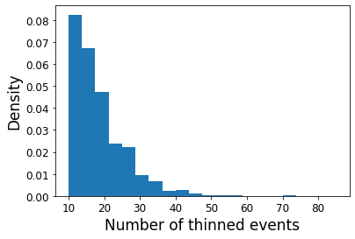
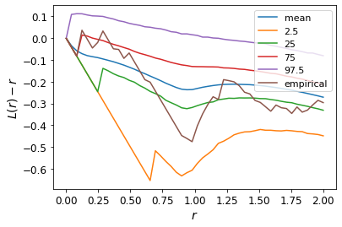
Extensions (Probabilistic thinning)
Number of initial events = 101. Thinned events = 51

Slide 34
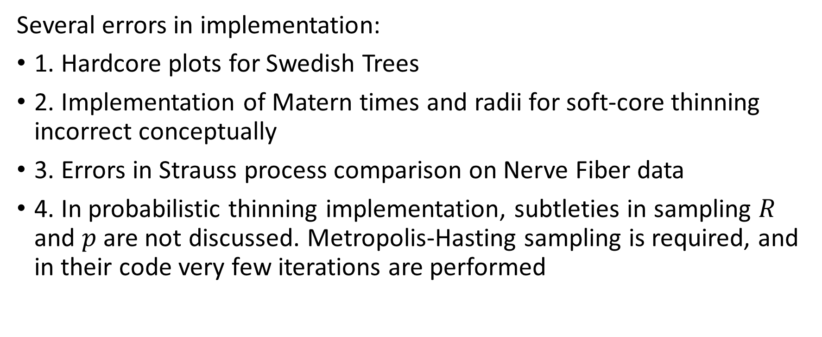
Limitations of analysis
Several errors in implementation:
1. Hardcore plots for Swedish Trees
2. Implementation of Matern times and radii for soft-core thinning incorrect conceptually
3. Errors in Strauss process comparison on Nerve Fiber data
4. In probabilistic thinning implementation, subtleties in sampling $R$ and $p$ are not discussed. Metropolis-Hasting sampling is required, and in their code very few iterations are performed

Slide 35
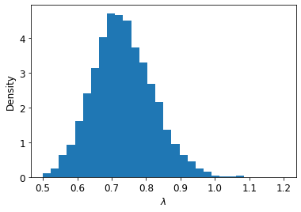
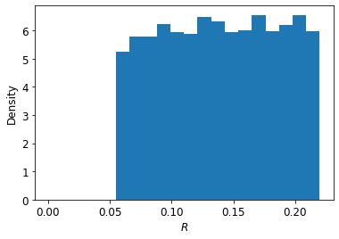
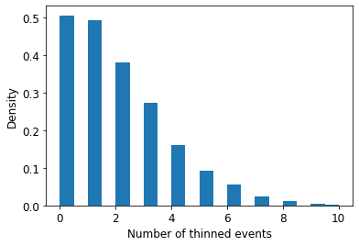
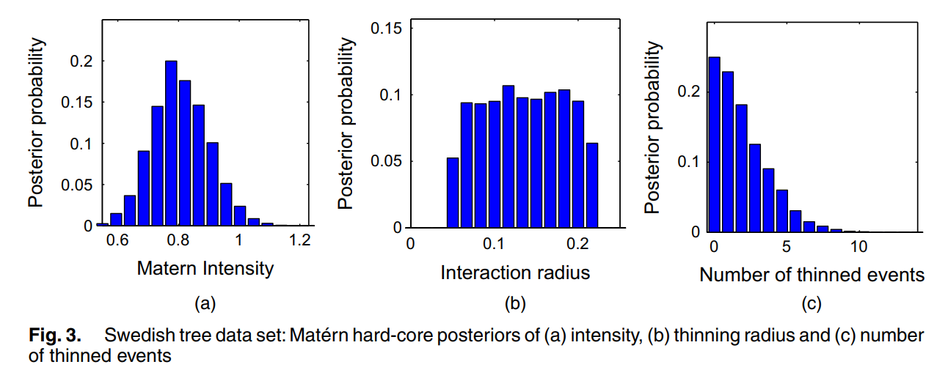
Errors in hard-core plots

Slide 36
Correct plots

Slide 37



Issues with comparison (Nerve Fiber) (Strauss process)

Slide 38
Summary
An approach to Bayesian modeling of the type III Matern Process introduced
Corollary 1 is a nice result that allows for much easier sampling than previous works
More flexible thinning procedures are introduced which their theory and methods capture (as well as a relaxation of the homogeneity assumption)
Not clear that Matern type III processes are better or worse than related models for repulsive point process data

Slide 39
Thanks for listening!
Questions?

