Slide 1
Update: Attenuation
August 15, 2019

Slide 2
Attenuation Paper: Major Reviewer Comments
Reviewer #1
Calculate reflection losses using layered media approach
Table with raw values of density, thickness, and insertion loss
More examples of raw signal
Reviewer #2 – No major comments
Reviewer #3
Difficult to assess accuracy
Present attenuation across frequency spectra
More information on how attenuation values compare to prior literature
Separate regressions for the diploe and cortical samples

Slide 3
Attenuation Paper: Major Reviewer Comments
Reviewer #1
Calculate reflection losses using layered media approach
Table with raw values of density, thickness, and insertion loss
More examples of raw signal
Reviewer #2 – No major comments
Reviewer #3
Difficult to assess accuracy
Present attenuation across frequency spectra
More information on how attenuation values compare to prior literature
Separate regressions for the diploe and cortical samples

Slide 4
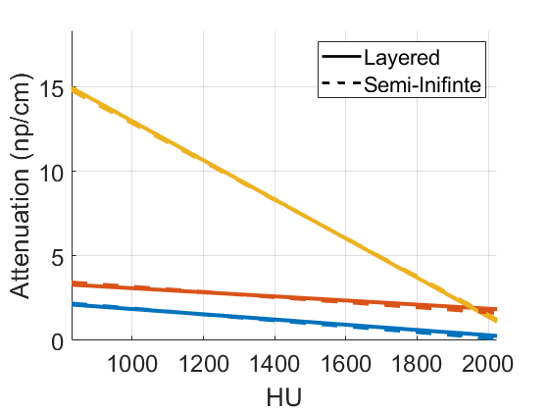
Transformation is Mostly Unchanged by Method of Computing Reflection Coefficient
Layered Media Calculation
Slightly increases R-squared values at 0.5 and 1 MHz
Slightly increases slope at 0.5 and 1 MHz
No change to average values for 2.25 MHz

Slide 5
Attenuation Paper: Major Reviewer Comments
Reviewer #1
Calculate reflection losses using layered media approach
Table with raw values of density, thickness, and insertion loss
More examples of raw signal
Reviewer #2 – No major comments
Reviewer #3
Difficult to assess accuracy
Present attenuation across frequency spectra
More information on how attenuation values compare to prior literature
Separate regressions for the diploe and cortical samples

Slide 6
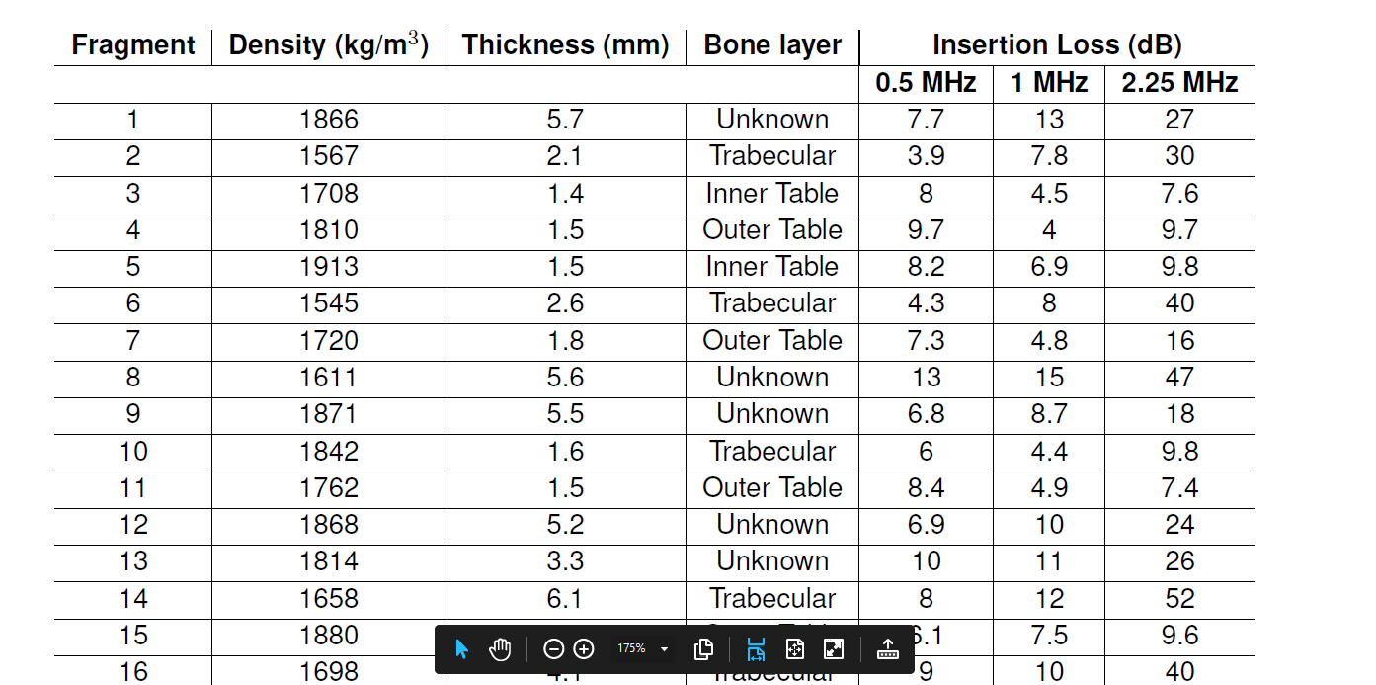

Slide 7
Attenuation Paper: Major Reviewer Comments
Reviewer #1
Calculate reflection losses using layered media approach
Table with raw values of density, thickness, and insertion loss
More examples of raw signal
Reviewer #2 – No major comments
Reviewer #3
Difficult to assess accuracy
Present attenuation across frequency spectra
More information on how attenuation values compare to prior literature
Separate regressions for the diploe and cortical samples

Slide 8
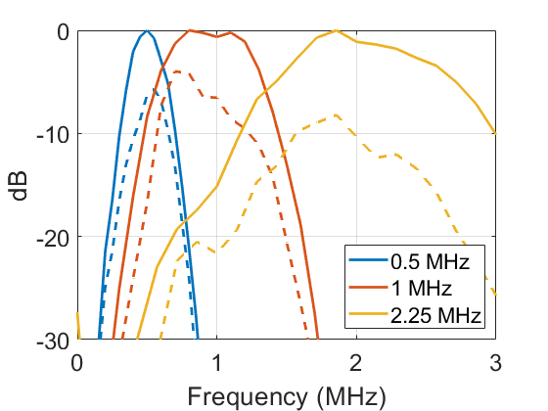
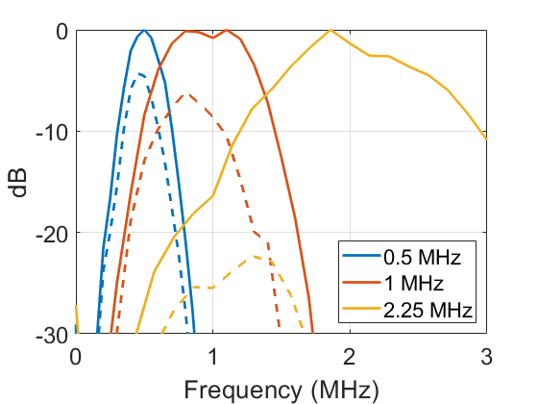
Raw Data
Cortical
Trabecular

Slide 9
Attenuation Paper: Major Reviewer Comments
Reviewer #1
Calculate reflection losses using layered media approach
Table with raw values of density, thickness, and insertion loss
More examples of raw signal
Reviewer #2 – No major comments
Reviewer #3
Difficult to assess accuracy
Present attenuation across frequency spectra
More information on how attenuation values compare to prior literature
Separate regressions for the diploe and cortical samples

Slide 10
Assessing Accuracy
Report more details about the frame
Repeat measurements with different thicknesses of acrylic
Verify that I get the same answer each time
Verify that it is in the right range for attenuation in acrylic
Working on putting together a setup for this
Have:
Hydrophone, aluminum frame, water tank, o-scope, 0.5 and 1 MHz Tx
Need:
2.25 MHz Tx, acrylic pieces cut to different sizes

Slide 11
Attenuation Paper: Major Reviewer Comments
Reviewer #1
Calculate reflection losses using layered media approach
Table with raw values of density, thickness, and insertion loss
More examples of raw signal
Reviewer #2 – No major comments
Reviewer #3
Difficult to assess accuracy
Present attenuation across frequency spectra
More information on how attenuation values compare to prior literature
Separate regressions for the diploe and cortical samples

Slide 12
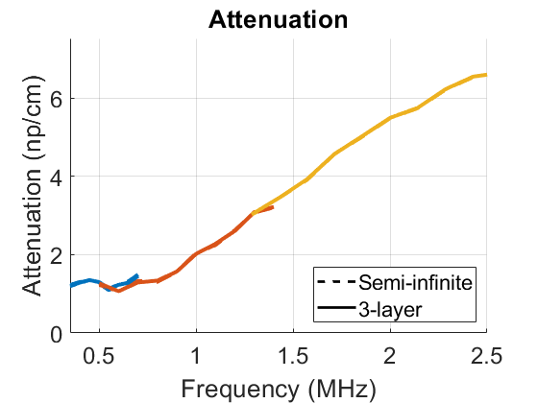
Attenuation and Frequency
Good agreement across the three transducers
Large variation around 0.5 MHz
Not improved by 3-layer reflection coefficient

Slide 13
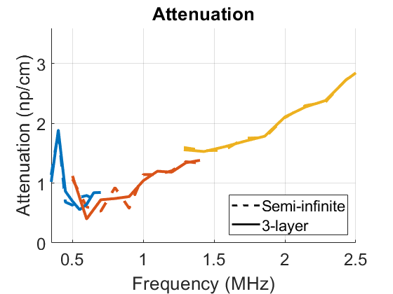
Attenuation and Frequency
Good agreement across the three transducers
Large variation around 0.5 MHz
Not improved by 3-layer reflection coefficient
Only small differences between two methods of computing reflection coefficient

Slide 14
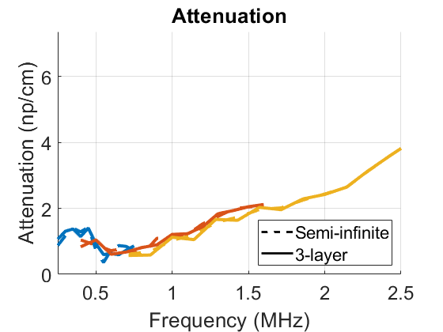
Attenuation and Frequency
Good agreement across the three transducers
Large variation around 0.5 MHz
Not improved by 3-layer reflection coefficient
Only small differences between two methods of computing reflection coefficient

Slide 15
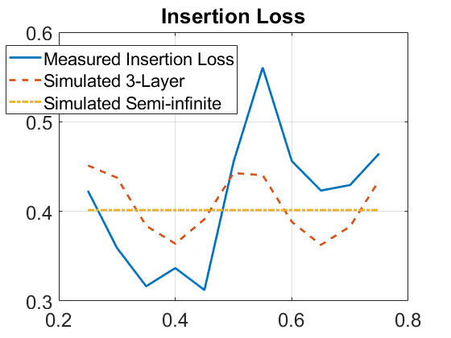
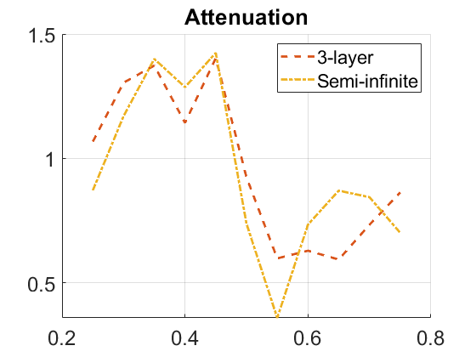
Low Frequency Variation
Insertion loss varies more than simulations would predict

Slide 16
Attenuation Paper: Major Reviewer Comments
Reviewer #1
Calculate reflection losses using layered media approach
Table with raw values of density, thickness, and insertion loss
More examples of raw signal
Reviewer #2 – No major comments
Reviewer #3
Difficult to assess accuracy
Present attenuation across frequency spectra
More information on how attenuation values compare to prior literature
Separate regressions for the diploe and cortical samples

Slide 17
Update: T2
August 15, 2019

Slide 18
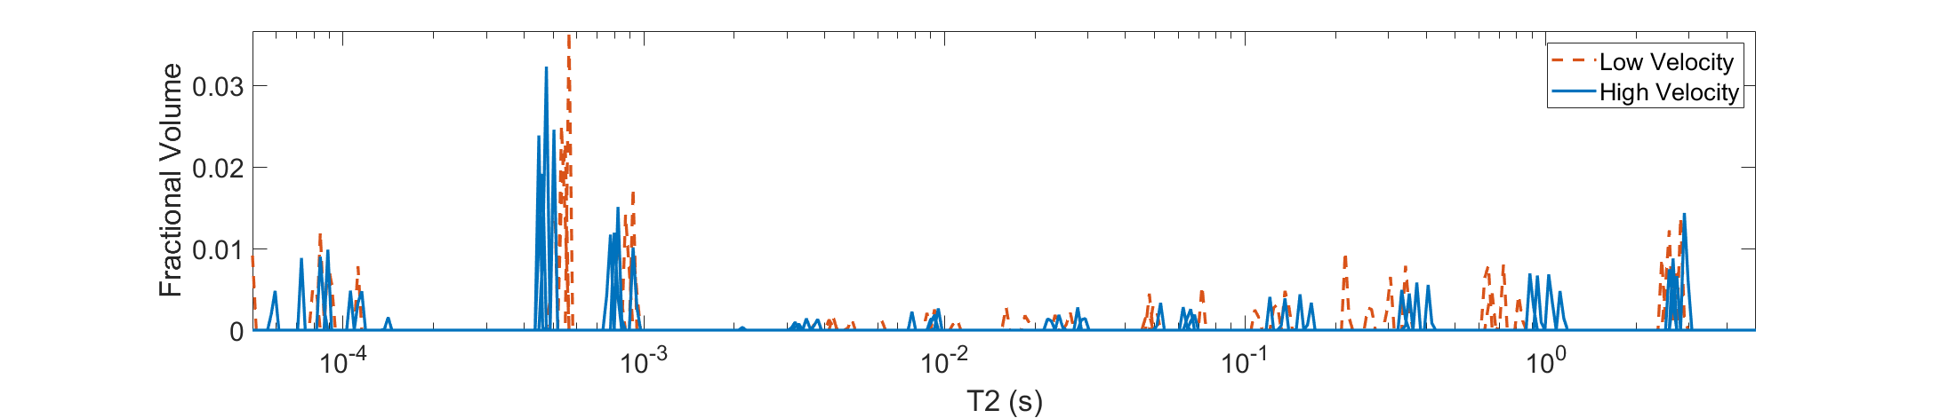
Next Steps
Thoughts on the results so far?
Send the remainder of the fragments?
We don’t have long enough echoes to look at the 0.8 s peaks (max echo time in our data is 10 ms)
Need a non-GRE method?
When to write up and publish?

