Slide 1
Data overview

Slide 2
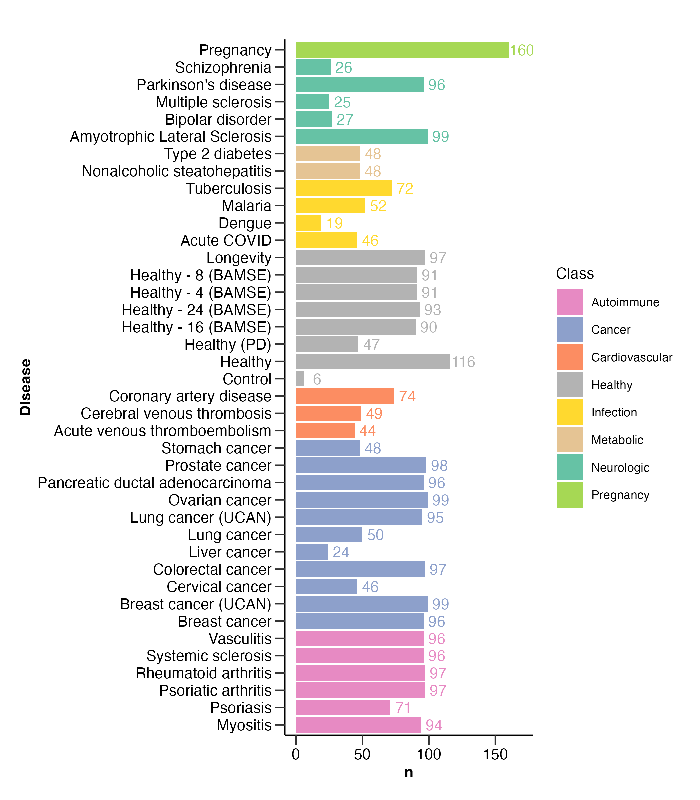
Number of samples

Slide 3
Number of samples
Age, sex, bmi

Slide 4
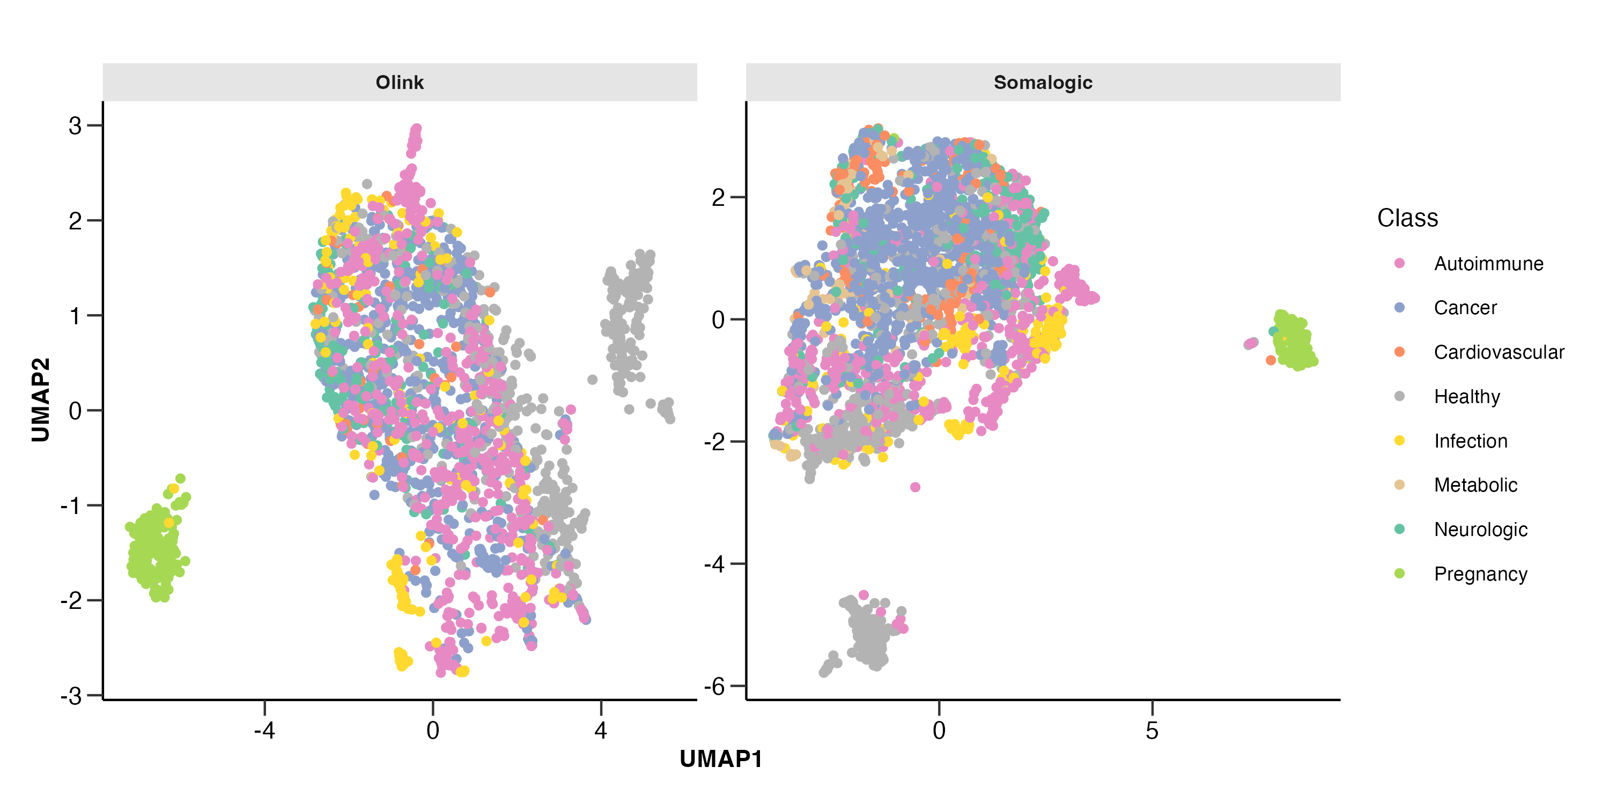
UMAP

Slide 5
Number of proteins

Slide 6
Number of aptamers per protein

Slide 7
Number of aptamers per protein

Slide 8
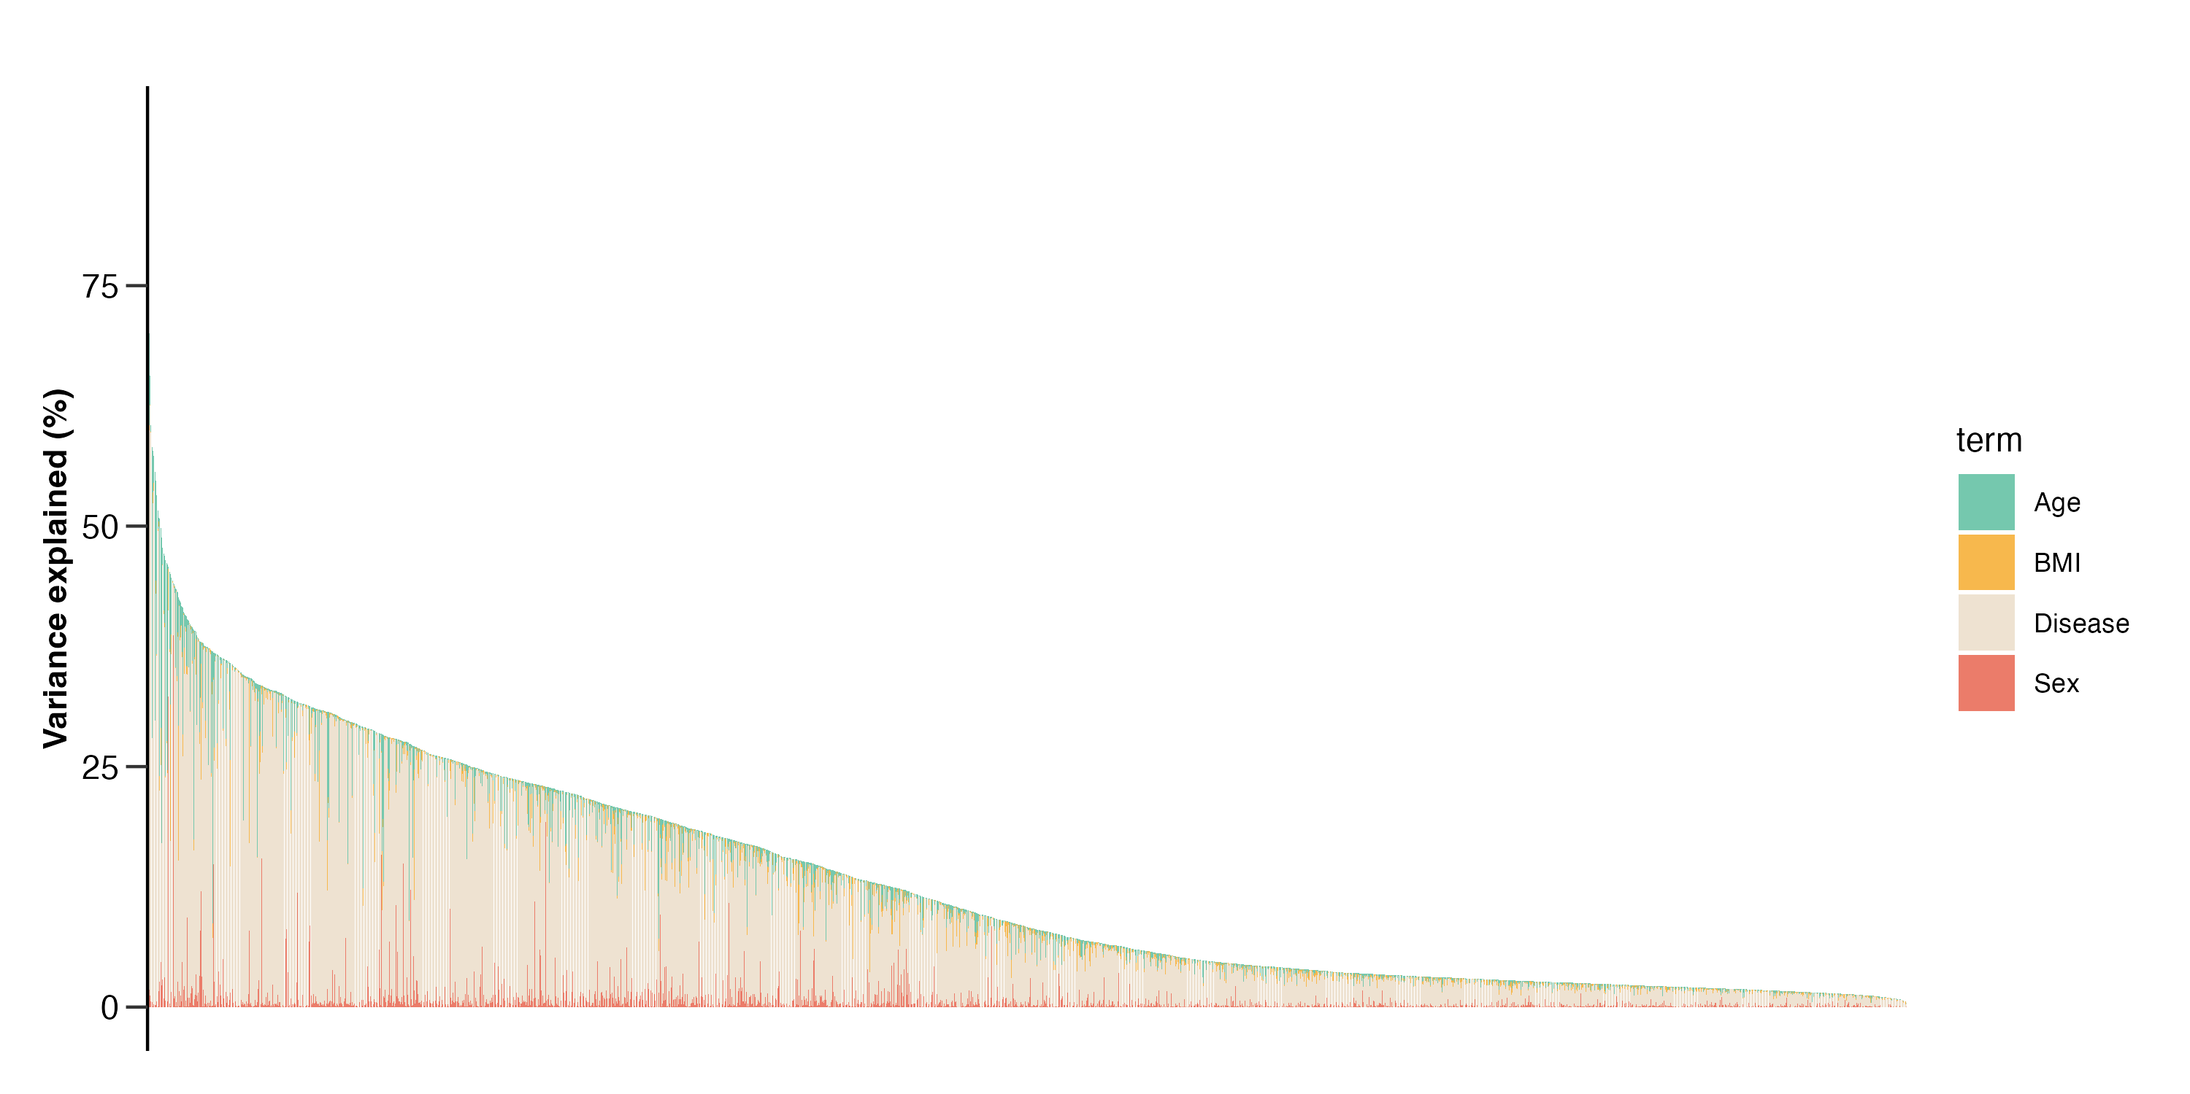
Variance explained - Olink

Slide 9
Variance explained - Somalogic

Slide 10
Variance explained - Comparison

Slide 11
Disease classfication

Slide 12
ML (separate)

Slide 13
ML (together)

Slide 14
Age prediction

Slide 15
ML (together)
* Excluded: UCAN cancers

Slide 16
Disease-specific

Slide 17
Disease-focus publications
~30 diseases analyzed with Olink & Somascan
Olink Explore 1.5K
Olink Explore HT
Somascan
2 (3) platforms
Differential expression
Machine learning
2 methods
Against helathy
Against related diseases
Against non-reated diseases
3 comparisons
Run by Explore HT and Somascan
Run exclusively by Explore HT
Run by Explore 1.5K (already published)
Run buy UK biobank (if available)
4 sample sets

