Slide 1
Data overview

Slide 2
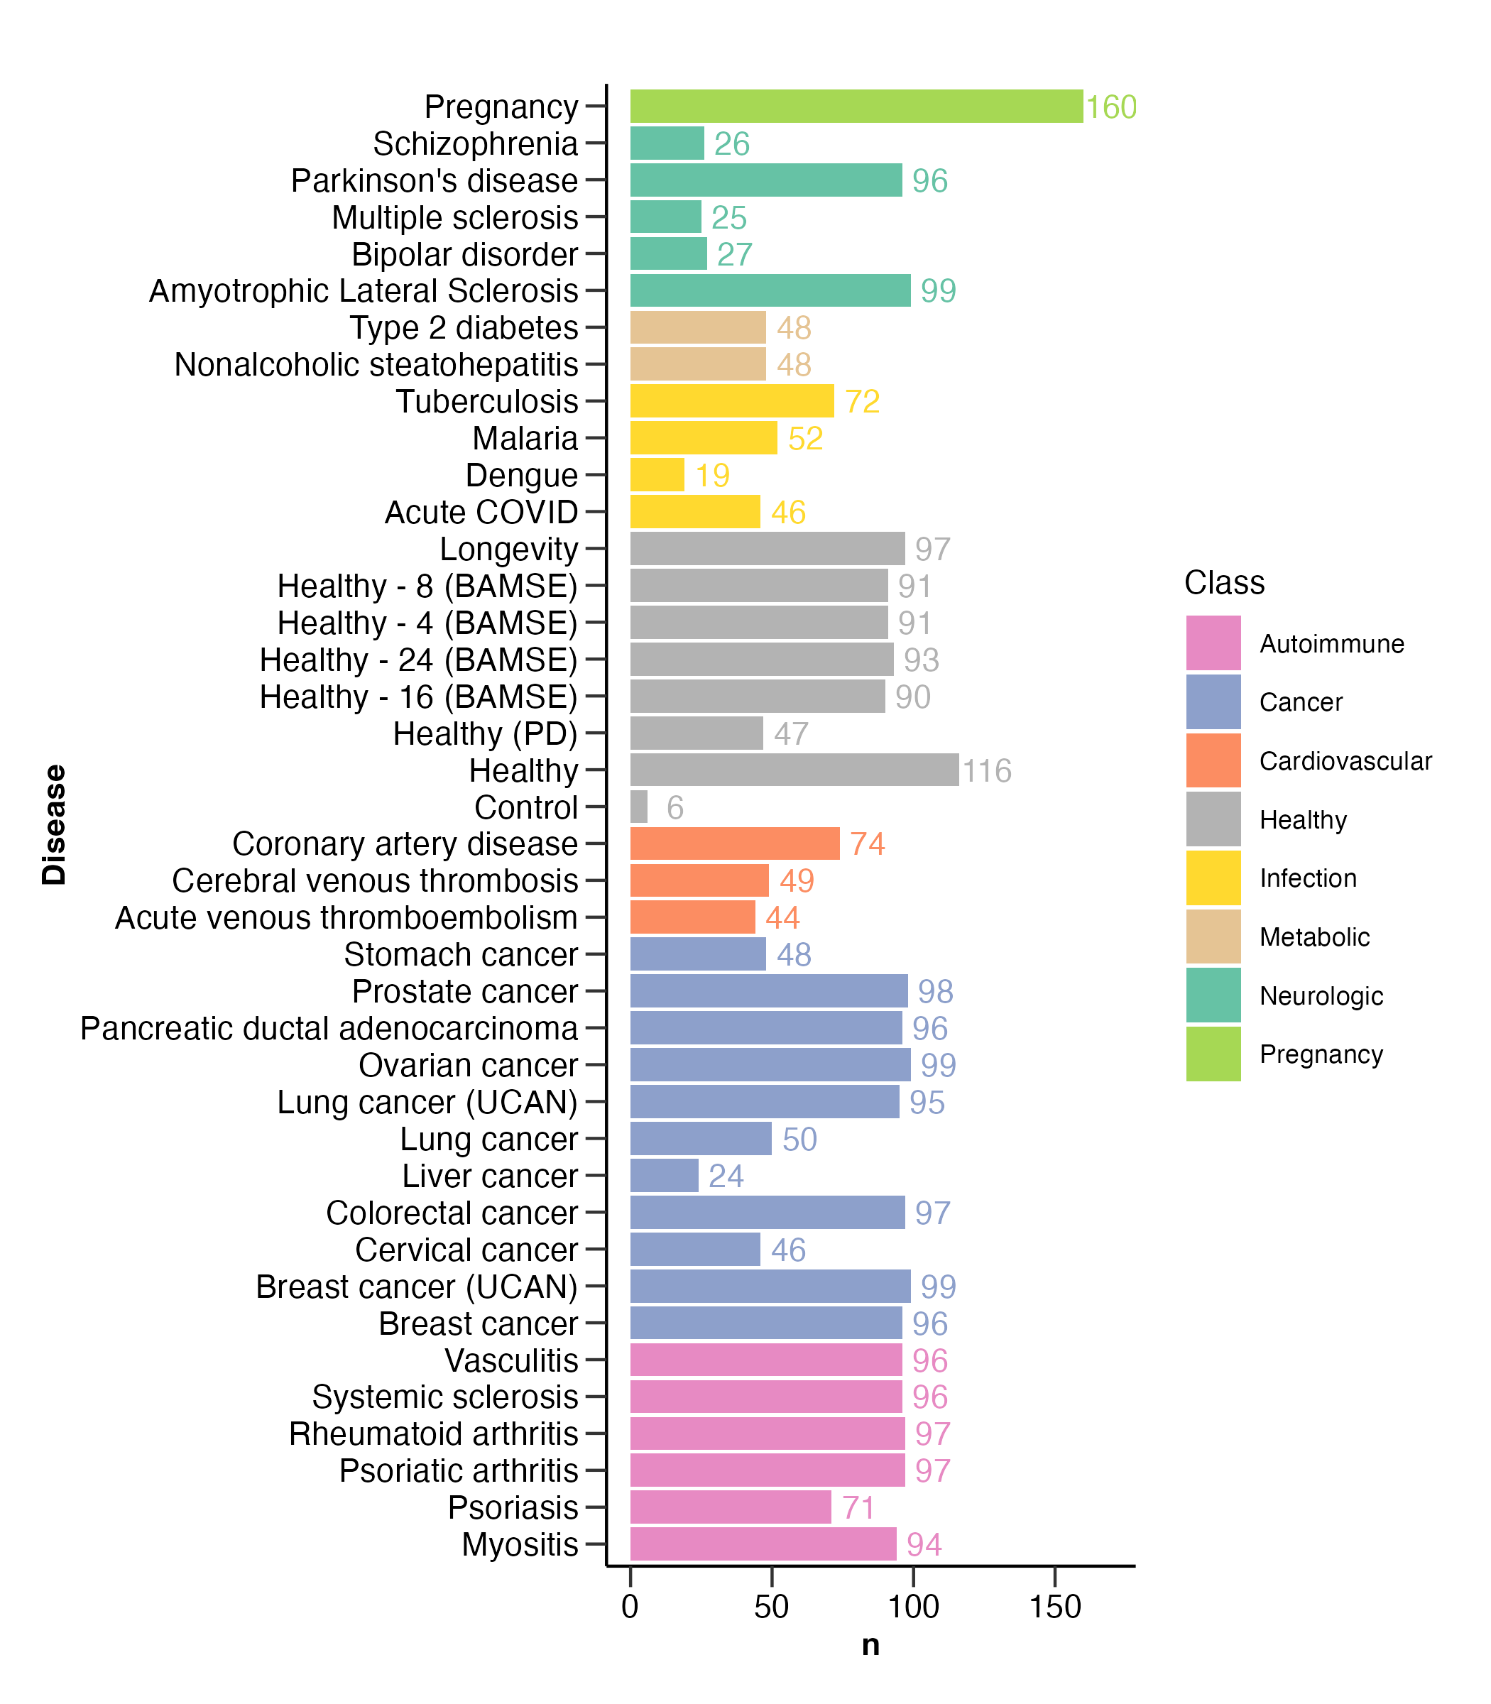
Number of samples

Slide 3
UMAP

Slide 4
Variance explained

Slide 5
Disease classfication

Slide 6
ML (separate)

Slide 7
ML (together)

Slide 8
Age prediction

Slide 9
ML (together)
* Excluded: UCAN cancers

Slide 10
Disease-specific

Slide 11
Disease-focus publications
~30 diseases analyzed with Olink & Somascan
Olink Explore 1.5K
Olink Explore HT
Somascan
2 (3) platforms
Differential expression
Machine learning
2 methods
Against helathy
Against related diseases
Against non-reated diseases
3 comparisons
Run by Explore HT and Somascan
Run exclusively by Explore HT
Run by Explore 1.5K (already published)
Run buy UK biobank (if available)
4 sample sets

