Slide 1

Internship Program 2019 - Development
Training and Results

Slide 2
Training Contents
Oracle Database
- PL/SQL Developer.
SQL Windows
- OpenText Gupta Team Developer 6.3.
Version Control of Project
- Sami-Git.
Agile Methodology
- Scrum.
Company Business
- Special Programs (Foreign Trade).
Development of an Asset Control System Project.

Slide 3

Asset Control System Project

Slide 4
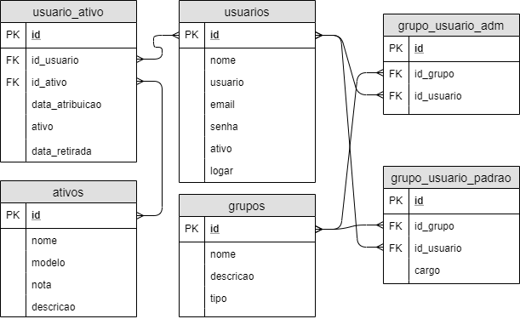
Asset Control System Project
Database Model.

Slide 5
Asset Control System Project
Administrators.
Sectors
Managers.
Users.

Slide 6
Asset Control System Project
http://10.197.69.94:82/web/

Slide 7

Questions?

