Slide 1

Internship Program 2016 - Development
Training and Results

Slide 2
Training Contents
Web Development Tools
- Eclipse IDE, Tomcat, PL/SQL Developer and TortoiseSVN.
Hibernate
- Mapping of Java classes to database tables.
Java Server Faces (JSF 1.2)
- Life cycle, managed beans, basic components, data table, validation and events.
Implementation of new features to the financial system project.

Slide 3
Support
Meeting every two days.
Doubts were solved when they came up and during the meetings.

Slide 4
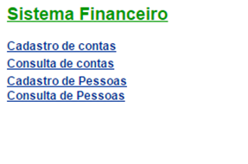
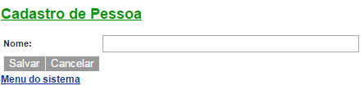
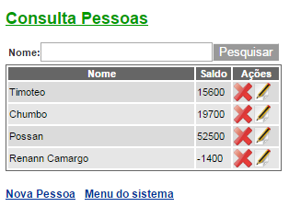
Financial System Project
New features.

Slide 5
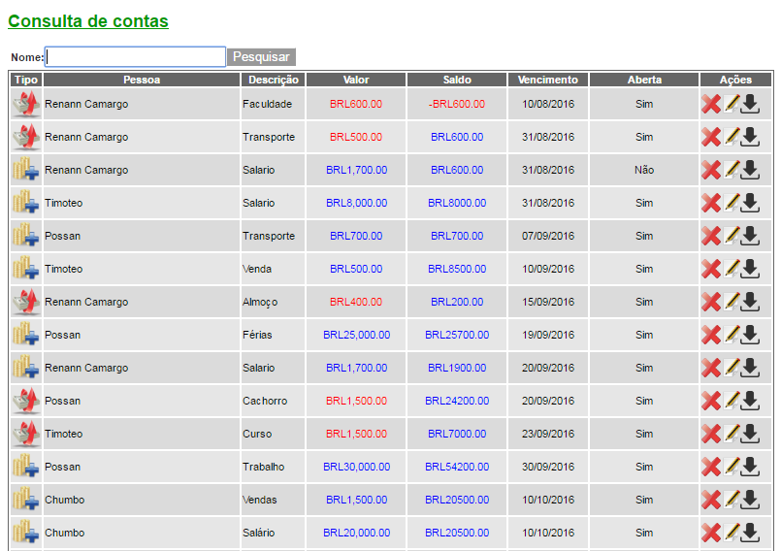

Financial System Project
2
3
1

Slide 6
Financial System Project
Implemented items:
Search by person’s name;
Balance calculated for each registered account.
Button to write off the bill.
1
2
3

Slide 7

Questions?

