Slide 1
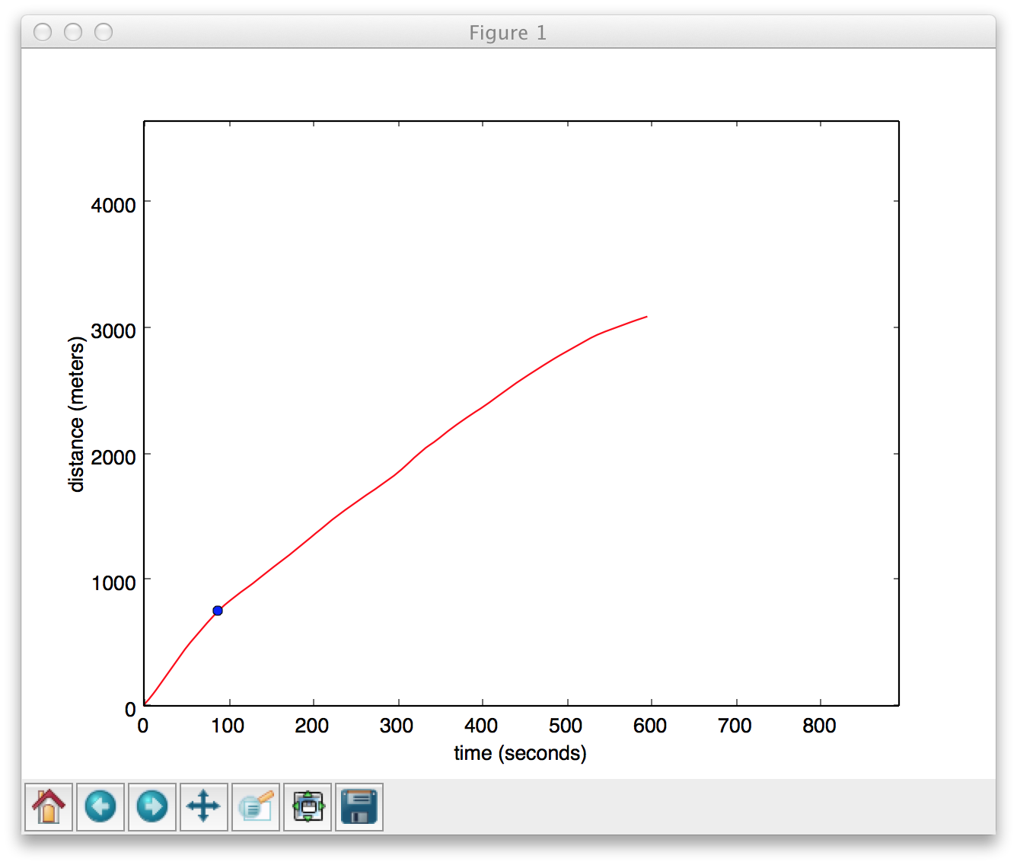

10minute2.csv 743.400868695 3095.76129245 4.62794763401 4.85226810528

Slide 2
10minute2.csv 743.400868695 3095.76129245 4.62794763401 4.85226810528

