Slide 1
CUSTOMER RESEARCH BRIEFING
NetMamba+
from source to a measured demo
Actual GPU training, saved-classifier inference and a practical IDS roadmap
3 × 120
86.65%
1,041
completed fine-tuning epochs
mean test accuracy · three seeds
flows in the fixed test split
Source-based fine-tuning on a GB10 compatibility port. Exact paper reproduction remains unestablished.
15 September 2026
Notes:
Start with the evidence boundary. We ran the original multimodal Mamba classifier and native training workflow on a GB10. The results belong to a documented source-based protocol, which differs from the paper's environment and batch/rate settings. The customer demo is backed by a real saved classifier. Do not call this a validated production IDS or claim the paper's 97.50 percent accuracy as our result.
Evidence: https://github.com/buffbeefalo/netmambaplus-reproduction/tree/main/docs/customer/evidence

Slide 2
01 / WHAT WAS ACTUALLY TRIED
From an untested harness to GPU evidence
The work includes failures, fixes and a repeatable installation rehearsal.
Runtime
Training
Inference
Built the authors' Mamba fork and causal convolution for GB10.
Seven forward/backward checks passed in two isolated environments.
Masked pretraining: 132 updates on training-only flows.
Fine-tuning: three seeds, 120 epochs and 7,920 updates each.
Strictly reloaded the selected classifiers.
Recomputed confusion matrices and metrics from saved predictions.
Built an offline replay.
Commands, hashes, losses and prediction records are published alongside the explanation.
NETMAMBA+ / MEASURED RESEARCH / 15 September 2026
02
Notes:
The initial repository had standard-library tests and parser dry runs only. The old native extensions did not build directly on CUDA 13. The compatibility fixes affect compiler targets, removed CUB APIs and the assembler path; the original model and loader checkout stays unchanged. Both the first build and the automated rebuild passed numerical checks. A short pretraining run exercises reconstruction learning; it does not recreate the paper's entire pretraining history.
Evidence: https://github.com/buffbeefalo/netmambaplus-reproduction/tree/main/docs/customer/evidence

Slide 3
02 / INPUTS AND OUTPUTS
One prediction describes one flow
The uploaded packet CSVs cannot establish this ordered, multimodal flow representation.
Byte content
Packet sizes
Arrival intervals
First 5 packets × 320 bytes
Tensor: [B, 1, 1, 1600]
400 embedded byte strides
First 20 values
Native clipping and padding
20 size tokens
First 20 values
Native monotonic transform
20 interval tokens
443 tokens → four Mamba blocks → three summed summary vectors → six class logits
NETMAMBA+ / MEASURED RESEARCH / 15 September 2026
03
Notes:
The plus sign is material: NetMamba+ combines byte content, sizes and timing. The CSVs contain 1,500 payload-byte columns per packet, plus TTL, length, protocol, time delta and label. Full scans found 1,410,255 CICIDS2017 rows and 79,881 UNSW rows, but no flow identifiers or established packet grouping. We therefore used the authors' separate CICIoT2022 flow release. The six outputs are Flood, RTSP Brute Force and four IoT power/device categories, not a universal benign/malicious decision.
Evidence: https://github.com/buffbeefalo/netmambaplus-reproduction/tree/main/docs/customer/evidence

Slide 4
03 / HOW LEARNING WORKS
Three stages, three different questions
A pretraining checkpoint becomes a classifier only after supervised fine-tuning.
1 · Pretrain
2 · Fine-tune
3 · Infer
Hide byte, size and timing entries.
Reconstruct the missing content.
Learn an encoder without attack-category targets.
Load the pretrained encoder.
Learn six labeled categories.
Select the checkpoint using validation accuracy.
Freeze the selected classifier.
Load weights and class meanings strictly.
Emit six scores and a predicted label.
The released pretraining file has no classification head. Our saved fine-tuned classifier does.
NETMAMBA+ / MEASURED RESEARCH / 15 September 2026
04
Notes:
Pretraining masks 90 percent of byte strides and 15 percent of each sequence modality in the selected recipe. The paper reports Browser and Kitsune pretraining; its exact corpus and checkpoint history have not been established here. Our short training-only functional run proves that the reconstruction path executes and learns on downstream data. Main fine-tuning begins from the released pretraining weights. Inference does not update weights or consume the benchmark label as a model feature. Softmax confidence is uncalibrated.
Evidence: https://github.com/buffbeefalo/netmambaplus-reproduction/tree/main/docs/customer/evidence

Slide 5
04 / EXPERIMENTAL PROTOCOL
The source recipe differs from the paper
Preserve those differences when describing the result.
Setting
Measured source profile
Paper v1
Fine-tuning budget
120 epochs × 3 seeds
120 epochs
Batch size
128
64
Maximum effective LR
0.001 (blr 0.002)
Reported 0.002
Runtime
GB10 / Torch 2.9.1 / cu130
A100 / Torch 2.1.1
Pretraining history
Released weights; partly unknown
Browser + Kitsune
Official splits: 8,323 train / 1,040 validation / 1,041 test. Seed 0 was chosen for the demo before test scores.
NETMAMBA+ / MEASURED RESEARCH / 15 September 2026
05
Notes:
The source preset runs 120 epochs with batch 128 and a base learning-rate parameter of 0.002. Native scaling gives a maximum effective rate of 0.001 for one process and accumulation one. The paper specifies batch 64 and rate 0.002. We used seeds zero, one and two and report them all. Five exact stored raw inputs overlap train and validation; six overlap train and test. Unknown earlier checkpoint exposure and physical capture independence remain limitations. Repeated strict evaluation checks the same frozen test result, not another independent holdout.
Evidence: https://github.com/buffbeefalo/netmambaplus-reproduction/tree/main/docs/customer/evidence

Slide 6
05 / MEASURED RESULTS
Report every seed and name the metric
Test accuracy, support-weighted F1 and macro F1 are independently recomputed.
Seed
Accuracy
Weighted F1
Macro F1
0
91.26%
91.26%
91.58%
1
84.05%
84.08%
84.86%
2
84.63%
84.67%
85.38%
Mean
86.65%
86.67%
87.27%
Accuracy sample SD: 4.00 percentage points across seeds on this fixed split.
Paper Table IV: NetMamba+ CICIoT2022 accuracy/F1 = 97.50%. This is a reference under different conditions.
NETMAMBA+ / MEASURED RESEARCH / 15 September 2026
06
Notes:
Our measured test accuracies were 91.26 percent for seed zero, 84.05 percent for seed one and 84.63 percent for seed two: 86.65% mean, with a sample standard deviation of 4.00 percentage points. The paper reports 97.50 percent; we did not reproduce that score, and we have not isolated the reason for the gap. Accuracy is correct predictions divided by test rows. Weighted F1 weights each class by its number of true examples. Macro F1 treats every class equally, so a small weak class can lower macro F1 more strongly. The table reports all three declared seeds; the mean and sample standard deviation describe seed variability on the same dataset, not uncertainty across customer networks. The paper number is not our measurement and is not a directly controlled comparison. The full source-based experiment and strict re-evaluation are complete even if their scores do not match the paper.
Evidence: https://github.com/buffbeefalo/netmambaplus-reproduction/tree/main/docs/customer/evidence

Slide 7
06 / WHERE THE CLASSIFIER MAKES MISTAKES
Make the errors visible
Seed 0, selected for the demo in advance. Rows are true classes; columns are predictions.
TRUE / PRED.
Flood
RTSP
Audio
Other
Camera
Home
Seed 0 accuracy
Flood
185
14
0
0
1
0
91.26%
RTSP
1
199
0
0
0
0
Seed 0 macro F1
Audio
0
0
185
1
12
2
91.58%
Other
0
1
1
37
0
2
Test examples
Camera
0
0
7
0
168
25
1,041 flows / six classes
Home
1
1
6
0
16
176
The smallest test class contains 41 flows. Keep per-class support and recall beside the overall score.
NETMAMBA+ / MEASURED RESEARCH / 15 September 2026
07
Notes:
Walk through one off-diagonal cell as a concrete mistake: the row says what the dataset label was, and the column says what the classifier predicted. Diagonal cells are correct. These six classes mix two attacks with four IoT categories. A high aggregate score cannot establish coverage of other attacks or acceptable false alerts on a real network. The full prediction inventory preserves errors; no examples were removed to improve the display.
Evidence: https://github.com/buffbeefalo/netmambaplus-reproduction/tree/main/docs/customer/evidence

Slide 8
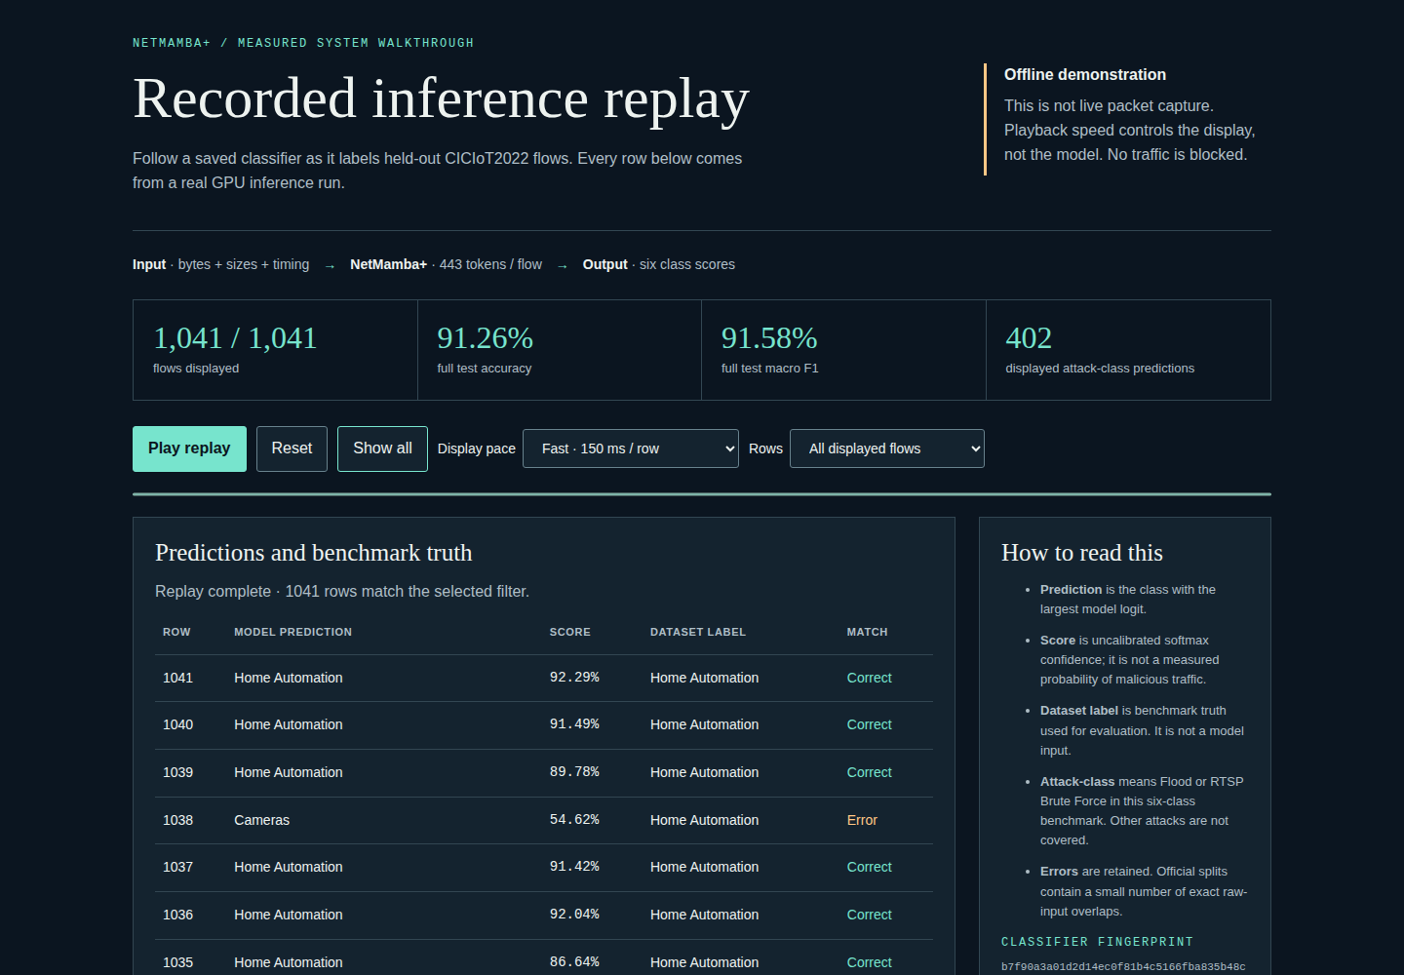
07 / WORKING DEMONSTRATION
Replay actual saved-classifier predictions
The browser page works offline. GPU inference produced the records behind it.
Present it
Play, then Show all.
Filter Prediction errors.
Explain one mistake and show the checkpoint hash.
State the limit
Recorded inference only.
No capture or blocking.
Display pace is adjustable.
Scores are uncalibrated.
A recorded walkthrough and PDF are included as meeting backups.
NETMAMBA+ / MEASURED RESEARCH / 15 September 2026
08
Notes:
Open the HTML before the meeting. Press Play replay, then Show all, then select Prediction errors. The six class meanings and checkpoint hash are embedded with the measurements. This is a recorded inference demonstration, not live network traffic. The same repo contains commands to rerun actual GPU inference using the trained checkpoint. Raw packet payloads are not embedded in the presentation page.
Evidence: https://github.com/buffbeefalo/netmambaplus-reproduction/tree/main/docs/customer/evidence

Slide 9
08 / MEASURED INFERENCE COST
Time the model and state what is excluded
GB10 · float16 autocast · 20 warmups + 100 synchronized measurements per batch size
Batch
Median batch latency
95th percentile
Flows/s from mean
1
0.88 ms
0.93 ms
1,120.0
16
4.32 ms
4.64 ms
3,679.1
128
36.55 ms
37.38 ms
3,502.3
First 128 flows: 100.00% prediction agreement between single-flow and batched execution.
These are model-only flows/second. Capture, flow waiting, preprocessing, transfers and alert handling are excluded.
NETMAMBA+ / MEASURED RESEARCH / 15 September 2026
09
Notes:
The benchmark uses the frozen seed-zero classifier at batch sizes one, sixteen and one hundred twenty-eight, after training has finished. Each timing synchronizes CUDA before and after the model call. Show median and 95th-percentile batch latency, plus flows per second computed from mean time. Do not convert these figures into network line rate. The paper's 261.87 Mb/s and 3.15-second prototype figures concern its byte-only NetMamba online system on other hardware, not this model-only measurement.
Evidence: https://github.com/buffbeefalo/netmambaplus-reproduction/tree/main/docs/customer/evidence

Slide 10
09 / FROM DEMO TO A SIMPLE IDS
The next build is a capture-to-alert system
The classifier is measured. The online integration still needs its own implementation and tests.
Capture
Flow cache
Extractor
Native tensors
NetMamba+
Alert policy
→
→
→
→
→
Future
Future
Future
Measured offline
Measured on GPU
Future
Measure independent-traffic accuracy, false alerts, packet loss, flow waiting and queue delay.
First milestone: a reviewed PCAP produces the same tensors as the training extractor, then run alert-only trials.
NETMAMBA+ / MEASURED RESEARCH / 15 September 2026
10
Notes:
A deployable IDS requires capture, a bounded flow cache, exact feature extraction, a model queue, an alert policy and monitoring. The authors' extraction helpers have hardcoded paths and a missing common-module dependency, so we do not present them as turnkey live capture. Measure packet loss, queue delays, active-flow memory and false alerts on independent traffic. Mamba's internal sequence state is per model input; it is not already a persistent online connection cache.
Evidence: https://github.com/buffbeefalo/netmambaplus-reproduction/tree/main/docs/customer/evidence

Slide 11
10 / AI NPU AND SMARTNIC MAPPING
Split packet handling from neural inference
No NPU or SmartNIC execution is claimed in this project.
SmartNIC / DPU
GPU / AI NPU
Proof before sizing
Steer, filter, count and queue packets.
Host or Arm cores manage flows and extraction.
DOCA Flow is a candidate integration layer.
GPU path works here.
An NPU needs a named compiler/device and support for the selective scan, causal convolution and normalization.
Export status: not captured in the tested Torch path
Then verify precision, memory and per-class accuracy.
Measure on the target hardware.
DGX Spark does not support GPUDirect RDMA in current DOCA GPUNetIO documentation. Do not assume a direct NIC-to-GPU path.
NETMAMBA+ / MEASURED RESEARCH / 15 September 2026
11
Notes:
A SmartNIC is not automatically a neural accelerator. DOCA Flow describes packet match/action and steering capabilities. For an AI NPU, Intel Core Ultra through OpenVINO is one example to investigate, not an already supported target. The custom CUDA Mamba operations need a supported graph or replacement kernels. Parameter storage alone is about 7.48 MB in FP32; total memory includes buffers, activations and workspaces. TOPS does not predict latency for an input-dependent recurrence. Our export probe only tests one Torch graph-capture route.
Evidence: https://github.com/buffbeefalo/netmambaplus-reproduction/tree/main/docs/customer/evidence

Slide 12
11 / THE DEFENSIBLE CUSTOMER STATEMENT
A measured research baseline to build from
We trained and tested the original NetMamba+ classifier on compatible flows, with a documented GB10 runtime port.
Ready to show
Still to establish
Three completed fine-tuning runs
Strict saved-model inference
Independent metrics and errors
Offline replay, documents and evidence
Full Browser/Kitsune pretraining history
Exact paper-protocol reproduction
Independent customer traffic + live extraction
Calibrated IDS policy + target hardware execution
Next decision: agree on representative traffic and a specific deployment target before promising operational performance.
NETMAMBA+ / MEASURED RESEARCH / 15 September 2026
12
Notes:
This sentence is the safe summary to repeat: We trained and tested the original NetMamba+ classifier on the authors' compatible CICIoT2022 flows using a documented GB10 compatibility port, and can show the measured results and replay. It is not an exact reproduction of all paper results and not a production IDS. The remaining work is concrete: pretraining provenance, independent traffic, a compatible online extractor, operational alert validation and actual deployment on the chosen device.
Evidence: https://github.com/buffbeefalo/netmambaplus-reproduction/tree/main/docs/customer/evidence

Slide 13
APPENDIX / COMPARED WITH THE AUTHORS’ REPOSITORY
Keep the model; add a verified execution route
The paper proposes a method. The authors release research code and assets. This repo records a measured port.
Authors’ research
Our additions
Disclosed changes
Original NetMamba+ model
Native loader and engine
Compatible flow data
Pretrained encoder weights
Source and asset checks
GB10 build support
Strict evaluation + prediction
Replay, results and guides
Compiler edits in build copies
New GPU / Torch runtime
Source batch and rate recipe
Unknown pretraining history
The original model and loader checkout is unchanged. Runtime and experiment differences prevent an exact paper reproduction claim.
NETMAMBA+ / MEASURED RESEARCH / 15 September 2026
13
Notes:
The paper studies intrusion detection: recognizing patterns in network traffic that may indicate attacks. NetMamba+ combines byte content, packet sizes and timing. The authors’ repository is a research implementation and asset source. Our repository is a pinned execution and evidence wrapper around that implementation. We preserve all 103 tracked upstream files and seven core source hashes. Compiler compatibility edits are made only in disposable copies used to build Mamba and causal convolution for the newer GB10. We add data/source validation, reproducible commands, strict checkpoint loading, unlabeled inference, measurements and presentation material. The paper reports A100, Torch 2.1.1, batch 64 and learning rate 0.002; our source preset uses GB10, Torch 2.9.1, batch 128 and effective maximum rate 0.001. We have not isolated which differences caused the accuracy gap. The uploaded packet CSVs are not the separate CICIoT2022 flows used for training. Read upstream-comparison.md for the file-level comparison and dataset explanation.
Evidence: https://github.com/buffbeefalo/netmambaplus-reproduction/tree/main/docs/customer/evidence

Slide 14
12 / SET UP AND USE IT
Choose the route that matches your goal
Viewing, verifying and running the model have different requirements.
Present now
Check the package
Run new inference
Open the guide and recorded replay in a browser.
Download the ZIP for offline use.
No Python or GPU needed.
Clone or unzip the project.
Use Python 3.10 or newer.
Run the CPU tests and package verifier.
No training assets needed.
Follow the GB10 setup runbook.
Fetch pinned data and source.
Train a local classifier, then evaluate or predict.
Start at docs/customer/quickstart.md. The full GPU setup is tested on GB10, not promised for every computer.
NETMAMBA+ / MEASURED RESEARCH / 15 September 2026
14
Notes:
For the customer meeting, open guide.html and index.html under docs/customer/demo in the downloaded ZIP. No software installation is needed to view those pages. For a CPU check, open a terminal in the project root and run python3 -m unittest discover -s tests -v, followed by python3 tools/verify_package.py. The quickstart explains successful output. For fresh inference, follow the detailed runbook: acquire pinned upstream assets, build the GB10 runtime, run its numerical checks, train a classifier and pass its checkpoint to evaluate.py or predict.py. We do not distribute inherited pretrained weights in the customer ZIP, so it is not a ready-to-run GPU model download. Keep each run in a fresh output directory.
Evidence: https://github.com/buffbeefalo/netmambaplus-reproduction/tree/main/docs/customer/evidence

Slide 15
13 / WHAT THE CHECKS PROVED
Read a passing test in its proper scope
Passing software checks and successful GPU runs answer different questions.
CPU checks
Fresh GPU checks
Known limit
54 tests passed.
Saved metrics, hashes, links and document alignment checked.
Prior package CI passed on Python 3.10 and 3.12.
All three model-only exports reproduced their scores.
Unlabeled inference matched all 1,041 seed-0 predictions in this run.
GPU inference works.
The tested Torch export path cannot trace a custom CUDA operation.
No NPU or live IDS test has passed.
See verification.md for dated evidence and quickstart.md for commands. A passing CPU test does not rerun GPU training.
NETMAMBA+ / MEASURED RESEARCH / 15 September 2026
15
Notes:
The CPU suite passed all 54 tests. It checks the harness including failure paths; the package verifier independently recomputes retained predictions and checks artifact identity. The GPU evidence is separate: three full fine-tuning runs, seven numerical checks in each of two environments, strict reloading of every classifier and new evaluation of all three model-only exports. Removing all benchmark labels and predicting the full 1,041-flow test input produced exactly the recorded seed-zero classes and logits in this fresh run. That is a frozen-result check on the same data, not a new independent accuracy result or a guarantee of universal bitwise repeatability. The strict Torch graph-capture probe failed at causal_conv1d_cuda.causal_conv1d_fwd after eager GPU inference passed. Known warnings and unimplemented deployment paths remain visible.
Evidence: https://github.com/buffbeefalo/netmambaplus-reproduction/tree/main/docs/customer/evidence

Slide 16
APPENDIX / WHERE TO VERIFY IT
Every measured claim has a saved artifact
The repository is the handoff: explanation, editable files, commands and reviewed evidence.
Start here
Verify results
Read the research
docs/customer/README.md
Briefing PDF + PowerPoint + slide PDF
Runbook + talk track + recorded demo
evidence/results.json
Per-seed manifests, epoch logs and predictions
Runtime parity + build records + benchmark
docs/research/research-record.md
Pinned paper/source links
Exact council decision and its evidence limits
github.com/buffbeefalo/netmambaplus-reproduction
NETMAMBA+ / MEASURED RESEARCH / 15 September 2026
16
Notes:
The AI research is shared as a reviewed research record, not a raw private conversation. The focused council reviewed the staged plan. Later audit reviews and their exact outcomes are recorded separately with their evidence limits; they are not independent GPU certification. Earlier unratified reviews remain historical. The command line tools and full measured records let a reviewer inspect the work directly. Third-party data and original weights remain externally obtained assets; hashes and acquisition instructions are included.
Evidence: https://github.com/buffbeefalo/netmambaplus-reproduction/tree/main/docs/customer/evidence

