Slide 1
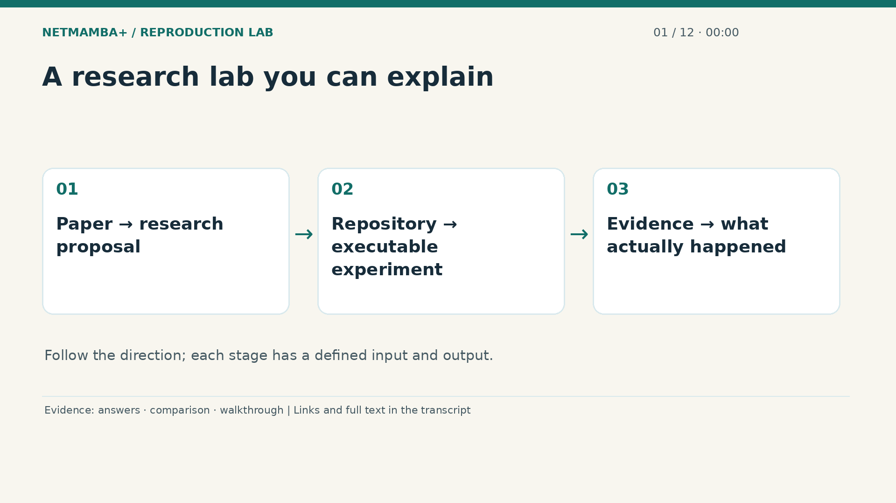
Notes:
00:00:00 — A research lab you can explain
Welcome. This course will take you from the three files you started with to a clear explanation of the repository you now have. You do not need a networking or machine learning background. We will read the paper's ideas, inspect both spreadsheet shaped datasets, follow a flow through the original model, and examine the experiments that actually ran. Then we will walk through the code, setup, tests, downloads, demonstration, and hardware roadmap. Codex wrote and produced this lesson. A synthetic voice renders the narration. The research claims come from recorded evidence.
Evidence:
https://github.com/buffbeefalo/netmambaplus-reproduction/blob/main/docs/customer/answers.md
https://github.com/buffbeefalo/netmambaplus-reproduction/blob/main/docs/customer/upstream-comparison.md
https://github.com/buffbeefalo/netmambaplus-reproduction/blob/main/docs/repository-walkthrough.md
Slide image follows the video; notes are editable. Source SHA-256: 12f5572869db415fdbe34fc539500f2e0f980043de77eab69ec14bfa52d3338e

Slide 2
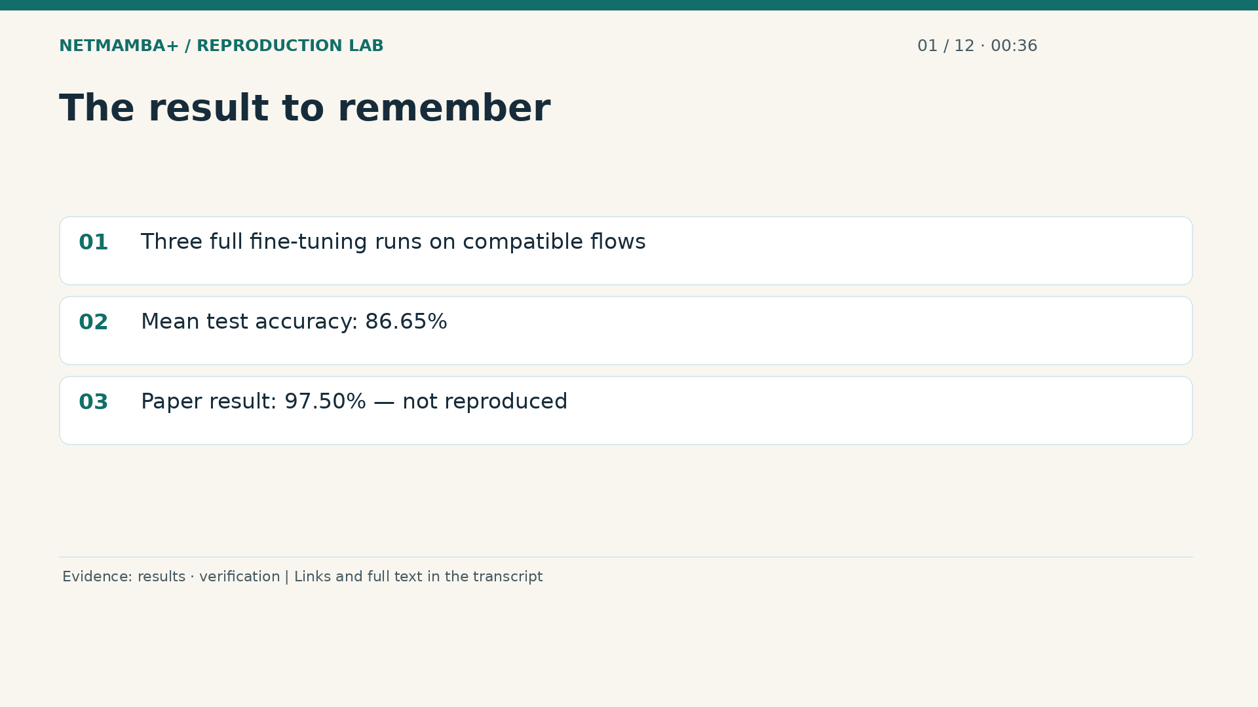
Notes:
00:00:36 — The result to remember
The central result is a working, measured reproduction attempt. The original multimodal classifier trained and performed inference on compatible research flows using an NVIDIA G B ten graphics processor. Three full fine tuning runs achieved an average test accuracy of eighty six point six five percent. The paper reports ninety seven point five percent for its comparison. We did not reproduce that number. We also did not build a complete live intrusion detection system. Those limits do not erase the work. They tell you precisely what the work establishes and what a next experiment needs to resolve.
Evidence:
https://github.com/buffbeefalo/netmambaplus-reproduction/blob/main/docs/customer/evidence/results.json
https://github.com/buffbeefalo/netmambaplus-reproduction/blob/main/docs/customer/verification.md
Slide image follows the video; notes are editable. Source SHA-256: 12f5572869db415fdbe34fc539500f2e0f980043de77eab69ec14bfa52d3338e

Slide 3
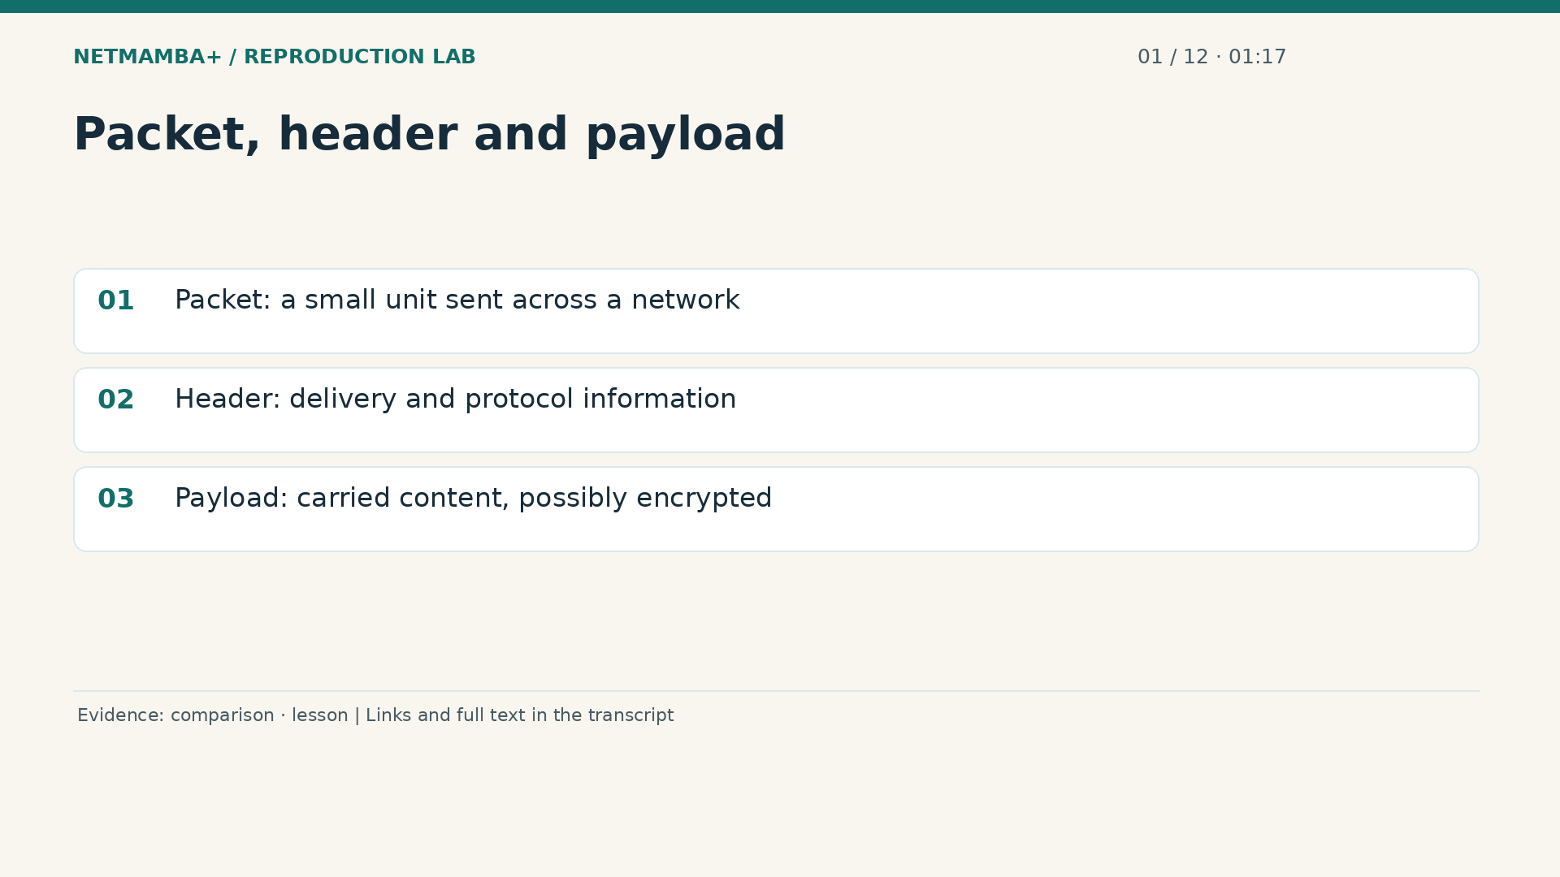
Notes:
00:01:17 — Packet, header and payload
A network moves information in packets. Think of one packet as a small delivery envelope. Its header contains information used to handle the delivery. Its payload contains the carried content, which may be encrypted. A byte is a small numerical unit with values from zero to two hundred fifty five. The model can process those numbers without turning them into readable sentences. The envelope analogy is only a starting point: real packets use several protocol layers, and a payload is not guaranteed to contain a complete application message. One conversation usually spans many packets.
Evidence:
https://github.com/buffbeefalo/netmambaplus-reproduction/blob/main/docs/customer/upstream-comparison.md
https://github.com/buffbeefalo/netmambaplus-reproduction/blob/main/docs/lesson.md
Slide image follows the video; notes are editable. Source SHA-256: 12f5572869db415fdbe34fc539500f2e0f980043de77eab69ec14bfa52d3338e

Slide 4
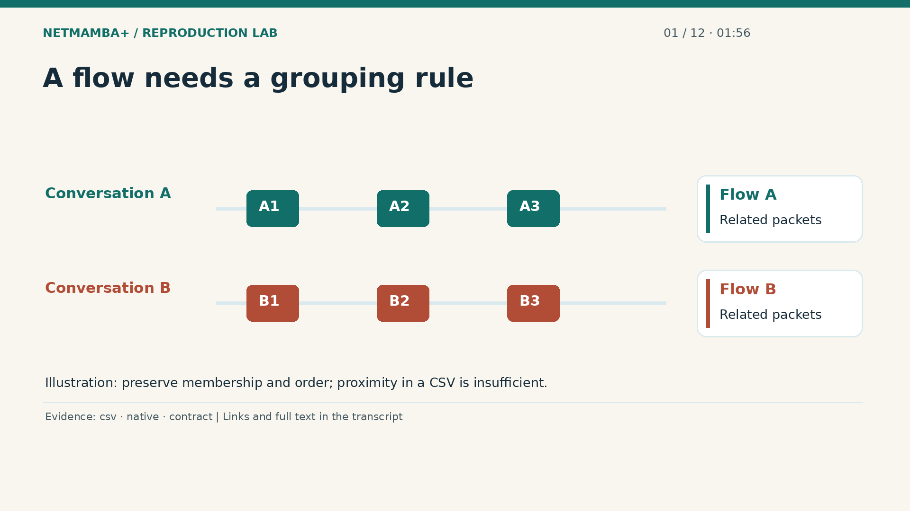
Notes:
00:01:56 — A flow needs a grouping rule
A flow is a set of related packets, grouped using an explicit rule. A common starting point uses source and destination addresses, source and destination ports, and the transport protocol. Direction handling, timeouts, and packet ordering also need a definition. Imagine two cameras sending messages at the same time. The next two captured packets could belong to different cameras. Their proximity in a file does not make them one conversation. This matters because Net Mamba Plus learns from a structured view of a flow. Supplying unrelated packet rows changes the meaning of its input.
Evidence:
https://github.com/buffbeefalo/netmambaplus-reproduction/blob/main/docs/customer/evidence/uploaded-csv-profile.json
https://github.com/buffbeefalo/netmambaplus-reproduction/blob/main/docs/customer/evidence/native-data-validation.json
https://github.com/buffbeefalo/netmambaplus-reproduction/blob/main/docs/harness-reference.md
Slide image follows the video; notes are editable. Source SHA-256: 12f5572869db415fdbe34fc539500f2e0f980043de77eab69ec14bfa52d3338e

Slide 5
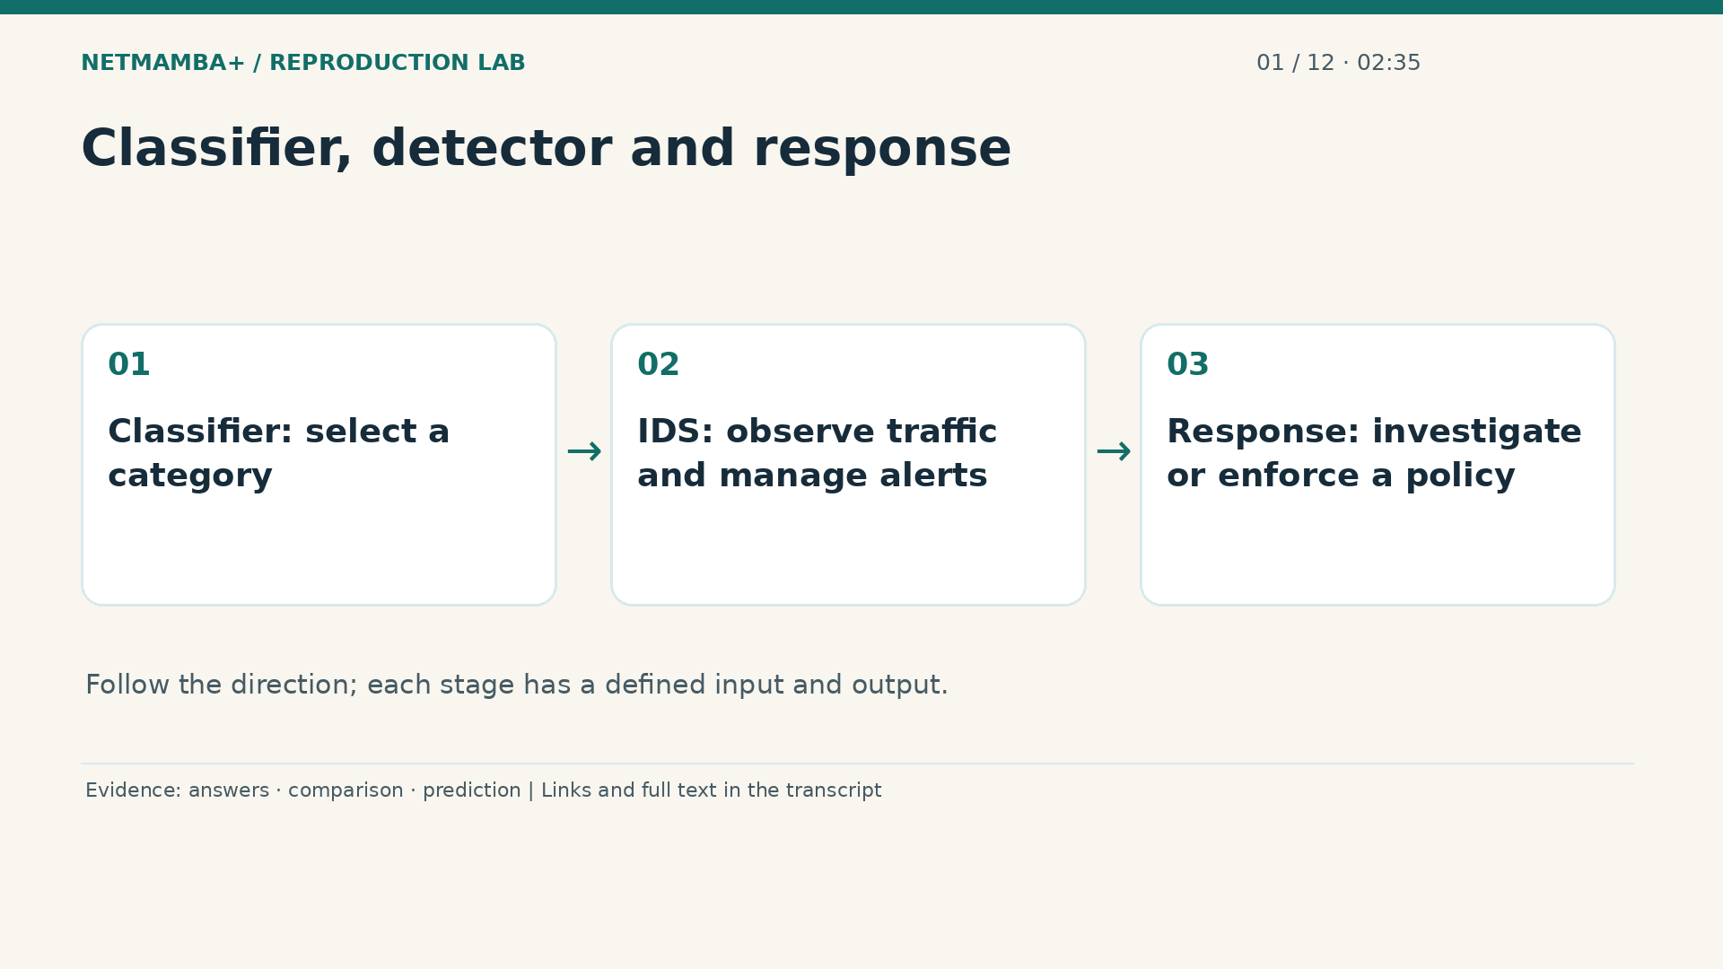
Notes:
00:02:35 — Classifier, detector and response
An intrusion detection system, often shortened to I D S, observes traffic and raises alerts for investigation. The neural classifier is one component that can help assign a category. Capture, flow assembly, data transformation, alert thresholds, event storage, and operational response are additional components. A prediction alone does not decide whether to block a customer connection. In this project the browser demonstration displays previously recorded predictions. That is useful for explaining behavior and mistakes, but opening the page does not connect to a network tap or execute a model inside your browser.
Evidence:
https://github.com/buffbeefalo/netmambaplus-reproduction/blob/main/docs/customer/answers.md
https://github.com/buffbeefalo/netmambaplus-reproduction/blob/main/docs/customer/upstream-comparison.md
https://github.com/buffbeefalo/netmambaplus-reproduction/blob/main/docs/customer/evidence/seed0/replay/predictions.json
Slide image follows the video; notes are editable. Source SHA-256: 12f5572869db415fdbe34fc539500f2e0f980043de77eab69ec14bfa52d3338e

Slide 6
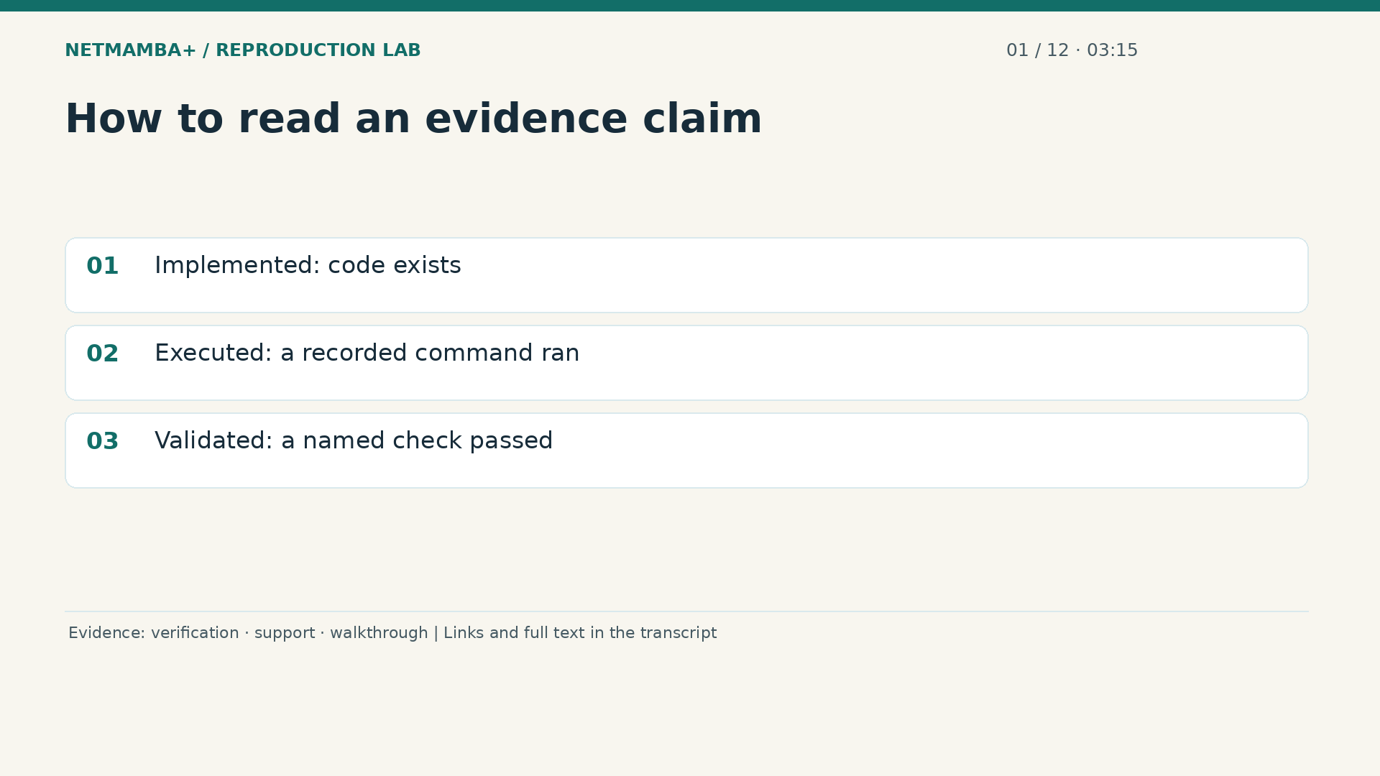
Notes:
00:03:15 — How to read an evidence claim
Throughout the lesson, separate three claims. Implemented means there is code intended to do a job. Executed means a recorded command actually ran. Validated means a specific check passed against a stated expectation. A script can exist without its hardware path being tested. A training job can complete without matching a published accuracy. A checksum can match without proving the dataset is unbiased. When someone says everything works, ask which activity, on which environment, with which evidence. The repository's manifests, logs, predictions, and failure records make that question answerable.
Evidence:
https://github.com/buffbeefalo/netmambaplus-reproduction/blob/main/docs/customer/verification.md
https://github.com/buffbeefalo/netmambaplus-reproduction/blob/main/docs/support-matrix.md
https://github.com/buffbeefalo/netmambaplus-reproduction/blob/main/docs/repository-walkthrough.md
Slide image follows the video; notes are editable. Source SHA-256: 12f5572869db415fdbe34fc539500f2e0f980043de77eab69ec14bfa52d3338e

Slide 7
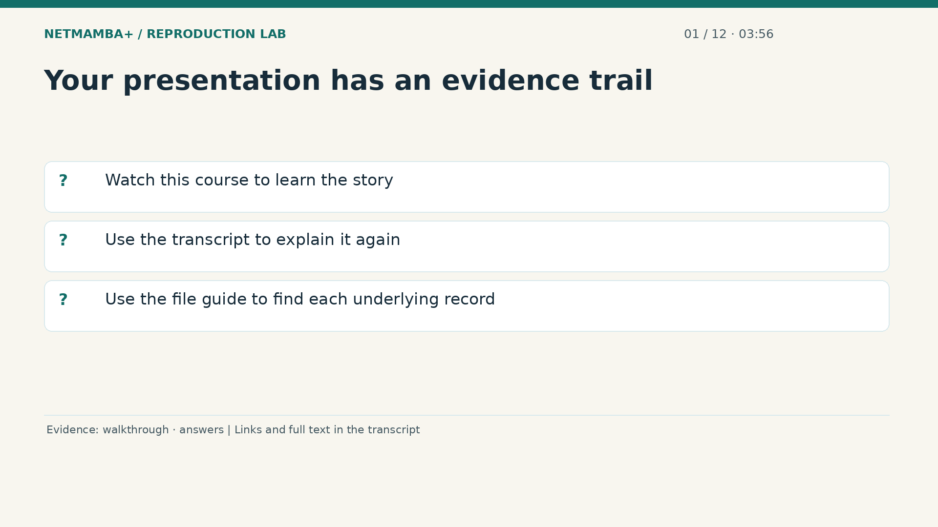
Notes:
00:03:56 — Your presentation has an evidence trail
You now have the vocabulary needed for the rest of the course. We will use short questions to check understanding, with clearly labeled pauses that resume automatically. The transcript repeats the narration and links each scene to supporting files. The companion file guide explains every tracked file and every release download, so you can look up a particular filename without memorizing the directory tree. First, practice the most important boundary. Does a working classifier prove that a complete live security system has been deployed? Take ten seconds to formulate your answer.
Evidence:
https://github.com/buffbeefalo/netmambaplus-reproduction/blob/main/docs/repository-walkthrough.md
https://github.com/buffbeefalo/netmambaplus-reproduction/blob/main/docs/customer/answers.md
Slide image follows the video; notes are editable. Source SHA-256: 12f5572869db415fdbe34fc539500f2e0f980043de77eab69ec14bfa52d3338e

Slide 8
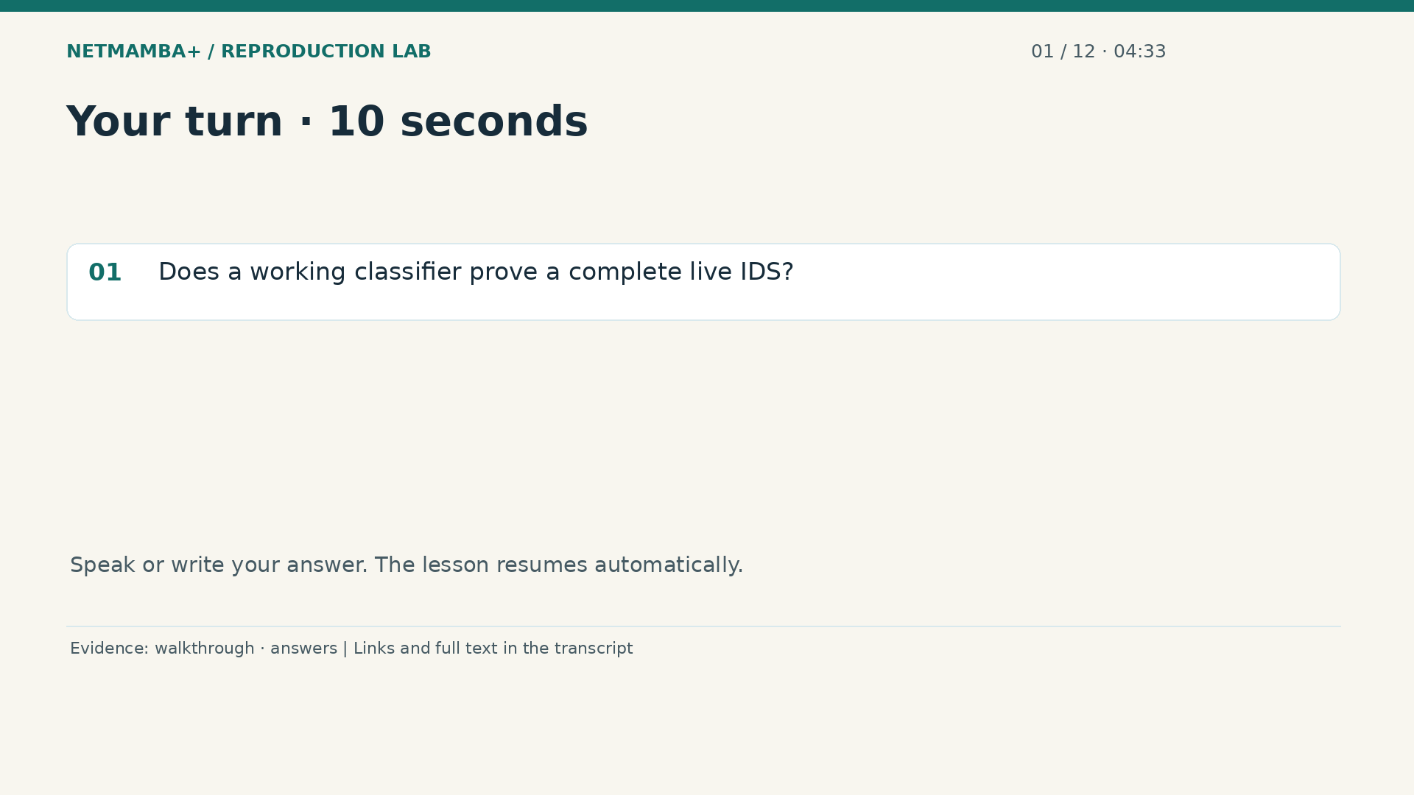
Notes:
00:04:33 — Your turn · 10 seconds
Practice for 10 seconds: Does a working classifier prove a complete live IDS?
Evidence:
https://github.com/buffbeefalo/netmambaplus-reproduction/blob/main/docs/repository-walkthrough.md
https://github.com/buffbeefalo/netmambaplus-reproduction/blob/main/docs/customer/answers.md
Slide image follows the video; notes are editable. Source SHA-256: 12f5572869db415fdbe34fc539500f2e0f980043de77eab69ec14bfa52d3338e

Slide 9
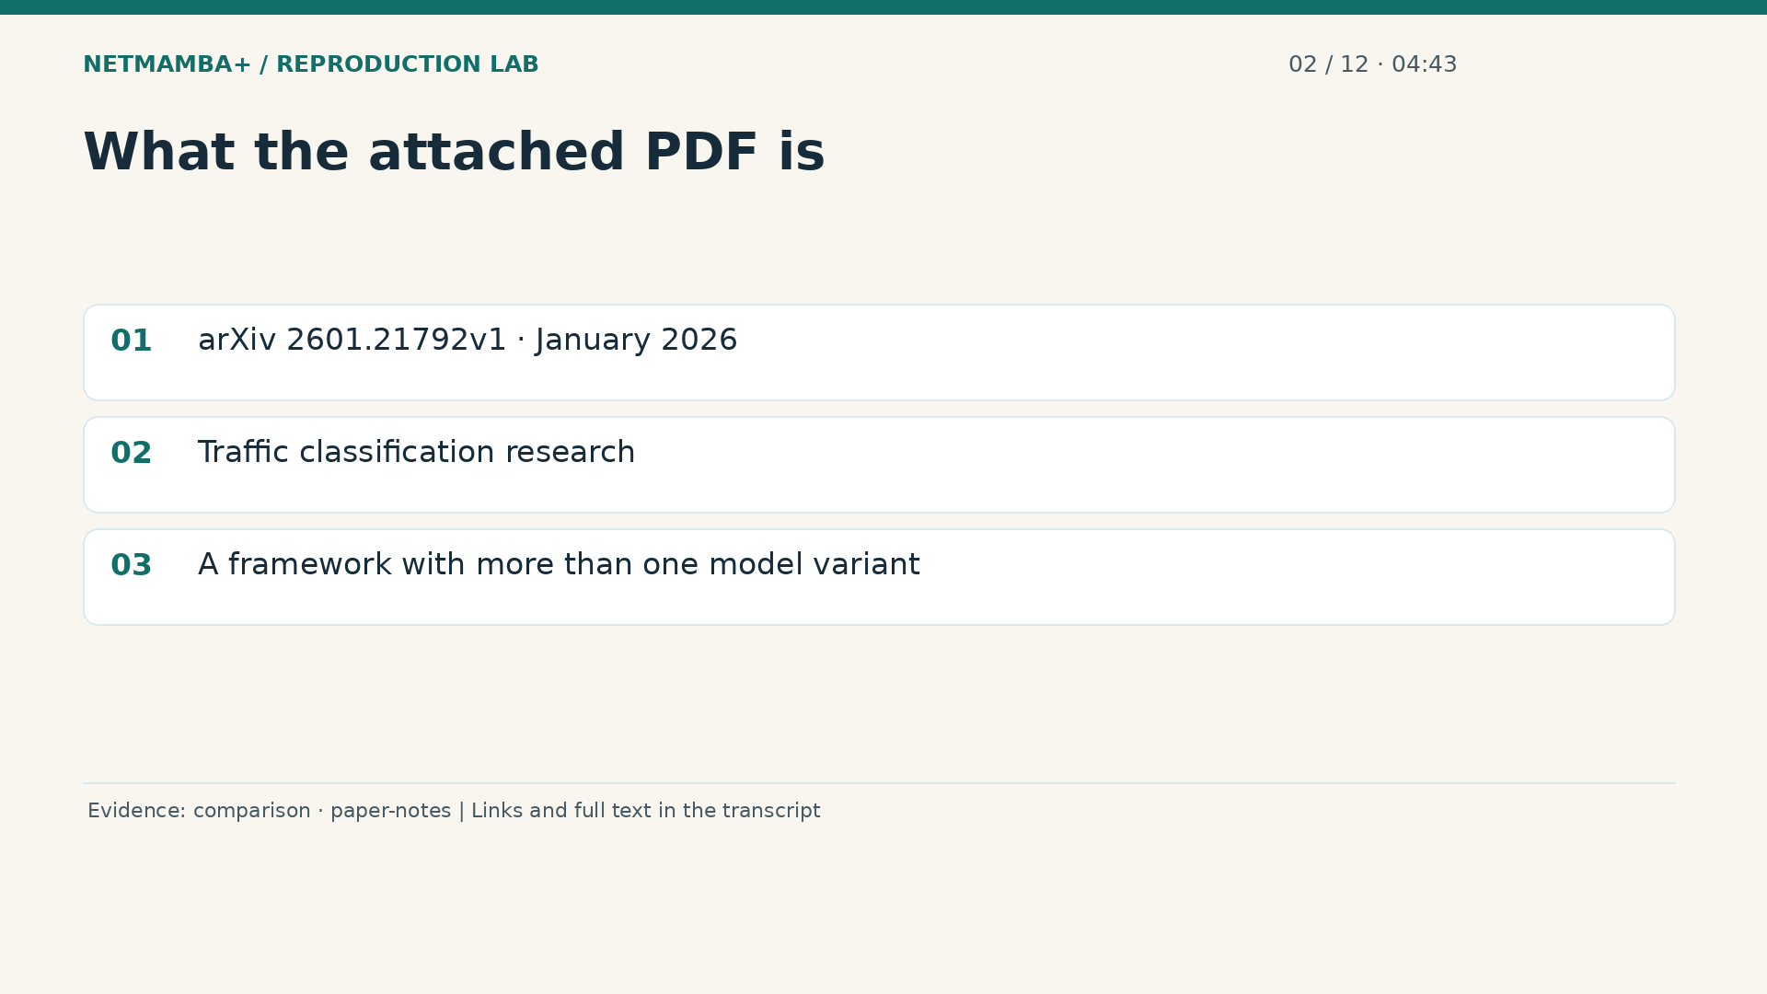
Notes:
00:04:43 — What the attached PDF is
The answer is no: the classifier is one tested component. Now open the attached paper conceptually. It is the January twenty twenty six first arXiv version of Net Mamba Plus, a framework of pretrained models for efficient and accurate network traffic classification. A research paper describes a problem, a proposed method, experiments, and conclusions. It is not an installation manual or a complete specification of every released data file. This paper covers several model variants and datasets. Our repository exercises a particular multimodal Mamba classifier and one compatible downstream dataset, so its scope is narrower.
Evidence:
https://github.com/buffbeefalo/netmambaplus-reproduction/blob/main/docs/customer/upstream-comparison.md
https://github.com/buffbeefalo/netmambaplus-reproduction/blob/main/docs/customer/paper-and-data-explained.md
Slide image follows the video; notes are editable. Source SHA-256: 12f5572869db415fdbe34fc539500f2e0f980043de77eab69ec14bfa52d3338e

Slide 10
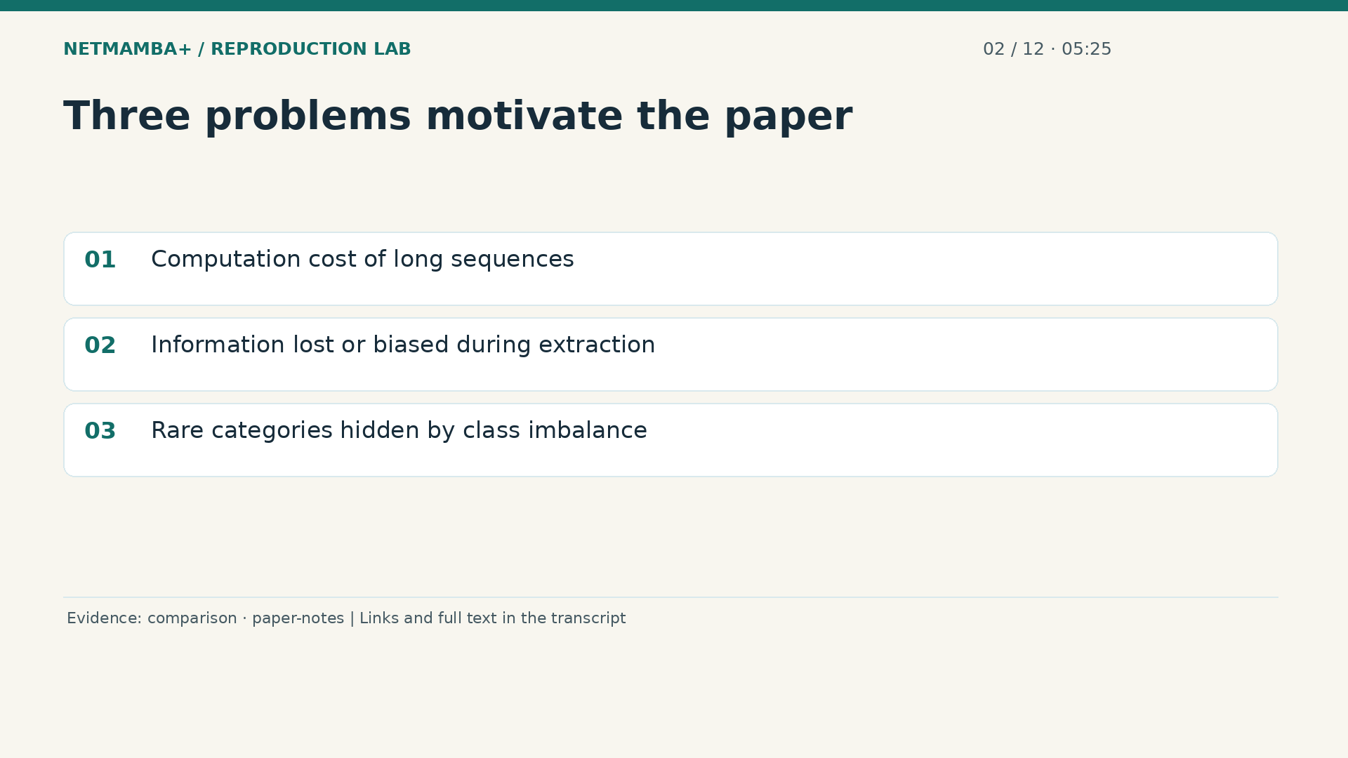
Notes:
00:05:25 — Three problems motivate the paper
The authors identify three difficulties. First, some sequence models become expensive when processing many input units. Second, a traffic representation may discard useful content while keeping misleading clues, such as identifiers tied to the collection environment. Third, common categories can dominate learning while rare categories perform poorly. These are distinct problems. A faster model does not automatically fix biased input data. Adding packet timing does not automatically solve a rare class problem. The paper combines architectural, representation, and training ideas to address them. Our measurements should be interpreted against the parts actually enabled.
Evidence:
https://github.com/buffbeefalo/netmambaplus-reproduction/blob/main/docs/customer/upstream-comparison.md
https://github.com/buffbeefalo/netmambaplus-reproduction/blob/main/docs/customer/paper-and-data-explained.md
Slide image follows the video; notes are editable. Source SHA-256: 12f5572869db415fdbe34fc539500f2e0f980043de77eab69ec14bfa52d3338e

Slide 11
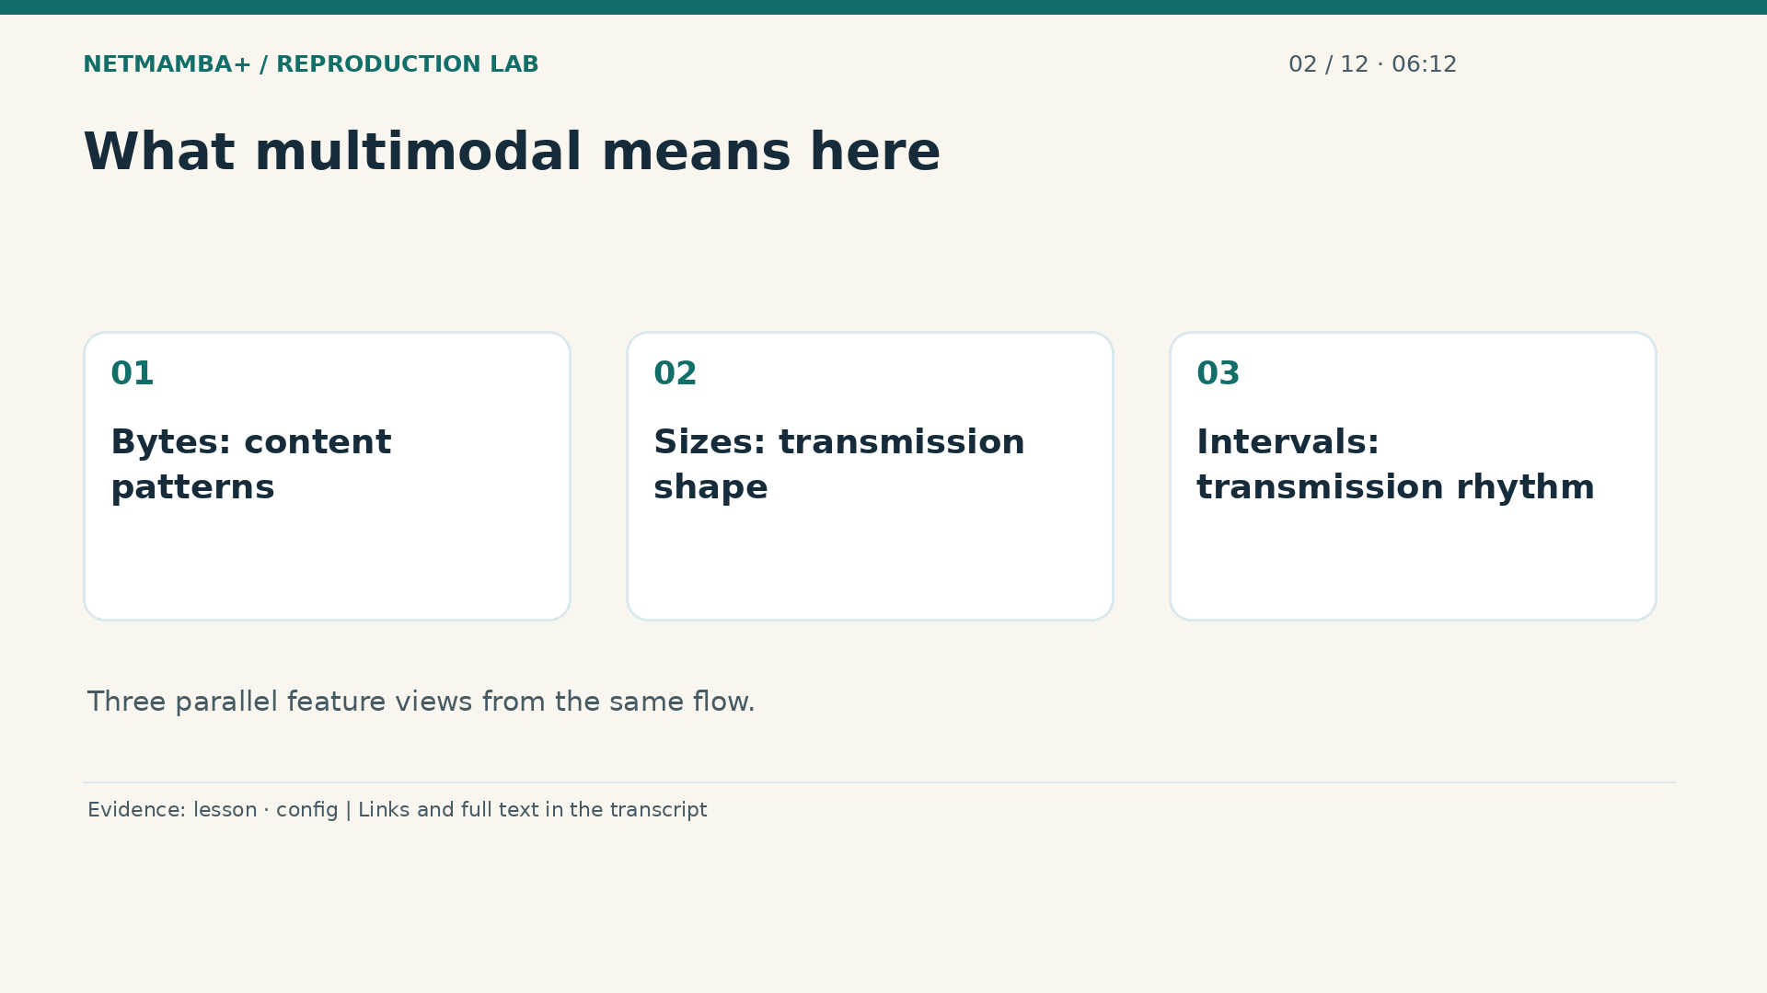
Notes:
00:06:12 — What multimodal means here
Multimodal means using several views of the same observation. Here it means packet byte content, packet lengths, and time gaps. Suppose two flows contain similarly encrypted bytes, but one sends a steady series of small packets while another sends large bursts. Size and timing can provide additional structure. This is an explanatory example, not a measured claim about our test set. The important requirement is that all three views describe the same flow. Combining bytes from one connection with timing from another would create a physically inconsistent example even if the tensor dimensions still matched.
Evidence:
https://github.com/buffbeefalo/netmambaplus-reproduction/blob/main/docs/lesson.md
https://github.com/buffbeefalo/netmambaplus-reproduction/blob/main/configs/ciciot2022.json
Slide image follows the video; notes are editable. Source SHA-256: 12f5572869db415fdbe34fc539500f2e0f980043de77eab69ec14bfa52d3338e

Slide 12
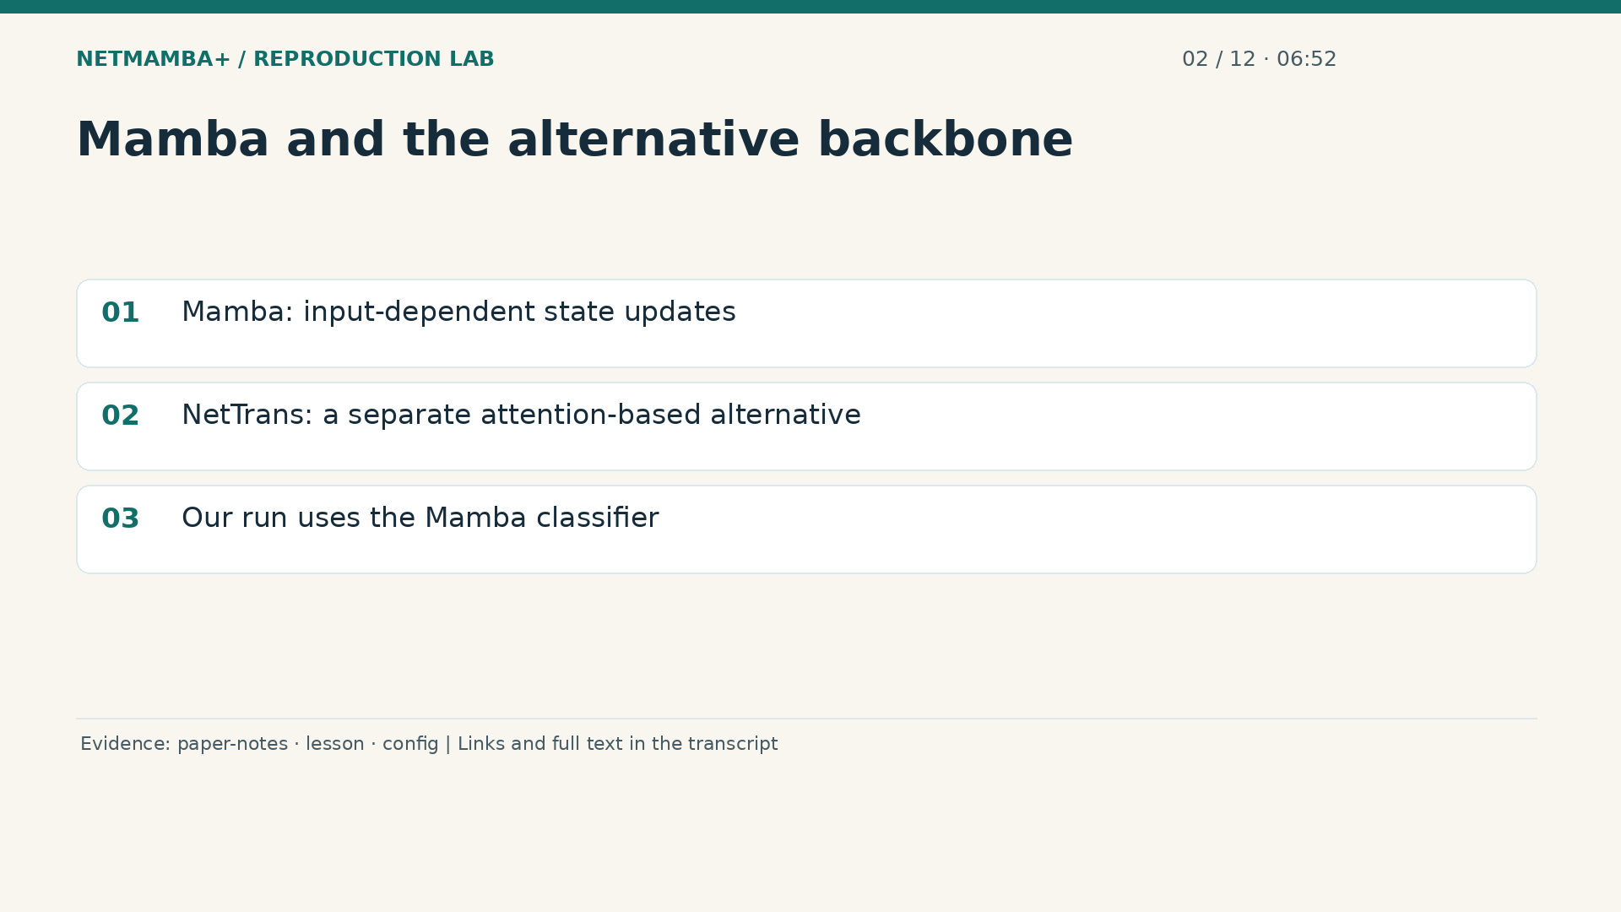
Notes:
00:06:52 — Mamba and the alternative backbone
The paper discusses Mamba and an alternative optimized Transformer called Net Trans. Flash Attention belongs to that alternative's attention implementation; it is not evidence that our active Mamba classifier uses an attention layer. A Mamba block processes a sequence while updating numerical state, with updates influenced by the input. This can make sequence processing efficient. It does not mean the software maintains a live table of network connections between predictions. In our tested configuration the classifier uses four Mamba blocks. Other branches present in a source repository are not automatically exercised by that configuration.
Evidence:
https://github.com/buffbeefalo/netmambaplus-reproduction/blob/main/docs/customer/paper-and-data-explained.md
https://github.com/buffbeefalo/netmambaplus-reproduction/blob/main/docs/lesson.md
https://github.com/buffbeefalo/netmambaplus-reproduction/blob/main/configs/ciciot2022.json
Slide image follows the video; notes are editable. Source SHA-256: 12f5572869db415fdbe34fc539500f2e0f980043de77eab69ec14bfa52d3338e

Slide 13
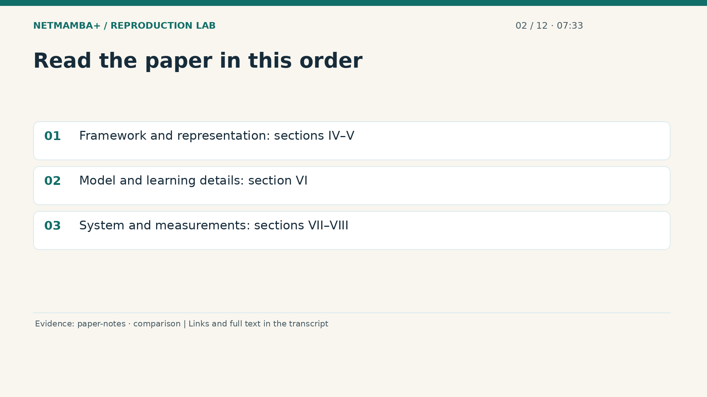
Notes:
00:07:33 — Read the paper in this order
For a first reading, use the framework diagram to understand the overall path. Then read the traffic representation section to see how raw traffic becomes structured inputs. The model details explain embeddings, sequence processing, pretraining, and classification. The online system section adds capture and shared memory around a classifier. The evaluation section reports dataset comparisons, efficiency, and other experiments. Keep a note beside each number identifying the model, task, and machine that produced it. This reading habit prevents a result from one experiment being accidentally used as proof for a different system.
Evidence:
https://github.com/buffbeefalo/netmambaplus-reproduction/blob/main/docs/customer/paper-and-data-explained.md
https://github.com/buffbeefalo/netmambaplus-reproduction/blob/main/docs/customer/upstream-comparison.md
Slide image follows the video; notes are editable. Source SHA-256: 12f5572869db415fdbe34fc539500f2e0f980043de77eab69ec14bfa52d3338e

Slide 14
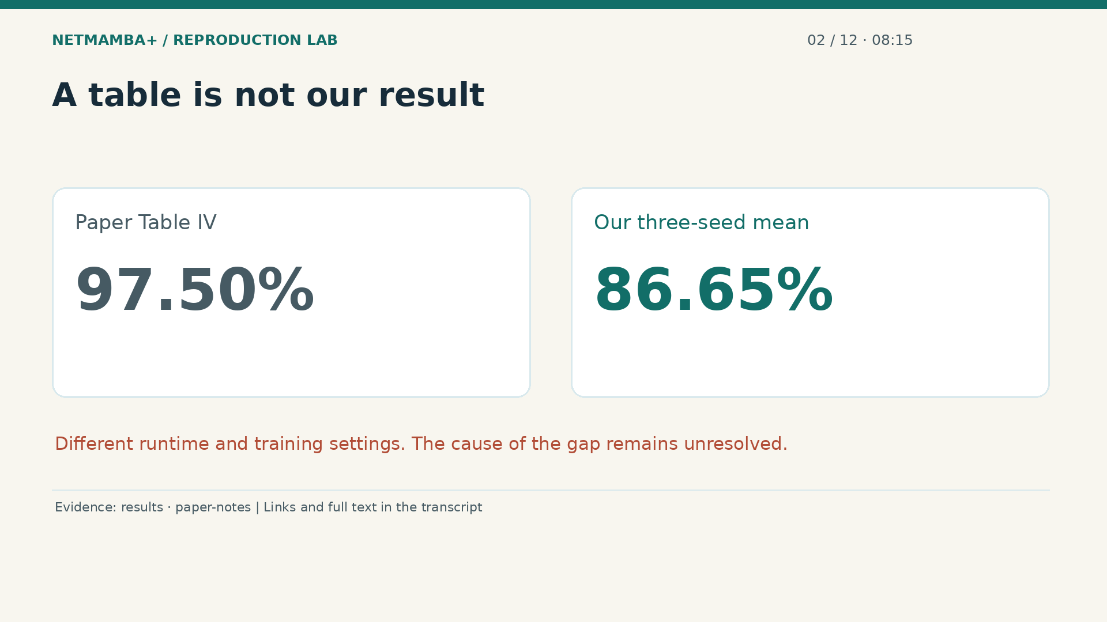
Notes:
00:08:15 — A table is not our result
The paper's comparison includes a ninety seven point five percent accuracy figure for the relevant C I C IoT twenty twenty two result. Our three seed mean is eighty six point six five percent. We preserve both numbers and the differences in runtime and training settings. We did not isolate the cause of the gap. The paper also studies few shot learning, unfamiliar distributions, and a label distribution aware strategy for imbalanced classes. Those results do not become reproduced merely because our basic classifier runs. Each additional claim would need its own matching protocol, inputs, and measured outputs.
Evidence:
https://github.com/buffbeefalo/netmambaplus-reproduction/blob/main/docs/customer/evidence/results.json
https://github.com/buffbeefalo/netmambaplus-reproduction/blob/main/docs/customer/paper-and-data-explained.md
Slide image follows the video; notes are editable. Source SHA-256: 12f5572869db415fdbe34fc539500f2e0f980043de77eab69ec14bfa52d3338e

Slide 15
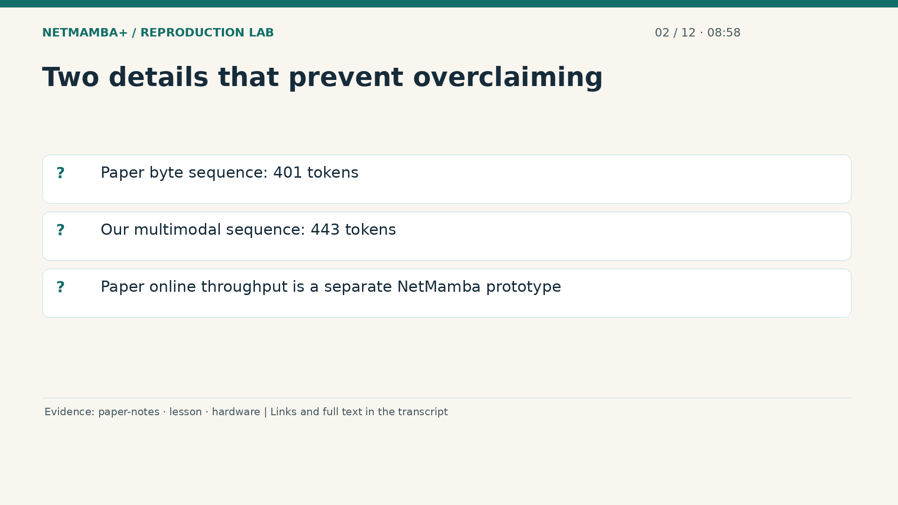
Notes:
00:08:58 — Two details that prevent overclaiming
Two details deserve special care. A token is a numerical input unit for the sequence model; we will build those units later. The paper's hyperparameter table shows four hundred one tokens for its byte representation. Our actual multimodal classifier receives four hundred forty three tokens, after including sizes, intervals, and three summary tokens. Later, the paper reports online throughput of two hundred sixty one point eight seven megabits per second for its Net Mamba prototype on different hardware. That is not our measured multimodal deployment. Before presenting any paper number, identify the exact experiment it describes. Take ten seconds to name one paper claim that this repository has not independently reproduced.
Evidence:
https://github.com/buffbeefalo/netmambaplus-reproduction/blob/main/docs/customer/paper-and-data-explained.md
https://github.com/buffbeefalo/netmambaplus-reproduction/blob/main/docs/lesson.md
https://github.com/buffbeefalo/netmambaplus-reproduction/blob/main/docs/customer/hardware-roadmap.md
Slide image follows the video; notes are editable. Source SHA-256: 12f5572869db415fdbe34fc539500f2e0f980043de77eab69ec14bfa52d3338e

Slide 16
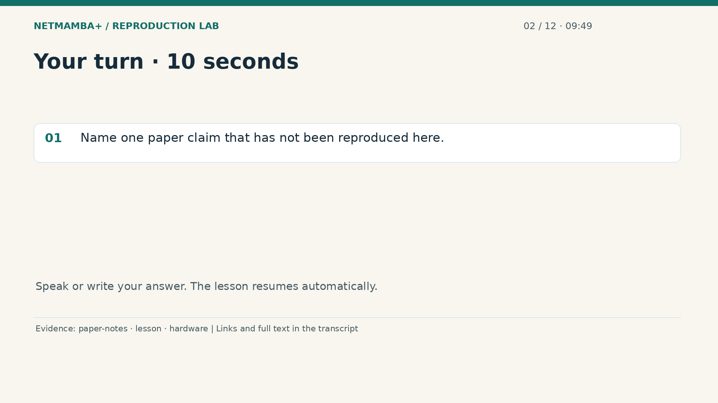
Notes:
00:09:49 — Your turn · 10 seconds
Practice for 10 seconds: Name one paper claim that has not been reproduced here.
Evidence:
https://github.com/buffbeefalo/netmambaplus-reproduction/blob/main/docs/customer/paper-and-data-explained.md
https://github.com/buffbeefalo/netmambaplus-reproduction/blob/main/docs/lesson.md
https://github.com/buffbeefalo/netmambaplus-reproduction/blob/main/docs/customer/hardware-roadmap.md
Slide image follows the video; notes are editable. Source SHA-256: 12f5572869db415fdbe34fc539500f2e0f980043de77eab69ec14bfa52d3338e

Slide 17
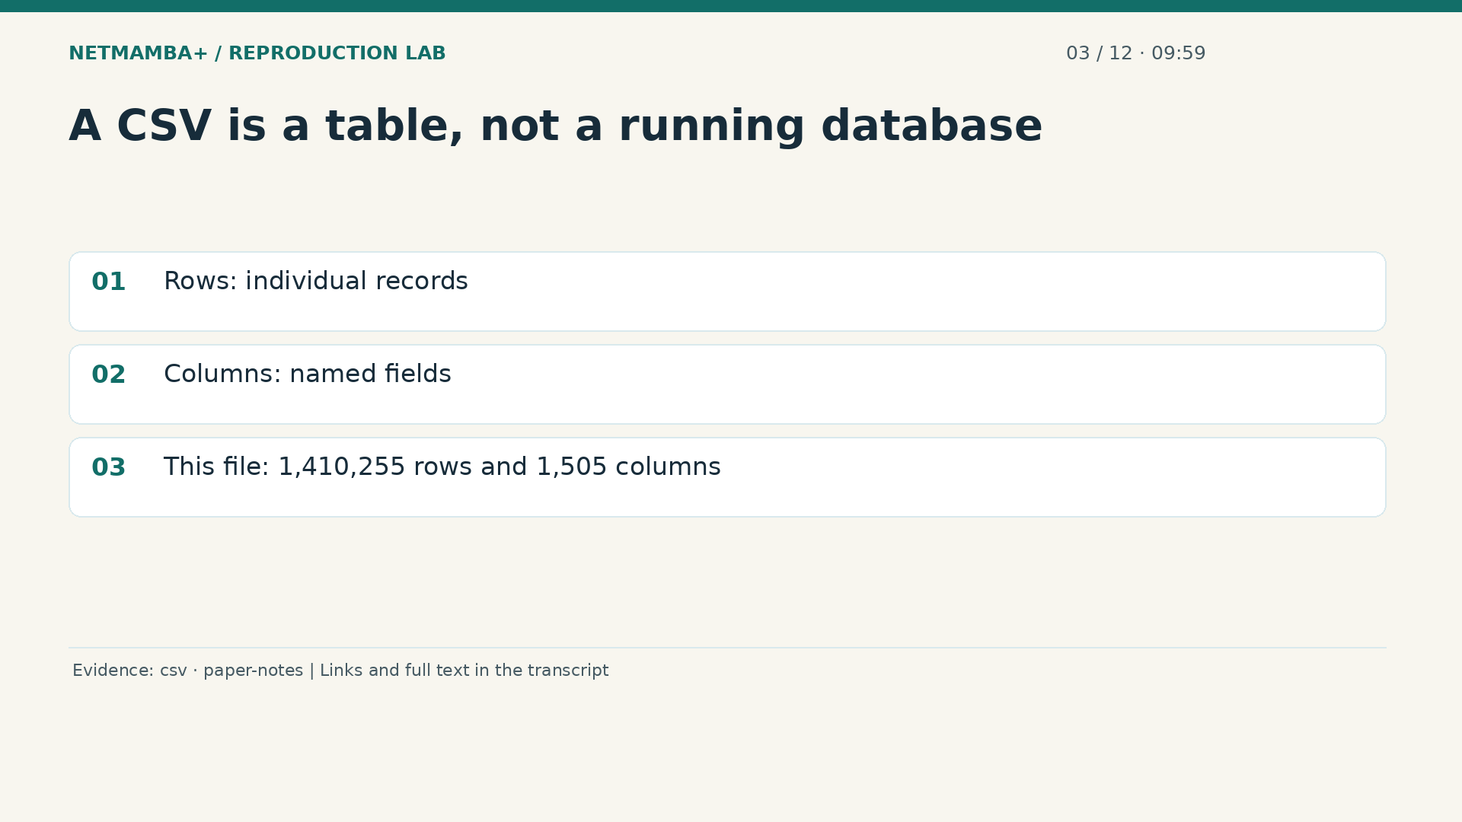
Notes:
00:09:59 — A CSV is a table, not a running database
Examples include the paper's headline accuracy, its full pretraining protocol, and its online throughput. Next, inspect your first attached data file. A C S V is plain text organized as rows and comma separated fields. A spreadsheet can display it as a table, but this file is not a database server or a network capture program. The full profile counted one million four hundred ten thousand two hundred fifty five packet records in the C I C I D S twenty seventeen file. Each row has fifteen hundred five columns. The stored profile lets you inspect that structure without opening a multi gigabyte spreadsheet.
Evidence:
https://github.com/buffbeefalo/netmambaplus-reproduction/blob/main/docs/customer/evidence/uploaded-csv-profile.json
https://github.com/buffbeefalo/netmambaplus-reproduction/blob/main/docs/customer/paper-and-data-explained.md
Slide image follows the video; notes are editable. Source SHA-256: 12f5572869db415fdbe34fc539500f2e0f980043de77eab69ec14bfa52d3338e

Slide 18
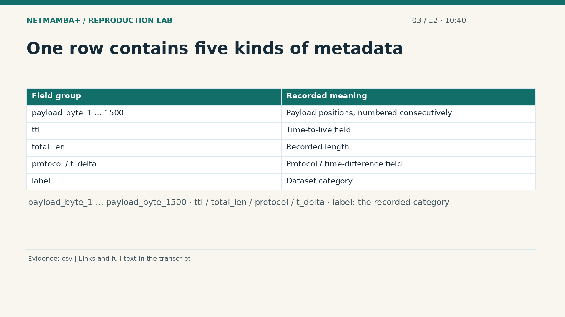
Notes:
00:10:40 — One row contains five kinds of metadata
Fifteen hundred columns are named payload byte one through payload byte fifteen hundred, using underscores in the exact header names. They describe payload byte positions. Five additional columns are time to live, total length, protocol, a delta time field, and the label. Time to live is a protocol field limiting how far a packet can travel; it is not a timestamp. Total length is a recorded packet length value. Protocol describes the communication protocol. Delta time suggests a time difference, but the CSV alone does not establish its units or how it was computed. The label is the category supplied with the record.
Evidence:
https://github.com/buffbeefalo/netmambaplus-reproduction/blob/main/docs/customer/evidence/uploaded-csv-profile.json
Slide image follows the video; notes are editable. Source SHA-256: 12f5572869db415fdbe34fc539500f2e0f980043de77eab69ec14bfa52d3338e

Slide 19
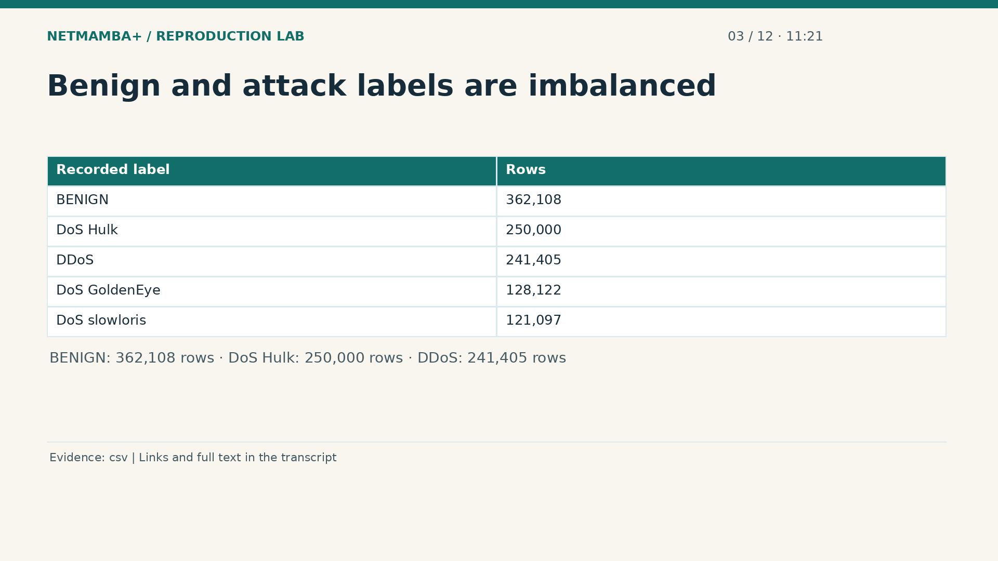
Notes:
00:11:21 — Benign and attack labels are imbalanced
This CSV contains fifteen label names. The largest group is labeled benign, with three hundred sixty two thousand one hundred eight rows. Do S Hulk has two hundred fifty thousand, and D Do S has two hundred forty one thousand four hundred five. In general terms, a denial of service attack attempts to disrupt availability, and a distributed denial of service uses multiple sources. Here those are dataset labels, not events newly detected by our model. The table also contains credential attack, web attack, scanning, bot, infiltration, and other categories. Their counts describe this supplied extract, not every version of the original dataset.
Evidence:
https://github.com/buffbeefalo/netmambaplus-reproduction/blob/main/docs/customer/evidence/uploaded-csv-profile.json
Slide image follows the video; notes are editable. Source SHA-256: 12f5572869db415fdbe34fc539500f2e0f980043de77eab69ec14bfa52d3338e

Slide 20
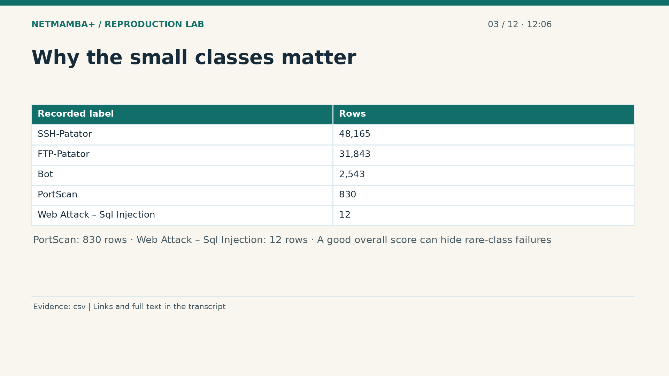
Notes:
00:12:06 — Why the small classes matter
At the small end, Port Scan has eight hundred thirty rows. The web attack SQL injection label has only twelve. That is why a single overall accuracy can hide a serious weakness. Imagine a model that handles a common label well but fails every rare example. Its aggregate score might still look impressive. A defensible packet classifier study would examine per class support, precision, recall, and a confusion matrix, with careful splitting. We have not trained that packet classifier here. These counts explain a possible future adaptation and its evaluation requirements; they do not report new model performance.
Evidence:
https://github.com/buffbeefalo/netmambaplus-reproduction/blob/main/docs/customer/evidence/uploaded-csv-profile.json
Slide image follows the video; notes are editable. Source SHA-256: 12f5572869db415fdbe34fc539500f2e0f980043de77eab69ec14bfa52d3338e

Slide 21
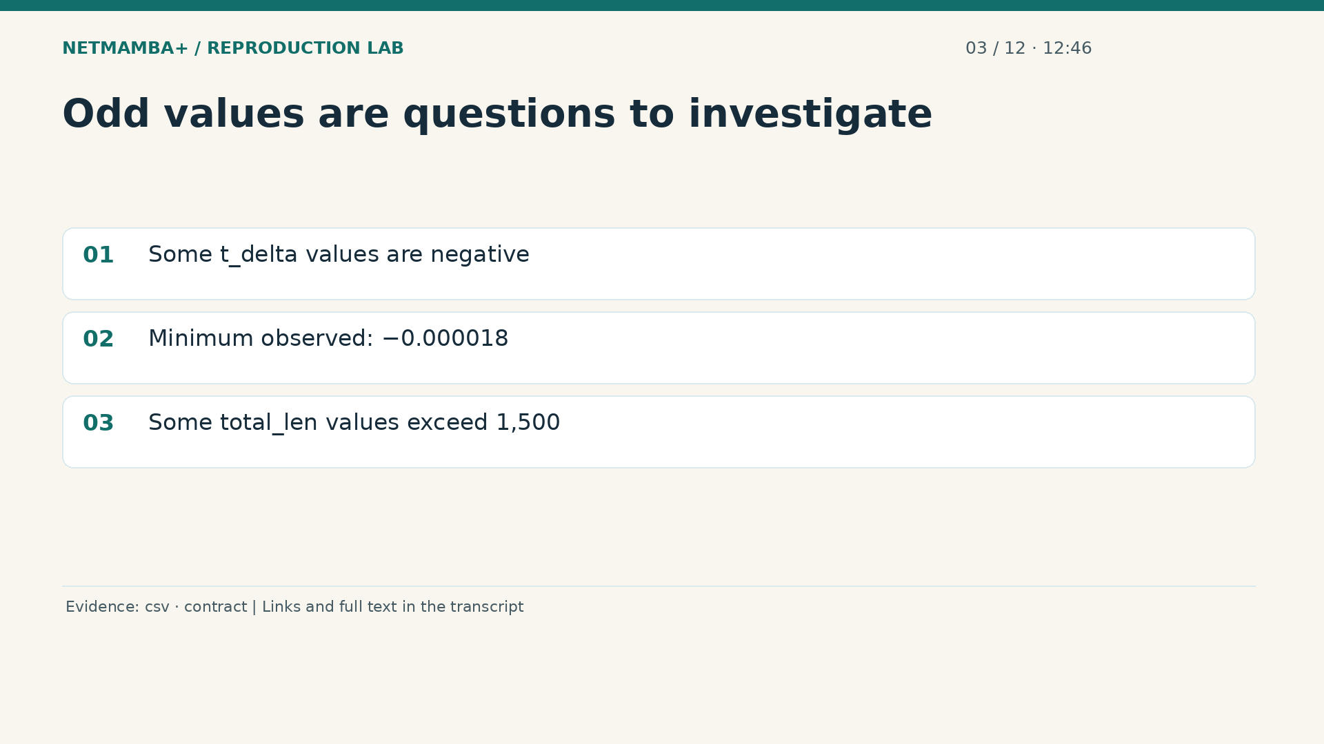
Notes:
00:12:46 — Odd values are questions to investigate
The full metadata scan also found negative delta times, with a minimum of negative zero point zero zero zero zero one eight. We do not know the time unit from this extract. Some recorded total lengths exceed fifteen hundred even though there are fifteen hundred payload columns. Those observations are reasons to investigate the extraction procedure. They are not enough to diagnose corruption, reconstruct missing headers, or invent time ordering. A field name is a clue, not a complete data contract. Our strict native flow path requires observed intervals to be finite and nonnegative, so blindly copying these values would be unsafe scientifically.
Evidence:
https://github.com/buffbeefalo/netmambaplus-reproduction/blob/main/docs/customer/evidence/uploaded-csv-profile.json
https://github.com/buffbeefalo/netmambaplus-reproduction/blob/main/docs/harness-reference.md
Slide image follows the video; notes are editable. Source SHA-256: 12f5572869db415fdbe34fc539500f2e0f980043de77eab69ec14bfa52d3338e

Slide 22
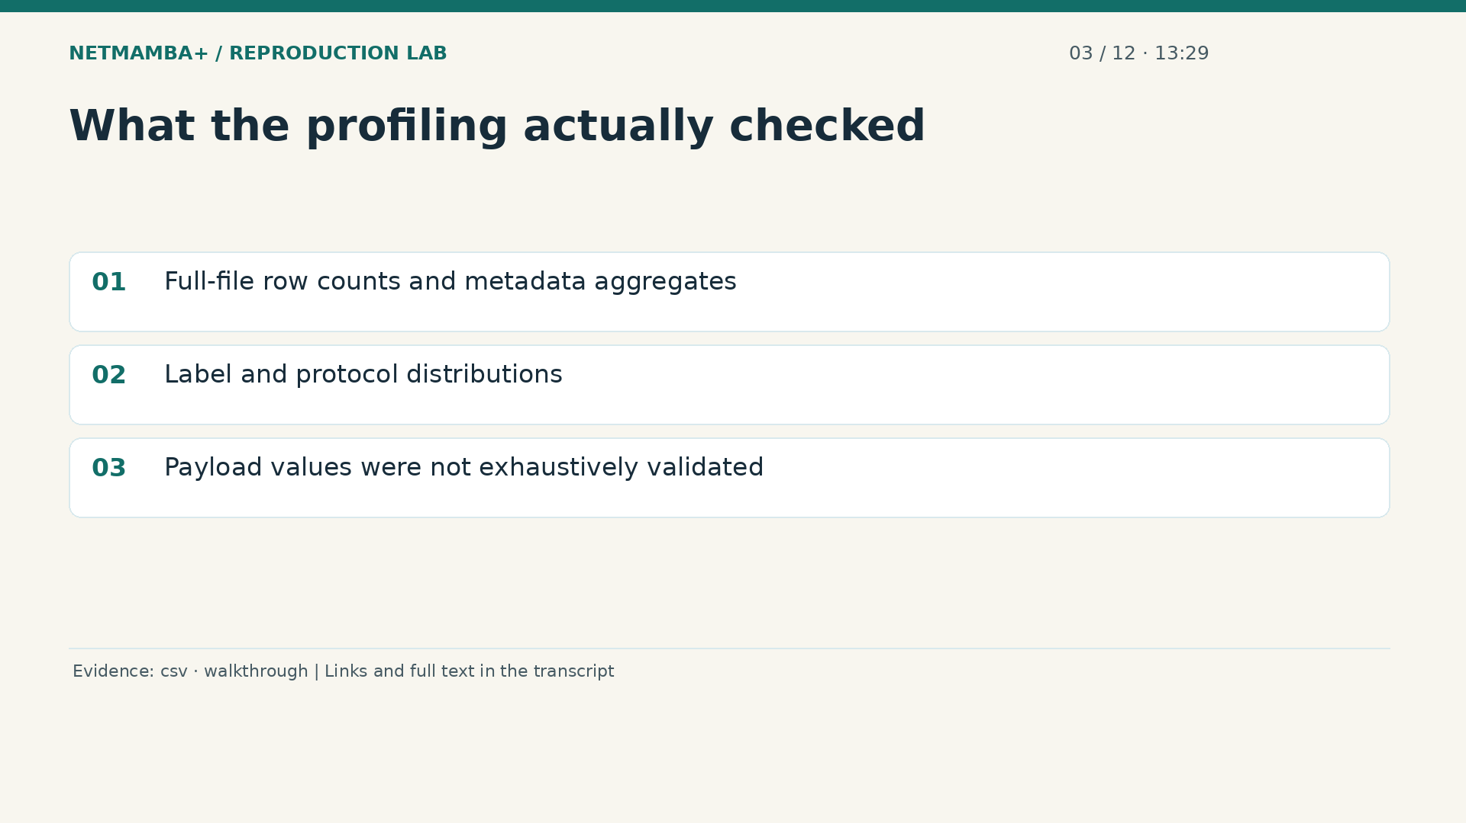
Notes:
00:13:29 — What the profiling actually checked
The profiling program scans the full file to count rows and aggregate the selected metadata. That is stronger evidence than looking at the first fifty rows. However, it is narrower than exhaustively validating every payload byte cell. The report states that limit explicitly. It records file size and a content hash so another person can identify the same input. It does not recover capture history, packet direction, or a flow identifier that the columns do not supply. Keeping the exact scope of a data audit visible prevents a useful profile from being mistaken for a complete certification.
Evidence:
https://github.com/buffbeefalo/netmambaplus-reproduction/blob/main/docs/customer/evidence/uploaded-csv-profile.json
https://github.com/buffbeefalo/netmambaplus-reproduction/blob/main/docs/repository-walkthrough.md
Slide image follows the video; notes are editable. Source SHA-256: 12f5572869db415fdbe34fc539500f2e0f980043de77eab69ec14bfa52d3338e

Slide 23
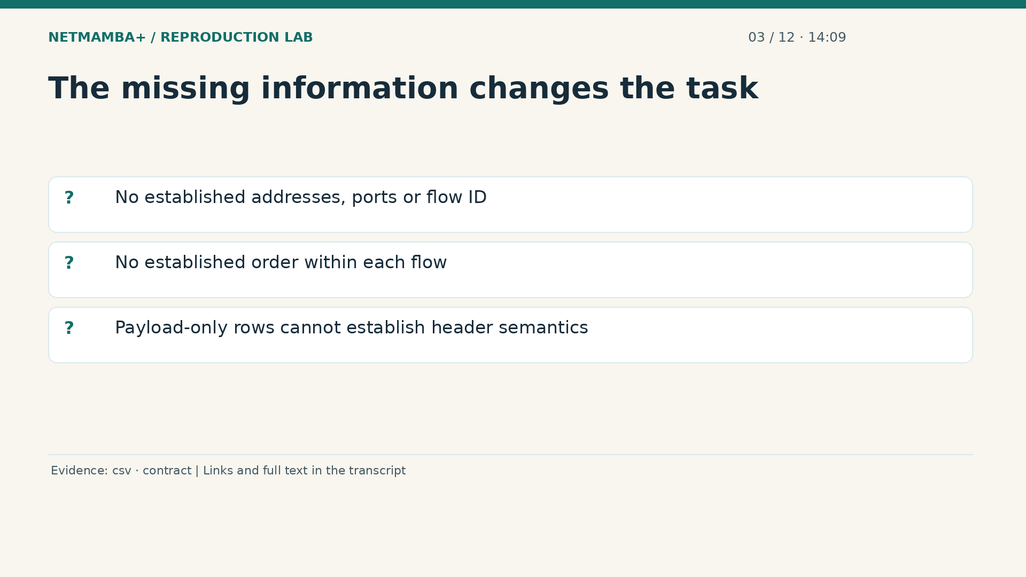
Notes:
00:14:09 — The missing information changes the task
Most importantly, the supplied schema does not establish source and destination addresses, ports, a flow identifier, or packet order within a flow. Its payload byte columns also do not establish the paper's header and payload representation. Taking five neighboring rows and calling them one flow would add an unsupported assumption. A classifier trained directly on these rows could still be an interesting project, but it would be a packet based adaptation with its own labels and evaluation. Take ten seconds: explain why matching the number of numeric columns would not make these rows compatible Net Mamba Plus inputs.
Evidence:
https://github.com/buffbeefalo/netmambaplus-reproduction/blob/main/docs/customer/evidence/uploaded-csv-profile.json
https://github.com/buffbeefalo/netmambaplus-reproduction/blob/main/docs/harness-reference.md
Slide image follows the video; notes are editable. Source SHA-256: 12f5572869db415fdbe34fc539500f2e0f980043de77eab69ec14bfa52d3338e

Slide 24
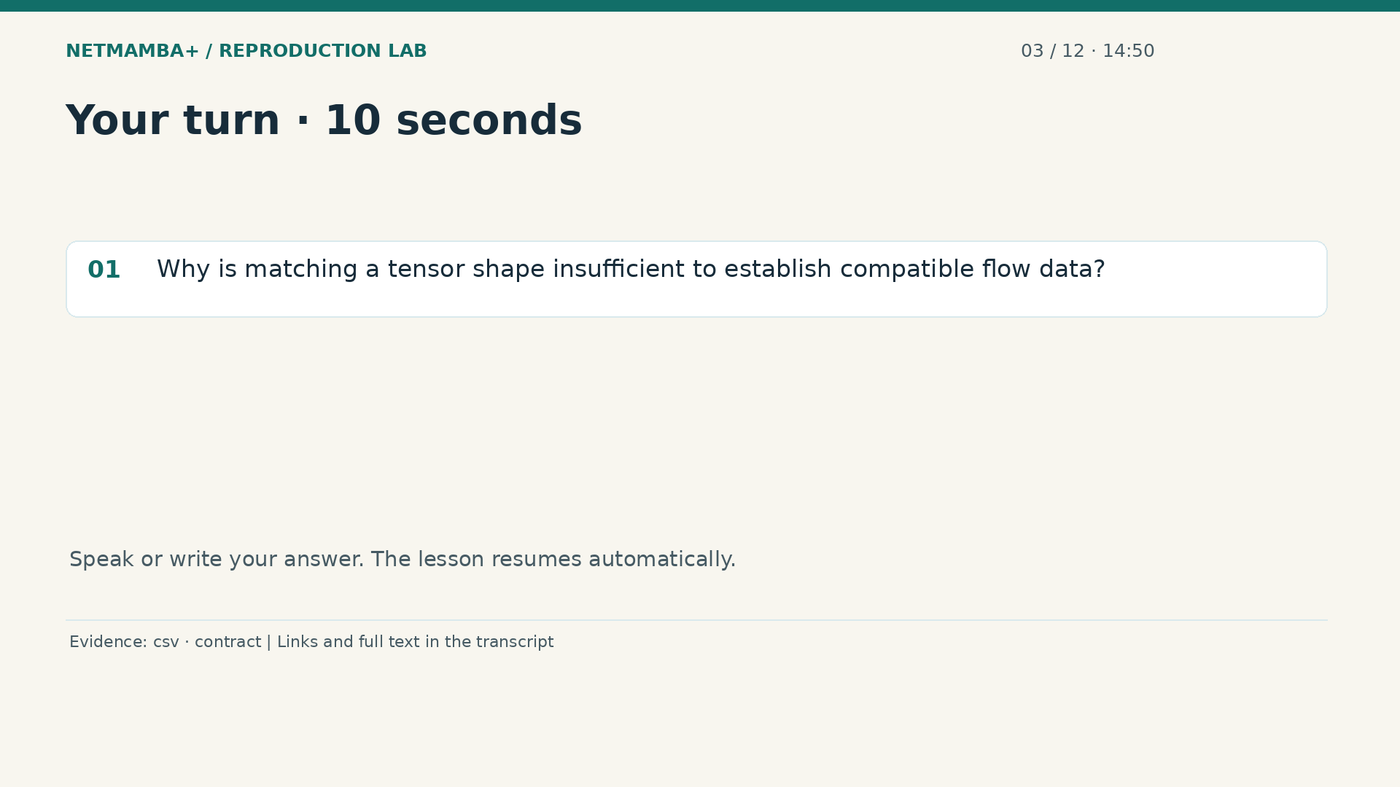
Notes:
00:14:50 — Your turn · 10 seconds
Practice for 10 seconds: Why is matching a tensor shape insufficient to establish compatible flow data?
Evidence:
https://github.com/buffbeefalo/netmambaplus-reproduction/blob/main/docs/customer/evidence/uploaded-csv-profile.json
https://github.com/buffbeefalo/netmambaplus-reproduction/blob/main/docs/harness-reference.md
Slide image follows the video; notes are editable. Source SHA-256: 12f5572869db415fdbe34fc539500f2e0f980043de77eab69ec14bfa52d3338e

Slide 25
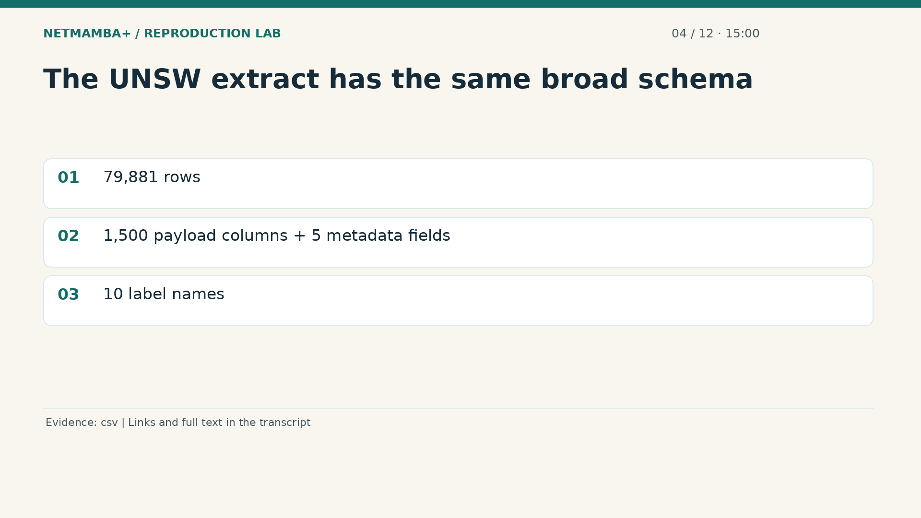
Notes:
00:15:00 — The UNSW extract has the same broad schema
A tensor shape describes dimensions, not the meaning or origin of the numbers. Your second CSV makes that distinction clearer. The U N S W extract contains seventy nine thousand eight hundred eighty one rows. It has the same broad structure: fifteen hundred payload byte columns followed by time to live, total length, protocol, delta time, and label. There are ten category names. The common column layout makes joint profiling convenient. It does not prove the two files were captured, labeled, or extracted with the same procedure, and it does not make their category names interchangeable.
Evidence:
https://github.com/buffbeefalo/netmambaplus-reproduction/blob/main/docs/customer/evidence/uploaded-csv-profile.json
Slide image follows the video; notes are editable. Source SHA-256: 12f5572869db415fdbe34fc539500f2e0f980043de77eab69ec14bfa52d3338e

Slide 26
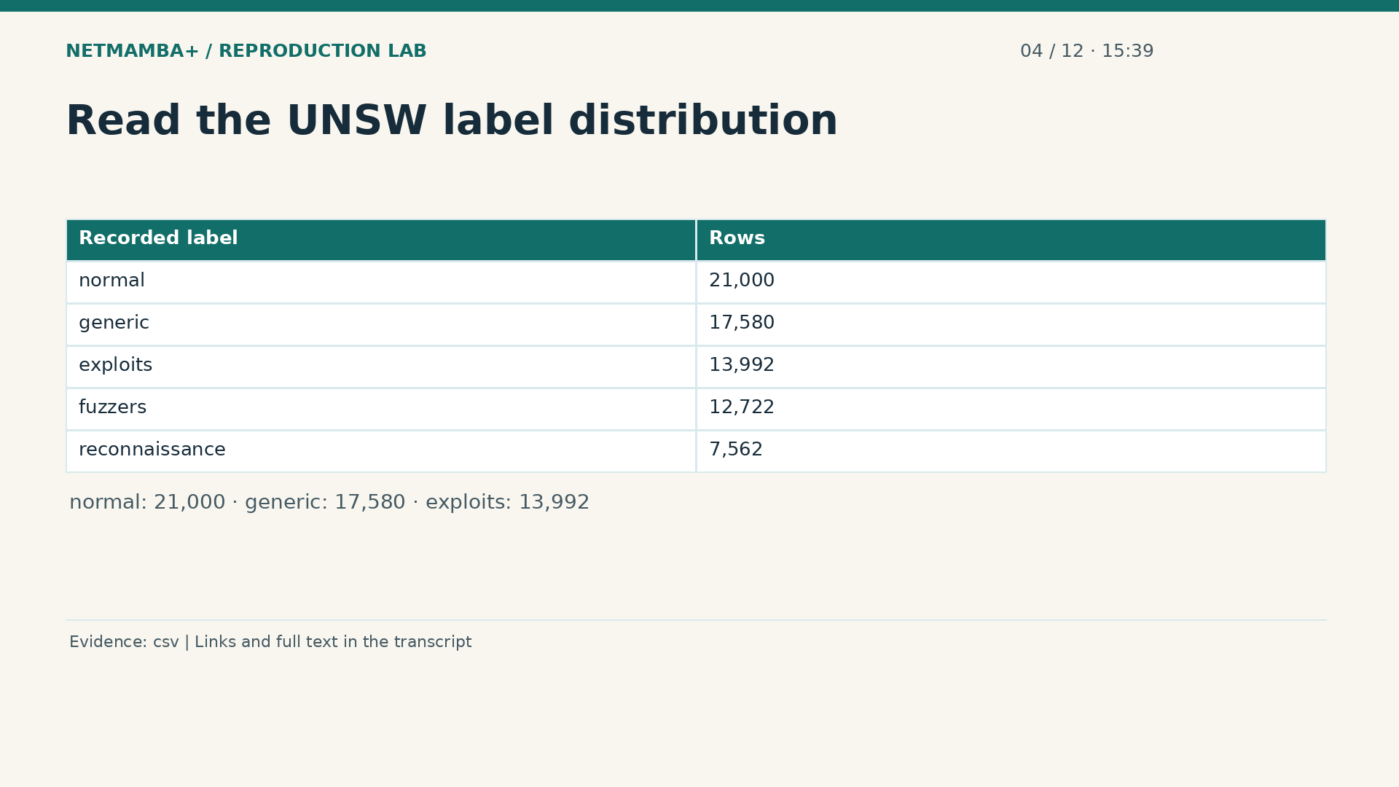
Notes:
00:15:39 — Read the UNSW label distribution
The largest U N S W category is normal, with twenty one thousand rows. Generic contains seventeen thousand five hundred eighty, and exploits contains thirteen thousand nine hundred ninety two. Fuzzers and reconnaissance are also substantial groups. At a high level, reconnaissance means attempts to learn about a target, and fuzzing probes how software handles unusual inputs. These descriptions help interpret the names, but the exact labeling rules come from the dataset's production process. The table is a count of stored labels. It is not a claim that our trained six class model recognizes these ten categories.
Evidence:
https://github.com/buffbeefalo/netmambaplus-reproduction/blob/main/docs/customer/evidence/uploaded-csv-profile.json
Slide image follows the video; notes are editable. Source SHA-256: 12f5572869db415fdbe34fc539500f2e0f980043de77eab69ec14bfa52d3338e

Slide 27
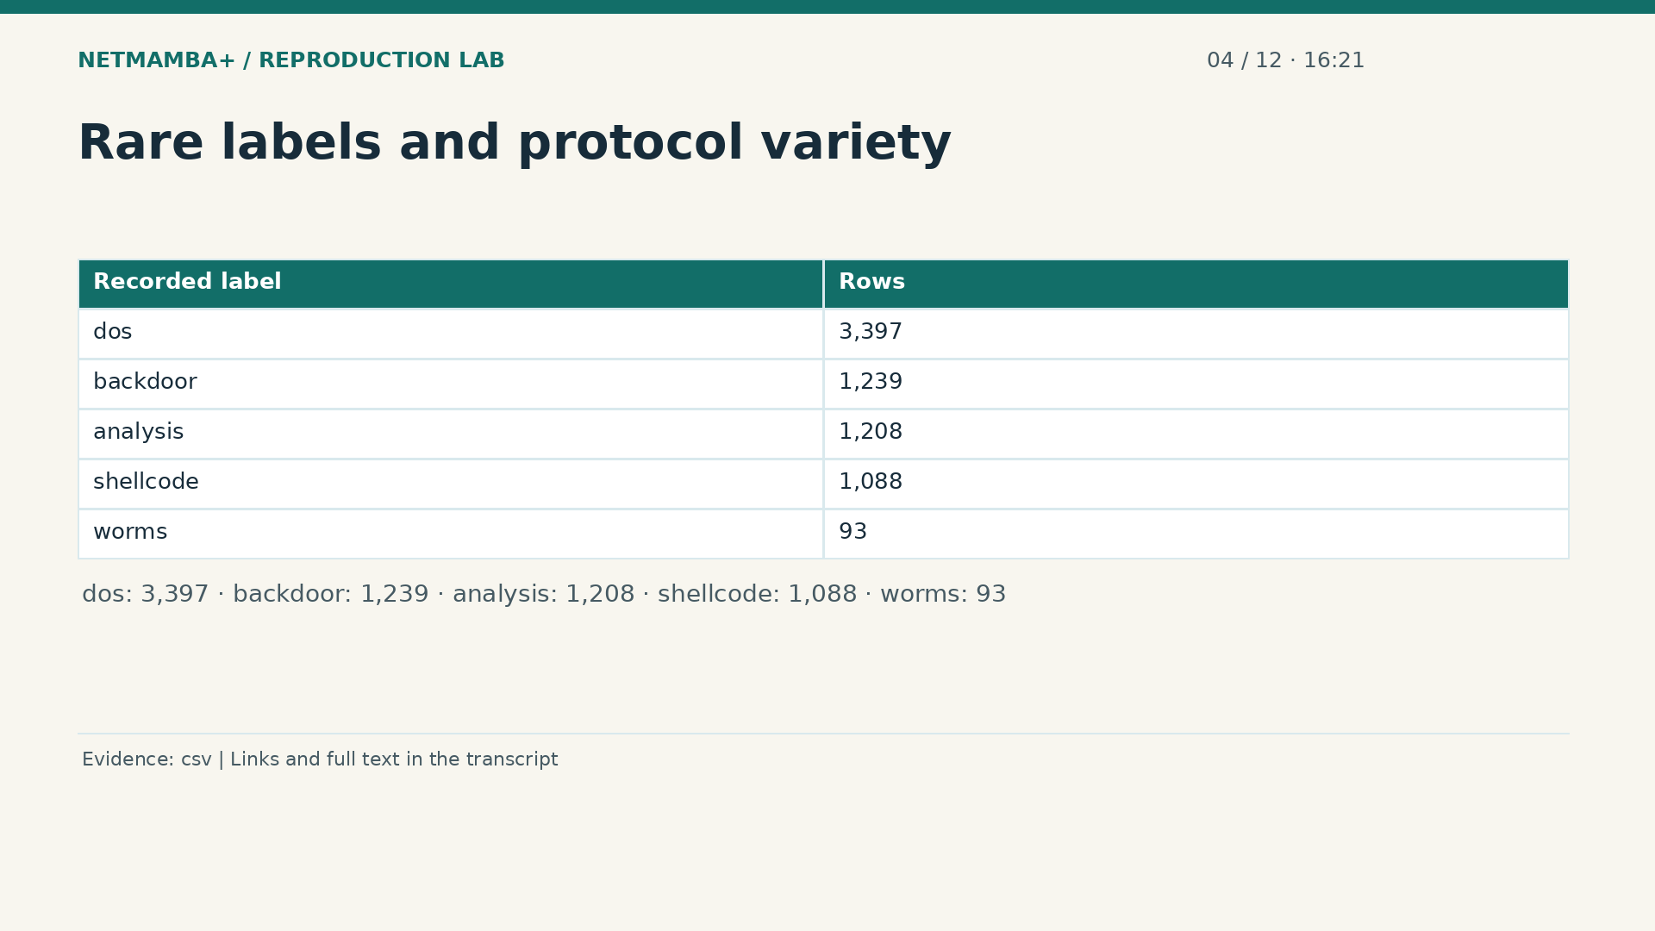
Notes:
00:16:21 — Rare labels and protocol variety
The remaining labels are do s, backdoor, analysis, shellcode, and worms. Worms has only ninety three rows. Unlike the mostly T C P and U D P protocol entries in the first extract, this file includes a broader range of protocol strings. Some may be uncommon to a beginner, but the practical lesson is simple: a future preprocessing program must handle the actual declared values rather than assume two protocols. The full profile records their counts by label. Again, no packet model was trained on this extract, and these category frequencies do not describe the native flow dataset used in our experiment.
Evidence:
https://github.com/buffbeefalo/netmambaplus-reproduction/blob/main/docs/customer/evidence/uploaded-csv-profile.json
Slide image follows the video; notes are editable. Source SHA-256: 12f5572869db415fdbe34fc539500f2e0f980043de77eab69ec14bfa52d3338e

Slide 28
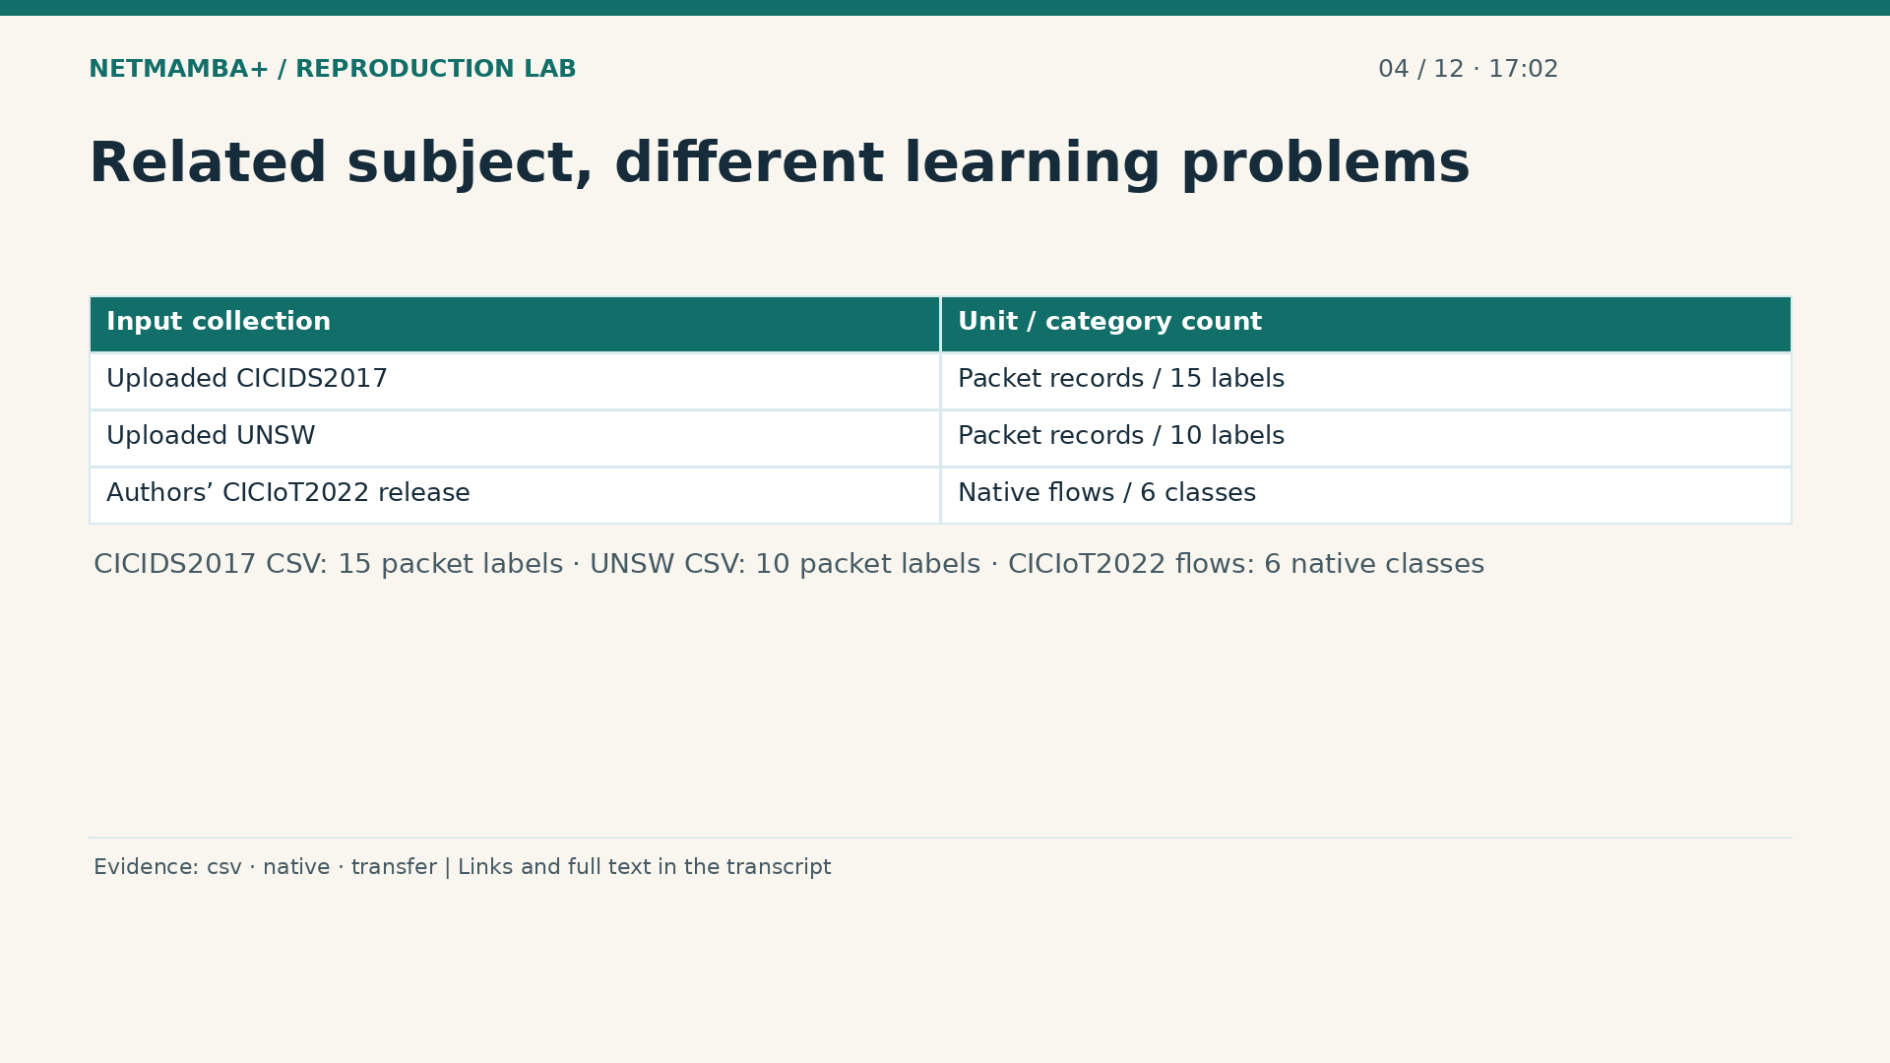
Notes:
00:17:02 — Related subject, different learning problems
All three data sources concern network traffic, but they define different learning problems. Your C I C I D S extract has fifteen packet label names. Your U N S W extract has ten. The authors' compatible C I C IoT twenty twenty two flow release has six class meanings. A classifier's output layer is tied to its training labels. Six output numbers cannot simply be relabeled with a new ten category vocabulary. Changing the dataset can require a new class mapping, classification head, training protocol, and evaluation. The repository checks that a saved classifier stays attached to the correct class meanings.
Evidence:
https://github.com/buffbeefalo/netmambaplus-reproduction/blob/main/docs/customer/evidence/uploaded-csv-profile.json
https://github.com/buffbeefalo/netmambaplus-reproduction/blob/main/docs/customer/evidence/native-data-validation.json
https://github.com/buffbeefalo/netmambaplus-reproduction/blob/main/docs/customer/evidence/checkpoint-transfer.json
Slide image follows the video; notes are editable. Source SHA-256: 12f5572869db415fdbe34fc539500f2e0f980043de77eab69ec14bfa52d3338e

Slide 29
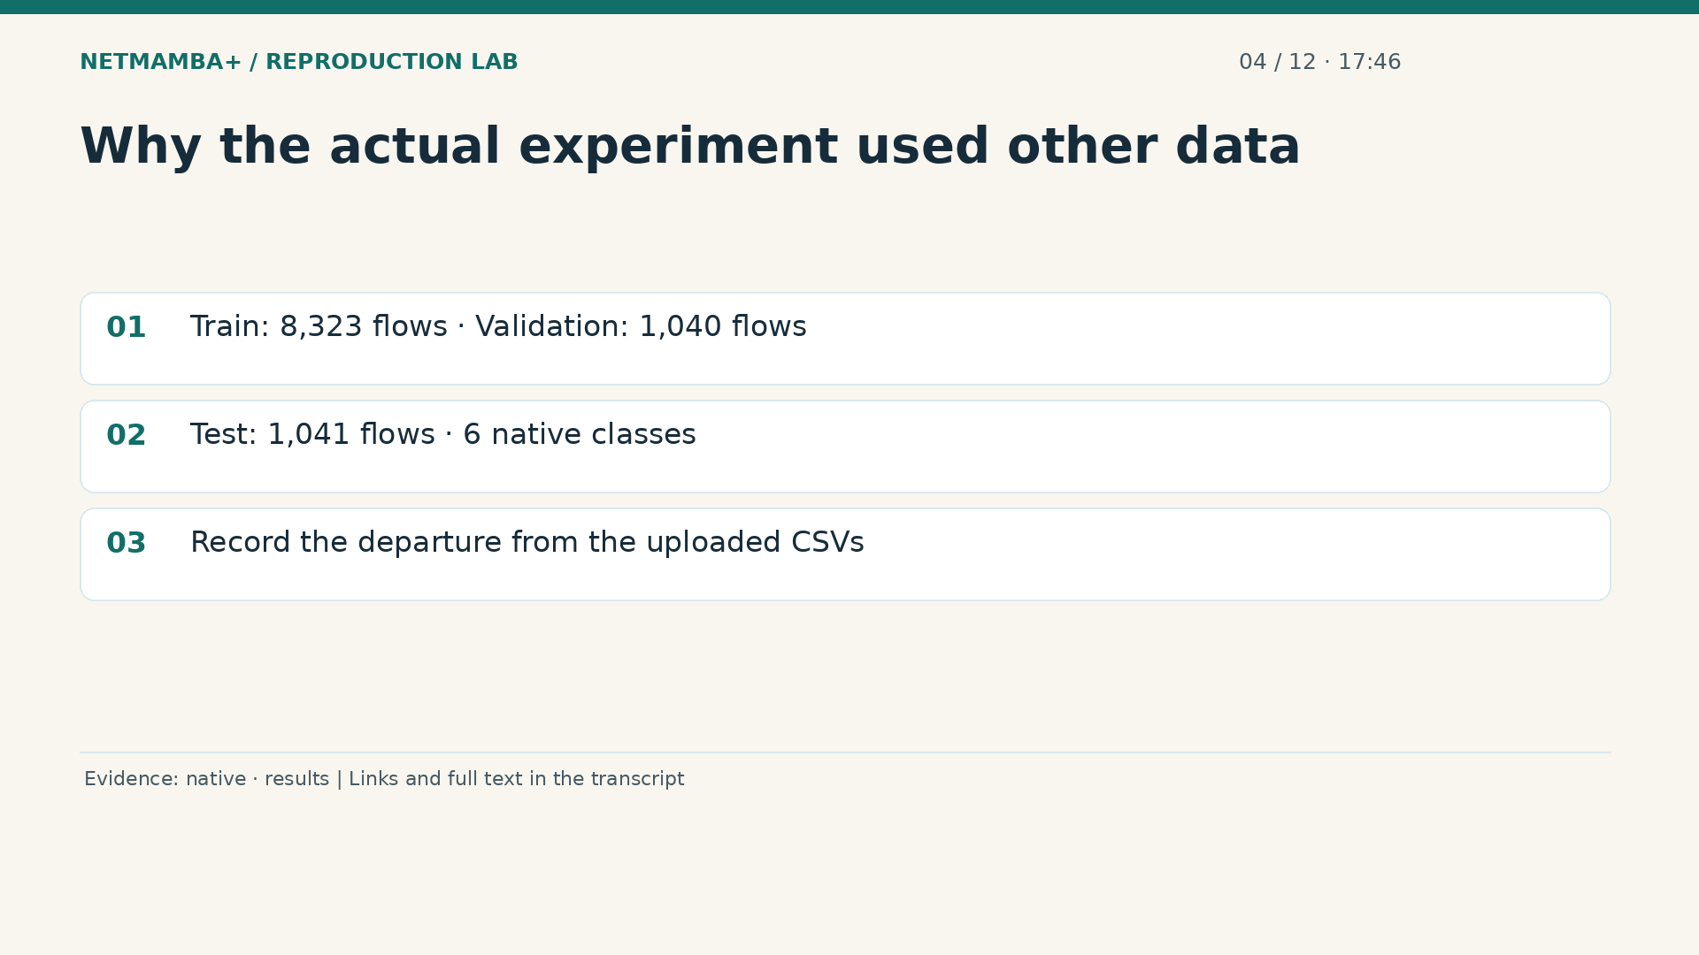
Notes:
00:17:46 — Why the actual experiment used other data
To exercise the original Net Mamba Plus path, we acquired the authors' native flow release rather than silently fabricate flow context for the CSV rows. The training split has eight thousand three hundred twenty three flows, validation has one thousand forty, and the test split has one thousand forty one. Those three files total ten thousand four hundred four flows. The provided split boundaries were retained. This choice makes the original loader and classifier executable with meaningful inputs. It also means the actual training result is not a result on either of your uploaded CSVs. That distinction belongs in the customer presentation.
Evidence:
https://github.com/buffbeefalo/netmambaplus-reproduction/blob/main/docs/customer/evidence/native-data-validation.json
https://github.com/buffbeefalo/netmambaplus-reproduction/blob/main/docs/customer/evidence/results.json
Slide image follows the video; notes are editable. Source SHA-256: 12f5572869db415fdbe34fc539500f2e0f980043de77eab69ec14bfa52d3338e

Slide 30
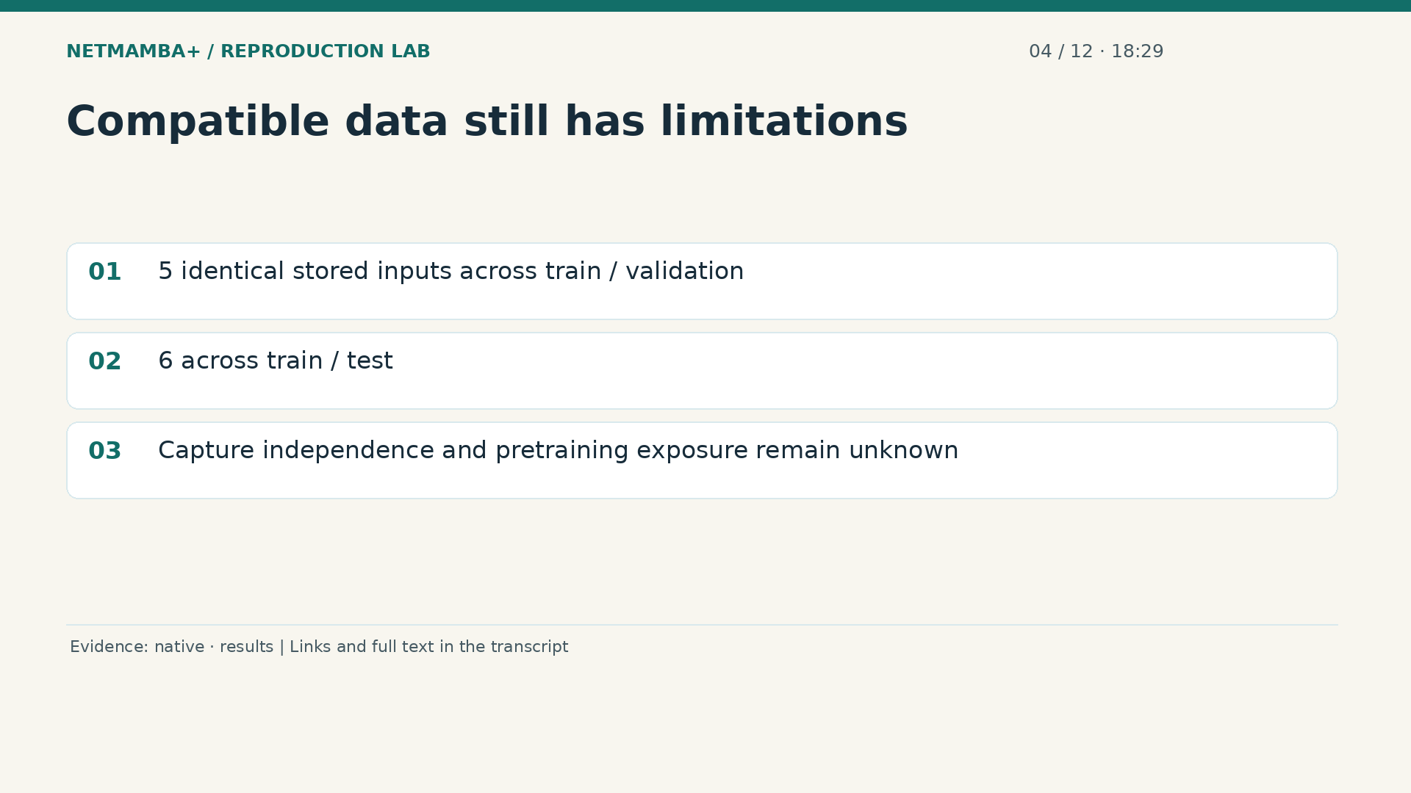
Notes:
00:18:29 — Compatible data still has limitations
Compatibility is not a guarantee of independent evaluation. The validation report found five identical stored inputs shared between training and validation, and six shared between training and test. File names and hashes identify records, but they cannot establish that all physical captures are independent. The released pretrained checkpoint's earlier exposure is also unknown. We preserved the authors' splits and disclosed these issues. A stronger future generalization study would define a new capture independent holdout and document its provenance. Repeating inference on the existing test file checks reproducibility of that result; it does not create a new holdout.
Evidence:
https://github.com/buffbeefalo/netmambaplus-reproduction/blob/main/docs/customer/evidence/native-data-validation.json
https://github.com/buffbeefalo/netmambaplus-reproduction/blob/main/docs/customer/evidence/results.json
Slide image follows the video; notes are editable. Source SHA-256: 12f5572869db415fdbe34fc539500f2e0f980043de77eab69ec14bfa52d3338e

Slide 31
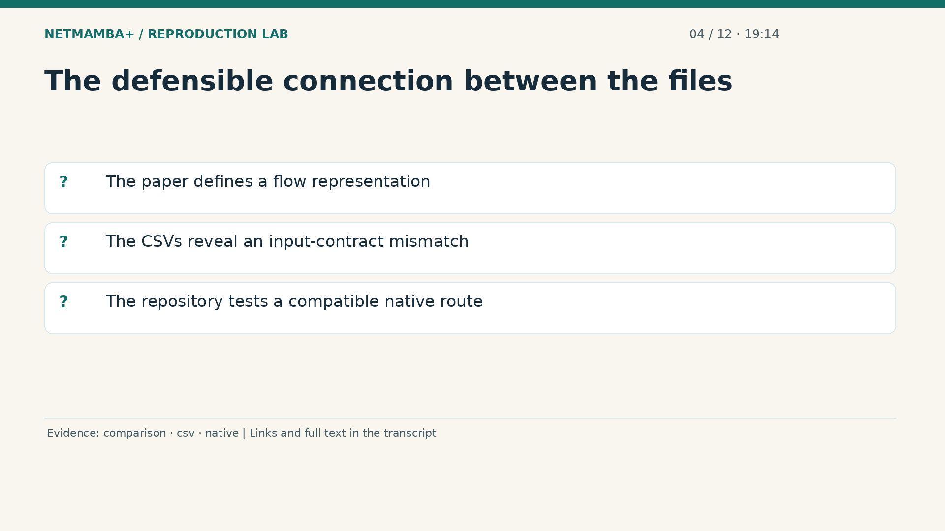
Notes:
00:19:14 — The defensible connection between the files
This is the connection between your original three files and the repository. The PDF provides the research method. The CSVs provide packet records that can be profiled, but do not establish the method's required flow context. The repository therefore preserves that finding and runs a compatible native flow experiment instead. If you later obtain raw captures with trustworthy grouping and extraction rules, you can investigate a matching data preparation path. Alternatively, you can explicitly design a packet classifier adaptation. Take ten seconds to explain which data was actually used for the published training runs, and why.
Evidence:
https://github.com/buffbeefalo/netmambaplus-reproduction/blob/main/docs/customer/upstream-comparison.md
https://github.com/buffbeefalo/netmambaplus-reproduction/blob/main/docs/customer/evidence/uploaded-csv-profile.json
https://github.com/buffbeefalo/netmambaplus-reproduction/blob/main/docs/customer/evidence/native-data-validation.json
Slide image follows the video; notes are editable. Source SHA-256: 12f5572869db415fdbe34fc539500f2e0f980043de77eab69ec14bfa52d3338e

Slide 32
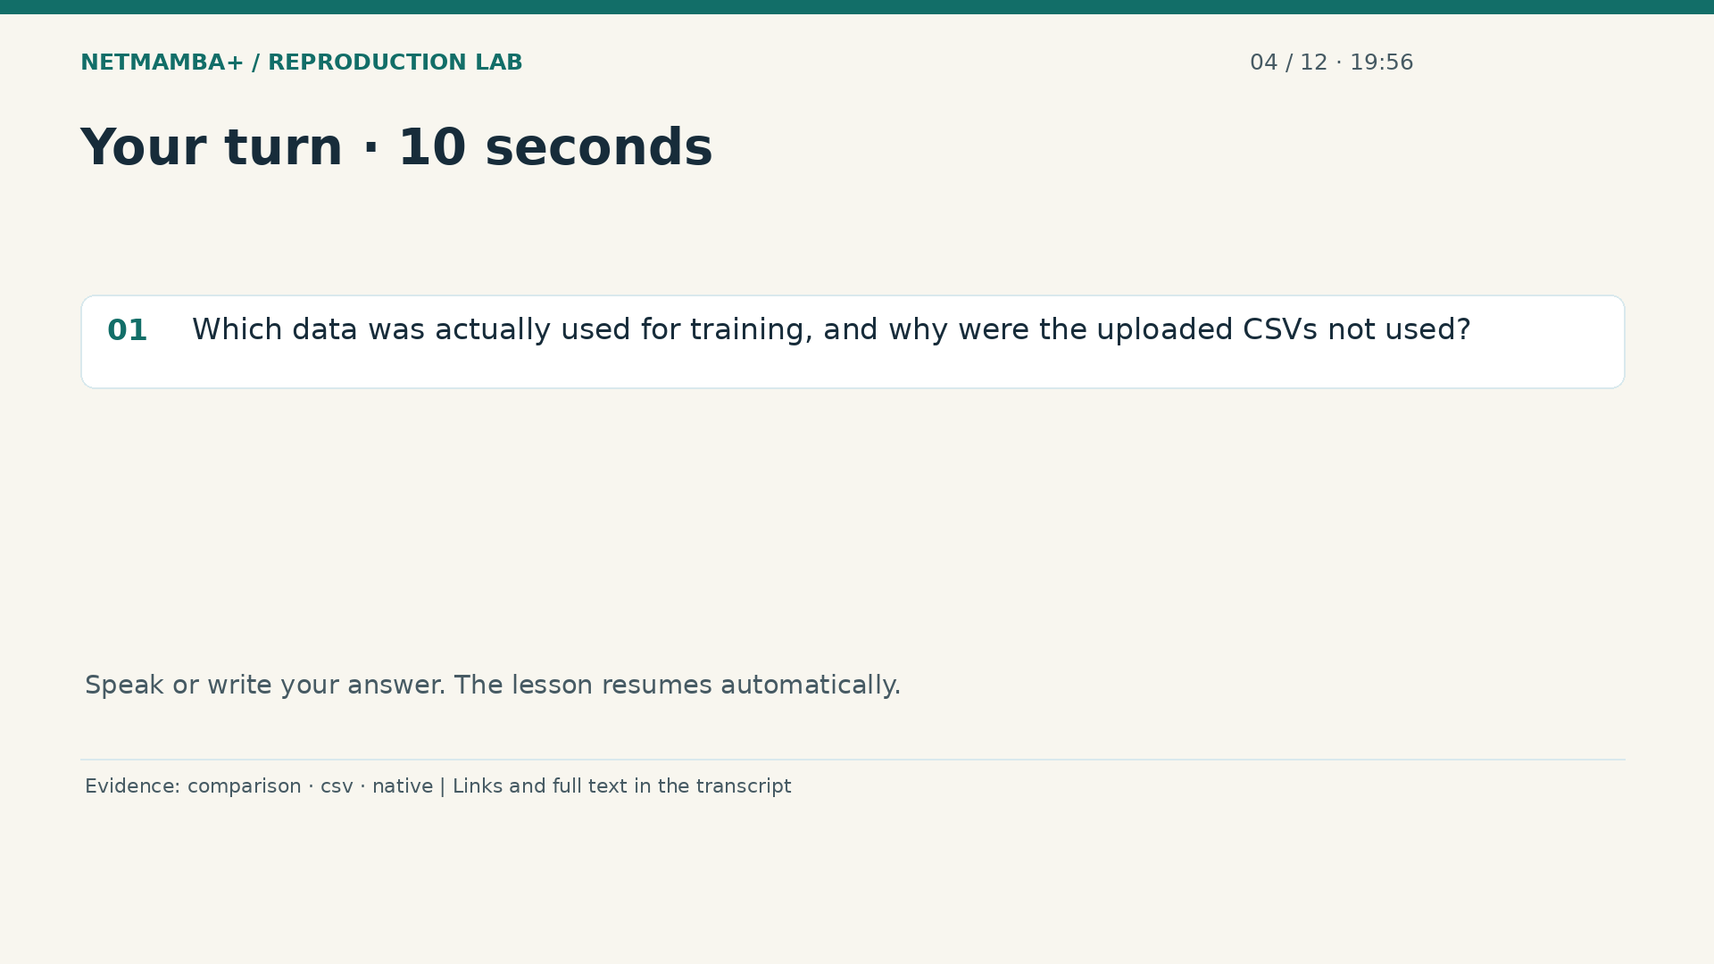
Notes:
00:19:56 — Your turn · 10 seconds
Practice for 10 seconds: Which data was actually used for training, and why were the uploaded CSVs not used?
Evidence:
https://github.com/buffbeefalo/netmambaplus-reproduction/blob/main/docs/customer/upstream-comparison.md
https://github.com/buffbeefalo/netmambaplus-reproduction/blob/main/docs/customer/evidence/uploaded-csv-profile.json
https://github.com/buffbeefalo/netmambaplus-reproduction/blob/main/docs/customer/evidence/native-data-validation.json
Slide image follows the video; notes are editable. Source SHA-256: 12f5572869db415fdbe34fc539500f2e0f980043de77eab69ec14bfa52d3338e

Slide 33
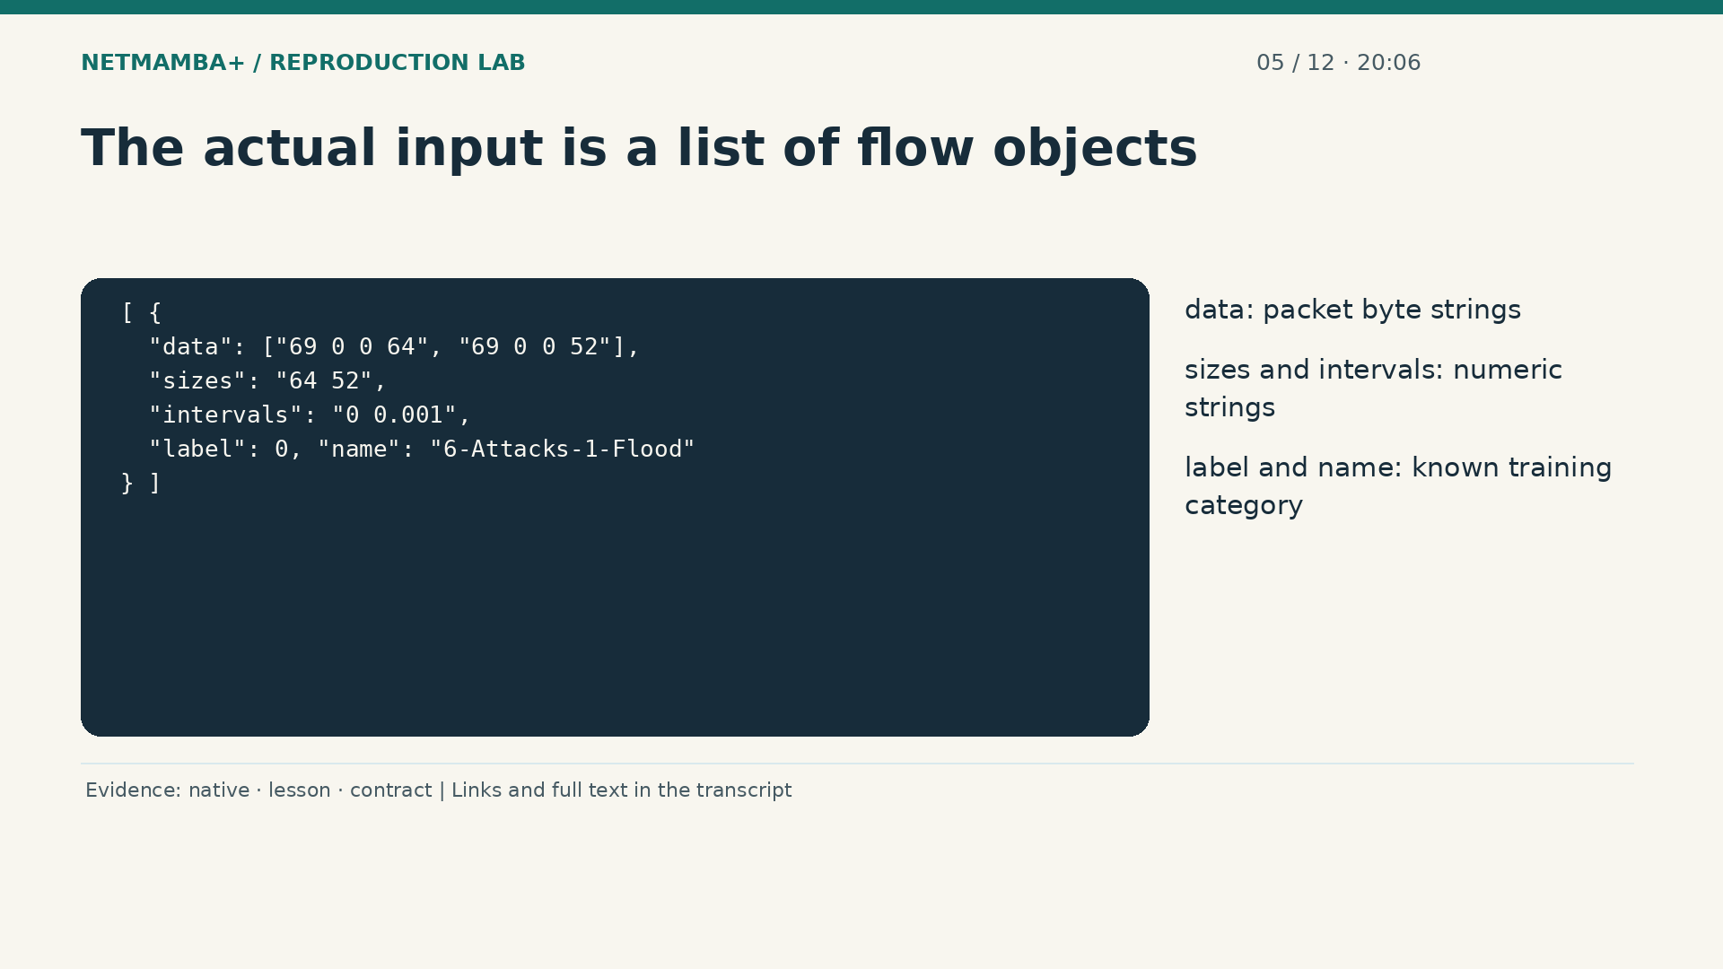
Notes:
00:20:06 — The actual input is a list of flow objects
The actual experiment uses the authors' native flow files. Each file contains a JSON array of flow objects. JSON is structured text with named fields and lists. The data field holds a list of packet byte strings. Sizes and intervals are space separated numeric strings. Labeled examples also carry class information. The small example on screen is synthetic and deliberately shortened to explain the schema. It is not a recovered packet capture. The real loader converts these fields into fixed numerical arrays, so variable length flows can enter the same neural model.
Evidence:
https://github.com/buffbeefalo/netmambaplus-reproduction/blob/main/docs/customer/evidence/native-data-validation.json
https://github.com/buffbeefalo/netmambaplus-reproduction/blob/main/docs/lesson.md
https://github.com/buffbeefalo/netmambaplus-reproduction/blob/main/docs/harness-reference.md
Slide image follows the video; notes are editable. Source SHA-256: 12f5572869db415fdbe34fc539500f2e0f980043de77eab69ec14bfa52d3338e

Slide 34
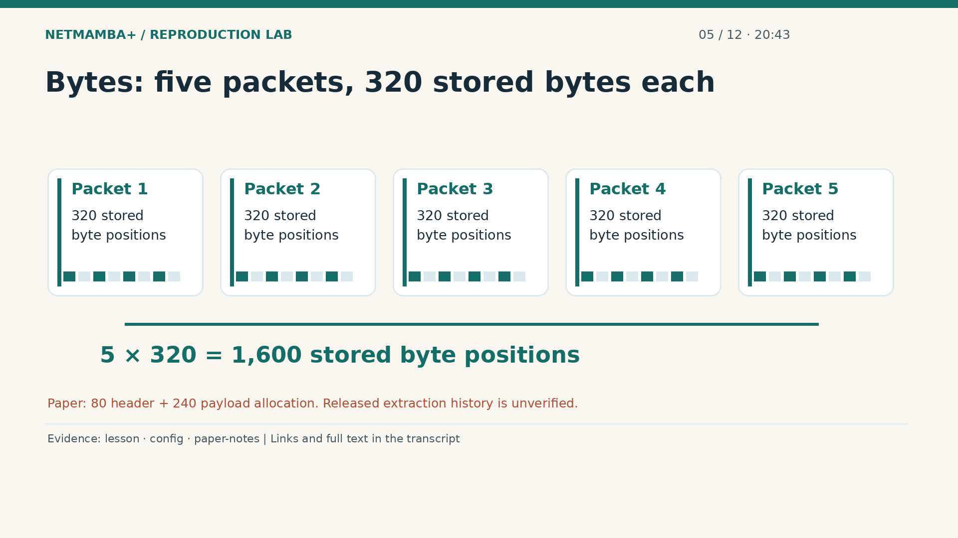
Notes:
00:20:43 — Bytes: five packets, 320 stored bytes each
The byte branch uses the first five packets and up to three hundred twenty stored bytes from each. Five times three hundred twenty gives sixteen hundred byte positions. Short inputs receive padding and long inputs are truncated. The paper describes an eighty byte header allocation and a two hundred forty byte payload allocation per packet. The released stored bytes can be loaded, but their complete extraction history has not been independently verified. We therefore say stored bytes when describing what our executed loader actually consumed. This preserves the difference between a paper's intended representation and a release's established provenance.
Evidence:
https://github.com/buffbeefalo/netmambaplus-reproduction/blob/main/docs/lesson.md
https://github.com/buffbeefalo/netmambaplus-reproduction/blob/main/configs/ciciot2022.json
https://github.com/buffbeefalo/netmambaplus-reproduction/blob/main/docs/customer/paper-and-data-explained.md
Slide image follows the video; notes are editable. Source SHA-256: 12f5572869db415fdbe34fc539500f2e0f980043de77eab69ec14bfa52d3338e

Slide 35
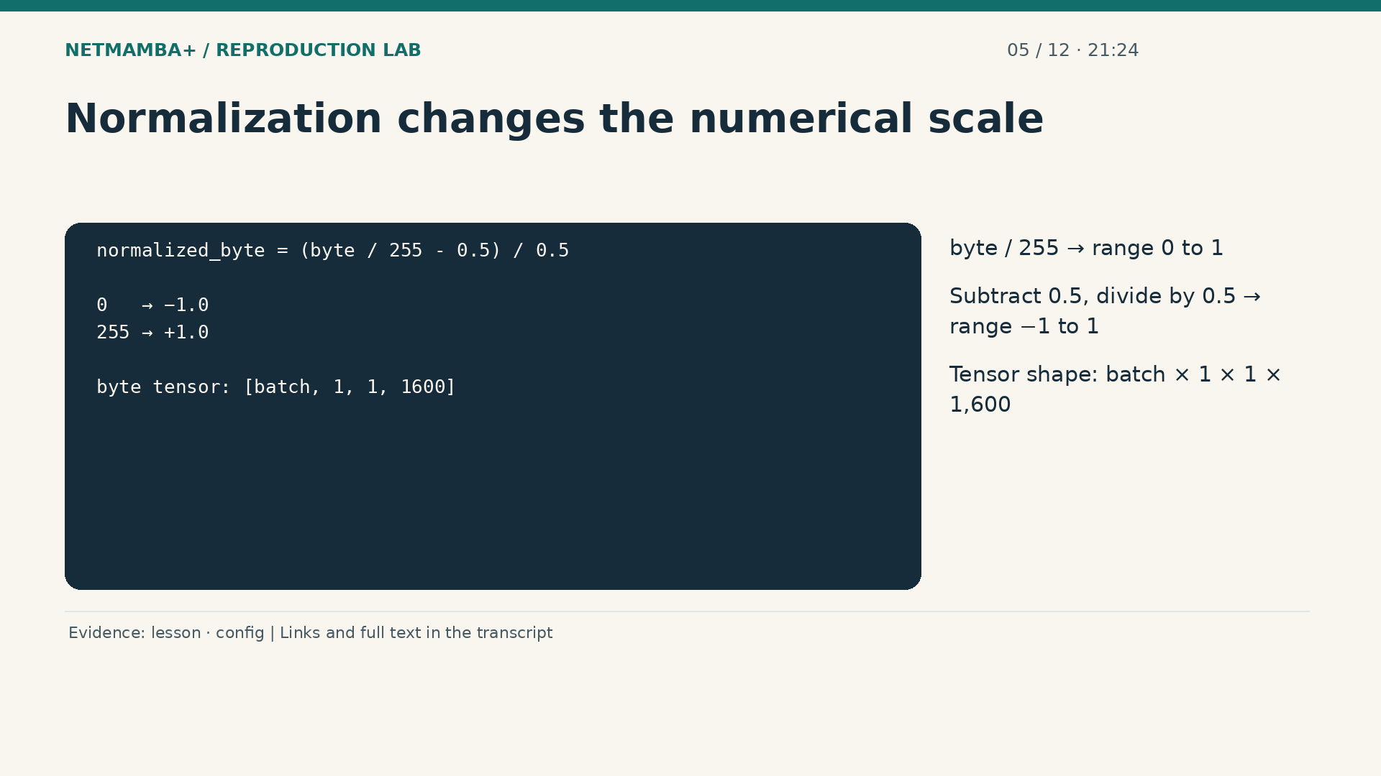
Notes:
00:21:24 — Normalization changes the numerical scale
The loader scales a byte value by dividing by two hundred fifty five. It then subtracts one half and divides by one half. Zero becomes negative one, and two hundred fifty five becomes positive one. This puts byte inputs on a common numerical scale. A tensor is simply a multidimensional array of numbers. For a batch of flows, the byte tensor has dimensions batch, one, one, and sixteen hundred. The extra dimensions match the original model's interface. A matching shape is necessary for execution, but it still does not prove that the underlying bytes mean the right thing.
Evidence:
https://github.com/buffbeefalo/netmambaplus-reproduction/blob/main/docs/lesson.md
https://github.com/buffbeefalo/netmambaplus-reproduction/blob/main/configs/ciciot2022.json
Slide image follows the video; notes are editable. Source SHA-256: 12f5572869db415fdbe34fc539500f2e0f980043de77eab69ec14bfa52d3338e

Slide 36
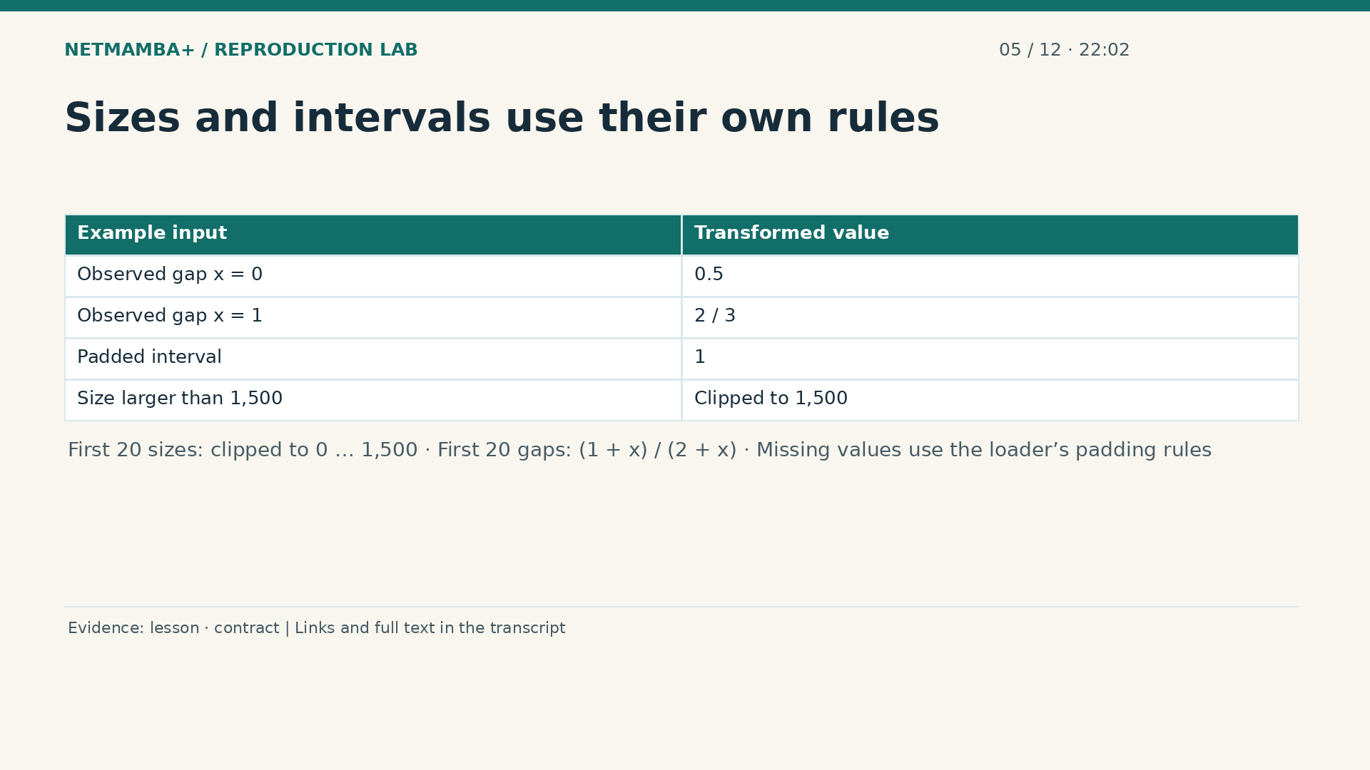
Notes:
00:22:02 — Sizes and intervals use their own rules
The size branch uses the first twenty packet sizes, clipped between zero and fifteen hundred. Its padding value is clipped to the same upper limit. The timing branch uses the first twenty gaps and maps an observed gap x to one plus x divided by two plus x. Zero maps to one half; one maps to two thirds. Those are numerical examples, not an assertion about seconds. Missing intervals use padding that maps to one. The wrapper requires actual observed gaps to be finite and nonnegative. Training and inference must use the same rules or they present different problems to the model.
Evidence:
https://github.com/buffbeefalo/netmambaplus-reproduction/blob/main/docs/lesson.md
https://github.com/buffbeefalo/netmambaplus-reproduction/blob/main/docs/harness-reference.md
Slide image follows the video; notes are editable. Source SHA-256: 12f5572869db415fdbe34fc539500f2e0f980043de77eab69ec14bfa52d3338e

Slide 37
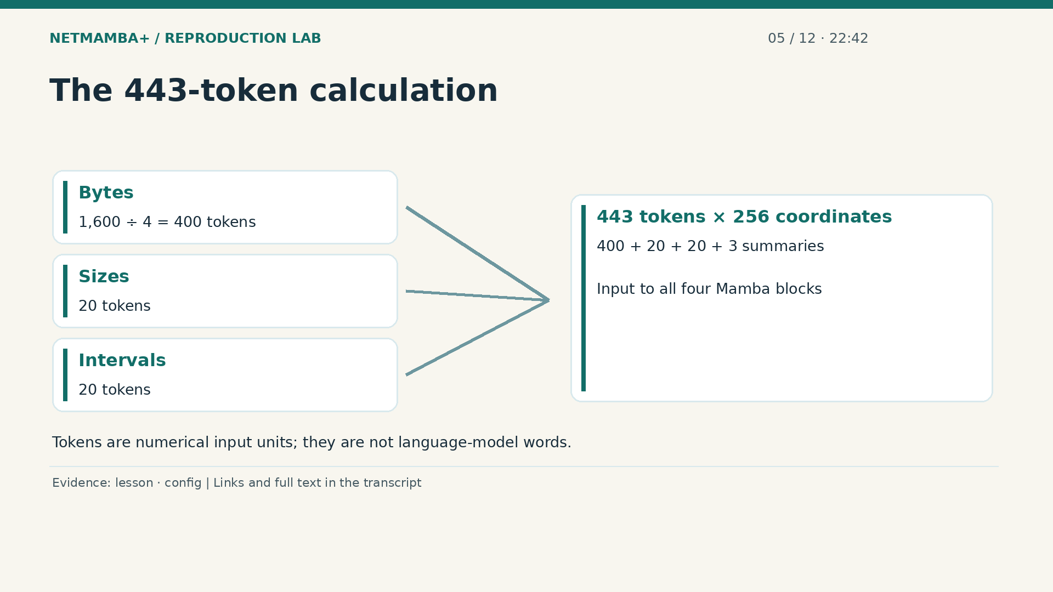
Notes:
00:22:42 — The 443-token calculation
A token here is one input unit for the sequence model. It is not a word from a language model. The sixteen hundred byte positions are grouped into four byte strides, producing four hundred byte tokens. Twenty size tokens and twenty interval tokens add forty more. Three learned summary tokens bring the total to four hundred forty three. Each token is embedded into a vector with two hundred fifty six coordinates. An embedding is a learned numerical representation. The model learns how useful patterns in those coordinates relate to the dataset categories.
Evidence:
https://github.com/buffbeefalo/netmambaplus-reproduction/blob/main/docs/lesson.md
https://github.com/buffbeefalo/netmambaplus-reproduction/blob/main/configs/ciciot2022.json
Slide image follows the video; notes are editable. Source SHA-256: 12f5572869db415fdbe34fc539500f2e0f980043de77eab69ec14bfa52d3338e

Slide 38
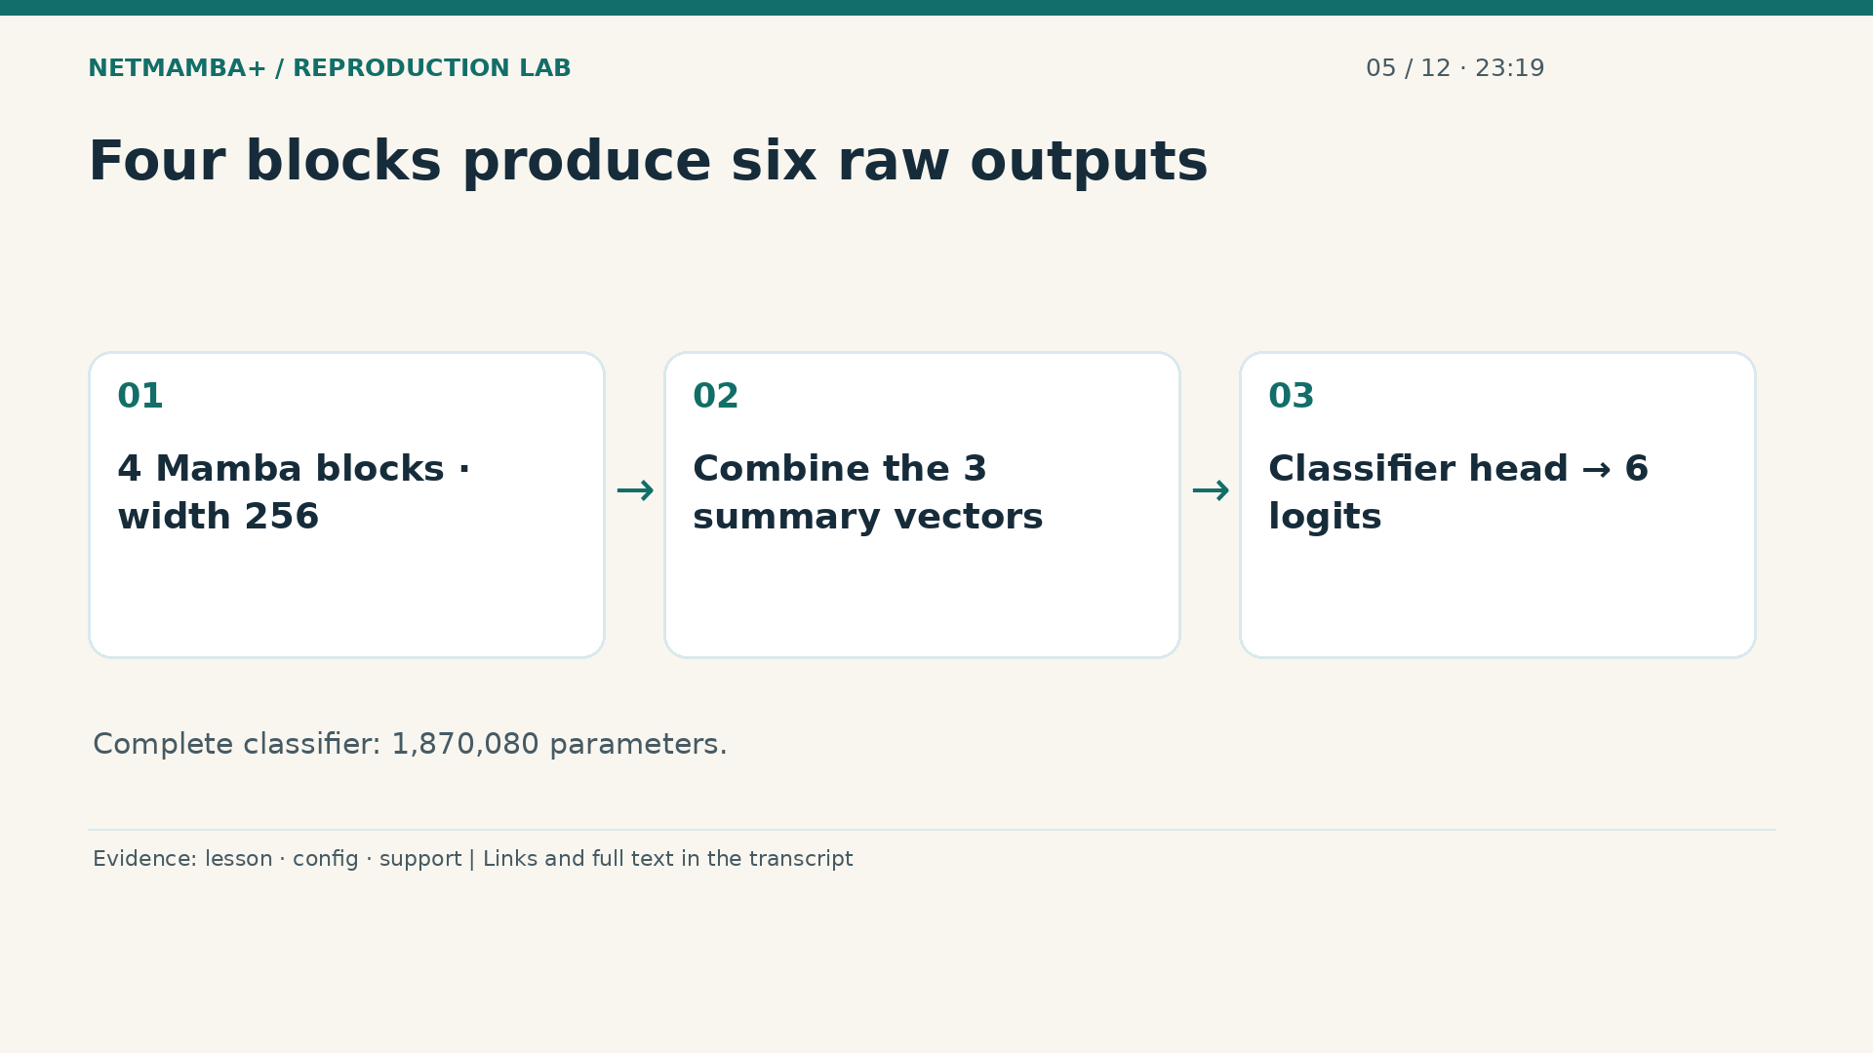
Notes:
00:23:19 — Four blocks produce six raw outputs
The sequence passes through four Mamba blocks. The active configuration uses the unidirectional branch and its fast execution path. After processing, the three summary vectors are added together and passed to the classification head. The result is six logits, or raw category scores, for each flow. The six class meanings are Flood, R T S P brute force, Audio, Other, Cameras, and Home Automation. Four describe device or activity groups, so these are not six attack types. The complete classifier has one million eight hundred seventy thousand eighty parameters. Parameters are the learned numbers updated during training. They are different from the input tensor values. The runtime checks exercise this complete model rather than replacing it with a smaller lookalike.
Evidence:
https://github.com/buffbeefalo/netmambaplus-reproduction/blob/main/docs/lesson.md
https://github.com/buffbeefalo/netmambaplus-reproduction/blob/main/configs/ciciot2022.json
https://github.com/buffbeefalo/netmambaplus-reproduction/blob/main/docs/support-matrix.md
Slide image follows the video; notes are editable. Source SHA-256: 12f5572869db415fdbe34fc539500f2e0f980043de77eab69ec14bfa52d3338e

Slide 39
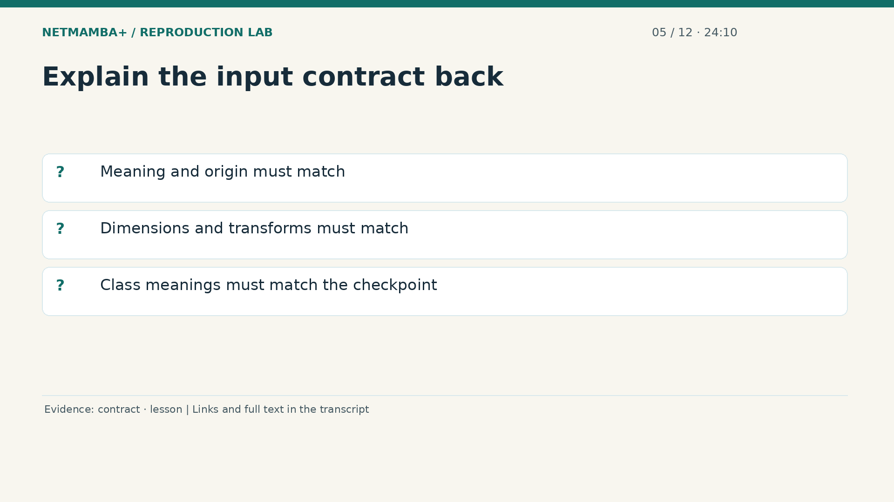
Notes:
00:24:10 — Explain the input contract back
To explain the input contract, cover three levels. The fields must describe the correct flow. Their dimensions and transformations must match the original loader. Finally, the label vocabulary must match the saved classifier. A file can pass a basic JSON parser and still fail one of these requirements. Our wrappers reject incompatible or invalid inputs before model execution where those conditions can be checked. Take ten seconds to describe the three feature views and the six number output, without using the word artificial intelligence as a substitute for the actual process.
Evidence:
https://github.com/buffbeefalo/netmambaplus-reproduction/blob/main/docs/harness-reference.md
https://github.com/buffbeefalo/netmambaplus-reproduction/blob/main/docs/lesson.md
Slide image follows the video; notes are editable. Source SHA-256: 12f5572869db415fdbe34fc539500f2e0f980043de77eab69ec14bfa52d3338e

Slide 40
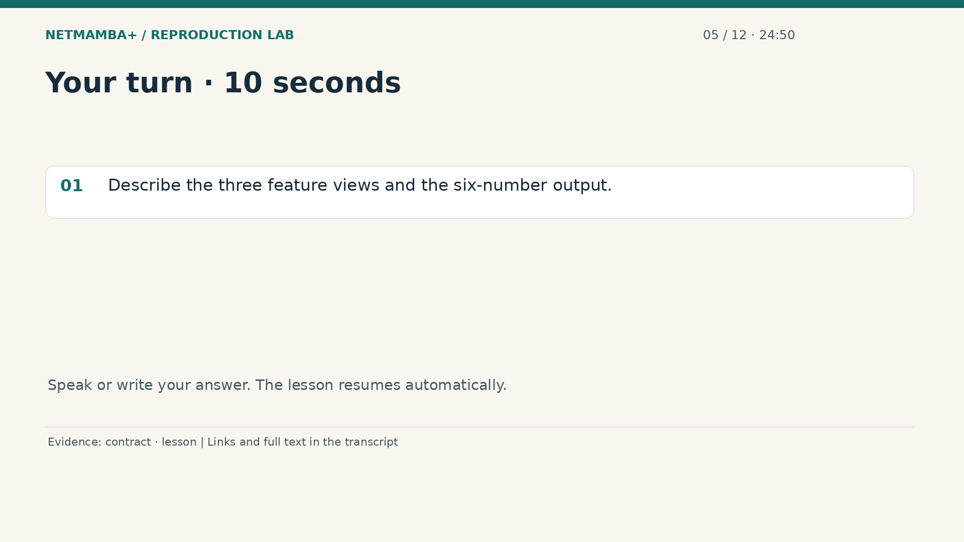
Notes:
00:24:50 — Your turn · 10 seconds
Practice for 10 seconds: Describe the three feature views and the six-number output.
Evidence:
https://github.com/buffbeefalo/netmambaplus-reproduction/blob/main/docs/harness-reference.md
https://github.com/buffbeefalo/netmambaplus-reproduction/blob/main/docs/lesson.md
Slide image follows the video; notes are editable. Source SHA-256: 12f5572869db415fdbe34fc539500f2e0f980043de77eab69ec14bfa52d3338e

Slide 41
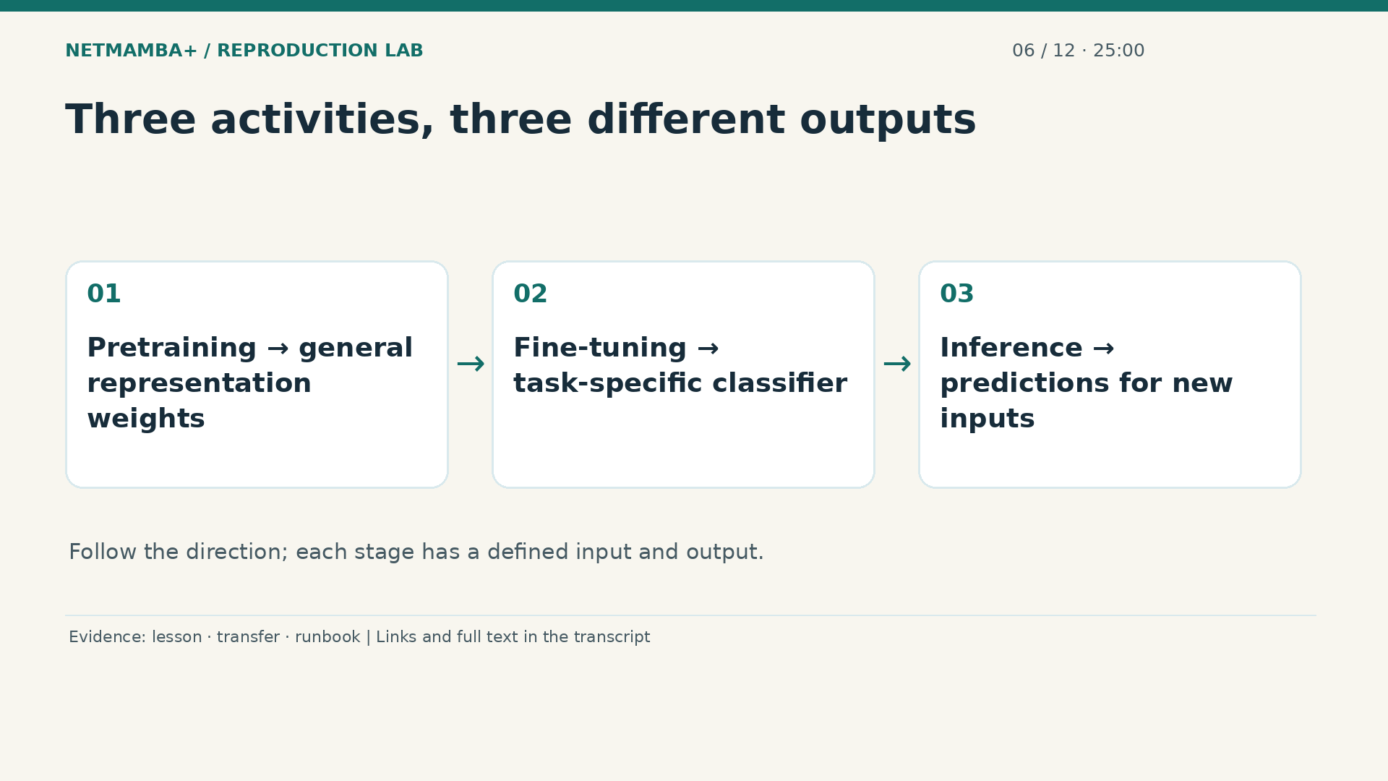
Notes:
00:25:00 — Three activities, three different outputs
Bytes, sizes, and intervals enter the model; six raw scores come out. Now separate learning from using what was learned. Pretraining teaches a representation from a reconstruction task. Fine tuning adapts that representation to known categories using labeled examples. Inference uses a fixed classifier to produce scores without updating its parameters. A checkpoint saves model state so a later process can reload it. Some training checkpoints also include optimizer state and settings. The word checkpoint therefore describes a file's role, not a guarantee that it contains a complete deployment package.
Evidence:
https://github.com/buffbeefalo/netmambaplus-reproduction/blob/main/docs/lesson.md
https://github.com/buffbeefalo/netmambaplus-reproduction/blob/main/docs/customer/evidence/checkpoint-transfer.json
https://github.com/buffbeefalo/netmambaplus-reproduction/blob/main/docs/customer/runbook.md
Slide image follows the video; notes are editable. Source SHA-256: 12f5572869db415fdbe34fc539500f2e0f980043de77eab69ec14bfa52d3338e

Slide 42
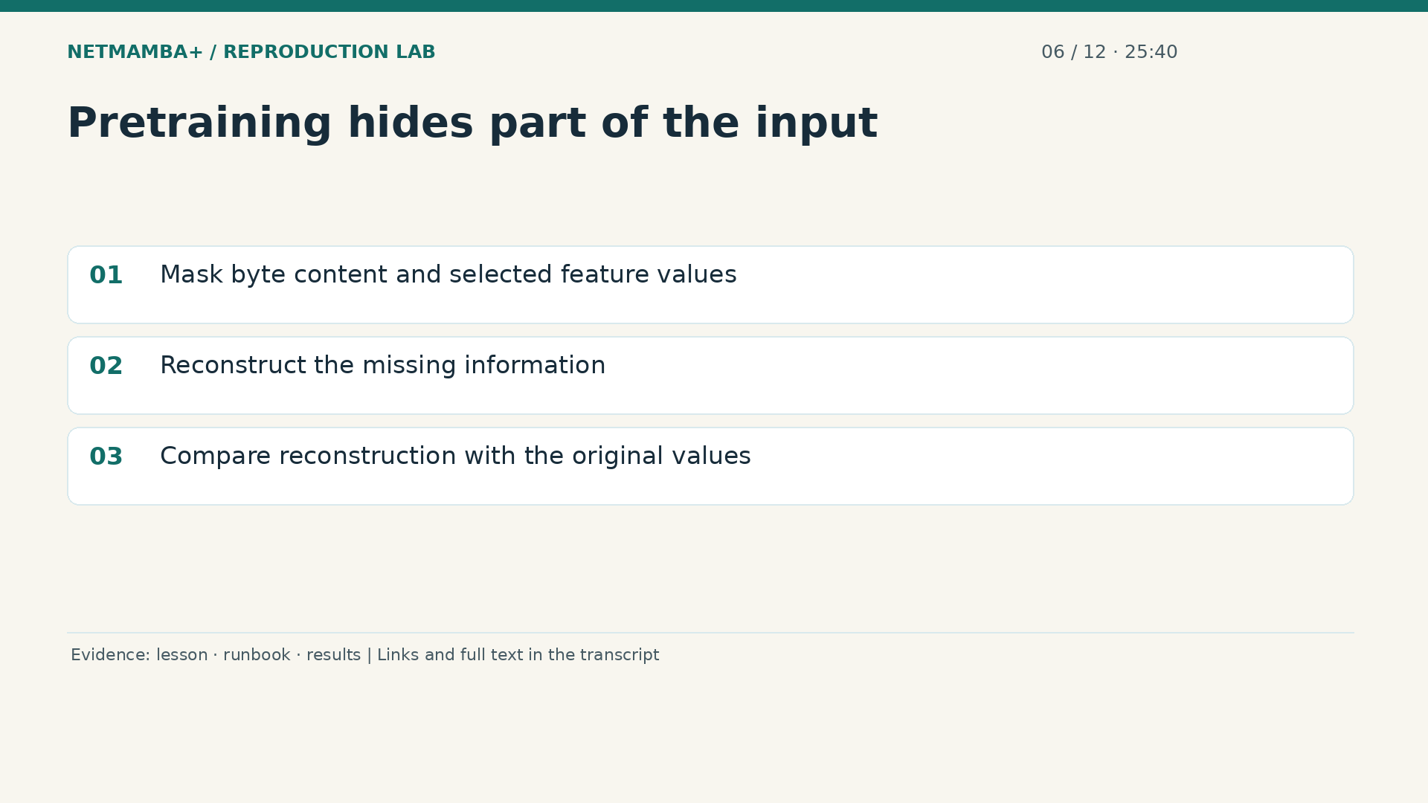
Notes:
00:25:40 — Pretraining hides part of the input
During masked pretraining, parts of the input are hidden or zeroed according to the original procedure. A reconstruction decoder tries to recover the missing content and feature values. The loss measures reconstruction error. The optimizer adjusts parameters to reduce that error over examples. Labels such as Flood or Cameras are not the reconstruction target. Learning a useful representation this way may help a later classification task, but a falling reconstruction loss does not itself prove attack detection accuracy. The full paper uses a much larger pretraining protocol than the short functional check we executed.
Evidence:
https://github.com/buffbeefalo/netmambaplus-reproduction/blob/main/docs/lesson.md
https://github.com/buffbeefalo/netmambaplus-reproduction/blob/main/docs/customer/runbook.md
https://github.com/buffbeefalo/netmambaplus-reproduction/blob/main/docs/customer/evidence/results.json
Slide image follows the video; notes are editable. Source SHA-256: 12f5572869db415fdbe34fc539500f2e0f980043de77eab69ec14bfa52d3338e

Slide 43
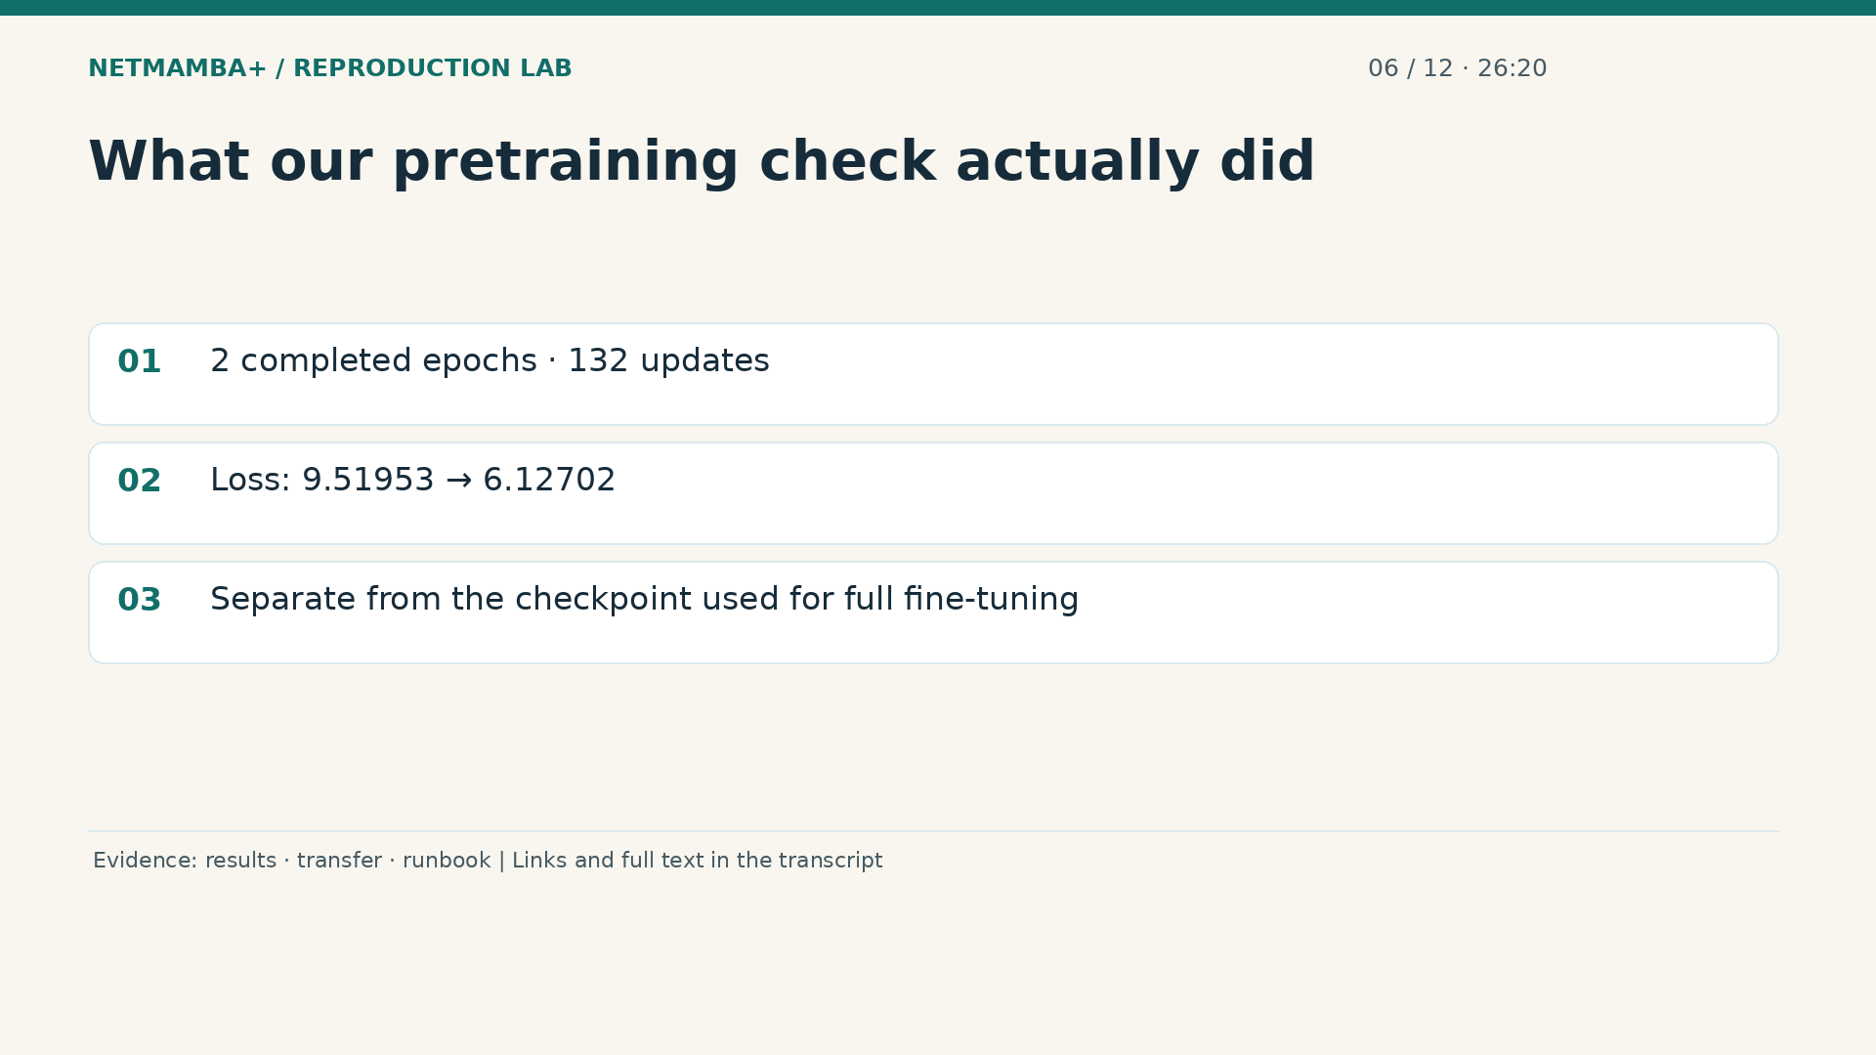
Notes:
00:26:20 — What our pretraining check actually did
Our limited check completed two epochs and one hundred thirty two optimizer updates on downstream training data. Reconstruction loss fell from about nine point five two to six point one three. The requested short step budget was rounded by the original loop to complete epochs. This demonstrates that the masked training path executes and learns on that check. It does not recreate the paper's one hundred fifty thousand step pretraining. The three main fine tuning runs started from the authors' released pretrained checkpoint, not the output of our short check. Keep those two branches separate when drawing the workflow.
Evidence:
https://github.com/buffbeefalo/netmambaplus-reproduction/blob/main/docs/customer/evidence/results.json
https://github.com/buffbeefalo/netmambaplus-reproduction/blob/main/docs/customer/evidence/checkpoint-transfer.json
https://github.com/buffbeefalo/netmambaplus-reproduction/blob/main/docs/customer/runbook.md
Slide image follows the video; notes are editable. Source SHA-256: 12f5572869db415fdbe34fc539500f2e0f980043de77eab69ec14bfa52d3338e

Slide 44
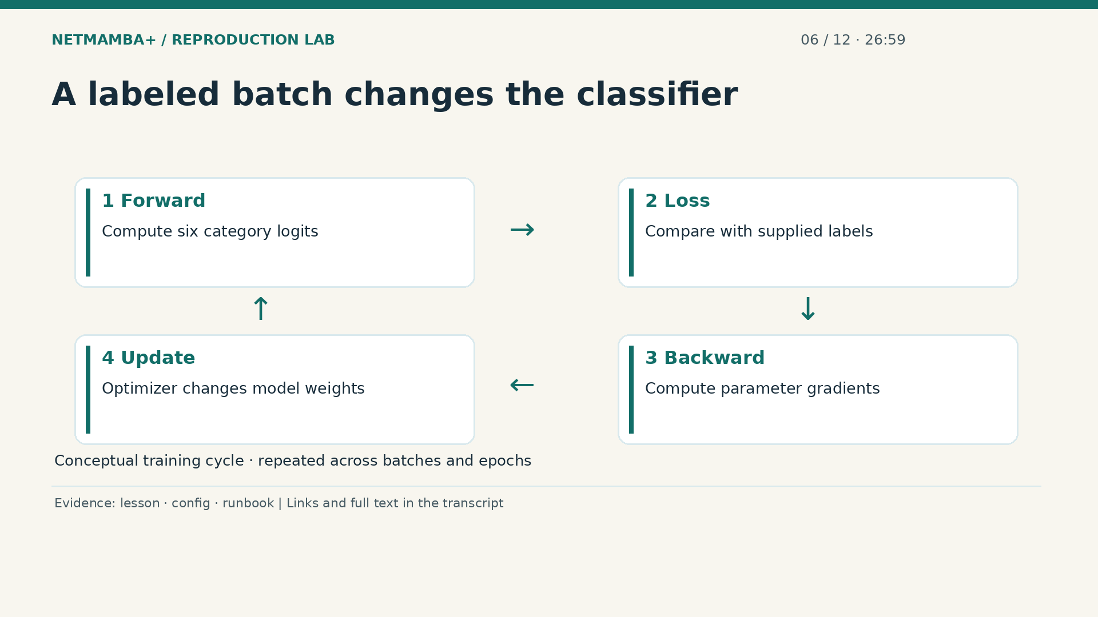
Notes:
00:26:59 — A labeled batch changes the classifier
In fine tuning, a batch contains multiple labeled flows. The forward pass computes category scores. A classification loss compares those scores with the supplied labels, with the configured smoothing. The backward pass computes gradients, which describe how parameter changes affect the loss. The optimizer then updates those parameters. Repeating this process across the training loader forms an epoch. A learning rate controls the scale of updates. This is why training needs much more computation than simply opening the recorded demo. The demo reads saved outputs; a training command repeatedly changes the model.
Evidence:
https://github.com/buffbeefalo/netmambaplus-reproduction/blob/main/docs/lesson.md
https://github.com/buffbeefalo/netmambaplus-reproduction/blob/main/configs/ciciot2022.json
https://github.com/buffbeefalo/netmambaplus-reproduction/blob/main/docs/customer/runbook.md
Slide image follows the video; notes are editable. Source SHA-256: 12f5572869db415fdbe34fc539500f2e0f980043de77eab69ec14bfa52d3338e

Slide 45
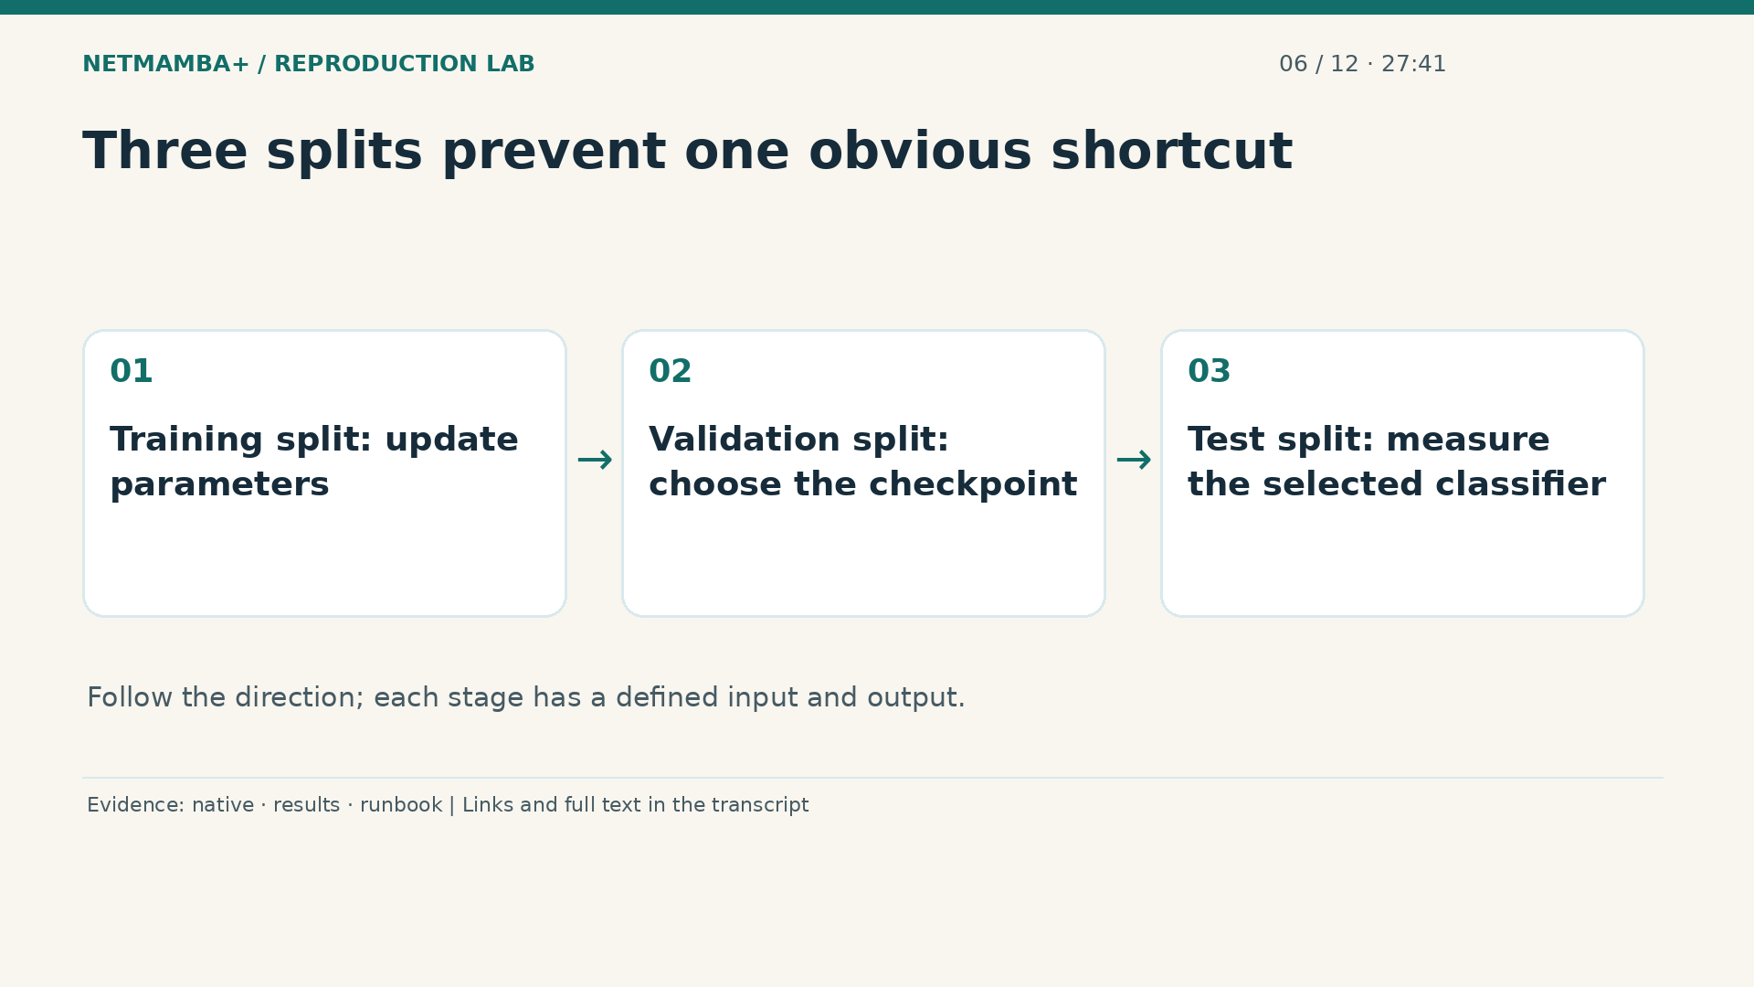
Notes:
00:27:41 — Three splits prevent one obvious shortcut
The training split supplies parameter updates. Validation results select a checkpoint. The test split measures the selected classifier's performance afterward. Choosing a checkpoint by its test score would use the test set as a tuning signal. The native fine tuner selects the best validation accuracy and then performs its final test pass. Separate evaluation strictly reloads that selected classifier. This separation is necessary, although the previously disclosed input overlaps and unknown capture history still limit the evidence. Following the split procedure cannot undo uncertainty in how the underlying data was collected.
Evidence:
https://github.com/buffbeefalo/netmambaplus-reproduction/blob/main/docs/customer/evidence/native-data-validation.json
https://github.com/buffbeefalo/netmambaplus-reproduction/blob/main/docs/customer/evidence/results.json
https://github.com/buffbeefalo/netmambaplus-reproduction/blob/main/docs/customer/runbook.md
Slide image follows the video; notes are editable. Source SHA-256: 12f5572869db415fdbe34fc539500f2e0f980043de77eab69ec14bfa52d3338e

Slide 46
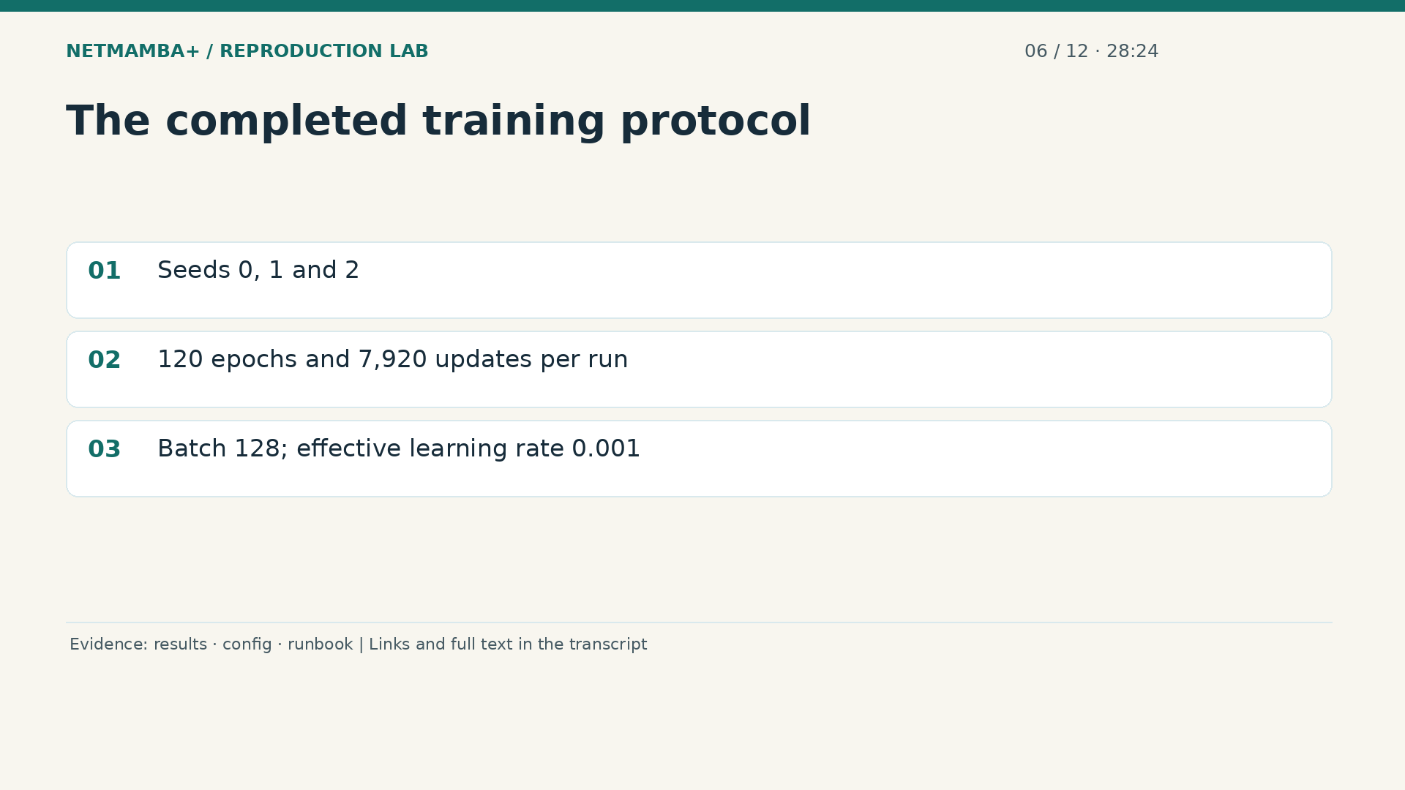
Notes:
00:28:24 — The completed training protocol
Each of the three declared seeds completed one hundred twenty epochs and seven thousand nine hundred twenty updates. A seed sets the starting values for randomized operations; the seeds are not three independent datasets. The source based recipe uses batch size one hundred twenty eight and a base learning rate that resolves to an effective rate of zero point zero zero one. The paper describes different batch and runtime conditions. Our training ran without mixed precision, while native evaluation used its recorded mixed precision path. These details help another engineer reproduce our execution rather than accidentally claim an exact paper configuration.
Evidence:
https://github.com/buffbeefalo/netmambaplus-reproduction/blob/main/docs/customer/evidence/results.json
https://github.com/buffbeefalo/netmambaplus-reproduction/blob/main/configs/ciciot2022.json
https://github.com/buffbeefalo/netmambaplus-reproduction/blob/main/docs/customer/runbook.md
Slide image follows the video; notes are editable. Source SHA-256: 12f5572869db415fdbe34fc539500f2e0f980043de77eab69ec14bfa52d3338e

Slide 47
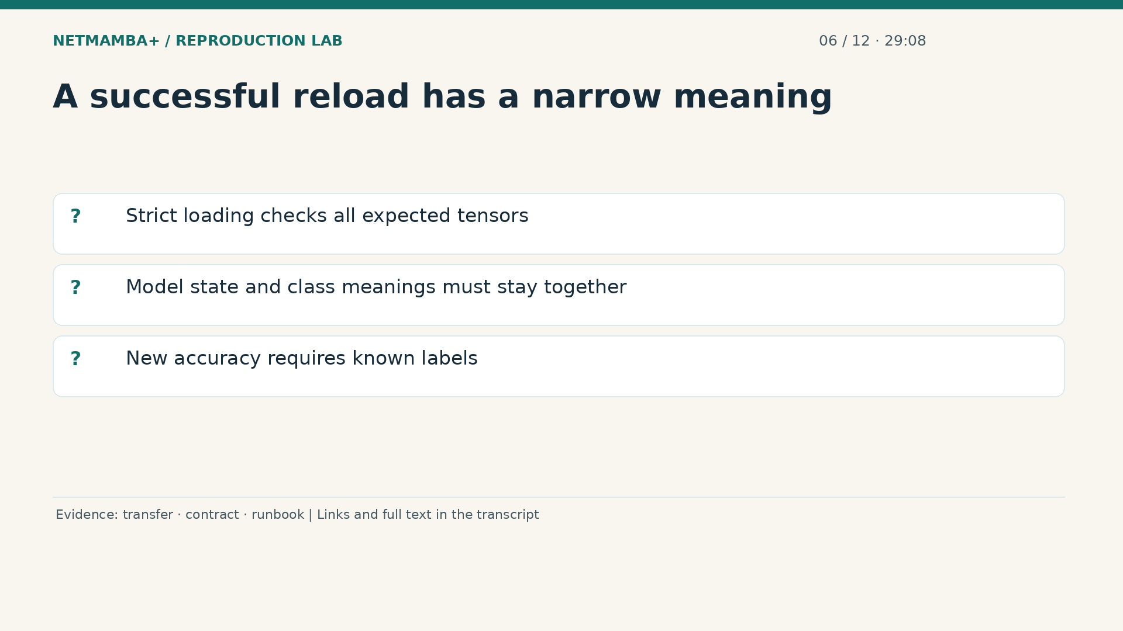
Notes:
00:29:08 — A successful reload has a narrow meaning
Strict reloading rejects missing or unexpected model tensors rather than quietly ignoring them. The wrapper also checks the class meaning associated with each output index. This matters because a numerically valid classifier could otherwise display the wrong category names. Inference can return logits, display scores, and a selected class for unlabeled flows. It cannot calculate accuracy without ground truth. Take ten seconds: explain the difference between demonstrating a short pretraining update, completing fine tuning, and using a saved classifier to predict. Name the separate output produced by each activity.
Evidence:
https://github.com/buffbeefalo/netmambaplus-reproduction/blob/main/docs/customer/evidence/checkpoint-transfer.json
https://github.com/buffbeefalo/netmambaplus-reproduction/blob/main/docs/harness-reference.md
https://github.com/buffbeefalo/netmambaplus-reproduction/blob/main/docs/customer/runbook.md
Slide image follows the video; notes are editable. Source SHA-256: 12f5572869db415fdbe34fc539500f2e0f980043de77eab69ec14bfa52d3338e

Slide 48
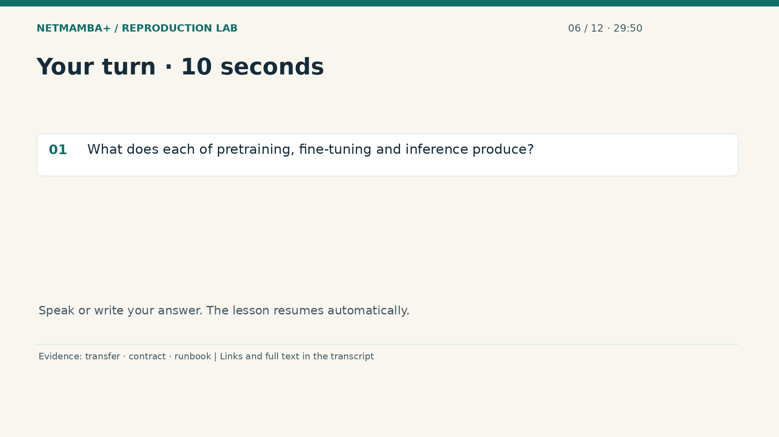
Notes:
00:29:50 — Your turn · 10 seconds
Practice for 10 seconds: What does each of pretraining, fine-tuning and inference produce?
Evidence:
https://github.com/buffbeefalo/netmambaplus-reproduction/blob/main/docs/customer/evidence/checkpoint-transfer.json
https://github.com/buffbeefalo/netmambaplus-reproduction/blob/main/docs/harness-reference.md
https://github.com/buffbeefalo/netmambaplus-reproduction/blob/main/docs/customer/runbook.md
Slide image follows the video; notes are editable. Source SHA-256: 12f5572869db415fdbe34fc539500f2e0f980043de77eab69ec14bfa52d3338e

Slide 49
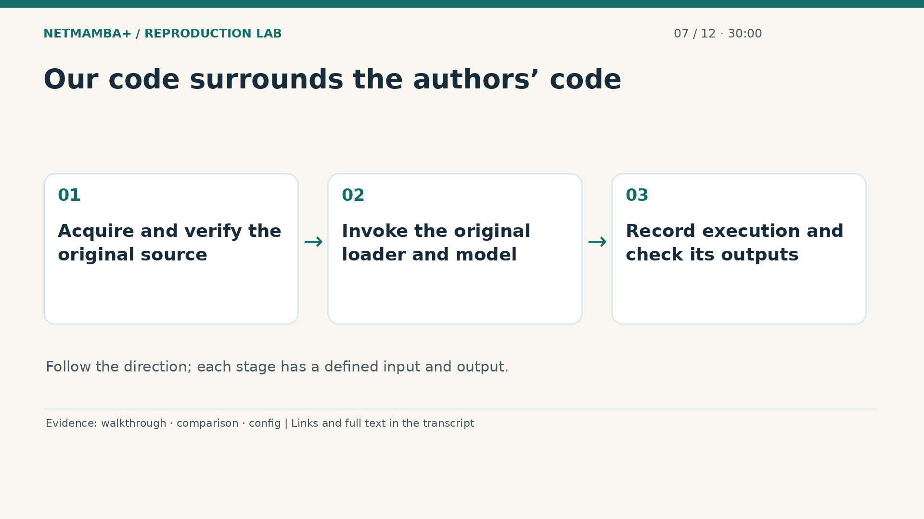
Notes:
00:30:00 — Our code surrounds the authors’ code
Pretraining produces representation weights, fine tuning produces a task specific classifier, and inference produces predictions. Now follow the code that organizes those activities. This repository is an execution and evidence layer around the authors' source. It does not claim authorship of Net Mamba Plus. The source is fetched at a pinned commit, with a recorded inventory of one hundred three source files and additional core hashes. Keeping the original loader avoids writing a second interpretation of byte padding and normalization. The surrounding code supplies validation, reproducible commands, manifests, and independent output checks.
Evidence:
https://github.com/buffbeefalo/netmambaplus-reproduction/blob/main/docs/repository-walkthrough.md
https://github.com/buffbeefalo/netmambaplus-reproduction/blob/main/docs/customer/upstream-comparison.md
https://github.com/buffbeefalo/netmambaplus-reproduction/blob/main/configs/ciciot2022.json
Slide image follows the video; notes are editable. Source SHA-256: 12f5572869db415fdbe34fc539500f2e0f980043de77eab69ec14bfa52d3338e

Slide 50
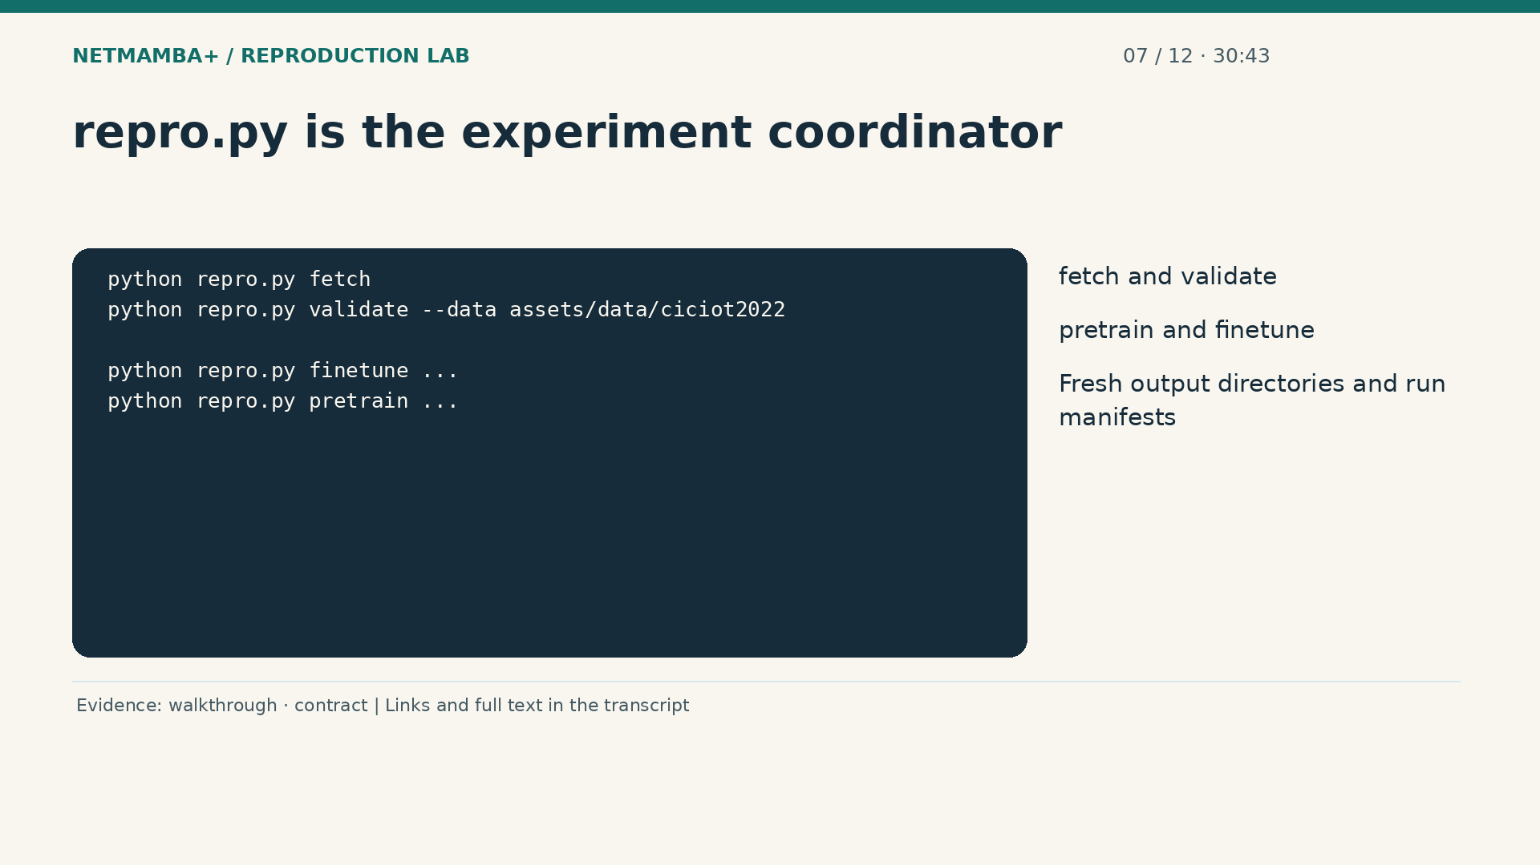
Notes:
00:30:43 — repro.py is the experiment coordinator
The main entry point is repro dot p y. Its commands acquire or validate the pinned source and data, resolve the original command line settings, and launch training subprocesses. A subprocess is a separately running program invoked by the coordinator. The wrapper creates a fresh output directory and a manifest recording identities, configuration, environment, and status. A failed job should leave an informative record. It should not overwrite a prior successful result and make the two runs impossible to distinguish. Shared preparation helpers are reused by the other entry points.
Evidence:
https://github.com/buffbeefalo/netmambaplus-reproduction/blob/main/docs/repository-walkthrough.md
https://github.com/buffbeefalo/netmambaplus-reproduction/blob/main/docs/harness-reference.md
Slide image follows the video; notes are editable. Source SHA-256: 12f5572869db415fdbe34fc539500f2e0f980043de77eab69ec14bfa52d3338e

Slide 51

Notes:
00:31:22 — evaluate.py answers: how accurate is this model?
Evaluate dot p y loads a saved classifier strictly and evaluates labeled test flows through the original loader and evaluation engine. It does not train the model again. It also does not choose a checkpoint by maximizing test accuracy. Its result is a set of metrics attached to the evaluated model and data. If someone sends you a number without a checkpoint identity or class mapping, you cannot establish that it describes the intended classifier. This wrapper records those bindings so the reported accuracy can be traced to a particular execution.
Evidence:
https://github.com/buffbeefalo/netmambaplus-reproduction/blob/main/docs/repository-walkthrough.md
https://github.com/buffbeefalo/netmambaplus-reproduction/blob/main/docs/customer/runbook.md
https://github.com/buffbeefalo/netmambaplus-reproduction/blob/main/docs/customer/evidence/results.json
Slide image follows the video; notes are editable. Source SHA-256: 12f5572869db415fdbe34fc539500f2e0f980043de77eab69ec14bfa52d3338e

Slide 52

Notes:
00:31:59 — predict.py answers: which category fits this flow?
Predict dot p y is for native flows whose true categories are unknown. It adapts those records to the original loader's expected structure, removes target information before prediction, and returns the classifier outputs with class names. This is useful for testing the inference interface with already assembled flows. It is not a packet capture tool, and it cannot reconstruct missing flow context from an arbitrary CSV. It does not calculate accuracy for unlabeled records. That behavior prevents a common reporting error: presenting confident looking predictions as evidence that those predictions are correct.
Evidence:
https://github.com/buffbeefalo/netmambaplus-reproduction/blob/main/docs/repository-walkthrough.md
https://github.com/buffbeefalo/netmambaplus-reproduction/blob/main/docs/harness-reference.md
https://github.com/buffbeefalo/netmambaplus-reproduction/blob/main/docs/customer/runbook.md
Slide image follows the video; notes are editable. Source SHA-256: 12f5572869db415fdbe34fc539500f2e0f980043de77eab69ec14bfa52d3338e

Slide 53

Notes:
00:32:39 — replay.py connects execution to explanation
Replay dot p y records labeled model predictions and independently recomputes metrics from the saved outputs. It also builds the self contained browser demonstration. The browser page displays the data already written into it. It does not need CUDA or a model checkpoint to replay those results. This split is intentional: the numerical experiment can be reviewed once and then explained on another computer without rerunning training. The tradeoff is that the page is a recorded demonstration. New customer flows require actual inference through a checked runtime, not just a browser refresh.
Evidence:
https://github.com/buffbeefalo/netmambaplus-reproduction/blob/main/docs/repository-walkthrough.md
https://github.com/buffbeefalo/netmambaplus-reproduction/blob/main/docs/customer/evidence/seed0/replay/predictions.json
Slide image follows the video; notes are editable. Source SHA-256: 12f5572869db415fdbe34fc539500f2e0f980043de77eab69ec14bfa52d3338e

Slide 54

Notes:
00:33:17 — Configurations and assets define the recipe
The configuration files are recipes and identity checks. They contain settings, source pins, expected asset hashes, and class metadata. The assets directory holds separately acquired data and weights on your machine. The downloaded authors' source lives in the local upstream slash Net Mamba Plus directory. Those external assets are not mirrored as public repository contents. This distinction explains why cloning the repository is enough for document checks but not enough for neural training. The acquisition tools must obtain the additional files, verify their identities, and preserve their unresolved inherited redistribution and commercial terms.
Evidence:
https://github.com/buffbeefalo/netmambaplus-reproduction/blob/main/docs/repository-walkthrough.md
https://github.com/buffbeefalo/netmambaplus-reproduction/blob/main/configs/ciciot2022.json
https://github.com/buffbeefalo/netmambaplus-reproduction/blob/main/docs/customer/evidence/checkpoint-transfer.json
Slide image follows the video; notes are editable. Source SHA-256: 12f5572869db415fdbe34fc539500f2e0f980043de77eab69ec14bfa52d3338e

Slide 55

Notes:
00:34:02 — Read a run in this order
When auditing a run, start with its manifest. Then inspect the log and the saved metrics or predictions. A configuration file proves what was requested, not that the run completed. A model file proves saved state exists, not which data produced it. A chart is a presentation of measurements, not their origin. The records work together. Take ten seconds to decide which entry point you would use for an unlabeled native flow, and which one you would use to score a labeled test set. Then identify the file that records the run's provenance.
Evidence:
https://github.com/buffbeefalo/netmambaplus-reproduction/blob/main/docs/repository-walkthrough.md
https://github.com/buffbeefalo/netmambaplus-reproduction/blob/main/docs/customer/verification.md
Slide image follows the video; notes are editable. Source SHA-256: 12f5572869db415fdbe34fc539500f2e0f980043de77eab69ec14bfa52d3338e

Slide 56

Notes:
00:34:36 — Your turn · 10 seconds
Practice for 10 seconds: Which scripts handle unlabeled prediction and labeled evaluation? Where is run provenance recorded?
Evidence:
https://github.com/buffbeefalo/netmambaplus-reproduction/blob/main/docs/repository-walkthrough.md
https://github.com/buffbeefalo/netmambaplus-reproduction/blob/main/docs/customer/verification.md
Slide image follows the video; notes are editable. Source SHA-256: 12f5572869db415fdbe34fc539500f2e0f980043de77eab69ec14bfa52d3338e

Slide 57

Notes:
00:34:46 — Three runs, one fixed test set
Use predict for unlabeled flows, evaluate for labeled scoring, and the manifest for run provenance. Now examine the recorded results. Seed zero correctly classified nine hundred fifty of one thousand forty one test flows. Seed one got eight hundred seventy five correct. Seed two got eight hundred eighty one. Those correspond to ninety one point two six, eighty four point zero five, and eighty four point six three percent accuracy. All three results are retained. Selecting only the strongest seed would give a misleading impression of this training procedure's observed variability.
Evidence:
https://github.com/buffbeefalo/netmambaplus-reproduction/blob/main/docs/customer/evidence/results.json
Slide image follows the video; notes are editable. Source SHA-256: 12f5572869db415fdbe34fc539500f2e0f980043de77eab69ec14bfa52d3338e

Slide 58

Notes:
00:35:26 — Mean and spread answer different questions
The average accuracy is eighty six point six five percent. The sample standard deviation is four percentage points. The mean summarizes these three runs; the standard deviation summarizes their spread. It is not a confidence interval and does not prove how performance will vary on a customer's network. All three seeds used the same test split. One result has therefore been repeated under different randomized training conditions, rather than evaluated on three independently collected networks. Those are useful measurements, but they answer a narrower question than real world generalization.
Evidence:
https://github.com/buffbeefalo/netmambaplus-reproduction/blob/main/docs/customer/evidence/results.json
https://github.com/buffbeefalo/netmambaplus-reproduction/blob/main/docs/customer/evidence/native-data-validation.json
Slide image follows the video; notes are editable. Source SHA-256: 12f5572869db415fdbe34fc539500f2e0f980043de77eab69ec14bfa52d3338e

Slide 59

Notes:
00:36:04 — Accuracy, precision, recall and F1
Accuracy counts correct predictions across the full test set. Precision asks how many predictions of a category were right. Recall asks how many actual examples of that category were found. F one combines precision and recall. Macro F one treats categories equally, while weighted F one accounts for how many true examples each category has. These metrics can disagree when class sizes differ or errors concentrate in one category. The repository preserves independent metrics and a confusion matrix so you can inspect the pattern, rather than trust a single percentage.
Evidence:
https://github.com/buffbeefalo/netmambaplus-reproduction/blob/main/docs/customer/evidence/results.json
https://github.com/buffbeefalo/netmambaplus-reproduction/blob/main/docs/customer/evidence/seed0/replay/predictions.json
Slide image follows the video; notes are editable. Source SHA-256: 12f5572869db415fdbe34fc539500f2e0f980043de77eab69ec14bfa52d3338e

Slide 60

Notes:
00:36:44 — Read a confusion matrix
In the matrix, each row is a known category and each column is the model's prediction. Counts on the diagonal are correct. Off diagonal counts show which categories were confused. Our test set has two hundred examples for each category except Other, which has forty one. That support difference matters when comparing percentages. The matrix is computed from saved predictions, so another reviewer can recompute it. A large diagonal is encouraging, but the mistakes remain important: an operational system must understand the cost of both missed attacks and incorrect alerts on benign activity.
Evidence:
https://github.com/buffbeefalo/netmambaplus-reproduction/blob/main/docs/customer/evidence/seed0/replay/predictions.json
https://github.com/buffbeefalo/netmambaplus-reproduction/blob/main/docs/customer/evidence/results.json
Slide image follows the video; notes are editable. Source SHA-256: 12f5572869db415fdbe34fc539500f2e0f980043de77eab69ec14bfa52d3338e

Slide 61

Notes:
00:37:23 — Rechecking a result is different from retraining
The final native evaluation, strict reloaded evaluation, and recorded replay agree for the three seeds. A later fresh environment on the same G B ten hardware reproduced all one thousand forty one seed zero predictions and all six thousand two hundred forty six saved logits exactly. That is strong evidence that the checked environment can reexecute the frozen classifier result. It is not another training run or an independent dataset evaluation. Smaller differences in an earlier limited comparison remain recorded separately. Each check retains its own inputs, environment, and scope.
Evidence:
https://github.com/buffbeefalo/netmambaplus-reproduction/blob/main/docs/customer/verification.md
https://github.com/buffbeefalo/netmambaplus-reproduction/blob/main/docs/support-matrix.md
Slide image follows the video; notes are editable. Source SHA-256: 12f5572869db415fdbe34fc539500f2e0f980043de77eab69ec14bfa52d3338e

Slide 62

Notes:
00:38:04 — The paper gap is still an open question
The paper comparison is higher than our measured result. Possible contributing factors include runtime differences, training settings, extraction details, and checkpoint history, but we have not isolated their effects. Naming plausible causes is not the same as testing them. A defensible follow up would change one relevant factor under a controlled protocol and retain every outcome. It would also address data independence and record exact preprocessing. For now the accurate statement is that the model executes and trains, while the paper's headline accuracy has not been reproduced under our measured conditions.
Evidence:
https://github.com/buffbeefalo/netmambaplus-reproduction/blob/main/docs/customer/evidence/results.json
https://github.com/buffbeefalo/netmambaplus-reproduction/blob/main/configs/ciciot2022.json
https://github.com/buffbeefalo/netmambaplus-reproduction/blob/main/docs/customer/upstream-comparison.md
Slide image follows the video; notes are editable. Source SHA-256: 12f5572869db415fdbe34fc539500f2e0f980043de77eab69ec14bfa52d3338e

Slide 63

Notes:
00:38:45 — Choose wording the evidence can support
A customer can reasonably ask what confidence these checks provide. Answer with the activity actually tested. Three complete training runs produced recorded classifiers. Strict inference and independent metrics agree. Fresh runtime checks reproduce the frozen result. The data and runtime limitations remain explicit. None of those statements requires pretending that the paper number was matched or that an operational network was protected. Take ten seconds to practice explaining the average accuracy and the four percentage point spread, while mentioning that all seeds used the same fixed test set.
Evidence:
https://github.com/buffbeefalo/netmambaplus-reproduction/blob/main/docs/customer/evidence/results.json
https://github.com/buffbeefalo/netmambaplus-reproduction/blob/main/docs/customer/verification.md
Slide image follows the video; notes are editable. Source SHA-256: 12f5572869db415fdbe34fc539500f2e0f980043de77eab69ec14bfa52d3338e

Slide 64

Notes:
00:39:23 — Your turn · 10 seconds
Practice for 10 seconds: Explain the mean and spread without claiming customer-network validation.
Evidence:
https://github.com/buffbeefalo/netmambaplus-reproduction/blob/main/docs/customer/evidence/results.json
https://github.com/buffbeefalo/netmambaplus-reproduction/blob/main/docs/customer/verification.md
Slide image follows the video; notes are editable. Source SHA-256: 12f5572869db415fdbe34fc539500f2e0f980043de77eab69ec14bfa52d3338e

Slide 65

Notes:
00:39:33 — Open the recorded replay
Now use the browser replay to make the result concrete. The page can be opened on a presentation machine without installing CUDA, Python, or a checkpoint. It displays seed zero's saved predictions and their known labels. Its controls let you inspect the recorded sequence and errors. The screenshot comes from the actual working page. This is a good customer demonstration because the evidence is available offline and can be inspected consistently. Say recorded replay before presenting it, so a moving table is not mistaken for a live packet feed.
Evidence:
https://github.com/buffbeefalo/netmambaplus-reproduction/blob/main/docs/customer/evidence/seed0/replay/predictions.json
https://github.com/buffbeefalo/netmambaplus-reproduction/blob/main/docs/repository-walkthrough.md
Slide image follows the video; notes are editable. Source SHA-256: 12f5572869db415fdbe34fc539500f2e0f980043de77eab69ec14bfa52d3338e

Slide 66

Notes:
00:40:08 — Choose the demo model before inspecting outcomes
Seed zero was declared as the demonstration model. The other two results remain published beside it. A demo often needs one fixed model and a manageable story, but that choice must not hide variability. Also, the number of predictions assigned to attack categories is not the number of operational security alerts. A real alert policy might combine repeated observations, thresholds, exceptions, and analyst context. Those policy components have not been implemented here. The recorded page lets you explain classification behavior; it does not establish an incident response workflow.
Evidence:
https://github.com/buffbeefalo/netmambaplus-reproduction/blob/main/docs/customer/evidence/seed0/replay/predictions.json
https://github.com/buffbeefalo/netmambaplus-reproduction/blob/main/docs/customer/evidence/results.json
https://github.com/buffbeefalo/netmambaplus-reproduction/blob/main/docs/customer/answers.md
Slide image follows the video; notes are editable. Source SHA-256: 12f5572869db415fdbe34fc539500f2e0f980043de77eab69ec14bfa52d3338e

Slide 67

Notes:
00:40:48 — Inspect JSON row 635
Look at the saved prediction with JSON index six hundred thirty five. The browser numbers rows from one, so it displays that record as zero six three six. The highest score belongs to R T S P brute force. Its normalized display score is eighty four point four three percent. Before looking at the true label, notice how confident that display can appear. Softmax converts six logits into scores that add to one. That arithmetic does not establish that the top score is a calibrated probability of an attack.
Evidence:
https://github.com/buffbeefalo/netmambaplus-reproduction/blob/main/docs/customer/evidence/seed0/replay/predictions.json
Slide image follows the video; notes are editable. Source SHA-256: 12f5572869db415fdbe34fc539500f2e0f980043de77eab69ec14bfa52d3338e

Slide 68

Notes:
00:41:23 — Reveal the known label
The known label is Other. This prediction is wrong. That single record gives you a useful way to explain why a high display score is not sufficient evidence to block traffic. The model must assign one of its known categories, even when a flow is ambiguous or unlike its training examples. The project has not validated an unknown attack detector or a confidence calibration procedure. Showing a real error makes the demonstration more informative: it reveals the gap between a classifier's output and an operational security decision.
Evidence:
https://github.com/buffbeefalo/netmambaplus-reproduction/blob/main/docs/customer/evidence/seed0/replay/predictions.json
Slide image follows the video; notes are editable. Source SHA-256: 12f5572869db415fdbe34fc539500f2e0f980043de77eab69ec14bfa52d3338e

Slide 69

Notes:
00:41:59 — New inference starts outside the browser
If you want new predictions, use the prediction command with already assembled native flows and a checked classifier checkpoint. The input path identifies your flow JSON. The checkpoint path identifies the model. The output path must be fresh so that provenance stays unambiguous. The command returns class names, logits, and display scores. It will not invent accuracy when no correct labels are supplied. This interface is a useful component for a future service, but capture, flow creation, and customer data validation still need to be built around it.
Evidence:
https://github.com/buffbeefalo/netmambaplus-reproduction/blob/main/docs/customer/runbook.md
https://github.com/buffbeefalo/netmambaplus-reproduction/blob/main/docs/harness-reference.md
Slide image follows the video; notes are editable. Source SHA-256: 12f5572869db415fdbe34fc539500f2e0f980043de77eab69ec14bfa52d3338e

Slide 70

Notes:
00:42:34 — A simple next IDS prototype
A simple future prototype would capture packets, group them into flows, produce the exact expected feature representation, invoke the classifier, and log outputs for review. Initially, it could run in observation mode while comparing predictions with independently established labels. The original extraction code has unresolved dependencies and path assumptions, so that capture to feature route is not currently established by this repository. Do not insert a box labeled preprocessing into a diagram and assume the engineering is complete. Its grouping, timing, byte extraction, and truncation rules are part of the model's effective specification.
Evidence:
https://github.com/buffbeefalo/netmambaplus-reproduction/blob/main/docs/customer/hardware-roadmap.md
https://github.com/buffbeefalo/netmambaplus-reproduction/blob/main/docs/customer/upstream-comparison.md
https://github.com/buffbeefalo/netmambaplus-reproduction/blob/main/docs/harness-reference.md
Slide image follows the video; notes are editable. Source SHA-256: 12f5572869db415fdbe34fc539500f2e0f980043de77eab69ec14bfa52d3338e

Slide 71

Notes:
00:43:14 — Practice the demonstration handoff
To hand this demo to another presenter, show the saved result, reveal the incorrect example, and explain the missing operational stages. Keep the native inference command available for an engineer who wants to run new compatible flows. Keep the offline replay available for a meeting with unreliable internet. Neither route needs a chatbot to classify traffic. Take ten seconds to explain why the eighty four point four three percent score was not enough to trust this particular prediction, even though the score calculation itself was valid.
Evidence:
https://github.com/buffbeefalo/netmambaplus-reproduction/blob/main/docs/customer/evidence/seed0/replay/predictions.json
https://github.com/buffbeefalo/netmambaplus-reproduction/blob/main/docs/customer/answers.md
Slide image follows the video; notes are editable. Source SHA-256: 12f5572869db415fdbe34fc539500f2e0f980043de77eab69ec14bfa52d3338e

Slide 72

Notes:
00:43:51 — Your turn · 10 seconds
Practice for 10 seconds: Why was the 84.43% display score insufficient to trust this prediction?
Evidence:
https://github.com/buffbeefalo/netmambaplus-reproduction/blob/main/docs/customer/evidence/seed0/replay/predictions.json
https://github.com/buffbeefalo/netmambaplus-reproduction/blob/main/docs/customer/answers.md
Slide image follows the video; notes are editable. Source SHA-256: 12f5572869db415fdbe34fc539500f2e0f980043de77eab69ec14bfa52d3338e

Slide 73

Notes:
00:44:01 — Choose one of three setup routes
The score was uncalibrated and the known label showed an error. Next, choose the setup you actually need. For a presentation, use the video, documents, and recorded browser demo. For portable evidence checks, use Git and Python. For new neural training or inference, use the checked Linux CUDA environment and separately acquired assets. These routes have different requirements. A laptop can display the presentation without supporting the model's CUDA extensions. This separation makes the project usable on other systems while keeping the model execution claims tied to hardware that was actually tested.
Evidence:
https://github.com/buffbeefalo/netmambaplus-reproduction/blob/main/docs/support-matrix.md
https://github.com/buffbeefalo/netmambaplus-reproduction/blob/main/docs/repository-walkthrough.md
Slide image follows the video; notes are editable. Source SHA-256: 12f5572869db415fdbe34fc539500f2e0f980043de77eab69ec14bfa52d3338e

Slide 74

Notes:
00:44:39 — Clone and run the portable checks
For the portable route, clone the repository, enter its directory, and run the commands shown. Use Python three if that is your system's executable name. The unit tests and the package and video source checks use the standard library without downloading research data. A successful suite ends with O K, and the verifiers exit successfully. These checks protect important behavior such as input rejection, file identity, and consistent published artifacts. They are deliberately different from a GPU training test. Read the workflow record for the exact test count and commit that passed.
Evidence:
https://github.com/buffbeefalo/netmambaplus-reproduction/blob/main/docs/support-matrix.md
https://github.com/buffbeefalo/netmambaplus-reproduction/blob/main/docs/repository-walkthrough.md
Slide image follows the video; notes are editable. Source SHA-256: 12f5572869db415fdbe34fc539500f2e0f980043de77eab69ec14bfa52d3338e

Slide 75

Notes:
00:45:17 — What cross-platform CI establishes
The automated workflow runs the portable checks on Linux and Windows with x eighty six processors, and macOS on ARM, using Python three point ten and three point twelve. That makes six combinations. Earlier failures exposed text encoding, newline, and temporary directory issues. Those were corrected and retained as regression tests rather than removing platforms from the matrix. A green workflow means those particular checks passed on the recorded commit. It does not establish native Windows or macOS execution of the original neural model. The support matrix keeps those boundaries separate.
Evidence:
https://github.com/buffbeefalo/netmambaplus-reproduction/blob/main/docs/support-matrix.md
https://github.com/buffbeefalo/netmambaplus-reproduction/blob/main/docs/repository-walkthrough.md
Slide image follows the video; notes are editable. Source SHA-256: 12f5572869db415fdbe34fc539500f2e0f980043de77eab69ec14bfa52d3338e

Slide 76

Notes:
00:45:57 — The model environment has native dependencies
The GPU route uses a specific environment profile. It includes Python three point twelve, Torch two point nine point one with CUDA thirteen, and pinned native extensions for Mamba and causal convolution. These extensions contain compiled GPU code. A compatible Python package name alone is not enough: the driver, compiler, selected GPU architecture, and installed binaries must work together. The current support guide provides the full commands. The generalized builder uses disposable source copies, checks the selected target, and records actual compiler flags. It preserves the original model's source identity.
Evidence:
https://github.com/buffbeefalo/netmambaplus-reproduction/blob/main/docs/support-matrix.md
https://github.com/buffbeefalo/netmambaplus-reproduction/blob/main/configs/ciciot2022.json
Slide image follows the video; notes are editable. Source SHA-256: 12f5572869db415fdbe34fc539500f2e0f980043de77eab69ec14bfa52d3338e

Slide 77

Notes:
00:46:40 — Pass two gates before a new experiment
After building, run the numerical checker and the complete model checker. The numerical checker compares selected GPU operations with reference computations. The complete model checker processes six synthetic fixtures through all four blocks, performs an optimizer update, saves and strictly reloads the state, and checks inference. It can bind installed extension hashes to the completed build report. This catches failures that a successful import would miss. Synthetic fixtures prove functionality, not accuracy. Only after those gates pass should you acquire and validate the real flow assets and start a new measured experiment.
Evidence:
https://github.com/buffbeefalo/netmambaplus-reproduction/blob/main/docs/support-matrix.md
https://github.com/buffbeefalo/netmambaplus-reproduction/blob/main/docs/repository-walkthrough.md
Slide image follows the video; notes are editable. Source SHA-256: 12f5572869db415fdbe34fc539500f2e0f980043de77eab69ec14bfa52d3338e

Slide 78

Notes:
00:47:21 — Know what is still platform-specific
The original model has measured execution on G B ten. A fresh environment on that same hardware also passed the generalized build and model checks. Other physical NVIDIA GPUs still need their own validation. There is no complete CPU model fallback, Apple graphics backend, or validated N P U implementation. Some reference formulas exist, but normal imports and active execution still depend on CUDA and fused operations. If a setup fails, inspect the fresh build report and logs. Do not turn off checks until it appears green; determine which prerequisite or computation actually failed.
Evidence:
https://github.com/buffbeefalo/netmambaplus-reproduction/blob/main/docs/support-matrix.md
Slide image follows the video; notes are editable. Source SHA-256: 12f5572869db415fdbe34fc539500f2e0f980043de77eab69ec14bfa52d3338e

Slide 79

Notes:
00:48:03 — Match the test to the claim
You can now explain setup without promising that every machine runs every layer. Use the simplest route for the job. Preserve output directories and their manifests. Read failures before retrying with a corrected configuration. When someone asks whether it works elsewhere, specify whether they mean opening the materials, rechecking evidence, or running the neural model. Take ten seconds to choose the correct route for a colleague who only needs to present the demo on a Windows laptop, and the separate route for an engineer who wants new GPU predictions.
Evidence:
https://github.com/buffbeefalo/netmambaplus-reproduction/blob/main/docs/support-matrix.md
https://github.com/buffbeefalo/netmambaplus-reproduction/blob/main/docs/customer/verification.md
Slide image follows the video; notes are editable. Source SHA-256: 12f5572869db415fdbe34fc539500f2e0f980043de77eab69ec14bfa52d3338e

Slide 80

Notes:
00:48:39 — Your turn · 10 seconds
Practice for 10 seconds: Which setup is enough to present, and which setup is needed for new model predictions?
Evidence:
https://github.com/buffbeefalo/netmambaplus-reproduction/blob/main/docs/support-matrix.md
https://github.com/buffbeefalo/netmambaplus-reproduction/blob/main/docs/customer/verification.md
Slide image follows the video; notes are editable. Source SHA-256: 12f5572869db415fdbe34fc539500f2e0f980043de77eab69ec14bfa52d3338e

Slide 81

Notes:
00:48:49 — Use the file guide as the complete index
A presenter needs the viewing route; new neural predictions require the checked GPU route. Now tour the rest of the repository. The file guide is the complete inventory, with one entry for every tracked file. This chapter explains how the areas fit together so that the inventory is useful instead of becoming a wall of unfamiliar names. Tracked means included in Git. Locally downloaded source, raw data, checkpoints, environments, and temporary runs are separate. A GitHub release attachment is another separate object: it belongs to its tagged release, not automatically to the current working tree.
Evidence:
https://github.com/buffbeefalo/netmambaplus-reproduction/blob/main/docs/repository-walkthrough.md
Slide image follows the video; notes are editable. Source SHA-256: 12f5572869db415fdbe34fc539500f2e0f980043de77eab69ec14bfa52d3338e

Slide 82

Notes:
00:49:30 — Root files, configuration and dependencies
At the root, the read me is the front door and the four Python entry points coordinate execution. Configs contains the source based fine tuning recipe, the short pretraining recipe, and the asset inventory. Requirements separates packages used for different activities, such as GPU execution, browser checks, and video production. Dot git ignore keeps local outputs and sensitive settings out of normal tracking. Dot git attributes preserves the exact bytes of recorded documents and configurations across platforms. Neither file establishes data rights or scientific correctness; they support reliable repository handling.
Evidence:
https://github.com/buffbeefalo/netmambaplus-reproduction/blob/main/docs/repository-walkthrough.md
Slide image follows the video; notes are editable. Source SHA-256: 12f5572869db415fdbe34fc539500f2e0f980043de77eab69ec14bfa52d3338e

Slide 83

Notes:
00:50:11 — Tools: acquire, build, measure and explain
The tools directory groups supporting programs. Fetch assets obtains verified external files. Profile C S Vs produces the data profiles. Capture runtime records the environment. The CUDA builders compile the pinned extensions, while the numerical and model checkers exercise them. Benchmark measures model execution timing. Probe export tests graph capture. Review experiments collects run results. Publish evidence copies reviewed records into the package; its name does not mean arbitrary files are automatically sent to GitHub. Each tool's entry in the file guide states its input, output, and when you would use it.
Evidence:
https://github.com/buffbeefalo/netmambaplus-reproduction/blob/main/docs/repository-walkthrough.md
Slide image follows the video; notes are editable. Source SHA-256: 12f5572869db415fdbe34fc539500f2e0f980043de77eab69ec14bfa52d3338e

Slide 84

Notes:
00:50:55 — Tools: documents, replay and this video
Other tools build the customer package, the plain language learning guide, replay outputs, and teaching materials. The video pipeline separates the lesson source, speech rendering, visual assembly, and browser page. Codex authors the narration and explanations. Microsoft's Andrew neural voice converts that text into sound; the speech service does not research or write the lesson. Verification tools compare identities and inspect encoded media. The archived interactive course builders remain for reference continuity, but the retired public course route is excluded from deployment. The one active video is the current teaching path.
Evidence:
https://github.com/buffbeefalo/netmambaplus-reproduction/blob/main/docs/repository-walkthrough.md
Slide image follows the video; notes are editable. Source SHA-256: 12f5572869db415fdbe34fc539500f2e0f980043de77eab69ec14bfa52d3338e

Slide 85

Notes:
00:51:37 — Tests, workflows, documents and evidence
Tests contains controlled cases for the wrappers, acquisition, portability, runtime checking, and presentation tooling. The workflow files run portable checks and publish the selected browser material. Docs contains foundational explanations and the customer package. Figures are reusable charts; evidence contains original experiment records; audit evidence contains later rechecks. Research records preserve plans and council outcomes. A council discussion can improve a design, but it is not an executed GPU test. An unratified review remains unratified even when ordinary implementation later fixes a technical problem. Read the status and evidence scope of each record.
Evidence:
https://github.com/buffbeefalo/netmambaplus-reproduction/blob/main/docs/repository-walkthrough.md
https://github.com/buffbeefalo/netmambaplus-reproduction/blob/main/docs/customer/verification.md
Slide image follows the video; notes are editable. Source SHA-256: 12f5572869db415fdbe34fc539500f2e0f980043de77eab69ec14bfa52d3338e

Slide 86

Notes:
00:52:24 — Choose the right download
The original customer release contains a briefing PDF, editable PowerPoint, slide PDF, offline package, and supporting presentation materials at its recorded revision. It remains a frozen experiment package. The new course has its own versioned video, transcript, captions, and companion materials. A transcript is the narration in text. Caption files add time boundaries for video players. Chapter metadata supports navigation, and the media manifest records hashes and provenance. Use the current support matrix for later portability work. Do not assume the original release ZIP silently changes whenever the repository gains a new file.
Evidence:
https://github.com/buffbeefalo/netmambaplus-reproduction/blob/main/docs/repository-walkthrough.md
https://github.com/buffbeefalo/netmambaplus-reproduction/blob/main/docs/support-matrix.md
Slide image follows the video; notes are editable. Source SHA-256: 12f5572869db415fdbe34fc539500f2e0f980043de77eab69ec14bfa52d3338e

Slide 87

Notes:
00:53:08 — A practical reading order
For a new colleague, begin with the read me and this course, then use the file guide to explore a specific task. Before running commands, read the current support matrix and the runbook. Before presenting a result, trace it from the results document to its manifest, log, and predictions. You do not need to memorize every audit JSON file. You need to know which question it answers and how it was produced. Take ten seconds to choose the file you would open to check a platform claim, and the record you would open to verify an actual training result.
Evidence:
https://github.com/buffbeefalo/netmambaplus-reproduction/blob/main/docs/repository-walkthrough.md
https://github.com/buffbeefalo/netmambaplus-reproduction/blob/main/docs/support-matrix.md
https://github.com/buffbeefalo/netmambaplus-reproduction/blob/main/docs/customer/evidence/results.json
Slide image follows the video; notes are editable. Source SHA-256: 12f5572869db415fdbe34fc539500f2e0f980043de77eab69ec14bfa52d3338e

Slide 88

Notes:
00:53:43 — Your turn · 10 seconds
Practice for 10 seconds: Where would you verify a platform claim and an actual training result?
Evidence:
https://github.com/buffbeefalo/netmambaplus-reproduction/blob/main/docs/repository-walkthrough.md
https://github.com/buffbeefalo/netmambaplus-reproduction/blob/main/docs/support-matrix.md
https://github.com/buffbeefalo/netmambaplus-reproduction/blob/main/docs/customer/evidence/results.json
Slide image follows the video; notes are editable. Source SHA-256: 12f5572869db415fdbe34fc539500f2e0f980043de77eab69ec14bfa52d3338e

Slide 89

Notes:
00:53:53 — Keep the measured timing boundary visible
Use the support matrix for platform claims and the run records for training evidence. Finally, consider hardware deployment. The model only benchmark measured a median batch one latency of about zero point eight eight milliseconds on G B ten. It used twenty warmup iterations and one hundred measured repetitions. That timing excludes packet capture, waiting for enough packets, preprocessing, transfers, model loading, and alert handling. A fast classifier can still be part of a slow pipeline. End to end latency must be measured across the complete path a real observation follows.
Evidence:
https://github.com/buffbeefalo/netmambaplus-reproduction/blob/main/docs/customer/evidence/benchmark/metrics.json
https://github.com/buffbeefalo/netmambaplus-reproduction/blob/main/docs/customer/hardware-roadmap.md
Slide image follows the video; notes are editable. Source SHA-256: 12f5572869db415fdbe34fc539500f2e0f980043de77eab69ec14bfa52d3338e

Slide 90

Notes:
00:54:31 — A possible SmartNIC and NPU division
A network interface card moves traffic into and out of a machine. A Smart N I C can take on additional packet handling or computation. An N P U accelerates neural operations that its runtime supports. A possible future division places capture and some flow handling near the network interface, with a host coordinating buffers, features, inference, and alert policy. This is an architectural proposal. Our repository has not executed Net Mamba Plus on a Smart N I C or N P U, and it does not establish a direct memory transfer path on the measured hardware.
Evidence:
https://github.com/buffbeefalo/netmambaplus-reproduction/blob/main/docs/customer/hardware-roadmap.md
Slide image follows the video; notes are editable. Source SHA-256: 12f5572869db415fdbe34fc539500f2e0f980043de77eab69ec14bfa52d3338e

Slide 91

Notes:
00:55:08 — Weights are not a portable computation graph
A model only checkpoint export saves parameter tensors without the training optimizer. A graph export tries to represent the computation for another execution system. These are different operations. Our strict graph capture probe failed at the custom causal convolution CUDA operator, while ordinary eager GPU inference works. Copying the weight file to an N P U therefore does not solve deployment. A port needs supported operators or equivalent implementations, compatible layouts, controlled precision, and numerical validation against the known outputs. The recorded failure is useful because it identifies a concrete obstacle rather than a vague future optimization.
Evidence:
https://github.com/buffbeefalo/netmambaplus-reproduction/blob/main/docs/customer/evidence/export-probe/metrics.json
https://github.com/buffbeefalo/netmambaplus-reproduction/blob/main/docs/customer/hardware-roadmap.md
https://github.com/buffbeefalo/netmambaplus-reproduction/blob/main/docs/customer/evidence/checkpoint-transfer.json
Slide image follows the video; notes are editable. Source SHA-256: 12f5572869db415fdbe34fc539500f2e0f980043de77eab69ec14bfa52d3338e

Slide 92

Notes:
00:55:52 — A defensible hardware validation process
After implementing a target backend, first compare its full model outputs with the checked reference. Where training is part of the target, compare gradients as well. If reducing numerical precision through quantization, measure the effect on the labeled task instead of assuming the same accuracy. Then measure throughput, tail latency, memory, buffering, and packet drops under an actual traffic path. A compiler success message proves a build stage, not useful security behavior. Only a complete measured pipeline can support a deployment claim, and none of those N P U or Smart N I C measurements exists here yet.
Evidence:
https://github.com/buffbeefalo/netmambaplus-reproduction/blob/main/docs/customer/hardware-roadmap.md
https://github.com/buffbeefalo/netmambaplus-reproduction/blob/main/docs/support-matrix.md
Slide image follows the video; notes are editable. Source SHA-256: 12f5572869db415fdbe34fc539500f2e0f980043de77eab69ec14bfa52d3338e

Slide 93

Notes:
00:56:33 — What remains missing
The remaining work is specific. We have not matched the paper's accuracy or repeated its full pretraining. We have not established the live capture and extraction path, capture independent customer validation, calibrated attack confidence, unknown attack detection, or an N P U deployment. Other physical GPU configurations still need their own checks. Data and inherited asset terms remain unresolved. Those items should stay beside the positive evidence. They define the next engineering and research milestones rather than being hidden behind a claim that everything is complete.
Evidence:
https://github.com/buffbeefalo/netmambaplus-reproduction/blob/main/docs/customer/evidence/results.json
https://github.com/buffbeefalo/netmambaplus-reproduction/blob/main/docs/customer/hardware-roadmap.md
https://github.com/buffbeefalo/netmambaplus-reproduction/blob/main/docs/support-matrix.md
Slide image follows the video; notes are editable. Source SHA-256: 12f5572869db415fdbe34fc539500f2e0f980043de77eab69ec14bfa52d3338e

Slide 94

Notes:
00:57:11 — Teach the project to someone else
Now explain the project aloud in your own words. Start with the paper's idea, distinguish the uploaded packet files from the training flows, and follow inputs through training and inference. Give the measured result and one real error. Explain what the repository adds and which setup your listener needs. Finish with the remaining deployment work. You have ninety seconds, and you can pause longer. The transcript, slides, and every file guide remain available afterward. Your strongest presentation is one in which each claim leads to evidence and each limitation leads to a clear next test.
Evidence:
https://github.com/buffbeefalo/netmambaplus-reproduction/blob/main/docs/customer/answers.md
https://github.com/buffbeefalo/netmambaplus-reproduction/blob/main/docs/repository-walkthrough.md
https://github.com/buffbeefalo/netmambaplus-reproduction/blob/main/docs/customer/evidence/results.json
Slide image follows the video; notes are editable. Source SHA-256: 12f5572869db415fdbe34fc539500f2e0f980043de77eab69ec14bfa52d3338e

Slide 95

Notes:
00:57:51 — Your turn · 90 seconds
Practice for 90 seconds: Explain the data choice, tested result, repository and remaining deployment work.
Evidence:
https://github.com/buffbeefalo/netmambaplus-reproduction/blob/main/docs/customer/answers.md
https://github.com/buffbeefalo/netmambaplus-reproduction/blob/main/docs/repository-walkthrough.md
https://github.com/buffbeefalo/netmambaplus-reproduction/blob/main/docs/customer/evidence/results.json
Slide image follows the video; notes are editable. Source SHA-256: 12f5572869db415fdbe34fc539500f2e0f980043de77eab69ec14bfa52d3338e

Slide 96

Notes:
00:59:21 — Your concise explanation
Here is a concise handoff. We built a checked execution and evidence layer around the authors' original Net Mamba Plus model. We profiled the two uploaded packet CSVs and established why they were not compatible flow inputs. Using the authors' native flow data, three full training runs averaged eighty six point six five percent test accuracy. The repository includes strict inference, independent results, a recorded demo, setup checks, and teaching materials. The paper number and a live deployed intrusion detection system remain unproven by this work.
Evidence:
https://github.com/buffbeefalo/netmambaplus-reproduction/blob/main/docs/customer/answers.md
https://github.com/buffbeefalo/netmambaplus-reproduction/blob/main/docs/customer/evidence/results.json
https://github.com/buffbeefalo/netmambaplus-reproduction/blob/main/docs/repository-walkthrough.md
Slide image follows the video; notes are editable. Source SHA-256: 12f5572869db415fdbe34fc539500f2e0f980043de77eab69ec14bfa52d3338e

