Slide 1
Grammar-Guided Deterministic Decoding for Diffusion Language Model
Jeng-Yue Liu, Wilson Zheng, Haoling Pu
Advanced NLP Final Project
Mar 24, 2026

Slide 2
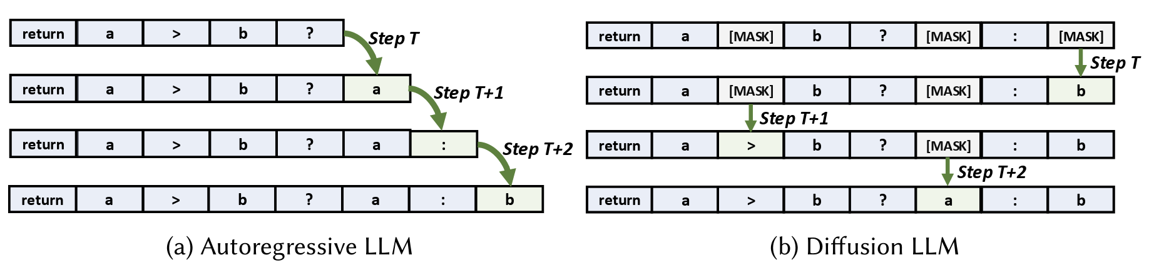
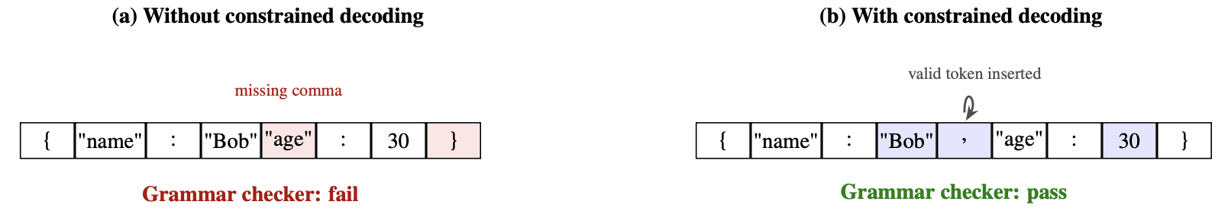
Motivation
Diffusion LLMs enable parallel generation
Structured generation needs strict grammar compliance
Current constrained decoding (e.g., LAVE) is stochastic and position-wise
→ We need a deterministic, joint decoding algorithm

Slide 3
Related works
DLLMs:
LLaDA-8B, Dream-7B
AR constrained decoding:
Outlines and Xgrammar
Monotonic left-to-right prefix
Diffusion constrained decoding:
CFG-constrained decoding, DINGO, LAVE
Gaps in prior work
Computationally expensive or stochastic/local in verification (parser checker)

Slide 4
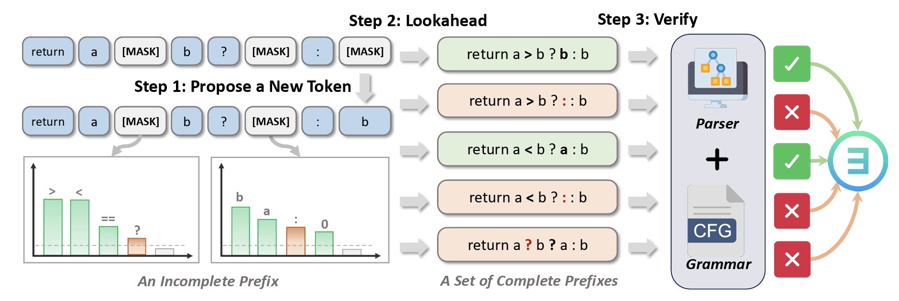
LAVE (sota method for constrained decoding)
Time consuming

Slide 5
Proposed Method
Problem | Solution
Stochastic verification may reject valid tokens | Replace post-hoc random sampling with incremental parser-state tracking. Track grammar legality as the beam expands.
Position-wise checks miss cross-token dependencies, which can lead to globally invalid tokens | Multi-tokens denoising in single step from both direction. Joint beam search over the entire unmasked span, while tracking parser states to enforce global grammar consistency.

Slide 6
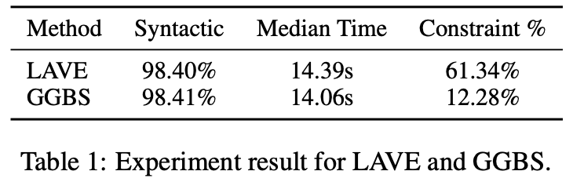
Current result
Notes:
Constraint 數字偏高（例如 LAVE 中位數 61%）：表示很多時間花在 constraint、mask、合法 token 選擇等，而不是純 model forward。
數字偏低（例如 GGBS 中位數 12%）：表示 constraint 相對整體耗時比較少（同表也註明 LAVE 的 mean 會被極端值拉得很怪，所以用 median 報告）。

Slide 7
Future directions
DP + Trie
Vectorizing the Trie: Efficient Constrained Decoding for LLM-based Generative Retrieval on Accelerators (Youtube + Google DeepMind 2026)
Compressed sparse matrix load → 948x speedup

