Slide 1


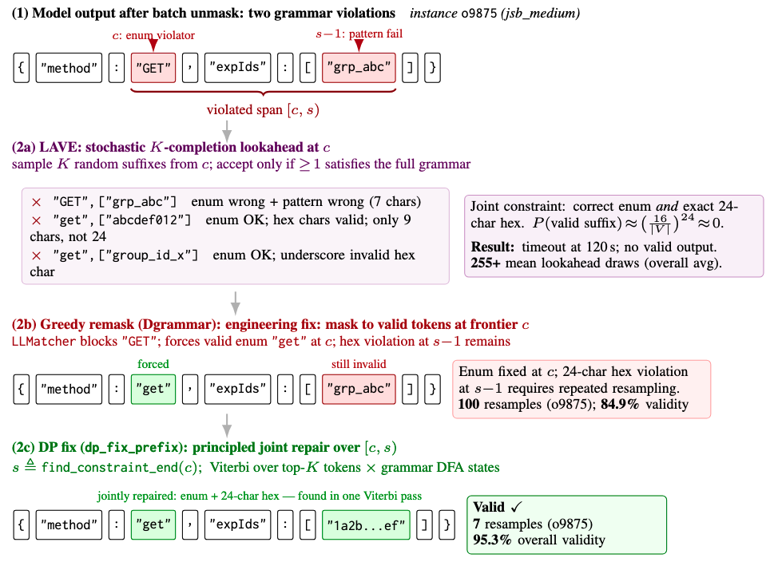
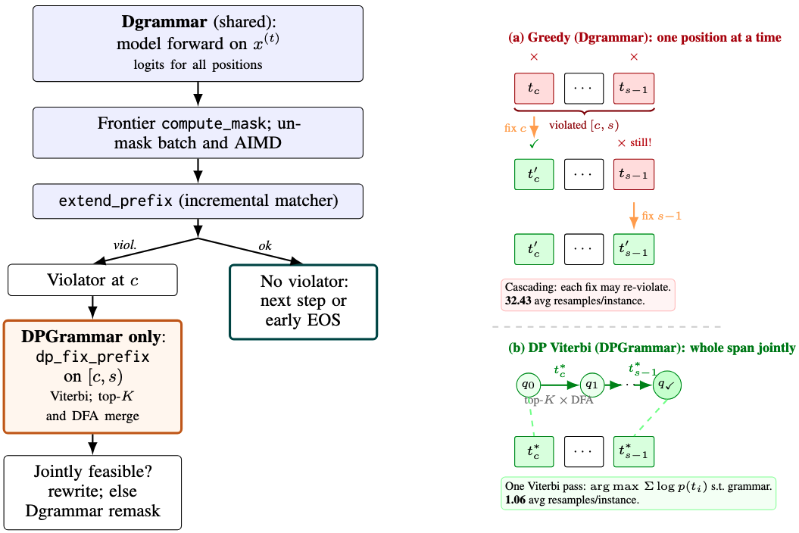
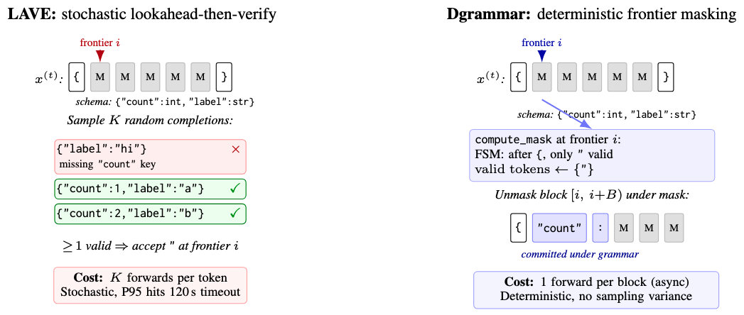
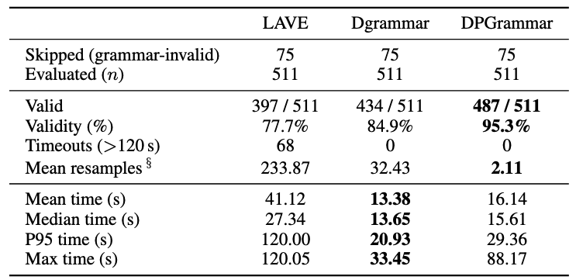
DPGrammar: Frontier Constrained Decoding for Diffusion Language Models
Jeng-Yue Liu, Wilson Zheng, Haoling Pu
Carnegie Mellon University, Language Technologies Institute
Introduction
Motivated Example
Greedy vs. DP Viterbi Repair
Problem Statement:
Discrete Diffusion Language Models (dLLMs) are powerful because they generate and refine tokens in parallel. However, this parallel nature makes Constrained Decoding (ensuring the model follows a specific JSON schema or grammar) extremely difficult. Unlike traditional models that generate text from left to right, dLLMs update the entire sequence simultaneously, making it impossible to use standard Finite State Machine (FSM) masks directly.
Challenges:
Stochastic lookahead is unreliable on hard schemas:
LAVE^{[1]}, the leading method, verifies each token by sampling random completions, but on schemas with joint multi-token constraints (e.g., nested types, regex patterns), the probability that a random suffix is valid drops to near zero, causing false rejections, 255× redundant forward passes, and frequent timeouts.
Greedy per-position repair cascades:
Fixing one violated token at a time ignores correlations, where re-masking position c can leave downstream positions in a newly invalid state, triggering repeated resamples across the span.
Method
Engineering Optimization (Dgrammar):
Frontier-only masking: grammar constraints apply exclusively at the first unfilled position; all other parallel slots sample freely, avoiding the K-completion overhead of stochastic lookahead and making token placement fully deterministic
Incremental parser state: a live LLMatcher automaton advances token-by-token as tokens are committed, so each mask computation is a diff from the current state rather than a full replay from the prompt
AIMD batching: batch size grows by 1 on each successful commit and resets to 1 on any grammar violation, dynamically balancing throughput against resample risk without manual tuning
Early EOS: once the automaton signals a complete, schema-valid string, remaining diffusion steps are skipped entirely, avoiding wasted forward passes on already-settled tokens
Algorithmic Innovation (DPGrammar):
Violation detection: after each batch unmask, extend_prefix walks the committed sequence through the grammar automaton; the first position where try_consume fails marks the start c of the violated span
Span boundary (find_constraint_end): probes forward from c using the automaton while tracking bracket depth in the original token sequence; the span end s is set at the first grammar-consistent junction where net bracket depth returns to zero, preventing the DP from stopping inside an unclosed array or object
Phase 1 – rollback exploration: for each position in [c, s), iterates over top-K tokens, calling try_consume then rollback on the shared matcher to cheaply score all candidates in-place
Phase 2 – clone winners: only the surviving DFA states (one per unique automaton state reachable at this step) are deep-copied; memory and clone cost scale with the number of reachable DFA states (~20–200 for typical JSON schemas), not with K
Viterbi merge: when two token paths arrive at the same DFA state, the lower-log-probability path is pruned; the backtracked sequence is thus globally optimal over the span under the current forward's log-probabilities
Stochastic vs. Deterministic
Conclusion
Deterministic frontier masking (Dgrammar) eliminates stochastic lookahead, removing all timeouts and raising validity to 84.9%
Viterbi span repair (DPGrammar) closes the remaining gap with 99.2% validity, 1.06 mean resamples, by solving joint multi-token violations in one pass
Near-perfect structured generation under discrete diffusion requires both deterministic constraint enforcement and principled joint repair over violated spans
Future Work
Extend evaluation to additional benchmark splits (e.g., jsb_hard, code grammars) and larger backbones to test generalization beyond LLaDA-8B
Integrate sparse automaton acceleration (CSR-based DFA transitions) to reduce DP cost on grammars with large state spaces or wide vocabularies
Experimental Results
Limitations
Validity ≠ Content Quality: grammar constraints guarantee structural correctness but cannot improve semantic richness, LLaDA-8B-Instruct still produces degenerate yet valid outputs ([], {}, "x") on complex schemas, a property of the underlying model rather than the constraint method
DP cannot fix empty-value degenerate outputs: the Viterbi repair only triggers on grammar violations; once generation completes, {} and [] are already placed as concrete tokens (no MASK positions remain), and both are grammatically valid JSON, the automaton never raises a violation, so data: {} or links: [] are never visible to the DP; this is a fundamental limitation of violation-driven repair, not a beam-width issue
Table 1: jsb_medium results (T = 128 steps). LAVE resamples count lookahead verification draws; Dgrammar/DPGrammar resamples count token re-mask events.
References:
[1] Zhang et al., “Lookahead-then-Verify: Reliable Constrained Decoding for Diffusion LLMs under Context-Free Grammars”, ACM’26
Notes:
1

Slide 2
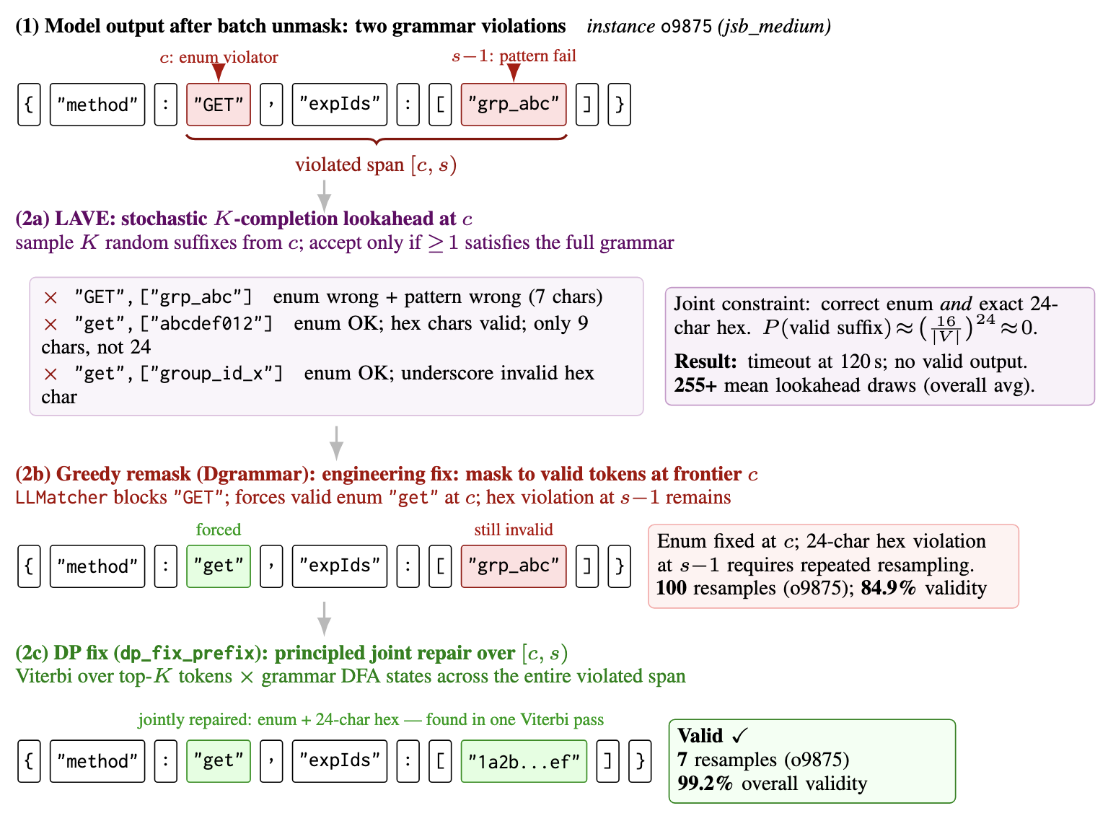
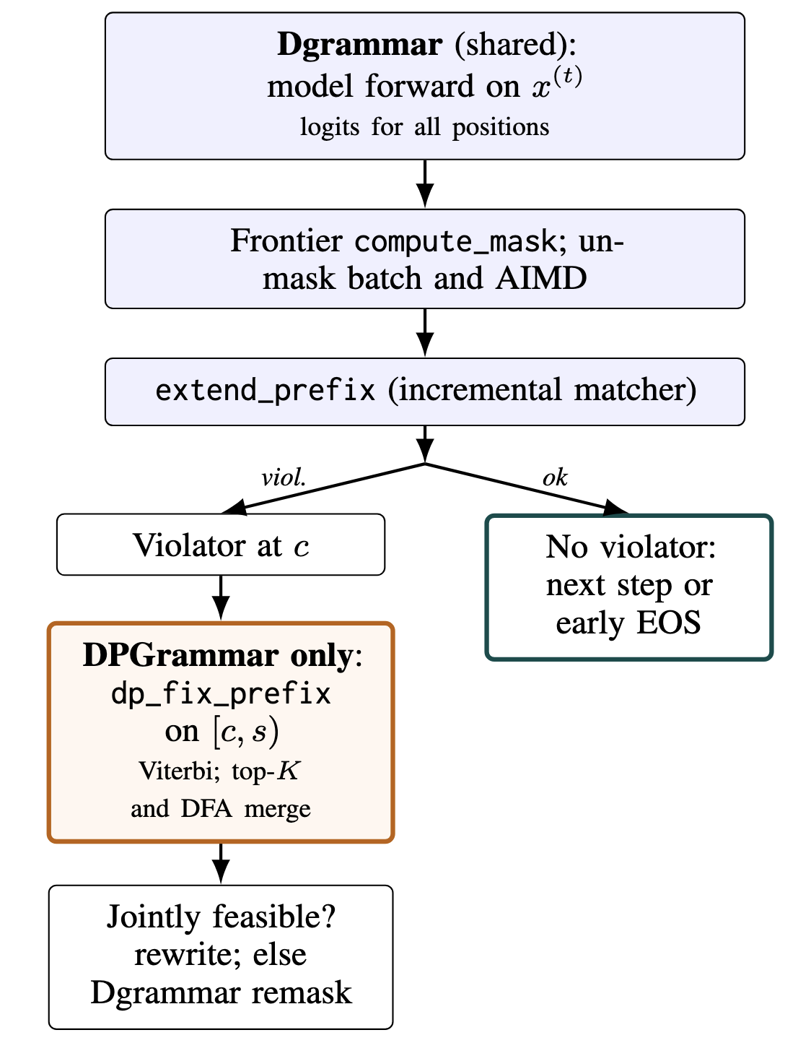
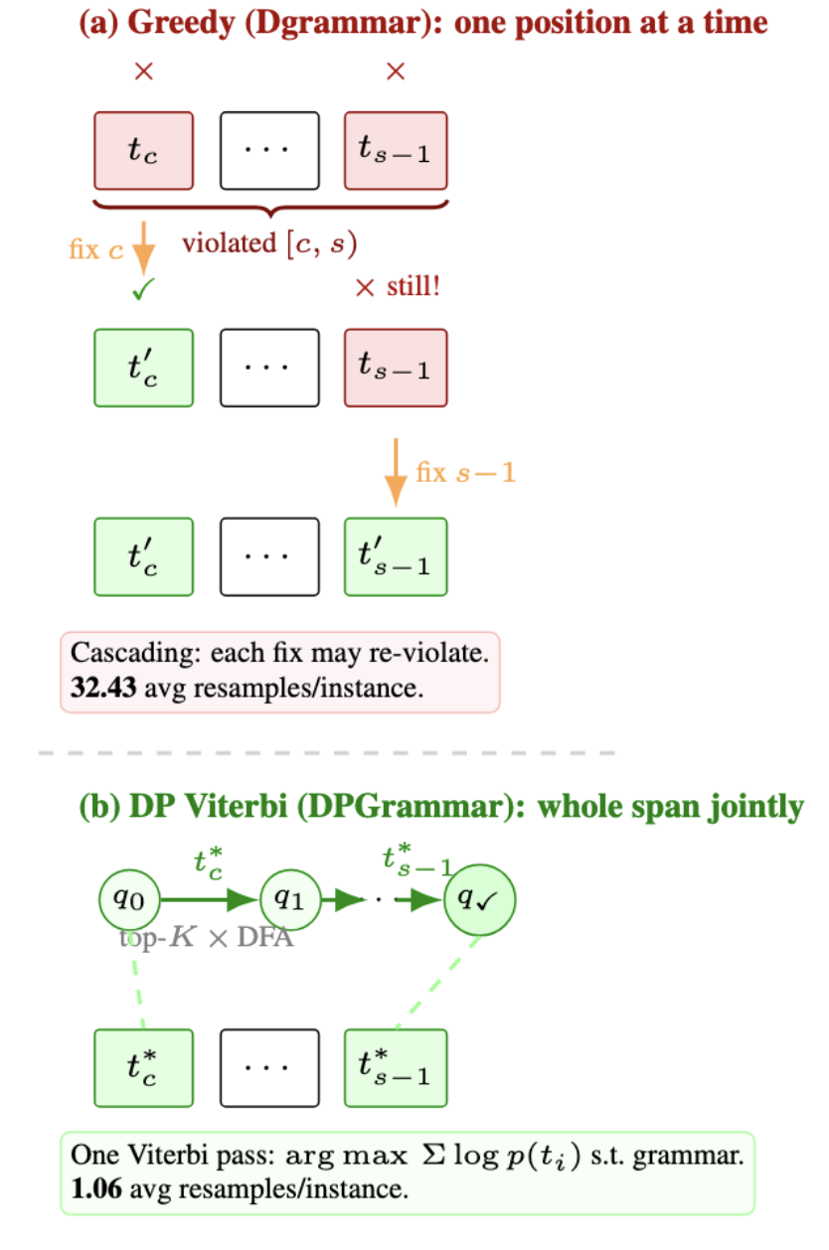
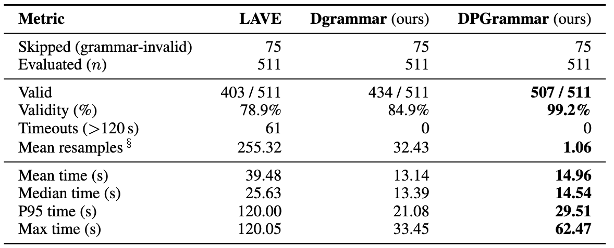
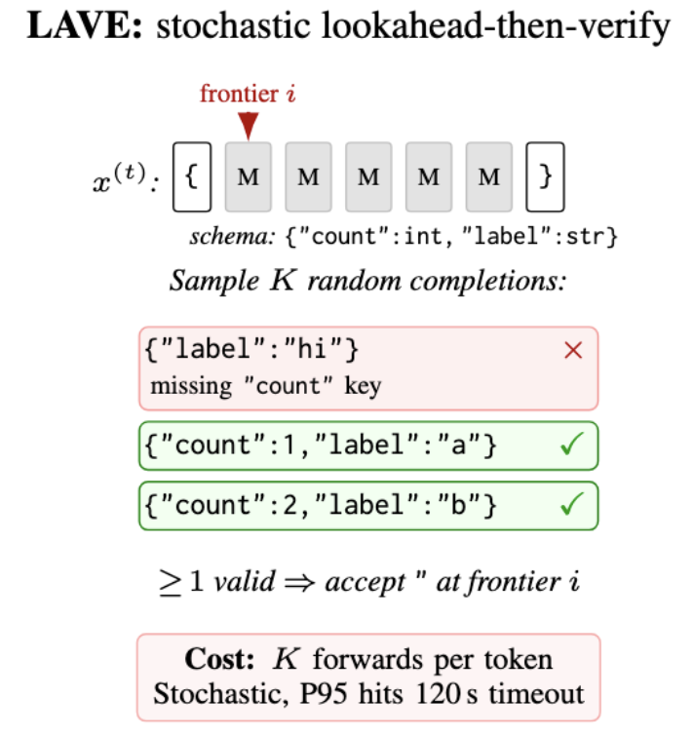
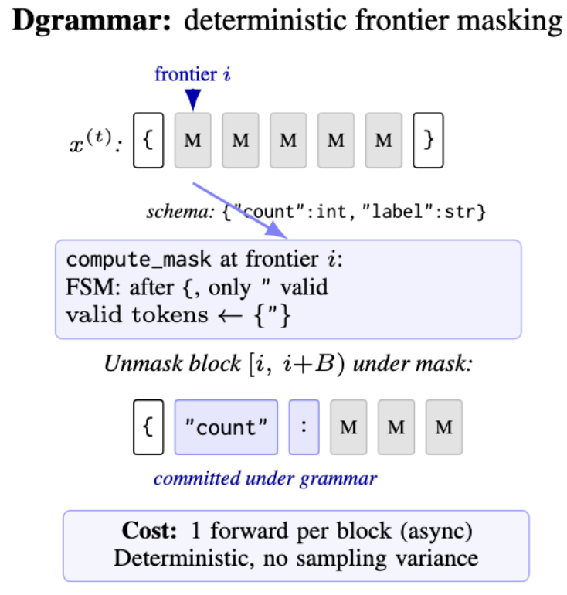
DPGrammar: Frontier Constrained Decoding for Diffusion Language Models
Jeng-Yue Liu, Wilson Zheng, Haoling Pu
Carnegie Mellon University, Language Technologies Institute
Introduction
Motivated Example
Greedy vs. DP Viterbi Repair
Problem Statement:
Discrete Diffusion Language Models (dLLMs) are powerful because they generate and refine tokens in parallel. However, this parallel nature makes Constrained Decoding (ensuring the model follows a specific JSON schema or grammar) extremely difficult. Unlike traditional models that generate text from left to right, dLLMs update the entire sequence simultaneously, making it impossible to use standard Finite State Machine (FSM) masks directly.
Challenges:
Stochastic lookahead is unreliable on hard schemas:
LAVE^{[1]}, the leading method, verifies each token by sampling random completions, but on schemas with joint multi-token constraints (e.g., nested types, regex patterns), the probability that a random suffix is valid drops to near zero, causing false rejections, 255× redundant forward passes, and frequent timeouts.
Greedy per-position repair cascades:
Fixing one violated token at a time ignores correlations, where re-masking position c can leave downstream positions in a newly invalid state, triggering repeated resamples across the span.
Our Solution:
Engineering Optimization (Efficiency Side – DGrammar)
Replace stochastic lookahead with deterministic frontier masking, the valid token set is computed directly at each position via an incremental grammar automaton, with no random completions drawn.
Implemente an Additive Increase / Multiplicative Decrease (AIMD) mechanism to dynamically scale token submission batches, maximizing hardware throughput
Algorithmic Innovation (Accuracy Side – DPGrammar)
Detects violated spans [c, s) after each batch unmask, positions where the committed tokens break the grammar automaton state.
Runs a Viterbi Dynamic Programming over the entire span, tracking grammar DFA states across top-K token candidates to jointly select the highest-probability valid replacement sequence in one pass.
Method
Experimental Results
DGrammar:
Incremental parser state: maintains a live grammar automaton (LLMatcher) that advances token-by-token, so mask computation at each position requires only a diff from the previous state rather than recomputing from scratch
Async mask overlap: CPU grammar mask construction runs concurrently with the GPU forward pass, by the time logits are ready, the allowed-token mask is already computed, effectively hiding constraint overhead
AIMD batching: batch size grows additively when tokens are accepted and shrinks multiplicatively on violation, dynamically balancing throughput against resample risk without manual tuning
Early EOS: once the automaton signals a complete, schema-valid string, remaining diffusion steps are skipped, avoiding unnecessary forward passes on already-settled tokens
DPGrammar:
Violation detection: after each batch unmask, extend_prefix walks the committed sequence through the grammar automaton; the first position where try_consume fails marks the start c of the violated span [c, s)
Phase 1 – rollback exploration: for each position in [c, s), iterates over top-K tokens and calls try_consume then rollback on the shared matcher, no cloning, pure in-place state manipulation, to cheaply score all candidates
Phase 2 – clone winners: only the surviving DFA states (one per unique automaton state reached) are deep-copied, so memory scales with grammar branching factor rather than K
Viterbi merge: when two token paths arrive at the same DFA state, the lower-log-probability path is pruned, guaranteeing the backtracked sequence is globally optimal over the span under the current forward's log-probabilities
Table 1: jsb_medium results (T = 128 steps). LAVE resamples count lookahead verification draws; Dgrammar/DPGrammar resamples count token re-mask events.
Stochastic vs. Deterministic
Conclusion and Future Work
Conclusion:
Deterministic frontier masking (Dgrammar) eliminates stochastic lookahead, removing all timeouts and raising validity to 84.9%
Viterbi span repair (DPGrammar) closes the remaining gap with 99.2% validity, 1.06 mean resamples, by solving joint multi-token violations in one pass
Future work:
Extend to code grammars and stricter JSON splits beyond jsb_medium and close the final 0.8% gap with tighter completion-phase fallbacks
Integrate sparse automata acceleration for large-vocabulary efficiency
References:
[1] Zhang et al., “Lookahead-then-Verify: Reliable Constrained Decoding for Diffusion LLMs under Context-Free Grammars”, ACM’26
Notes:
2

Slide 3
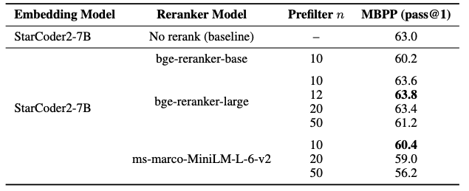
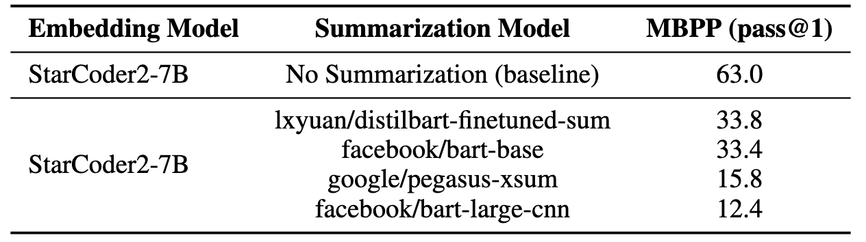
DPGrammar: Frontier Constrained Decoding for Diffusion Language Models
Jeng-Yue Liu, Wilson Zheng, Haoling Pu
Carnegie Mellon University, Language Technologies Institute
Motivation
Pipeline
Problem Statement:
Discrete Diffusion Language Models (dLLMs) are powerful because they generate and refine tokens in parallel. However, this parallel nature makes Constrained Decoding (ensuring the model follows a specific JSON schema or grammar) extremely difficult. Unlike traditional models that generate text from left to right, dLLMs update the entire sequence simultaneously, making it impossible to use standard Finite State Machine (FSM) masks directly.
Challenges:
Stochastic lookahead is unreliable on hard schemas:
The leading method (LAVE) verifies each token by sampling random completions, but on schemas with joint multi-token constraints (e.g., nested types, regex patterns), the probability that a random suffix is valid drops to near zero, causing false rejections, 255× redundant forward passes, and frequent timeouts.
Greedy per-position repair cascades:
Fixing one violated token at a time ignores correlations, where re-masking position c can leave downstream positions in a newly invalid state, triggering repeated resamples across the span.
Our Solution:
Engineering Optimization (Efficiency Side)
Replace stochastic lookahead with deterministic frontier masking, the valid token set is computed directly at each position via an incremental grammar automaton, with no random completions drawn.
Implemente an Additive Increase / Multiplicative Decrease (AIMD) mechanism to dynamically scale token submission batches, maximizing hardware throughput
Algorithmic Innovation (Accuracy Side)
Detects violated spans [c, s) after each batch unmask, positions where the committed tokens break the grammar automaton state.
Runs a Viterbi DP over the entire span, tracking grammar DFA states across top-K token candidates to jointly select the highest-probability valid replacement sequence in one pass.
Method
Experimental Results
Reranker (Experiment 1):
Insert a cross-encoder reranker between BM25 retriever and code generator
Reranker scores “prefilter n” (top n) candidates and selects top k chunks as context
Selected chunks concatenate with problem description before decoding
Evaluate three pretrained rerankers on top of StarCoder2-7B.
bge-reranker-base / bge-reranker-large: cross-encoder models optimized for reranking tasks
ms-marco-MiniLM-L-6-v2: a cross-encoder model trained on the MS Marco Passage Ranking task
Experiment with various prefilter n and blend weights to study reranking configurations
Prefilter n controls BM25 candidates passed to reranker
Blend weight interpolates BM25 score with reranker score during ranking
Context Summarization (Experiment 2):
A pre-trained summarization model compresses large code files into concise, structured representations
These summaries provide clean, canonicalized views of project components, enabling much more effective use of the available context window
Pretrained Summarization Model:
facebook/bart-base: fine-tuned for text generation (e.g. summarization)
facebook/bart-large-cnn: fine-tuned on CNN Daily Mail, a large collection of text-summary pairs
google/pegasus-xsum: pretrained on unlabeled text to perform abstractive summarization
lxyuan/distilbart-finetuned-summarization: lightweight distilled model for faster, resource-efficient summarization
Table1: Effect of different reranking models on MBPP pass@1 accuracy
Table2: Effect of different summarization models on MBPP pass@1 accuracy
Related Work
CodeRAG-Bench:
Provides the first large-scale benchmark evaluating RAG for code generation across multiple LLMs
Highlights that limited context windows force truncation of long retrieved code examples, reducing the impact of correct retrieval
Finds that RAG gains are highly dependent on the quality and precision of retrieved context
Lost in the Middle: How Language Models Use Long Contexts
Introduces the lost-in-the-middle effect: LLMs ignore information buried in long inputs due to quadratic attention cost and memory budgets
Demonstrates that placing relevant information at the beginning or end of the prompt is significantly more effective
AllianceCoder:
Shows that naive concatenation of raw retrieved code causes context bloat and distracts the model
Uses reranking and summarization to produce more focused input for the generator
Results Analysis
Future Work
Reranker:
bge-reranker-large yields MBPP gains; weaker rerankers consistently underperform the no-rerank baseline
Increasing prefilter n beyond 20 degrades pass@1, likely due to noisy candidate overload
Blend weights have negligible effect once n is small and the reranker is strong
Context Summarization:
Applying summarization didn’t improve StarCoder2-7B performance on MBPP
Summarization succeeded at reducing input size but sacrificed semantic fidelity
Text-trained summarizers strip away critical program semantics, making them poorly suited to preserve programming logic or structure
Generic text-style summarization does not benefit RAG-based code generation
Advanced Summarization Strategies:
Investigate hybrid approaches that combine natural-language abstraction with symbolic representations to maintain logical fidelity and reduce loss of critical implementation details
Code Based Reranking:
Develop learned or supervised reranking models trained on code-specific relevance signals, such as API usage similarity, dependency paths, or semantic proximity between functions
Hierarchical Compression for Repository-Scale Input:
Develop multi-level compression that preserves semantic structure rather than raw text, allowing efficient injection of repository-level information into long contexts
Notes:
3

