Slide 1
The Ethics of AI in Healthcare: Privacy, Decision-Making, and Resource Allocation
Jacob Navarrete, Ethan Shust
Dr. Yang - CSCI 2150

Slide 2

AI’s Promise and Ethical Challenges
AI transforms healthcare: diagnostics, personalized medicine, crisis management
Ethical dilemmas: privacy, human judgment, resource allocation
AI’s potential requires robust ethical frameworks to preserve human values

Slide 3
Traditional Privacy
AI relies on massive datasets (e.g., EHRs), straining anonymization
99.98% of Americans re-identifiable from "de-identified" data (Rocher et al., 2019)
Consent issues: Patients unaware of future AI uses (e.g., DeepMind-NHS case)
Data ownership shifts to hospitals, tech firms, drug companies
Need new consent models for AI’s future-oriented applications
Stricter regulations (e.g., post-DeepMind UK rules)
Balance individual rights vs. collective benefits (e.g., pandemic prediction)
Update laws like HIPAA for AI’s systemic demands

Slide 4
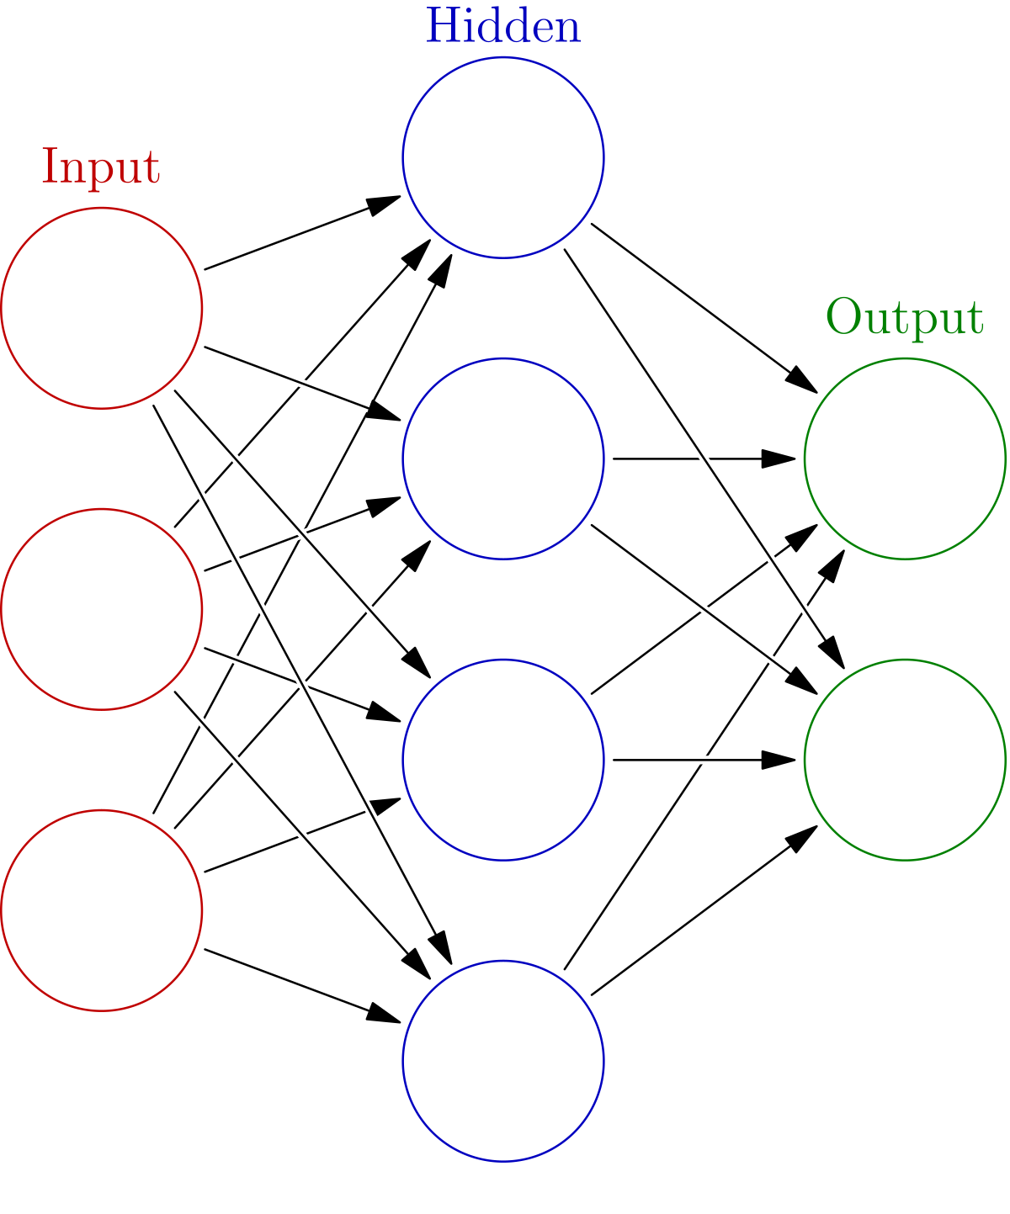
Accuracy vs. Autonomy
AI outperforms doctors in tasks like dermatology (81.1% sensitivity vs. 74.8%) and glaucoma detection (93.7% sensitivity)
Dilemma: Should AI override doctors or patients when more accurate?
Doctors offer context; patients have autonomy (e.g., religious exceptions)
“Black box” AI undermines trust; should advise, not dictate

Slide 5
Fairness or Cold Calculus?
AI scores patients for resources (e.g., ventilators) by survival odds
Pros: Fast, consistent, avoids human bias
Cons: Risks perpetuating inequities (e.g., 2019 study on deprioritizing minorities)
Solution: Hybrid approach—AI suggests, humans decide

Slide 6

Real-World Voices on AI in Healthcare
Interviews with Leslie Sommers (CEO) and Matt Mixon (CTO)
Healthcare kiosks, regulation, human-AI collaboration
Connecting ethical themes to real-world experience

Slide 7
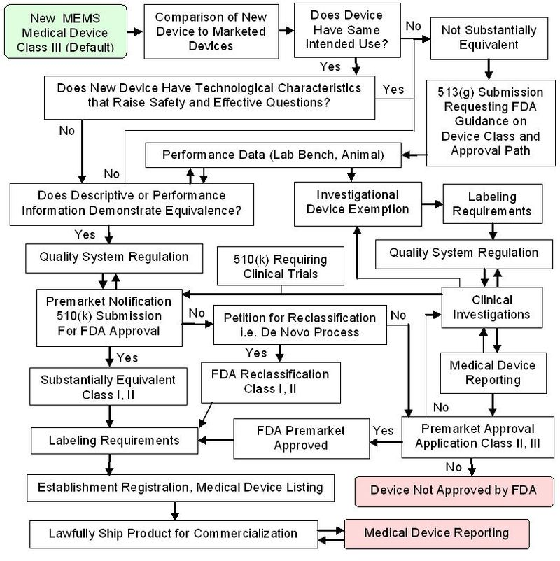
CEO Perspective: Regulation & Human-Centered AI
• "Being that physician tool... the physician aide." • Retinal imaging kiosks use AI to assist • Heavy FDA regulations • Overregulation slows smaller innovators

Slide 8
CTO Perspective: Trust, Safety & Engineering Challenges
• "Physicians using AI as an assistant." • Public trust issues after AI mistakes • ISO 62304, cybersecurity requirements • Human oversight still needed

Slide 9
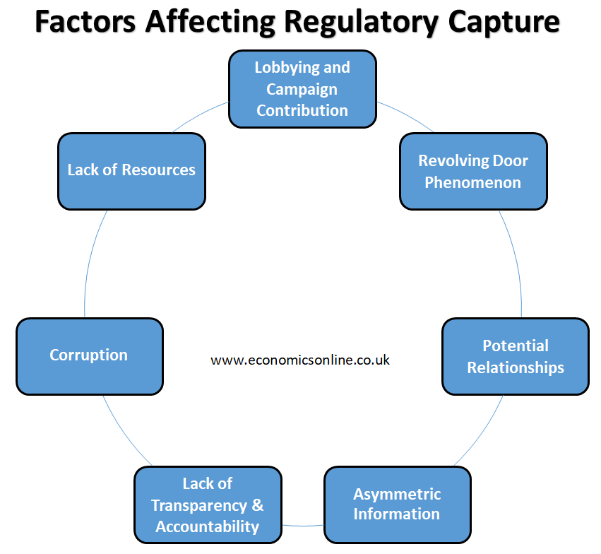
Room for Unethical Behavior
Big tech companies can pay for any fines in the development of an AI
Companies can lobby for stricter regulations
Small companies that may want to help are stopped killing any competition
Raises a question: Is regulation protecting the public or preserving monopolies?

Slide 10
Outtakes from the Interviews
• AI already used in diagnostics like retinal scans • HIPAA slows innovation • Patients might give up privacy for better care • Trust, fairness, transparency, and human judgment are still key

Slide 11
Where This Could Go Next
• AI likely to manage chronic conditions first • Need reimbursement changes • Patients deserve control over their data • Human-AI collaboration will define the future

Slide 12
References
Beauchamp, Tom L., and James F. Childress. Principles of Biomedical Ethics. 8th ed., Oxford UP, 2020.
Cohen, I. Glenn. "Informed Consent and Medical AI." Harvard Law Review, vol. 133, no. 4, 2020, pp. 123-145.
Makary, Martin A., and Michael Daniel. "Medical Error—The Third Leading Cause of Death in the US." BMJ, vol. 353, 3 May 2016, doi:10.1136/bmj.i2139.
Obermeyer, Ziad, et al. "Dissecting Racial Bias in an Algorithm Used to Manage the Health of Populations." Science, vol. 366, no. 6464, 25 Oct. 2019, pp. 447-453, doi:10.1126/science.aax2342.
Powles, Julia, and Hal Hodson. "Google DeepMind and Healthcare in an Age of Algorithms." Nature Biotechnology, vol. 35, no. 9, Sept. 2017, pp. 845-847, doi:10.1038/nbt.3952.
Rocher, Luc, et al. "Estimating the Success of Re-identification in Incomplete Datasets Using Generative Models." Nature Communications, vol. 10, no. 3069, 23 July 2019, doi:10.1038/s41467-019-10933-3.
Topol, Eric J. "High-Performance Medicine: The Convergence of Human and Artificial Intelligence." Nature Medicine, vol. 25, no. 1, Jan. 2019, pp. 241-245, doi:10.1038/s41591-018-0300-7.
Wachter, Sandra, and Brent Mittelstadt. "A Right to Reasonable Inferences: Re-Thinking Data Protection Law in the Age of Big Data and AI." Columbia Business Law Review, vol. 2019, no. 2, 2019, pp. 94-139.
White, Douglas B., and Bernard Lo. "A Framework for Rationing Ventilators and Critical Care Beds During the COVID-19 Pandemic." New England Journal of Medicine, vol. 382, no. 21, 21 May 2020, pp. 1865-1867, doi:10.1056/NEJMp2006142.

