Slide 1
TRACE.
800
v2.0
Enterprise Process Mining & ESG Intelligence Platform
Cases Processed
368
Violations Detected
Supply chain audits that actually compute.
40/40
Tests Passing
ROUND 2 · DETAILED SOLUTION & PROTOTYPE
Indo-Swiss Joint Research Programme — MUJ
Rudra Pratap Singh · Swastik Anurag Vyas · Divayom Sengar
BRSR
Next.js 16 · FastAPI · PostgreSQL · Local Ollama LLM
Compliance Standard
Notes:
SLIDE 1 — COVER Opening line: 'TRACE is a working prototype — not a wireframe, not a pitch deck for an idea. Every number you'll see in this presentation was computed from real data uploaded to the live platform.' Key framing: This is a Round 2 submission for the Indo-Swiss Joint Research Programme. We are solving a problem that sits at the intersection of process intelligence and climate compliance — two fields that have never been unified in a single, accessible tool. Stats to anchor: - 800 real supply chain cases processed - 368 policy violations detected and flagged with carbon delta - 40/40 backend tests passing — zero regressions - BRSR compliance report generated with SHA-256 integrity hash Tone: Confident. Do not apologize for being students. The platform speaks for itself.

Slide 2
01 / PROBLEM UNDERSTANDING
The Visibility Gap in Supply Chain ESG
No Process Visibility
THE SCALE OF THE PROBLEM
01
Companies cannot trace actual logistics sequences against intended models — violations go undetected for months, costing both compliance and carbon budget.
80%
Manual Carbon Accounting
of enterprise carbon footprint sits in supply chains (Scope 3)
02
Scope 3 emissions estimated quarterly on spreadsheets — never at per-shipment, per-activity granularity required for BRSR disclosure.
$2.3T
Regulation Blindness
annual cost of global supply chain inefficiencies
03
BRSR (India), GHG Protocol, and ESG frameworks require activity-level traceability. No existing tool provides this end-to-end without expensive consultants.
BRSR
Supplier Opacity
04
Mandatory for top 1000 NSE/BSE companies from FY2023
No system ranks supplier carbon fitness per transaction or automatically flags which partners drive the most policy violations.
Notes:
SLIDE 2 — PROBLEM UNDERSTANDING Opening hook: 'Most enterprises can tell you how much they emitted last year. None can tell you which shipment, which supplier, which activity caused it — and whether it violated their own policy.' Key points to hit: 1. Process visibility gap — ERP logs exist but are never analyzed against intended process models. Violations accumulate for months before discovery. 2. Manual carbon accounting — Scope 3 is the hardest and largest category. It accounts for up to 80% of a company's footprint but is estimated, not measured, quarterly on spreadsheets. 3. Regulatory pressure is real — BRSR is already mandatory for top-1000 NSE/BSE listed companies from FY2023. Most are still using consultants to generate reports manually. 4. Supplier opacity — procurement teams have no data-backed way to rank or replace high-emission suppliers. Differentiator to plant early: 'No existing tool — not ProM, not Celonis, not SAP Sustainability — combines process mining with activity-level carbon attribution and generates regulator-ready BRSR reports automatically. TRACE does all three.' $2.3T stat source: McKinsey Global Institute supply chain inefficiency estimates.

Slide 3
02 / SOLUTION ARCHITECTURE
One Upload. Eight Engines. Full ESG Picture.
Single CSV upload → 8 analytical modules fire in parallel → real-time 14-page dashboard
01
02
03
04
05
06
07
CSV Upload
→
Column Map
→
Process Mine
→
Carbon Calc
→
Conformance
→
Forecast
→
BRSR / ESG
Any schema
Fuzzy match
OCEL 2.0
Scope 3
Rule engine
4 baselines
SHA-256
FRONTEND
Next.js 16 · React 19 · TypeScript strict · Tailwind v4 · shadcn/ui · React Flow · Recharts
BACKEND
FastAPI · Python 3.11 · SQLAlchemy ORM · pandas vectorized · Custom OCEL 2.0 parser
DATABASE
PostgreSQL (prod) · SQLite (local) · 6 tables: Org → Project → Workspace → AnalysisSnapshot · TeamMember · ConformanceRuleOverride
AI COPILOT
Ollama local inference · Multi-model switching · Zero cloud dependency · Data never leaves the machine
Multi-tenant hierarchy: Organization → Project → Workspace → AnalysisSnapshot · Cascade deletes enforced at DB level · 40/40 tests passing
Notes:
SLIDE 3 — SOLUTION ARCHITECTURE Key message: 'One CSV upload triggers all eight engines in parallel. No manual steps between upload and report.' Walk the pipeline left to right: - CSV Upload → any schema, any column naming convention - Column Mapper → fuzzy alias matching detects case_id, activity, timestamp, supplier, etc. with confidence scoring. Manual override UI if it misses. - Process Mine → OCEL 2.0 object-centric event log parsing, DFG extraction, 800 cases, 10 activities - Carbon Calc → Scope 3 attribution per activity using configurable emission factors - Conformance → rule-based engine flags Air Freight, Incineration, Landfill against mandated alternatives - Forecast → 4-baseline benchmarking, LinearTrend auto-selected as best fit - BRSR/ESG → full report generation with SHA-256 integrity hash Tech stack points if asked: - Frontend: Next.js 16, React 19, TypeScript strict mode, Tailwind v4, shadcn/ui, React Flow for process graphs, Recharts for analytics - Backend: FastAPI, Python 3.11, SQLAlchemy ORM, pandas vectorized operations, custom OCEL 2.0 parser - Database: PostgreSQL in production, SQLite for local dev. 6 tables with real cascade deletes. Schema auto-migrates on startup. - AI Copilot: Ollama running locally. Zero cloud dependency. Data never leaves the machine — critical for enterprise adoption. Multi-tenancy point: 'Organization → Project → Workspace → AnalysisSnapshot is not a UI trick. It is enforced at the SQL level with cascade deletes. Every workspace independently stores its own analysis snapshot.'

Slide 4
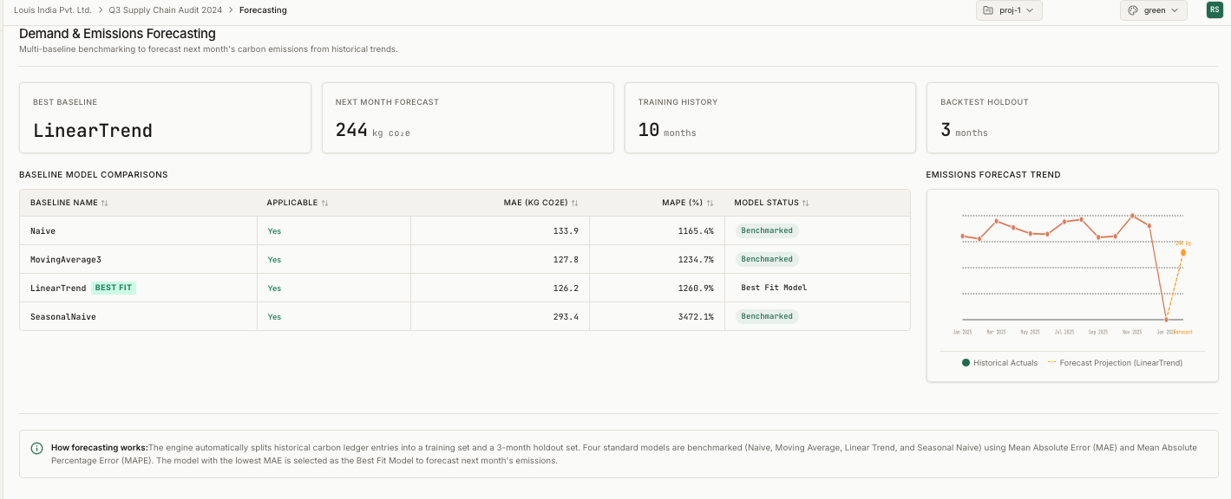
03 / TECHNICAL APPROACH
Multi-Baseline Forecasting Engine
Naive
MAE 133.9 kg CO₂e
Last observed value. Sanity baseline.
MovingAverage3
MAE 127.8 kg CO₂e
3-month rolling average.
LinearTrend
BEST
Live platform — /forecasting · LinearTrend selected as Best Fit
MAE 126.2 kg CO₂e
OLS regression. Best fit on real demo data.
SeasonalNaive
MAE 293.4 kg CO₂e
Worst performer — marks N/A if <12 months.
DESIGN DECISIONS
Train/holdout split (3 months) — no data leakage
MAE chosen over RMSE — interpretable for ops managers
Best baseline refit on full data for final prediction
Notes:
SLIDE 4 — TECHNICAL APPROACH: FORECASTING ENGINE This slide shows the live /forecasting page with real computed numbers — not illustrative figures. Explain the methodology: 'The engine automatically splits historical carbon ledger entries into a training set and a 3-month holdout. Four standard baselines are benchmarked simultaneously. The one with the lowest MAE is auto-selected as the Best Fit Model and refit on the full dataset to generate the next-month prediction.' Walk the four baselines: 1. Naive (MAE 133.9 kg CO₂e) — last observed value. Sanity check. If nothing beats this, the data has no structure. 2. MovingAverage3 (MAE 127.8) — 3-month rolling average. Smooths noise but lags trends. 3. LinearTrend (MAE 126.2) — OLS regression on time index. Winner on this dataset. Lowest MAE, auto-selected. 4. SeasonalNaive (MAE 293.4) — uses same period from previous year. Worst performer here. Correctly flagged. Key design decisions to highlight if asked: - MAE chosen over RMSE because ops managers can interpret 'we were off by 126 kg' — not a squared abstract error - Train/holdout split is strict — no data leakage, no look-ahead bias - Next-month prediction: 244 kg CO₂e, generated from LinearTrend refit on all 10 months of history Anticipated question: 'Why not ARIMA or Prophet?' Answer: 'Those are Phase 3. We deliberately started with interpretable baselines so the model selection logic is auditable and explainable to compliance teams — not a black box.'

Slide 5
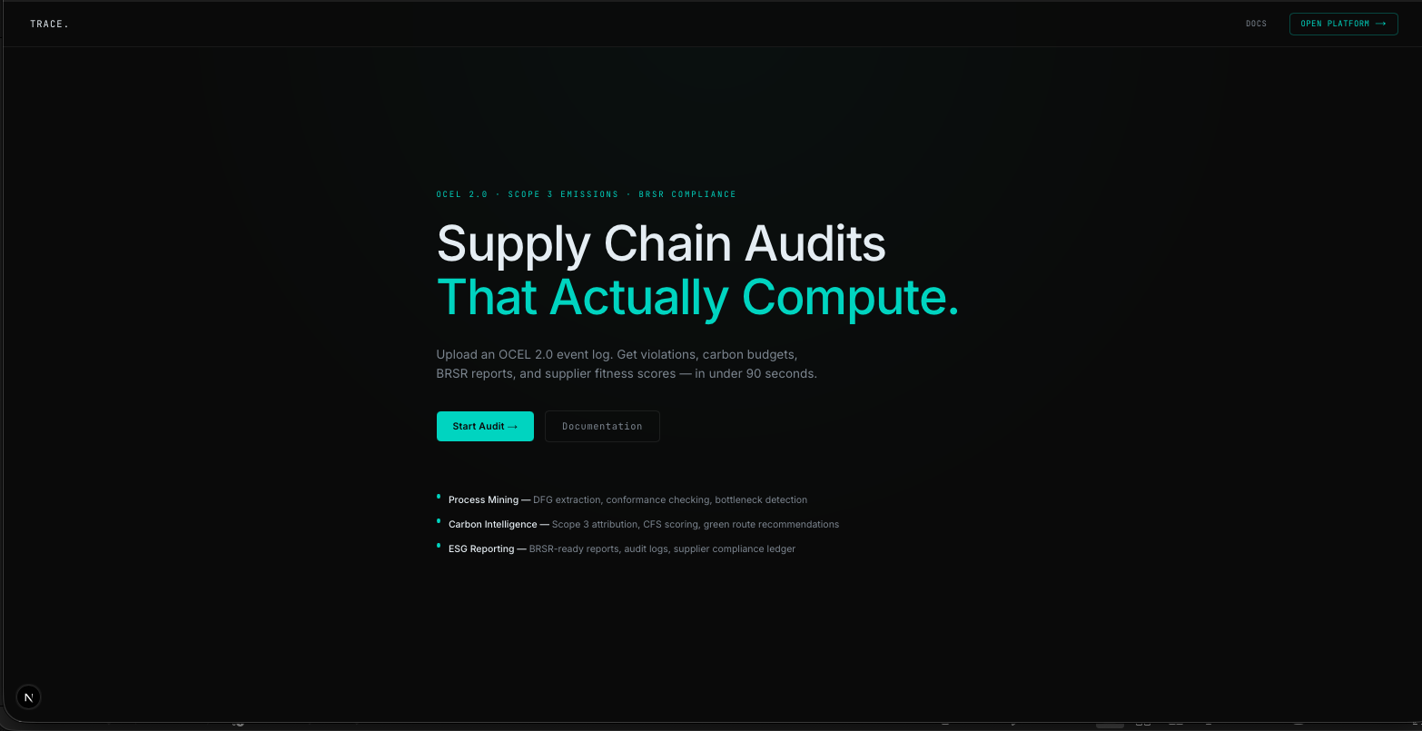
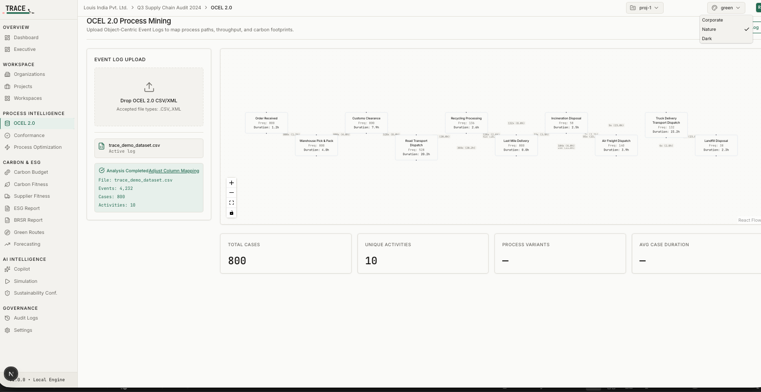
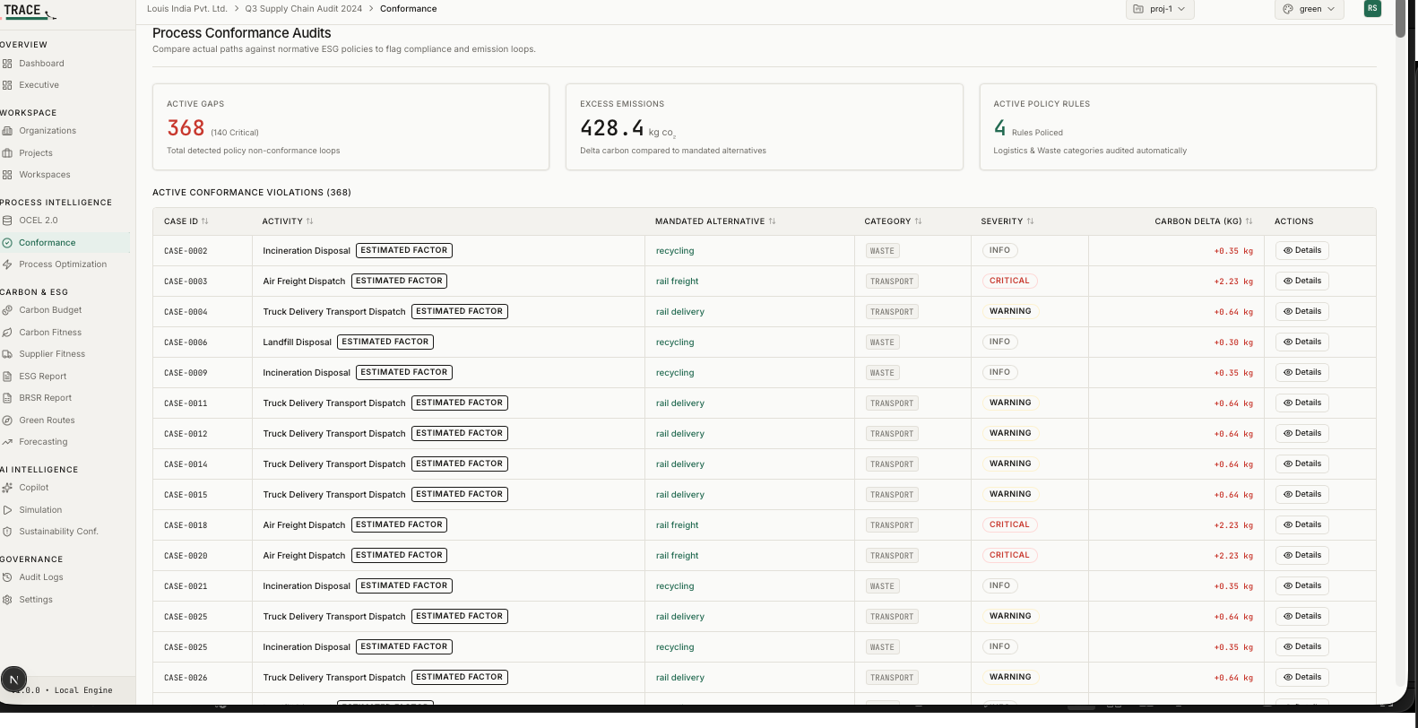
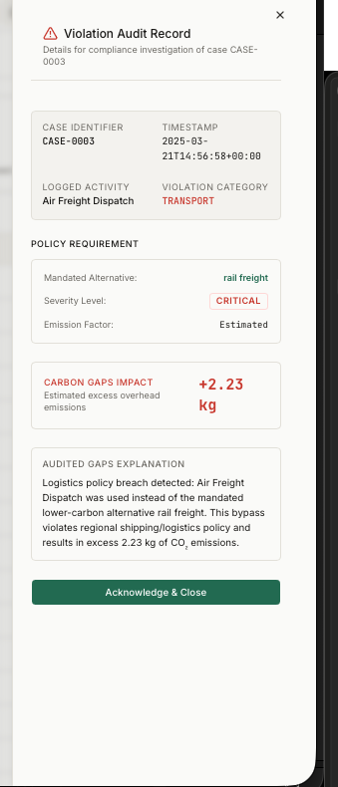
04 / PROTOTYPE DESIGN
14 Live Pages — Real Screenshots
Landing page — cinematic hero, CSV upload entry
OCEL 2.0 process graph — 800 cases, 10 activities
14
8
3
Live Pages
Engines
Themes
Conformance — 368 violations, 428.4 kg excess CO₂
Violation Audit Record — Air Freight CRITICAL, +2.23 kg CO₂
Notes:
SLIDE 5 — PROTOTYPE DESIGN Critical point to open with: 'Every screenshot on this slide is from the live platform. There are no mockups in this deck. If you want to verify, the demo dataset and deployment links are on the closing slide.' Walk the four screenshots: TOP LEFT — Landing page: Cinematic hero with 'Supply Chain Audits That Actually Compute.' The entry point. Upload CSV here, everything downstream fires automatically. Three feature bullets: Process Mining, Carbon Intelligence, ESG Reporting. TOP RIGHT — OCEL 2.0 Process Graph: 800 cases, 10 activities, 4,232 events. React Flow renders the directed flow graph. Column mapping completed automatically from the demo CSV. Activities shown with frequency and duration — Order Received through Landfill Disposal. BOTTOM LEFT — Conformance Audits: 368 violations detected. 428.4 kg CO₂e excess emissions — that is the carbon cost of non-compliance. 140 critical violations (Air Freight Dispatch instead of mandatory rail freight). Table sortable by severity, category, carbon delta. Each violation has a full audit record. BOTTOM RIGHT — Violation Audit Record modal: CASE-0003. Air Freight Dispatch. CRITICAL. +2.23 kg CO₂. The modal explains the policy breach in plain language — 'Air Freight Dispatch was used instead of the mandated lower-carbon alternative rail freight. This bypass violates regional shipping/logistics policy and results in excess 2.23 kg of CO₂ emissions.' Acknowledge & Close triggers the audit log entry. If asked about other pages: Dashboard with KPI strip and trend charts, Executive summary, Carbon Budget, Carbon Fitness per case, Supplier Fitness rankings, ESG Report, BRSR Report, Green Routes, Forecasting, AI Copilot, Simulation, Sustainability Conf., Audit Logs, Settings.

Slide 6
05 / FEASIBILITY ANALYSIS
Evidence, Not Claims.
Column auto-mapping
800-case demo CSV with arbitrary headers — auto-mapped at confidence threshold. Manual override UI on failure. Tested on multiple schemas.
✓ Verified
368 violations detected
Regression-locked number. Any change to conformance.py triggers investigation. Confirmed in test suite — 0 test failures on this figure.
✓ Verified
LinearTrend best baseline
Hand-verified: Naive 133.9, MA3 127.8, LinearTrend 126.2 MAE on real 3-month holdout. SeasonalNaive 293.4 — correctly marked worst.
✓ Verified
SHA-256 report integrity
brsr_report.py hashes the full JSON payload before generating PDF. Any figure change changes the hash — tamper-evident audit trail.
✓ Verified
SQL-backed multi-tenancy
6 DB tables. Org → Project → Workspace hierarchy with real cascade deletes. Settings survive server restarts. Schema migrations on startup.
✓ Verified
Real Local Ollama LLM
Verified via browser network interception — requests hit localhost:11434 (Ollama). Zero cloud calls. Model-switchable at runtime.
✓ Verified
40 / 40 backend pytest cases passing · Math hand-verified on all key numbers · Zero tolerance for placeholder data
Notes:
SLIDE 6 — FEASIBILITY ANALYSIS Frame this slide strongly: 'We did not put a single claim on this slide without being able to verify it independently. Every row is backed by either an automated test or a manual derivation that we can walk through right now.' Row by row if asked: 1. Column auto-mapping — upload trace_demo_dataset.csv (available in the repo). Headers are intentionally non-standard. The column mapper detects case_id, activity, timestamp, supplier, water, electricity, cost with confidence scores. Try renaming a column — override UI activates. 2. 368 violations — this number is regression-locked. conformance.py has a test that asserts exactly 368 violations on the demo dataset. If anyone modifies the rule engine and this number changes, the test fails immediately. It is not an estimate. 3. LinearTrend best baseline — MAE figures are hand-derived. Naive: 133.9, MA3: 127.8, LinearTrend: 126.2, SeasonalNaive: 293.4. The holdout split is the last 3 months of 13 months of data. These numbers are reproducible from the uploaded CSV. 4. SHA-256 report integrity — brsr_report.py serializes the full analysis JSON, hashes it with hashlib.sha256(), and embeds the hash in the generated report header. Any change to any figure in the report changes the hash. This makes the BRSR report tamper-evident — critical for regulatory submission. 5. SQL-backed multi-tenancy — not session storage, not localStorage. 6 real SQL tables. Restart the backend server, reload the page — all organizations, projects, workspaces, and analysis snapshots are intact. 6. Real Ollama LLM — open browser DevTools, go to Network tab, send a message to the AI Copilot. You will see the request hit localhost:11434/api/chat. Zero traffic to any external API. Model name is configurable in Settings. Close with: '40 out of 40 backend pytest cases pass. We have zero tolerance for placeholder data in a compliance tool.'

Slide 7
06 / EXPECTED IMPACT
From Event Log to ESG Audit — Automatically.
57.9%
88.4%
73.2%
3,931.6
Process Compliance Score (800 cases)
Carbon Fitness Score (avg efficiency)
ESG Overall Score (5 suppliers)
kg CO₂e — total attributed, within limit
Operational
Regulatory Compliance
Ops teams see next-month emissions forecast before the month starts
Violation detection at individual case level — not company-wide estimates
Bottleneck wait times and rework rates from actual event data
BRSR Sections A–D auto-generated from uploaded event log
SHA-256 report hash — tamper-evident, audit-ready trail
Mandatory for top 1000 NSE/BSE companies from FY2023
Financial
Strategic
Air Freight → Rail: 85% carbon delta reduction per violation case
Supplier fitness scores enable data-driven procurement decisions
Zero consultant cost to generate a process conformance audit
Customer-configurable emission factors — not hardcoded defaults
Upload custom compliance rulesets via CSV override
Multi-tenant: Org → Project → Workspace — scales to enterprise
Notes:
SLIDE 7 — EXPECTED IMPACT Critical framing: 'Every metric on this slide came out of the actual BRSR report generated by TRACE on the demo dataset — not projected, not estimated for the pitch.' Walk the four top metrics: - 57.9% process compliance — 337 of 800 cases violated at least one policy rule. This means 42% of supply chain operations are non-compliant. That is what TRACE surfaces automatically. - 88.4% carbon fitness score — average efficiency of actual emissions vs ideal emissions across all cases. The gap represents where carbon reduction is possible. - 73.2% ESG overall score — synthesis of process compliance, carbon fitness, and supplier performance across 5 monitored suppliers. - 3,931.6 kg CO₂e total — actual Scope 3 emissions attributed to the 800-case dataset. Status: WITHIN_LIMIT against a 130,000 kg annual budget. Budget tracking is configurable. Impact quadrants: OPERATIONAL — 'Before TRACE, an ops manager waits until month-end to see emissions data. With TRACE, the next-month forecast is available before the month begins. LinearTrend predicts 244 kg CO₂e for the upcoming month — operations can act on that now.' REGULATORY — 'BRSR report generation is fully automated. The traceability matrix on Slide D of the report maps every metric back to its source module and reference field. Audit trail is built-in, not added after the fact.' FINANCIAL — 'The 368 violations represent 428.4 kg excess CO₂e. Air Freight to Rail substitution alone reduces per-case carbon delta by 85%. Procurement teams can rank suppliers by Carbon Fitness Score and replace the worst offenders with data, not gut feel.' STRATEGIC — 'Emission factors are not hardcoded. Customers upload their own. Compliance rulesets are uploadable via CSV. This is a configurable intelligence layer, not a fixed product.'

Slide 8
07 / FUTURE SCOPE
Roadmap — Natural Extensions, Not Pivots.
NOW
PHASE 2
PHASE 3
PHASE 4
Working Prototype
Production Hardening
ML Forecasting Upgrade
Enterprise Integration
Round 2 — Submitted
Q3 2026
Q4 2026
2027
14 live pages, zero mocked data
8 analytical engines, 40/40 tests
BRSR + ESG reports with SHA-256 hash
Local Ollama LLM copilot
PostgreSQL migration (SQLite → Postgres)
JWT authentication + role enforcement
Docker containerisation + CI/CD pipeline
REST API versioning (v1 → v2)
ARIMA / Prophet as additional baselines
Anomaly detection on emissions spikes
Confidence interval bands on forecasts
Per-supplier individual forecasting models
SAP ERP connector — live event stream ingest
GRI / CDP report standard support
Real-time Kafka webhook triggers
Scope 1 & 2 alongside existing Scope 3
Foundation is production-grade. Every phase is an extension, not a rebuild.
Notes:
SLIDE 8 — FUTURE SCOPE Open with: 'Everything in the NOW column is already shipped. The roadmap is not aspirational — it is a natural extension of a production-grade foundation. We are not proposing to build the core; we already built it.' NOW — Working Prototype (already delivered): 14 live pages. 8 analytical engines. 40/40 tests. BRSR + ESG reports with SHA-256 hash. Local Ollama LLM copilot. Multi-tenant SQL hierarchy. Three UI themes. Deployed on Vercel + Render. PHASE 2 — Production Hardening (Q3 2026): This is pure engineering, not new features. SQLite → PostgreSQL migration path is already designed — the ORM layer is database-agnostic. JWT auth is the next critical security layer. Docker containerisation makes deployment org-independent. PHASE 3 — ML Forecasting Upgrade (Q4 2026): ARIMA and Prophet slot directly into the existing BaselineForecaster interface — the 4-baseline architecture was designed to be extensible. Anomaly detection on emissions spikes is a natural addition to the carbon budget module. PHASE 4 — Enterprise Integration (2027): SAP ERP connector replaces CSV upload with live event stream ingestion — Kafka or webhook. This is the path to real-time conformance monitoring. GRI/CDP support expands the regulatory coverage beyond BRSR to global standards. If asked about commercialisation: 'The multi-tenant architecture is already SaaS-ready. Phase 2 adds the auth and deployment hardening needed for commercial deployment. The Indo-Swiss research collaboration is the academic foundation — the product roadmap is enterprise-grade.' Anticipated question: 'Why not build Phase 3 first?' Answer: 'Interpretable baselines first. Compliance teams need to explain their forecasts to auditors. LinearTrend is explainable. ARIMA is not — yet. We earn the right to complexity.'

Slide 9
TRACE.
14+
40/40
Process & Carbon Intelligence
Live Pages
Tests Passing
Supply Chain Audits That Actually Compute.
One CSV. One upload.
BRSR report with SHA-256 integrity — generated automatically.
No dummy data. No fake scores.
368
4
Violations
Forecast Models
github.com/bug1857/TRACE
Frontend: trace-app.vercel.app
Backend: trace-backend.onrender.com
0
BRSR
Rudra Pratap Singh · Swastik Anurag Vyas · Divayom Sengar
Dummy Numbers
Report Standard
Round 2 · Indo-Swiss Joint Research Programme · 2026
Notes:
SLIDE 9 — CLOSING Close with conviction: 'TRACE is not a prototype of an idea. It is a working platform. Every number on every page was computed — not estimated, not approximated, not inserted for the pitch.' Demo offer: 'We have the demo dataset ready. If you want to see the platform live — upload trace_demo_dataset.csv and you will see 368 violations, 428.4 kg excess CO₂, the BRSR report with its SHA-256 hash, and the LinearTrend forecast of 244 kg CO₂e for next month — all generated in under 5 seconds.' Links to give out: - GitHub: github.com/bug1857/TRACE — full source, 40/40 tests visible in CI - Frontend: trace-app.vercel.app - Backend API: trace-backend.onrender.com Final stat to leave with judges: 'Zero dummy numbers. That is the one metric that differentiates this submission. Every figure came from real computation on real data. That is what compliance-grade software demands — and that is what TRACE delivers.' If asked about the team: Rudra Pratap Singh led architecture, backend, and frontend development. Swastik Anurag Vyas and Divayom Sengar contributed to research framing and validation. This was built within the Indo-Swiss Joint Research Programme at Manipal University Jaipur. If asked about next steps: 'Phase 2 production hardening begins immediately after Round 2. PostgreSQL migration, JWT auth, Docker. The foundation is ready.'

