Slide 1
Konika Ferdous 141014016
Introduction to Git and Github

Slide 2
What is Git and Github?
Git is an open-source version control system.
Projects on GitHub can be accessed and manipulated using the standard Git command-line interface and all of the standard Git commands work with it.
Git is a command line tools, it provides a web based graphical interface. It also treated as a social platfrom to share knowledge and work.

Slide 3
Concepts of Github
Creating a repo
Creating a branch
Adding commits
Master in a repository
Forking a repositories
Pull request
Issues

Slide 4
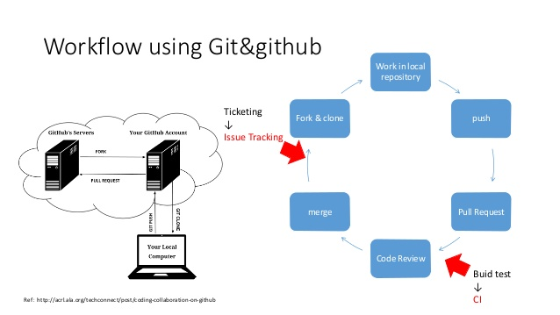
Workflow of git and github

Slide 5
Installing Github
Windows: git-scm.com/download/win
Mac: git-scm.com/mac
Linux: sudo apt-get install git (Ubuntu)
Once installed check Git version: git -version

Slide 6
Installing Github
Install git and create a GitHub account
Create a local git repository
Add a new file to the repo
Add a file to the staging environment
Create a commit
Create a new branch
Push a branch to GitHub
Get changes on GitHub back to your computer

Slide 7
Some basic Terminology
git = the shell command to work with Git
repo = Repository, where the code for a given project is kept
commit = verb, means push the code to the server (in Git, commit = (commit + push)
diff = the difference between two versions of a file
SSH = Secure SHell – Network protocol for communication between machines
RSA = Rivest, Shamir, Adleman – public-key cryptography algorithm

Slide 8
Thank you all….

