Slide 1
Model-View-controller

Slide 2

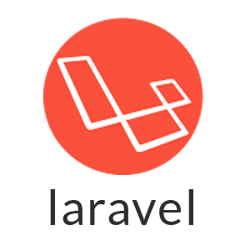

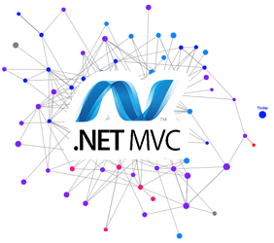
FRAME_WORKS !

Slide 3
Model–view–controller
In object-oriented programming development, model-view-controller (MVC) is the name of a methodology or design pattern for successfully and efficiently relating the user interface to underlying data model

Slide 4
What is Controller ?
A Controller , which represents the classes connecting the model and the view, and is used to communicate between classes in the model and view.
What is View ?
A view can be any output representation of information. Multiple views of the same information are possible.
What is Model ?
The model is the central component of the pattern; which represents the underlying, logical structure of data in a software application and the high-level class associated with it.

Slide 5
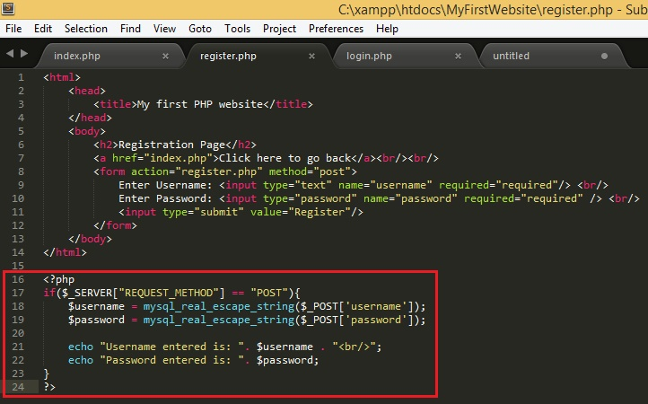


MODEL .php
CONTROLLER.php
VIEW.php

Slide 6
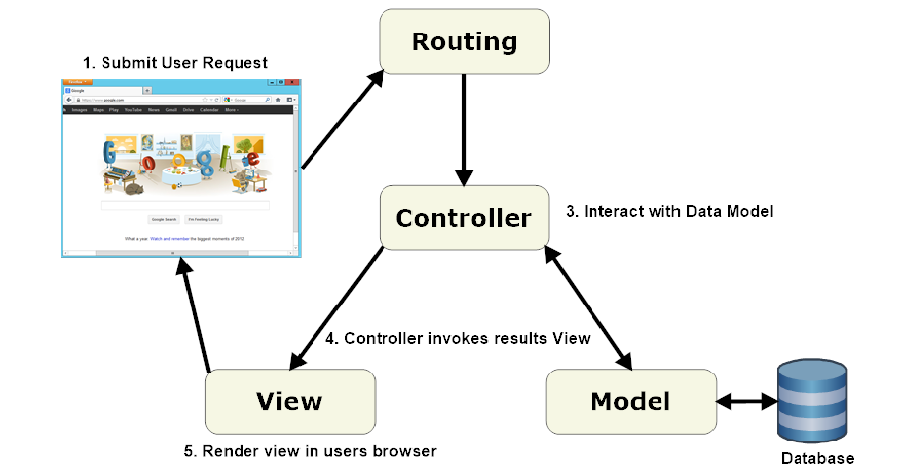

Slide 7


Thank You

