Slide 1
Introduction to Model View Controller (MVC)

Slide 2
1) Anuka Tabassum 141014035
2) Abdul Ahad 141014025
3) Md. Saky 141014026
4) Konika Ferdous 141014016
5) Zahid Islam 142014030
6) Dil Ware Alam 143014006
Group 2

Slide 3

What is MVC?
It is a software architecture pattern which separates the representation of information from the user's interaction with it.
The model consists of application data, business rules, logic, and functions.
A view can be any output representation of data, such as a chart or a diagram.
The Controller, in modern applications is a module, or an intermediary section of code, that mediates communication (between the Model and View) and unifies validation.

Slide 4
Brief History Of MVC
MVC was one of the first works to describe and implement software constructs in terms of their responsibilities.
Trygve Reenskaug introduced MVC in the 1970s
In the 1980s, Jim Althoff and others implemented a version of MVC .
MVC was expressed as a general concept, in a 1988 article.

Slide 5
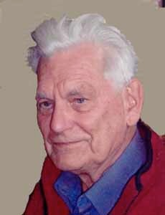
Father of MVC
Trygve Mikkjel Heyerdahl Reenskaug (born 1930 | Age 83) is a Norwegian computer scientist and professor emeritus of the University of Oslo.
He formulated the model-view-controller (MVC) pattern for Graphic User Interface (GUI) software design in 1979 while visiting the Xerox Palo Alto Research Center (PARC).

Slide 6




Some MVC Frameworks
Django (Python)
Rails(Ruby)
Laravel (PHP)
CodeIgniter (PHP)
ASP.NET MVC

Slide 7
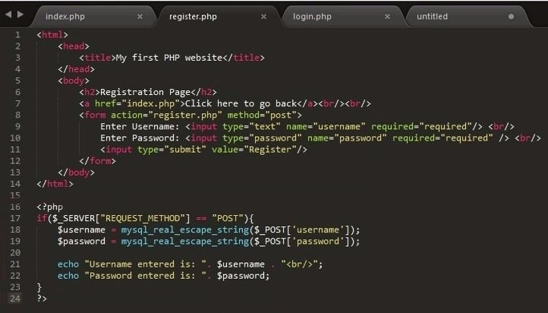


MODEL
CONTROLLER
VIEW

Slide 8

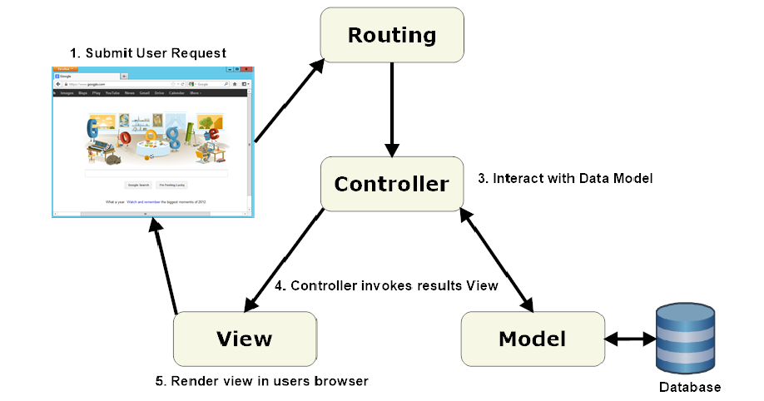
Work flow of MVC

Slide 9
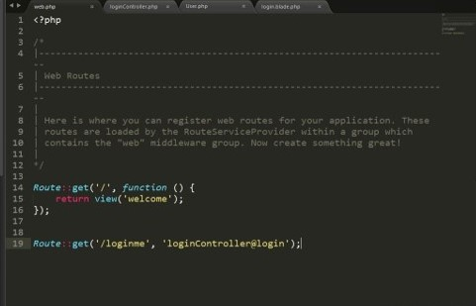
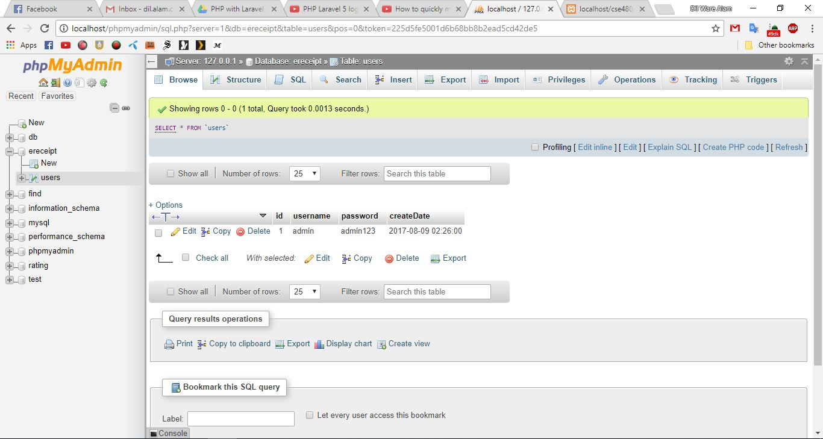
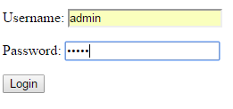
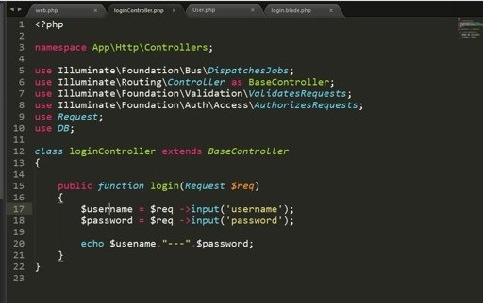
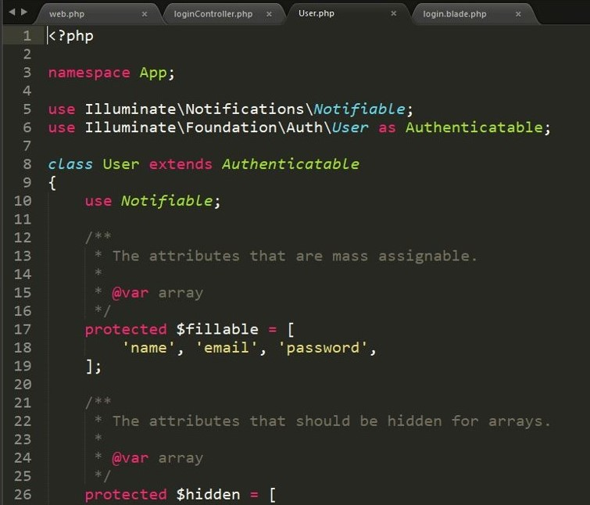
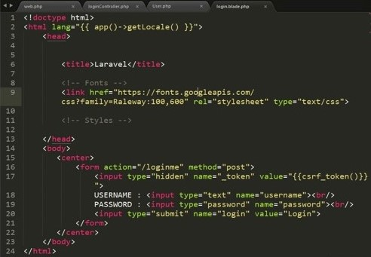
Routing
1
User
Database
Controller
2
5
4
8
Model
View
7
3
6

Slide 10
Advantages
More Structural
More Flexible
Can maintain code in better ways.
More suitable for future implementations
Reduce Complexity

Slide 11
Disadvantages
The complexity is high to develop the applications using this pattern without learning properly.
Not right suitable for extra-small applications .
The isolated development process by UI authors, business logic authors and controller authors may leads to delay in their respective modules development.

Slide 12
Use Case Diagrams
A Detailed Description

Slide 13
What is Use Case Diagrams
Use case diagrams describe relationships between users and use cases
It is a (usually high-level) user activity in the system
  A use case is a collection of related success and failure scenarios that describe actors using a system to support a goal
  And the name should generally begin with a verb

Slide 14
Components of Use Case Diagrams
Use case diagrams consist of at least two components:
  An actor
    Actors are represented as stick people, with a label below, naming the actor's role
    There may be multiple actors in a diagram
  A use case
    Use cases are represented as ellipses, with a label inside, naming the use case
    There may be multiple use cases in a diagram

Slide 15
Use Case
For an example, consider an e-commerce website (e.g. daraz.com)
The actor customer might:
  Search for items by keyword
  Check the status of this item
  Register for an account
  Payment for items

Slide 16
Actor
An actor represents a role that a user might play
  For example, a network administrator at a company might play the following roles:
    Admin
    Employee
  Each role must be represented separately

Slide 17
Use Case of E-receipt
E-commerce Website
Search for item
Check the
status
Register account
Customer
Payment

Slide 18
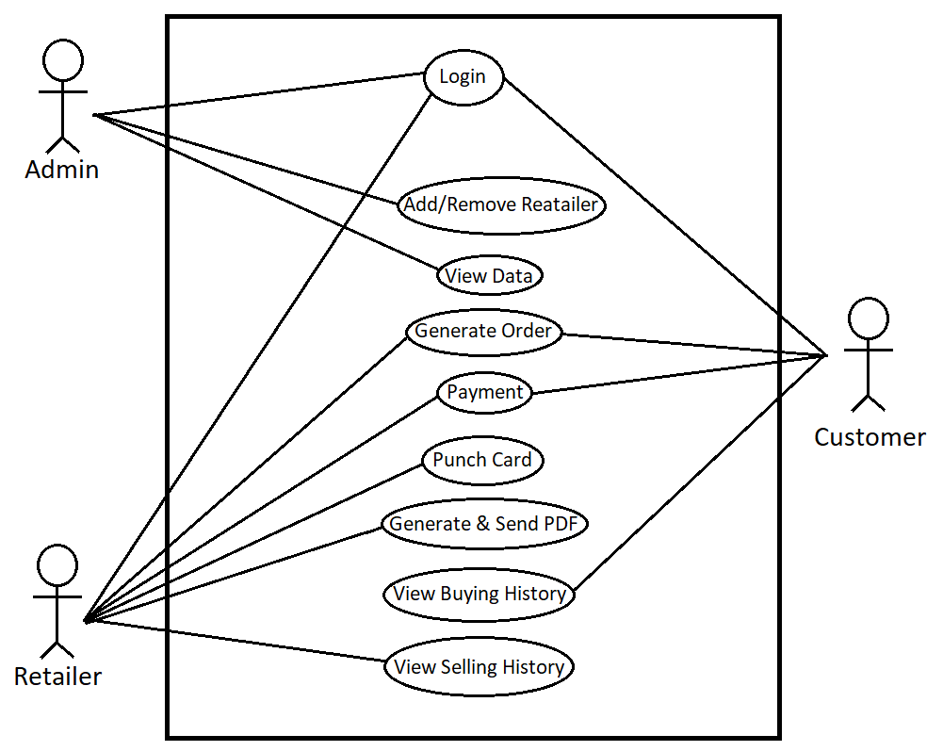
Use Case of E-receipt

Slide 19
Conclusion
Obviously, actor and use case names must be unique within a given diagram
Consider use cases to be similar to classes:
  A use case describes an activity that is possible
  A given system may have several instances of that activity throughout its lifetime
  A use case is a (coarse-grained/large) unit of behavior, and a class is a unit of software

Slide 20
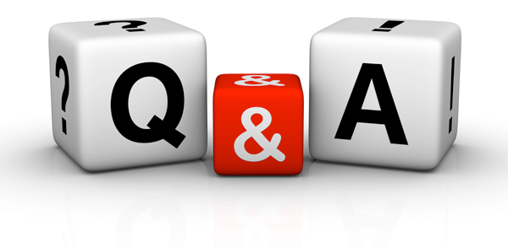
Any question ???
Thankyou

