Slide 1

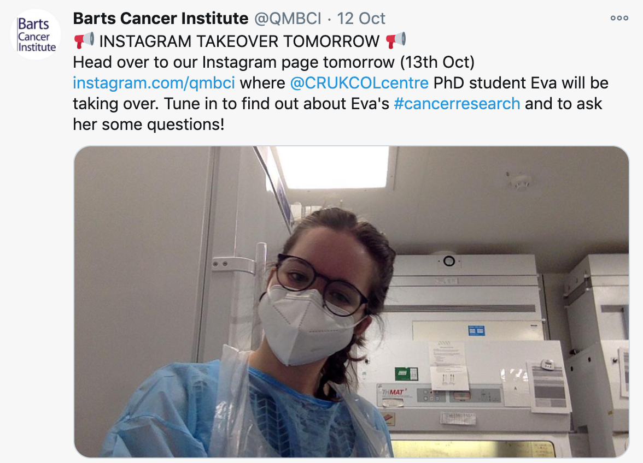
Family Fun Day- GOSH BRC

