Slide 1

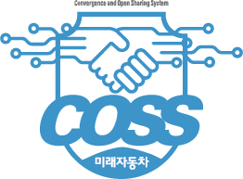

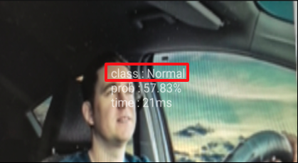
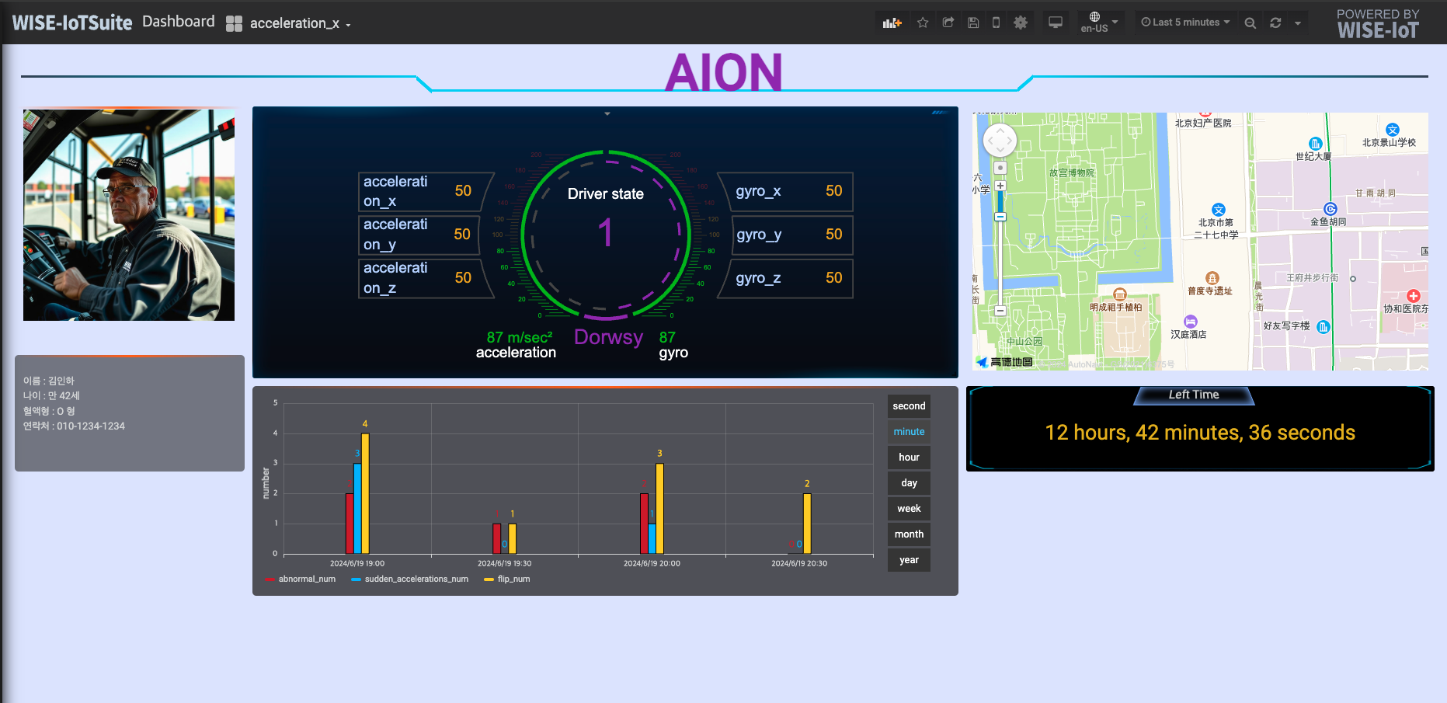
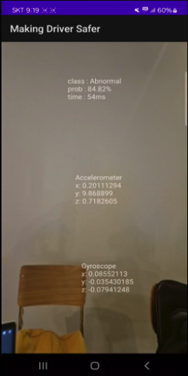
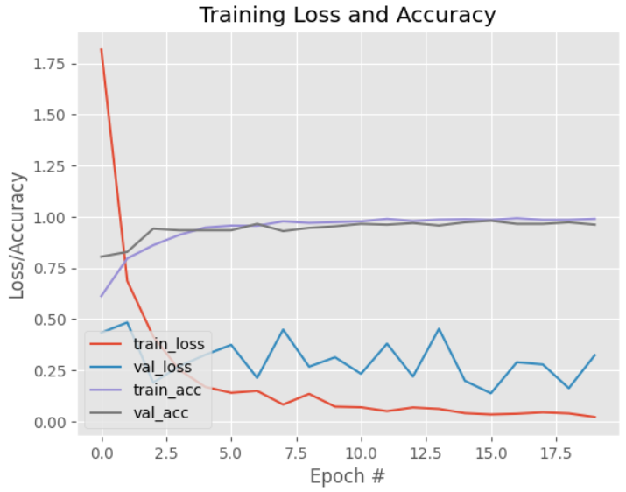
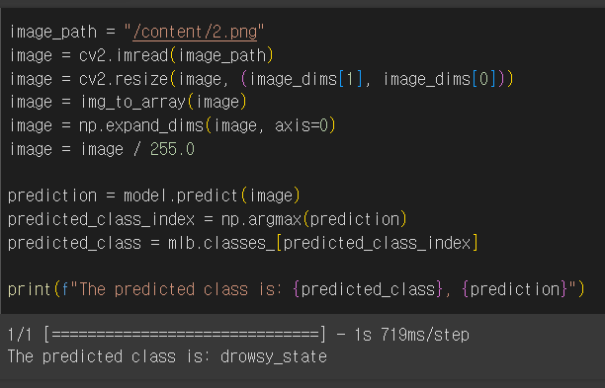
Alpha onion
2024년도 1학기 알파프로젝트 Vertically Integrated Projects
권장우(지도교수)
팽준호(팀장)/ 정상혁
Overview
System Architecture
Develop a Monitoring System to Reduce Accidents Involving Large Vehicles on Highways
Monitor the Stability of Vehicle Operation and the Condition of Drivers
- APP
Acquire data from gyro sensors, accelerometers, and camera images, and communicate with a database.
acceleration
gyro
database
Smart phone
camera
dashboard
Develop a Smartphone App to Acquire Accelerometer, Gyro Sensor, and Camera Image Data
Develop Algorithms to Detect Drowsiness and Driver Status
Transmit Real-time Data to a Database through the App
Display Real-time Monitoring Status on a Dashboard
- AI
Analyze the driver's image to determine the driver's state (normal, drowsy, abnormal).
Determination of driver status
Dashboard
- Dashboard
Displays the driver's condition, as well as other driver information such as the remaining time to the destination.
APP
AI
acceleration
Determination of bus status
Data Collection
Smart phone
gyro
Data Augmentation with Roboflow
camera
Determination of driver status
Data Training using MobileNet V2
Display driver status
Display bus acceleration
Display bus gyro
Dashboard
7
2
3
5
Driver status
Bus acceleration
Bus gyro
Number of Abnormal Conditions
Current Location
Remaining Time to Destination
Driver Information
1
4
6

