Slide 1
Experiment & Conclusion

Slide 2
Compared with CART
——CART: Classification And Regression Trees(normal decision tree)
Accuracy(ccp_alpha=1e-4)
dataset | cart | tnt
MINST | 88.39% | 90.05%
Letter | 87.05% | 87.4%
Pendigits | 96.18% | 96.09%
Time(s)
dataset | cart | tnt
MINST | 9.60 | 2.77
Letter | 0.06 | 22.61
Pendigits | 96.18% | 193.80

Slide 3
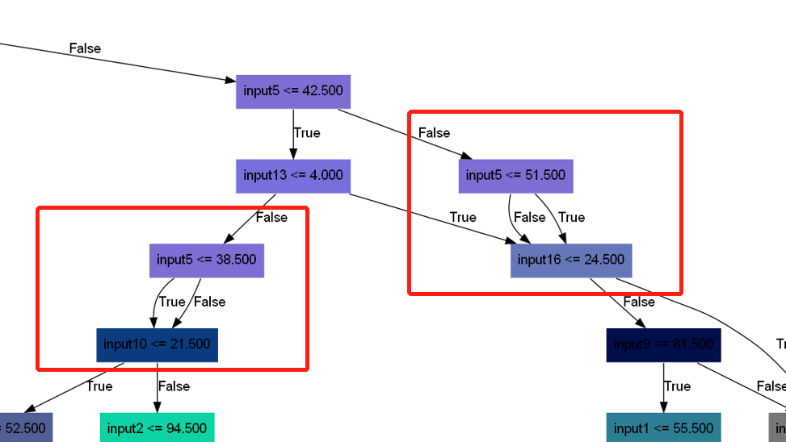
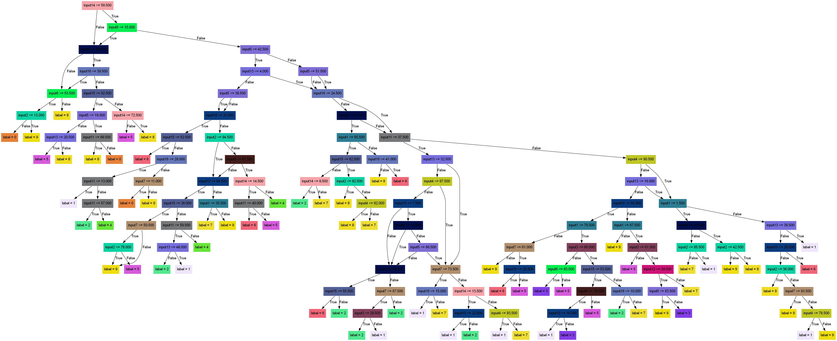
Redundant Node

Slide 4
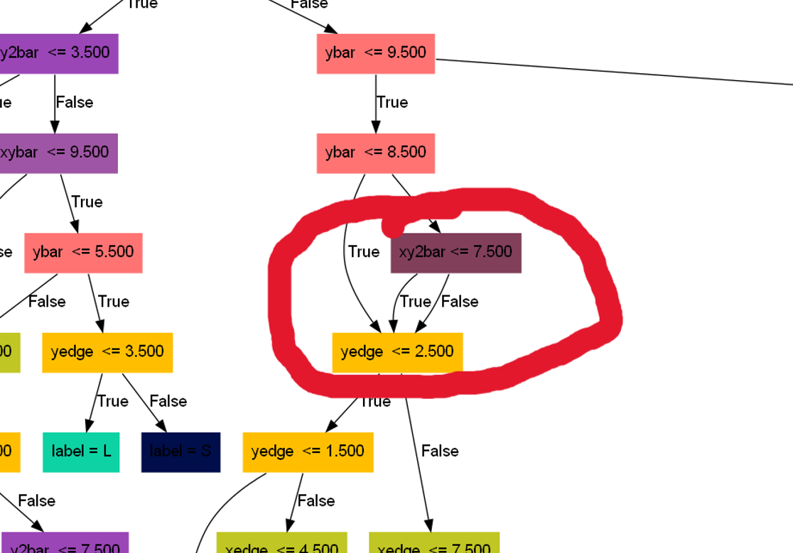
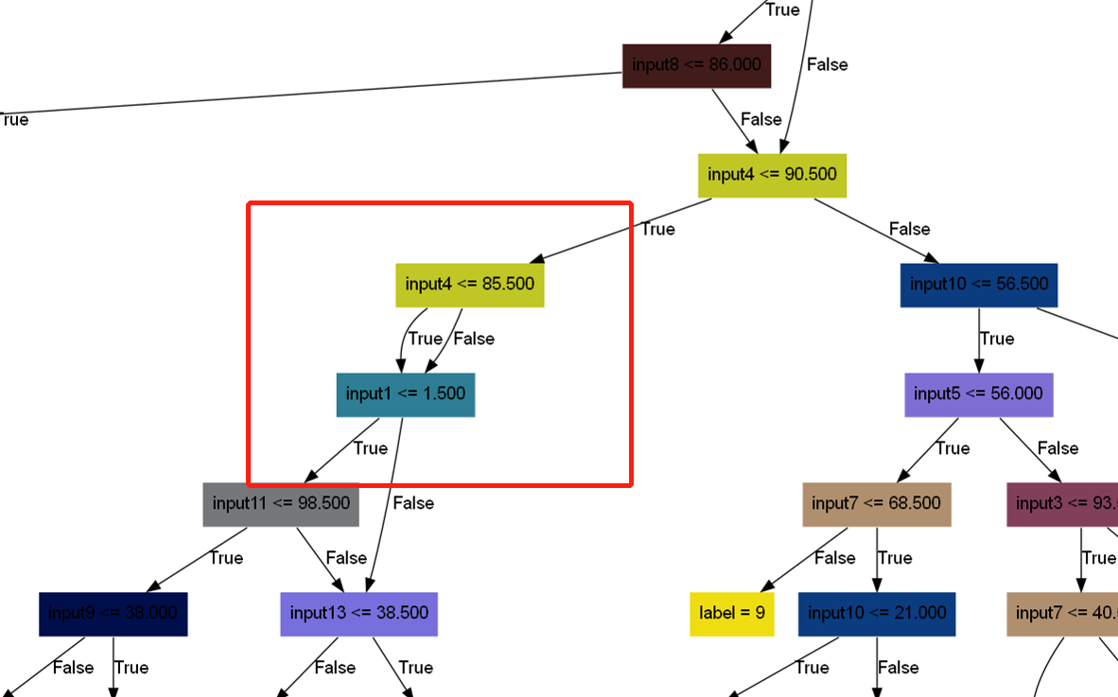
Redundant Node

Slide 5
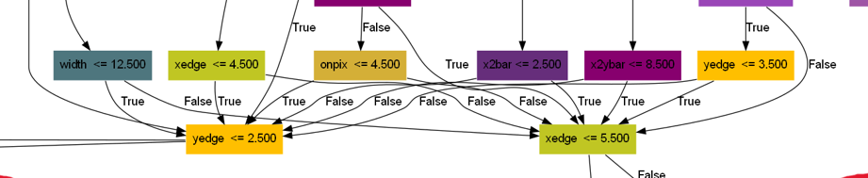
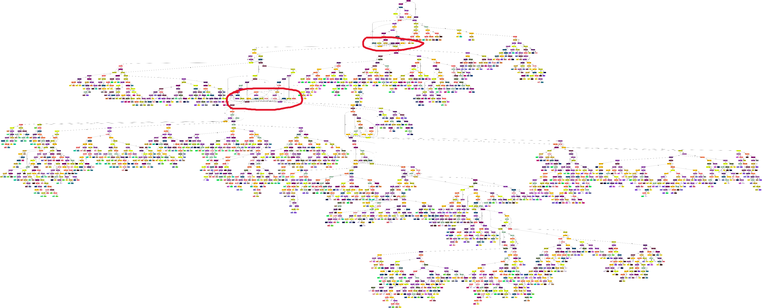
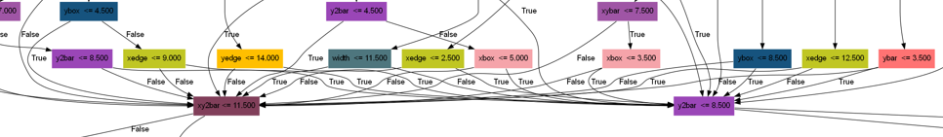
Similar to neural network

Slide 6
Conclusion
Pros:
- The core idea(every node is a tree) can be easily incorporated into other decision framework(e.g. random forest)
- achieve superior classification performance
Limitations:
- Time-consuming

