Slide 1
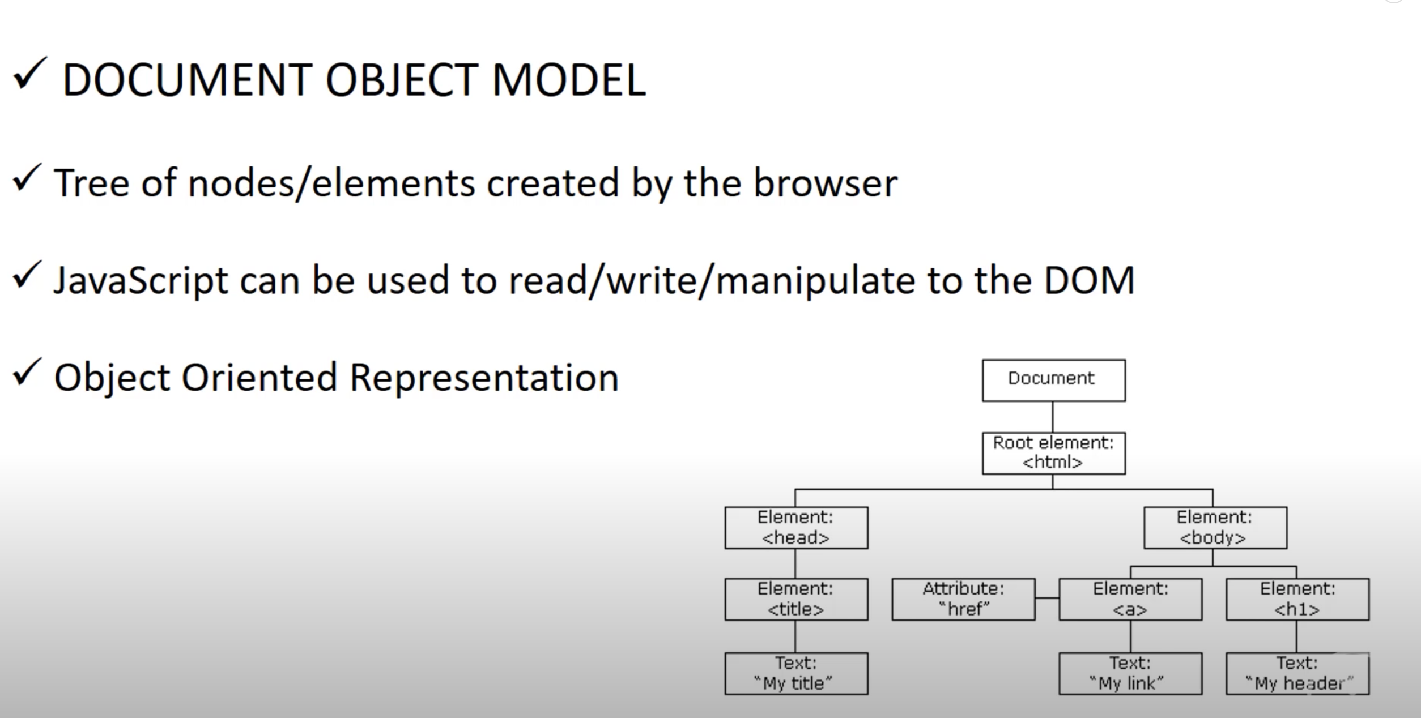
DOM

Slide 2
DOM Methods
getElementById()
IDs should be unique.
Returns an object
getElementsByTagName()
A tag can be used at multiple places in a DOM tree. Eg : <li/>, <ul/>, <a/>
Returns a html collection
An individual item from the collection can be used using index
getElementsByClassName()
Same classname can be used at multiple nodes.
Returns an html collection, similar to array

Slide 3
DOM methods
querySelector
Returns only one element, which was found first
querySelectorAll
Returns a collection of elements
The type of collection is nodeList, and need not to be converted to an array.

Slide 4
DOM Nodes
Everything in a DOM is a node.
There are different types of nodes
Element node
Comment node
Attribute node
Text node
Node Type -https://www.w3schools.com/jsref/prop_node_nodetype.asp

Slide 5
DOM Properties
innerHTML
outerHTML
nodeName
nodeType
hasChildNodes()
cloneNode(true)

Slide 6
DOM Traversal(parent -> child)
Element.parentNode
Element.parentElement
Element.childNodes
Element.children
Nodes vs Elements - https://stackoverflow.com/questions/9979172/difference-between-node-object-and-element-object/9979779#9979779

Slide 7
DOM Traversal (prevSibling - nextSibling)
Element.nextSibling
Element.nextElementSibling
Element.previousSibling
Element.previousElementSibling

Slide 8
Event Listeners
Event Listeners are handlers which are attached to element, where we expect certain event to occur, and when the event occurs, the event listeners fires the callback function attached to the event.
addEventListener function is used to attach the event listeners to the elements

Slide 9
Events Bubbling/capturing(Trickling)
Bubbling and Capturing are two ways in which event propagation occurs in browsers.
#grandparent
(onClickGrandparent)
#parent
(onClickParent)
#parent
#
Capture
down
#child
(onClickChild)
Bubble up

Slide 10
BOM- Browser Object Model
Manipulations using BOM
Get width and height of browser
Open close browser window
Move and resize the window
Scroll the window
Get URL, Hostname, protocol of browser window
Get history of browser window

Slide 11
List of functions/properties window offers
Window
window.innerHeight
Window
window.outerHeight
Window
window.innerWidth
Window
window.outerWidth
Window
Window.open(url,name, specs)
Window
Window.close()

Slide 12
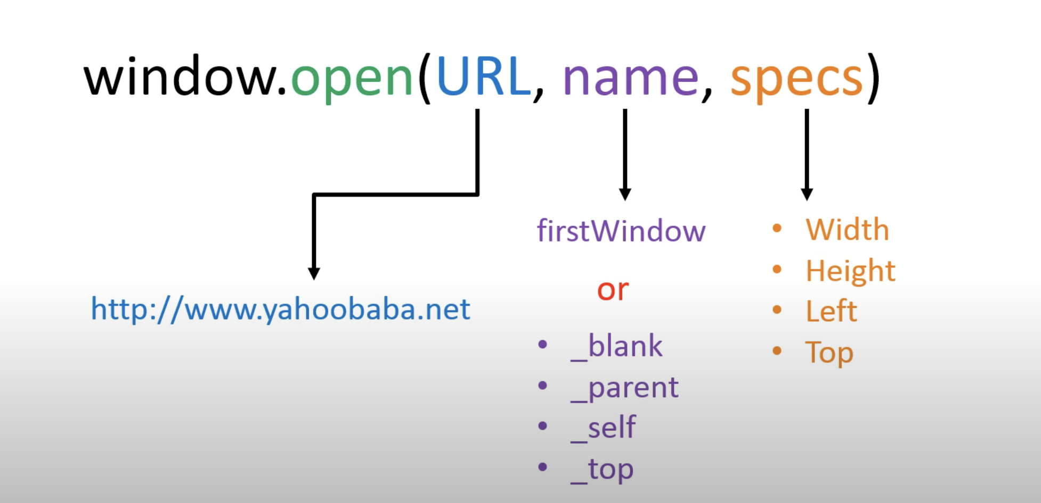
Window.open()

