Slide 1
Git and Github
Git is a version control system that lets you manage and keep track of your source code history.
GitHub is a cloud-based hosting service that lets you manage Git repositories.

Slide 2


Slide 3
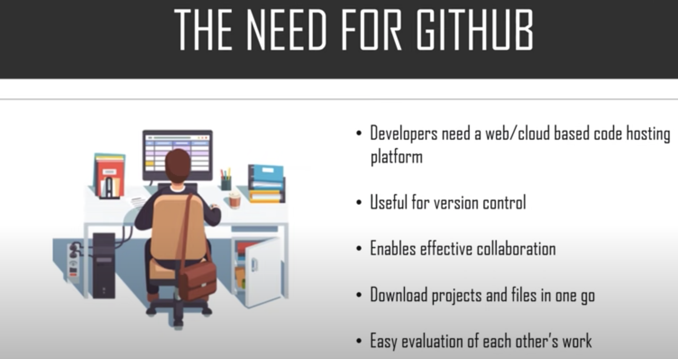

Slide 4
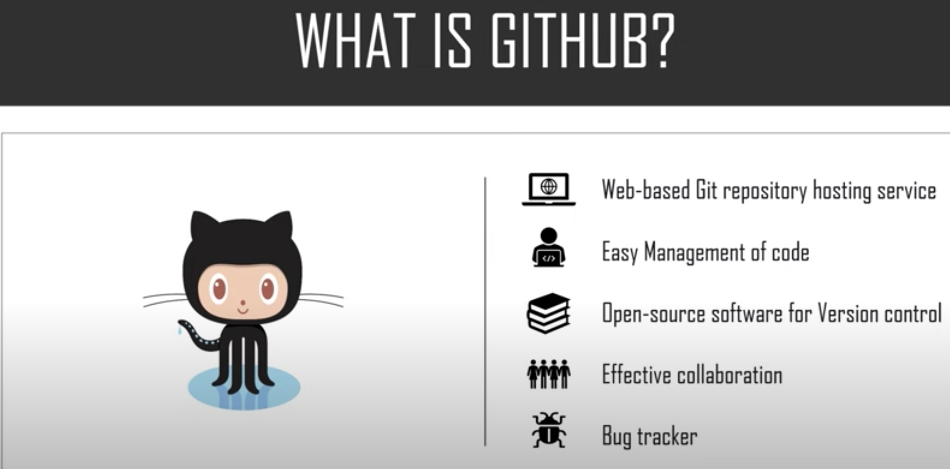

Slide 5

Branches

Slide 6
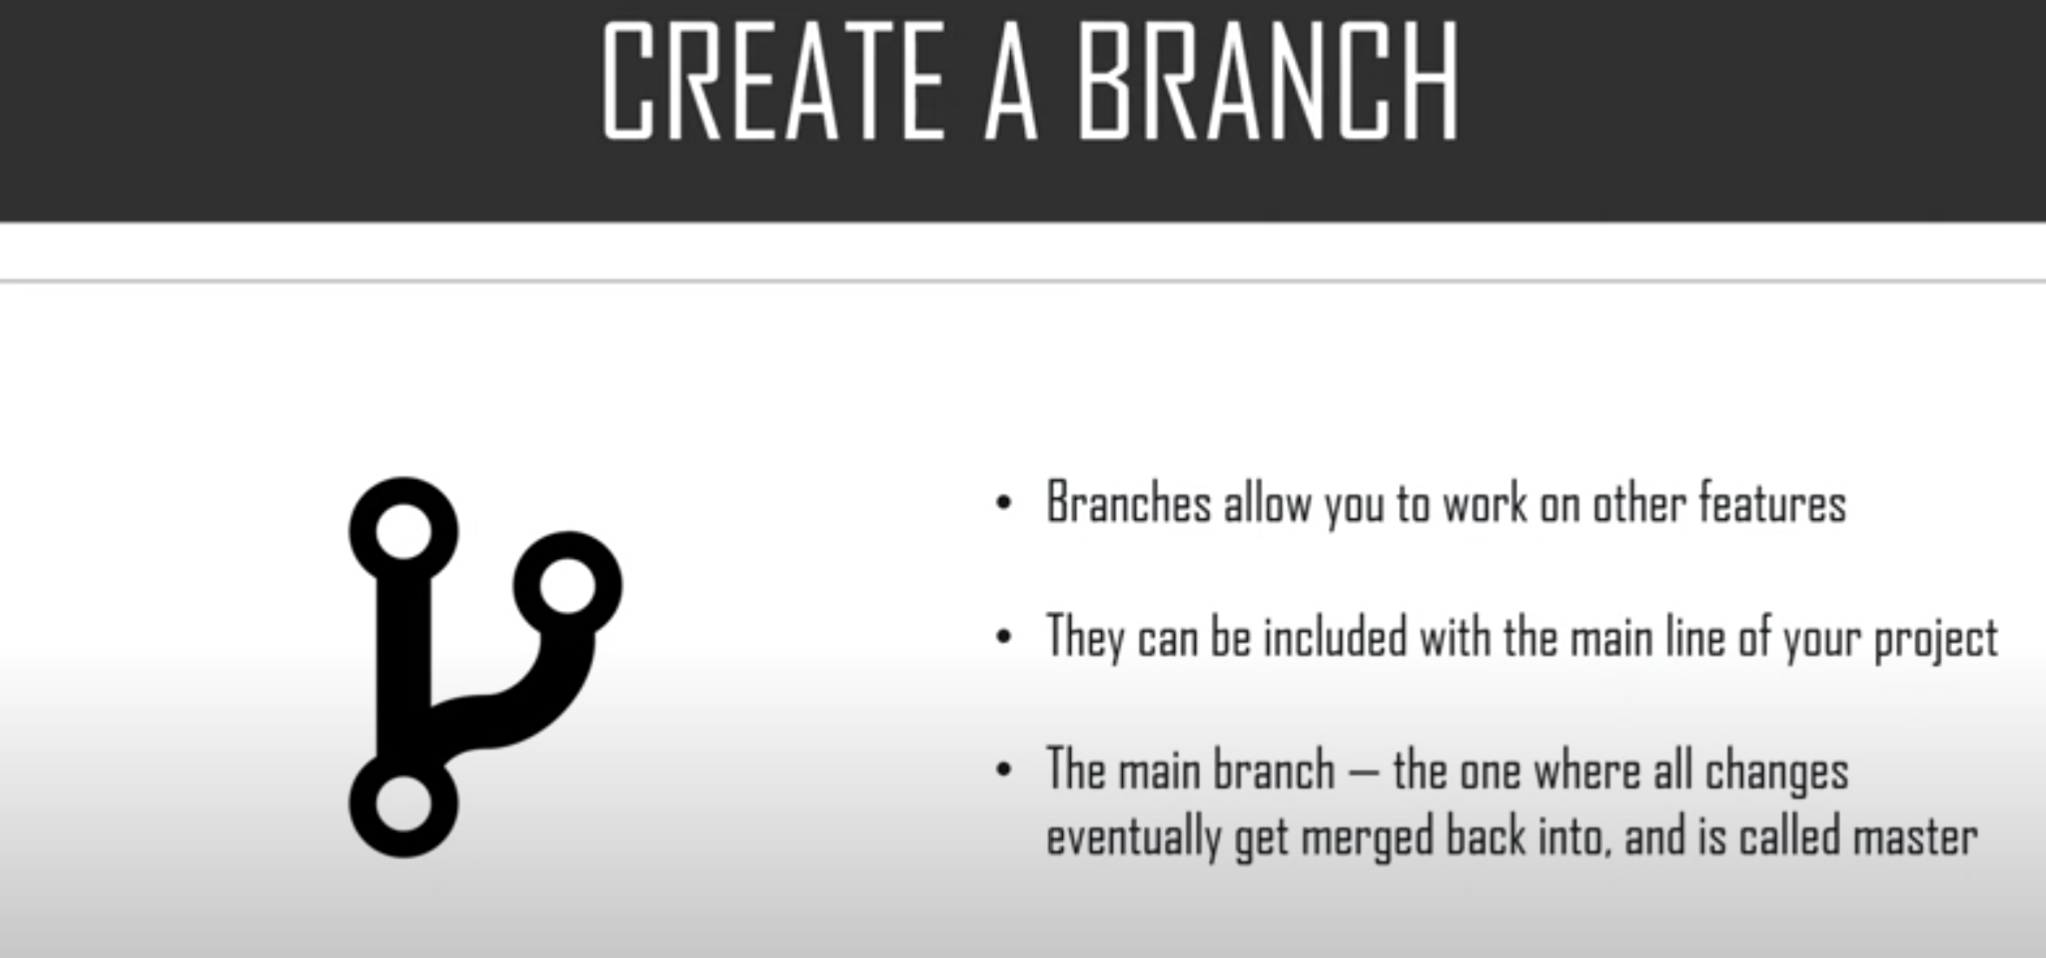

Slide 7
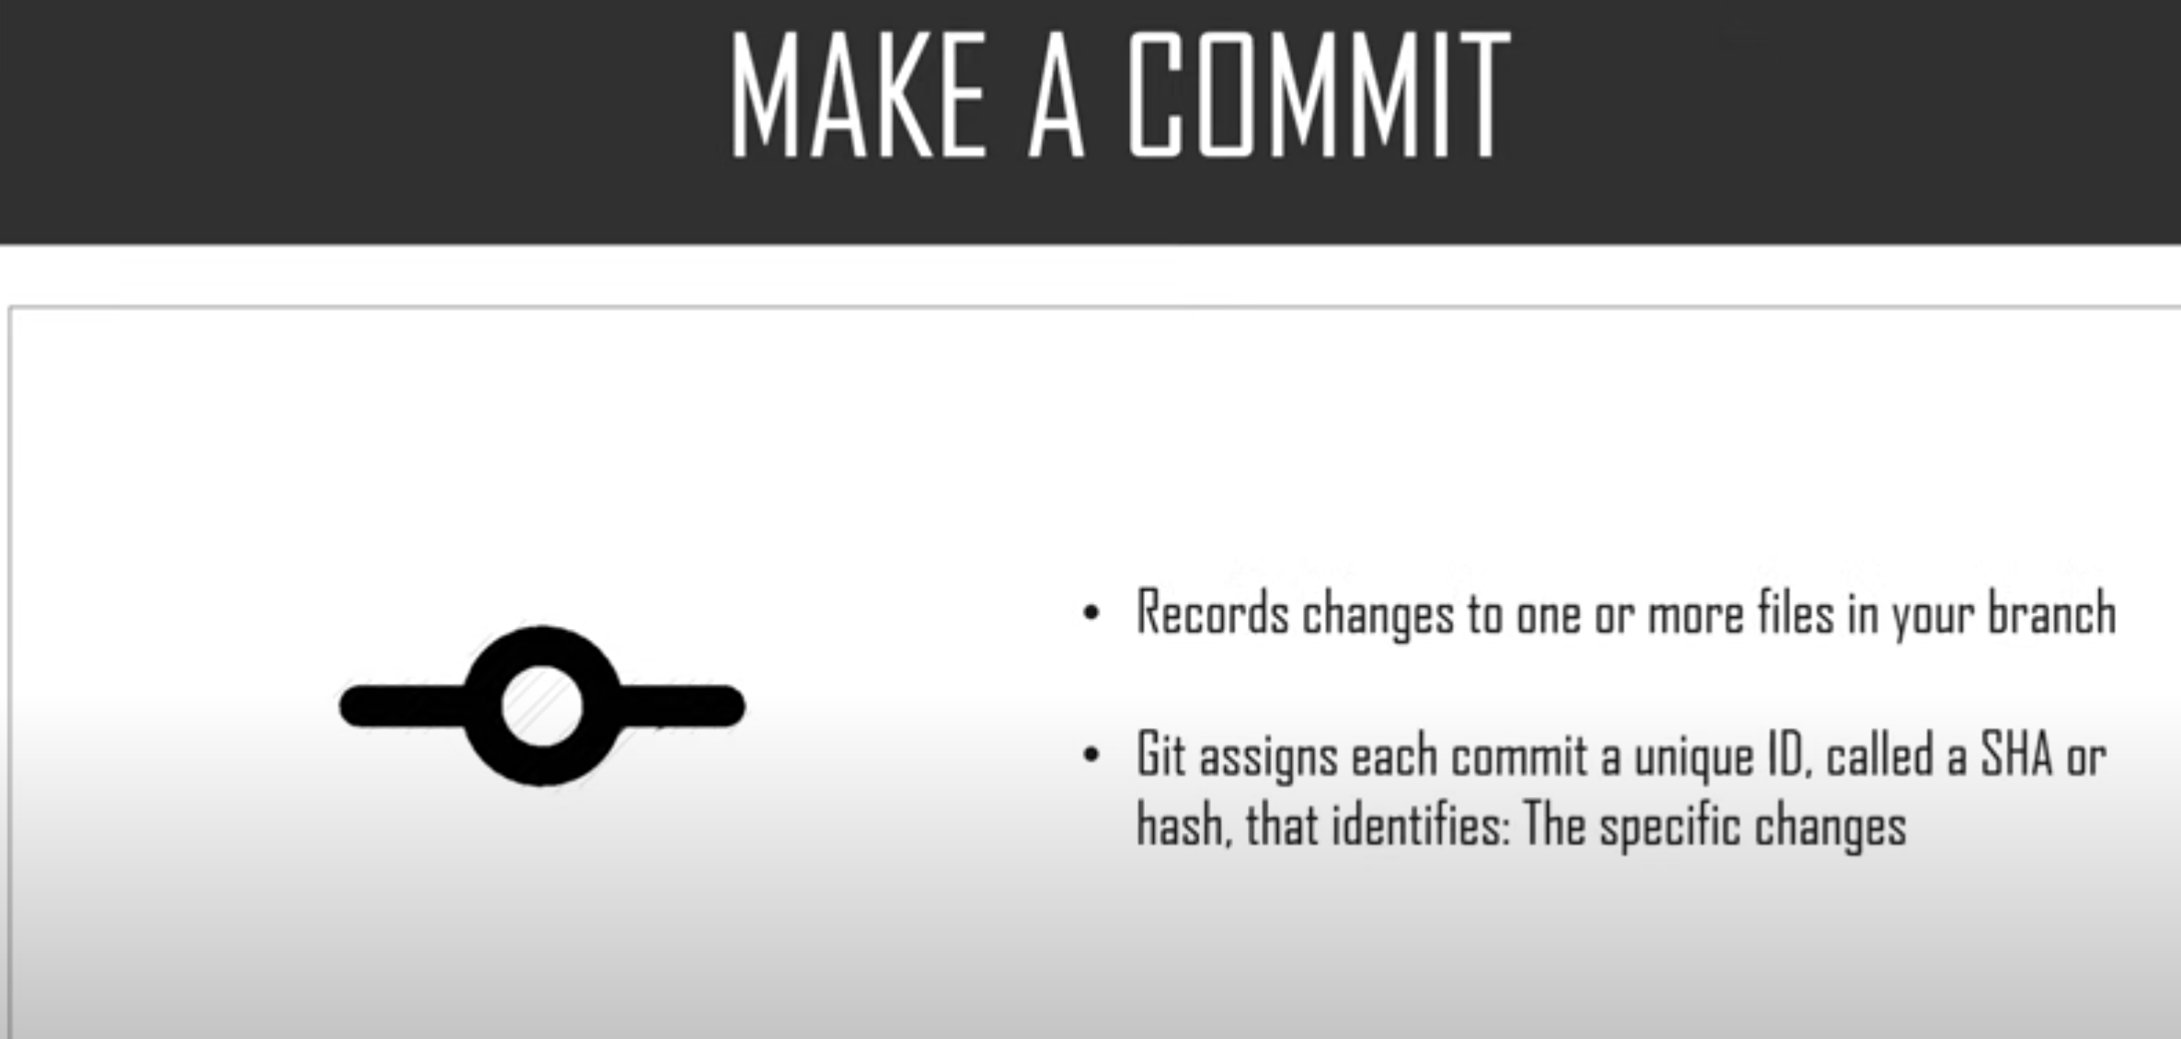

Slide 8
