Slide 1
JAVASCRIPT

Slide 2
AGENDA
JS Intro(all),JS Basics
JS Variables
JS constants
JS Primitive types
JS Dynamic typing
JS Basics of objects
JS Basics of arrays
JS Basics of functions
JS Types of functions
parseInt/ parseFloat

Slide 3
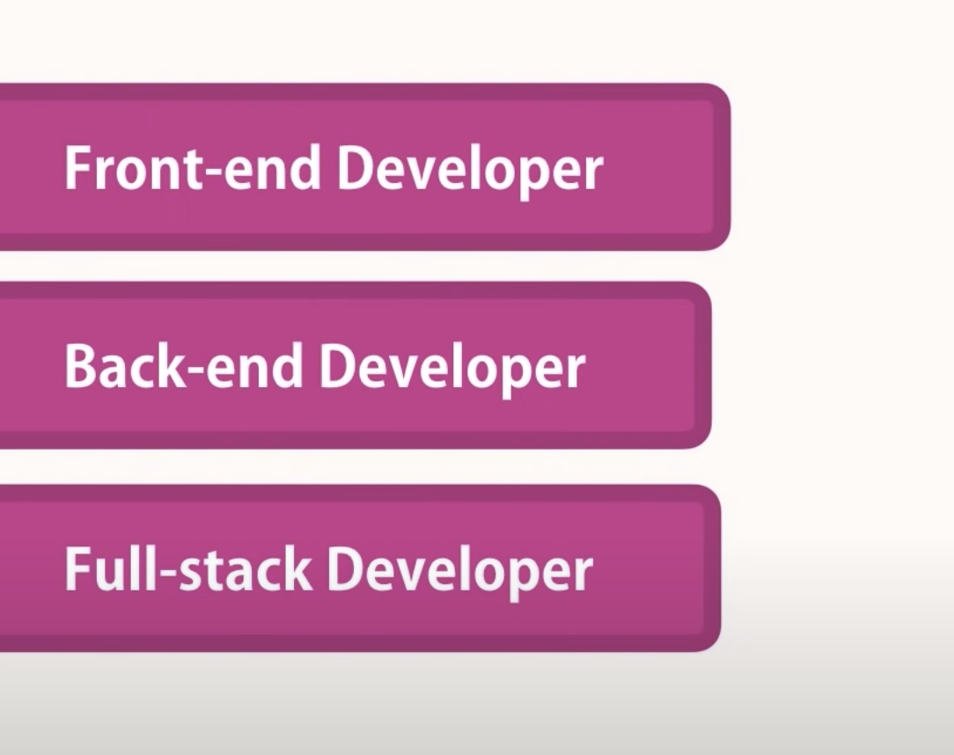
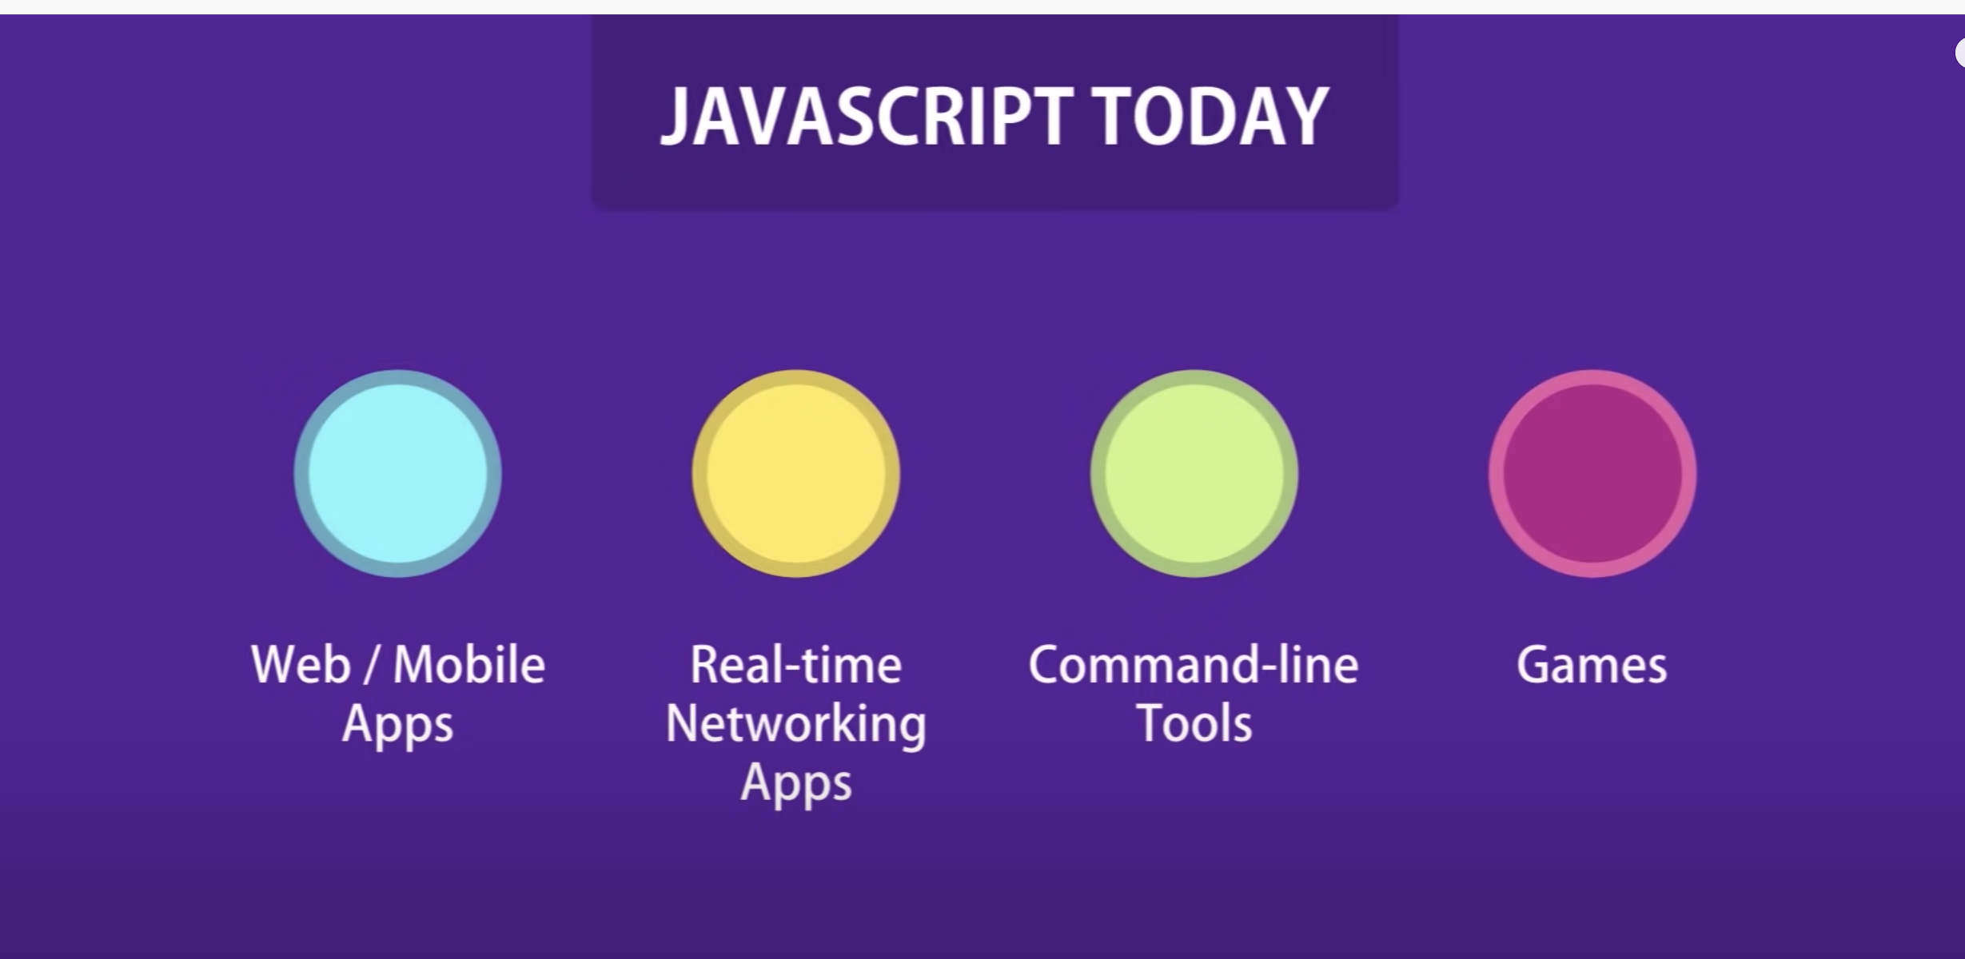
WHY JS

Slide 4
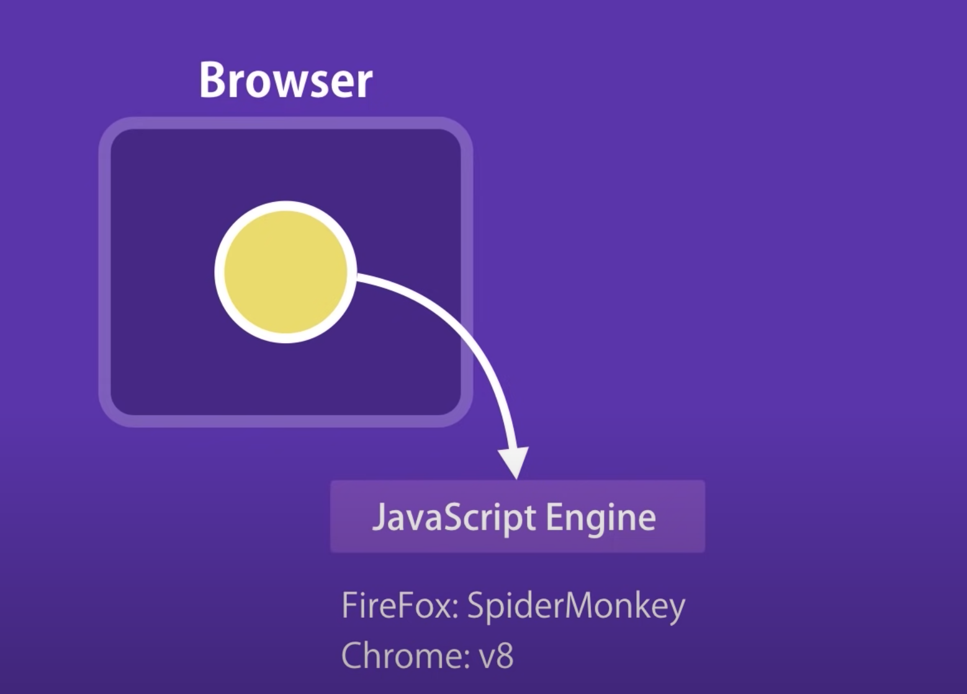
JS engine(compiler)

Slide 5
JS in Browser
All about engine, browser, console
2 + 2
Alert

Slide 6
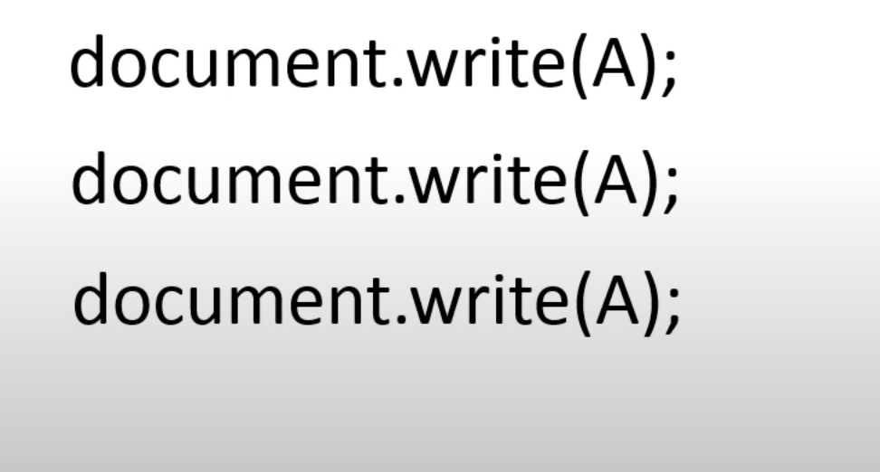
Variable – a place holder which holds a single value
Avoids repetition
Type of Variables
Var
Let // strictly typed language
Const

Slide 7
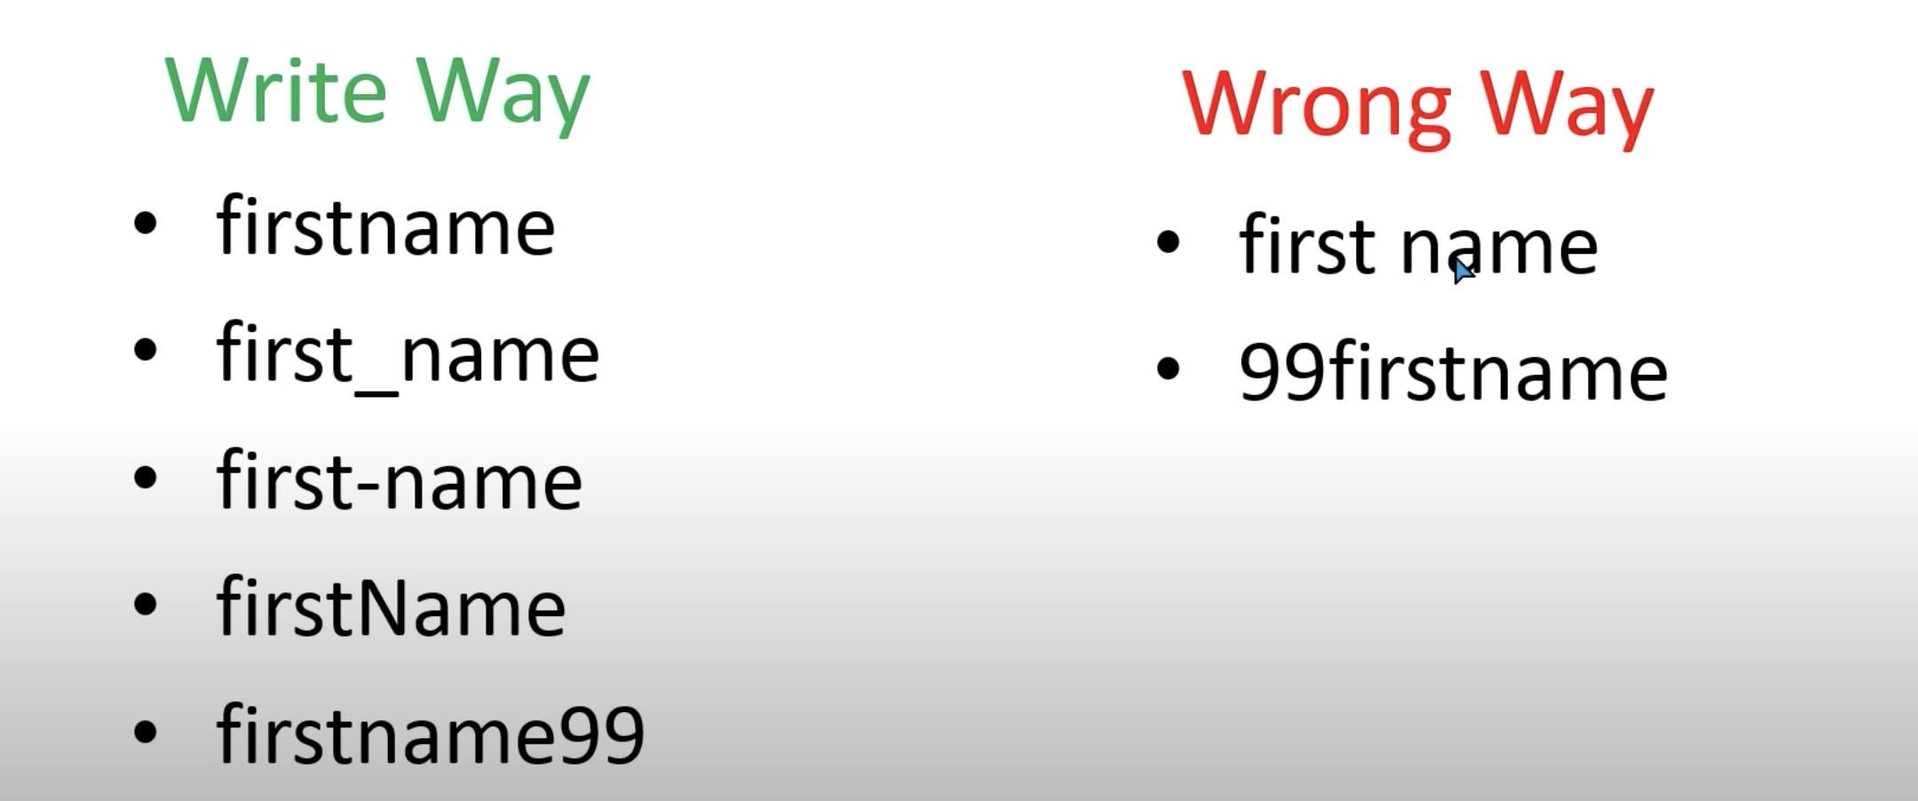
Good practices

Slide 8
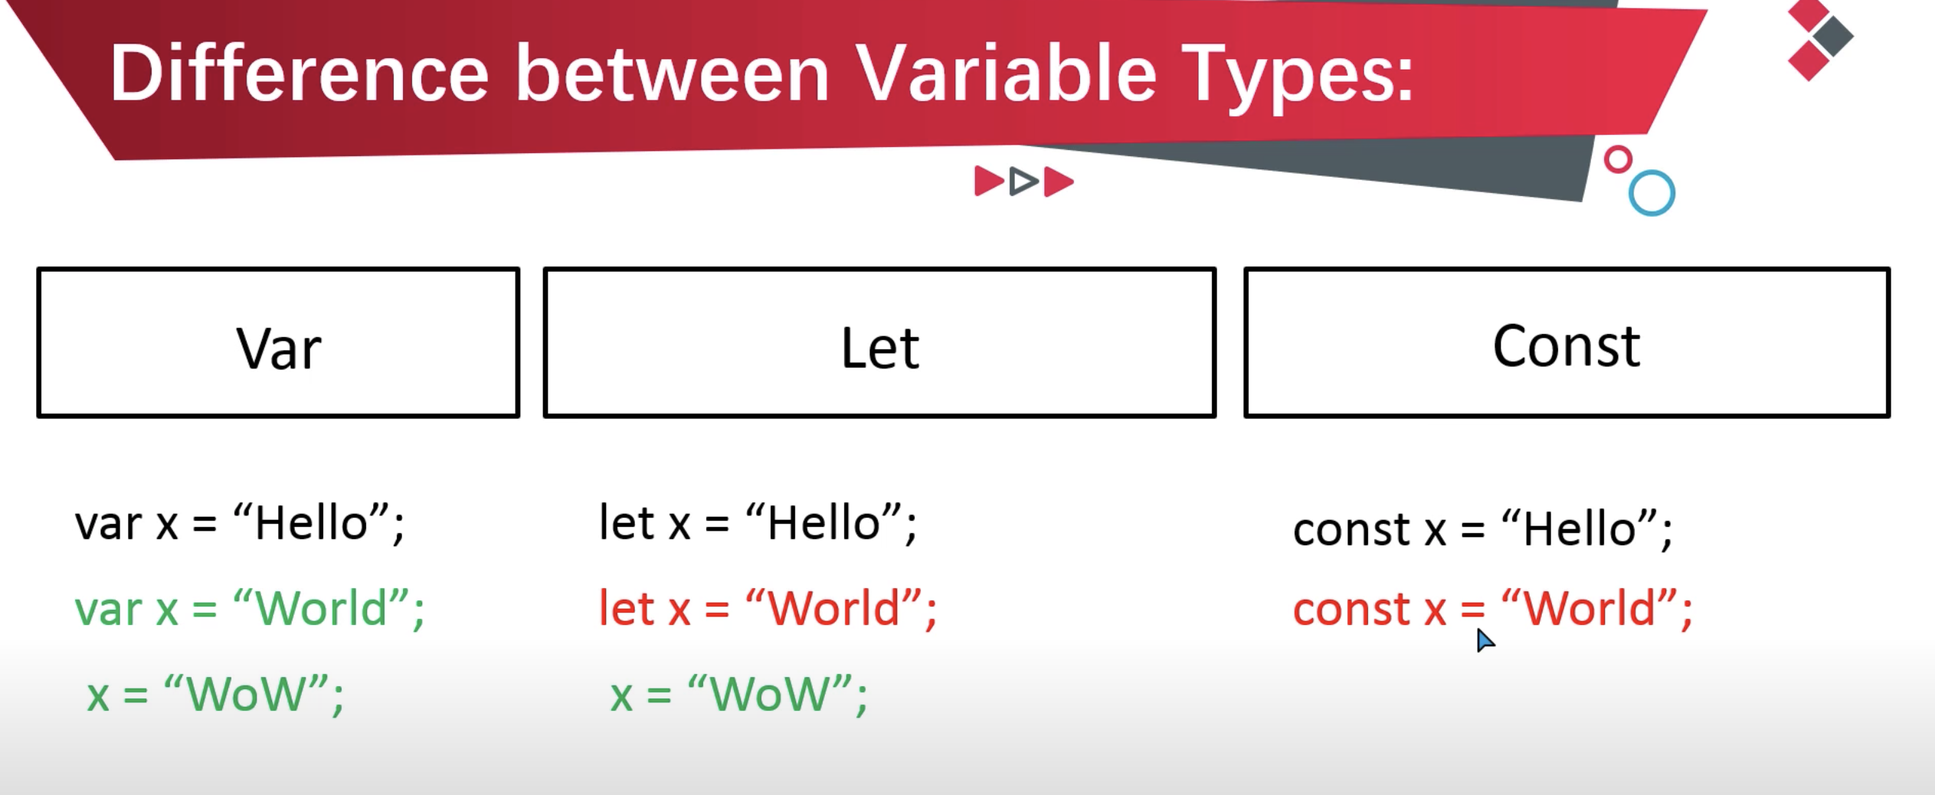
Difference between var, let const

Slide 9
Constants in JS
Primitive and Reference/dynamic/derived Datatype
Primitive
String
Number
Boolean
Undefined
Symbol
Null
Reference Types
Object
Functions
Arrays
Dates

Slide 10
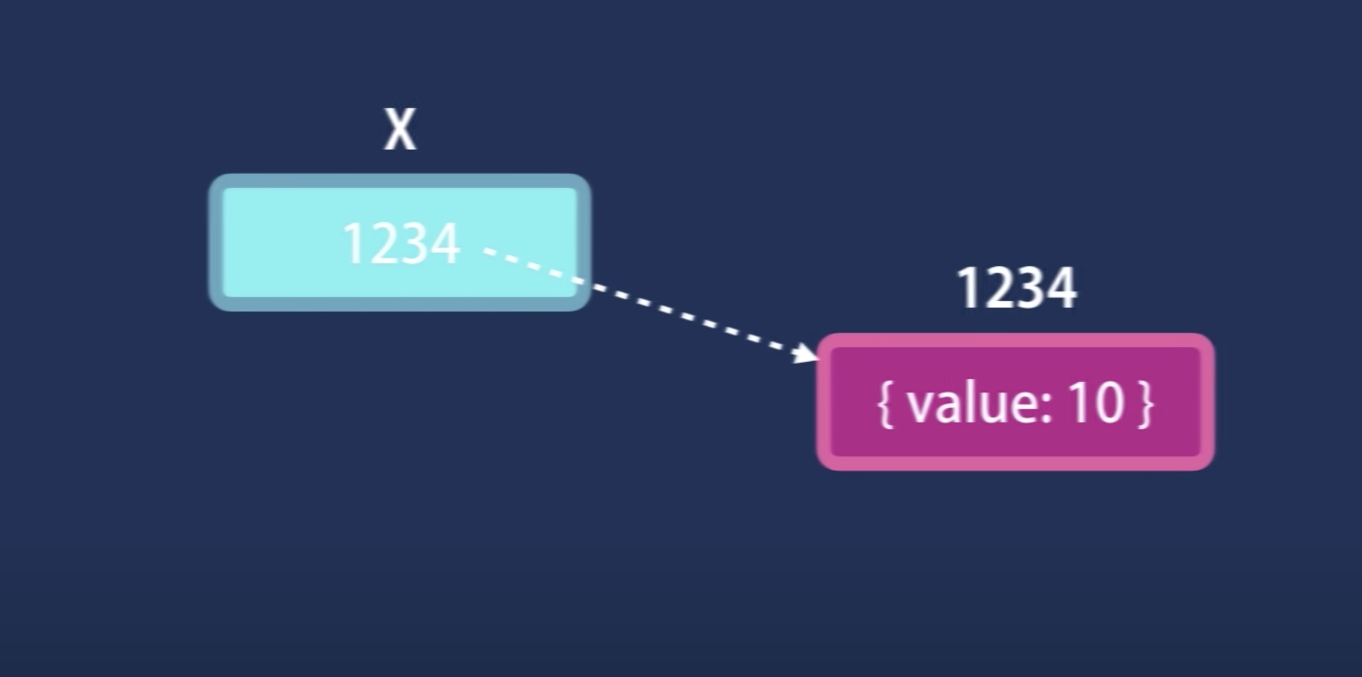
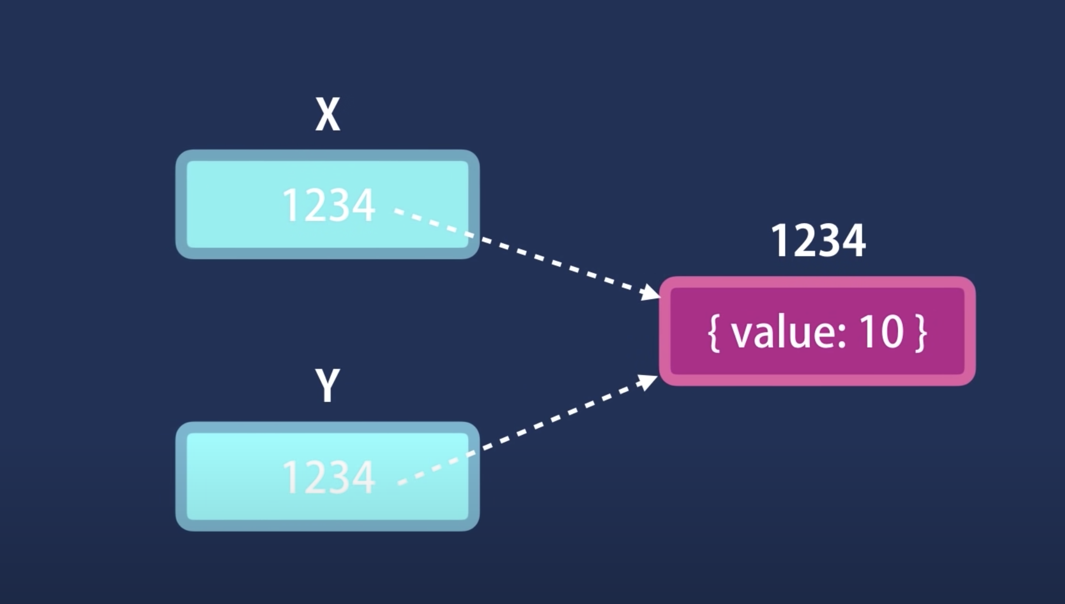
Copy by value/refernce
Primitive types are copied by value – (stack)
Reference types are copied by reference – (heap)

Slide 11

Functions - Functions (also called 'procedures' in some programming languages and 'methods' in most object-oriented programming languages) are a set of instructions bundled together to achieve a specific outcome.
Function parameters are the names listed in the function definition.
Function arguments are the real values passed to (and received by) the function.

Slide 12
Types of Functions
Named Functions
Anonymous Functions
Immediately Invoked Functions Expressions

Slide 13
Named Functions
Named function is the function that we define it in the code and then call it whenever we need by using the same name.

Slide 14

Annonymous Functions
The anonymous functions don’t have names. They need to be tied to something: variable.
Use the function as callback function, event handlers.

Slide 15
IIFE
The anonymous functions don’t have names. They need to be tied to something: variable or an event to run.
Privacy

Slide 16
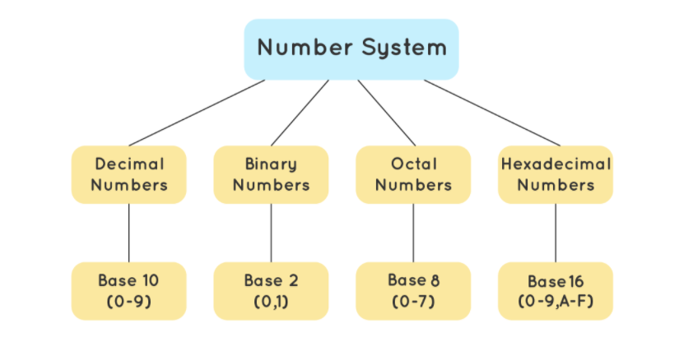
Number system

Slide 17
parseInt
The parseInt function parses a string argument and returns an integer.
Syntax
The syntax of parseInt is as follows:
parseInt(string, radix)
The parseInt function takes two parameters:
string – a string literal to be parsed;
radix – an integer between 2 and 36.

Slide 18
Radix
The Radix represents the mathematical base of the number to be parsed. When provided, the string argument is parsed in accordance with the radix (i.e. radix of 2 converts the string input to binary, 8 to octal, 10 to decimal, 16 to hexadecimal, and so forth).
According to MDN, if the radix is undefined, 0 (zero) or unspecified, JavaScript assumes the following:
If the string begins with “0x” (a zero followed by an “x”), the string is parsed as hexadecimal (radix = 16).
If the string begins only with a zero, the radix might be 8 or 10, it is implementation dependent. The ES5 standard clarifies that a decimal radix should be used, but not all browsers support this yet.
Due to this complexity in how input is handled, it is highly recommended to always specify a radix when using parseInt() to avoid unexpected behavior.

Slide 19
parseFloat(string)
If parseFloat encounters a character other than a plus sign (+), minus sign (- U+002D HYPHEN-MINUS), numeral (0–9), decimal point (.), or exponent (e or E), it returns the value up to that character, ignoring the invalid character and characters following it.
A second decimal point also stops parsing (characters up to that point will still be parsed).
Leading and trailing spaces in the argument are ignored.
If the argument’s first character can’t be converted to a number (it’s not any of the above characters), parseFloat returns NaN.

