Slide 1
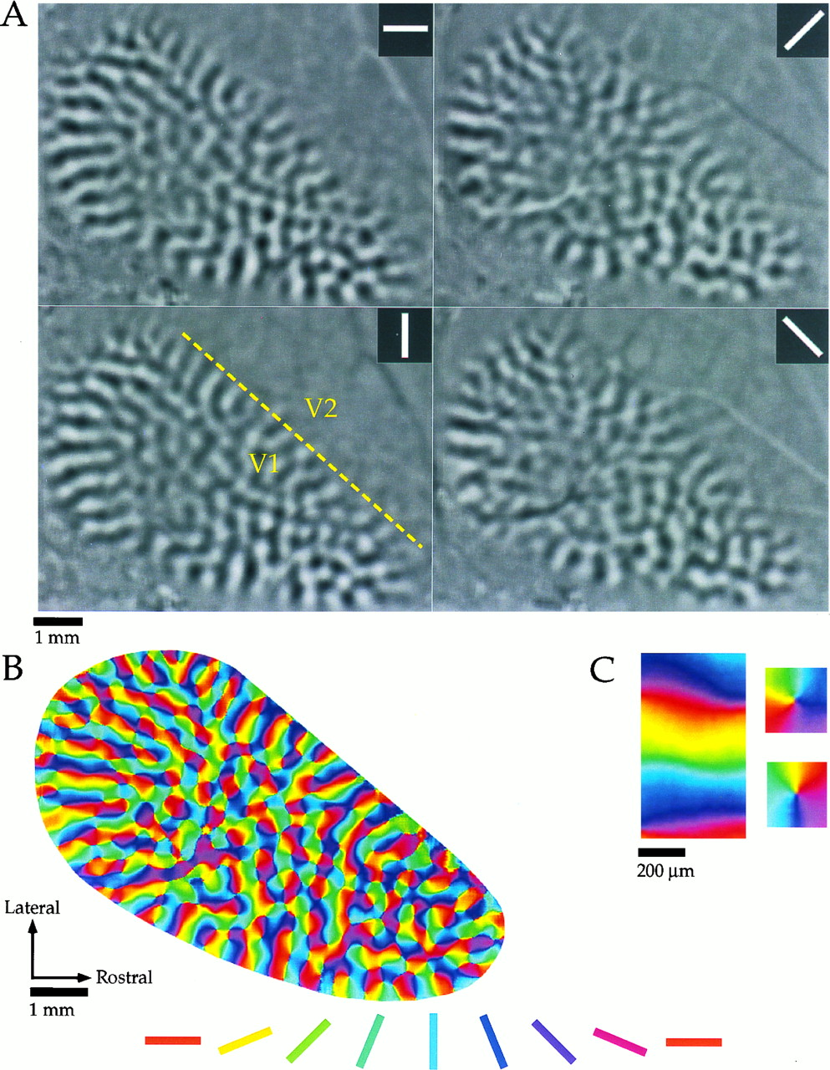

Optical imaging of intrinsic signals in tree shrew visual cortex.
William H. Bosking et al. J. Neurosci. 1997;17:2112-2127
©1997 by Society for Neuroscience
Notes:
Optical imaging of intrinsic signals in tree shrew visual cortex. A, Difference images obtained for four stimulus angles (0°, 45°, 90°, 135°, shown ininset of each panel) from one animal. Black areasof each panel indicate areas of cortex that were preferentially activated by a given stimulus, and light gray areasindicate areas that were active during presentation of the orthogonal angle. The dashed line in the 90° panel indicates the approximate location of the V1/V2 border. B, Orientation preference map obtained by vector summation of data obtained for each angle. Orientation preference of each location is color-coded according to the key shown below. C, Common features of the orientation preference maps. Portions of the orientation preference map shown in B have been enlarged to demonstrate that the orientation preference maps contained both linear zones (left) and pinwheel arrangements (right).

